Slide 1
The South and Slavery
Chapter 16

Slide 2
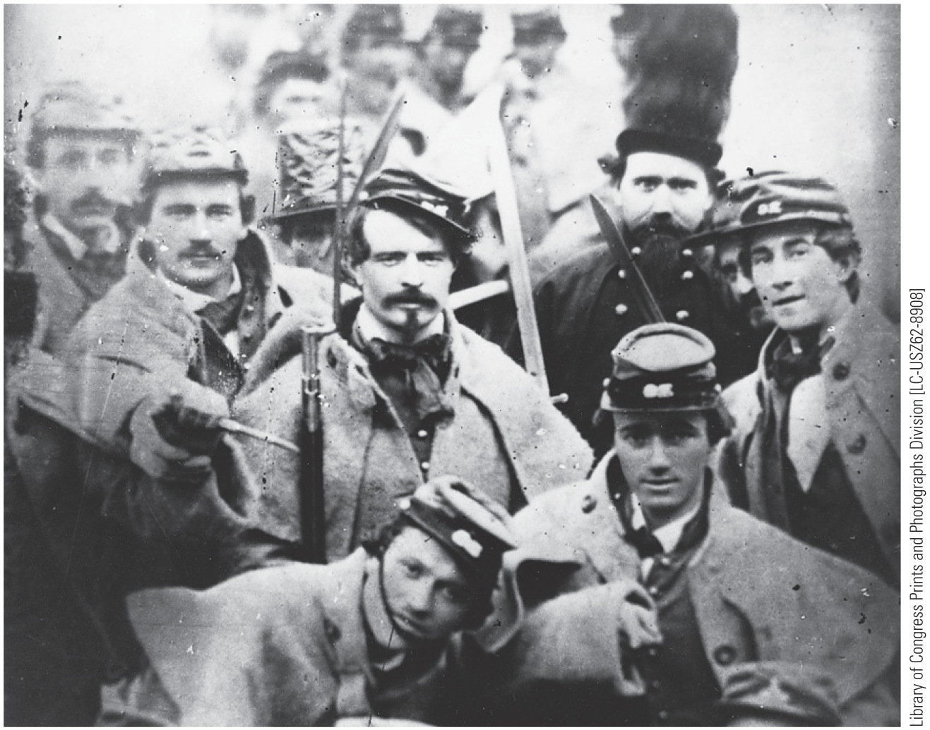
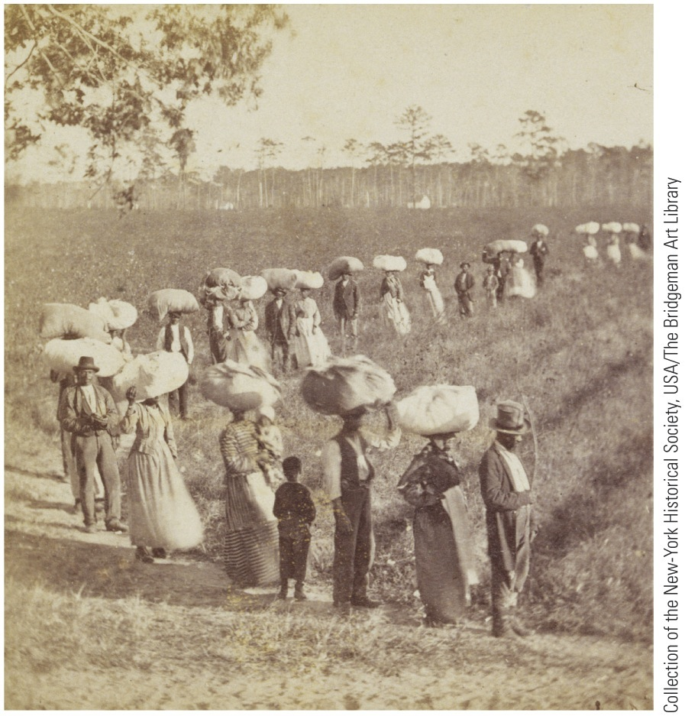
p338
Notes:
Returning from the Cotton Fields in South Carolina Enslaved African
American planted and picked virtually all the cotton that formed the foundation
of the nineteenth-century southern economy. The white South ferociously
defended its “peculiar institution” of slavery, which ended at last only in the
fires of the Civil War.

Slide 3
I. “Cotton Is King!”
Cotton Kingdom:
Developed into huge agricultural factory:
In an economic spiral, planters bought more slaves and land
Northern shippers reaped large profits from cotton trade
Prosperity of North, South, and England rested on bent backs of enslaved bondsmen
So too did nation's growing wealth:
Cotton accounted for half the value of American exports
Cotton export earnings provided capital for Republic's economic growth
South produced more than half of world's supply of cotton
About 75% of England's cotton came from South, and about 20% of England's populace worked in textiles
Southern leaders knew Britain was tied to them by cotton threads
This dependence gave South power
In South's eyes, “Cotton was King”

Slide 4
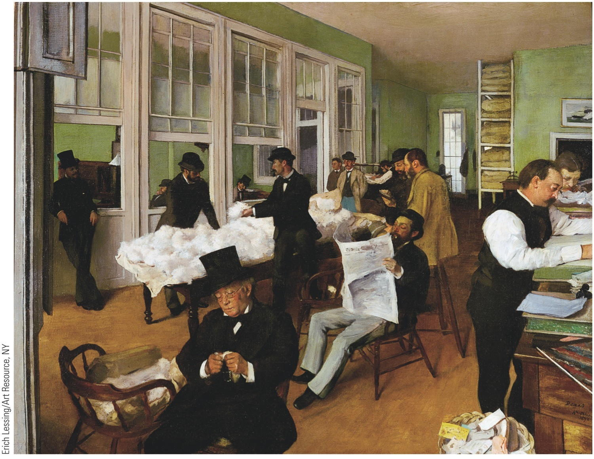
p341
Notes:
Interior of the Cotton Bureau
in New Orleans, by Edgar
Degas, 1873 Although this
painting dates from 1873,
French impressionist painter
Edgar Degas (1834–1917)
captured the insouciant selfconfidence
of cotton traders in
the pre–Civil War era. As cotton
cultivation spread into the new
states of the trans-Appalachian
Southwest, the entire Cotton
Kingdom paid tribute to New
Orleans, Queen City of the
South, and the port through
which millions of cotton bales
flowed out to British textile
mills.

Slide 5
II. The Planter “Aristocracy”
South was a planter aristocracy:
In 1850 only 1,733 families owned more than 100 slaves:
Select group provided political and social leadership
Enjoyed lion's share of southern wealth
Educated their children in finest schools
Money provided leisure for study, reflection, and statecraft:
Notable: John C. Calhoun (Yale), Jefferson Davis (West Point)
Felt keen sense of obligation to serve
Dominance by a favored aristocracy was basically undemocratic:
Widened gap between rich and poor
Hampered tax-supported public education
Idealized feudalism of medieval Europe
Plantation system shaped lives of southern women:
Mistresses commanded sizable household staff
Relationships between mistress and slaves ranged from affectionate to atrocious

Slide 6
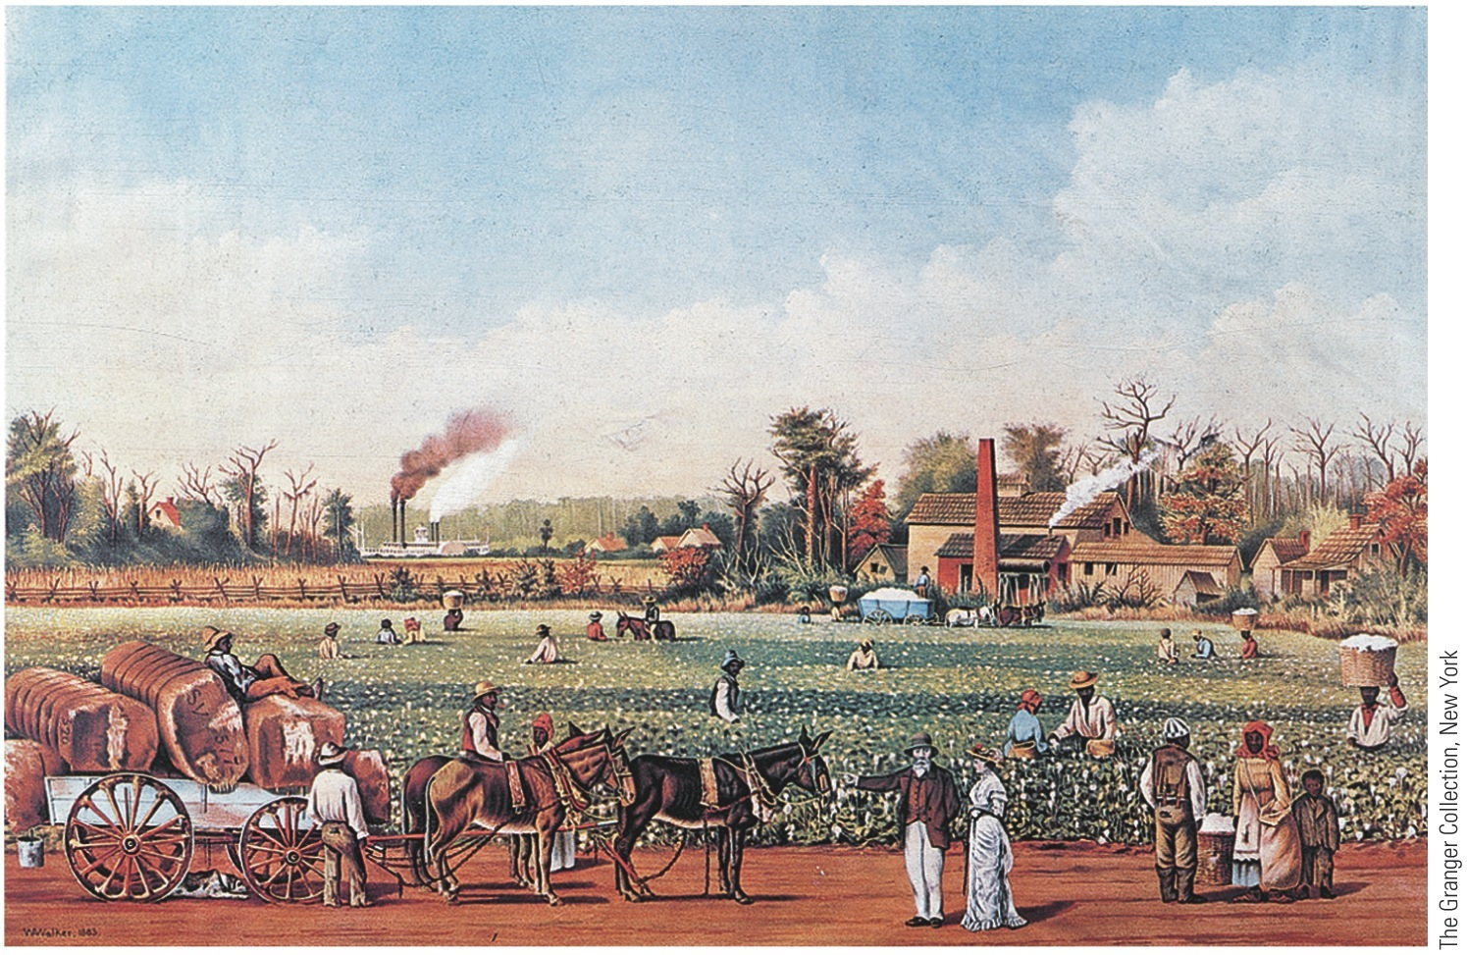
p342
Notes:
Harvesting Cotton This
Currier & Ives print shows slaves
of both sexes harvesting cotton,
which was then “ginned,” baled,
carted to the riverbank, and taken
by paddle wheeler downriver
to New Orleans for shipment to
New England or overseas.

Slide 7
II. The Planter “Aristocracy” (cont.)
Some mistresses showed tender regard for their bondwomen
Some slave women took pride in status as “members” of household
But slavery strained bonds of womanhood
Virtually no slaveholding women believed in abolition
Plantation life:
Plantation agriculture worrisome, distasteful, and sordid because despoiled good earth
Quick profit led to excessive cultivation or “land butchery”
Caused population to leave for West and Northwest
Economic structure of South became increasingly monopolistic:
Big got bigger and small smaller

Slide 8
III. Slaves of the Slave System
Financial instability of plantation system:
Over-speculation in land and slaves
Slaves represented heavy investment of capital
An entire slave quarter might be wiped out by disease
Dominance by King Cotton led to dangerous dependence on one-crop economy:
Prices at mercy of world conditions
System discouraged healthy diversification
Southern planters resented North growing fat at their expense
Cotton King repelled large-scale European immigration:
Immigrants added to manpower and wealth of North
1860 only 4.4 % of southern population was foreign-born as compared to 18.7% for North
German & Irish immigration to South discouraged by:
competition with slave labor
high cost of fertile land
European ignorance of cotton farming
South became most Anglo-Saxon part of U.S.A.

Slide 9
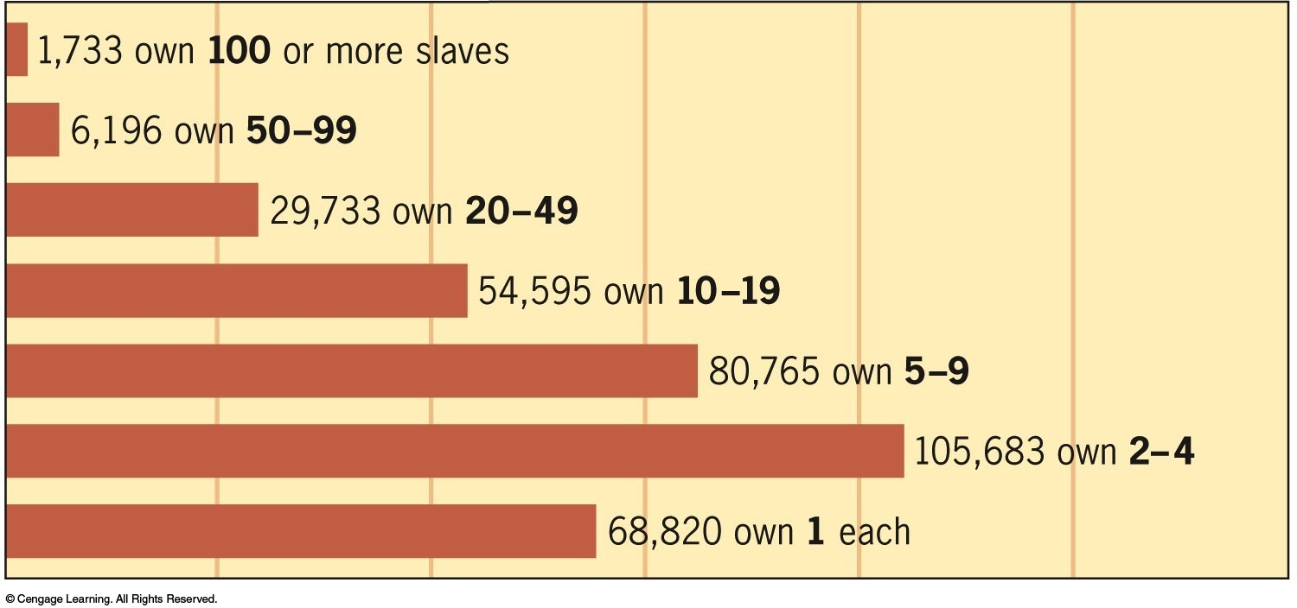
IV. The White Majority
Southern life:
Only handful of southern whites lived in Grecian-pillared mansions
Only 1,733 families owned a hundred or more slaves (see Figure 16.1)
Most slave owners had fewer than ten slaves
Smaller slave owners didn’t own majority of slaves, but were majority of masters
These lesser masters were typically small farmers

Slide 10
IV. The White Majority (cont.)
Beneath slave owners was great body of whites who owned no slaves (see Maps 16.1 and 16.2)
Only ¼ of white southerners owned slaves or belonged to slave owning family
Most whites were subsistence food farmers not part of cotton export economy
Whites without slaves had no direct economic stake in slavery, yet they defended slave system:
Hoped to buy slaves (“American dream” of upper mobility)
Took pride in presumed racial superiority
Logic of economics joined with illogic of racism to buttress slave system
In special category of white southerners were mountain whites:
Independent small farmers who lived in valleys of Appalachian range
Had little in common with whites of flatlands
When war came, mountain whites constituted vitally important peninsula of Unionism
Played significant role in crippling Confederacy
After Civil War, they were only concentrated Republican strength in solid Democratic South

Slide 11
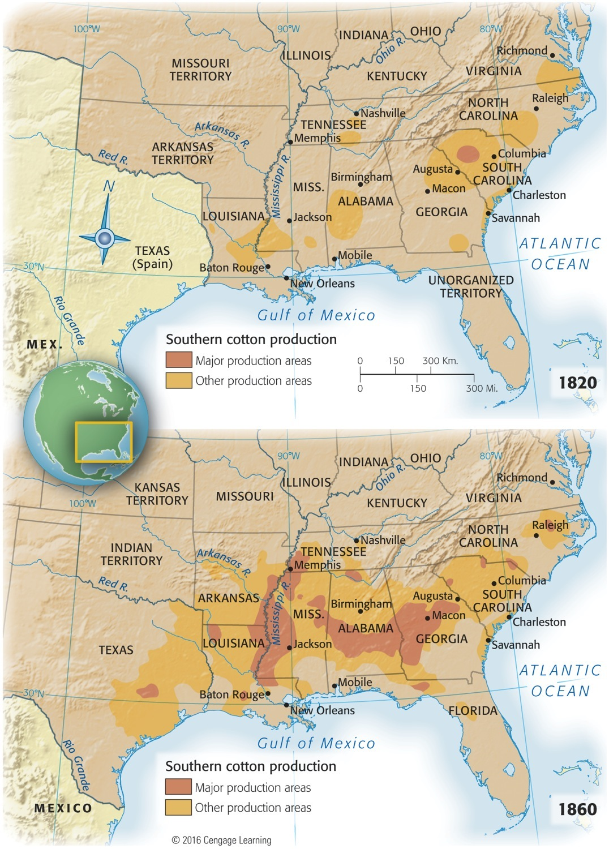
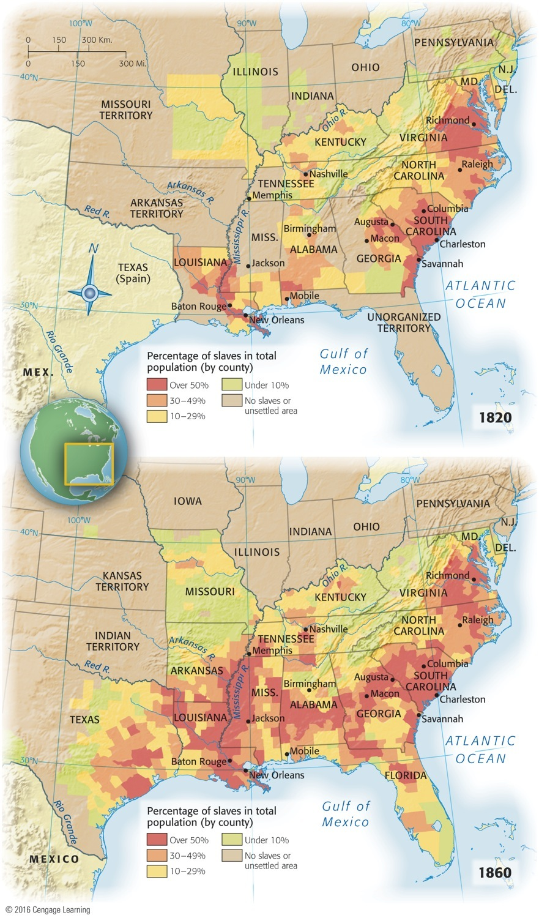
Map 16-1 p344
Notes:
Map 16.1 Southern Cotton
Production and Distribution
of Slaves, 1820 and 1860
© 2016 Cengage Learning

Slide 12
V. Free Blacks: Slaves Without Masters
South's free blacks:
Numbered about 250,000 by 1860:
Some in upper South traced emancipation to idealism of Revolutionary days
In lower South, many were mulattoes
Some purchased their freedom
Many owned property
Were a kind of “third race:”
Banned from certain occupations
Vulnerable to being hijacked into slavery
Hostile northern climate for free blacks (250,000):
Several states forbade their entrance
Most denied them right to vote
Some barred them from public schools
Northern blacks were particularly hated by Irish immigrants because two groups competed for menial jobs
Antiblack feelings in ways stronger in North than in South:
Southern whites liked blacks as individuals, but despised race
Northern whites professed to like race, but disliked individual blacks

Slide 13
VI. Plantation Slavery
In South of 1860, nearly four million black slaves:
Legal importation of African slaves into America ended in 1808 by Congress
Britain abolished slave trade in 1807:
Royal Navy's West African Squadron seized hundreds of slave ships and freed thousands of captives
Yet three million enslaved Africans still shipped to Brazil and West Indies after 1807
Slavery:
In U.S.A., price of “black ivory” so high before Civil War that thousands of blacks smuggled into South
Ironically, suppression of international slave trade fostered growth of vigorous internal slave trade
Most of increase in U.S. slave population came from natural reproduction:
Distinguished North American slavery from slavery in more disease-ridden southerly New World societies

Slide 14
VI. Plantation Slavery
Planters regarded slaves as investments:
Worth $2 billion in capital by 1860
Slaves were primary form of wealth in South:
Cared for as any asset is cared for by prudent capitalist
Sometimes spared dangerous work
Slavery was profitable, even though it hobbled economic development of region as a whole
Breeding of slaves not openly encouraged, but:
Women who bore thirteen or fourteen babies were prized as “rattlin' good breeders”
White masters forced their attentions on female slaves fathering sizable mulatto population, most of which remained enslaved
Slave auctions were brutal sights:
Most revolting aspects of slavery
Families separated with distressing frequency
Slavery's greatest psychological horror
Abolitionists decried practice
Harriet Beecher Stowe 1852 novel: Uncle Tom's Cabin

Slide 15
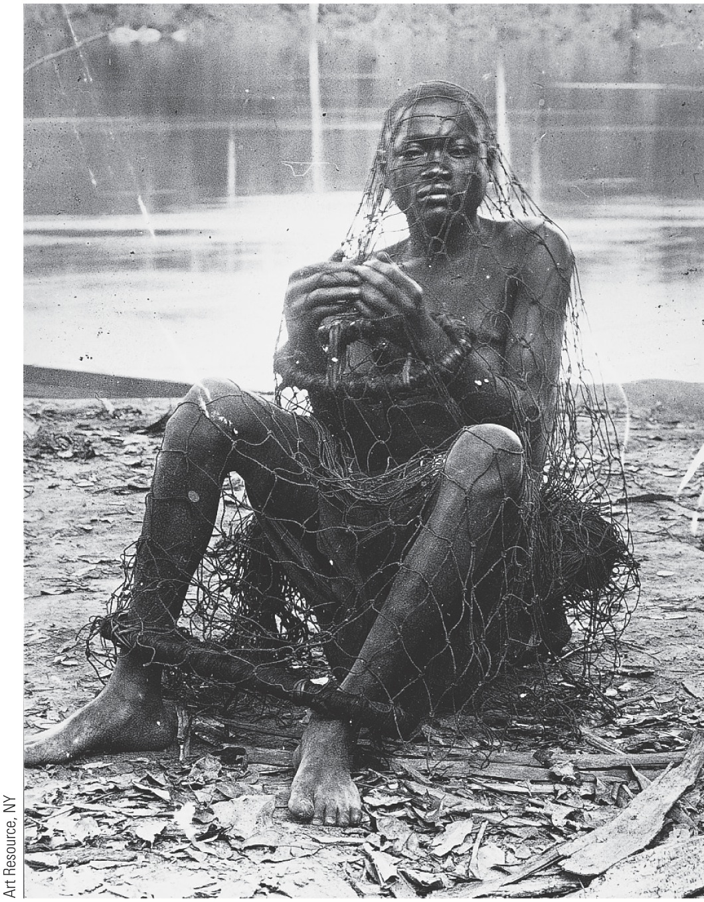
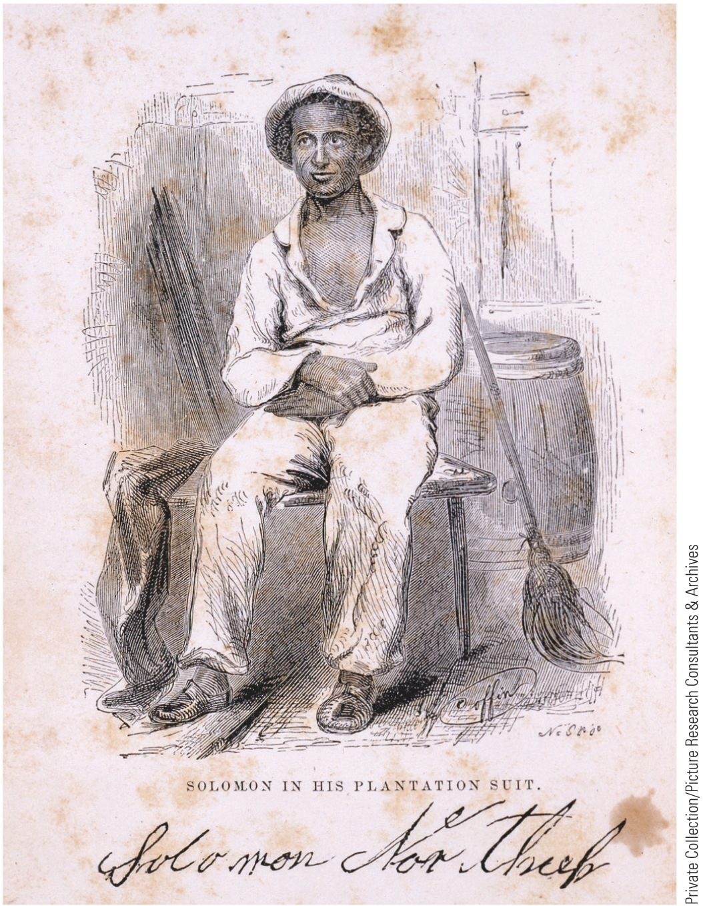
p347
Notes:
A Market in People (left) Held captive in a net, a slave sits on the Congo shore, waiting to be sold and
shipped. (right) Once in the United States, slaves continued to be treated like commodities. Even free
blacks in the northern states were at risk of being enslaved. Solomon Northrup (1808–1863?), shown on
the right, was a musician living in upstate New York in 1841, when he was kidnapped by slave traders,
shipped to New Orleans, and sold at auction. He spent twelve years enslaved on a Louisiana plantation.
Regaining his freedom at last, he wrote a sensational account of his experience, “Twelve Years a Slave,”
published in 1853. More than 150 years later the book became the basis for a major Hollywood film.

Slide 16
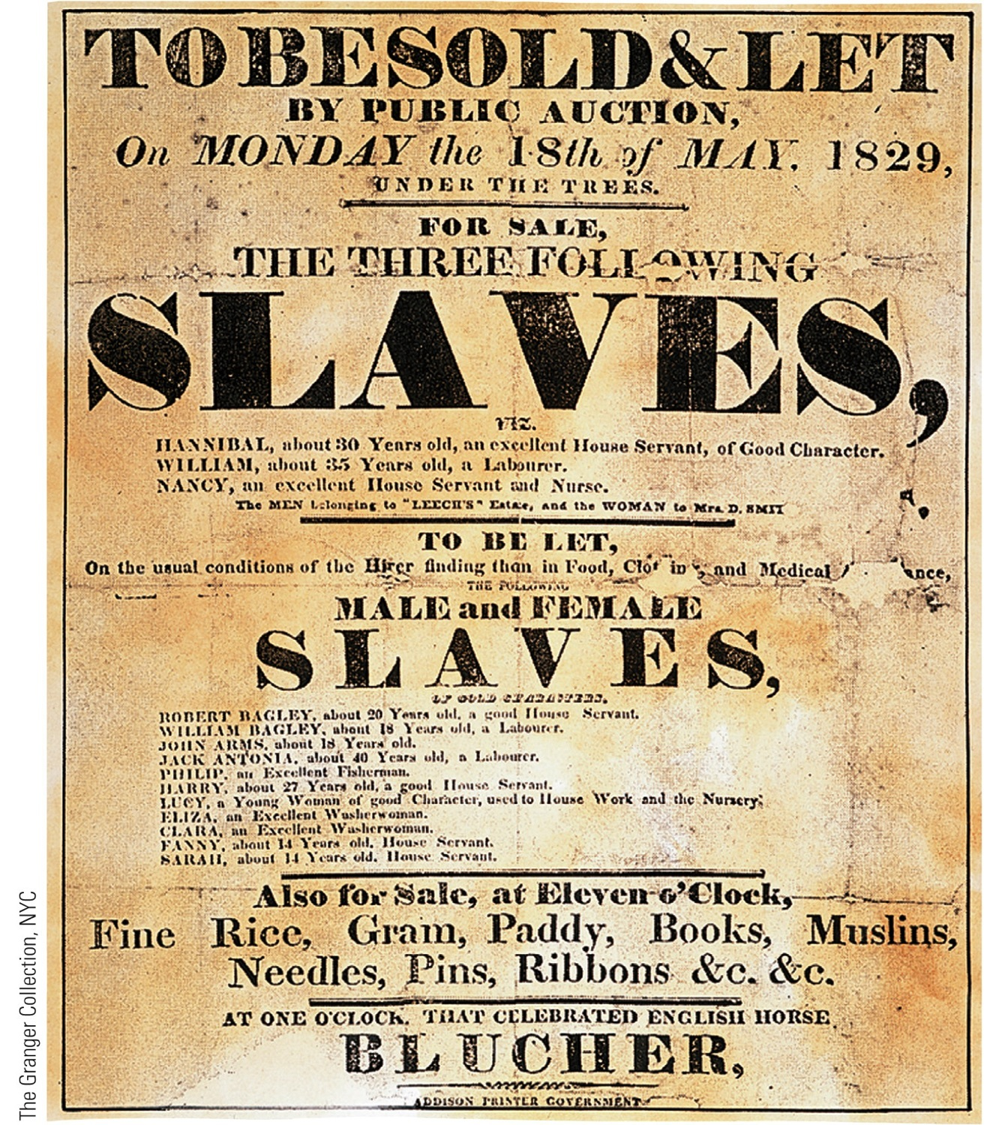
p348
Notes:
A Slave Auction Abraham
Lincoln said in 1865, “Whenever
I hear anyone arguing for
slavery, I feel a strong impulse
to see it tried on him
personally.”

Slide 17
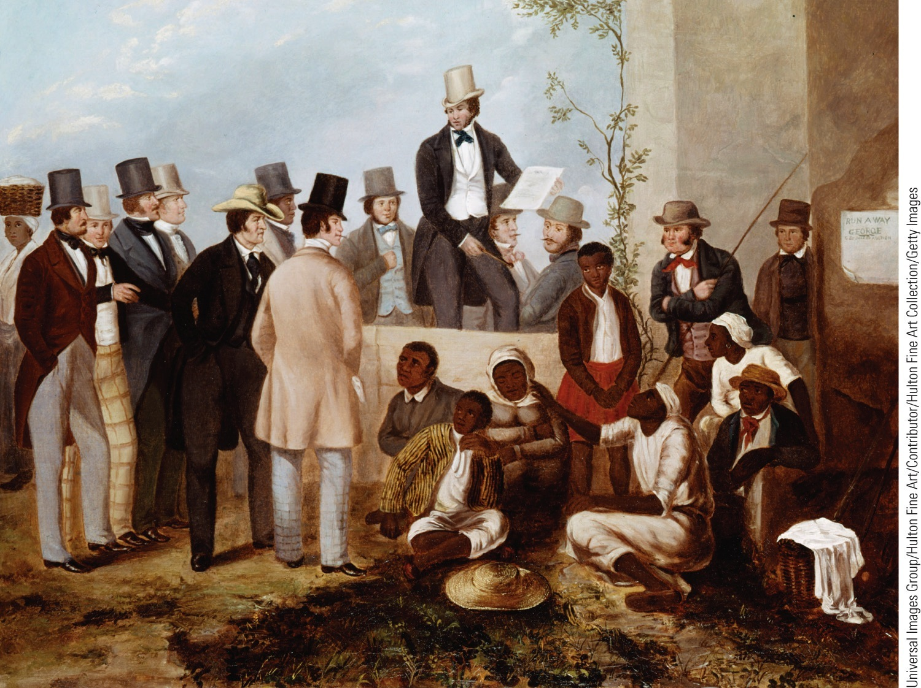
p348
Notes:
A Slave Auction Abraham
Lincoln said in 1865, “Whenever
I hear anyone arguing for
slavery, I feel a strong impulse
to see it tried on him
personally.”

Slide 18
VII. Life Under the Lash
How did slaves actually live?
Conditions varied greatly:
Slavery meant hard work, ignorance, and oppression
No political rights; minimal protection
Protection laws difficult to enforce since slaves forbidden to testify in court or to have marriages legally recognized
Floggings were common
Strong-willed slaves sometimes sent to breakers who lavishly used lash

Slide 19
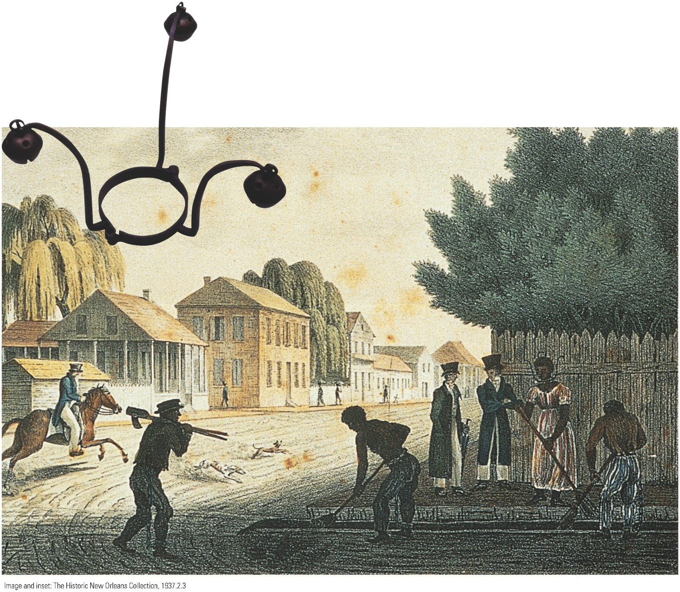
p349
Notes:
The Cruelty of Slavery Slaveowners used devices like this collar with bells to discipline and patrol
their slaves. This female slave shown toiling in New Orleans has such a collar riveted around her neck,
designed to prevent her from hiding from her master or escaping. Image and inset: The Historic New Orleans Collection, 1937.2.3

Slide 20
VII. Life Under the Lash
Savage beatings made sullen laborers & hurt resale values
Typical master had too much money invested in slaves to beat them bloody on regular basis
Blacks concentrated in black belt of Deep South by 1860:
Stretched from South Carolina to Georgia into new southwest: Alabama, Mississippi, Louisiana
Frontier life was harsh
Black living:
Most lived on large plantations of 20 or more slaves
In some Deep South areas, blacks 75% of population
Family life relatively stable, and distinctive African American slave culture developed
Forced separations more common on smaller plantations or in Upper South
Slaves managed to sustain family life
Most slave children raised in two-parent households

Slide 21
VIII. The Burdens of Bondage
Slavery intolerably degrading to victims:
Deprived of dignity and sense of responsibility that come from independence and right to make choices
Denied an education
Victims of “peculiar institution” devised ways to protest:
Slowed pace of labor to bare minimum
Filched food from “big house”
Pilfered other goods
Sabotaged expensive equipment
Slaves universally pined for freedom:
Many took off as runaways
Others rebelled, though never successfully
1800: armed insurrection led by slave named Gabriel in Richmond, Virginia—foiled by informers, its leaders hanged
1822: Denmark Vesey, a free black, led rebellion in Charleston, South Carolina; foiled by informers, Vesey & 30 followers hung
1813: Nat Turner, visionary black preacher, led uprising that slaughtered 60 Virginians—Nat Turner's rebellion soon crushed

Slide 22
VIII. The Burdens of Bondage
Enslaved Africans rebelled aboard Spanish slave ship Amistad in 1839
Slavery also affected southern whites:
Fostered brutality of whip, bloodhound, & branding iron
Increasingly lived in state of imagined siege, surrounded by potentially rebellious blacks inflamed by abolitionist propaganda from North
Such fears bolstered theory of biological racial superiority

Slide 23
IX. Early Abolitionism
Inhumanity of “peculiar institution” caused antislavery societies:
Abolitionist sentiment first stirred during Revolution, especially among Quakers
American Colonization Society (1817):
Transport blacks back to Africa
1822 Liberia, on West African coast, established for former slaves
Its capital, Monrovia, named after President Monroe
15,000 freed slaves transported over four decades
Most blacks had no wish to move to a strange civilization after having become partially Americanized
By 1860, most southern slaves were native-born African-Americans, with a distinctive history & culture
Yet colonization appealed to some antislaverites, including Abraham Lincoln, before Civil War

Slide 24
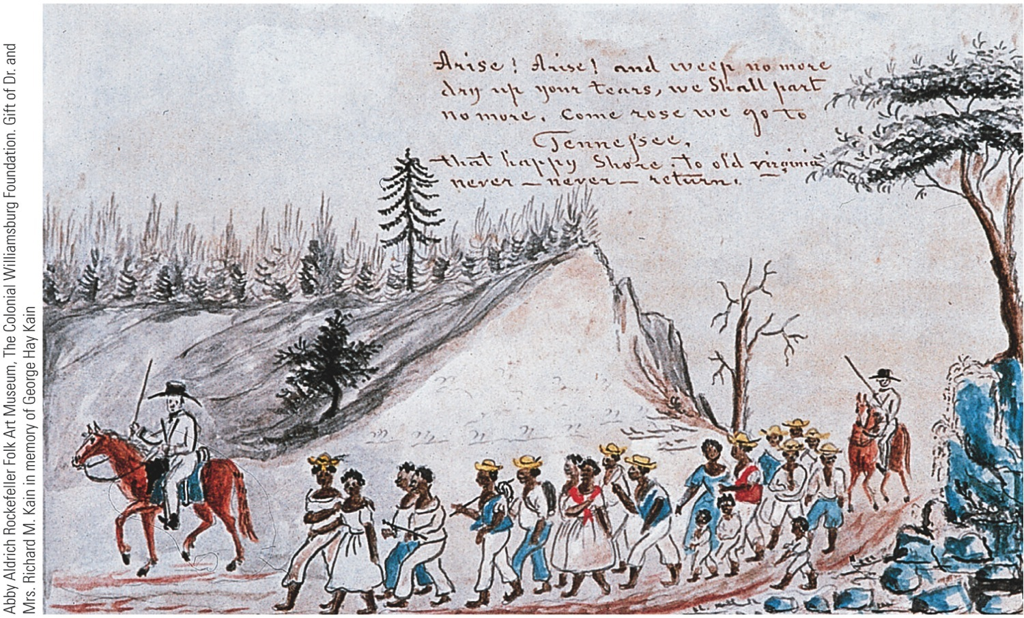
p351
Notes:
Slaves Being Marched from
Staunton, Virginia, to
Tennessee, by Lewis Miller,
1853 In this folk painting
of slaves in transit from the
upper South to the new cotton
lands of the lower South,
couples travel together and
children accompany parents.
In reality the forced movement
of slaves often involved
the painful separation of
family members.

Slide 25
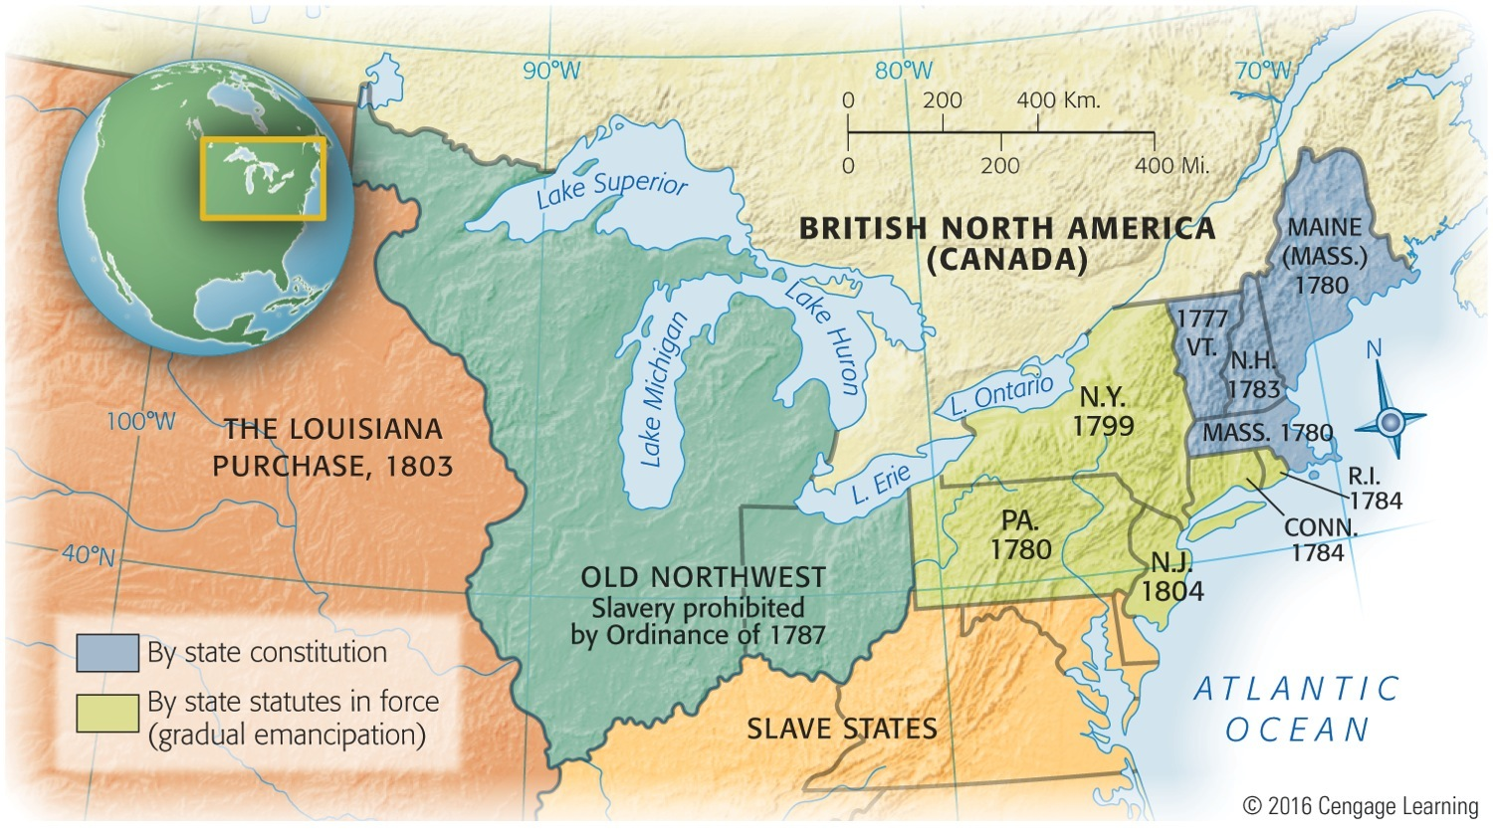
Map 16-3 p352
Notes:
Map 16.3 Early Emancipation in the North © 2016 Cengage Learning

Slide 26
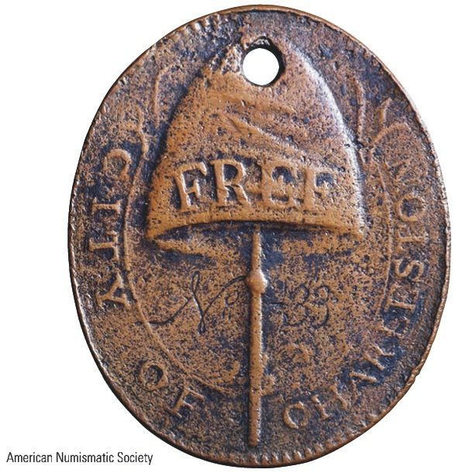
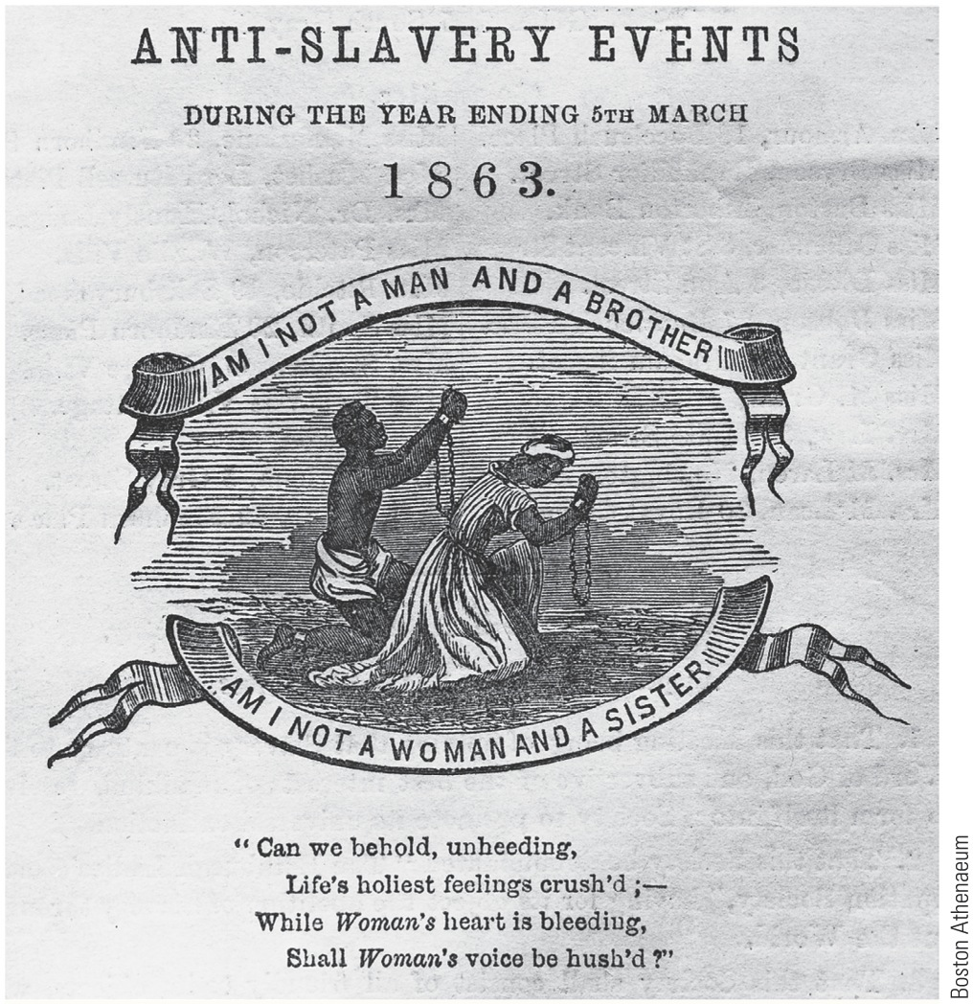
p353
Notes:
“Am I Not a Man and a Brother? Am I Not a Woman and a Sister?” A popular appeal.

Slide 27
X. Radical Abolitionism
Most white opponents of slavery were members of the democratic Protestant faiths.
These people believed that all humans had the right to choose their own destiny and follow God’s laws,
Many of these people believed, however that blacks and whites were not equal. There was still a deep prejudice that existed.

Slide 28
Harriet Beecher Stowe
Was an abolitionist
Wrote Uncle Tom’s Cabin in 1852.
It sold Millions
A story about a kind slave and a cruel master.
It introduced many people to the horrors of slavery.

Slide 29
X. Radical Abolitionism
William Lloyd Garrison:
Inspired by Second Great Awakening
The Liberator—his militantly antislavery newspaper started in 1831:
Under no circumstances would he tolerate poisonous weed of slavery, but would stamp it out, root & branch
American Anti-Slavery Society (1833):
Founders: Garrison, Wendell Phillips
Black abolitionists:
David Walker's Appeal to the Colored Citizens of World (1829)—advocated bloody end to white supremacy
Sojourner Truth—fought tirelessly for black emancipation and women's rights
Martin Delany:
one of few black leaders who took seriously notion of mass recolonization of Africa

Slide 30
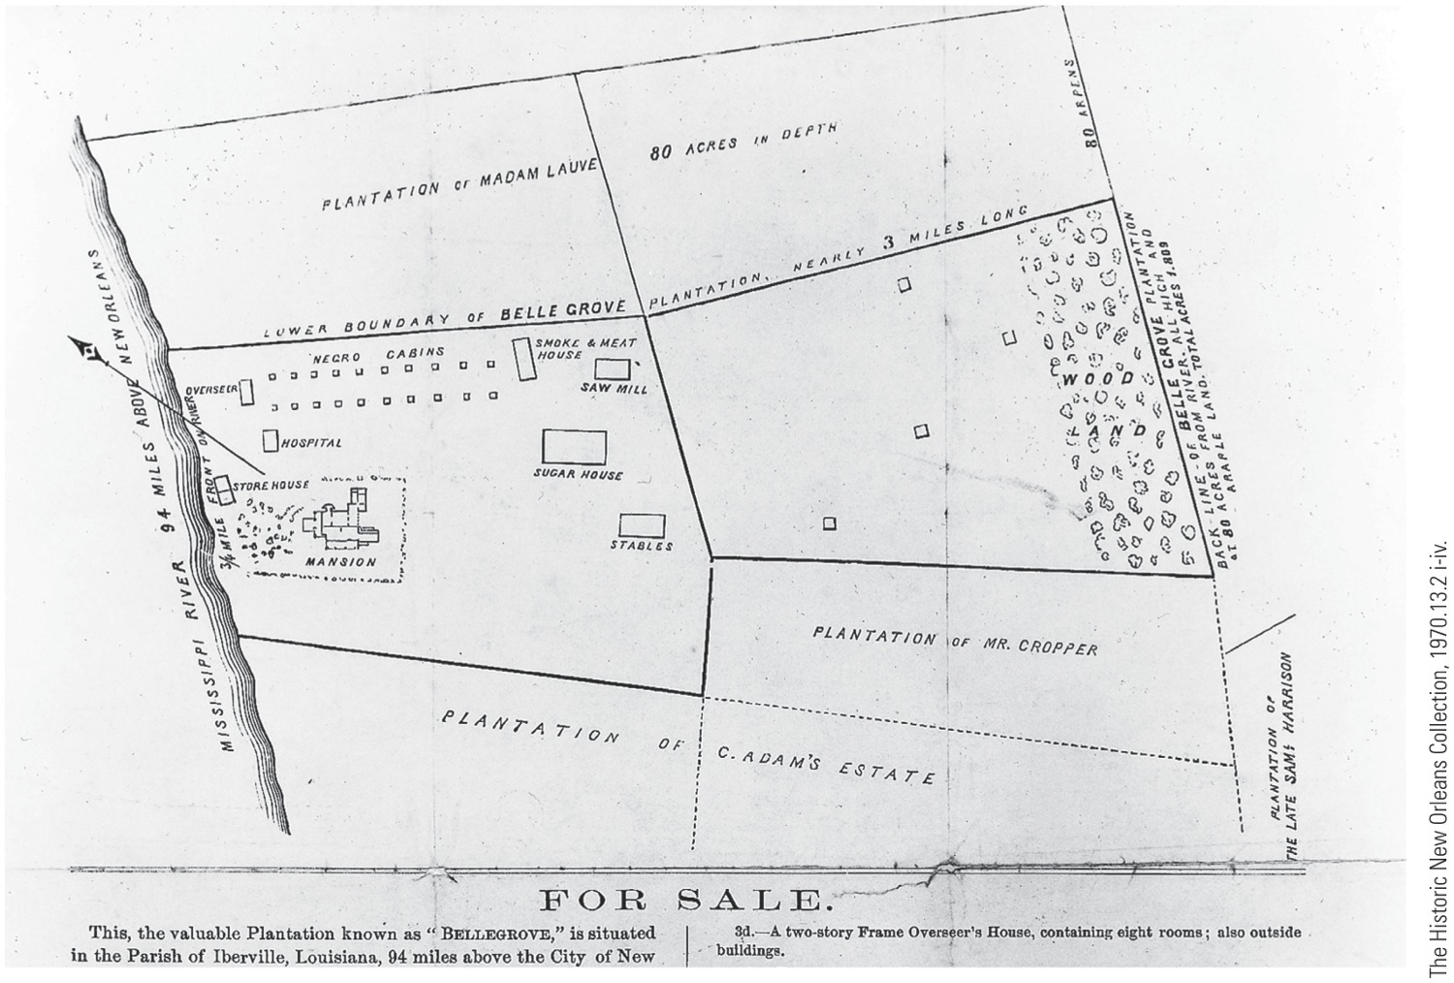
p354

Slide 31
X. Radical Abolitionism
Frederick Douglass—greatest black abolitionist:
Escaped bondage in 1838 at age 21
Was “discovered” by abolitionists in 1841 after giving impromptu speech at an antislavery meeting in Massachusetts
Continued to lecture, despite repeated punishment
Narrative of the Life of Fredrick Douglass (1845) his classic autobiography
Depicted his remarkable origins, his struggle to learn to read and write, and his eventual escape to North

Slide 32
X. Radical Abolitionism
Comparison of Garrison and Douglass:
Garrison:
Stubbornly principled
More interested in his own righteousness than in substance of slavery itself
Repeatedly demanded that “virtuous” North secede from “wicked” South.
Never explained how creation of independent slave republic would end “damning crime” of slavery.
Renouncing politics, he publicly burned a copy of Constitution as “a covenant with death and an agreement with hell” on July 4, 1854.
Critics charged he was cruelly probing moral wound in America's underbelly, but offered no acceptable balm to ease pain.
Douglas:
Flexibly practical
He and other abolitionists increasingly looked to politics to end slavery
Backed Liberty party in 1840; Free Soil party in 1848; Republican party in 1850s
Most abolitionists, including Garrison, followed logic of beliefs and supported war as price of emancipation

Slide 33
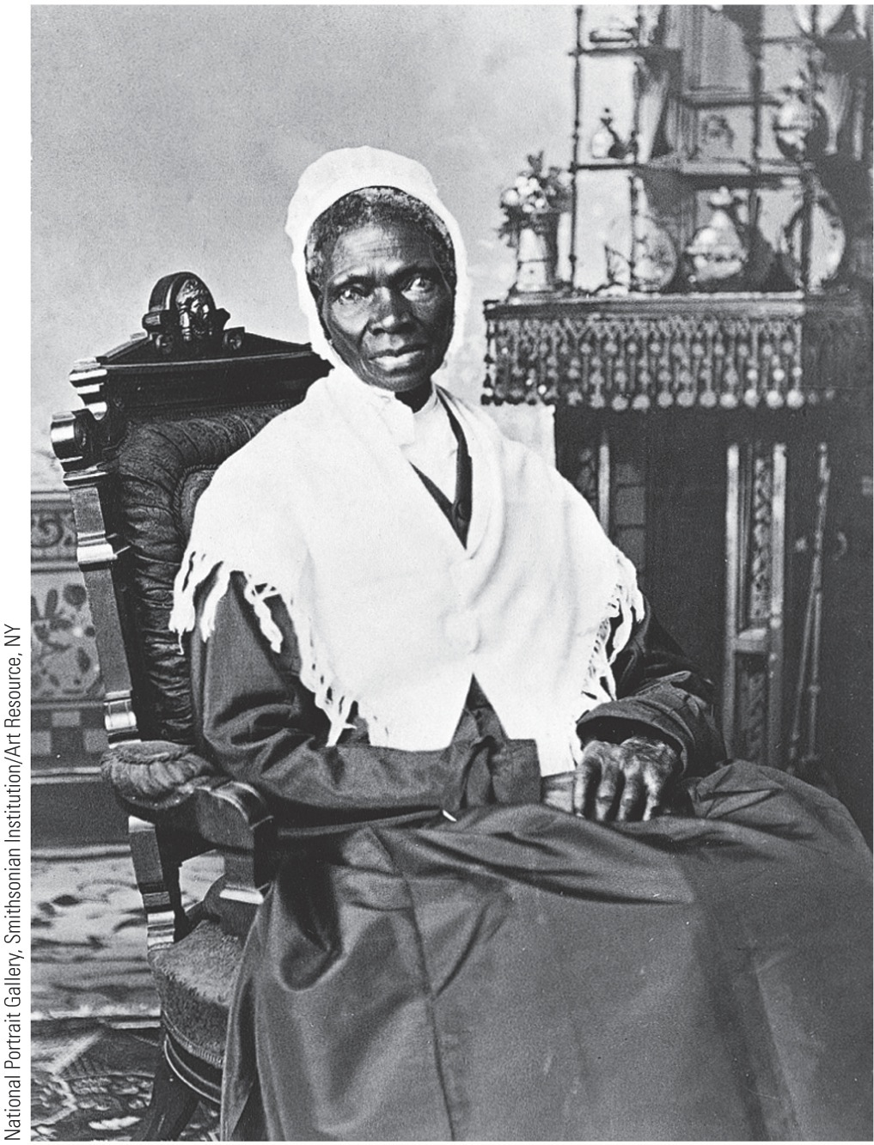
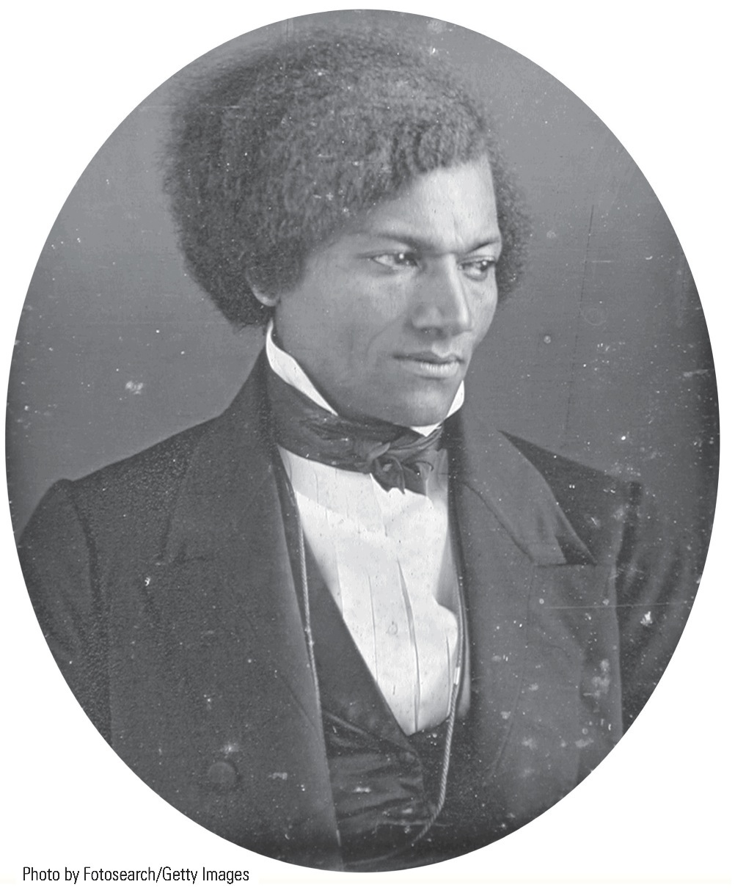
p355
Notes:
Sojourner Truth Also known simply as “Isabella,” she held audiences spellbound with her deep, resonant voice and the religious passion with which she condemned the sin of slavery. This photo was taken about 1870.

Slide 34
XI. The South Lashes Back
Antislavery sentiment existed in South
In 1820s, more antislavery societies south of Mason-Dixon line than north of it
After 1830 southern abolitionism silenced:
Virginia legislature debated and defeated various emancipation proposals in 1831-1832:
Marked turning point
Slave states tightened slave codes
Banned emancipation of any kind, voluntary or compensated
Nat Turner's rebellion in 1831:
Caused hysteria throughout South
Garrison bitterly condemned as terrorist and inciter of murder although he was unconnected with rebellion
State of Georgia offered $5,000 for his arrest and conviction
Nullification crisis of 1832 further implanted fear in white southern minds
Jailings, whippings, & lynching greeted rational efforts to discuss slavery problem in South

Slide 35
XI. The South Lashes Back
Proslavery whites responded by launching massive defense of slavery as positive good:
Claimed master-slave relationships resembled those of a family
Were quick to contrast “happy” lot of their “servants” with overworked northern wage slaves
Proslavery arguments widened chasm between South and North
Controversy increasingly limited free speech:
Gag Resolution:
Pushed through Congress by southerners
Required antislavery appeals to be tabled without debate
Southern whites resented use of mail for abolitionist literature:
Congress (1835) ordered southern postmasters to destroy abolitionist material
Called on southern states to arrest postmasters who did not comply

Slide 36
XII. The Abolitionist Impact in the North
Abolitionists, esp. Garrisonians, unpopular in North:
Northerners revered Constitution and saw its clauses on slavery as lasting bargain
Ideal of Union had deep roots
North had heavy economic stake in South:
Southern planters owed northern bankers & creditors about $300 million—would be lost if Union dissolved
Disruption to slave system might cut off vital supply of cotton to northern mills and thus bring unemployment
Abolitionists often suffered violent attacks.
They had influenced northern opinion by 1850s:
Many had come to see South as land of unfree and home of a hateful institution
Few prepared to abolish slavery outright, but growing number opposed extending it to western territories

Slide 37
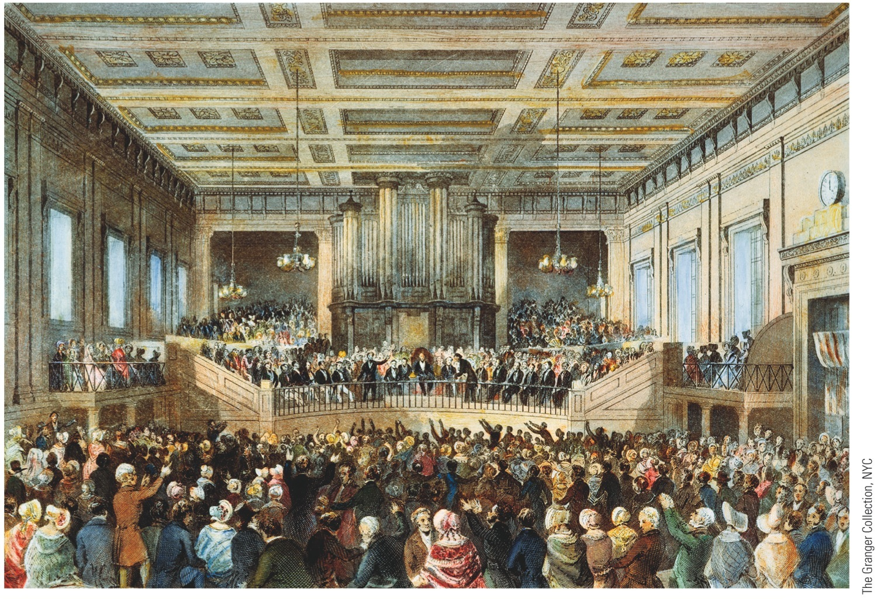
p356
Notes:
World’s Anti-Slavery Convention, London, 1840 The convention assembled antislavery advocates from around the world, but it refused to seat female delegates. Women were allowed to observe, but not to take part in, the official proceedings. The frustrations of the unseated American representatives led to the historic Woman’s rights Convention at Seneca Falls, New York, in 1848 (see p. 320).

Slide 38
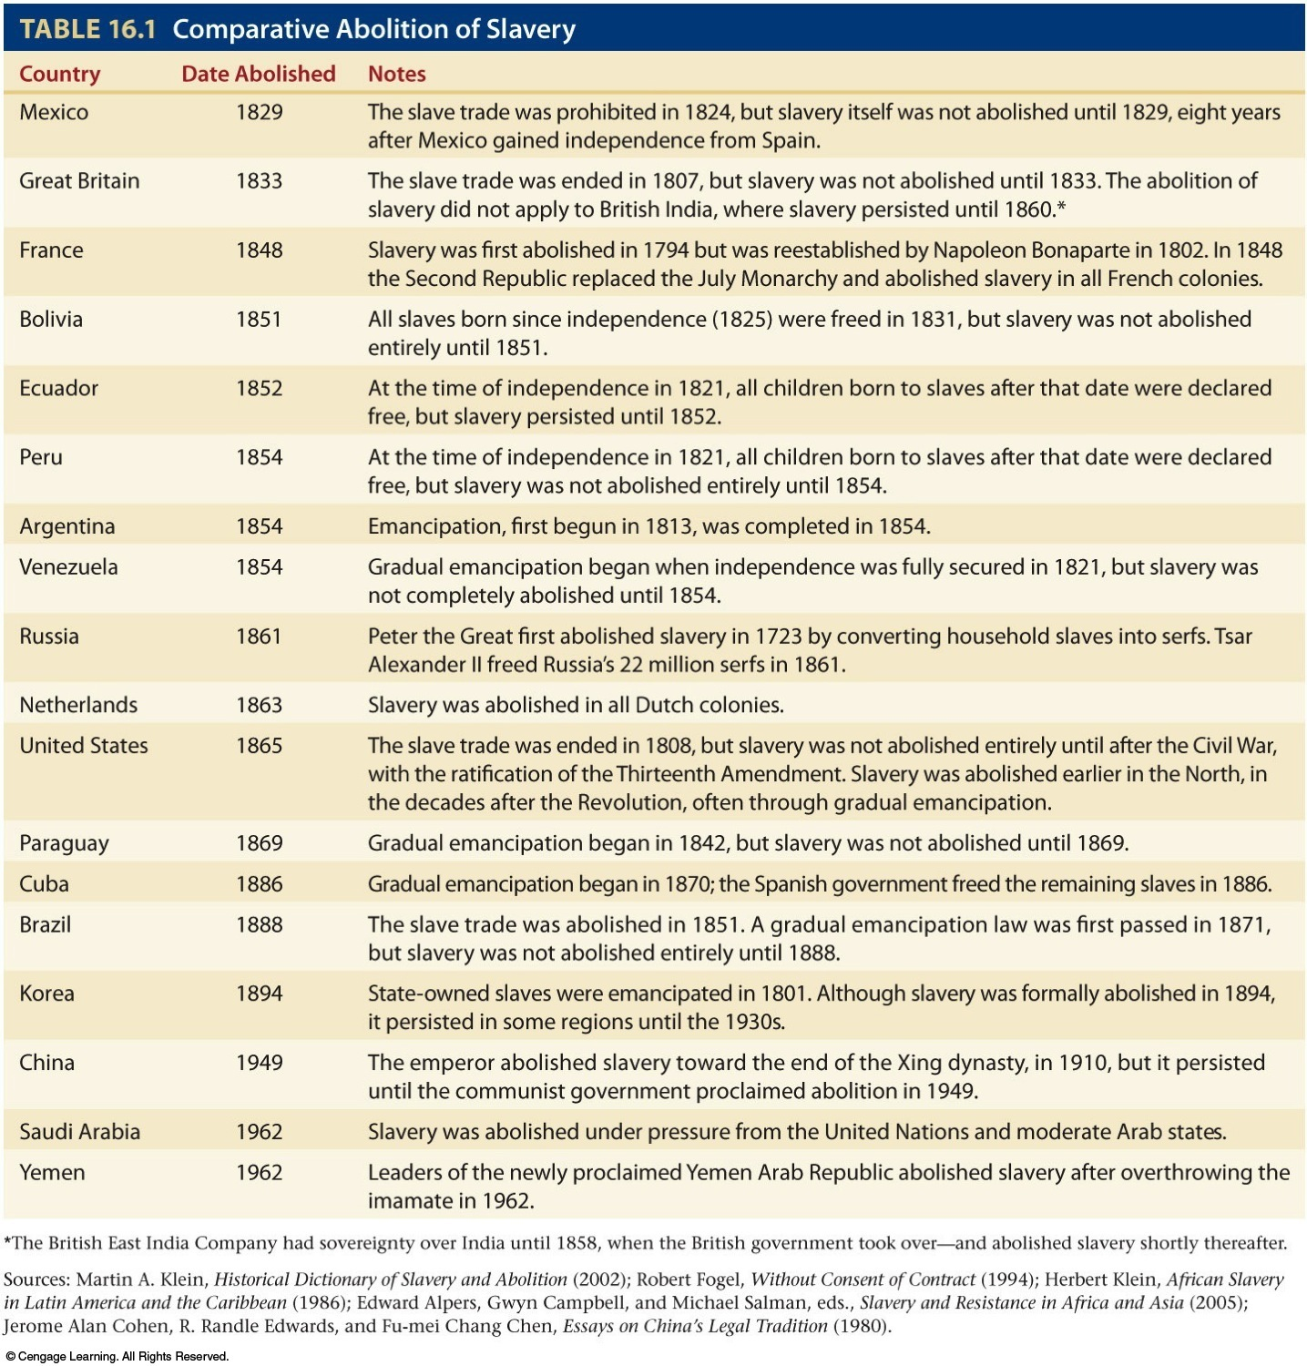
Table 16-1 p357

Slide 39
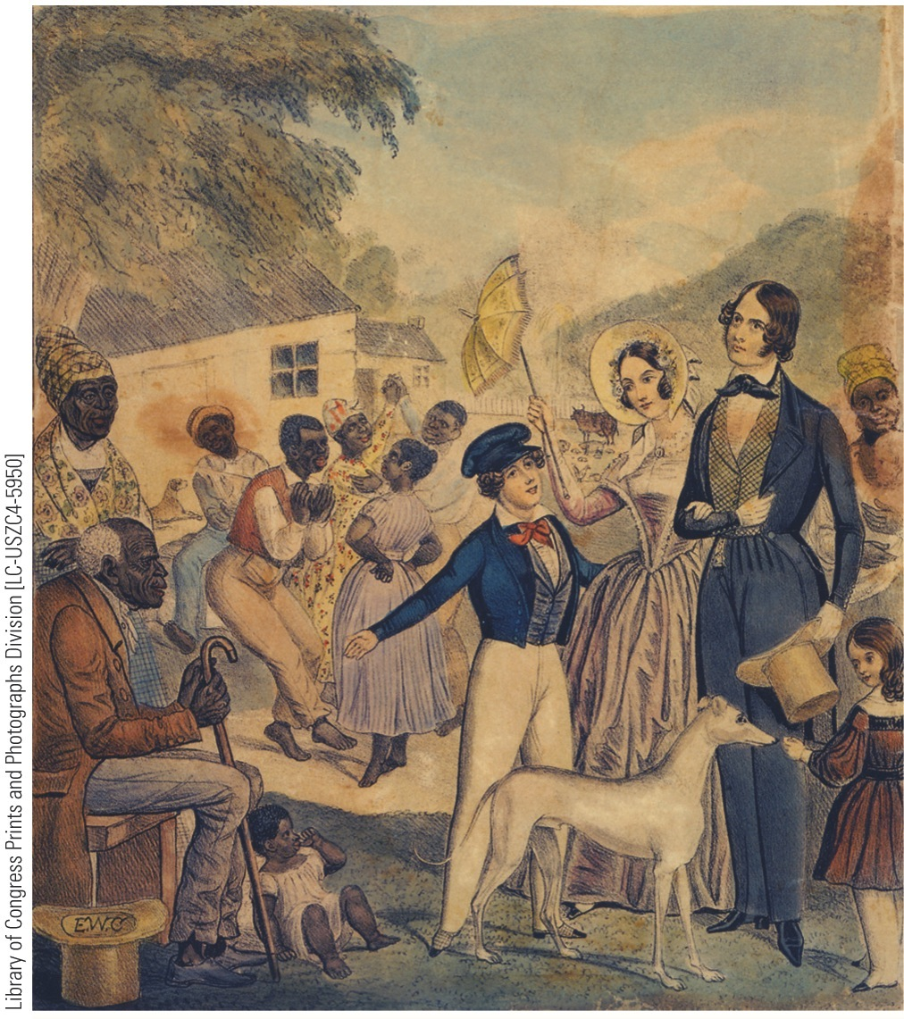
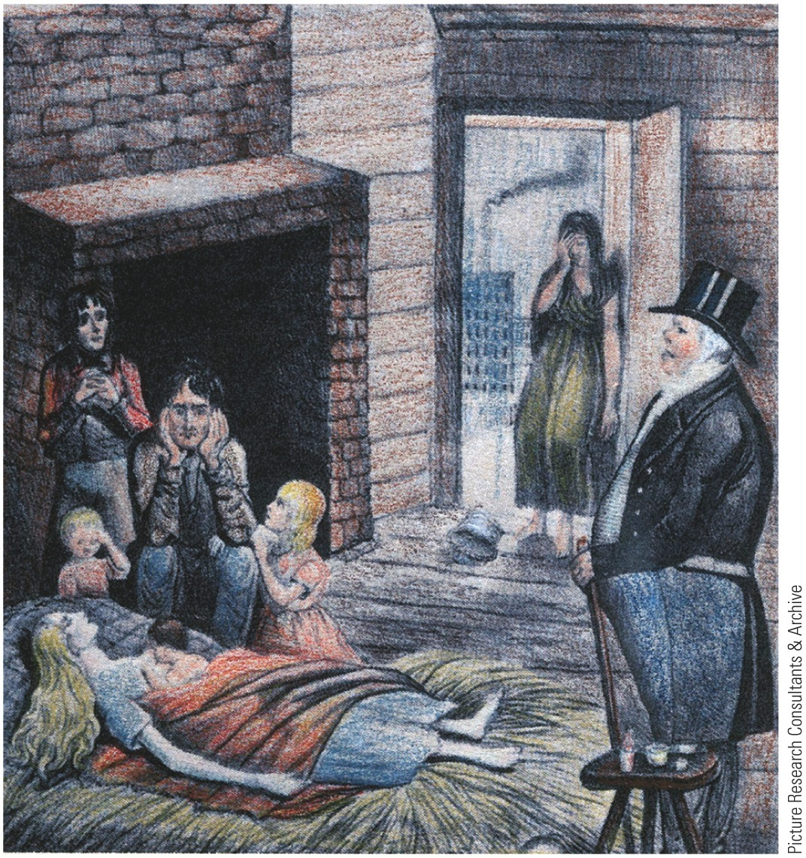
p358
Notes:
In Defense of Slavery This pair of illustrations contrasts the supposedly benevolent slave regime of the South with the harshness of working life in England, where starvation wages and unemployment blighted workers’ lives. Apologists for slavery frequently invoked this comparison between allegedly paternalistic slavemasters and the uncaring capitalists who captained the Industrial revolution.

Slide 40
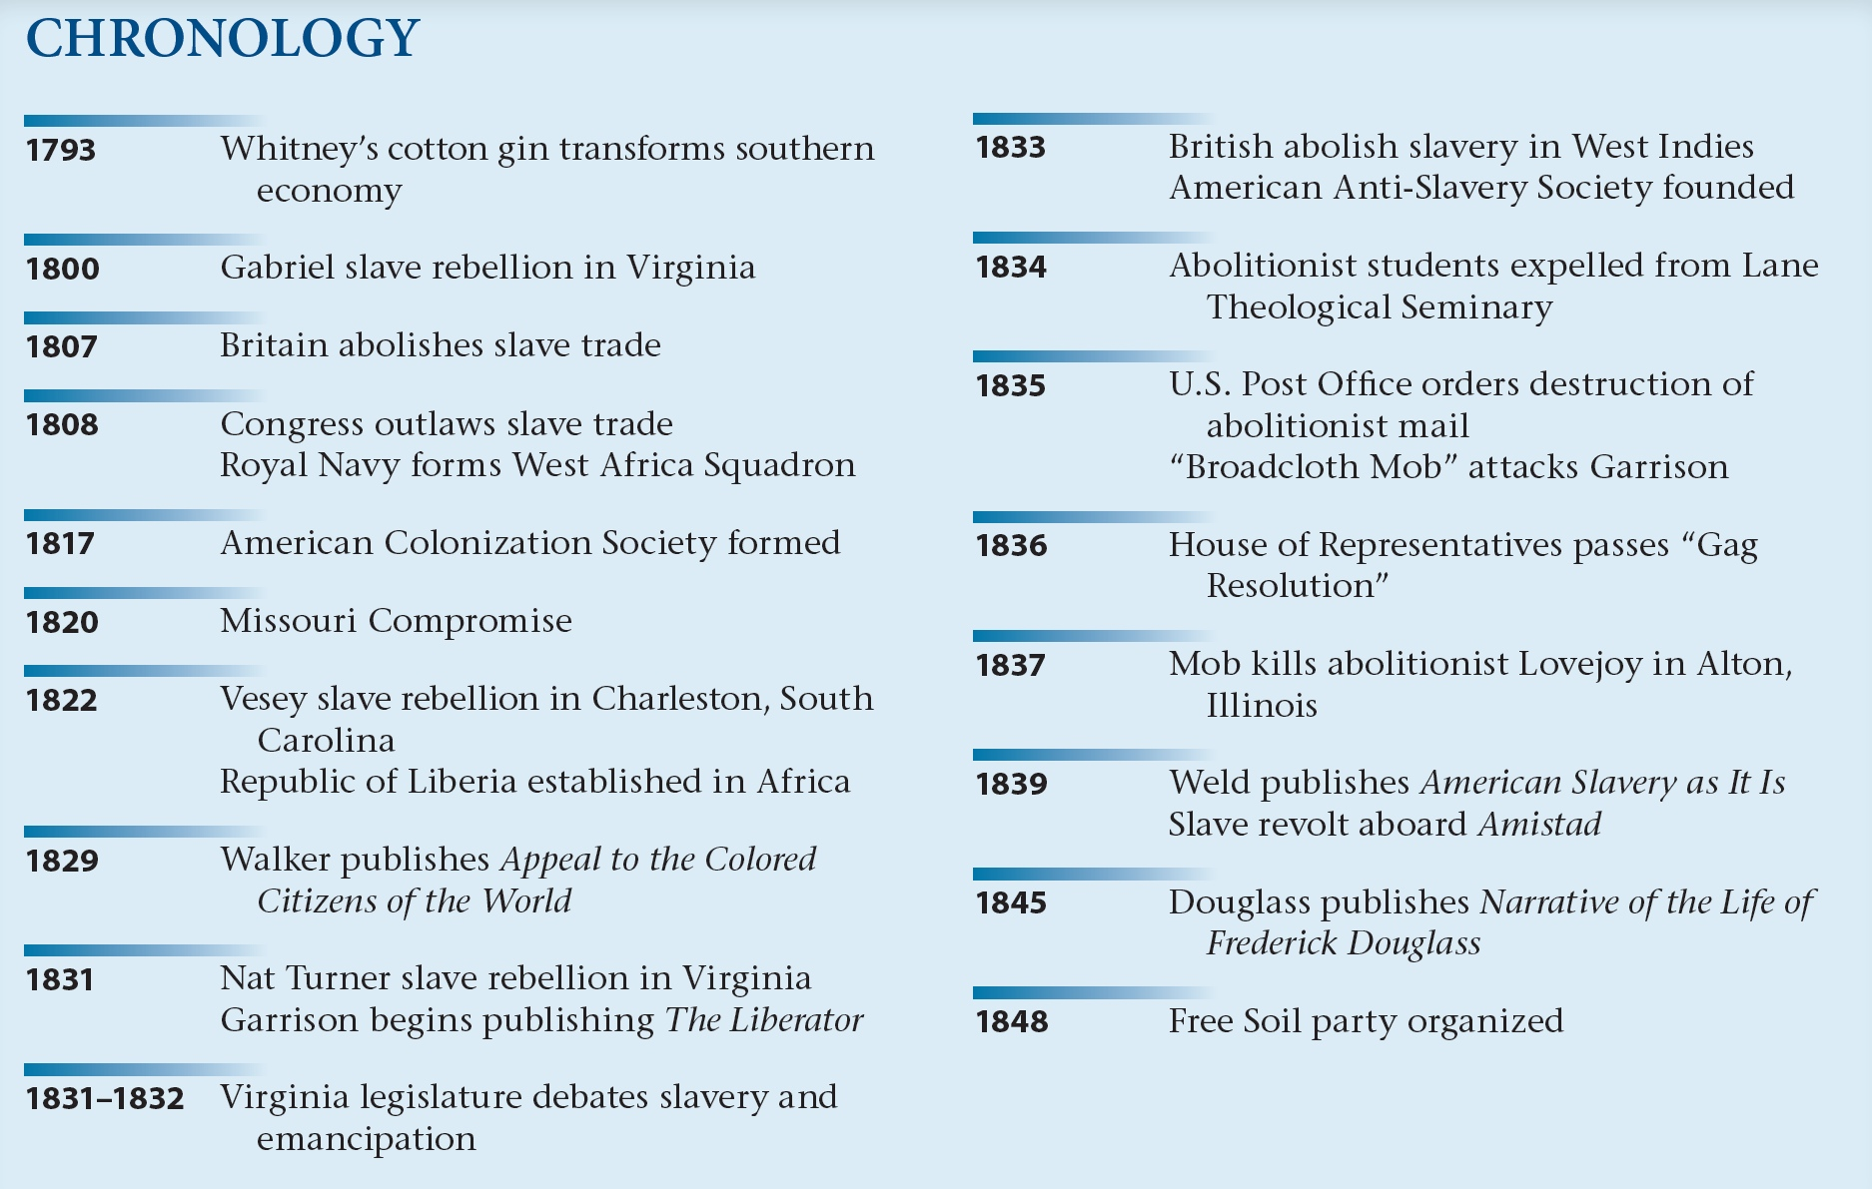
p361

