Slide 1
Chapter 6
Duel for North america

Slide 2
I. France Finds a Foothold in Canada
France was a latecomer in the scramble for New World real estate:
It was convulsed by foreign wars and domestic strife during the 1500s.
It was involved in clashes between Roman Catholics and Protestant Huguenots.
On St. Bartholomew’s Day, 1572, over 10,000 Huguenots―men, women, and children―were butchered in cold blood.

Slide 3
I. France Finds a Foothold in Canada (cont.)
1608: The permanent beginnings of a French empire (see Map. 6.1) were established at Québec:
Efforts were led by Samuel de Champlain, “Father of New France.”
He established friendly relationships with Huron Indian tribes.
He entered into a treaty with the Huron against the Iroquois tribes of the upper New York area.

Slide 4
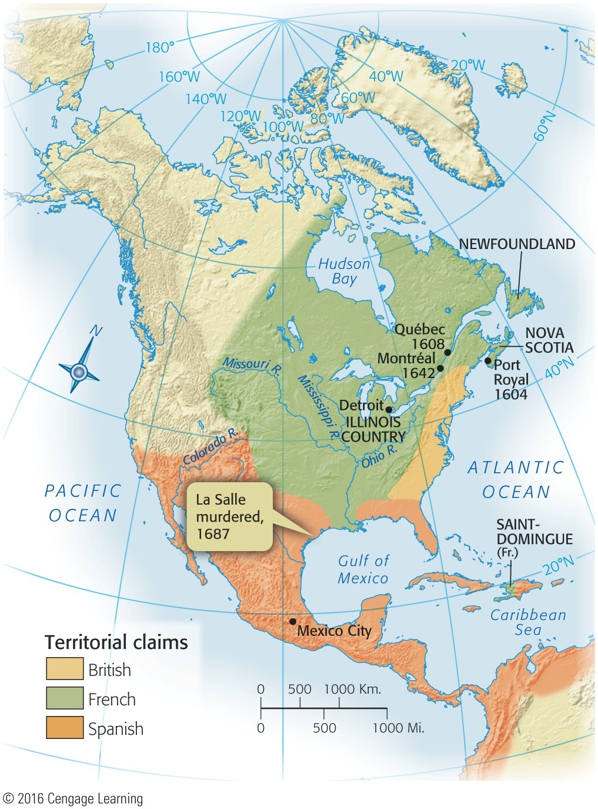
Map 6.1 p102
Notes:
Map 6.1 France’s American Empire at Its Greatest Extent, 1700

Slide 5
I. France Finds a Foothold in Canada (cont.)
Government of New France (Canada) finally fell under direct control of the king.
This regime was almost completely autocratic.
The people elected no representative assemblies.
They did not enjoy the right to trial by jury, as in the English colonies.

Slide 6
I. France Finds a Foothold in Canada (cont.)
The population of Catholic New France grew slowly:
In the late 1750s, only 60,000 or so whites were in New France.
Landowning French peasants had little motive to move.
French Huguenots were denied a refuge.
The French government favored its Caribbean islands.

Slide 7
II. New France Fans Out
New France contained one valuable resource—the beaver:
European fashion-setters valued beaver-pelt hats.
Colorful coureurs de bois trapped beavers.
They littered the land with scores of place names: Baton Rouge (red stick), Terre Haute (high land), Des Moines (some monks).
French voyageurs recruited Indians into the fur business (see Map 6.2):
The Indian fur flotilla that arrived in Montréal in 1693 numbered 400 canoes.
Many of these Indians were decimated by the white man’s diseases and alcohol.
Mass slaughter of beavers violated many Indians’ religious beliefs and caused ecological damage.

Slide 8
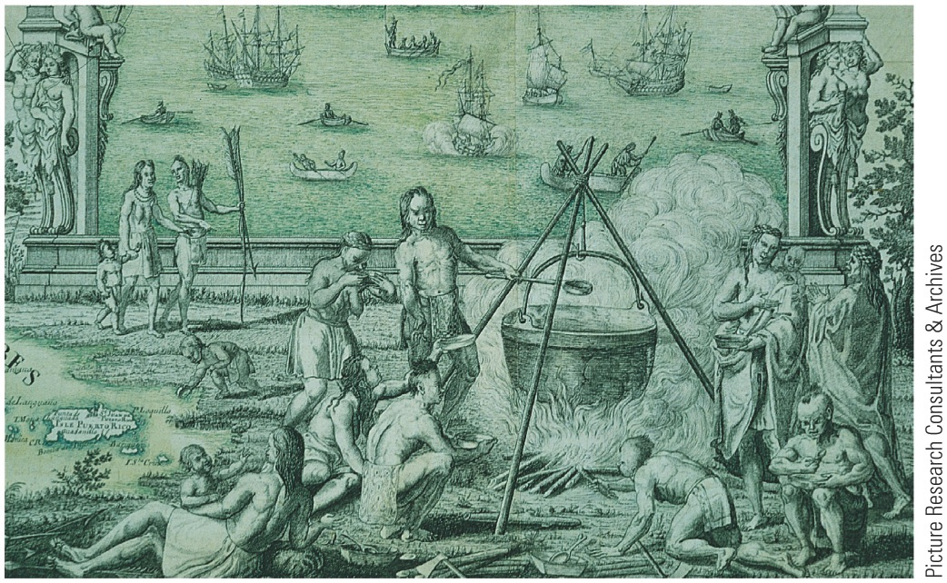
p102
Notes:
Québec Scene, by Jean-Baptiste-Louis Franquelin,
ca. 1699 (detail) The metal cooking pot and the Indians’
clothing and blankets show the Native Americans’
growing reliance on European trade goods.

Slide 9
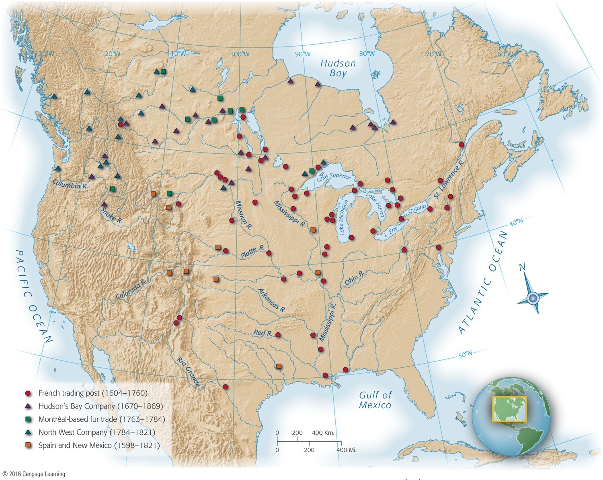
Map 6.2 p103
Notes:
Map 6.2 Fur-Trading Posts To serve the needs of European fashion, fur-traders pursued the beaver
for more than two centuries over the entire continent of North America. They brought many Indians for
the first time into contact with white culture.

Slide 10
II. New France Fans Out (cont.)
Catholic missionaries (Jesuits) tried to save Indians for Christ and from fur-trappers:
Some suffered torture by Indians.
They had few converts but did play a vital role as explorers and geographers.
Other explorers sought neither souls nor fur, but empire to block English and Spanish expansion.

Slide 11
II. New France Fans Out (cont.)
French explorers:
Antoine Cadillac founded Detroit, “the City of Straits.”
Robert de La Salle floated down the Mississippi in 1682 to where it mingles with the Gulf.
He named the interior basin “Louisiana,” after Louis XIV.
He failed to find the Mississippi delta, landed in Spanish Texas, and in 1687 was murdered.

Slide 12
III. The Clash of Empires
The earliest contests among European powers for control of North America:
In King William’s War (1689–1697) and Queen Anne’s War (1702–1713) (see Table 6.1), British colonists fought French coureurs de bois.
Indian allies ravaged Schenectady, New York, and Deerfield, Massachusetts (see Map 6.3).

Slide 13
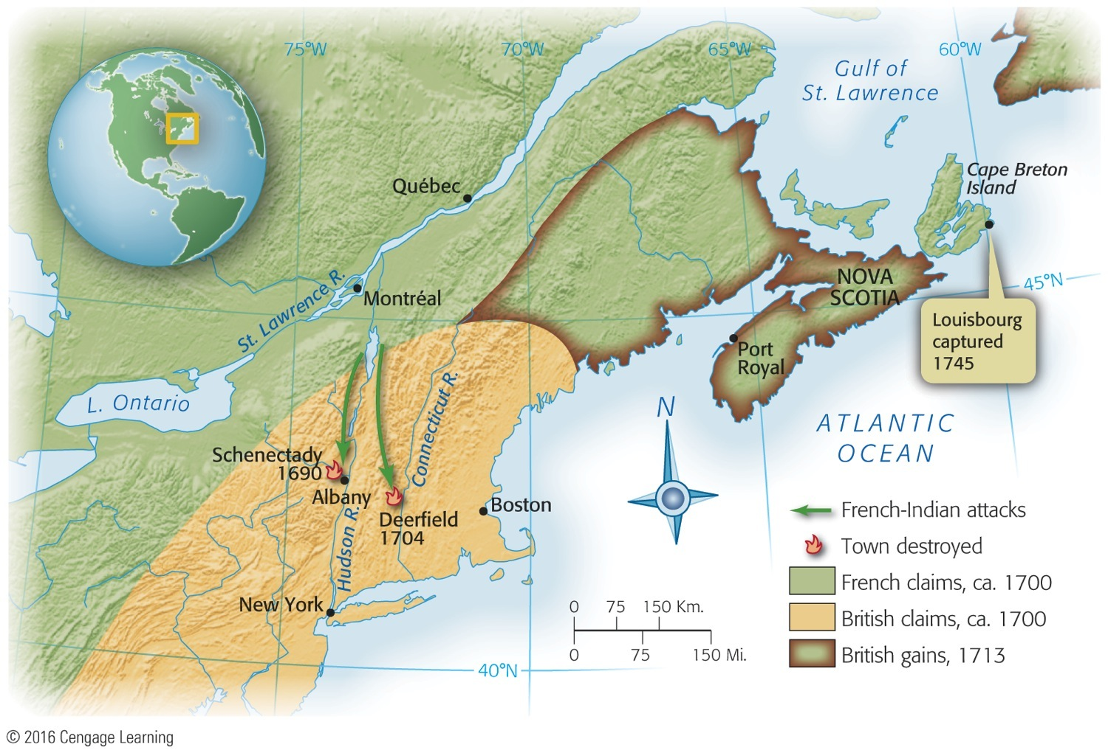
Map 6.3 p104
Notes:
Map 6.3 Scenes of the French Wars The arrows indicate French-Indian attacks. Schenectady
was burned to the ground in the raid of 1690. At Deerfield, site of one of the New
England frontier’s bloodiest confrontations, invaders killed fifty inhabitants and sent more
than a hundred others fleeing for their lives into the winter wilderness. The Indian attackers
also took over one hundred Deerfield residents captive, including the child Titus King.
He later wrote, “Captivity is an awful school for children, when we see how quick they will
fall in with the Indian ways. Nothing seems to be more taking [appealing]. In six months’
time they forsake father and mother, forget their own land, refuse to speak their own
tongue, and seemingly be wholly swallowed up with the Indians.”

Slide 14
Table 6.1 p104

Slide 15
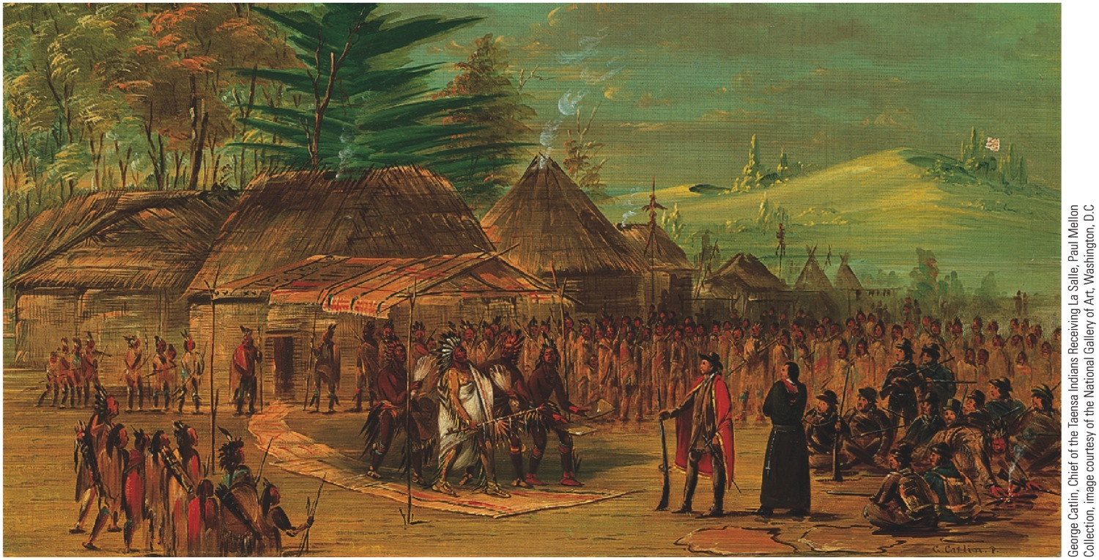
p105
Notes:
Chief of the Taensa Indians Receiving La Salle, March 20, 1682, by George Catlin, 1847–1848
Driven by the dream of a vast North American empire for France, La Salle spent years exploring the
Great Lakes region and the valleys of the Illinois and Mississippi Rivers. This scene of his encounter with
an Indian chieftain was imaginatively recreated by the nineteenth-century artist George Catlin.

Slide 16
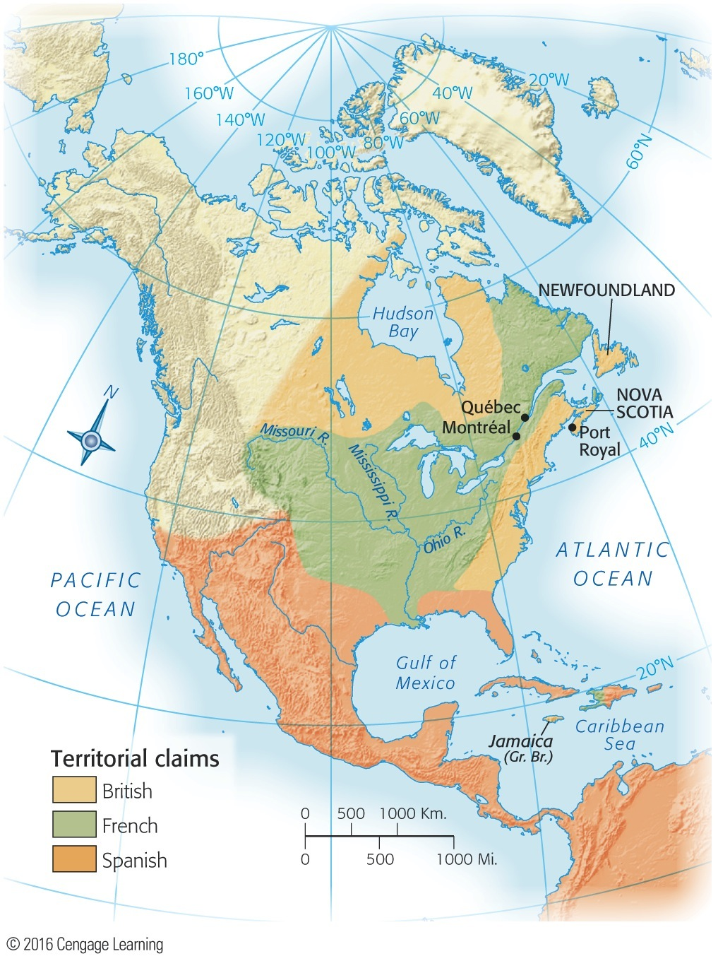
Map 6.4 p105
Notes:
Map 6.4 North America After Two Wars, 1713

Slide 17
III. The Clash of Empires (cont.)
American colonies then experienced decades of “salutary neglect”—fertile soil for roots of independence.
British also won limited trading rights in Spanish America, which led to smuggling.
British captain Robert Jenkins had one ear sliced off by a Spanish official, which led to the War of Jenkins’s Ear in 1739.
The War of Jenkins’s Ear merged with larger War of Austrian Succession in Europe (see Table 6.2), called King George’s War in America:
New Englanders with help from British navy captured Louisbourg, which commanded the St. Lawrence River (see Map 6.3).
But was returned to France by the treaty of 1748.
France still clung to its vast holdings.

Slide 18
IV. George Washington Inaugurates War with France
The Ohio Valley became the chief bone of contention between the French and British:
For the British, it was a critical area for westward movement.
The French needed it to link their Canadian holdings to those of the lower Mississippi Valley.
The British colonists were determined to fight for their economic security and supremacy.

Slide 19
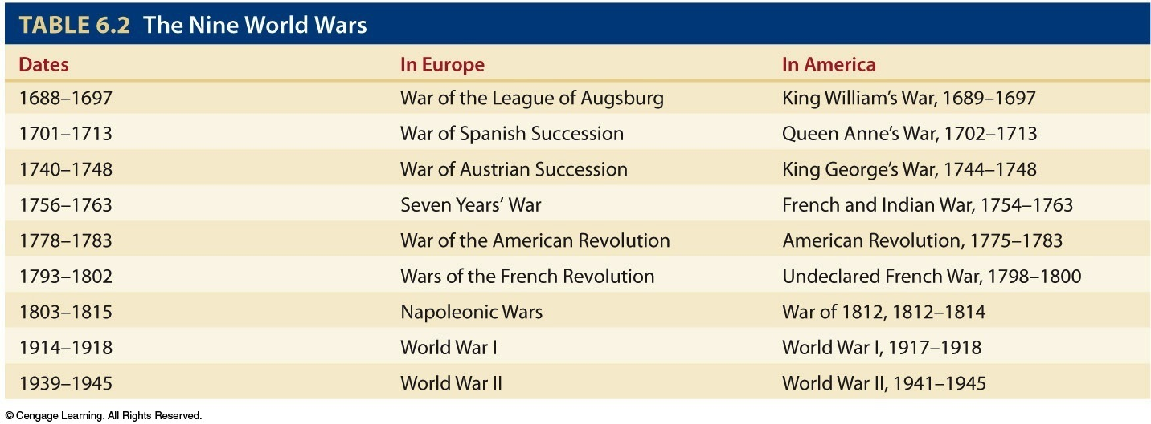
Table 6.2 p106

Slide 20
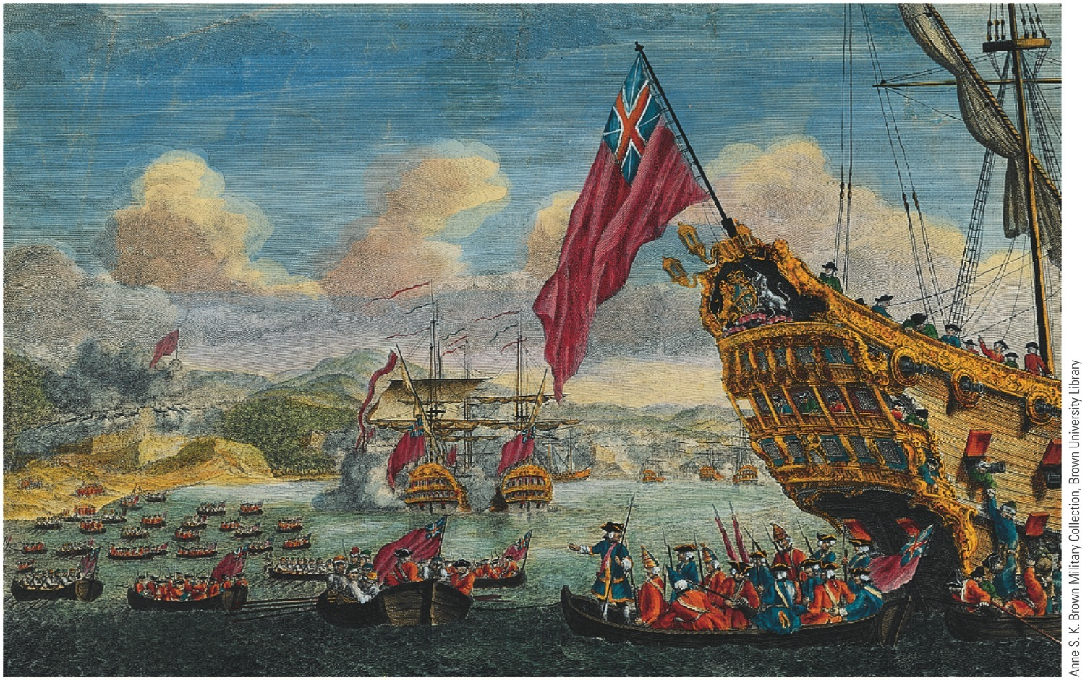
p106
Notes:
New Englanders Capture Louisbourg, 1745 When the final peace settlement of 1748 returned this
fortress to France, the American colonists felt betrayed by their British masters.

Slide 21
IV. George Washington Inaugurates War with France (cont.)
Ohio Valley rivalry increased tensions:
The French erected a chain of forts along the Ohio River.
Fort Duquesne was at the pivotal point where the Monongahela and Allegheny Rivers join to form the Ohio River—the later site of Pittsburgh.
In 1754, the governor of Virginia sent young George Washington to Ohio Country to secure the Virginians’ claim.

Slide 22
IV. George Washington Inaugurates War with France (cont.)
In this skirmish:
Washington met some French troops about 40 miles from Fort Duquesne (Map 6.5) and fired.
French leader was killed and his men retreated.
French returned and surrounded Washington.
Washington, after 10-hour siege, surrendered but was allowed to march troops away with honor.
In response, the British brutally uprooted French Acadians and scattered them as far as Louisiana: descendants are “Cajuns.”

Slide 23
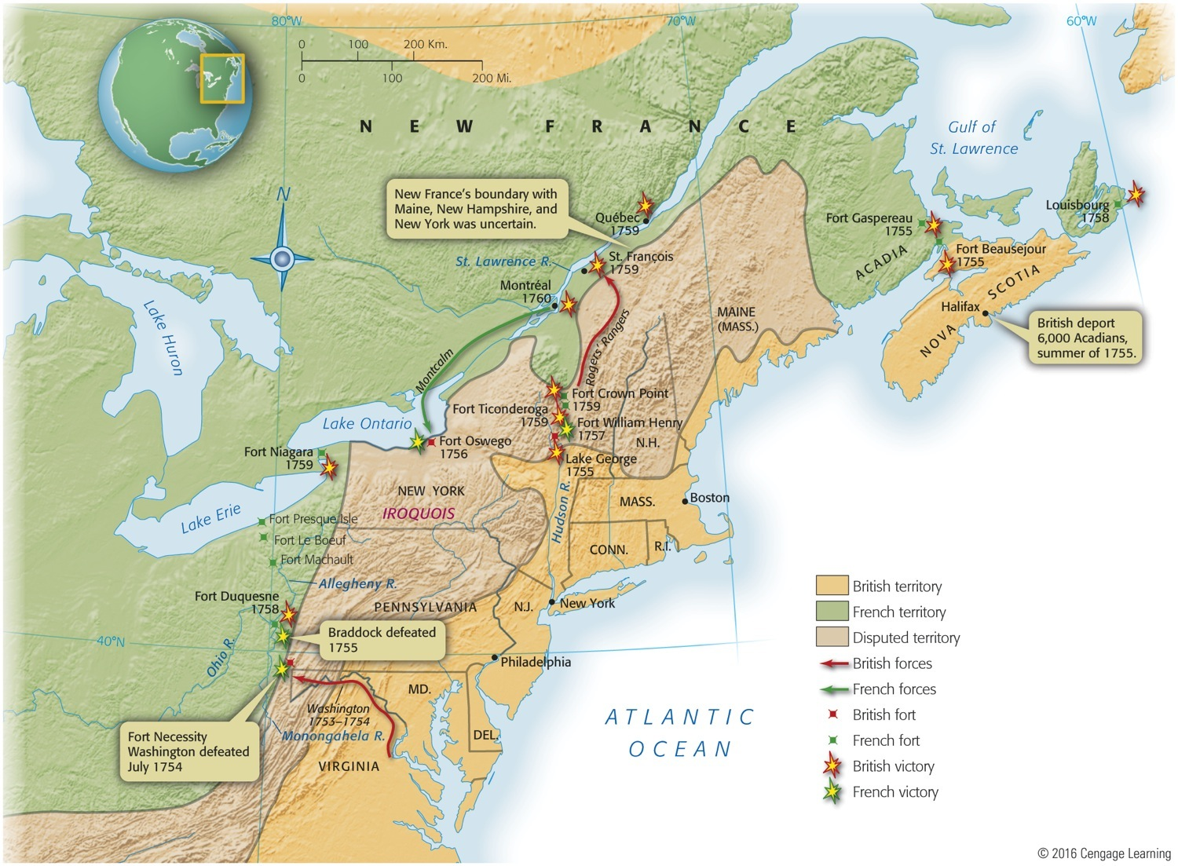
Map 6.5 p107
Notes:
Map 6.5 The French and Indian War in North America, 1754–1760

Slide 24
V. Global War and Colonial Disunity
First 3 Anglo-French colonial wars started in Europe, but the 4th one started in America:
The French and Indian War, started by Washington in the Ohio Valley (1754), widened after two years into the Seven Years’ War in America, Europe, the West Indies, Africa, Philippines, and on the ocean.
The Seven Years’ War was a 7-sea war (see Map 6.6).

Slide 25
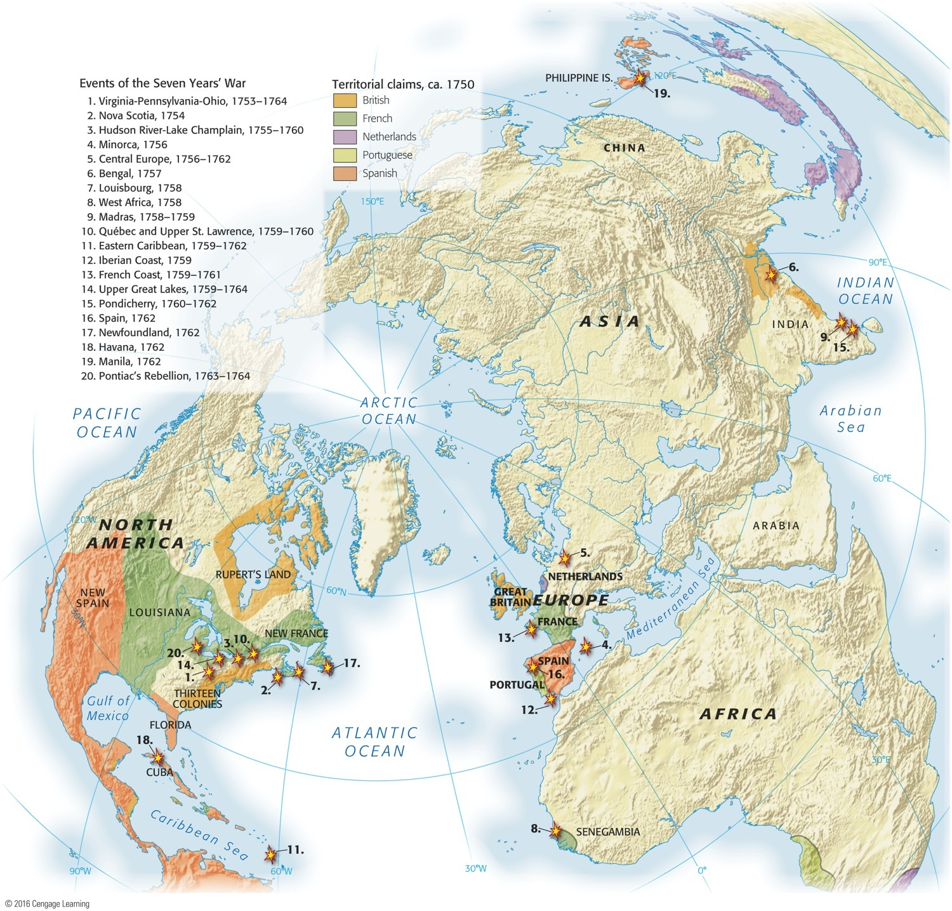
Map 6.6 p108
Notes:
Map 6.6 Global Scale of the Seven Years’ War Among the first of the truly “world wars” of the
modern era, the Seven Years’ War sucked in several nations who did battle around the globe.

Slide 26
V. Global War and Colonial Disunity
The crisis demanded concerted action:
In 1754, the British government summoned an intercolonial congress to met at Albany, N.Y.
Only 7 colonies sent delegates.
The immediate purpose was to control Iroquois tribes loyal to Britain.
The longer-range goal was to increase colonial unity and thus bolster common defense against France.

Slide 27
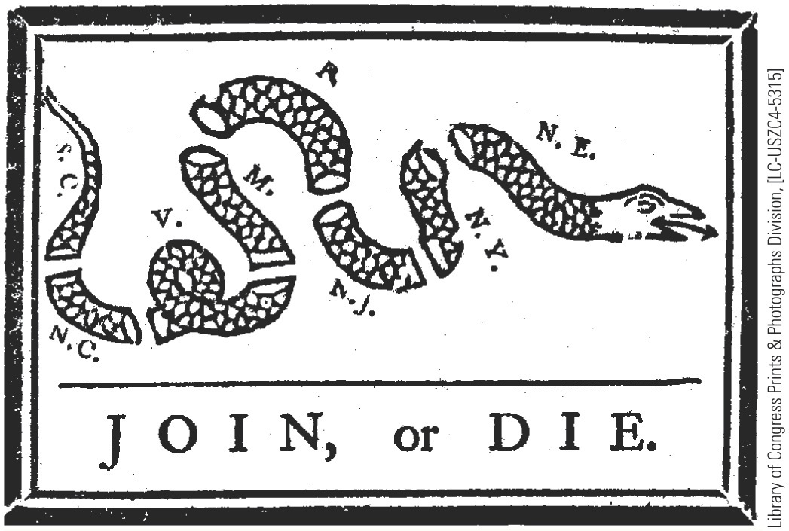
p109
Notes:
Famous Cartoon by Benjamin Franklin Delaware and Georgia were omitted.

Slide 28
VI. Braddock’s Blundering and Its Aftermath
Opening clashes of war went badly for British:
General Edward Braddock was sent to Virginia with a strong detachment of British regulars.
He set out in 1755 with 2,000 men to capture Fort Duquesne.
On his way he met a smaller French and Indian army.

Slide 29
VI. Braddock’s Blundering and Its Aftermath (cont.)
Opening clashes (cont.):
Washington had two horses shot from under him and four bullets pierced his coat.
Braddock was fatally wounded.
The British were routed and suffered large losses.
Inflamed by easy victory, Indians launched assaults from Pennsylvania to North Carolina.
Washington with 300 men tried to defend frontier.
The British experienced defeat after defeat.

Slide 30
VII. Pitt’s Palms of Victory
William Pitt was Britain's superlative leader:
He was known as the “Great Commoner.”
1757: He became a key leader in the London government.
He downplayed assaults on the French West Indies.
He concentrated on the vital Québec-Montréal area of Canada.
He picked young and energetic military leaders.
William Pitt (cont.):
1758: He dispatched an expedition that took Louisbourg, the first major British victory.
He sent James Wolfe to take Québec.
Wolfe battled the Marquis de Montcalm’s forces on the Plains of Abraham outside of Québec.
Both commanders were fatally wounded.
The French were defeated and Québec surrendered.

Slide 31
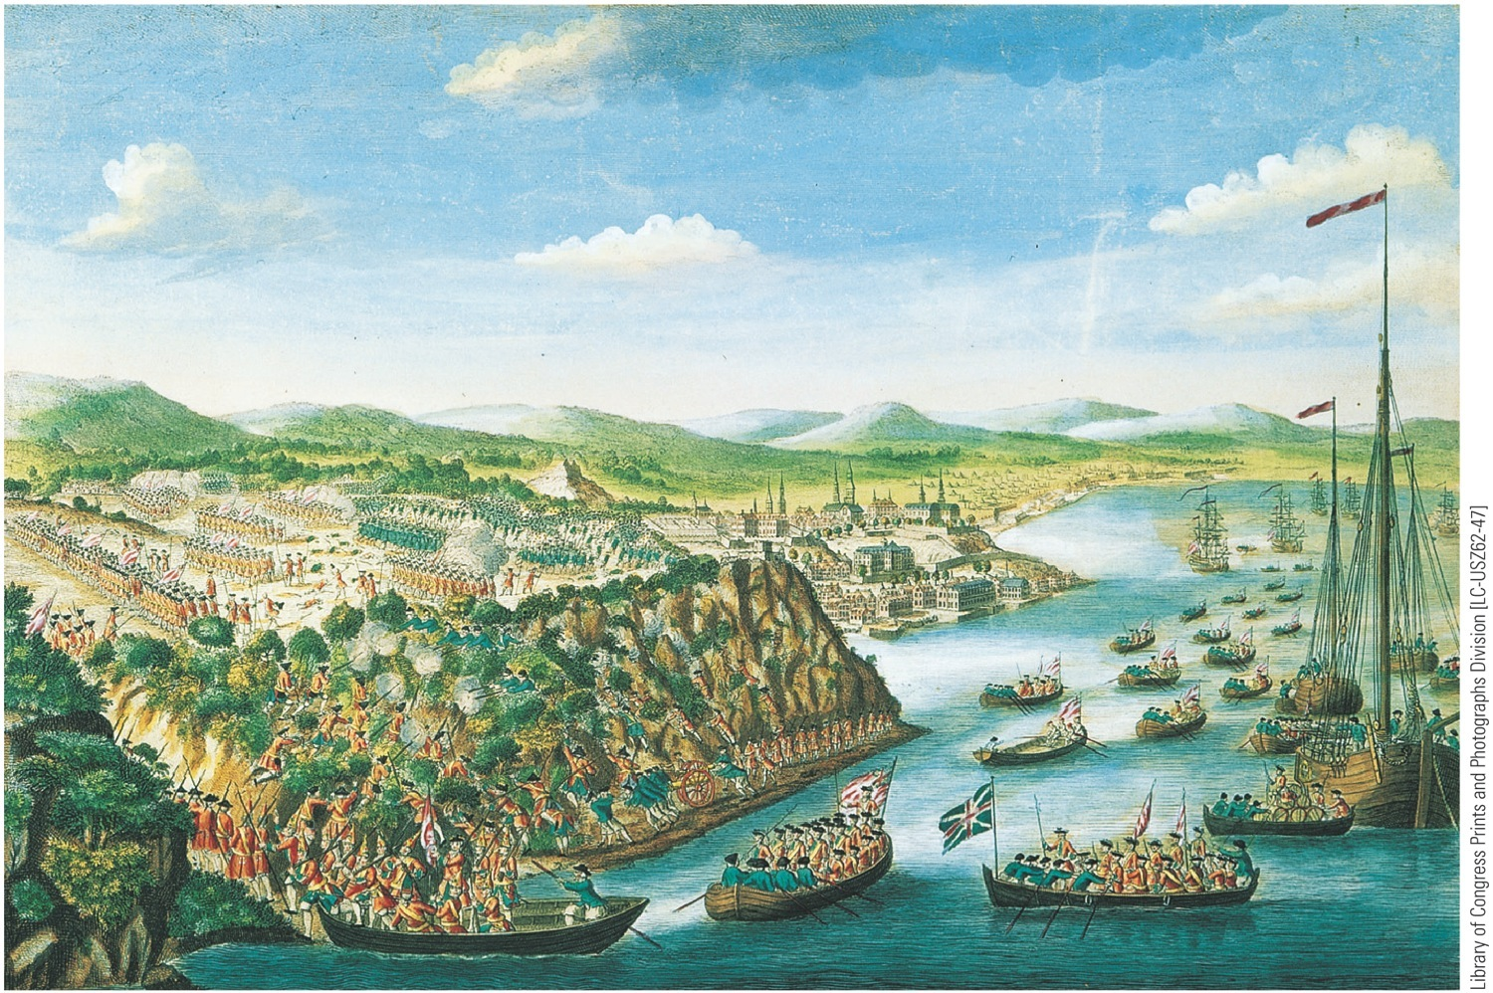
p110
Notes:
View of the Taking of Québec, 1759 On the night of September 13, British forces scaled the rocky
cliffs of Québec and defeated the French army defending the city. The following year, Montréal,
France’s last bastion in North America, surrendered. Fighting continued in the Caribbean, Europe, and
the Philippines for two more years, until the Treaty of Paris was signed in 1763, eliminating France as a
colonial power in North America.

Slide 32
VII. Pitt’s Palms of Victory (cont.)
Battle of Québec (1759) was one of the most significant battles in British and American history:
When Montreal fell in 1760, the French flag fluttered for the last time in Canada.
The Treaty of Paris in 1763 displaced the French empire from the North American continent.
The French were able to maintain several small but valuable sugar islands in the West Indies.

Slide 33
VII. Pitt’s Palms of Victory (cont.)
France also received two never-to-be-fortified islets in Gulf of St. Lawrence for fishing stations.
Final blow: France ceded to Spain all of trans-Mississippi Louisiana, including New Orleans (see Map 6.7).
Great Britain emerged as:
The dominant power in North America
The leading world naval power

Slide 34
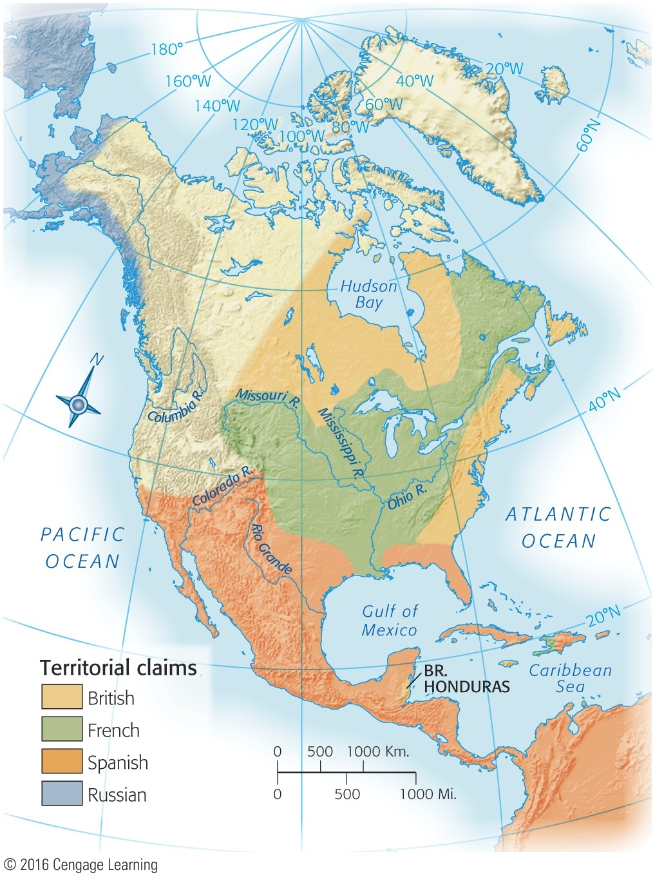
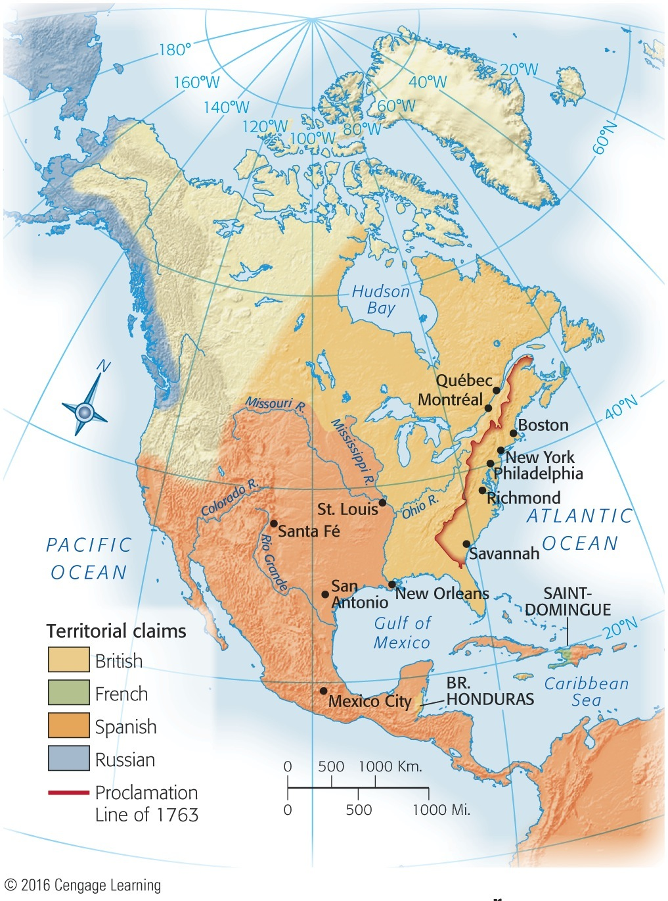
Map 6.7a p111
Notes:
Map 6.7A North America Before 1754

Slide 35
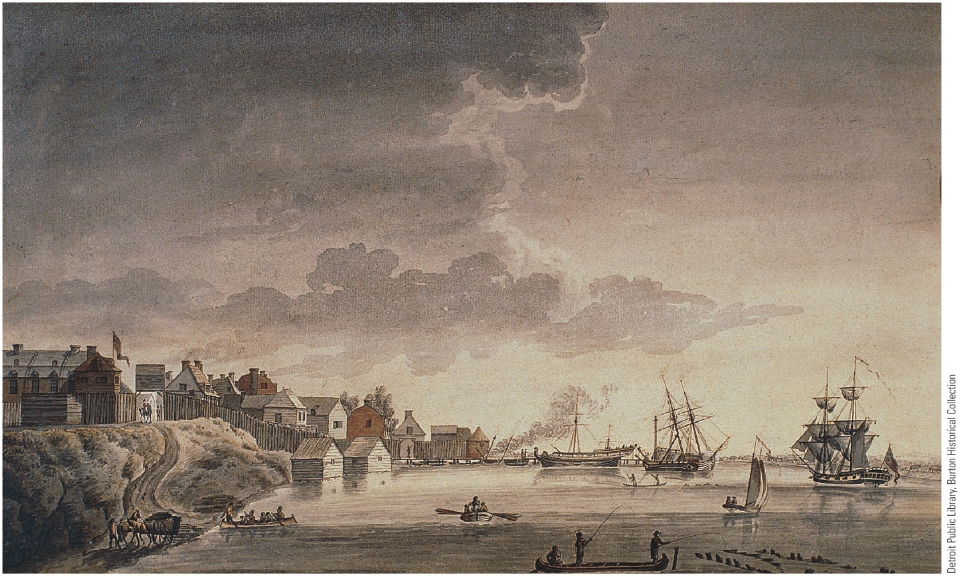
p112
Notes:
Detroit, 1794 A key French outpost from 1701 to 1760, Detroit fell to Britain during the Seven Years’
War. The British remained at Detroit even after the American War of Independence, exciting bitter
resentment in the infant American Republic (see “The World’s Ugly Duckling,” p. 167).

Slide 36
VIII. Restless Colonists
Britain’s colonists emerged with increased confidence in their military strength and skill.
20,000 colonists were under arms at war’s end.
War shattered the myth of British invincibility.
Displaying the contempt of professional soldiers, the British refused to recognize any American militia commission above the rank of captain.
British officials were distressed by reluctance of some colonies to support the war wholeheartedly.
Some colonies, self-centered and alienated by their distance from war, refused to provide troops and money for the conflict.
Colonies still exhibited strong tendencies toward disunity.
But unity among colonies received some encouragement during the war:
When soldiers and statesmen from different colonies met, they discovered they were all Americans who spoke the same language and shared common ideals.
A coherent nation could emerge, but it would not be easy.

Slide 37
IX. War’s Fateful Aftermath
Removal of French menace in Canada profoundly affected American attitudes:
In a sense history of the United States began with the fall of Québec and Montréal.
Spanish and Indian threats were substantially reduced.
Spanish removal from Florida and French removal from Canada deprived Indians of potential allies to outset growing British power.

Slide 38
IX. War’s Fateful Aftermath (cont.)
Pontiac’s uprising by Ottawa Chief Pontiac:
Laid siege to Detroit in 1763 and overran all but three British posts west of the Appalachians.
Killed some 2,000 soldiers and settlers.
British retaliated swiftly and cruelly with a primitive version of biological warfare.
Pontiac died in 1769 at hands of a rival chieftain.
Colonists were now free to cross Appalachian Mountains and take western lands.

Slide 39
IX. War’s Fateful Aftermath (cont.)
But London issued the Proclamation of 1763, which banned settlement beyond the Appalachians (see Map 6.8).
Britain only wanted to avoid another bloody Indian uprising.
But angry colonists flouted the proclamation.
The stage was set for conflict:
The colonists refused to be restrained.
British government was frustrated with colonies.

Slide 40
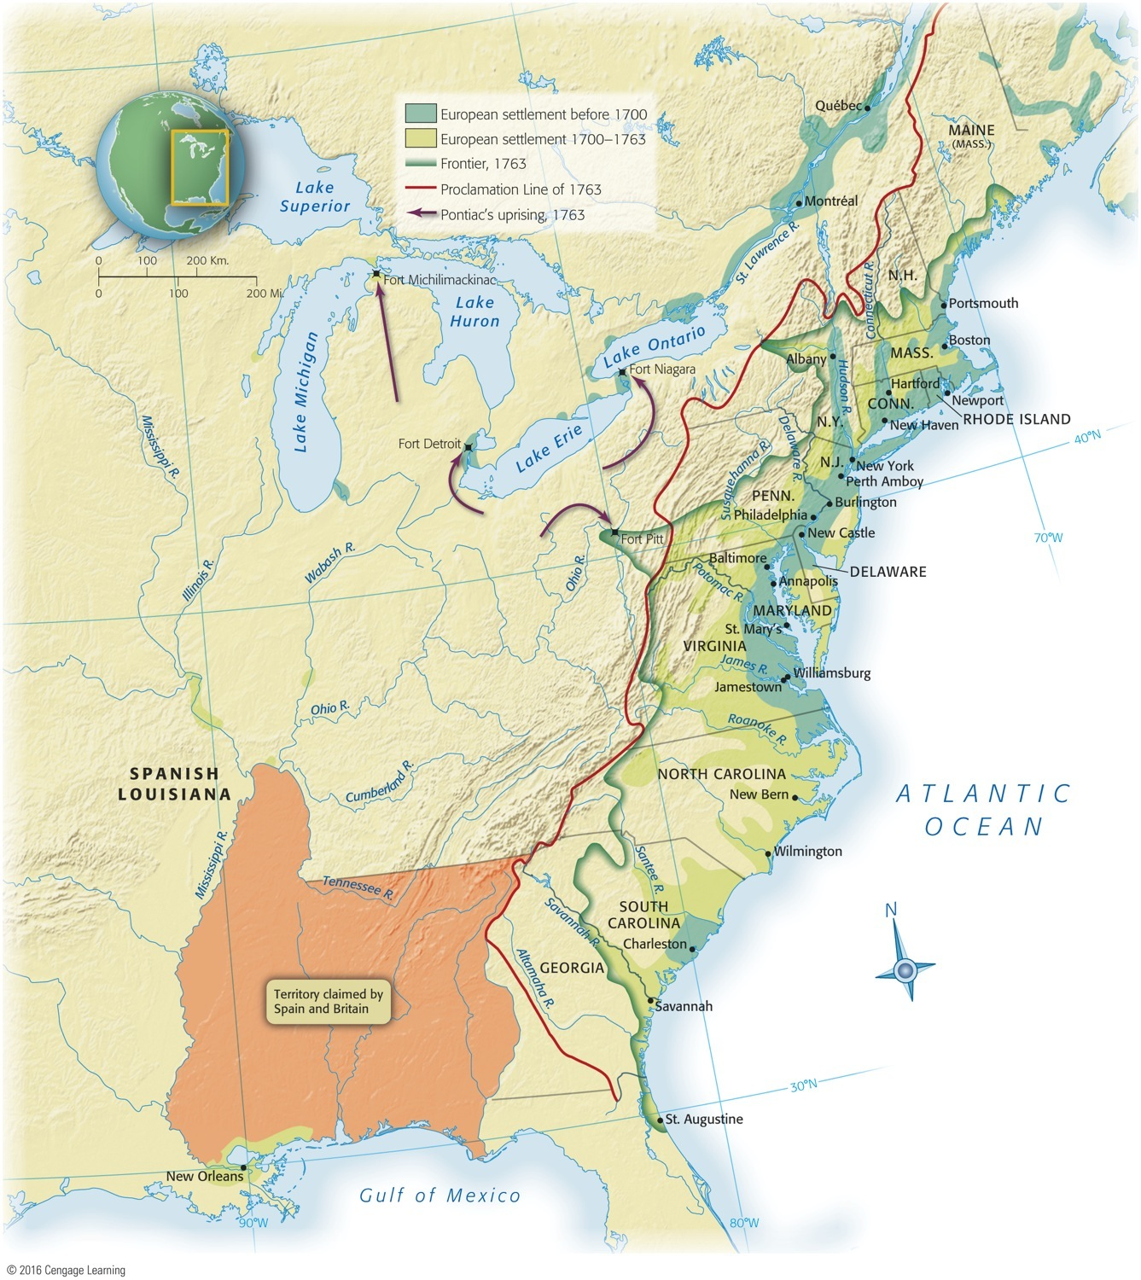
Map 6.8 p114
Notes:
Map 6.8 British Colonies at End of the Seven Years’ War, 1763 This map, showing
the colonies thirteen years before the Declaration of Independence, helps to explain why
the British would be unable to conquer their offspring. The colonists were spreading
rapidly into the backcountry, where the powerful British navy could not flush them out.
During the Revolutionary War, the British at one time or another captured the leading
colonial cities—Boston, New York, Philadelphia, and Charleston—but the more remote
interior remained a sanctuary for rebels.

Slide 41
p115

