Slide 1
America in the roaring twenties
Chapter 30

Slide 2
I. Seeing Red
Bolshevik Revolution (1919): coming of Communism to Russia
Effects on United States:
Small Communist Party emerged
Blamed for some labor strikes (Seattle, 1919)
Big red scare of 1919-1920:
Nationwide crusade against left-wingers whose Americanism was suspect
Attorney General A. Mitchell Palmer “saw red” too easily
“Fighting Quaker” rounded up 6,000 suspects
Number doubled in June 1919 when a bomb shattered both the nerves and the home of Palmer
Other events highlighted red scare:
December 1919: shipload of 249 alleged alien radicals deported on Buford (the “Soviet Ark”) to Russia
September 1920, still-unexplained bomb blast on Wall Street killed 38 people and wounded a hundred others
State legislatures 1919-1920 joined outcry; passed criminal syndicalism laws:
Anti-red statutes made unlawful mere advocacy of violence to secure social change
Critics protested that mere words not criminal deeds
Violence done to freedom of speech as IWW members and other radicals vigorously prosecuted

Slide 3
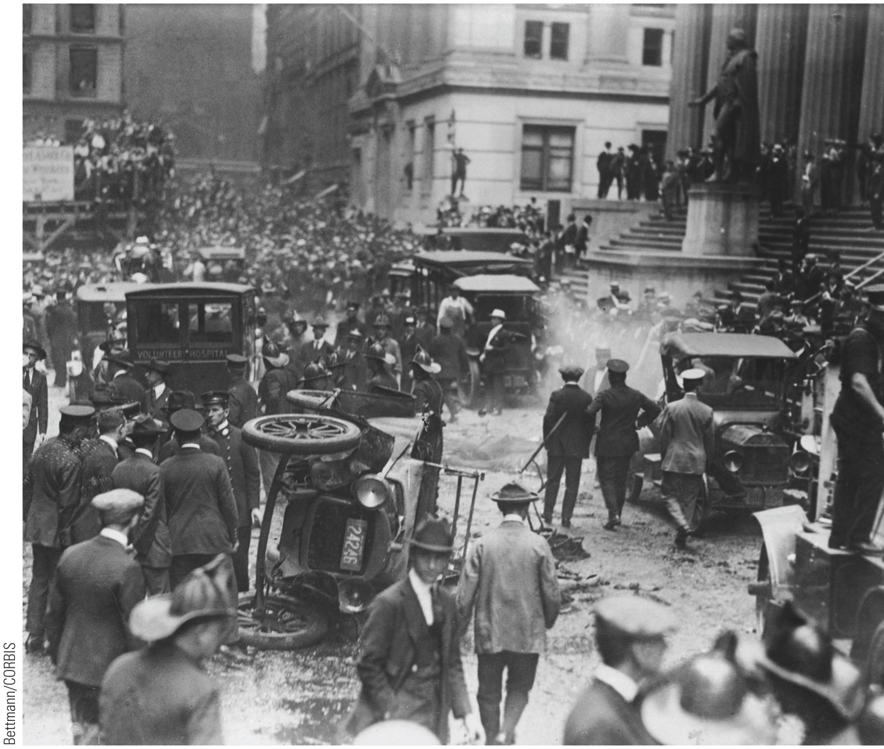
p693
Notes:
Bomb Blast on Wall Street,
September 1920 The target of this
terrorist attack seemed to be the offices
of the haughty financier J. P. Morgan,
but no person or group claimed
responsibility for the blast, and the
victims were random financial district
employees, not the moguls of Wall
Street. The bombing fed the antiradical,
anti-immigrant mood of the
day. Federal Hall, where George
Washington was inaugurated, can be
seen at the right.

Slide 4
I. Seeing Red (cont.)
Conservatives used red scare to break fledgling unions:
Unions called for “closed” or all-union shop; this was denounced as “Sovietism in disguise”
Employers hailed their antiunion campaign for “open” shop as American plan
Anti-redism and antiforeignism reflected in notorious case—regarded by liberals as “judicial lynching”
Nicola Sacco and Bartholomeo Vanzetti convicted in 1921 of murder of a Mass. Paymaster and his guard
Jury and judge prejudiced against defenders because they were Italians, atheists, anarchists, and draft dodgers
Liberals and radicals the world over rallied to their defense
Case dragged on for over six years until 1917 when condemned men electrocuted
Communists and radicals had two martyrs in “class struggle”

Slide 5
II. Hooded Hoodlums of the KKK
New Ku Klux Klan:
Resembled antiforeign “nativist” movement of 1850s rather than antiblack nightriders of 1860s:
Antiforeign, anti-Catholic, antiblack, anti-Jewish, antipacifists, anti-Communist, anti-internationalist, anti-evolutionist, antibootlegger, antigambling, anti-adultery, and anti-birth control
Pro-Anglo-Saxon, pro-“native” American, pro-Protestant
Klan betokened extremist, ultraconservative uprising against:
Forces of diversity and modernity transforming American culture
Spread rapidly in Midwest and Bible Belt South where Protestant Fundamentalism thrived
Mid-1920s peak had five million dues-paying members and wielded potent political influence
“Knights of the Invisible Empire” included among officials Imperial Wizards, Grand Goblins, King Kleagles, and other horrendous “kreatures”
Things of KKK:
Impressive “konclaves,” huge flag-waving parades
Chief warning was blazing cross
Principle weapon bloodied lash, supplemented by tar and feathers
Rallying songs and brutal slogan

Slide 6
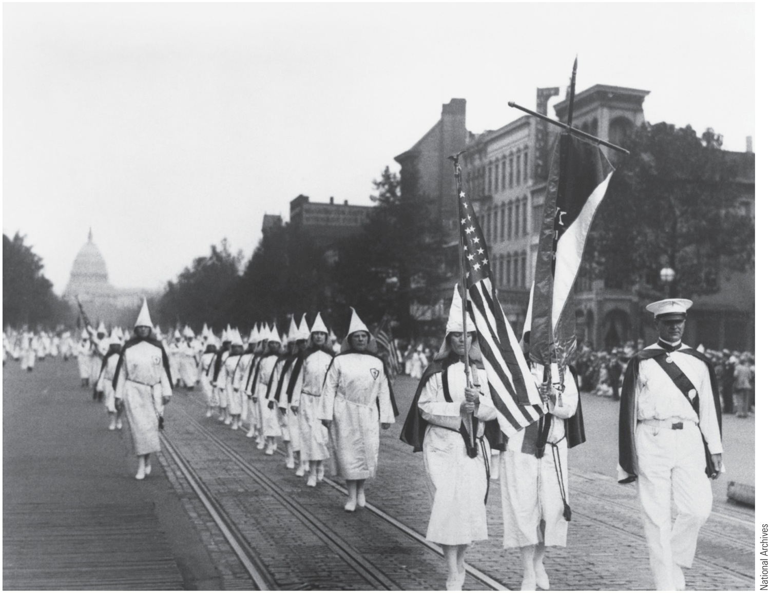
p694
Notes:
Klanswomen on Parade, 1928 Founded in the Reconstruction era, the Ku Klux Klan enjoyed a
remarkable resurgence in the 1920s. Here women members, unmasked and unapologetic, march
down Pennsylvania Avenue under the shadow of the Capitol dome.

Slide 7
III. Stemming the Foreign Flood
Isolationist America (1920s), ingrown and provincial, had little use for immigrants:
800,000 came in 1920-1921
2/3 from southern and eastern Europe
Americans recoiled at these “New Immigrants”
Congress passed Emergency Quota Act 1921
Newcomers from Europe restricted to a quota
Immigration Act of 1924 replaced Emergency Act
Quota cut from 3% to 2%; National origins base shifted from census of 1910 to 1890
Southern Europeans bitterly denounced device as discriminatory
Purpose was to freeze America's existing racial composition, which was largely northern Europeans
Slammed door absolutely against Japanese immigrants
“Hate America” rallies erupted in Japan
Exempt from quota system were Canadian and Latin Americans—
Easy to attract for jobs when times good
Easy to send home when times bad
Effected pivotal departure in American policy
Claimed nation was filling up—“No Vacancy” sign
By 1931 more foreigners left than arrived

Slide 8
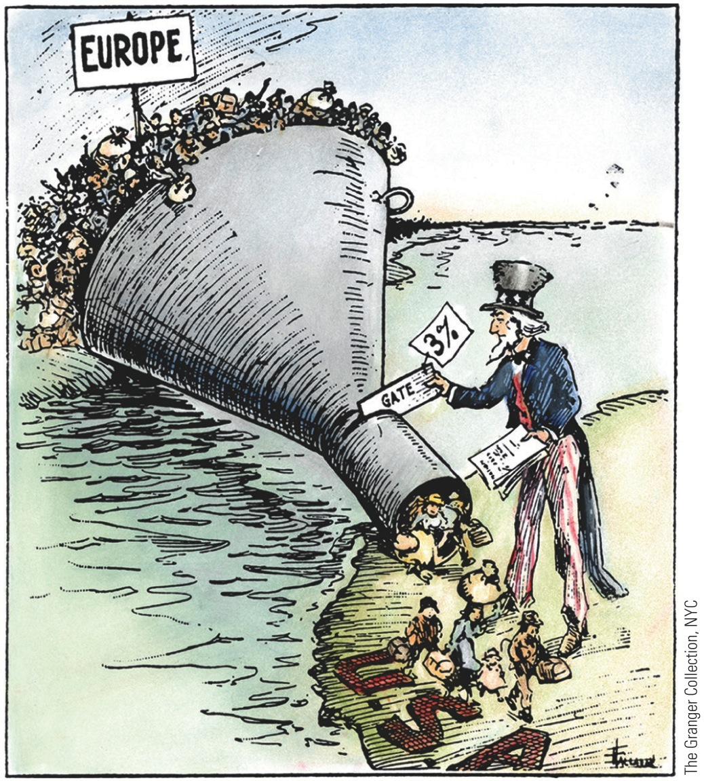
p695
Notes:
The Only Way to Handle It Isolationists and nativists
succeeded in damming up the flow of immigrants to the
United States in the early 1920s. The Immigration Act of
1924 placed strict quotas on European immigrants and
completely shut out the Japanese.

Slide 9
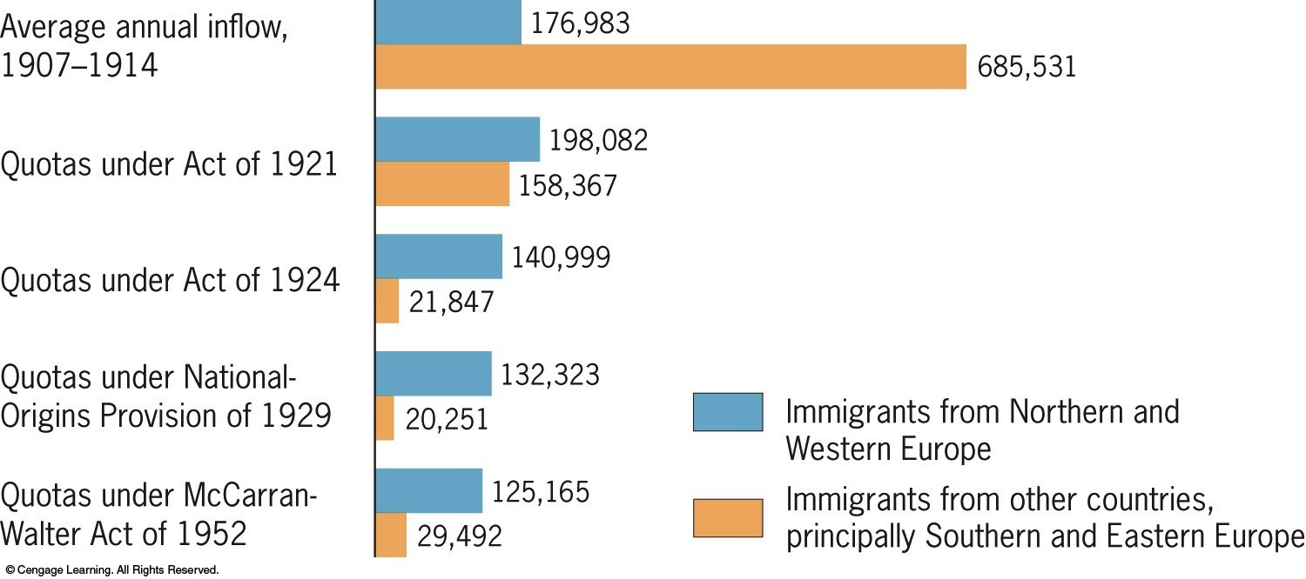
Figure 30-1 p696
Notes:
Figure 30.1 Annual Immigration and the Quota Laws The national-origins
quota system was abolished in 1965. Legislation in that year capped the level of
immigration at 170,000 per year but made exceptions for children, spouses, and parents
of persons already arrived. It also restricted immigration from any single country
to 20,000 people per year. The immigration laws were again significantly revised
in 1986, and changed twice more in 1990 and 1996. In the twenty-first century,
immigration laws remain highly controversial. (See pp. 887 and 1002.) © 2016 Cengage Learning

Slide 10
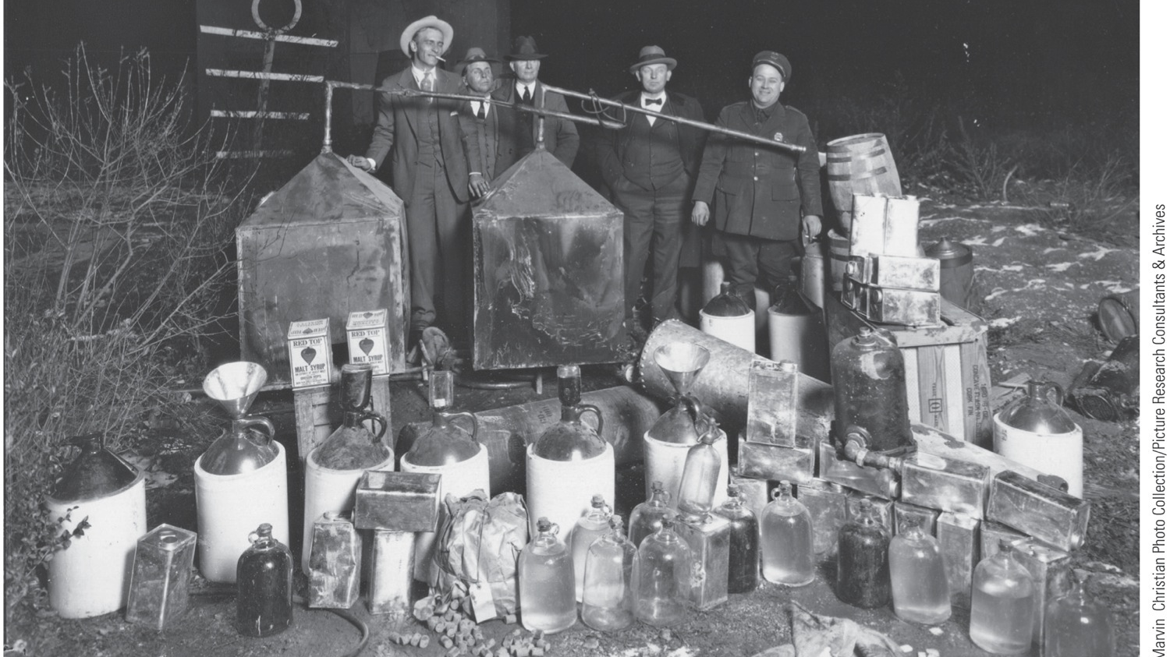
IV. The Prohibition “Experiment”
Prohibition—
Last cause of progressive reform movement
Eighteenth Amendment: (1919): authorized prohibition (See Appendix)
Implemented by Volstead Act passed by Congress in 1919
Made world “safe for hypocrisy”
Legal abolition of alcohol especially popular in South and West
In West, prohibition an attack on vices associated with western saloons (public drunkenness, prostitution, etc.)
Strong opposition to “dry” amendment in larger eastern cities
Especially for “wet” foreign-born people
Sociability built around drinking

Slide 11
IV. The Prohibition “Experiment” (cont.)
Most Americans assumed prohibition had come to stay
Prohibitionists naïve:
Overlooked tenacious American tradition of strong drink
Overlooked weak control by central government, especially over private lives
Federal government had never satisfactorily enforced a law that majority of people or strong minority rejected
Lawmakers could not legislate away thirst
Peculiar conditions hampered enforcement:
Wisdom of further self-denial after war
Slaking thirst became cherished personal liberty
Wets believed way to repeal was to violate law on large scale
Solders complained prohibition “put over” on them while they were “over there”
Workers bemoaned loss of cheap beer
Flaming youth thought it “smart” to swill bootleg liquor
Millions of older citizens found forbidden fruit fascinating as they engaged in “bar hunts”

Slide 12
IV. The Prohibition “Experiment” (cont.)
Might have been more successful if there had been large army of enforcement officials
Federal agencies understaffed
Underpaid snoopers susceptible to bribery
Prohibition simply did not prohibit:
“Men only” corner saloons replaced by “speakeasies”
Hard liquor drunk by men and women
Zeal of American prohibition agents strained relations with Canada
Worst of homemade “rotgut” produced blindness, even death
Bootlegger worked in partnership with undertaker
Yet “noble experiment” not entirely a failure:
Bank savings increased
Absenteeism in industry decreased
Death from alcoholism and cirrhosis declined
Less alcohol consumed than in days before prohibition

Slide 13
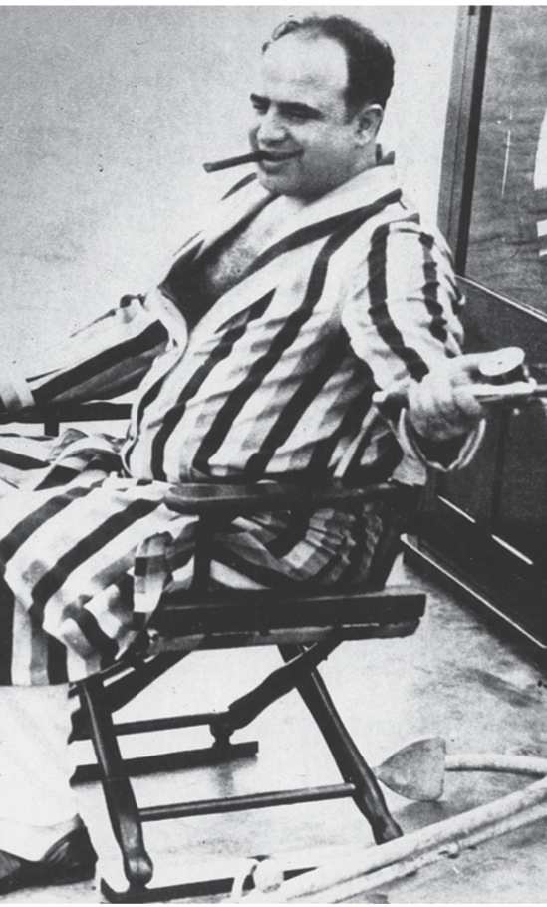
V. The Golden Age of Gangsterism
Prohibition spawned shocking crimes:
Profits of illegal alcohol led to bribery of police
Violent wars in big cities between rival gangs
Rival triggerman “erased” bootlegging competitors
Chicago (1920s): 500 mobsters murdered
Arrests few and convictions fewer
Chicago most spectacular example of lawlessness:
1925 “Scarface” Al Capone began six years of gang warfare
Zoomed through streets in armor-plated car with bulletproof windows
“Public Enemy Number One” could not be convicted of massacre on St. Valentine's Day 1929 of seven unarmed members of rival gang
After serving 11 years at Alcatraz for income tax evasion, Capone released as syphilitic wreck

Slide 14
V. The Golden Age of Gangsterism (cont.)
Gangsters moved into other profitable and illicit activities:
Prostitution, gambling, narcotics
Honest merchants forced to pay“protection money”
Racketeers invaded ranks of local labor unions as organizers and promoters
Organized crime came to be one of nation's biggest businesses
By 1930, annual “take” of underworld $12 to $18 billion
Criminal callousness sank to new depths in 1923:
Kidnapping for ransom and eventual murder of infant son of aviator-hero Charles A Lindbergh
Congress passed Lindbergh Law: making interstate abduction in certain circumstances a death-penalty offense

Slide 15
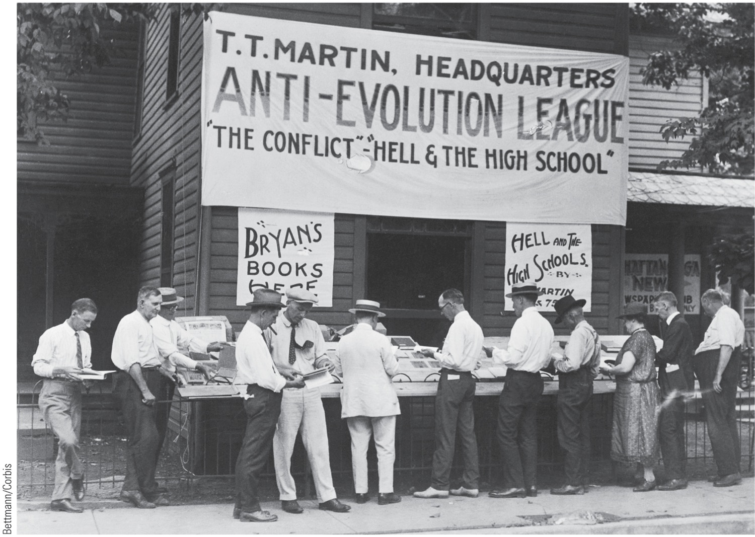
VI. Monkey Business in Tennessee
“Monkey Trial”:
In 1925, Dayton high-school biology teacher John T. Scopes indicted for teaching evolution
Defended by nationally renowned attorneys
William Jennings Bryan made to appear foolish by famed criminal lawyer Clarence Darrow
Five days after trial, Bryan died of stroke

Slide 16
VI. Monkey Business in Tennessee (cont.)
Historic clash between theology and biology proved inconclusive:
Scopes found guilty and fined $100
Tennessee supreme court upheld law, but set aside fine on technicality
Fundamentalists won only hollow victory
Fundamentalism (emphasis on literal reading of Bible)
Remained vibrant force in American spiritual life
Strong in Baptist Church and rapidly growing Churches of Christ, organized in 1906

Slide 17
VII. The Mass-Consumption Economy
Prosperity put “roar” into twenties:
Recent war and Treasury Secretary Andrew Mellon's tax policies:
Favored rapid expansion of capital investment
New machinery increased productivity
Assembly-line production reached perfection by Henry Ford's factories where a finished automobile emerged every ten seconds
New industries sprouted

Slide 18
VII. The Mass-Consumption Economy (cont.)
Automobile:
Now became carriage of common citizen
By 1930 Americans owned almost 30 million cars
Created shift in character of economy:
American manufacturers
Mastered problems of production
Shifted focus to consumption
Could they find mass markets for goods?
New arm of American commerce came into being:
Advertising
Bruce Barton published best seller: The Man Nobody Knows:
Provocative thesis: Jesus Christ greatest adman of all time
“Every advertising man ought to study the parables of Jesus”
“Marvelously condensed, as all good advertising should be”
Christ's executive ability: “He picked up twelve men from the bottom ranks of business and forged them into an organization that conquered the world

Slide 19
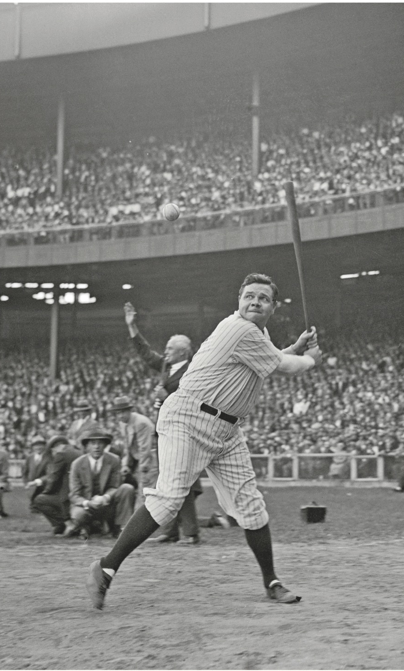
VII. The Mass-Consumption Economy
Sports:
Became big business in consumption economy
Heroes like George H. (“Babe”) Ruth far better known than most statesmen
Yankee Stadium became “house that Ruth built”
In 1921 heavyweight champion, Jack Dempsey, knocked out light heavyweight George Carpentier
Jersey City crowd paid more than a million dollars
First in series of million-dollar gates in 1920s

Slide 20
VII. The Mass-Consumption Economy
Buying on credit; another innovation of postwar economy:
“Possess today and pay tomorrow” was message
People went into debt to own all kinds of new marvels—refrigerators, vacuum cleaners, cars and radios—now
Prosperity accumulated an overhanging cloud of debt
Economy became increasingly vulnerable to disruptions of credit structure

Slide 21
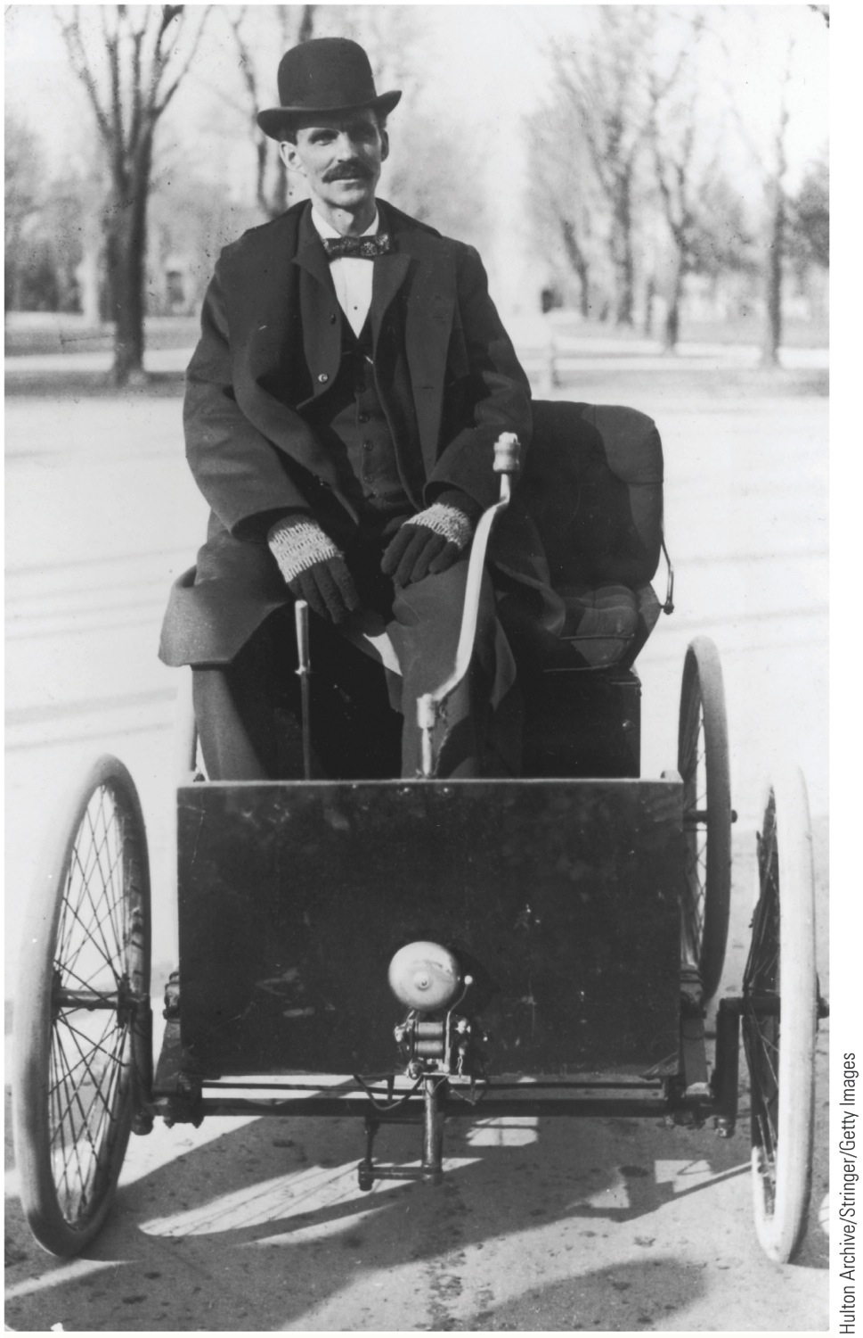
Machinery was new messiah—and automobile its principal prophet
Automobile
New industrial system:
Assembly-line methods
Mass-production techniques
Americans adapted rather than invented gasoline engine:
Europeans can claim original honor
1890s—daring American inventors and promoters
Henry Ford and Ransom E. Olds developed infant automotive industry

Slide 22
VIII. Putting America on Rubber Tires (cont.)
By 1910 sixty-nine car companies rolled out total annual production of 181,000 units
Detroit became motorcar capital of America
Scientific Management:
Stopwatch efficiency techniques of Frederick W. Taylor
Eliminate wasted motion
Henry Ford:
More than any other individual, put America on rubber tires
His Model T (“Tin Lizzie”)
Cheap, rugged, and reasonably reliable, though rough and clattering
Parts highly standardized

Slide 23
VIII. Putting America on Rubber (cont.)
Devoted himself to gospel of standardization
Grasped and applied technique of moving assembly line—Fordism
Sold Ford roadster for $260 (see Figure 30.2)
Fordism caught fire outside United States
Flood of Fords phenomenal:
In 1914 “ Automobile Wizard” turned out his 500,000th Model T
By 1930 total had risen to 20 million
By 1929, 26 million motor vehicles registered—one for every 4.9 American (see Figure 30.3)

Slide 24
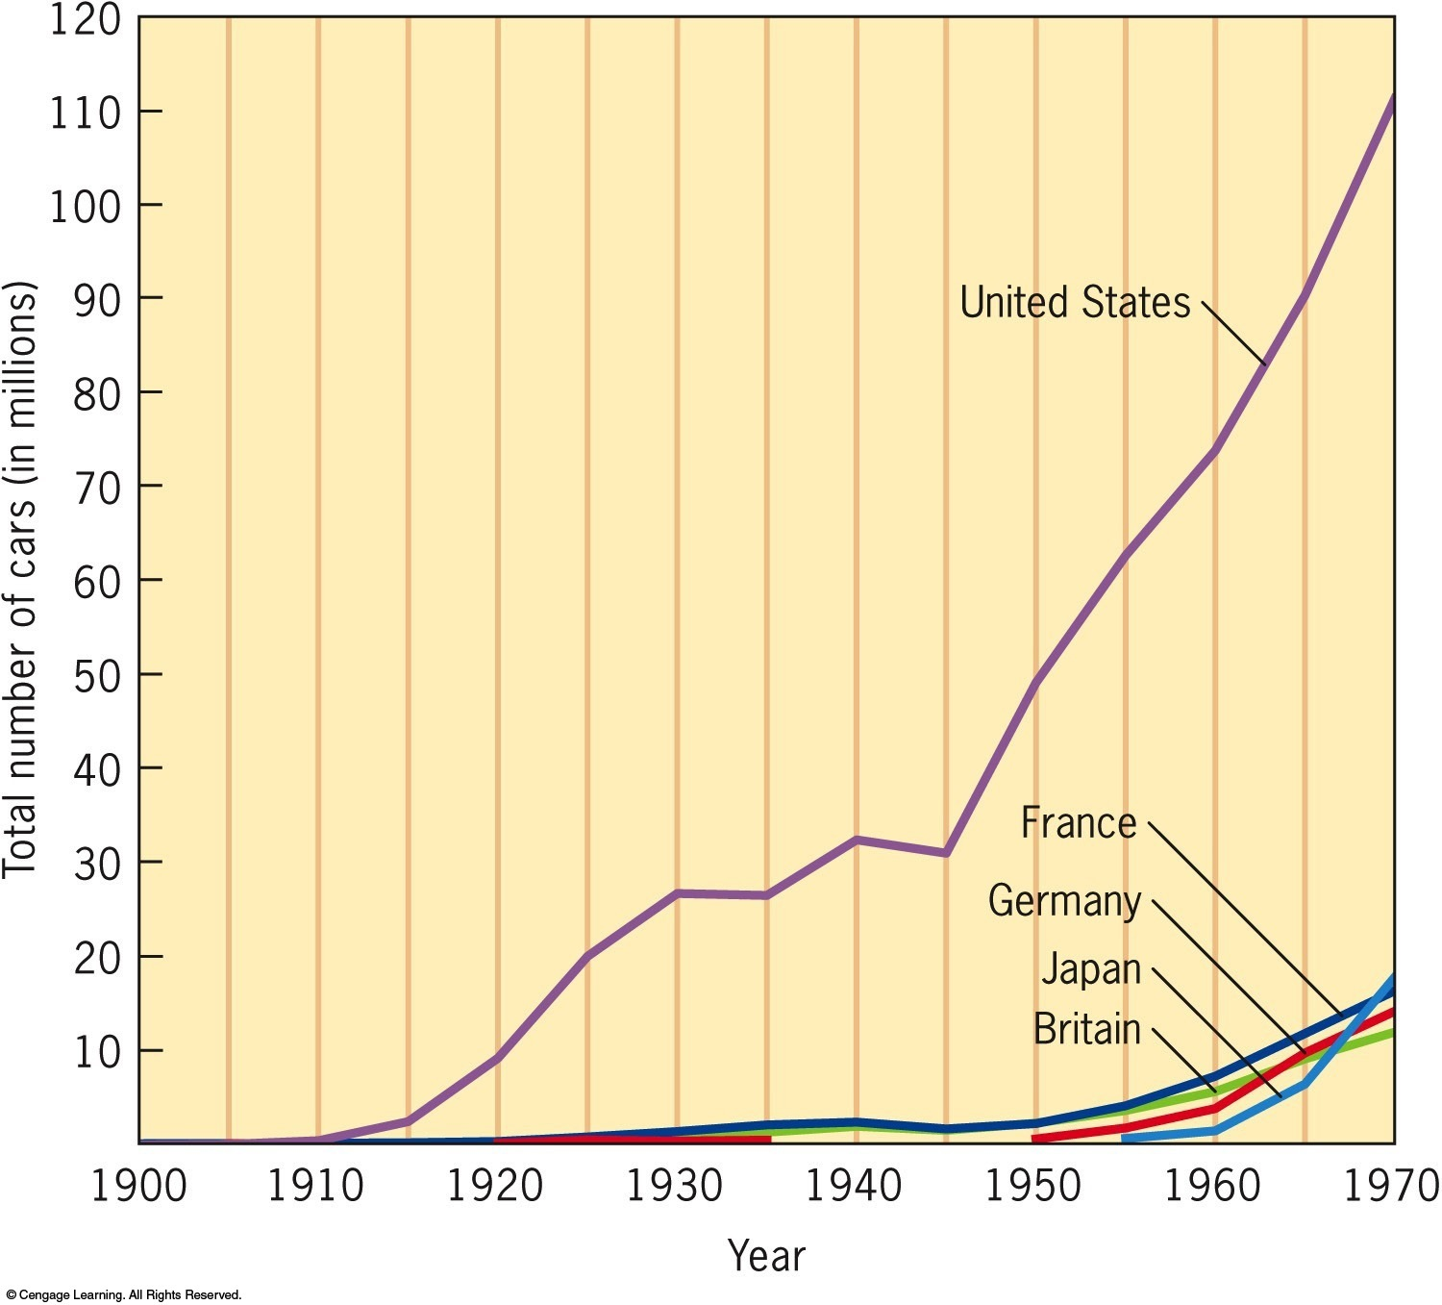
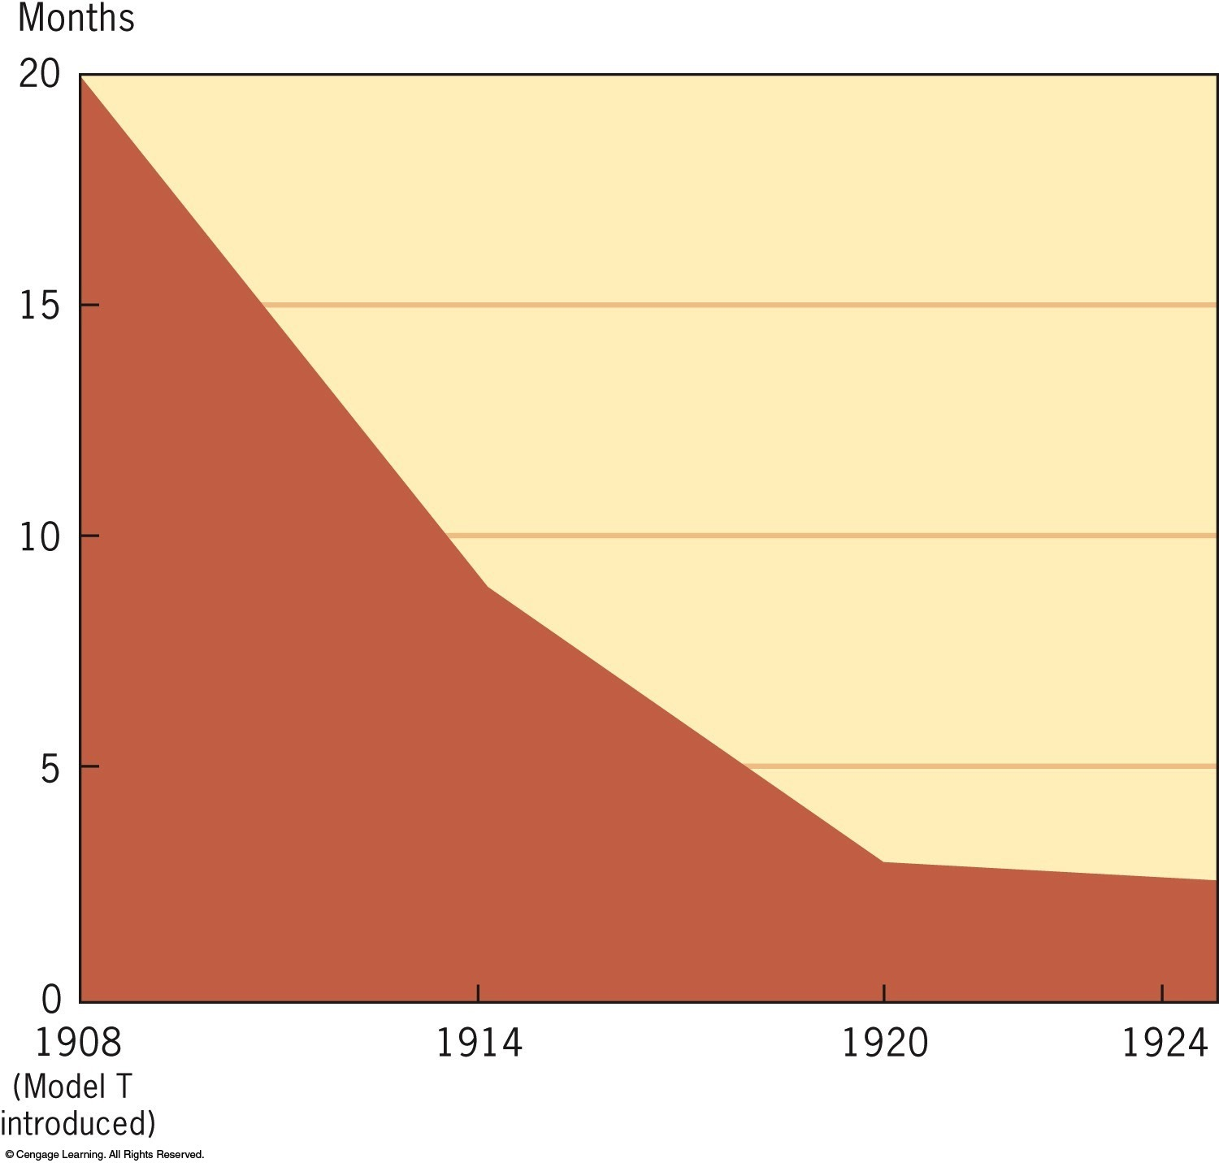
Figure 30-2 p704
Notes:
Figure 30.2 The Cost of a Model T Ford, 1908–1924
Henry Ford’s mass-production techniques cut the costs of
production dramatically and put the automobile within
reach of the workingperson’s purse. (Cost is shown in
months of labor for an employee at the average national
wage.) © 2016 Cengage Learning

Slide 25
IX. The Advent of the Gasoline Age
Impact of self-propelled carriage tremendous:
Gigantic new industry emerged
Employed directly or indirectly 6 million people
1,000s of new jobs created by supporting industries
Rubber, glass, and fabrics
Highway construction, service stations and garages
America's standard of living rose to enviable level
Petroleum business expanded:
Oil derricks shot up in California, Texas, Oklahoma
Railroads hard hit by competition with passenger cars, buses, and trucks

Slide 26
IX. The Advent of the Gasoline Age (cont.)
Speedy marketing of perishable foodstuffs accelerated
New prosperity enriched outlying farms
Countless new hard-surfaced roads constructed
Thanks to installment-plans, countless Americans acquired habit of riding
Zooming motorcars agents of social change:
At first a luxury, rapidly became a necessity
Became badge of freedom and equality
Ostentation seemed more important than transportation
Leisure hours could now be spent more pleasurably

Slide 27
IX. The Advent of the Gasoline Age (cont.)
Women further freed from dependence on men
Suburbs spread further from urban core
Isolation among sections declined
Autobuses made possible consolidation of schools, and to some extent churches
By 1951, a million Americans had died in motor vehicle accidents
Virtuous home life partially broke down as people abandoned parlor for highway
Morals of youth sagged correspondingly
Crime wave of 1920s and 1930s aided by motorcar

Slide 28
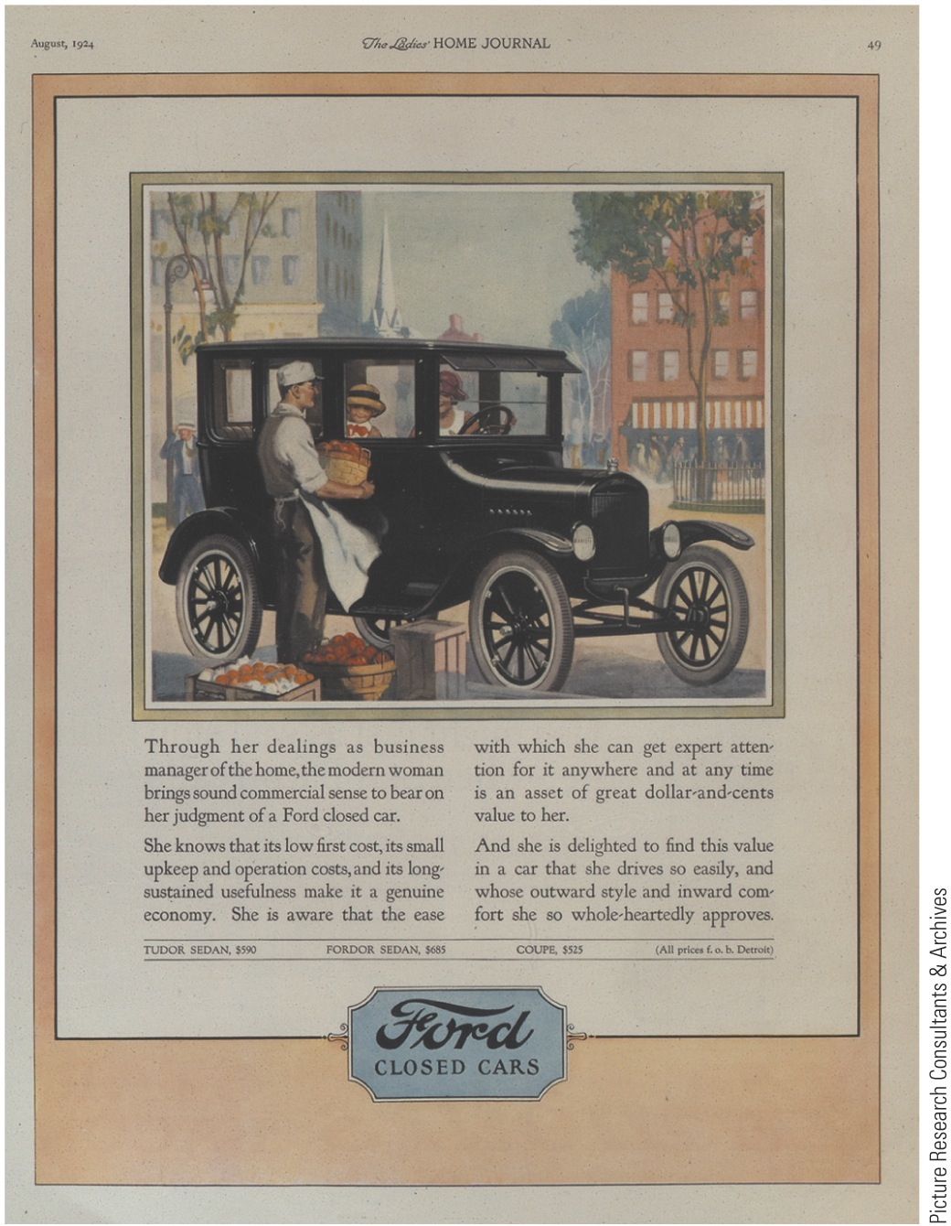
Air and environmental quality improved with less horse use
Automobile brought more convenience, pleasure, and excitement into more people's lives than almost any other single invention
p705
Notes:
The Modern Woman in the Driver’s Seat As part of its
effort to sell to a mass market, the Ford Motor Company
used advertising to convey that driving an automobile
was respectable for women. A woman who drove was not
only modern, but she also better fulfilled her traditional
duties as a household manager.

Slide 29
X. Humans Develop Wings
Gasoline engines provided power that enabled humans to achieve flight
Wright brothers, Orville and Wilbur, performed “miracle at Kitty Hawk,” N.C. on Dec. 17, 1903
Orville stayed airborne for 12 seconds and 120 feet
Air age launched by 2 obscure Ohio bicycle repairmen
Airplanes—“flying coffins” used for:
Various purposes during Great War, 1914-1918
Private companies operated passenger lines and transported mail

Slide 30
X. Human Develop Wings
1927 Charles A. Lindbergh:“Flyin' Fool” first solo flight across Atlantic
Piloted single-engine plane, Spirit of St. Louis from New York to Paris in grueling 33 hours and 39 minutes
Achievement did much to dramatize and popularize flying, while giving boost to infant aviation industry
Impact of airship tremendous:
Provided American spirit with another dimension
Gave birth to giant new industry
Unfortunately, initial accident rate high
By 1920s and 1930s, travel by air on regularly scheduled airlines significantly safer
Humanity's new wings increased tempo of already breathless civilization
Railroads further hurt by loss of passengers and mail
Lethal new weapon given to war with use of bombs
Isolation behind oceans becoming bygone dream as world slowly shrinks

Slide 31
XI. The Radio Revolution
Speed of airplane far eclipsed by speed of radio waves:
Guglielmo Marconi, an Italian, invented wireless telegraph in 1890s
Used for long-range communication during World War I
Next came voice-carrying radio:
Red-letter day in November 1920 when Pittsburgh radio station broadcast news of Harding's landslide victory
Later miracles achieved in transatlantic wireless phonographs, radio, telephones, and television
Earliest radio programs reached only local audiences
By late 1920s technological improvements made long-distance broadcasting possible
National commercial networks drowned out local programming
Advertising “commercials” made radio another vehicle for American free enterprise, as contrasted to government-owned systems of Europe

Slide 32
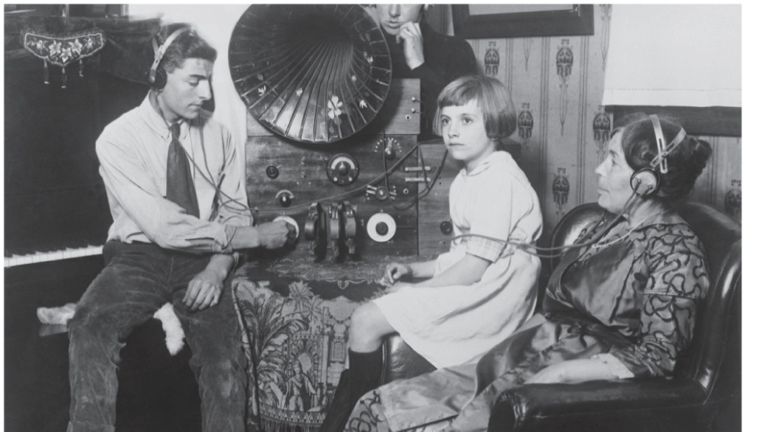
XI. The Radio Revolution
Radio drew people back home and knitted nation together
Programs sponsored by manufacturers and distributors of brand-name products helped make radio-touted labels household words and purchases
Sports further stimulated
Politicians adjusted speaking techniques to new medium
Host of listeners heard their favorite newscaster
Music of famous artists and orchestras beamed into countless homes

Slide 33
XII. Hollywood's Filmland Fantasies
Flickering movie fruit of numerous geniuses:
1903: birth of first story sequence on screen:
The Great Train Robbery –in five-cent theaters, popularly called “nickelodeons”
First full-length classic was D.W. Griffith's Birth of a Nation (1915):
Glorified Ku Klux Klan of Reconstruction days and defamed blacks and Northern carpetbaggers
Hollywood became movie capital of world
Used in World War I as engine of anti-German propaganda:
“Hang the kaiser” films helped sell war bonds and boost morale
1927—success of first “talkie”—The Jazz Singer:
“Silents” ushered out as theaters “wired for sound”
Early color films produced

Slide 34
XII. Hollywood's Filmland Fantasies (cont.)
Phenomenal growth in popularity of films
Movie “stars” commanded much higher salaries than president of United States
$100,000 for single film
Many actors and actresses more popular than nation's political leaders
Critics bemoaned vulgarization of popular tastes with films and radio
Effects of new mass media not all negative:
Insularity of ethnic communities eroded as immigrants' children took to public media
Some diversity of immigrants' Old Country culture lost, but:
Standardization of tastes and language hastened entrance into American mainstream
Set stage for working-class political coalition that would overcome divisive ethnic differences of past

Slide 35
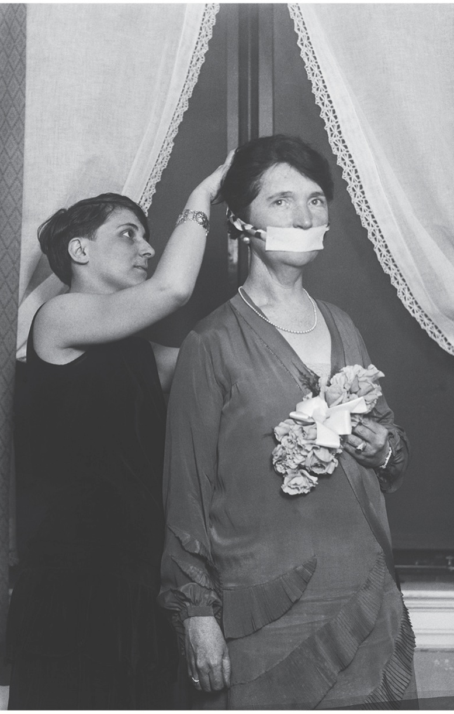
XIII. The Dynamic Decade
Changes in lifestyles and values:
More lived in urban areas than in countryside by 1920
Women continued to find employment in cities
Organized birth control movement:
Led by fiery feminist Margaret Sanger, who openly championed contraceptives
Campaign for Equal Rights Amendment
By Alice Paul's National Woman's party
Churches affected:
Fundamentalists lost ground to Modernists
Some churches tried to fight devil with worldly weapons

Slide 36
XIII. The Dynamic Decade (cont.)
Turned to new entertainment
Some even included moving pictures for youth
Chimes“struck sex o'clock in America”:
Advertisers exploited sexual allure to sell everything
Young women's clothing and styles changed
“Flapper” symbolized more independent lifestyle
Adventuresome females shocked elders when they sported new one-piece bathing suits
Justification for new sexual frankness found in writings of Dr. Sigmund Freud

Slide 37
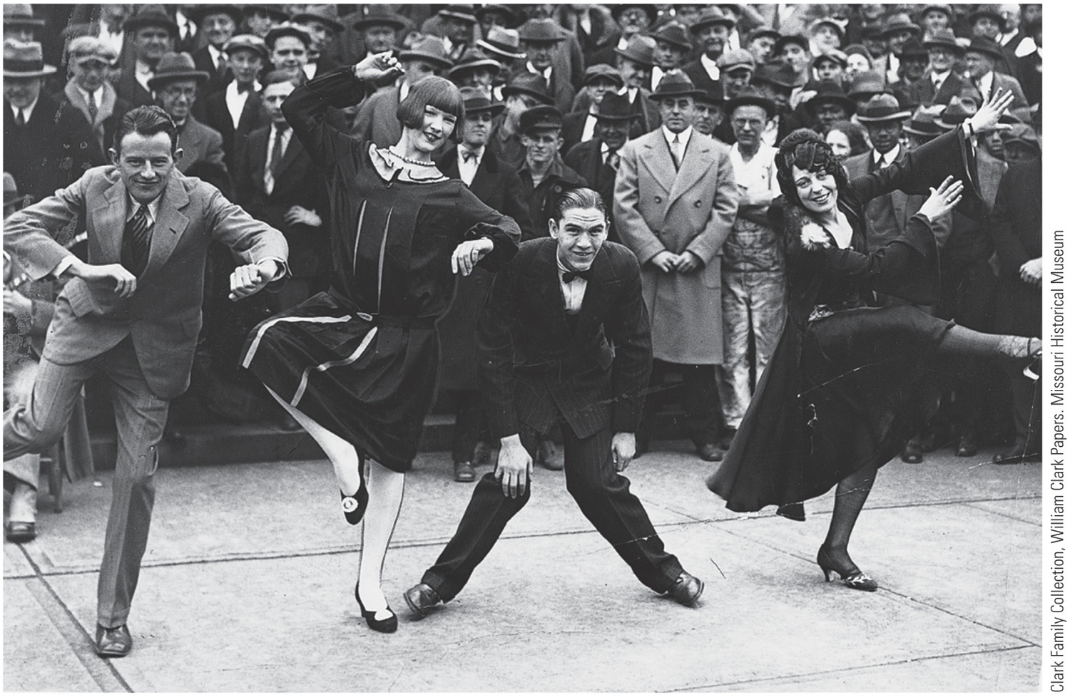
p710
Notes:
The Flapper New dance
styles, like the “Charleston,”
flamboyantly displayed the
new social freedom of the
“flapper,” whose dress and
antics frequently flummoxed
the guardians of
respectability.

Slide 38
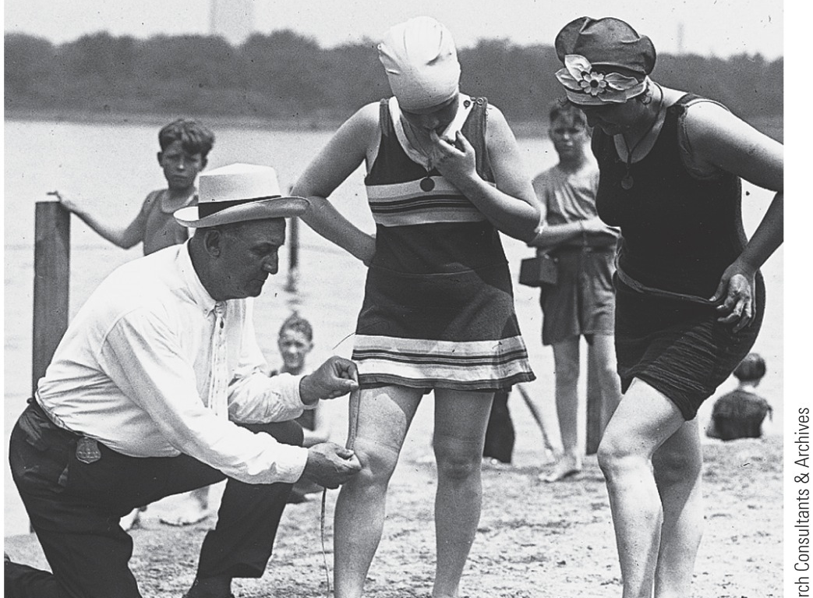
XIII. The Dynamic Decade
Many taboos flew out window
Sexual freedom became more prevalent
Flapper as goddess of “era of wonderful nonsense,” and jazz its sacred music:
Moved up from New Orleans with migrating blacks
Wailing saxophone became trumpet of new era
W.C. Handy, “Jelly Roll” Morton, Louis Armstrong, and Joe “King” Oliver gave birth to jazz

Slide 39
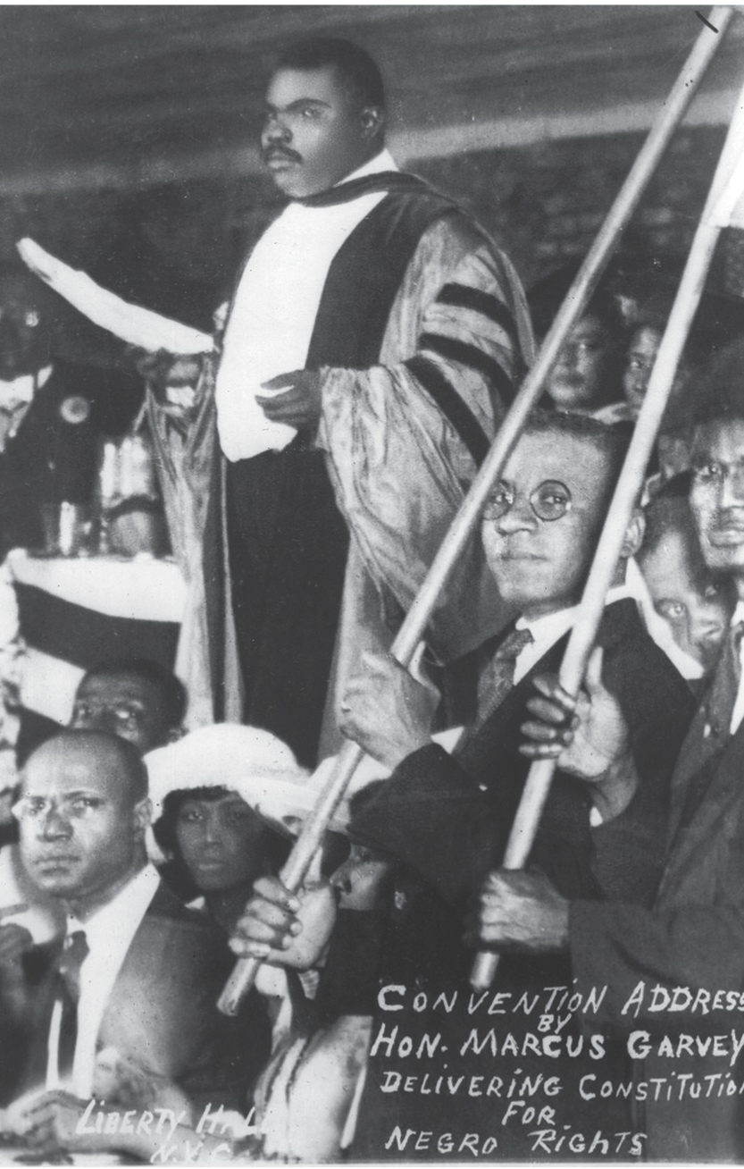
XIII. The Dynamic Decade
New racial pride blossomed in northern black communities:
Harlem in NYC—130,000 African American residents in 1920s
One of largest black communities in world
Culture nurtured by poets like Langston Hughes
The Weary Blues (1926)
Harlem spawned charismatic political leader, Marcus Garvey
Founded United Negro Improvement Association (UNIA) to promote resettlement of blacks in “African homeland”
Sponsored black businesses to keep money in black pockets
Helped newcomers to northern cities gain self-confidence and self-reliance
Example proved important to founding of Nation of Islam (Black Muslim) movement

Slide 40
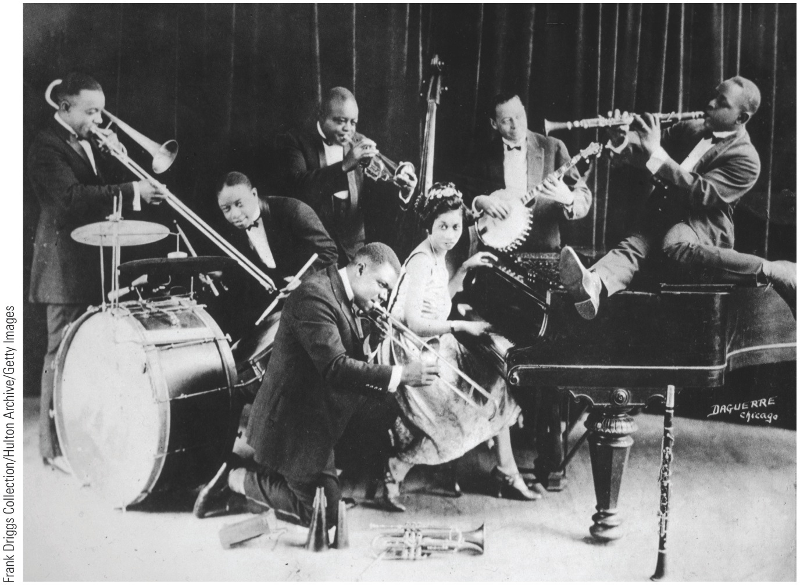
p711
Notes:
King Oliver’s Creole Jazz Band, Early
1920s Joe “King” Oliver arrived in
Chicago from New Orleans in 1918. His
band became the first important black
jazz ensemble and made Chicago’s Royal
Garden Café a magnet for jazz lovers.
Left to right: Honoré Dutrey, trombone;
Baby Dodds, drums; “King” Oliver, cornet;
Lil Hardin, piano; Bill Johnson, banjo;
and Johnny Dodds, clarinet. Kneeling
in the foreground is the young Louis
Armstrong.

Slide 41
XIV. Cultural Liberation
Literature and the arts:
Most of earlier genteel writers had died by 1920s
New Yorker Edith Wharton and Virginia-born Willa Cather continued to be popular
Now new modernists becoming popular (see Thinking Globally section)
Modernism questioned social conventions and traditional authorities, considered outmoded by accelerating changes of 20th century life
H.L. Mencken best personified this iconoclasm:
Known as “Bad Boy of Baltimore”
Promoted modernist causes in politics and literature
Assailed marriage, patriotism, democracy, prohibition, Rotarians, and other sacred icons of middle-class American “booboisie”
He dismissed South as “Sahara of the Bozart”
Attacked hypocritical do-gooders as “Puritans”
Puritanism, he jibed, was “haunting fear that someone, somewhere, might be happy”

Slide 42
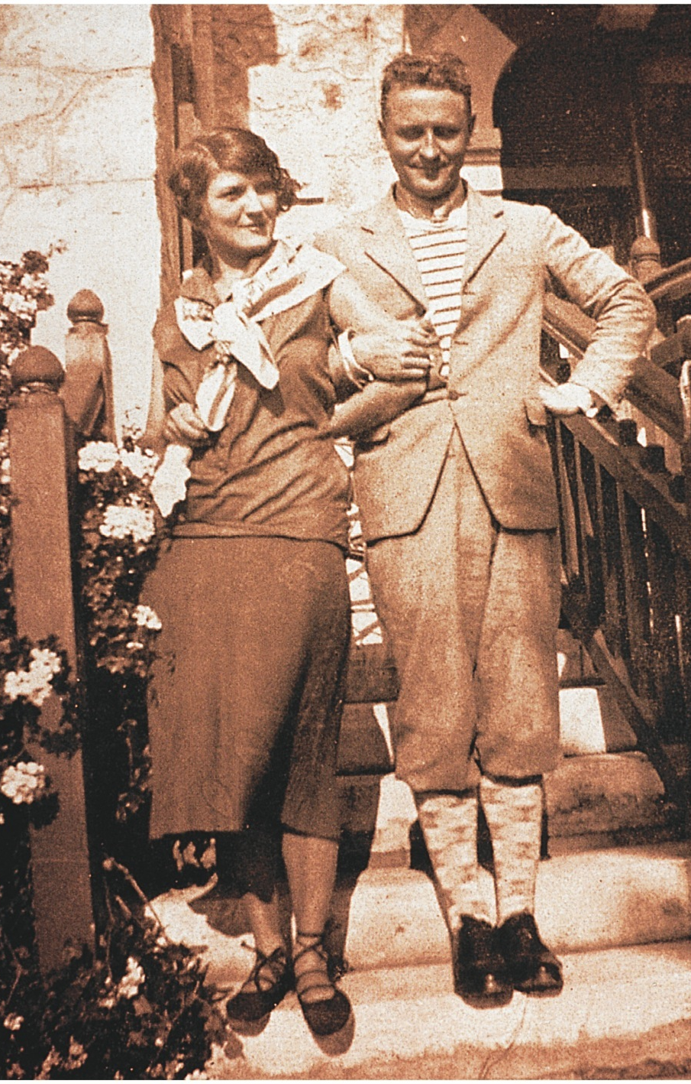
XIV. Cultural Liberation
Young writers jolted by WWI out of complacency about traditional values and literary standards
Probed for new codes of morals and understanding, as well as fresh forms of expression
F. Scott Fitzgerald—This Side of Paradise (1920)
“He found all gods dead, all wars fought, all faiths in man shaken”
The Great Gatsby (1925) brilliant commentary on illusory American ideal of self-made man
James Gatz reinvented himself as tycoon Jay Gatsby only to be destroyed by those with wealth and social standing

Slide 43
XIV. Cultural Liberation (cont.)
Theodore Dreiser's masterpiece An American Tragedy (1925) explored pitfalls of social striving
Ernest Hemingway:
Among writers most affected by WWI
His hard-boiled realism typified postwar writing
The Sun Also Rises (1926) told of disillusioned, spiritually numb American expatriates in Europe
In A Farewell to Arms (1929) he turned his own war story into one of finest novels about the war
His literary successes and flamboyant personal life made him one of most famous writers in world
Won Nobel Prize in literature in 1954

Slide 44
XIV. Cultural Liberation (cont.)
“Lost Generation”:
Hemingway, Fitzgerald and other American writers and painters formed artistic cadre:
As expatriates in postwar Europe
Found shelter and inspiration in Paris salon of Gertrude Stein:
Studied under William James at Harvard and her early works applied his theory of “stream of consciousness”
Friends with Pablo Picasso and Henri Matisse, she wrote radically experimental poetry and prose
Joined fellow American poets Ezra Pound and T. S. Eliot in vanguard of modernist literary innovation

Slide 45
XIV. Cultural Liberation (cont.)
“High modernists”:
Experimented with breakdown of traditional literary forms
Exposed losses associated with modernity
Wrote in self-consciously internationalist mode
Haughtily rejected parochialism they found at home
Pound rejected old civilization and proclaimed doctrine: “Make It New;” he strongly influenced Eliot
Eliot in The Waste Land (1922) produced one of most impenetrable but influential poems of century
e.e. Cummings used unorthodox diction and peculiar typesetting to produce startling poetic effects

Slide 46
XIV. Cultural Liberation (cont.)
Not all American writers radical:
Many continued familiar regionalist style
Robert Frost wrote hauntingly about nature and folkways of his adopted New England
Carl Sandburg extolled working classes of Chicago in strong, simple cadence
Sherwood Anderson in Winesburg, Ohio dissected various fictional personalities, finding them warped by their cramped psychological surroundings
American composers and playwrights made valuable contributions:
Jerome Kern and Oscar Hammerstein's Show Boat (1927) was America's first “musical play”
Eugene O'Neill's Strange Interlude (1928) laid bare Freudian notions of sex and subconscious in succession of dramatic soliloquies
Garnered Nobel Prize in literature (1936)

Slide 47
XIV. Cultural Liberation (cont.)
Harlem Renaissance:
Black cultural renaissance in uptown Harlem:
Led by writers Claude McKay, Langston Hughes, and Zora Neale Hurston
And jazz artists Louis Armstrong and Eubie Blake
Argued for “New Negro” who was a full citizen and social equal to whites
Adopted modernist techniques, Hughes and Hurston captured oral and improvisational traditions of contemporary blacks in dialect-filled poetry and prose

Slide 48
XV. Wall Street's Big Bull Market
Economic conditions of 1920s:
Several hundred banks failed annually
Florida boom: numerous underwater plots sold to eager purchasers for preposterous sums
Stocks provided even greater sensations:
Speculation ran wild
Boom-or-bust trading pushed market to dizzy peaks
Stock market became veritable gambling den

Slide 49
XV. Wall Street's Big Bull Market
In 1920s many bought stocks“on margin”
Intoxicated by lure of quick profits, few heeded warnings that this kind of prosperity could not last
Little done by Washington to curb speculators
1921 Congress moved toward budget sanity by creating Bureau of the Budget:
Assisted president in preparing estimates of receipts and expenditures to be submitted to Congress as annual budget

Slide 50
XV. Wall Street's Big Bull Market (cont.)
Burdensome taxes from war distasteful to Secretary of Treasury Mellon
Argued high taxes forced rich to invest in tax-exempt securities rather than in factories that provided payrolls
Argued high taxes not only:
Discouraged business, but
Brought in smaller return to Treasury than moderate taxes
Mellon helped engineer series of tax reductions from 1921 to 1926
Congress:
Repealed excess-profit tax
Abolished gift tax
Reduced excise taxes, the surtax, the income tax, and estate taxes
Mellon's spare-the-rich policies shifted tax burden from wealthy to middle-income groups
Mellon, lionized by conservatives as “greatest secretary of Treasury since Hamilton” remains controversial figure:
Reduced national debt by $10 billion
Accused of indirectly encouraging bull market

