Slide 1
Growing Sectionalism
Chapter 18

Slide 2
I. The Popular Sovereignty Panacea
Democrats in 1848:
Polk pledged himself to a single term
National Convention turned to aging leader General Lewis Cass
Platform silent on burning issue of slavery
Cass's views were well known because he was reputed father of popular sovereignty
Popular sovereignty—
doctrine stated the sovereign people of a territory, under general principle of the Constitution, should themselves determine status of slavery
Had persuasive appeal:
Public liked it because it accorded with democratic tradition of self-determination

Slide 3
I. Popular Sovereignty Panacea (cont.)
Politicians liked it because it seemed a comfortable compromise between:
Free-soilers' bid to ban slavery in territories
Southern demands that Congress protect slavery in territories
Popular sovereignty tossed slavery problem to people in various territories
Advocates hoped to dissolve slavery from a national issue to a series of local issues
Yet, popular sovereignty had one fatal defect:
Might spread blight of slavery
Whigs
Nominated Zachary Taylor, “Hero of Buena Vista”
Platform:
Dodged all troublesome issues
Extolled virtues of their candidate
He would not commit himself on issue of slavery's extension

Slide 4
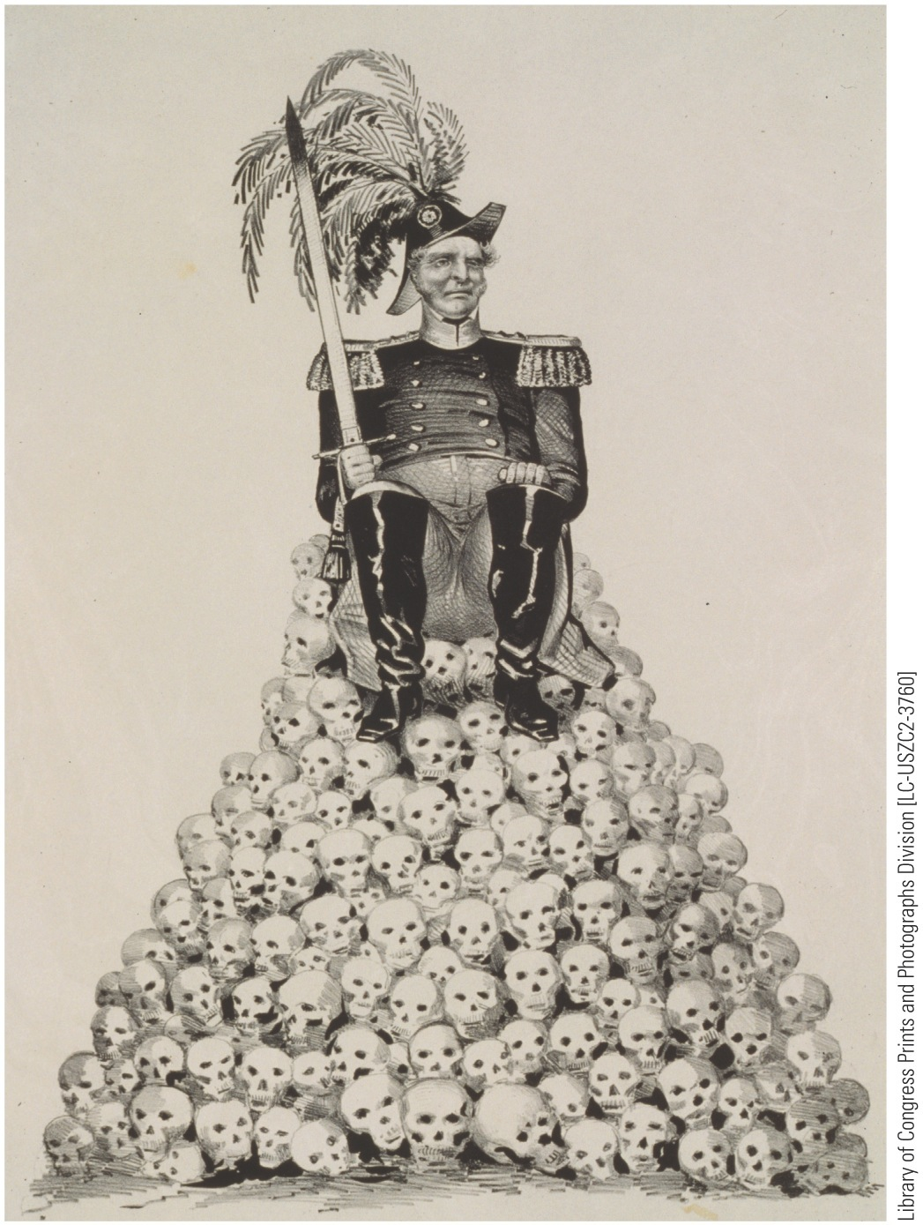
p382
Notes:
General Zachary Taylor (1784–1850) T his Democratic
campaign cartoon of 1848 charges that Taylor’s reputation
rested on Mexican skulls.

Slide 5
II. Political Triumphs for General Taylor
Free Soil party:
Organized by ardent antislavery Northerners
Came out for Wilmot Proviso and against slavery in territories
Broadened appeal by advocating:
Federal aid for internal improvement
Free government homesteads for settlers
Attracted industrialists opposed to Polk's reduction of protective tariffs
Appealed to Democrats resentful of Polk's settling for part of Oregon, while insisting on all of Texas
Harbored many northerners whose hatred was not directed at slavery as much as at African Americans:
Gagged at prospect of sharing new territories with blacks
Contained some “Conscience Whigs” who condemned slavery on moral grounds
Free soilers chose Van Buren

Slide 6
II. Political Triumphs for General Taylor (cont.)
Free-Soilers' party platform:
Condemned slavery not so much for enslaving blacks but for destroying chances of free whites to rise up from wage-earning dependence to self-employment
Argued that only with free soil in West could American commitment to upward mobility continue to flourish
First party organized around issue of slavery and confined to single section
Foreshadowed emergence of Republicans
Taylor's wartime popularity:
1,360,967 popular and 163 electoral votes
Cass:
1,222,342 popular and 127 electoral votes
Van Buren
291,263 ballots and diverted Democratic strength from Cass in critical state of New York

Slide 7
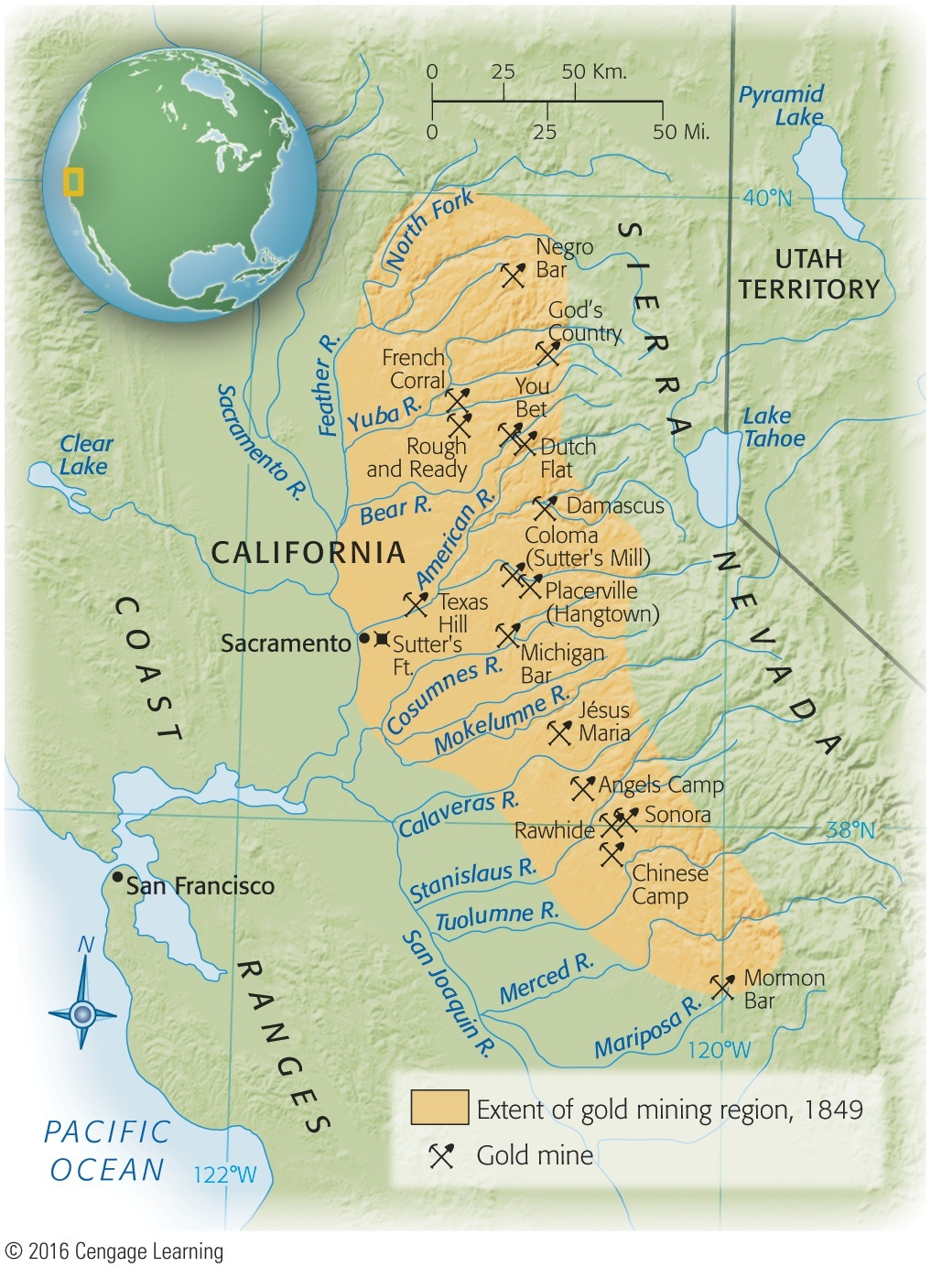
III. “Californy Gold”
Discovery of gold near Sutter's Mill, California, early in 1848:
Most reliable profits made by those who mined the miners:
Charged outrageous rates for laundry & other services
“Forty-niners” chased dream of gold, most notably to Australia in 1851

Slide 8
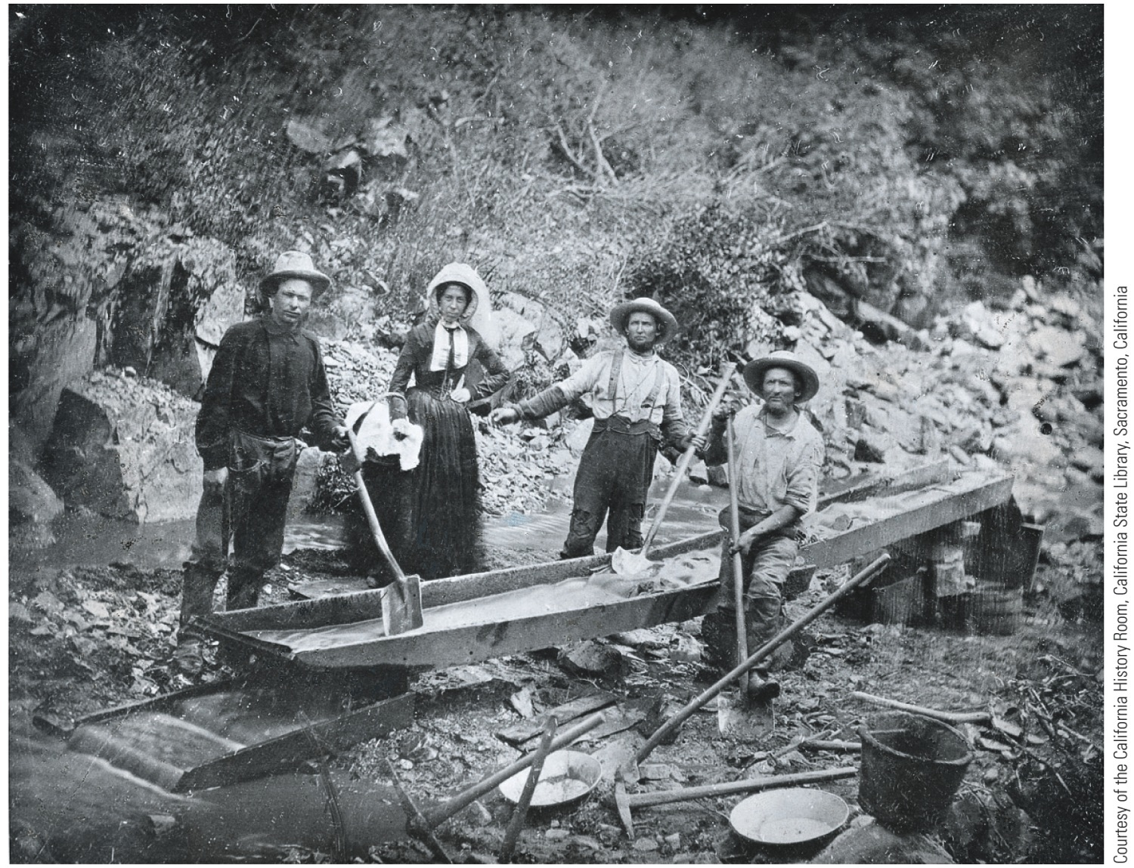
p384
Notes:
Placer Miners in California
Cheap but effective, placer
mining consisted of literally
“washing” the gold out of
surface deposits. No deep
excavation was required. This
crew of male and female
miners in California in 1852
was using a “long tom” sluice
that washed relatively large
quantities of ore.

Slide 9
III. “Californy Gold”
California gold rush:
Attracted tens of thousands of people
High proportion of newcomers were lawless men, accompanied or followed by virtueless women
Crime inevitably resulted
Robbery, claim jumping, & murder most commonplace
Majority of Californians were decent, law-abiding citizens; needed protection:
Struggled to erect adequate state government
Encouraged by President Taylor, they drafted a constitution in 1849 that excluded slavery
Then appealed to Congress for admission, bypassing usual territorial stage
Would California be straw that broke back of the Union?

Slide 10
IV. Sectional Balance and the Underground Railroad
South in 1850 was relatively well-off:
National leadership: Taylor in White House
Had a majority in cabinet and on Supreme Court
Cotton fields expanding
Cotton prices profitably high
Few believed slavery seriously threatened in fifteen states
South deeply worried by ever-tipping political balance: 15 slave states & 15 free states
Admission of California would destroy delicate equilibrium in Senate
Potential slave territory under American flag running short
Already agitation in territories of New Mexico & Utah for admission as nonslave states
California might establish a precedent

Slide 11
IV. Sectional Balance and the Underground Railroad (cont.)
Texas had additional grievances:
Huge area east of Rio Grande and north of forty-second parallel
Embraced half of present-day New Mexico (see Map 18.2)
Federal government proposed to detach area from Texas, but Texans threatened violence
Southerners:
Angered by agitation in North for abolition of slavery in District of Columbia
Alarmed by prospect of 10-mile oasis of free soil between slaveholding Maryland & slaveholding Virginia
More disagreeable to South was loss of runaway slaves:
Assisted by Underground Railroad
Amazing conductor: Harriet Tubman

Slide 12
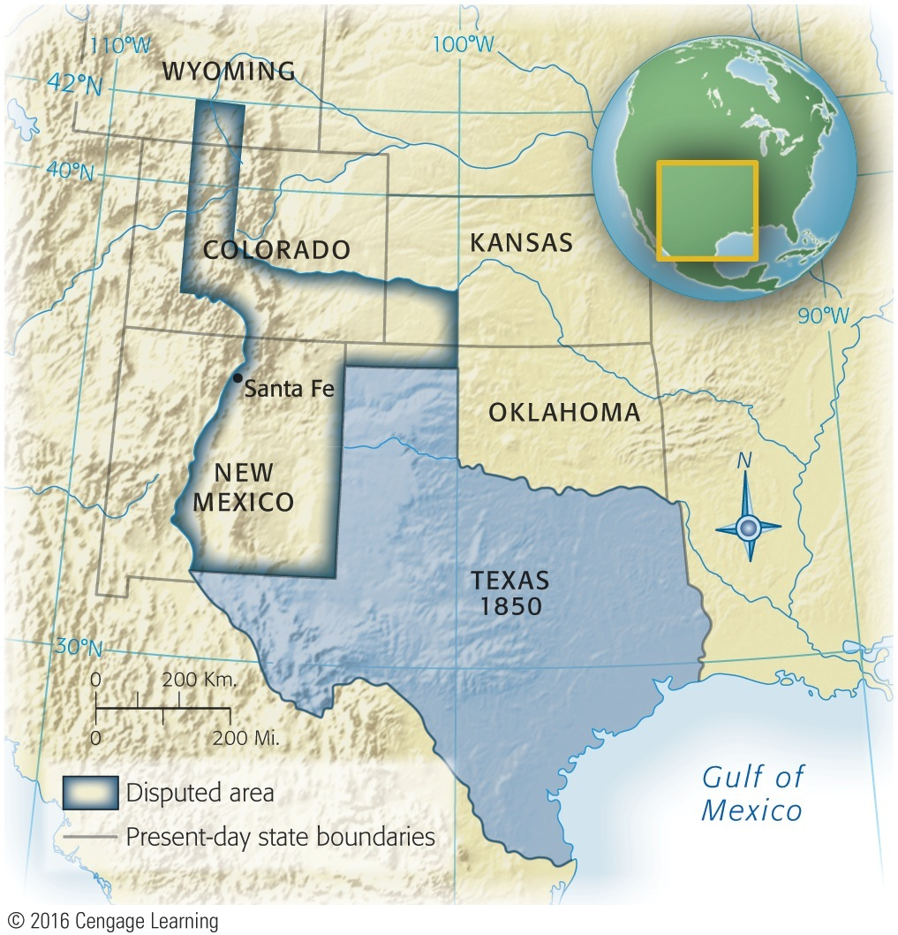
Map 18-2 p385
Notes:
Map 18.2 Texas and the Disputed Area Before the
Compromise of 1850 © 2016 Cengage Learning

Slide 13
IV. Sectional Balance and the Underground Railroad (cont.)
1850: southerners demanded more stringent fugitive-slave law:
1793 law inadequate to cope with runaways
Abolitionists who ran Underground Railroad did not profit from their lawlessness
Slave owners were losers
1,000 runaways a year out of some four million slaves
Masters argued Constitution protected slavery

Slide 14
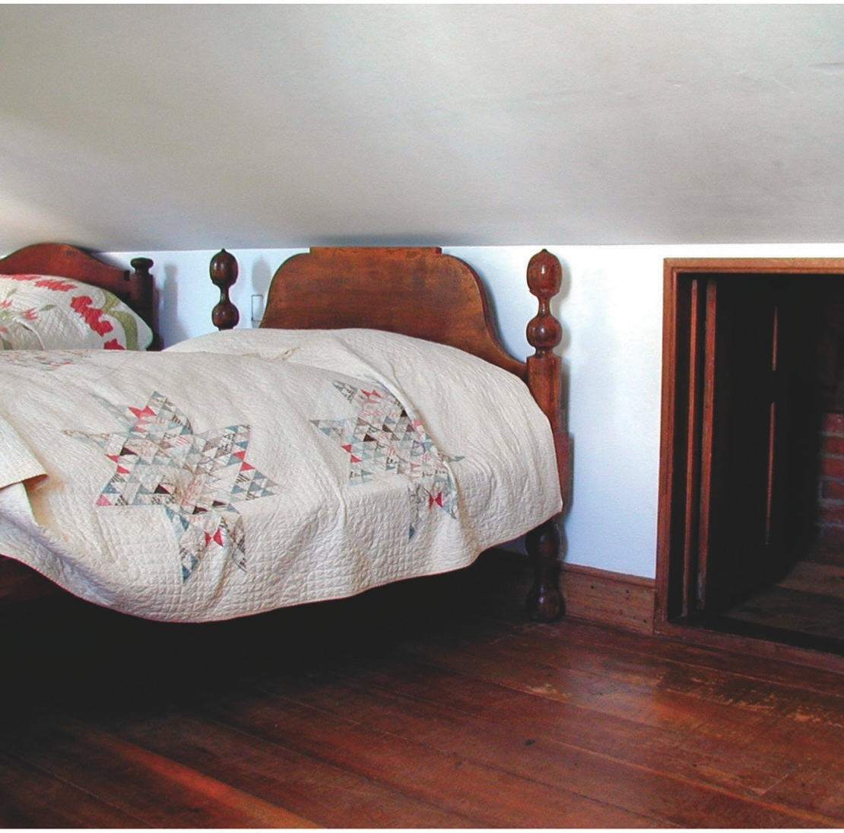
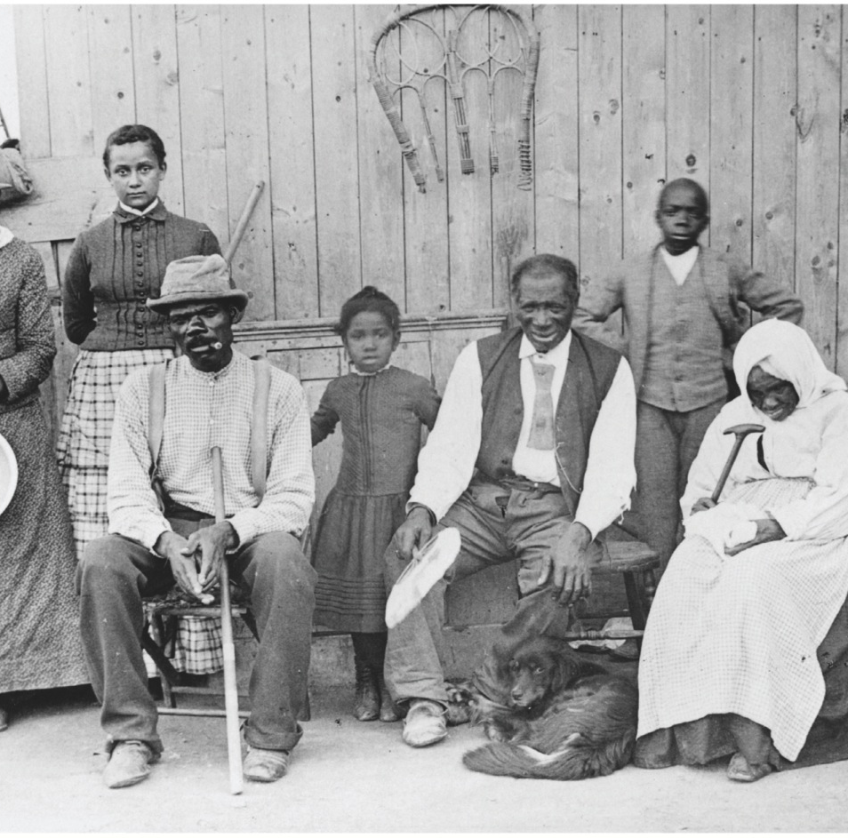
Notes:
A Stop on the Underground
Railroad Escaping slaves
could be hidden in this small
upstairs room of Levi and
Catharine Coffin’s House in
Newport, Indiana. The beds
were moved in front of the
door to hide its existence.
The Coffins were Quakers from
North Carolina who, during
twenty years in Newport,
helped more than 2,000
fleeing slaves safely reach
Canada—and freedom.

Slide 15
V. Twilight of the Senatorial Giants
Congressional catastrophe in 1850:
Free-soil California wanted admission
“Fire-eaters” in South threatened secession
Planned to meet in Nashville, Tenn. to withdraw from Union
“Immortal trio”—Clay, Calhoun, & Webster—met in Congress for last time
Henry Clay (73 years old) played critical role:
“Great Compromiser”—reprised role he played in Missouri and in nullification
Urged both North & South to make concessions
North partially yield by enacting more feasible fugitive-slave law

Slide 16
V. Twilight of the Senatorial Giants (cont.)
Senator John C. Calhoun (88 years old and dying of tuberculosis): “Great Nullifier”:
Approved Clay's proposed concessions
Rejected them as not providing adequate safe-guards for southern rights
Impassioned plea to leave slavery alone, return runaway slaves, give South its rights as minority, and restore political balance
Wanted to elect two presidents; one from North and one from South, each wielding a veto
Daniel Webster (86 years old):
Upheld Clay's compromise measures
Urged all reasonable concessions to South, including new fugitive-slave law with teeth
As for slavery in new territories, he asked, why legislate when area not conducive to plantations
His conclusion: only solutions were compromise, concession, and reasonableness

Slide 17
VI. Deadlock and Danger on Capitol Hill
Stormy congressional debate (1850) not over:
North's new Young Guard
William H. Seward:
Strong antislaveryite
Unequivocally against concession
Argued Christian legislators must obey God's moral law as well as man's mundane law
Appealed to exclude slavery in territories with reference to even “higher law” than Constitution
Appeal may have cost him presidential nomination and presidency in 1860
President Taylor bent on vetoing any compromise.
Ire aroused by threats of Texas to seize Santa Fe

Slide 18
VII. Breaking the Congressional Logjam
Taylor unknowingly helped cause of concession by dying suddenly.
Vice-President Millard Fillmore took reins:
As presiding officer of Senate, he was impressed with arguments for conciliation
Gladly signed series of compromise measures
Balancing of interests in Compromise of 1850 was extremely delicate (see Table 18.1).

Slide 19
VII. Breaking the Congressional Logjam (cont.)
Heat in Congress:
“Union savers”—Clay, Webster, Douglas—orated across North on behalf of compromise
Southern “fire-eaters” opposed concession
June 1850, southern extremists met in Nashville:
Took strong position in favor of slavery
Condemned compromise measure
Second Era of Good Feelings dawned:
Talk of secession subsided
Peace-loving people, both North and South, determined that:
Compromises should be “finality”
Explosive issue of slavery should be buried

Slide 20
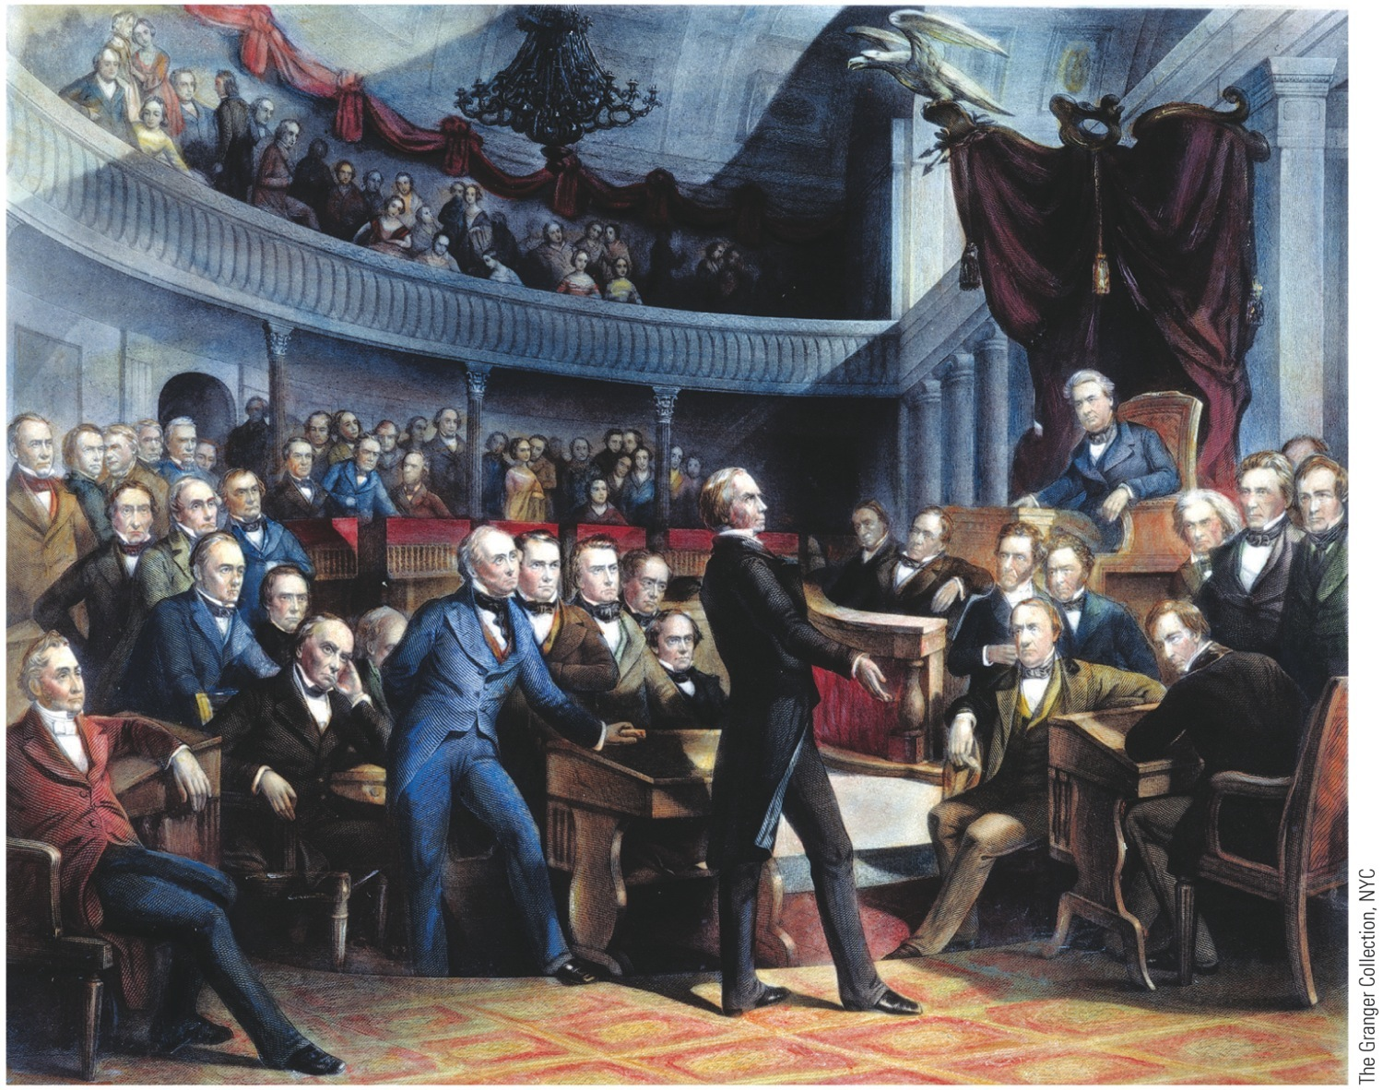
p388
Notes:
Henry Clay Proposing
the Compromise of
1850 This engraving
captures one of the
most dramatic moments
in the history of the
United States Senate.
Vice President Millard
Fillmore presides, while
on the floor sit several of
the “Senatorial Giants”
of the era, including
Daniel Webster, Stephen
A. Douglas, and John C.
Calhoun.

Slide 21
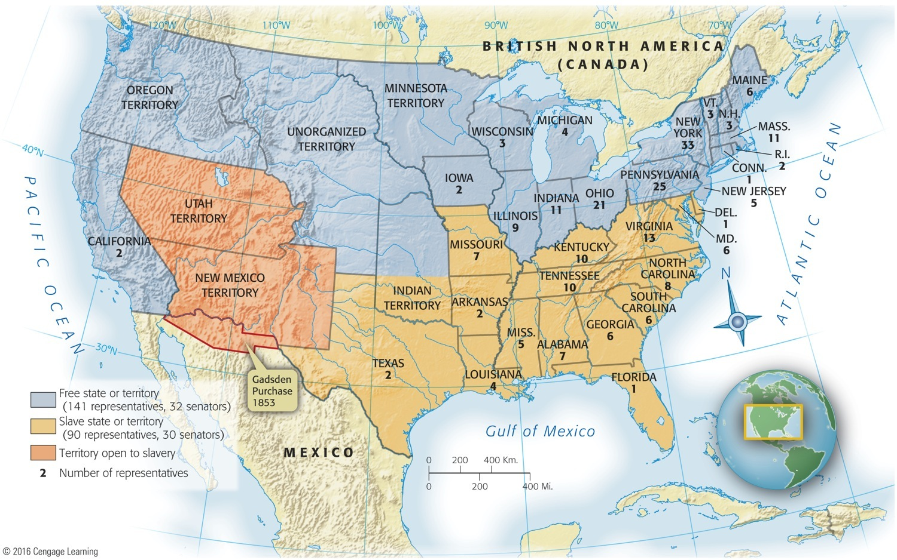
VIII. Balancing the Compromise Scales
Who got better deal from 1850 Compromise?
North (see Map 18.3):
California (free state) tipped balance permanently against South
Territories of New Mexico & Utah open to slavery—basis of popular sovereignty
Nature—“highest law”—not favor slavery there

Slide 22
VIII. Balancing the Compromise Scales (cont.)
South:
Urgently needed more slave territory to restore “sacred balance”
If not from recent conquests from Mexico, then Caribbean was one answer
Halted drive toward abolition in District of Columbia temporarily
Had to accept outlawing slave trade in D.C.
Fugitive Slave Law (1850):
Stirred up storm of opposition in North
Fleeing slaves:
Could not testify on their own
Denied jury trial
Federal commissioner who handled case of a fugitive:
If runaway was freed, earned $5
If not, earned $10

Slide 23
VIII. Balancing the Compromise Scales (cont.)
Northerners who helped a slave escape were liable to heavy fines and jail time
“Man-Stealing” Law was abhorrent:
Touched off explosive chain reaction in North
Underground Railroad stepped up its timetable
Mass. made it a penal offense for any state official to enforce new federal statute
Other states passed “personal liberty laws”
Abolitionists protested vehemently against law
Beyond question, Fugitive Slave Law a blunder by South
Slave catchers redoubled efforts
With delay of fighting during 1850s:
North forged ahead in population and wealth—in crops, factories, foundries, ships, & railroads
Delay added immensely to moral strength of North
1850s did much to bolster Yankee will to resist secession, whatever the cost
Thus Compromise of 1850 won Civil War for Union (see Map 18.4)

Slide 24
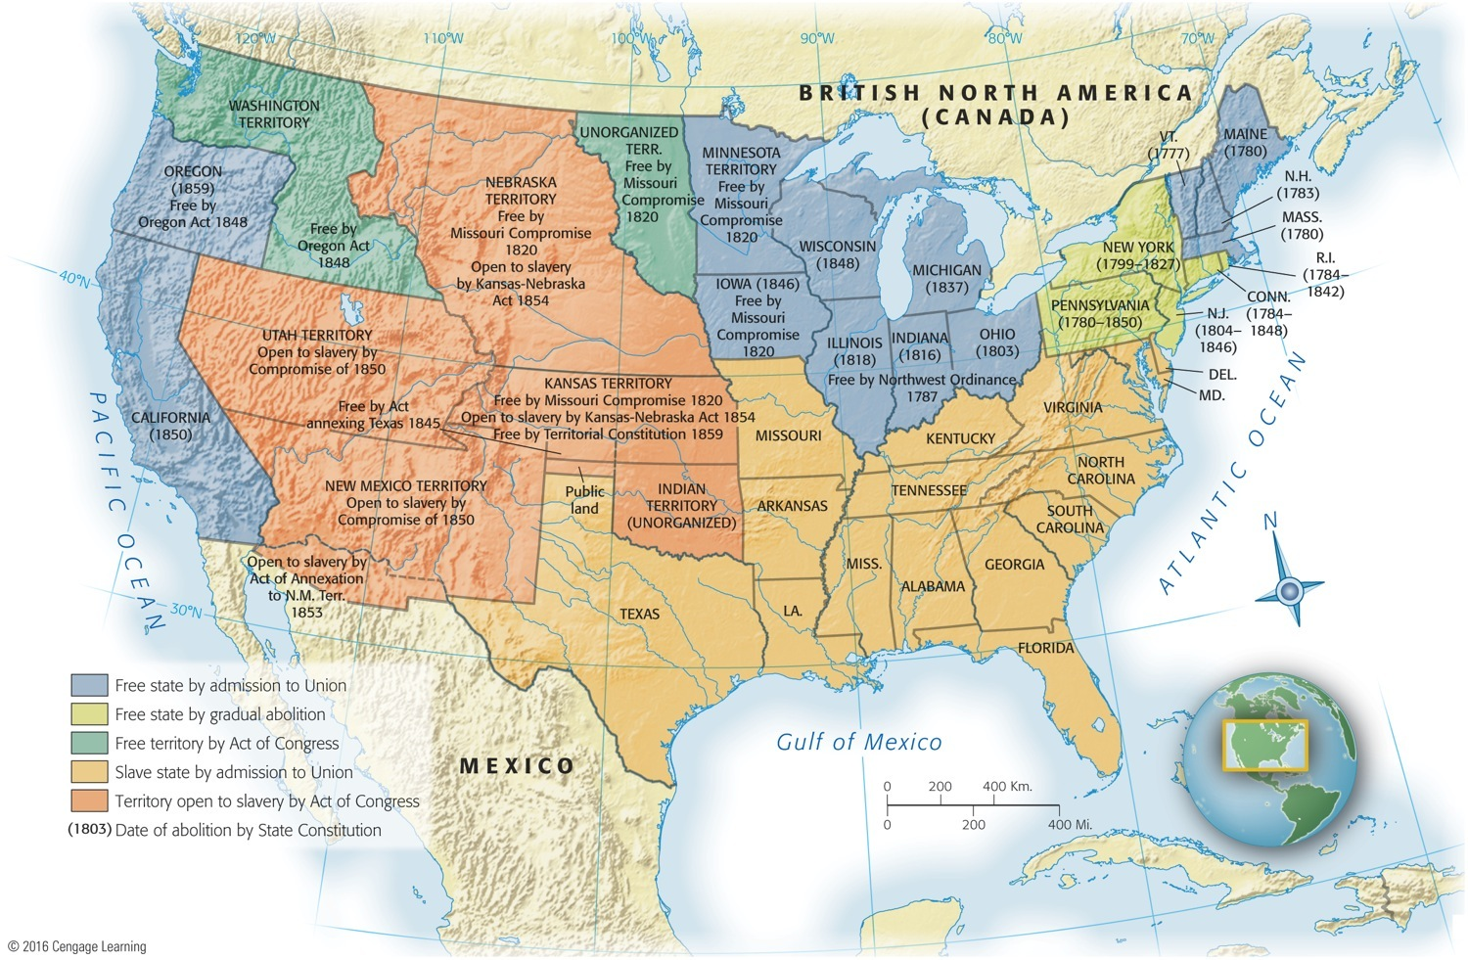
Map 18-4 p391
Notes:
Map 18.4 The Legal Status of Slavery, from the Revolution to the Civil War © 2016 Cengage Learning

Slide 25
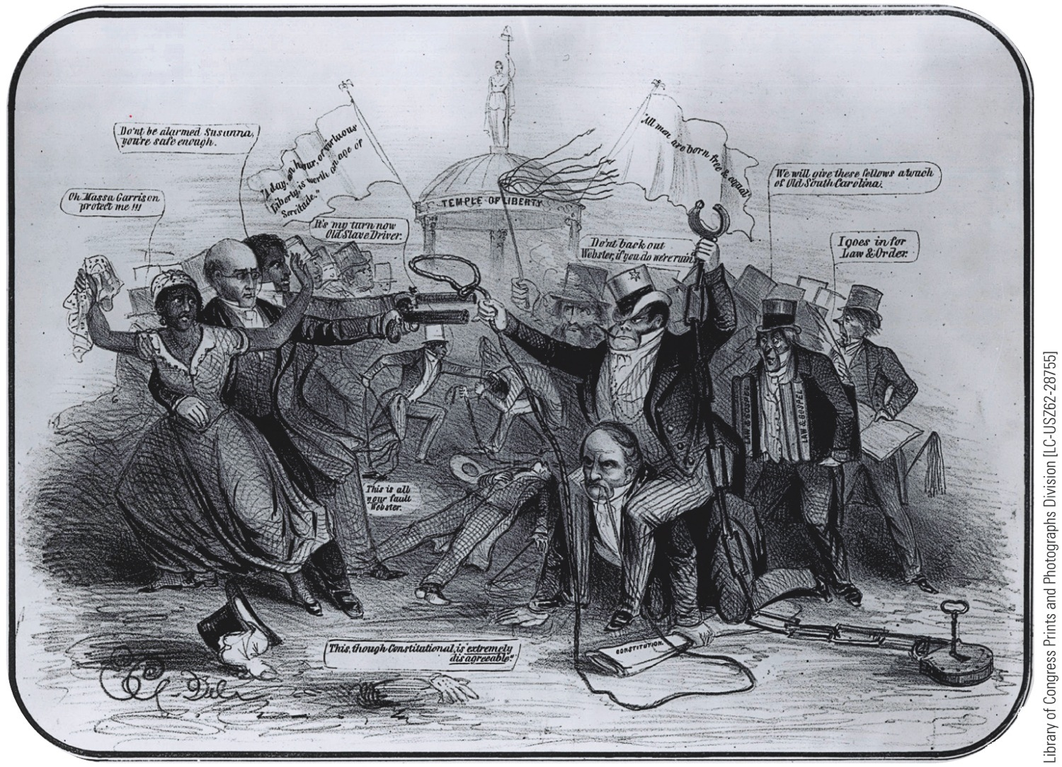
p390
Notes:
Protesting the Fugitive
Slave Law, 1850 The
cartoonist makes bitter
sport of the hated law and
heaps scorn on Daniel
Webster, on his hands
and knees at the right,
who voted for the law as
part of the Compromise
of 1850. The outspoken
abolitionist William Lloyd
Garrison is depicted
much more favorably
on the left.

Slide 26
IX. Defeat and Doom for the Whigs
1852 Democratic nominating convention in Baltimore:
Nominated “dark horse”—Franklin Pierce, from New Hampshire
Weak and indecisive figure
War injuries caused him to be known as “Fainting General”
Enemyless because he was inconspicuous
A prosouthern northerner, he was acceptable to slavery wing of Democratic Party
Platform revived commitment to territorial expansion as pursued by President Polk
Emphatically endorsed Compromise of 1850, incl. Fugitive Slave Law
Whigs convened in Baltimore:
Having won in past with war heroes, they turned to “Old Fuss and Feathers” Winfield Scott
Ablest American general of his generation

Slide 27
IX. Defeat and Doom for the Whigs
Whig platform praised Compromise of 1850
Campaign degenerated into personal attacks
Whig party hopelessly split:
Antislavery Whigs in North accepted Scott as nominee but deplored his platform—which endorsed Fugitive Slave Law
Southern Whigs doubted Scott's loyalty to Compromise of 1850 and Fugitive Slave Law—accepted his platform but rejected candidate
General Scott, victorious on battlefield, met defeat at ballot box.
Free-soil John Hale took northern Whig votes from Scott
Hale took 5% of popular vote
Pierce won with 254 electoral vote to 42;
Popular count was closer: 1,601,117 to 1,385,453
Election of 1852's frightening significance:
Marked effective end of Whig party

Slide 28
IX. Defeat and Doom for the Whigs
Whigs' complete death:
Augured eclipse of national parties and rise of purely sectional political alignments
Won two presidential elections (1840, 1848) with war heroes
Greatest contribution was to help uphold ideal of Union through:
Electoral strength in South
Eloquence of leaders Clay & Webster

Slide 29
X. Expansionist Stirrings South of the Border
Spirit of Manifest Destiny revived:
A continuous Atlantic-to-Pacific transportation route would effectively sever two Americas (see Map 18.5)
British encroachment in area drove governments of United States & New Granada to conclude treaty in 1848
Guaranteed American right of transit across isthmus in return for Washington's pledge to maintain “perfect neutrality” on route—“free transit of traffic might not be interrupted”
Agreement led to:
Theodore Roosevelt's assertion of American control of Panama Canal in 1903
Led to construction of first “transcontinental” railroad
Clayton-Bulwer Treaty (1850) stipulated neither U.S.A. nor Britain would fortify or seek executive control over any future isthmian waterway
(later rescinded by Hay-Pauncefote Treaty of 1910; see Chap 27).

Slide 30
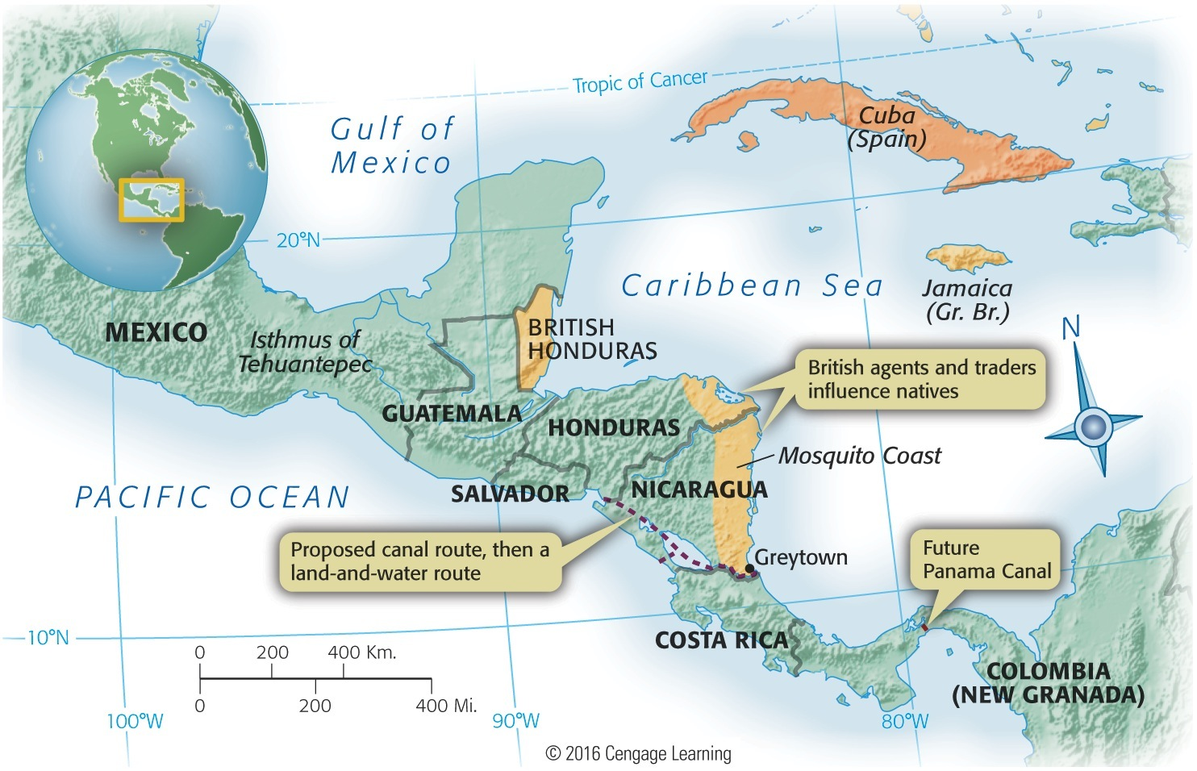
Map 18-5 p392
Notes:
Map 18.5 Central America,
ca. 1850, Showing British
Possessions and Proposed
Canal Routes Until President
Theodore Roosevelt swung into
action with his big stick in 1903, a
Nicaraguan canal, closer to the
United States, was generally judged
more desirable than a canal across
Panama. © 2016 Cengage Learning

Slide 31
XI. The Allure of Asia
Could Americans tap more deeply the supposedly rich markets of Asia?
Opium War—fought by Britain for right to peddle opium in China:
Britain gained free access to five so-called treaty ports
Control of island of Hong Kong
President Tyler dispatched Caleb Cushing to secure comparable concession for United States
Cushing arrived at Macao in early 1844
Treaty of Wanghia: first formal diplomatic agreement between U.S. and China on July 3, 1844:
Cushing secured vital commercial rights and privileges from Chinese
“Most favorable rights” granted to U.S.A.
“Extraterritoriality”—provided Americans, accused of crimes in China, a trial before American officials, not in Chinese courts

Slide 32
XI. The Allure of Asia (cont.)
American trade with China increased
Treaty also encouraged arrival of American missionaries; thousands came
Success in China prompted U.S. goals for Japan:
Japan had earlier withdrawn into cocoon of isolationism for over 200 years
Tokugawa Shogunate protected Japan's insularity
By 1853, Japan ready to emerge from self-imposed quarantine
President Fillmore dispatched Commodore Matthew Perry in 1852 for Japan
His four smoke-belching “black ships” steamed into Edo (later Tokyo Bay) on July 8, 1853
Once on shore, Perry requested free trade & friendly relations, then left promising to return next year to receive Japan's reply
Perry returned in February 1854; persuaded Japan to sign Treaty of Kanagawa on March 31, 1854

Slide 33
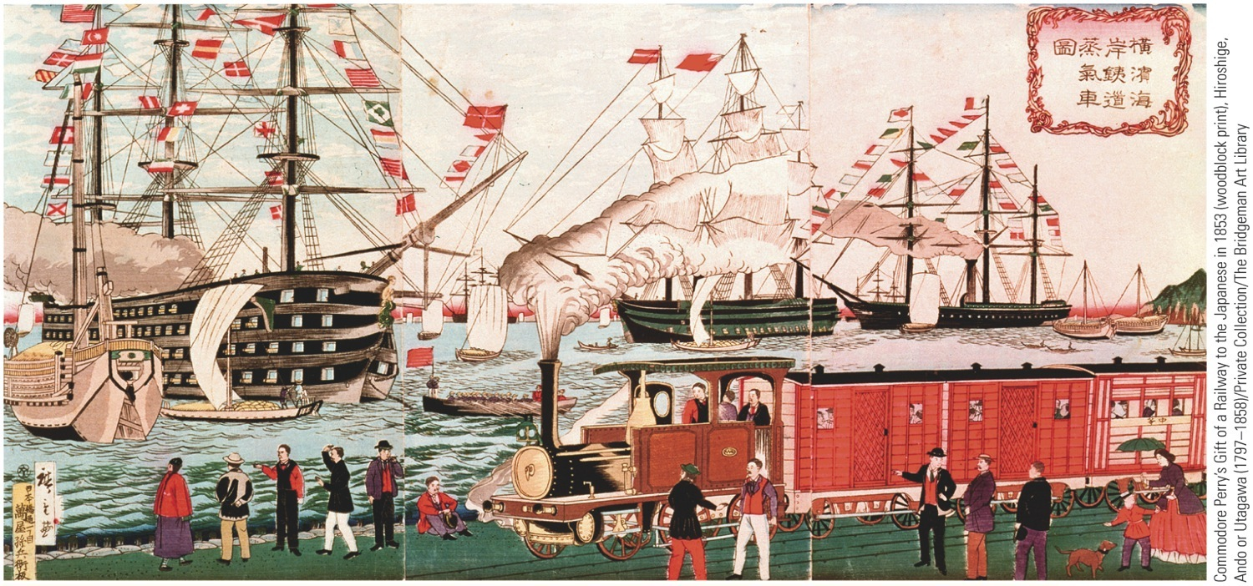
XI. The Allure of Asia
Perry cracked open Japan's two-century shell of isolation
Less than a decade later, “Meiji Restoration” would:
End Shogunate
Propel Japan headlong into modern world
Eventually into military crash with United States
p394
Notes:
Commodore Matthew Perry in Japan, 1853 A mong Perry’s gifts to the Japanese was a
miniature railway, complete with engine, cars, and track, which made a vivid impression on
the Japanese artist who created this work.

Slide 34
XII. Pacific Railroad Promoters and the Gadsden Purchase
Acute transportation problems another legacy of Mexican War
California & Oregon: 8,000 miles west of nation's capital
Sea routes too long
Travel by wagon slow and dangerous
Feasible land transportation imperative
Transcontinental railroad only real solution
Where to build railroad: north or south?
James Gadsden, minister to Mexico:
Santa Anna still in power and needed money
Gadsden negotiated Gadsden Purchase in 1853
Ceded more territory to U.S.A. for $10 million
Best route for a southern railroad (see Map 18.6)
In response, Northerners wanted Nebraska organized

Slide 35
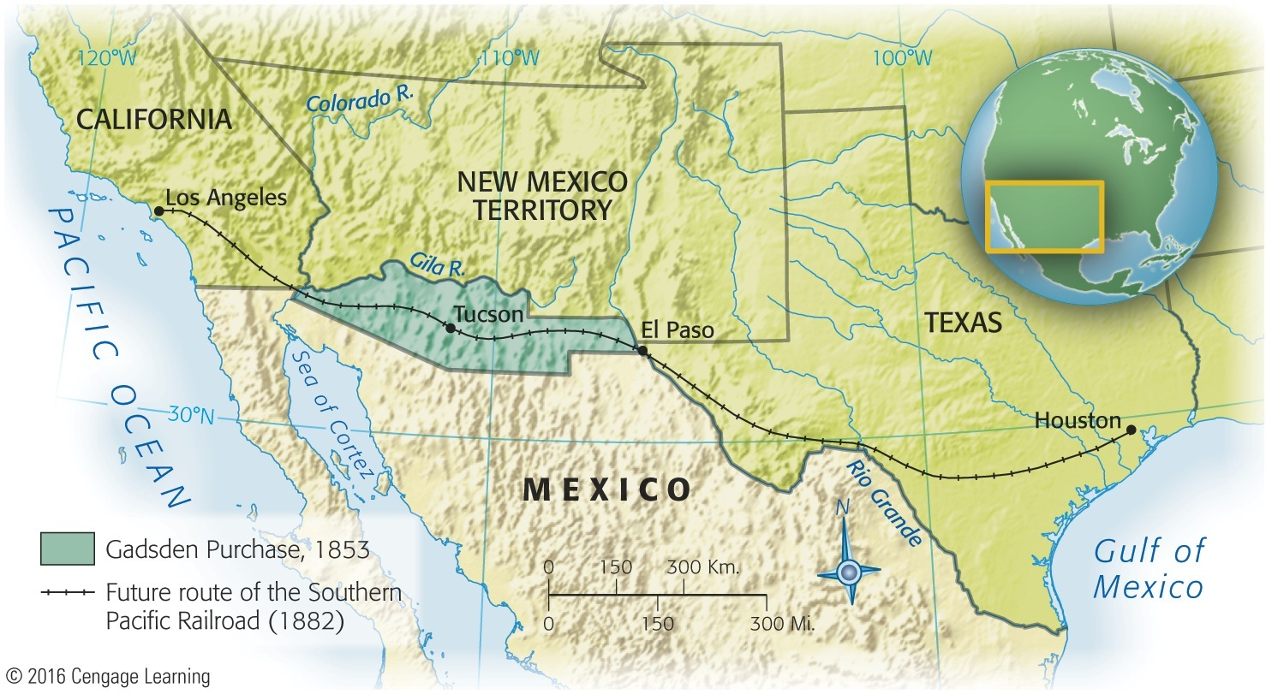
Map 18-6 p395
Notes:
Map 18.6 The Gadsden
Purchase, 1853 © 2016 Cengage Learning

Slide 36
XIII. Douglas's Kansas-Nebraska Scheme
Senator Stephen Douglas in 1854 sought to offset Gadsden's expansion to southwest
Longed to break North-South deadlock over westward expansion
Invested heavily in Chicago real estate & railway stock
Wanted Chicago to be eastern terminus for proposed railroad
Wanted to get South to support his scheme
Proposed territory of Nebraska be divided into two territories, Kansas and Nebraska (see Map 18.7)
Slavery then decided by popular sovereignty
Kansas, west of slaveholding Missouri, presumably would choose to become a slave state
Nebraska, west of free-soil Iowa, presumably would become a free state
Douglas's scheme contradicted Missouri Compromise of 1820 (forbade slavery in Nebraska Territory north of 36° 30' line)

Slide 37
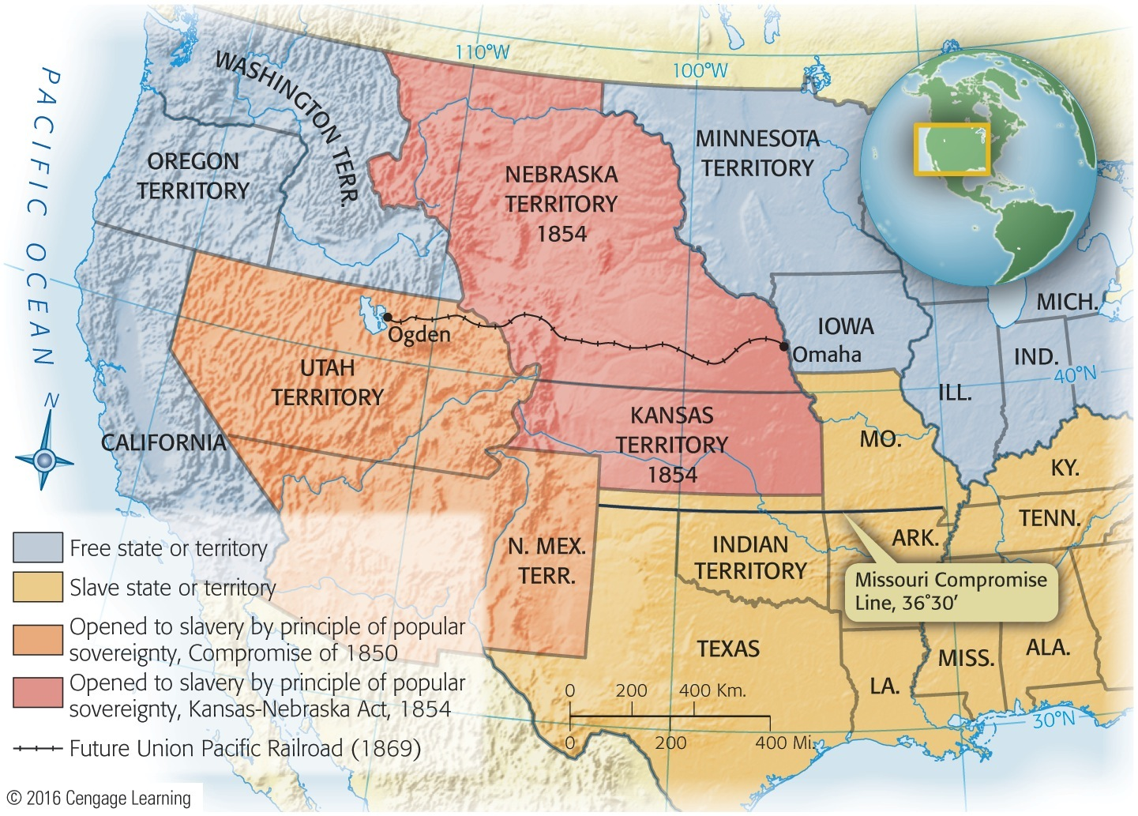
Map 18-7 p396
Notes:
Map 18.7 Kansas and Nebraska,
1854 The future Union Pacific
Railroad (completed in 1869) is shown.
Note the Missouri Compromise line
of 36° 30' (1820). © 2016 Cengage Learning

Slide 38
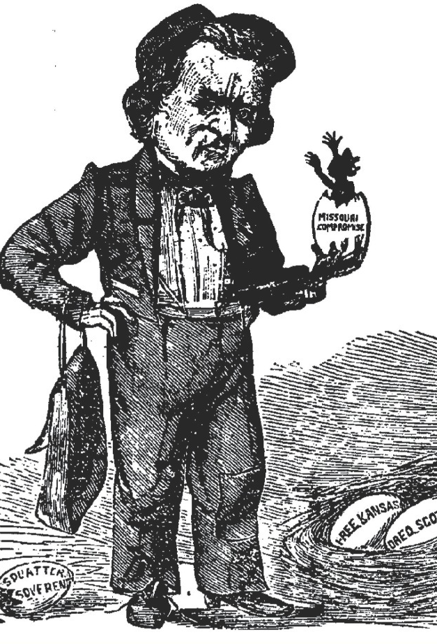
XIII. Douglas's Kansas-Nebraska Scheme
Only way to open region to popular sovereignty was to repeal Missouri Compromise
To southerners here was chance for another slave state
President Pierce threw support to Kansas-Nebraska Bill
Douglas rammed bill through Congress, with strong support from many southerners
Douglas acted impulsively and recklessly
Predicted opposition in North, but grossly underestimated it

Slide 39
XIV. Congress Legislates a Civil War
Kansas-Nebraska Act:
One of most momentous measures to pass Congress
Greased slippery slope to Civil War:
Infuriated antislavery northerners
Future compromise would be much more difficult
Fugitive Slave Law of 1850 became dead letter
Act wrecked two compromises—of 1820 and of 1850
Northern abolitionists and southern “fire-eaters” saw less and less they could live with
Ranks of antislaveryites gained numerous recruits
Democratic Party shattered by Kansas-Nebraska Act
Most durable offspring of Kansas-Nebraska blunder was new Republican Party

Slide 40
XIV. Congress Legislates a Civil War
Republican Party:
Sprang up in Middle West—Wisconsin & Michigan
Gathered dissatisfied elements, including Whigs, Democrats, Free-Soilers, Know-Nothings, and other foes of Kansas-Nebraska Act
Also included Abraham Lincoln
Grew rapidly, but a sectional party
Not accepted South of Mason-Dixon line
Union in dire peril

