Slide 1
Forging the National Economy
Chapter 14

Slide 2
I. The Westward Movement
Rise of Andrew Jackson, first president from beyond Appalachians, exemplified movement west
Late 1850s:
Half of Americans under age of 30
By 1840 “demographic center” of population map had crossed Alleghenies (see Map 14.1)
By 1860, it had crossed Ohio River
Life across Ohio River:
Downright grim for most pioneer families
Suffered diseases, depression, and premature death
Unbearable loneliness, especially for women
Breakdowns and madness were frequent
Frontier life could be tough and crude for men as well

Slide 3
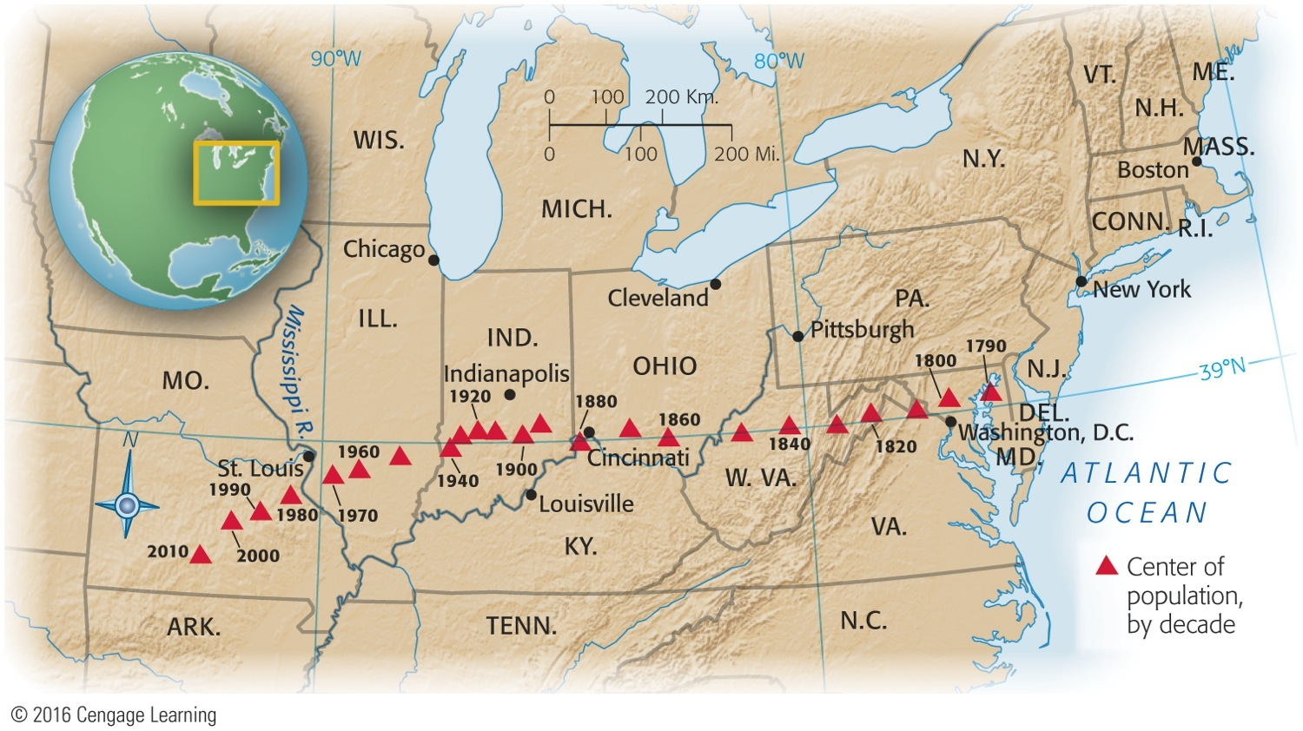
Map 14-1 p279
Notes:
Map 14.1 Westward Movement of Center of Population, 1790–2010 The triangles
indicate the points at which a map of the United States weighted for the population of
the country in a given year would balance. Note the remarkable equilibrium of the north south
pull from 1790 to about 1940, and the strong spurt west and south thereafter. The
1980 census revealed that the nation’s center of population had at last moved west of the
Mississippi River. The map also shows the slowing of the westward movement between
1890 and 1940—the period of heaviest immigration from Europe, which ended up mainly
in East Coast cities. © 2016 Cengage Learning

Slide 4
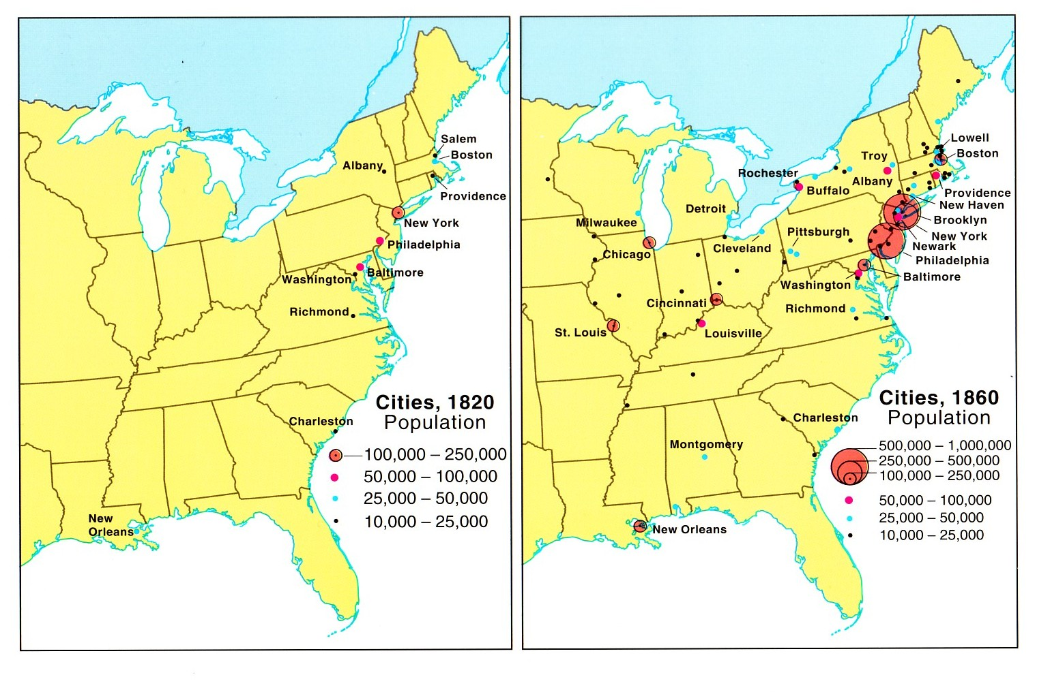

Slide 5
II. Shaping the Western Landscape
Westward movement molded physical environment:
By 1820s trappers active in vast Rocky Mountain region
Fur-trapping empire based on rendezvous (French for “meeting”) system
Trappers and Indians come together to trade beaver pelts for manufactured goods from East
Beaver all but disappeared from region
Buffalo were also almost annihilated
On California coast, traders sought sea-otter pelts, driving them to point of near-extinction
Some have called this aggressive, heedless exploitation of West's natural bounty ecological imperialism.
Yet Americans revered nature and admired its beauty
Many found wild, unspoiled character of land, esp. the West, to be among young nation's defining attributes

Slide 6
II. Shaping the Western Landscape (cont.)
America had pristine, natural beauty, unspoiled by human hands
This national mystique inspired literature, painting, and a powerful conservation movement:
George Catlin, painter and student of Native American life, was among the first to advocate preservation of nature as deliberate national policy
Proposed creation of a national park in 1830s:
Started with Yellowstone Park in 1872

Slide 7
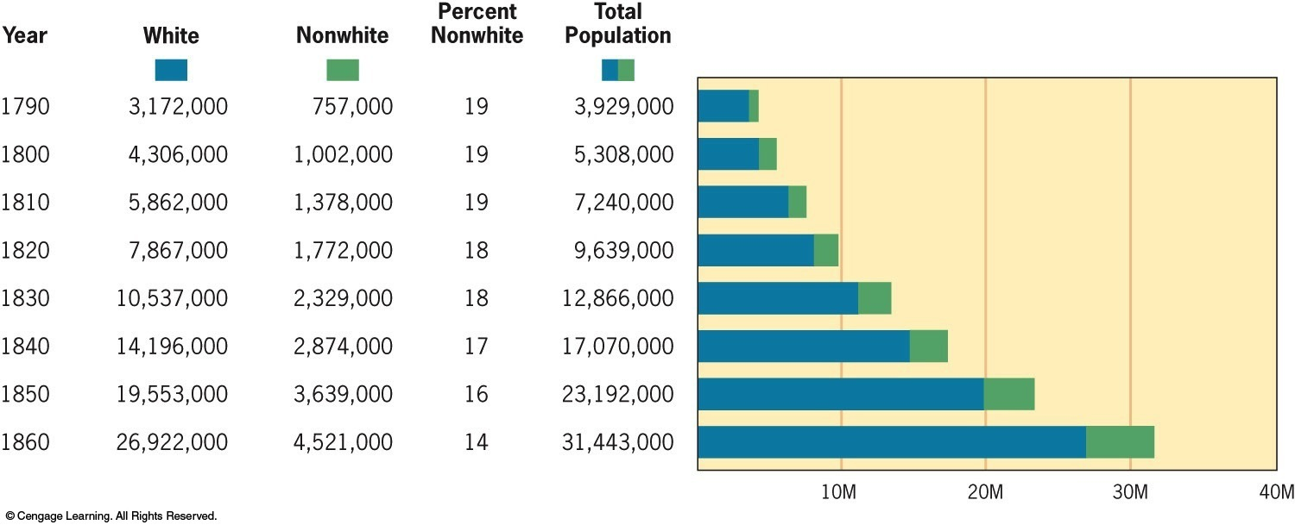
III. The March of the Millions
As American people moved West, they multiplied at an amazing rate:
By midcentury, population doubled every twenty-five years (see Figure 14:1)
By 1860, thirteen colonies had more than doubled in numbers; 33 stars graced flag
U.S.A. was fourth most populous nation in western world: exceeded by Russia, France, and Austria

Slide 8
III. The March of the Millions (cont.)
Urban growth continued explosively:
1790 only two American cities that could boast populations of 20,000—Philadelphia, New York
1860 there were 43 and 300 claimed over 5,000
New York was metropolis; New Orleans, “Queen of the South;” and Chicago, swaggering lord of Midwest—destined to be “hog butcher for the world”
Over-rapid urbanization brought undesirable by-products:
Smelly slums, inadequate policing, impure water, foul sewage, ravenous rats, and improper garbage disposal
Boston (1823) pioneered sewer system
New York (1842) abandoned wells and cisterns for piped-in water supply, thus eliminating breeding place for disease-carrying mosquitoes

Slide 9
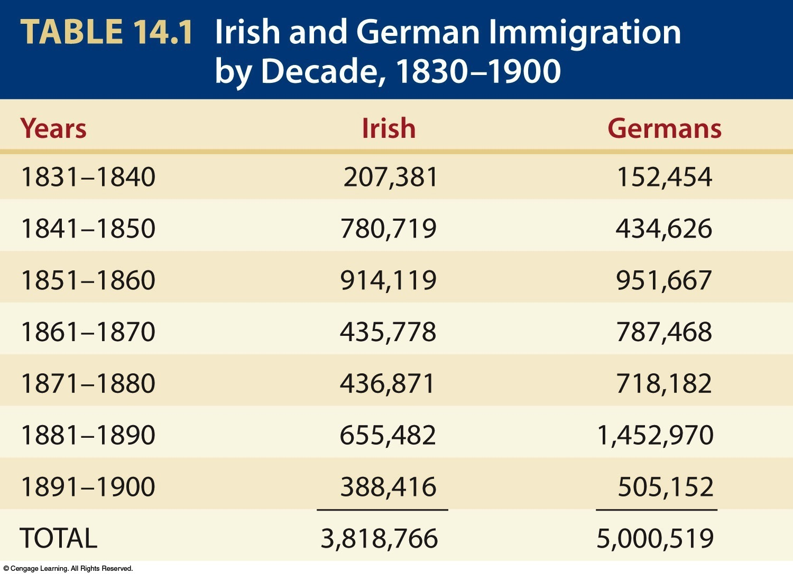
III. The March of the Millions (cont.)
High birthrate accounted for biggest increase in population, but immigration also helped:
By 1830s immigration was 60,000 a year
Influx tripled in 1840s and then quadrupled in the 1850s
During 1840s and 1850s, >1.5 million Irish, and nearly as many Germans came (see Table 14.1)

Slide 10
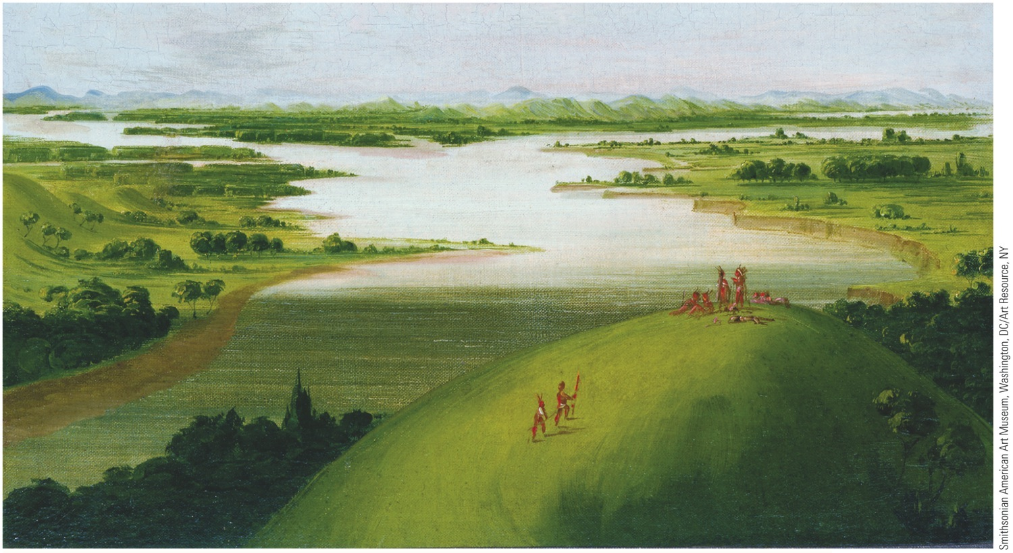
III. The March of the Millions (cont.)
Why did they come?
Because Europe seemed to be running out of room, had “surplus people”
Majority headed for “land of freedom and opportunity”
New transoceanic steamships allowed immigrants to move speedily and cheaply
United States received far more diverse array of immigrants than other countries
U.S.A. received immigrants from dozens of different nations

Slide 11
IV. The Emerald Isle Moves West
Ireland was devastated in mid-1840s:
2 million died as result of potato famine
Tens of thousands fled Land of Famine for Land of Plenty in “Black Forties”
Ireland's great export has been population:
Joined Jews and Africans as dispersed people (see “Makers of America: The Irish”)
Many swarmed into seaboard cities (e.g., Boston)
New York City became largest Irish city in world
Irish did not receive red-carpet treatment
Friendless “famine Irish” forced to fend for themselves:
Ancient Order of Hibernians, semisecret society founded in Ireland to fight rapacious landlords, served in America as benevolent society, ailing downtrodden
Helped spawn Molly Maguires, shadowy Irish miners' union that rocked Pennsylvania coal districts in 1860s and 1870s

Slide 12
IV. The Emerald Isle Moves West
Irish conditions in America:
Tended to remain in low-skill occupations
Gradually improved their lot, usually by acquiring modest amounts of property
Education of children was often cut short
Property ownership counted as a grand “success”
Politics attracted Gaelic newcomers
Gained control of powerful city machines, esp. New York's Tammany Hall, and reaped patronage rewards

Slide 13
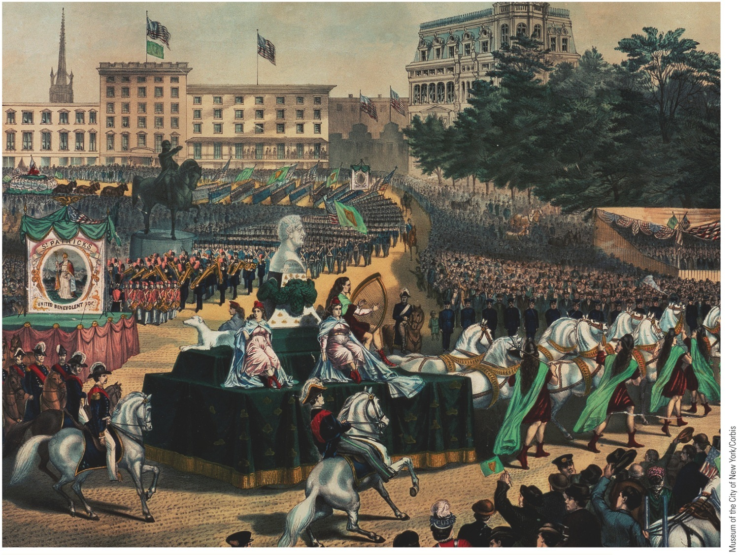
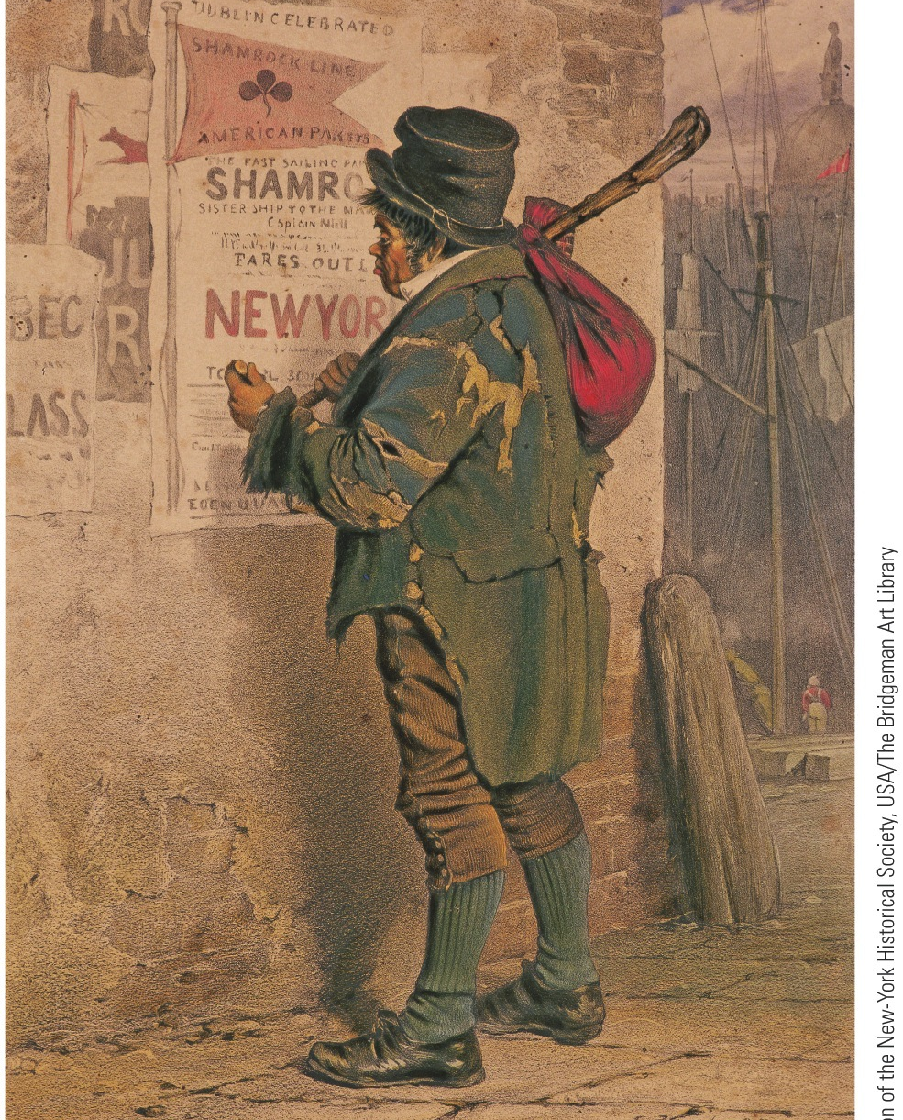
Notes:
Outward Bound, the Quay at Dublin, 1854 Thousands
fled famine in Ireland by coming to America in
the 1840s and 1850s.

Slide 14
V. The German Forty-Eighters
Influx of refugees from Germany b/t 1830 and 1860 hardly less spectacular than from Ireland:
>1.5 Germans stepped onto American soil (see “Makers of America: The Germans”)
Bulk were uprooted farmers
Some were liberal political refugees
Germany's loss was America's gain: Carl Schurz became relentless foe of slavery and public corruption
Germans:
Possessed modest amount of materials goods
Most pushed to lush lands of Middle West, influences still there today.
Formed influential body of voters wooed by politicians
Less potent politically than Irish since were more widely scattered

Slide 15
V. The German Forty-Eighters (cont.)
German influence in shaping American life:
Conestoga wagon, Kentucky rifle, and Christmas tree all German contributions
Supported public schools, including Kindergarten (children's garden)
Promoted music and arts
Relentless enemies of slavery
Sometimes dubbed “damned Dutchmen” and regarded with suspicion:
Seeking to preserve language and customs, they settled in compact “colonies” aloof from surrounding communities
Accustomed to “Continental Sunday,” they made merry on Sunday
Their Old World drinking habits further spurred advocates of temperance

Slide 16
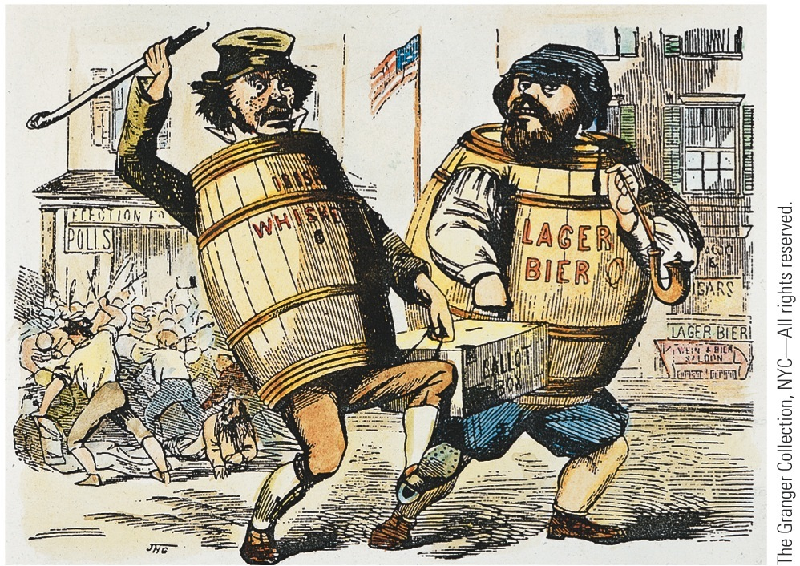
p286
Notes:
Crooked Voting A bitter “nativist” cartoon charging
Irish and German immigrants with “stealing” elections.

Slide 17
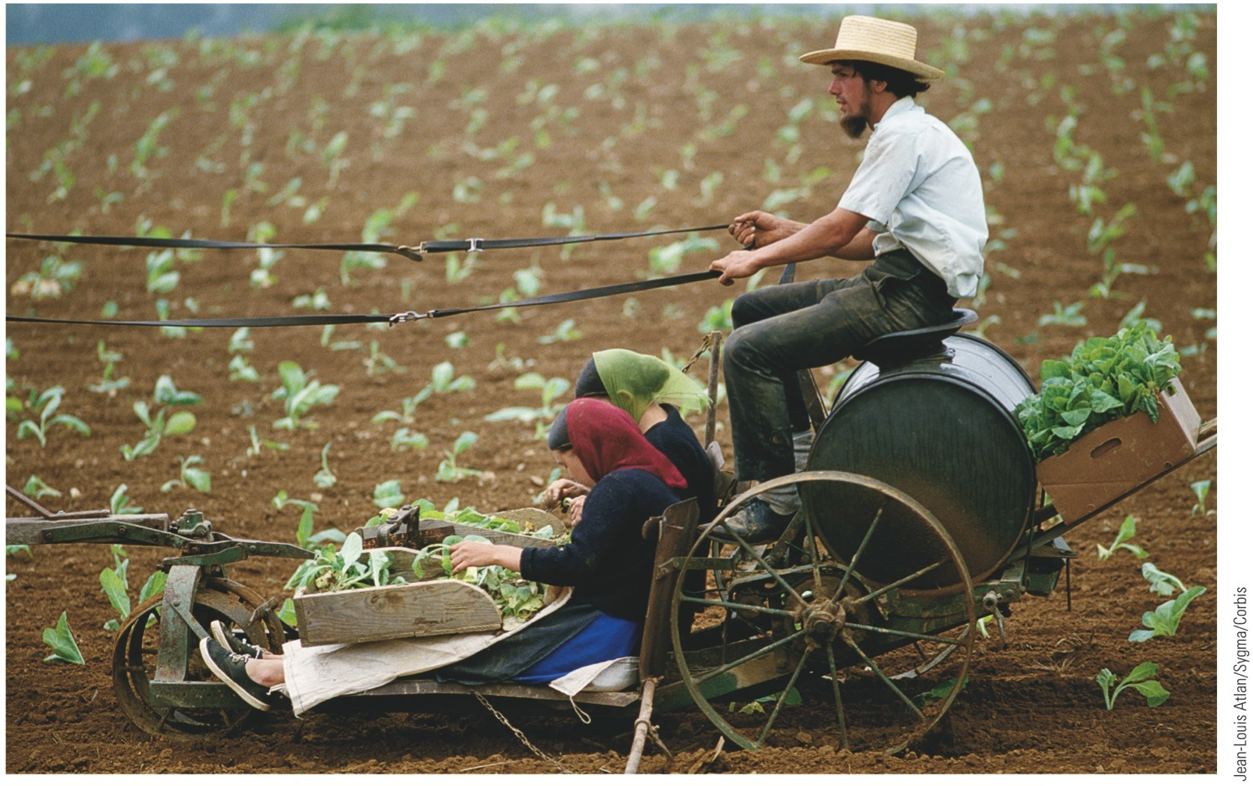
p289
Notes:
Amish Country, Near Lancaster, Pennsylvania For more than two centuries, the Amish
people have preserved their traditional way of life.

Slide 18
VI. Flare-ups of Antiforeignism
Influx of immigrants in 1840s and 1850s inflamed prejudices of American “nativists:”
Feared immigrants would outbreed, outvote, and overwhelm “native” stock
Also took jobs from “native” Americans
As Roman Catholics were regarded by many old-line Americans as following a “foreign” church
Roman Catholics on the move:
To avoid Protestant indoctrination in public schools, began in 1840s to construct separate Catholic educational system:
Expensive, revealed strength of religious commitment
With Irish and German influx, Catholics became large religious group:
In 1840 ranked fifth behind Baptists, Methodists, Presbyterians and Congregationalists

Slide 19
VI. Flare-ups of Antiforeignism (cont.)
Know-Nothing Party—organized by “nativists” for political action:
Agitated for rigid restriction on immigration and naturalization
Agitated for laws authorizing deportation of alien paupers
Promoted lurid literature of exposure, much of it pure fiction
Example: Maria Monk's Awful Disclosures
Occasional mass violence against Catholics:
Burned churches and schools
Some killed and wounded in days of fighting
Immigrants made U.S.A. one of most ethnically and racially diverse societies in world.
Not surprising that cultural clashes occurred.

Slide 20
VI. Flare-ups of Antiforeignism (cont.)
American economy:
Attracted immigrants and ensured them share of wealth without jeopardizing wealth of others
Immigrants helped fuel economic expansion
Immigrants and American economy needed each other
Together they helped bring Industrial Revolution

Slide 21
VII. Creeping Mechanization
British inventors in 1750s perfected series of machines for mass production of textiles:
Harnessed steam to usher in modern factory system of Industrial Revolution
Spectacular transformation in agricultural production
As well as methods of transportation and communication
Factory system slowly spread from Britain, “the world's workshop”.
Why was America slow to industrialize?
Land was cheap
Labor was scarce
Money for capital investment was scarce

Slide 22
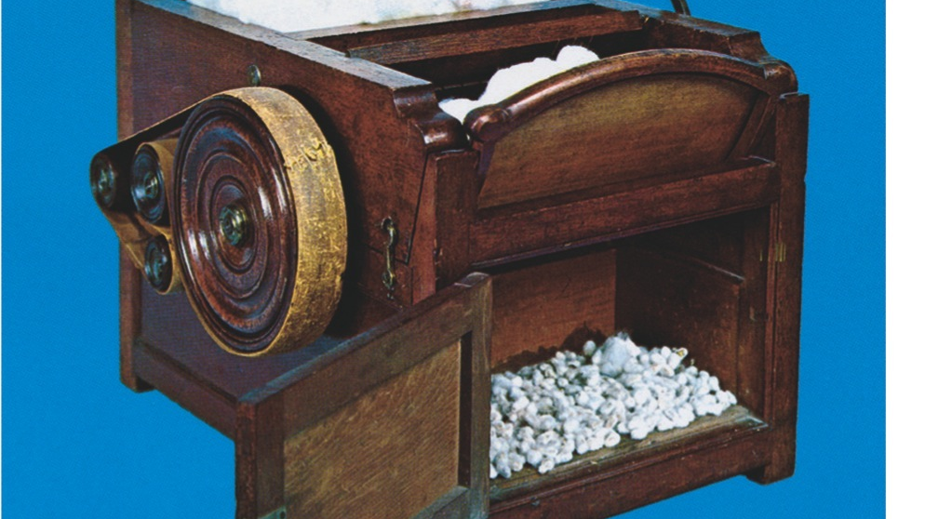
VIII. Whitney Ends the Fiber Famine
Samuel Slater— “Father of Factory System”
After memorizing plans for machinery, he escaped to America
Won backing of capitalist Moses Brown
Reconstructed essential apparatus in 1791
Thus put together 1st efficient machinery for spinning cotton thread in America
Problem was accessing cotton fiber
Eli Whitney's cotton gin solved problem

Slide 23
VIII. Whitney Ends the Fiber Famine (cont.)
Momentous effects of cotton gin:
Planters cleared more and more land for cotton
Cotton Kingdom pushed westward
Insatiable demand for cotton riveted chains of slavery more tightly on southern blacks
Yankee machines put out avalanches of textiles
America's Industrial Revolution first blossomed in cotton textiles
Factories 1st flourished in New England, then branched out to NY, NJ, Pennsylvania
The South:
Increasingly wedded to growing cotton
Little manufacturing
Capital invested in slaves
Local consumers for most part desperately poor

Slide 24
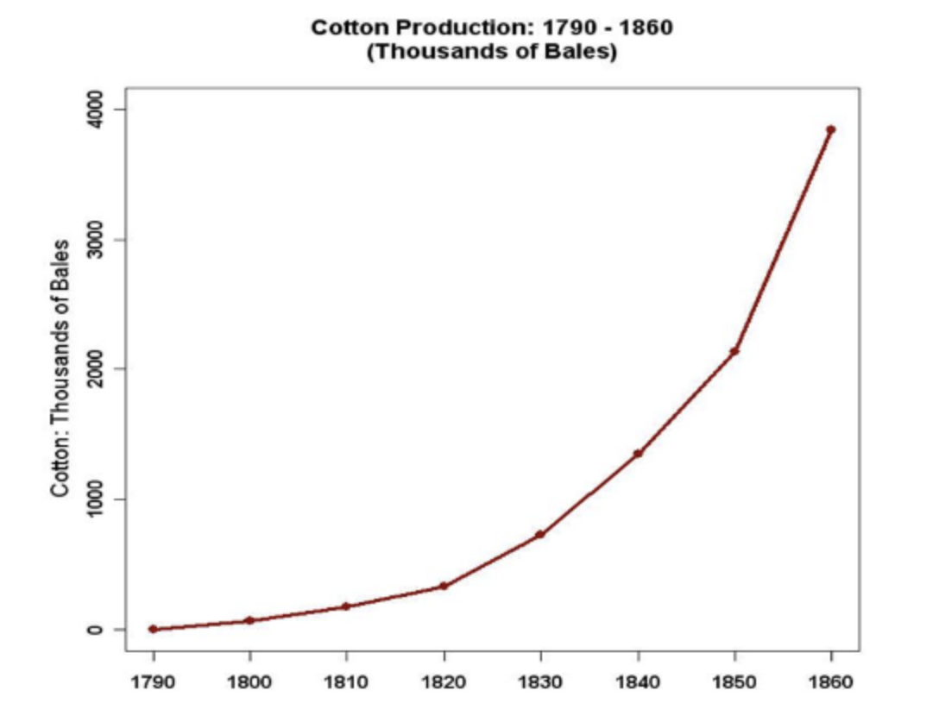
Whitney expands slavery?
The cotton gin invention solved the biggest problem with harvesting cotton: getting the seeds out of it.
Productivity for seed pickers expended 40-50 FOLD. So 1 worker now could do what a company needed 40-50 workers to do before.
As a result, the push to grow and get cotton explodes in the South, and who does that work?

Slide 25
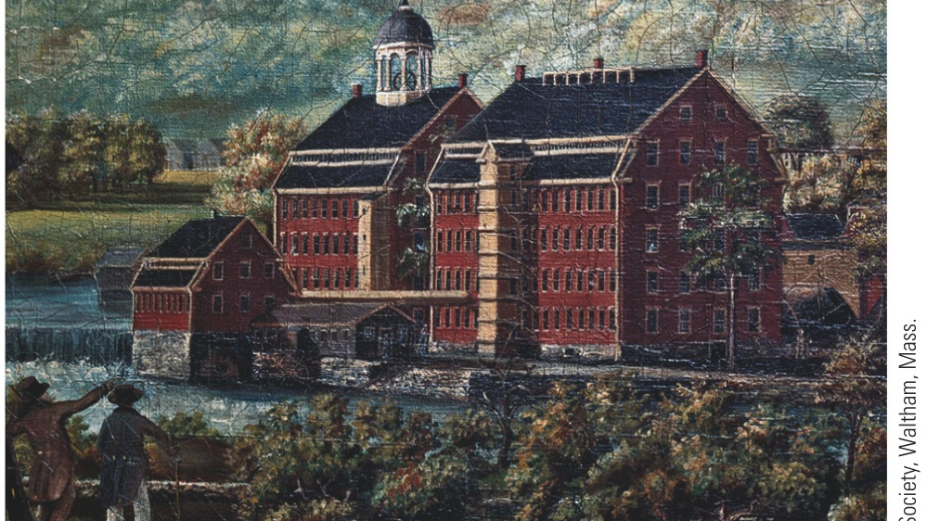
VIII. Whitney Ends the Fiber Famine (cont.)
New England favored as industrial center because:
Stony soil made farming difficult and manufacturing attractive
Dense population provided labor and markets
Seaports provided easy import of raw materials and export of finished products
Rivers provided abundant water power
By 1860, >400 million pounds of southern cotton poured into mills, mostly in New England

Slide 26
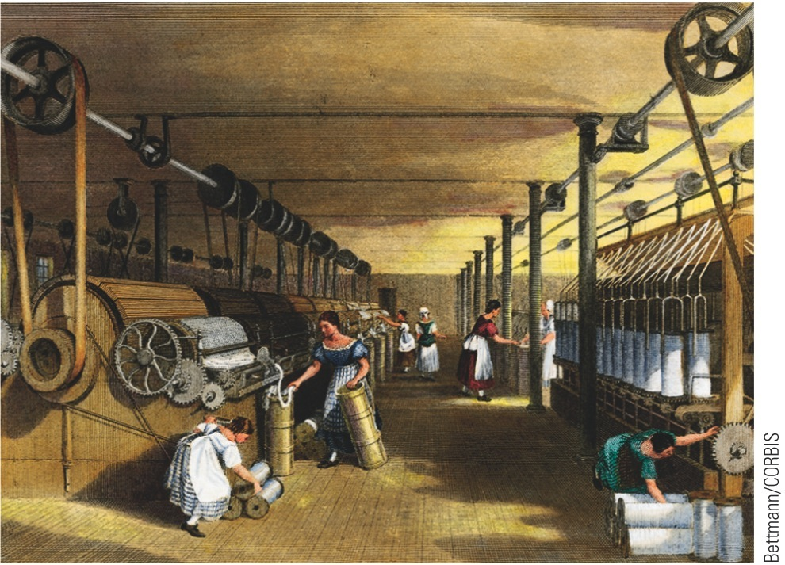
p290
Notes:
Francis Cabot Lowell’s Mill, Waltham, Massachusetts, 1826, and Cotton Industry; Carding,
Drawing, and Roving; Engraving, 1835 Built in 1814, Lowell’s mill (left) was a marvel of
manufacturing efficiency. It combined all phases of production, including spinning and weaving,
under one roof. The mill’s labor force (right) was composed primarily of young women from the
local farming communities.

Slide 27
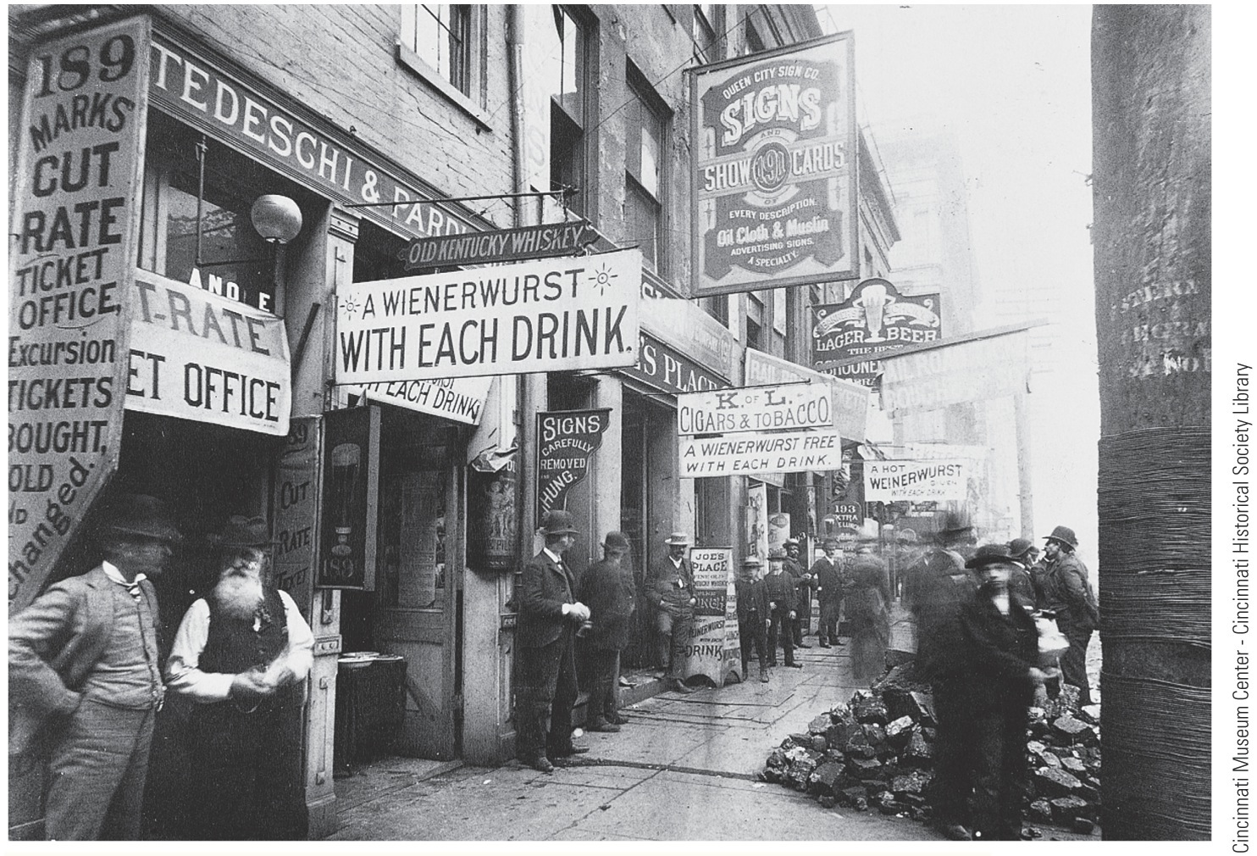
p288
Notes:
“Little Germany” Cincinnati’s “Over-the-Rhine” district in 1887.

Slide 28
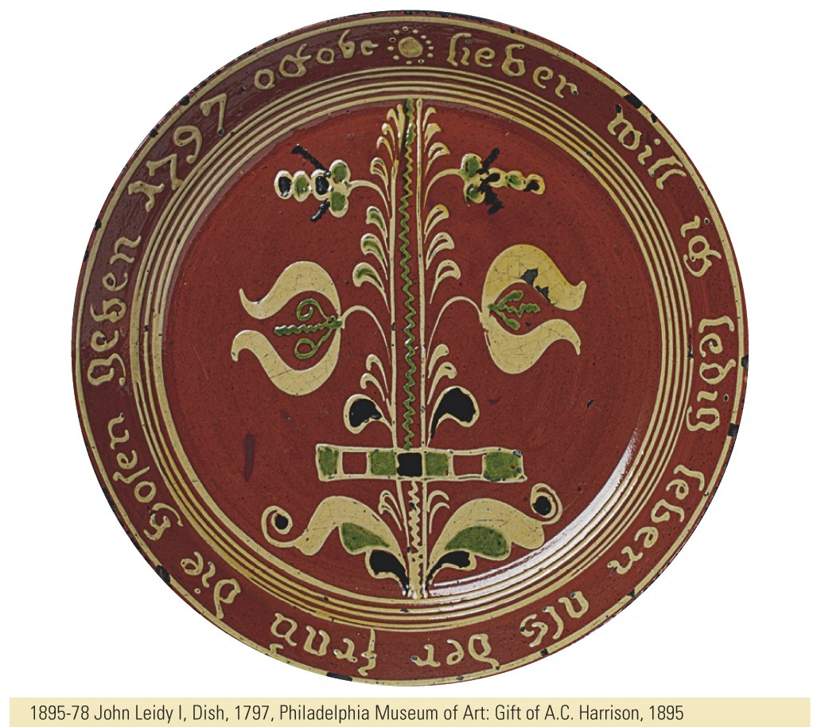
p289
Notes:
Marriage Plate, Bucks County, Pennsylvania, ca.
1806 The Germans who settled the “Pennsylvania
Dutch” communities in the eighteenth century preserved
ancient traditions of handicraft and art, as exemplified by
this whimsical “marriage plate” made by a sixteen-year old
potter named John Leidy. The inscription reads,
“Rather would I single live than the wife the breeches
[trousers] give.”
1895-78 John Leidy I, Dish, 1797, Philadelphia Museum of Art: Gift of A.C. Harrison, 1895

Slide 29
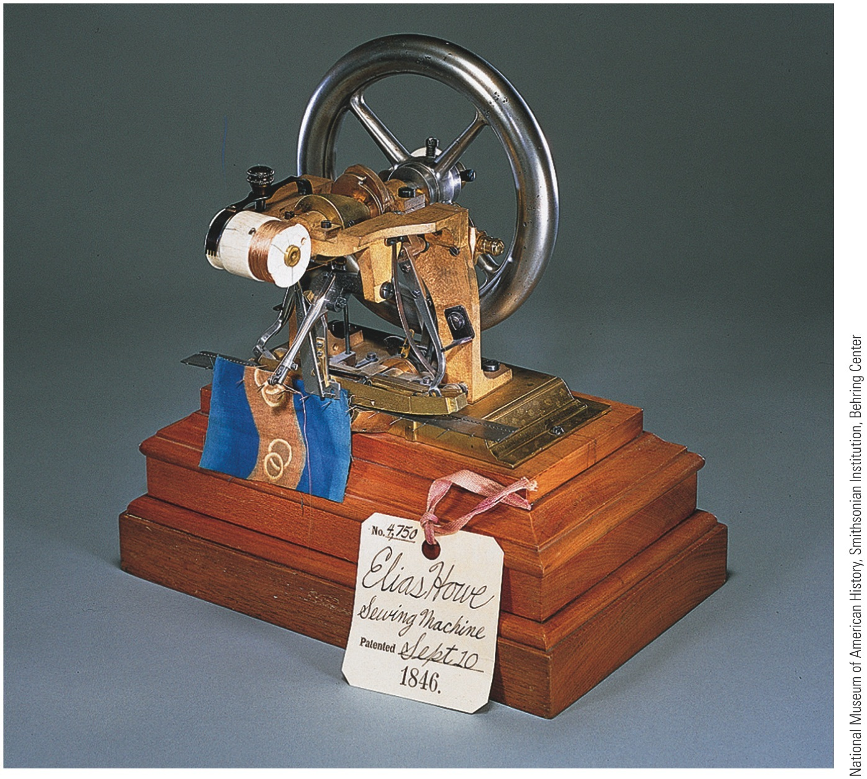
IX. Marvels in Manufacturing (cont.)
Sewing machine:
Invented by Elias Howe in 1846
Perfected by Isaac Singer
Strong boost to northern industrialization
Foundation of ready-made clothing
Moved sewing from private homes to factory

Slide 30
IX. Marvels in Manufacturing (cont.)
Each new invention stimulated still more imaginative inventions:
Decade ending in 1800: only 306 patents registered
Decade ending in 1860: 28,000 patents registered
Key changes in form and legal status of business organizations:
Principle of limited liability aided concentration of capital
Boston Associates created by 15 Boston families
Laws of “free incorporation” meant businessmen could create corporations without applying for individual charters from legislature

Slide 31
IX. Marvels in Manufacturing (cont.)
Samuel F. B. Morse:
Invented telegraph
Secured $30,000 from Congress to experiment with “talking wires”
In 1844, strung a wire 40 miles from Washington to Baltimore and tapped out historic message, “What hath God wrought?”

Slide 32
X. Workers and “Wage Slaves”
Factory system created acute labor problem.
Manufacturing had been done in home:
Master craftsman and apprentice worked together
Industrial Revolution submerged personal association into impersonal ownership of factories in “spindle cities” surrounded by hovels of “wage slaves.”

Slide 33
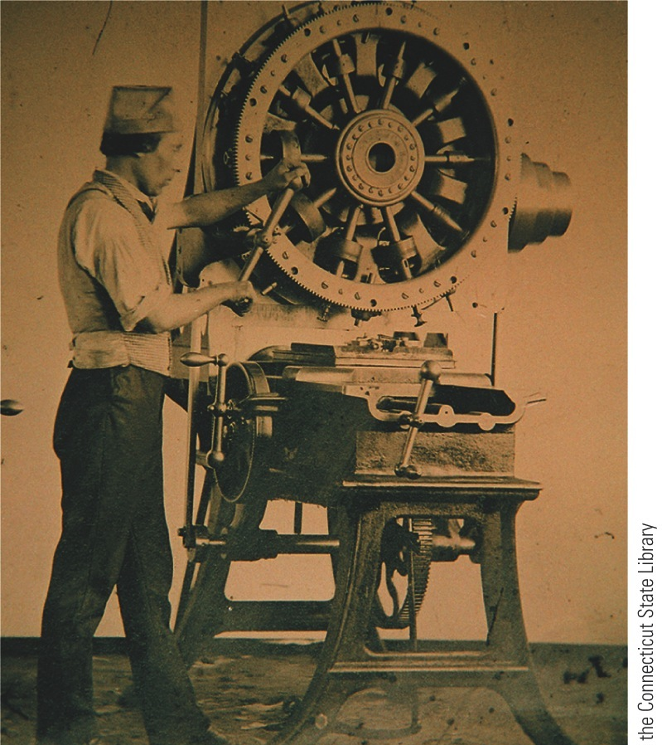
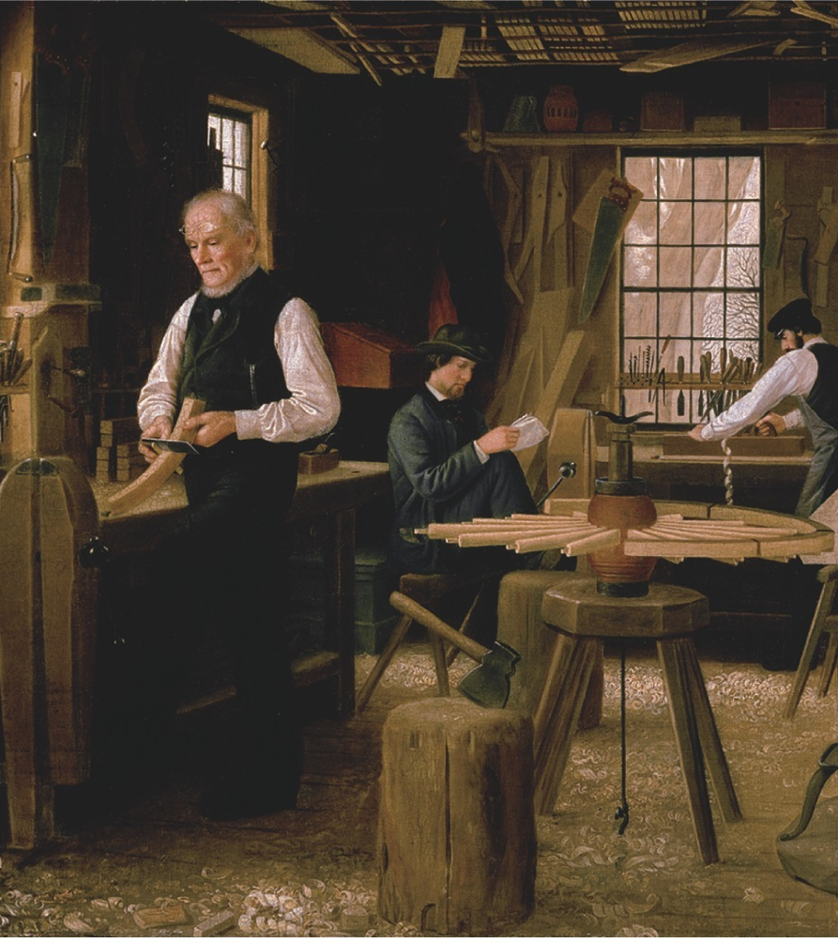
Notes:
Coexistence of the Craftsman’s Shop and the Factory, 1860 These two images recorded workers
laboring in very different kinds of work places in the same year. The painting, “The Wheelwright’s
Shop,” by Edwin Tryon Billings (right), captures the survival of a small-scale, intimate shop producing
hand-made wheels for carts and carriages. The daguerreotype (left) shows an operator working the
Lock Frame Jigging Machine in Samuel Colt’s state-of-the-art Hartford, Connecticut, gun factory. As
different as they were, both jobs required skill and focus.

Slide 34
X. Workers and “Wage Slaves” (cont.)
Workers' conditions:
Hours long, wages low
Meals skimpy and hastily gulped
Workers toiled in unsanitary buildings (poorly ventilated, lighted, heated)
Forbidden to form unions to raise wages
Only 24 recorded strikes before 1835
Exploitation of child labor:
In 1820, many of nation's industrial toilers were children under ten
Victims of factory, children were mentally blighted, emotionally starved, physically stunted, and brutally whipped in special “whipping rooms”
Slater's mill of 1791: first machine tenders were seven boys and two girls, all under 12

Slide 35
X. Workers and “Wage Slaves” (cont.)
Lot of adult wage workers in 1820s-1830s:
Many states granted laboring man the vote
Strove to lightened burden through workingmen's parties
Many workers gave loyalty to Democratic Party of Andrew Jackson
Besides 10-hour day, higher wages, and tolerable working conditions, workers demanded public education and end to imprisonment for debt

Slide 36
X. Workers and “Wage Slaves” (cont.)
Employers fought 10-hour day:
Argued reduced hours would lessen production, increase costs, and demoralize workers
Laborers would have so much leisure time that Devil would lead them to mischief
In 1840 President Van Buren established ten-hour day for federal employees on public works
In later years many states began reducing hours of working people

Slide 37
X. Workers and “Wage Slaves” (cont.)
Day laborers tried to improve their lot:
Strongest weapon was strikes
Dozens of strikes erupted in 1830s and 1840s
Sought higher wages, ten-hour days, and goals such as right to smoke on job
Workers lost more strikes than they won
Employers imported strike-breakers
Labor raised voice against immigrants
Labor's effort to organize:
Some 300,000 trade unionists by 1830
Declined as result of severe depression, 1837
Won promising legal victory in 1842 in Commonwealth v. Hunt
Mass. Supreme Court ruled unions not illegal conspiracies, provided methods were “honorable and peaceful”
Case did not legalize right to strike

Slide 38
XI. Women and the Economy
Women became part of factory production:
Factories undermined work of women in homes
Factories offered work to those displayed
Factory jobs promised greater economic independence for women
And means to buy manufactured products of new market economy
“Factory girls” toiled 6 days a week, 12 to 13 hours “from dark to dark”
Textile mill at Lowell, Mass.:
Workers mostly New England farm girls
Supervised on and off job by watchful matrons
Escorted to church from company boardinghouses
Forbidden to form unions
Few outlets to protest grueling working conditions

Slide 39
XI. Women and the Economy (cont.)
Factory jobs still unusual for women:
Few opportunities to be economically self-supporting (mainly nursing, domestic services, and teaching)
Teaching profession became “feminized” as men left for other opportunities
Other “opportunities” in household service:
One white family in ten employed poor white, immigrant, or black women
10% of white women worked outside home
20% of all women employed at some time before marriage
Vast majority of working women single
Upon marriage, left job to become wives and mothers, without wages

Slide 40
XII. Western Farmers Reap a Revolution in the Fields
Flourishing farms changed face of West:
Trans-Allegheny region—esp. Ohio-Indiana-Illinois tier—fast becoming nation's breadbasket
Before long, would become granary to world
Pioneer families hacked clearing out of forest
Then planted corn fields
Yellow grain amazingly versatile
Most western products first moved by Ohio-Mississippi Rivers
Inventions helped farmers:
John Deere in 1837 produced a steel plow that broke stubborn soil:
Light enough to be pulled by horses, rather than oxen
1830 Cyrus McCormick invented mechanical mower-reaper
Could do work of 5 men with sickles and scythes
To western farmers what cotton gin was to South

Slide 41
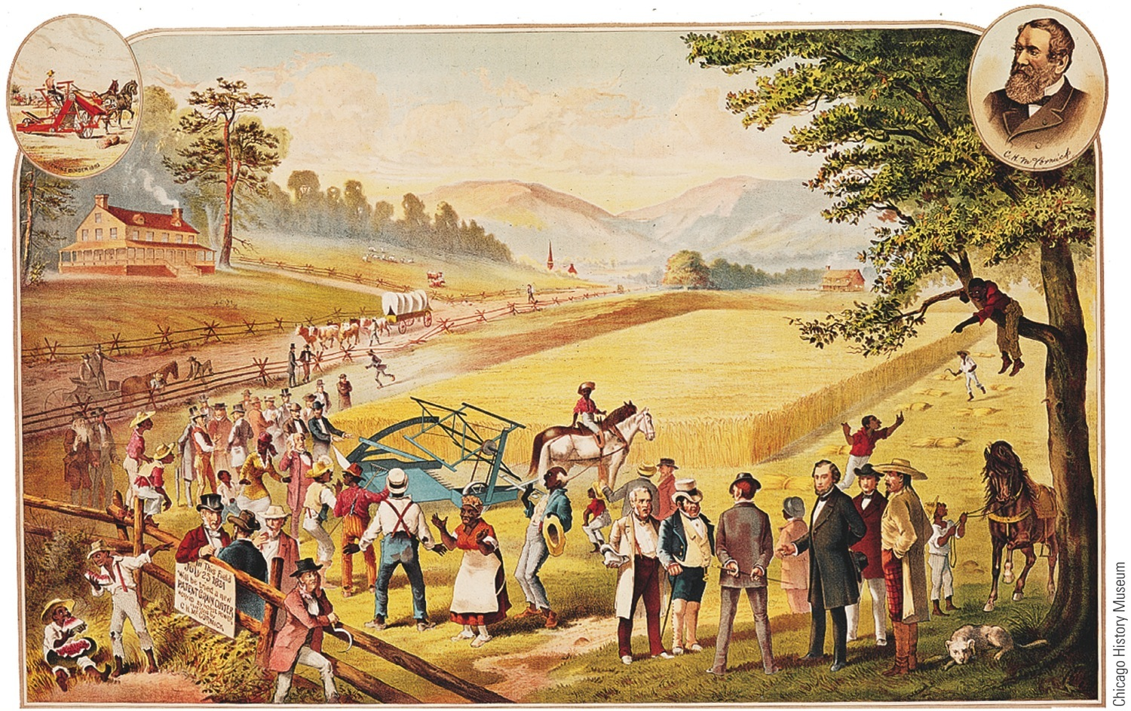
p297
Notes:
McCormick’s Miraculous Reaper This illustration shows an early test of Cyrus
McCormick’s mechanical reaper near his home in Virginia in 1831. The reaper was
best suited, however, to the horizonless fields of wheat on the rolling prairies of the
Midwest. By the 1850s McCormick’s Chicago factory was cranking out more than
twenty thousand reapers a year for midwestern farmers.

Slide 42
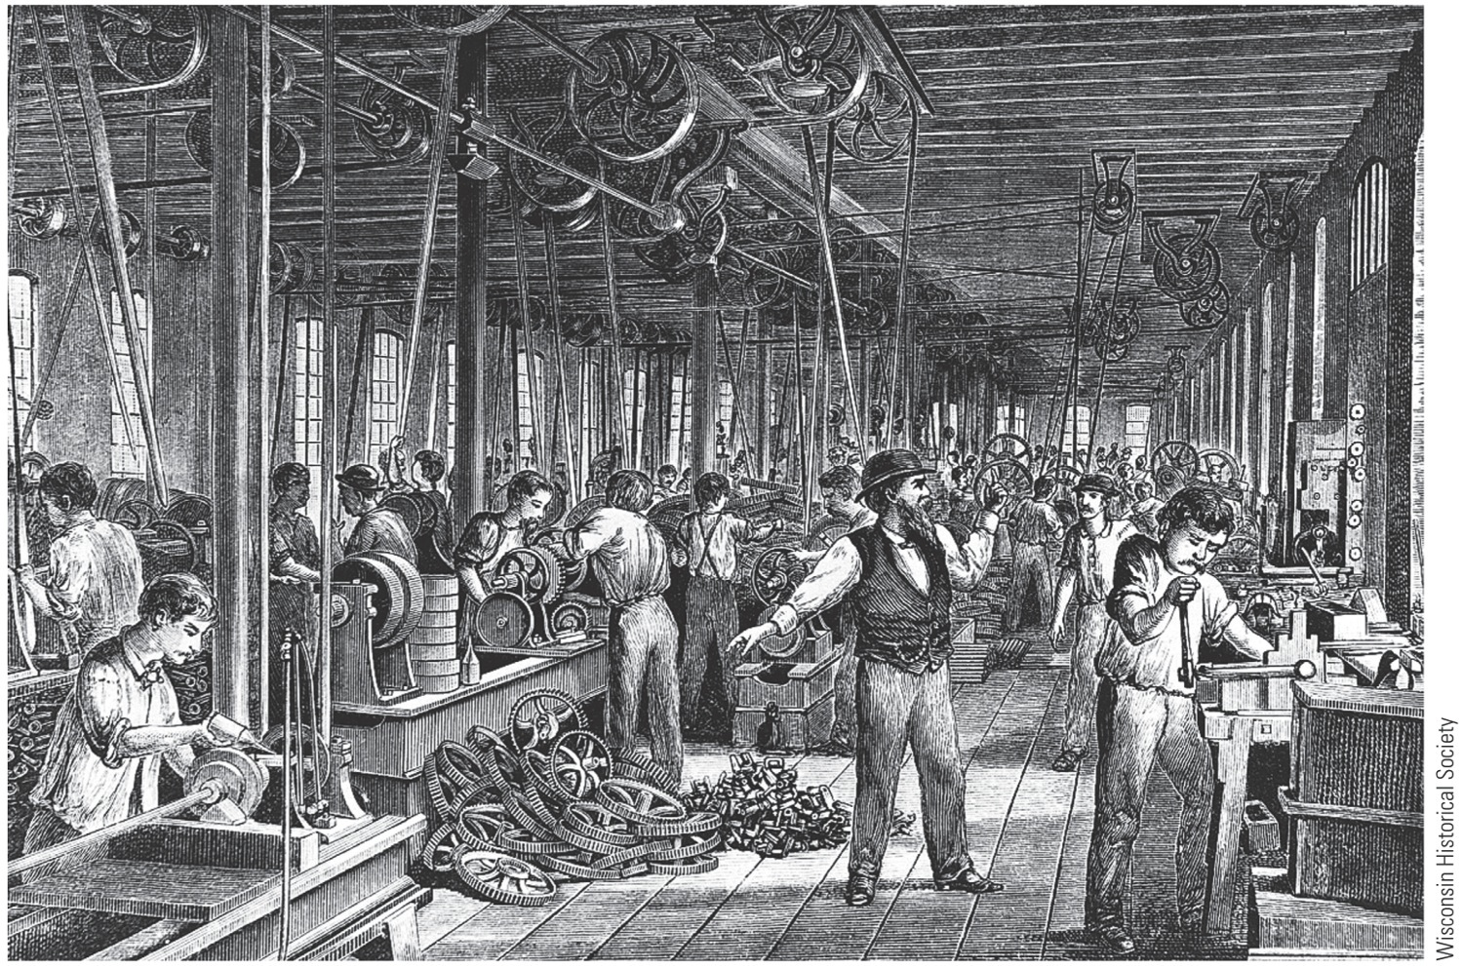
McCormick Reaper Works,
1850s Contrast this hectic
scene of “mass production”
with the simple workplace
depicted in “The Wheelwright’s Shop”
p298

Slide 43
XIII. Highways and Steamboats
In 1789, when Constitution launched, primitive methods of travel still dominated:
Waterborne travel slow, uncertain, often dangerous
Stagecoaches and wagons lurched over bone-shaking roads
Cheap, efficient transportation increasingly needed
In 1790s, private company completed profitable Lancaster Turnpike in Pennsylvania, running 62 miles from Philadelphia to Lancaster

Slide 44
XIII. Highways and Steamboats (cont.)
As driver approached tollgate, they confronted barrier of sharp pikes, which were turned aside when toll paid (hence, turnpike)
Western road building, always expensive, encountered many obstacles:
Noisy states' righters opposed federal aid to local projects
Eastern states protested against being bled of populations by westward-reaching arteries
Westerners scored key triumph in 1811 when federal government started construction of National Road—known as Cumberland Road

Slide 45
XIII. Highways and Steamboats (cont.)
Robert Fulton started steamboat craze:
Installed powerful steam engine on Clermont:
In 1807, it went from New York City up Hudson River to Albany—150 miles in 32 hours
Success of steamboat was sensational
Fulton changed all of America's navigable streams into two-way arteries, doubling carrying capacity
(1820): 60 steamboats on Mississippi and tributaries
(1860): 1,000

Slide 46
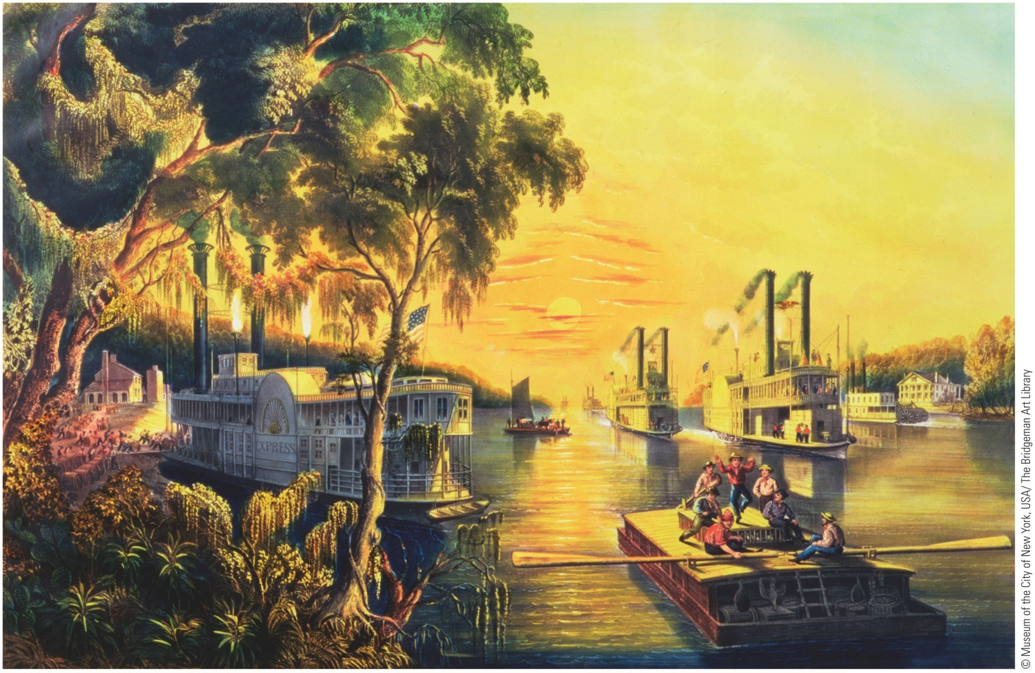
p299
Notes:
Mississippi in Time of Peace, by Mrs. Frances Flora Bond Palmer, 1865 By the mid-nineteenth
century, steamboats had made the Mississippi a bustling river highway—as it remains today.

Slide 47
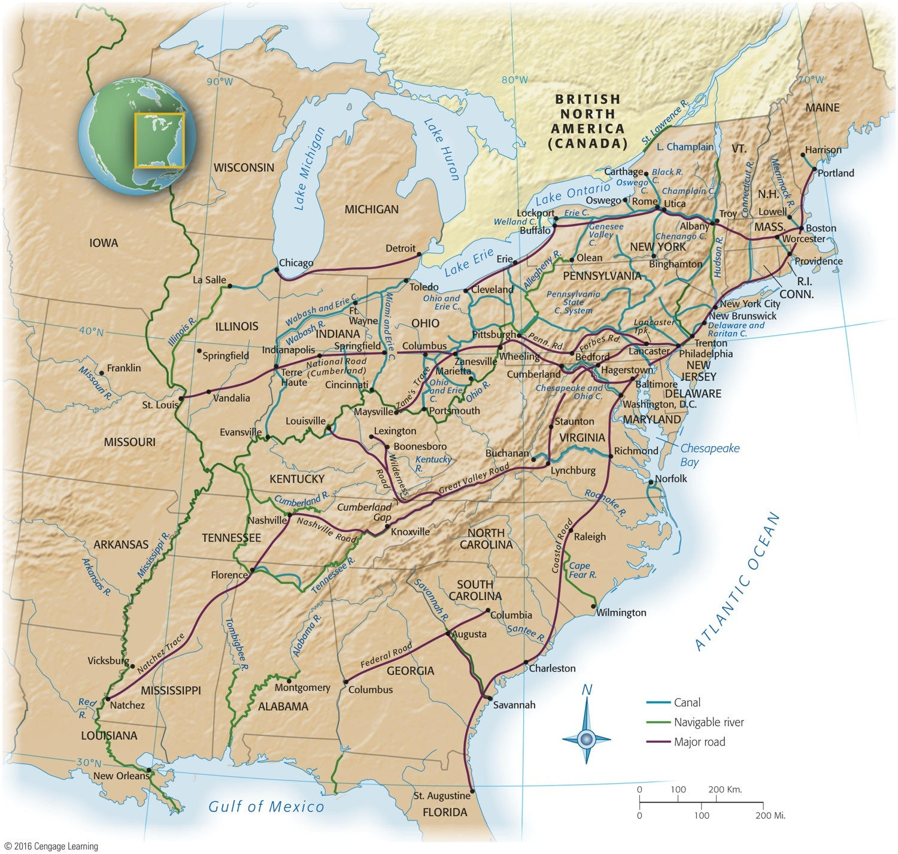
Canal-cutting craze paralleled boom in turnpikes and steamboats (see Map 14.2):
New Yorkers, denied federal aid by states' righters, funded Erie Canal themselves to link Great Lakes with Hudson River
Begun in 1817, canal stretched 363 miles from Buffalo on Lake Erie, to Hudson River, onto New York harbor
Shipping sped up as cost/time dropped significantly
Map 14-2 p300
Notes:
Map 14.2 Major Rivers, Roads, and Canals, 1825–1860 © 2016 Cengage Learning

Slide 48
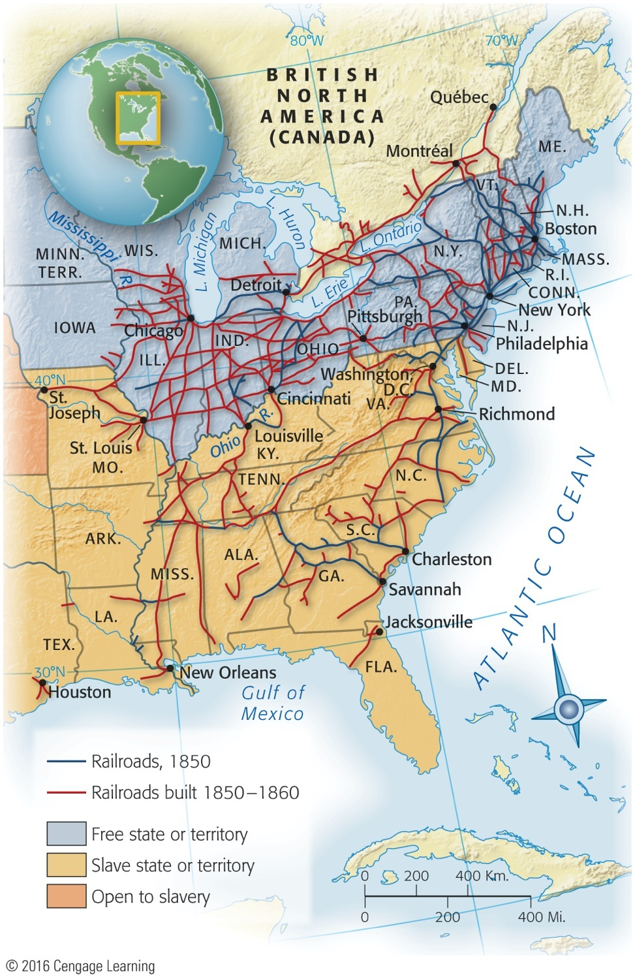
XV. The Iron Horse
Development of railroad:
Fast, reliable, cheaper than canals to construct, and not frozen over in winter
Able to go anywhere—it defied terrain and weather
First railroad appeared in 1828 and new lines spread swiftly
Faced strong opposition from canal builders
Other obstacles:
Brakes so feeble that engineers might miss station
Arrivals and departures were conjectural
Differences in gauge required passengers to make frequent changes of trains

Slide 49
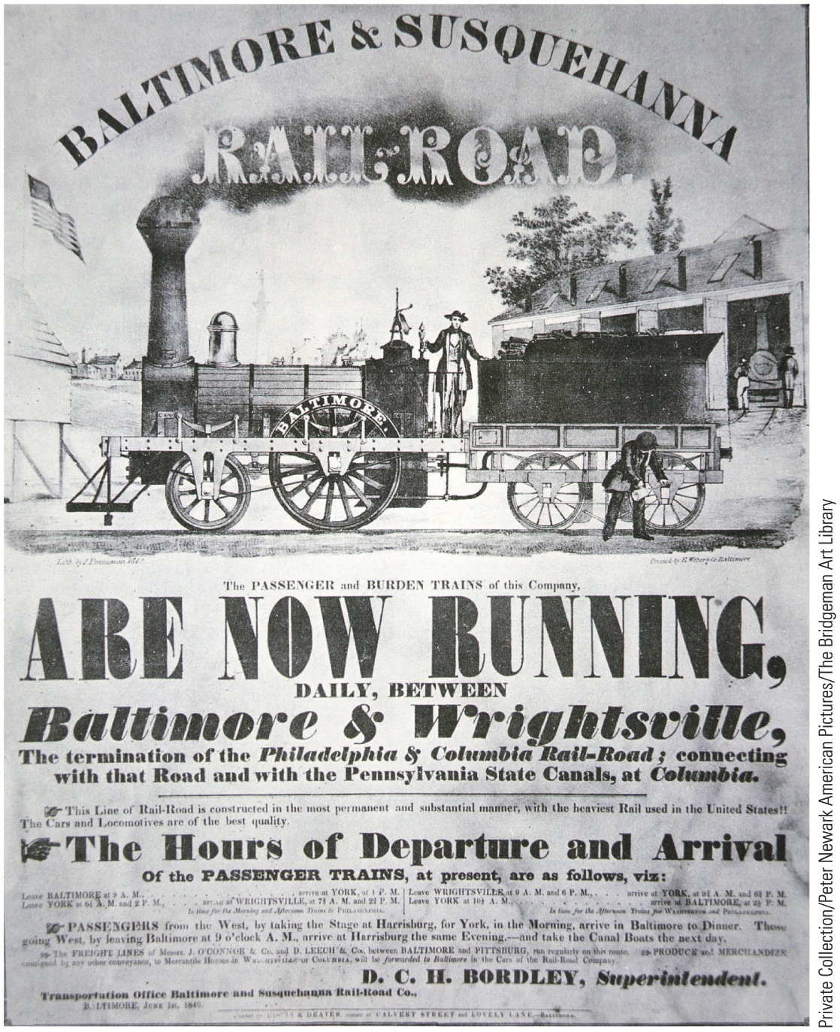
p302
Notes:
Poster-Timetable for Baltimore & Susquehanna
Railroad, 1840 Advertising the Baltimore & Susquehanna’s
train schedule alone was not sufficient to get
passengers to their destinations. A typical trip often
entailed coordinating legs on other railroad lines,
stagecoaches, and canal boats.

Slide 50
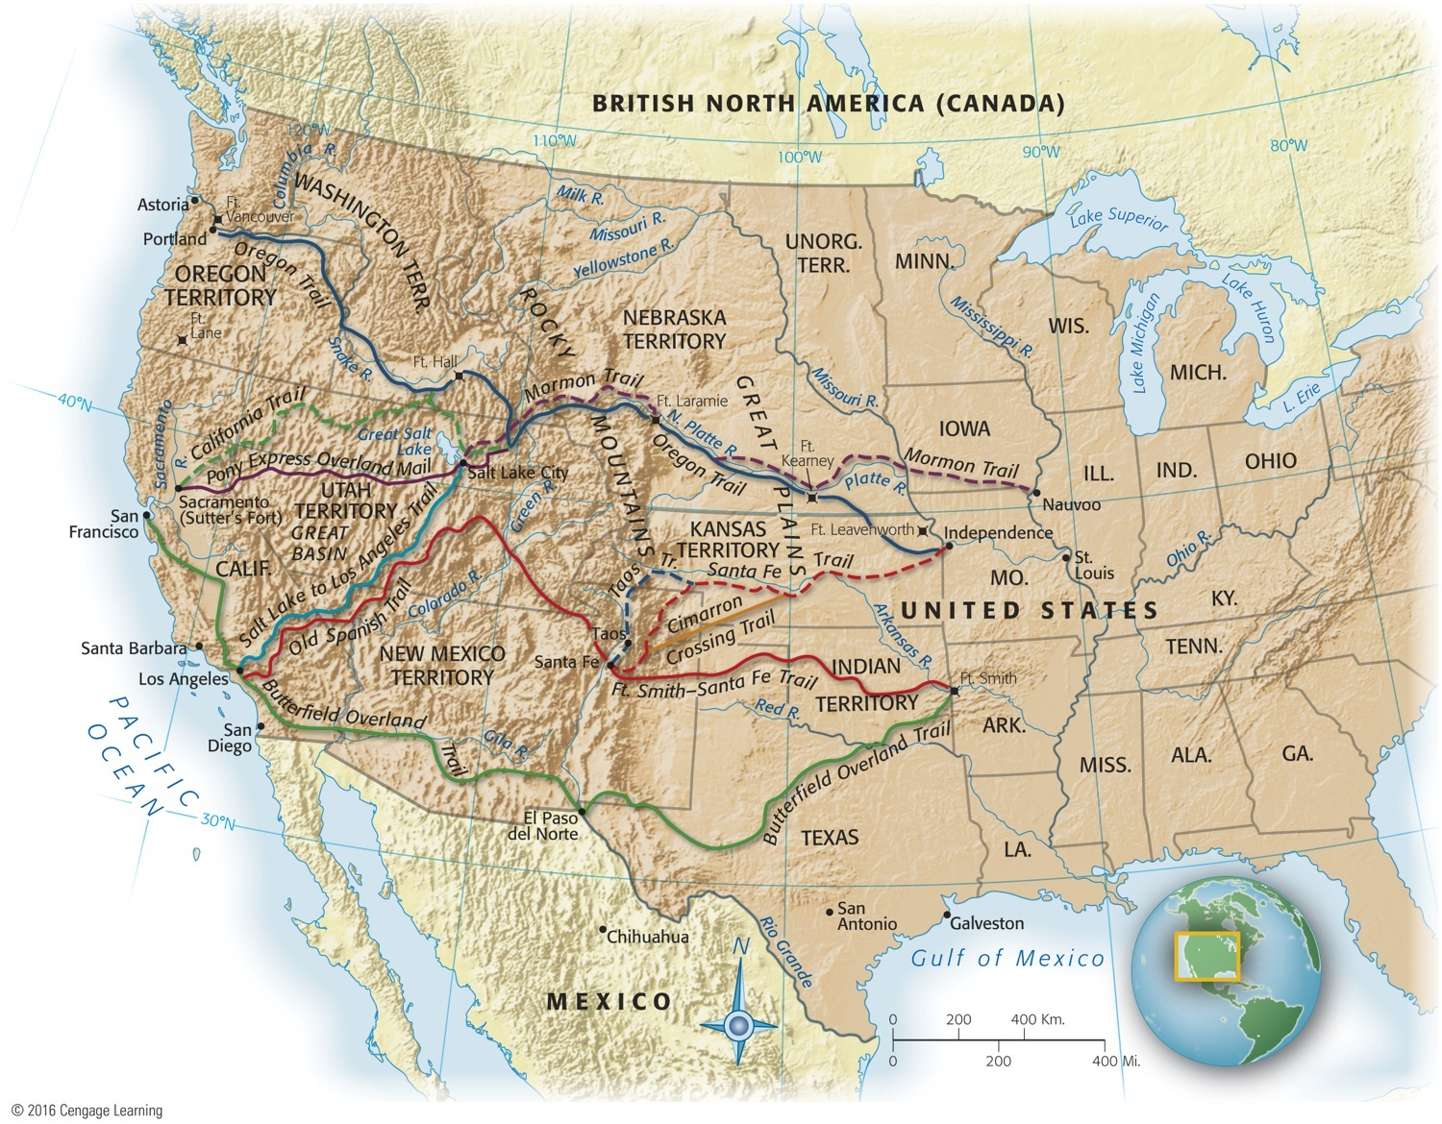
Map 14-4 p303
Notes:
Map 14.4 Main Routes West Before the Civil War Mark Twain described his stagecoach trip to
California in the 1860s in Roughing It: “We began to get into country, now, threaded here and there with
little streams. These had high, steep banks on each side, and every time we flew down one bank and
scrambled up the other, our party inside got mixed somewhat. First we would all be down in a pile at the
forward end of the stage, . . . and in a second we would shoot to the other end, and stand on our heads.
And . . . as the dust rose from the tumult, we would all sneeze in chorus, and the majority of us would
grumble, and probably say some hasty thing, like: ‘Take your elbow out of my ribs!—can’t you
quit crowding?’” © 2016 Cengage Learning

Slide 51
XVII. The Transport Web Binds the Union
Transportation revolution:
Stimulated by desire of East to tap West
Western rivers drained southward to cotton belt
Steamboats reversed flow by bringing finished goods to West and helped bind West and South together
Three decades before Civil War, canals and railroads from East tied seaboard with blossoming heartland
Impressive grid of “internal improvements” established
By 1860, a truly continental economy had emerged
Division of labor applied on a national level
Each region specialized in particular type of economic activity
South raised cotton
West grew grain and livestock
East made machines and textiles
Economic pattern had fateful political and military implications:
Many southerners regarded Mississippi as a chain linking upper valley states to southern Cotton Kingdom
They believed some or all of these states would secede with them or be strangled

Slide 52
XVIII. The Market Revolution
Market Revolution:
Transformed subsistence economy of scattered farms and tiny workshops into national network of industry and commerce (see Map 14.5)
Greater mechanization and robust market-oriented economy raised new legal questions:
How tightly should patents protect inventions?
Should government regulate monopolies?
Who should own technologies and networks?
Chief Justice John Marshall's Court protected contract rights by requiring states to grant irrevocable charters

Slide 53
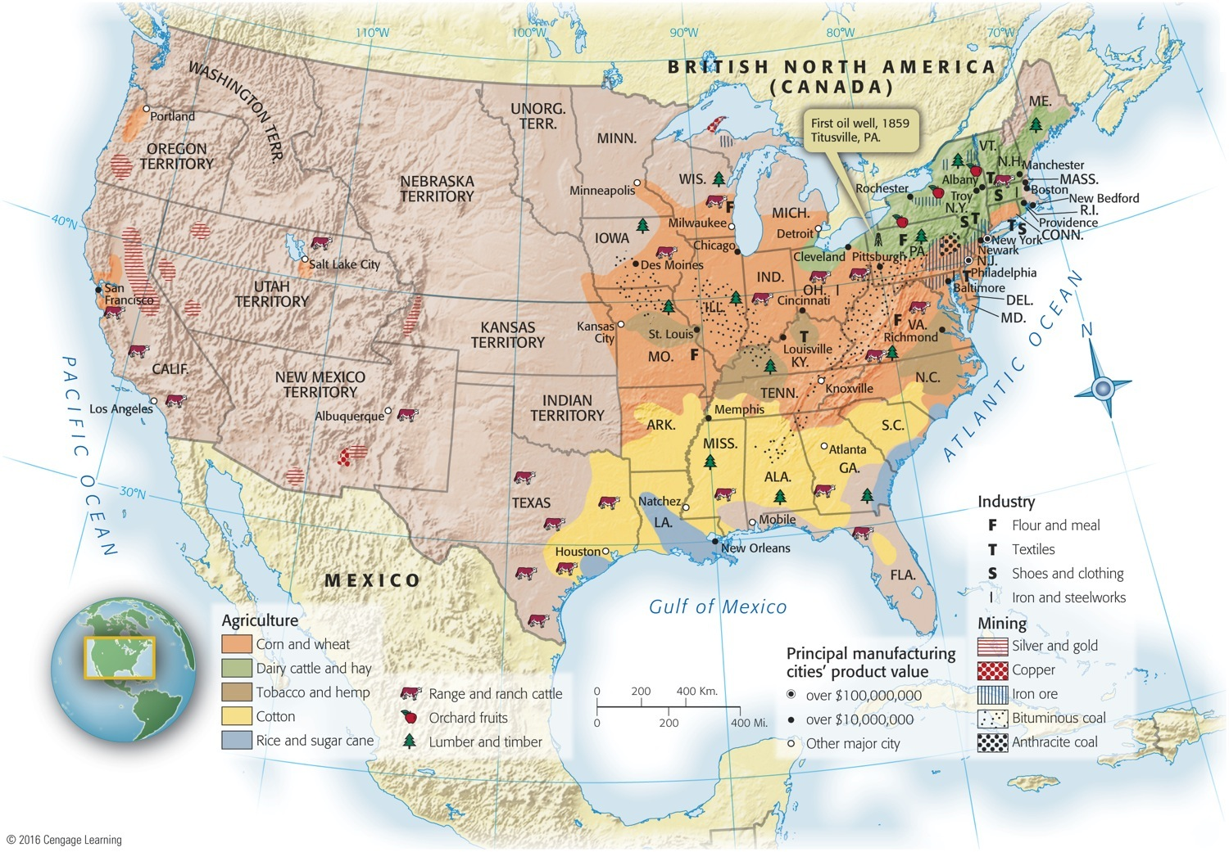
Map 14-5 p305
Notes:
Map 14.5 Industry and Agriculture, 1860 Still a nation of farmers on the eve of the Civil War,
Americans had nevertheless made an impressive start on their own Industrial Revolution, especially
in the Northeast. © 2016 Cengage Learning

Slide 54
XVIII. The Market Revolution
Monopolies easily developed and new companies found it difficult to break into markets
Chief Justice Roger Taney argued “rights of the community” outweighed exclusive corporate rights:
His decision encouraged greater competition
So did passage of more liberal state incorporation laws
Self-sufficient households of earlier were transformed:
Now families scattered to work for wages in factories
Or planted just a few crops for sale at market
Used money to buy goods made by strangers in far-off factories

Slide 55
XVIII. The Market Revolution
Store-bought products replaced homemade products
Changed division of labor and status in household
Traditional women's work rendered superfluous and devalued
Home grew into place of refuge from world of work that increasingly became special and separate sphere of women
Revolutionary advances in manufacturing and transportation brought increased prosperity:
Widened gulf between rich and poor
New examples of colossal economic success
John Jacob Astor left estate of $30 million in 1848

Slide 56
XVIII. The Market Revolution
Cities bred greatest extremes of economic inequality:
Unskilled workers fared worst; “drifted” from city to city
These workers accounted for up to ½ the population of new industrial centers
Were forgotten men and women of American history
Many myths about “social mobility:”
Mobility did exist in industrializing America
Rags-to riches success stories relatively few
American did provide more “opportunity” than elsewhere
Millions of immigrants headed for New World shores
General prosperity defused potential class conflict

Slide 57
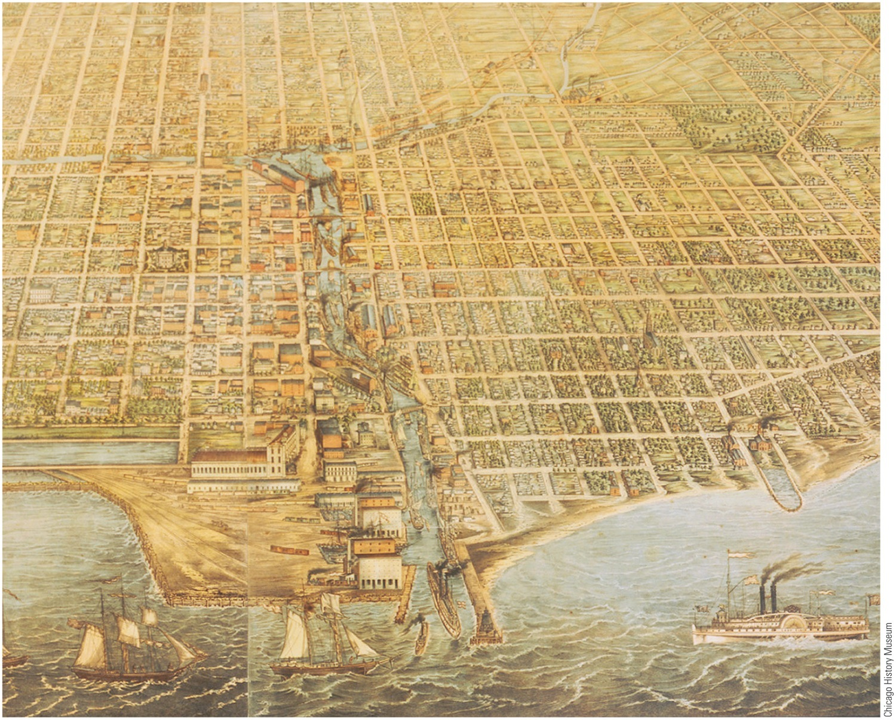
p306
Notes:
Chicago, 1857 A modest village of a few hundred souls in the 1830s, Chicago was a teeming
metropolis just two decades later—one of the fastest-growing cities in the world. A food and
livestock processing center and transportation hub, it served the vast farming area of the western
plains, a remarkably productive agricultural region and breadbasket to the world.

Slide 58
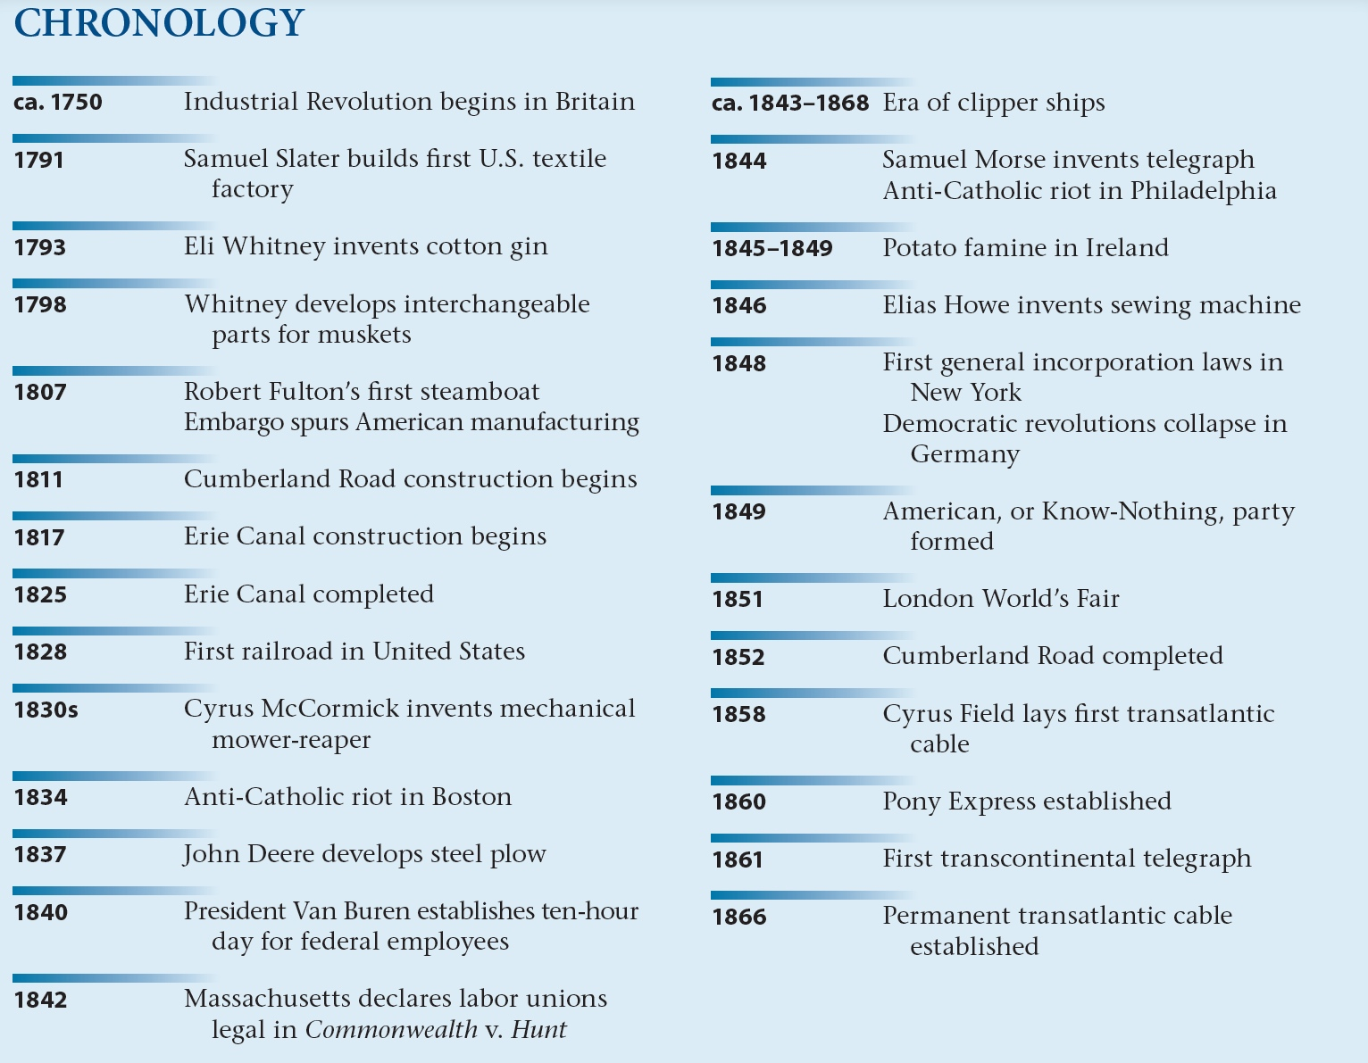
p305

