Slide 1
Chapter 28
Progressivism and the Republican Roosevelt, 1901–1912

Slide 2
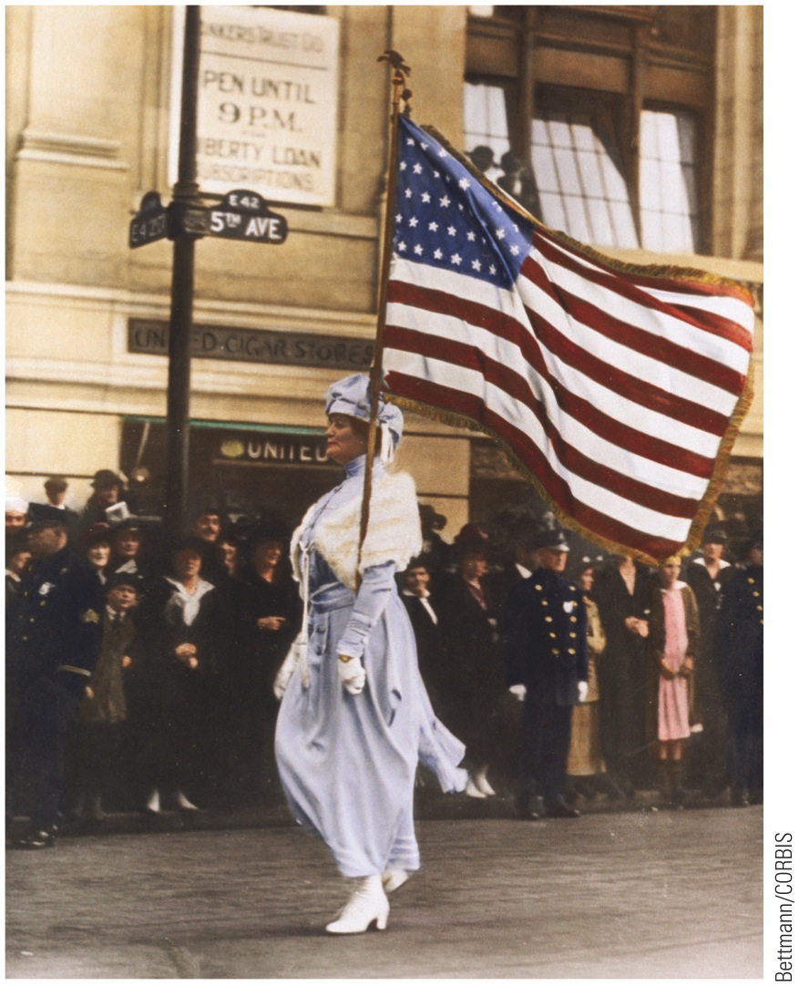
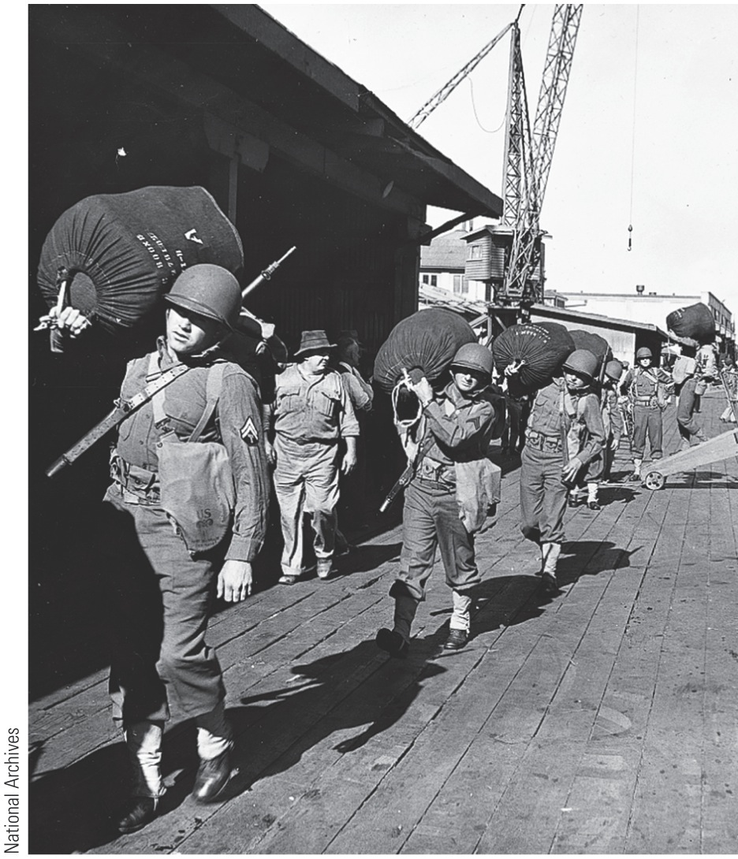
p636
Notes:
Marching for Suffrage Prominent New York socialite Mrs. Herbert
Carpenter, bearing an American flag, marches in a parade for women’s
suffrage on Manhattan’s Fifth Avenue, 1912.

Slide 3
I. Progressive Roots
Progressive ideas and theories:
Old philosophy of hands-off individualism seemed out of place in modern machine age
Progressive theorists insisted society could no longer afford luxury of limitless “let-alone” (laissez-faire) policy
The people, through government, must substitute mastery for drift
Politicians and writers began to pinpoint targets:
Bryan, Altgeld, and Populists branded “bloated trusts” with stigma of corruption and wrongdoing

Slide 4
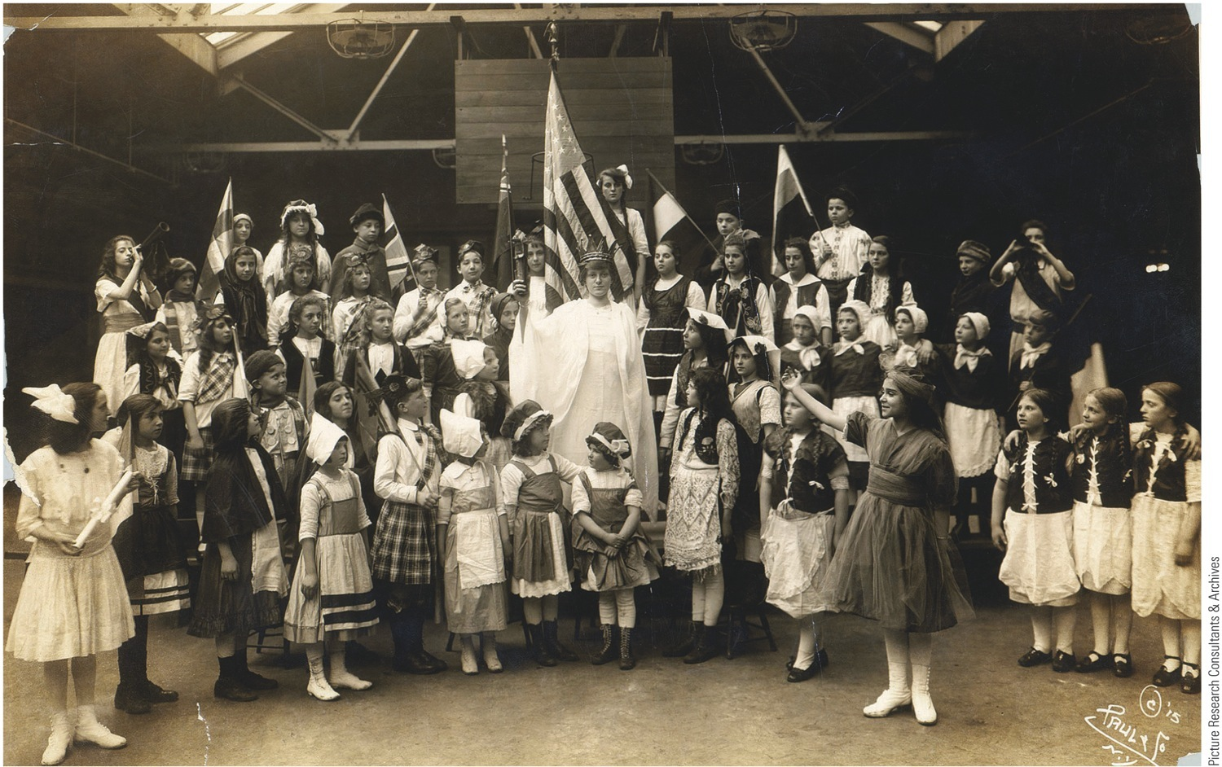
p639
Notes:
Melting Pot in P.S. 188, 1910 These immigrant children from the Lower East Side of New York
are dressed in costumes from their native lands and surround their teacher, adorned as the Statue of
Liberty. Schools like this one, flooded with immigrant children who could scarcely speak English, tried
to respect their students’ ancestral cultures while also cultivating loyalty to their adopted country by
teaching American “civics” and appreciation for patriotic symbols and rituals.

Slide 5
I. Progressive Roots (cont.)
1894: Henry Demarest Lloyd criticized Standard Oil Company in his book Wealth Against Commonwealth
Thorstein Veblen assailed new rich in his The Theory of the Leisure Class (1899):
Attacked “predatory wealth” and “conspicuous consumption”
In his view, parasitic leisure class engaged in wasteful “business” rather than productive “industry”
Urged social leadership pass from superfluous titans to useful engineers
Jacob A. Riis shocked middle-class Americans in 1890 with How the Other Half Lives
Damning indictment of dirt, disease, vice, and misery in New York slums
Book deeply influenced Theodore Roosevelt
Novelist Theodore Dreiser:
Used his blunt prose to batter promoters and profiteers in The Financier (1912) and The Titan (1914)
Other reformers:
University-based economists urged new reforms modeled on European examples
Feminists added social justice to suffrage on list of needed reforms
Urban pioneers entered fight to improve lot of families living and working in festering cities

Slide 6
II. Raking Muck with the Muckrakers
Popular magazines—McClure's, Cosmopolitan, Collier's and Everybody's:
Dug deep for dirt the public loved
Editors financed extensive research
President Theodore Roosevelt called them muckrakers
Reformer-writers Lincoln Steffens and Ida M. Tarbell targeted:
Corrupt alliance between big business and municipal government.
Exposé of Standard Oil Company
Malpractices of life insurance companies, tariff lobbies, trusts, etc.
Some of most effective fire by muckrakers directed at social evils:
Immoral “white slave” traffic in women, rickety slums, appalling number of industrial accidents, subjugation of blacks, and abuse of child labor
Vendors of patent medicines also criticized

Slide 7
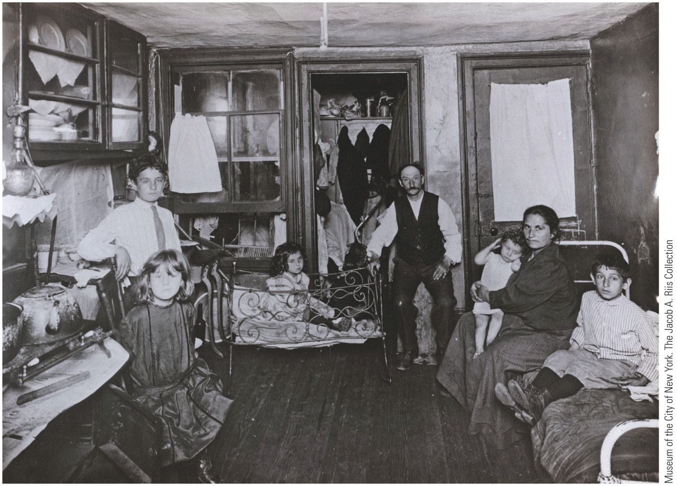
p640
Notes:
Room in a Tenement Flat,
1910 Tenement life on the
Lower East Side of New York
City was exposed by the
camera of Jacob Riis, who
compiled a large photographic
archive of turn-of-the-century
urban life. Many families
counted themselves lucky to
share a single room, no matter
how squalid.

Slide 8
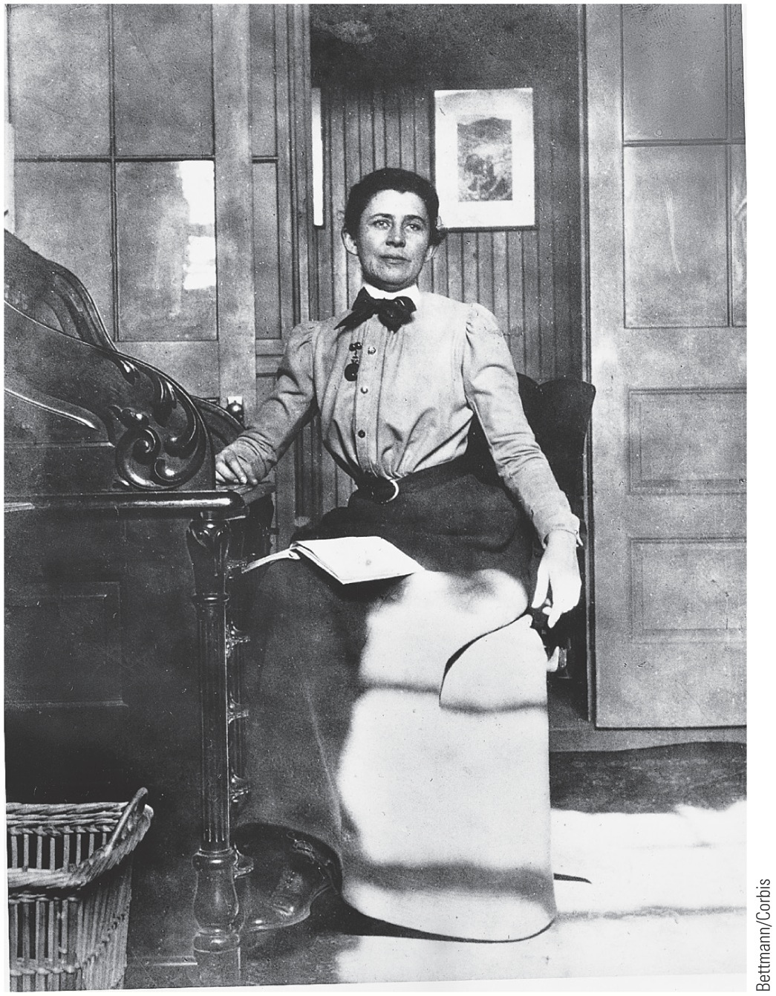
p641
Notes:
Ida Tarbell (1857–1944) in Her Office Tarbell was the
most eminent woman in the muckraking movement and
one of the most respected business historians of her
generation. In 1904 she earned a national reputation for
publishing a scathing history of the Standard Oil Company,
the “Mother of Trusts.” Two years later she joined Ray
Stannard Baker, William Allen White, and other muckrakers
in purchasing the American magazine, which became
a journalistic podium in their campaign for honest
government and an end to business abuses.

Slide 9
II. Raking Muck with the Muckrakers (cont.)
Muckrakers signified much about nature of progressive reform movement:
Long on lamentation but stopped short of revolutionary remedies
Counted on publicity to right social wrongs
Sought not to overthrow capitalism, but to cleanse it
Cure for ills of American democracy was more democracy

Slide 10
III. Political Progressivism (cont.)
“Who were the progressives?”
Militarists—Theodore Roosevelt
Pacifists—Jane Addams
Female settlement workers, labor unionists, and enlightened businessmen
Sought to modernize American institutions to achieve two goals:
Use state to curb monopoly power
Improve common person's conditions of life and labor

Slide 11
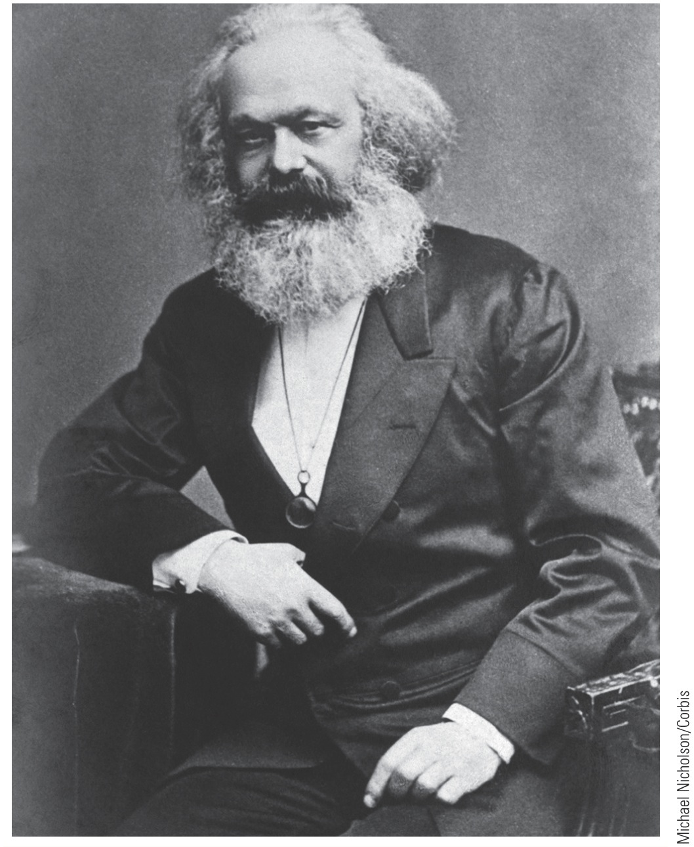
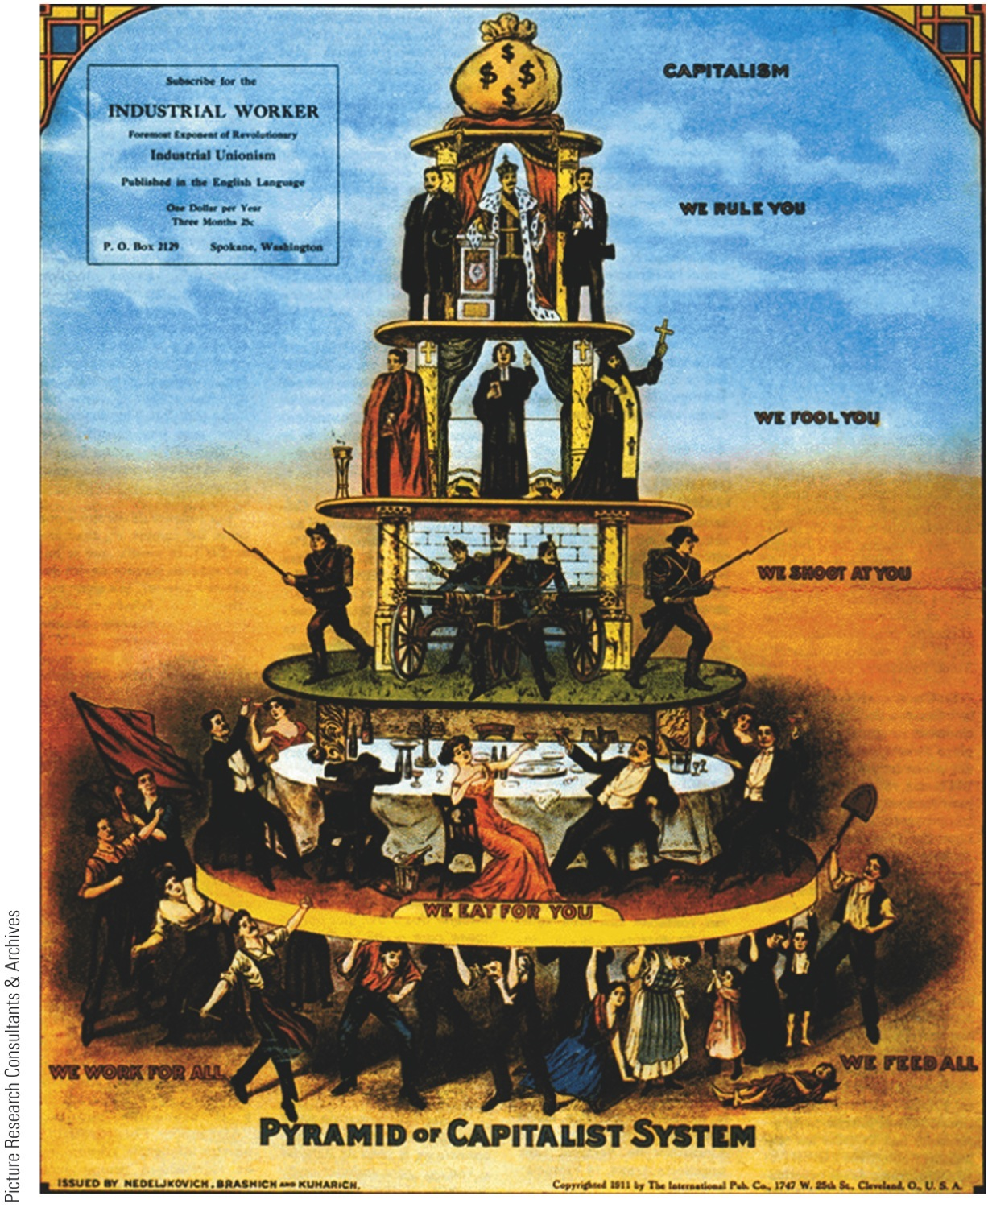
p642
Notes:
The Prophet of the Class Struggle, Karl Marx (1818–1883)

Slide 12
III. Political Progressivism (cont.)
Emerged in both political parties, in all regions, and at all levels of government
Regain power from corrupt “interests” by:
Direct primary elections to undercut party bosses
Initiative so voters could directly propose legislation
Referendum would place laws on ballot for final approval by people
Recall would enable voters to remove corrupt officials beholden to lobbyists

Slide 13
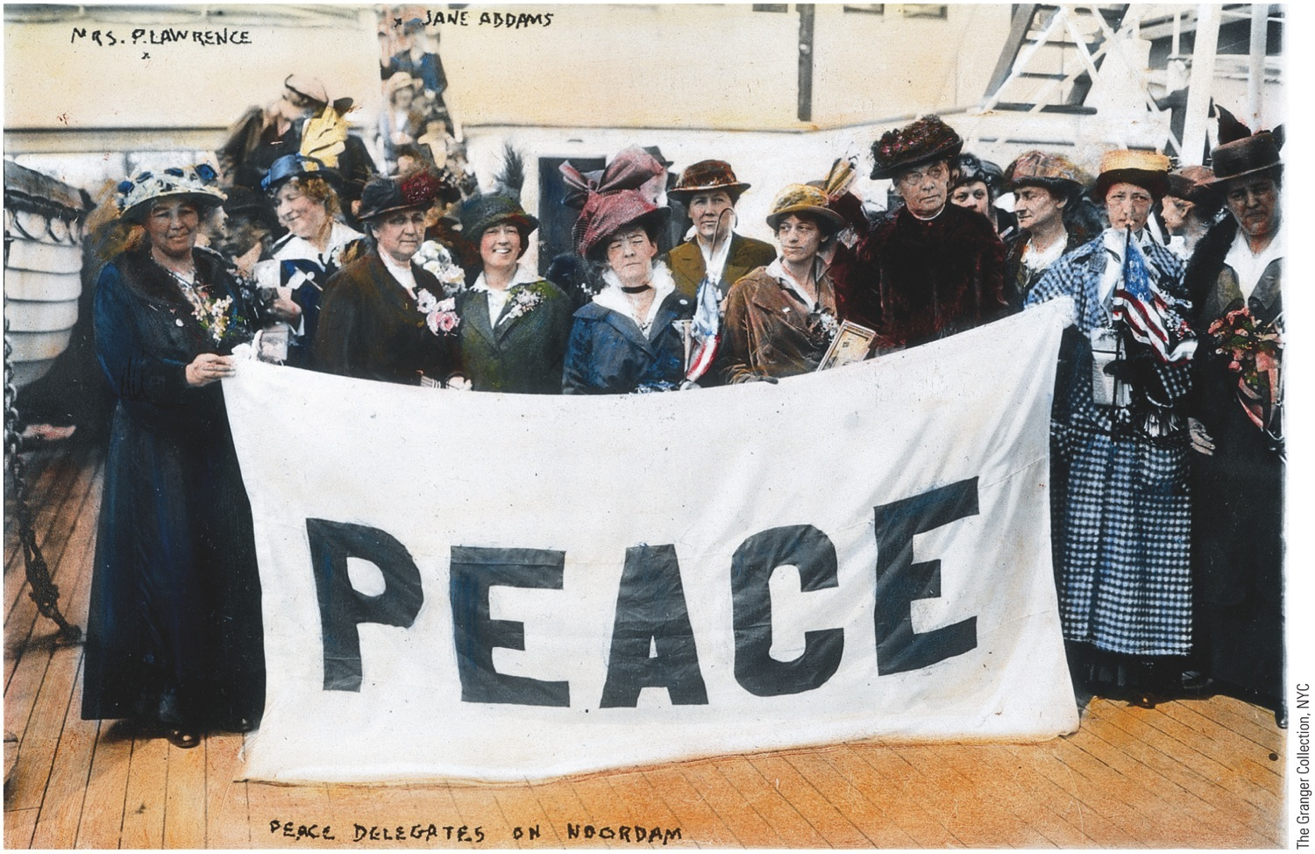
p644
Notes:
Jane Addams and Fellow Pacifists, 1915 A ddams cofounded the Women’s Peace Party
in 1915. Its pacifist platform was said to represent the views of the “mother half of humanity.”
Although the party initially attracted twenty-five thousand members, America’s entry into
the war two years later eroded popular support because pacifist internationalism became
suspect as anti-American.

Slide 14
III. Political Progressivism (cont.)
Rooting out graft became a prime goal
Introduced secret Australian ballot to counteract boss rule
Direct election of senators a favorite goal achieved by constitutional amendment:
Seventeenth Amendment, approved in 1913, established direct election of U.S. senators
Woman suffrage received growing support:
States like Washington, California, and Oregon gradually extended vote to women

Slide 15
IV. Progressivism in the Cities and States
Progressives scored impressive gains in cities:
Galveston, Texas appointed expert-staffed commissions to manage urban affairs
Other communities adopted city-manager system
Urban reformers attacked “slumlords,” juvenile delinquency, wide-open prostitution
Looked to German and English cities for examples of how to improve services:
Clean up water supplies
Light streets
Run trolley cars
Support for public ownership of utilities grew
Reforms bubbled up to states, like Wisconsin:
Governor Robert (“Fighting Bob”) La Follette a crusader and militant progressive Republican leader
Wrested considerable control from crooked railroad and lumber corporations and returned it to the people
Perfected a scheme for regulating public utilities

Slide 16
V. Progressive Women
Women an indispensable part of progressive army
Critical focus was settlement house movement—which offered a side door to public life:
Exposed middle-class women to problems plaguing cities:
Poverty, political corruption, and intolerable working and living conditions
Gave them skill and confidence to attack those evils

Slide 17
V. Progressive Women (cont.)
Women's club movement provided a broader civic entryway for middle-class women
Women, whose place was seen in home, defended new activities as an extension—not a rejection—of traditional roles:
Thus driven to moral and “maternal” issues:
Child labor, unsafe food, etc.
Agitated through groups like National Consumers League (1899) and Women's Trade Union League (1903)
Campaigned for factory reform and temperance:
Florence Kelley became State of Illinois's first chief factory inspector:
One of nation's leading advocates for improved factory conditions
Took control of new National Consumers League

Slide 18
V. Progressive Women (cont.)
In landmark case Muller v. Oregon (1908):
Louis D. Brandeis persuaded Supreme Court to accept laws protecting women workers by presenting evidence of harmful effects of factory labor on women's weaker bodies
Progressives hailed Brandeis's achievement as triumph over existing legal doctrines
American welfare state focused more on protecting women and children than on granting benefits to everyone
Setbacks:
1905, Supreme Court in Lochner v. New York voided New York law establishing ten-hour day for bakers
If laws regulating factories not enforced, they proved worthless—for example, lethal fire (1911) at Triangle Shirtwaist Company of New York
146 women died
By 1917 thirty states had workers' compensation laws

Slide 19
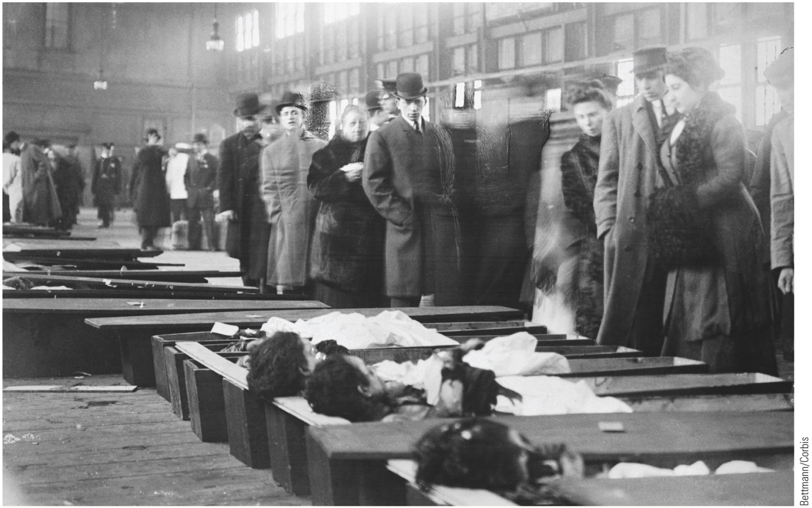
p646
Notes:
The Wages of Negligence Family members arrive at the morgue to identify the bodies
of victims of the Triangle Shirtwaist Company fire in 1911. Outrage over this calamity
galvanized a generation of reformers to fight for better workplace safety rules.

Slide 20
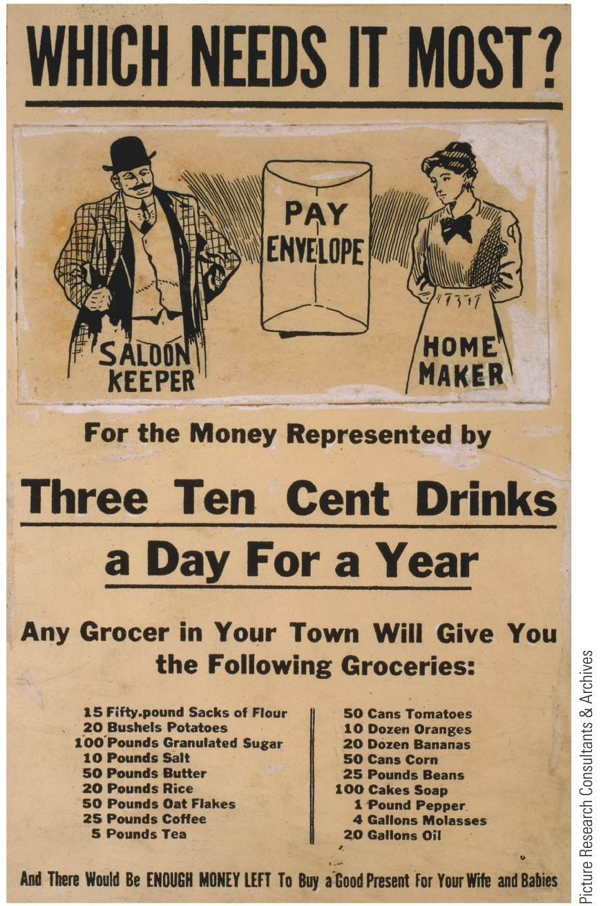
V. Progressive Women (cont.)
Corner saloons attracted ire of progressives:
Woman's Christian Temperance Union (WCTU) mobilized nearly one million women
Some states and counties passed “dry” laws to control, restrict, or abolish alcohol
Big cities generally “wet” because immigrants accustomed in Old Country to free flow of alcohol
By World War I (1914), nearly half of U.S. population lived in “dry” territory

Slide 21
VI. TR's Square Deal for Labor
TR feared public interest being submerged at home:
As a progressive, he called for a “Square Deal” for capital, labor, and public at large
His program embraced three C's:
Control of corporations
Consumer protection
Conservation of natural resources
First test came in coal mines of Pennsylvania (1902)
Exploited workers struck for better pay and hours

Slide 22
VI. TR's Square Deal for Labor (cont.)
Roosevelt finally threatened to seize mines if owners would not agree to arbitration with workers
First threat to use U.S. troops against owners, as opposed to against workers
Roosevelt urged Congress to create new Department of Commerce and Labor (1903)
Ten years later it was separated in two
New agency included a Bureau of Corporations authorized to investigate businesses engaged in interstate commerce:
Bureau helped break stranglehold of monopoly
Cleared road for era of “trust-busting”

Slide 23
VII. TR Corrals the Corporations
First—railroads:
Elkins Act (1903) aimed at railroad rebates:
Heavy fines imposed on railroads that gave rebates and on shippers that accepted them
Hepburn Act (1906):
Free passes severely restricted
Interstate Commerce Commission expanded:
Included express companies, sleeping-car companies and pipelines
Commission could nullify existing rates and stipulate maximum rates

Slide 24
VII. TR Corrals the Corporations (cont.)
Trusts a fighting word in progressive era
Roosevelt believed trusts here to stay:
Some were “good” trusts with public consciences
Some were “bad” trusts that lusted greedily for power
First burst into headlines with legal attack on Northern Securities Company (1902):
Railroad holding company organized by financial titan J.P. Morgan and empire builder James J. Hill
They sought a virtual monopoly in Northwest
TR challenged potentates of industrial aristocracy

Slide 25
VII. TR Corrals the Corporations (cont.)
Supreme Court upheld TR's antitrust suit and ordered Northern Securities Company to dissolve:
Northern Securities decision jolted Wall Street
Angered big business
Enhanced Roosevelt's reputation as trust smasher
TR initiated over forty legal proceedings against giant monopolies:
Supreme Court (1905) declared beef trust illegal
Fist of justice fell upon monopolists controlling sugar, fertilizer, harvesters, and other key products
TR's real purpose was symbolic: prove conclusively that government, not private business, ruled country
TR believed in regulating, not fragmenting, big business combines
He hoped to make business leaders more amenable to federal regulation
He never swung trust-crushing stick with maximum force
Industrial behemoths more “tame” by end of TR's reign
His successor, William Howard Taft actually “busted” more trusts than TR
Taft launched suit against U.S. Steel (1911) but it caused a political reaction by TR

Slide 26
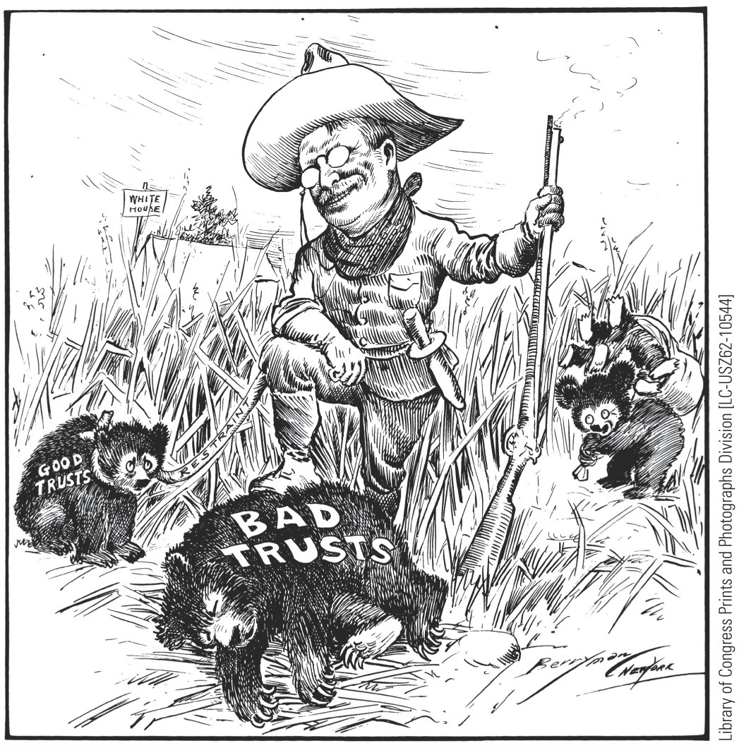
p649
Notes:
Roosevelt Tames the Trusts Legend to the contrary,
Roosevelt did not attack all trusts indiscriminately. Rather,
he pursued a few high-profile cases against a handful of
corporate giants, in order to “tame” other businesses into
accepting government regulation.

Slide 27
VIII. Caring for the Consumer
Roosevelt backed a measure (1906) that benefited both corporations and consumers:
Even meat packing industry called for safer canned products
Uproar from Upton Sinclair's The Jungle (1906):
Intended to focus on plight of workers
Instead appalled public with description of disgustingly unsanitary preparation of food products
Described Chicago's slaughterhouses
Roosevelt induced Congress to pass:
Meat Inspection Act (1906):
Decreed that preparation of meat shipped over state lines subject to federal inspection from corral to can
Pure Food and Drug Act (1906):
Designed to prevent adulteration and mislabeling of foods and pharmaceuticals

Slide 28
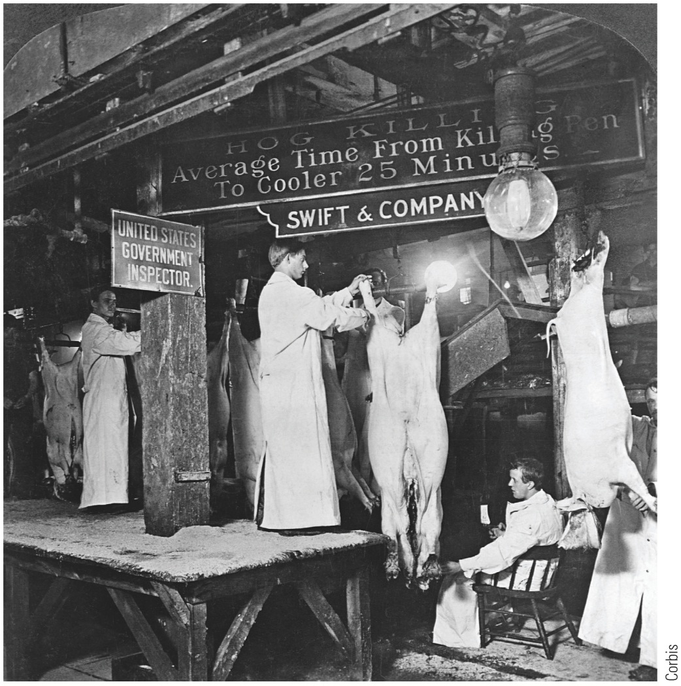
p650
Notes:
Minding the Meat White-jacketed inspectors examine
the hogs in a Swift & Company packinghouse in Chicago.
Agents like these made some progress in cleaning up
America’s septic slaughterhouses after the passage of the
Meat Inspection Act of 1906.

Slide 29
IX. Earth Control
Steps to conserve U.S. natural resources:
Desert Land Act (1877):
Whereby federal government sold arid land cheaply on condition that purchaser irrigate soil within three years
Forest Reserve Act (1891):
Authorized president to set aside public forests as national parks and other reserves
Some 46 million acres rescued from logging in 1890s

Slide 30
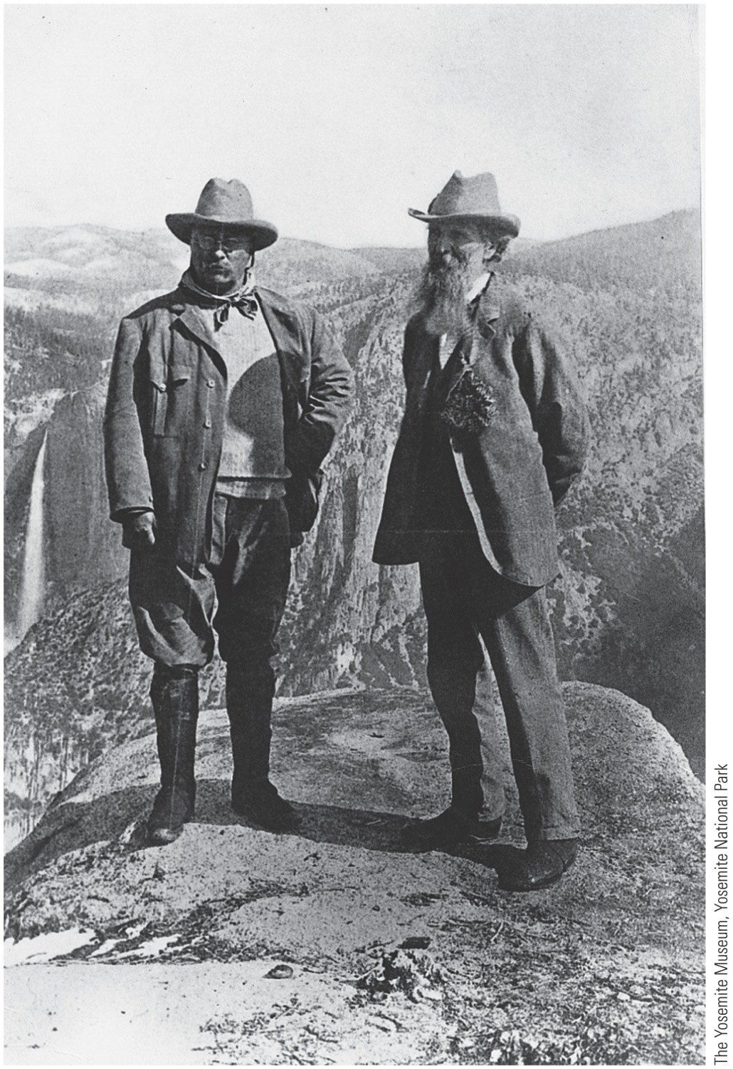
IX. Earth Control (cont.)
Carey Act (1894) distributed federal land to states on condition that it be irrigated and settled
New day for conservation dawned with Roosevelt (see “Makers of America: The Environmentalists”)
TR seized banner of conservation leadership
Congress responded with landmark Newlands Act (1902):
Washington authorized to collect money from sale of public land in western states
Use funds for development of irrigation projects
Roosevelt Dam, constructed on Arizona's Salt River, dedicated by Roosevelt in 1911

Slide 31
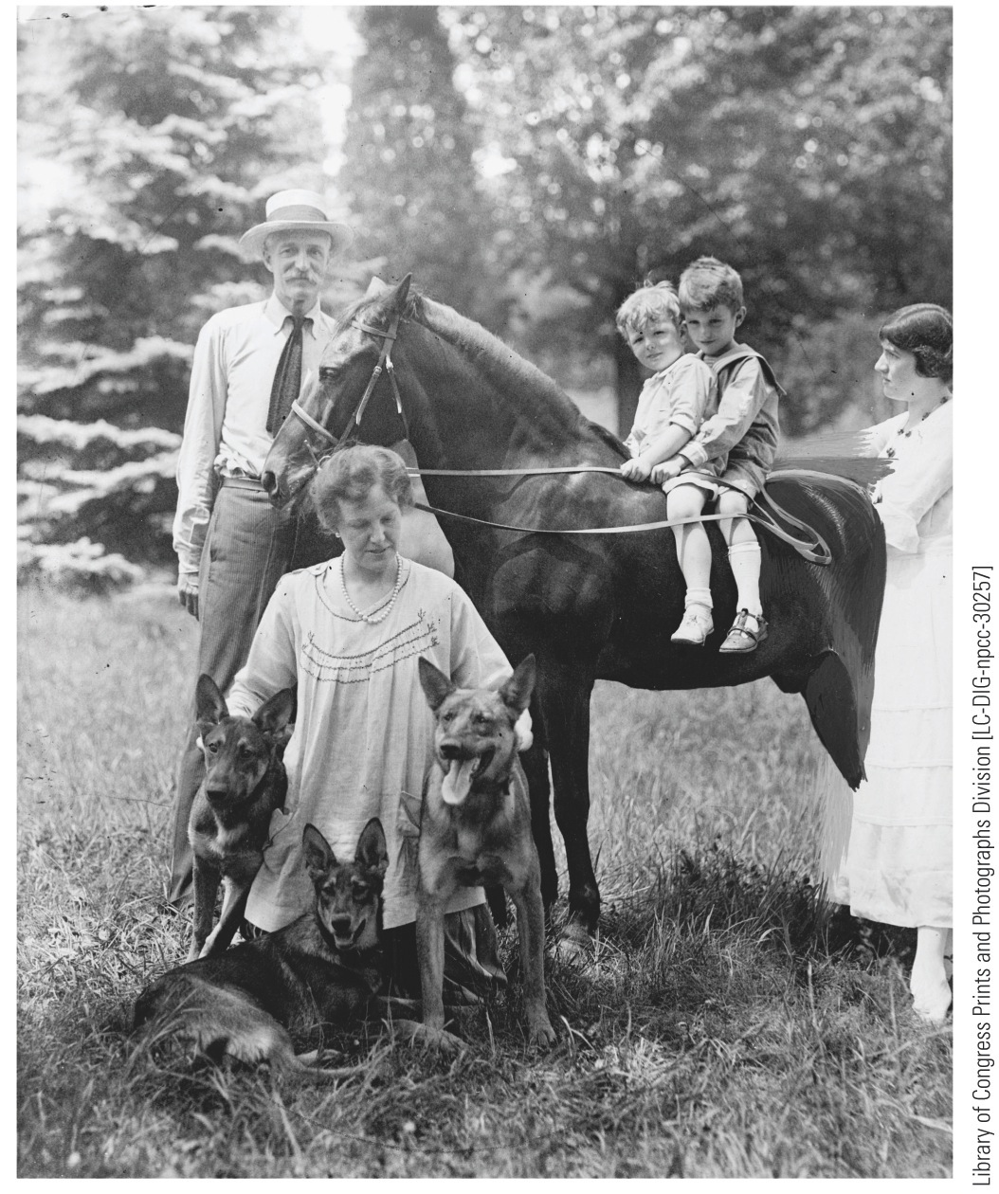
p652
Notes:
Pinchots in the Great Outdoors Gifford Pinchot, the
father of the modern Forest Service, poses with his family
of fellow nature-lovers. His wife Cornelia was a driven
feminist, political activist, and, as a passionate gardener, a
proponent in her own right of people’s “rational use” of
the natural world.

Slide 32
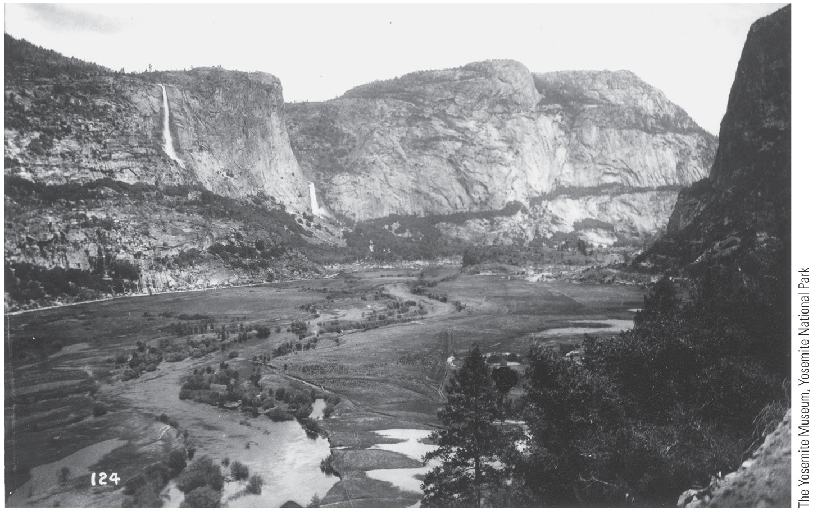
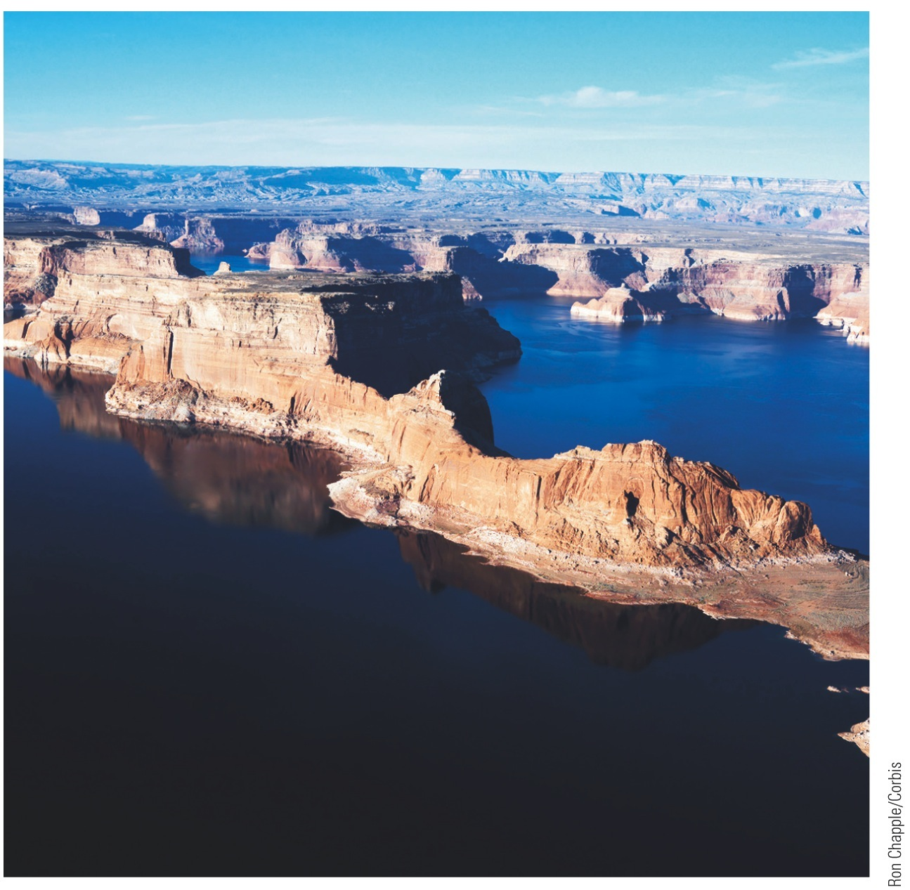
p653
Notes:
Lake Powell, Utah Named for the famed explorer John
Wesley Powell and formed by one of the several dams
on the Colorado River, Lake Powell has been a focus of
intense controversy. It drowned the spectacularly beautiful
Glen Canyon but created recreational facilities for countless
Americans.

Slide 33
IX. Earth Control (cont.)
TR worked to preserve nation's shrinking forests:
Set aside some 125 million acres in federal reserves
Earmarked millions of acres of coal deposits, and water resources useful for irrigation and power
Conservation and reclamation were Roosevelt's most enduring tangible achievements
Disappearance of frontier—believed to be source of national characteristics (individualism and democracy) encouraged popular support for conservation
As did Jack London's Call of the Wild (1903)

Slide 34
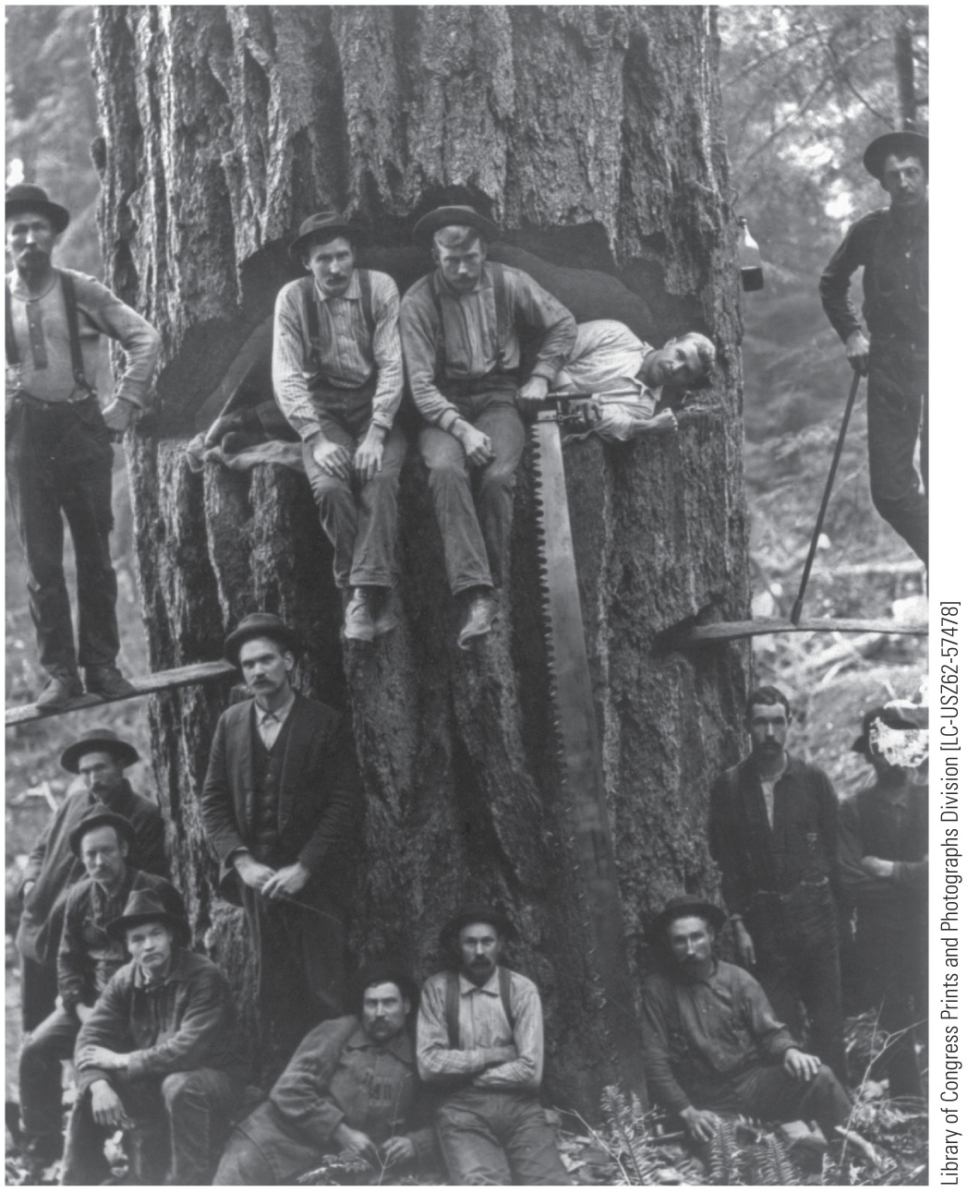
p654
Notes:
Loggers in the State of Washington, ca. 1901 It took
the sweat and skill of many men to conquer a giant fir like
this one. Once the tree was felled, a team of oxen driven
by a “bullwhacker” would drag the log out of the woods
along a “skid road.” Skid road (sometimes corrupted as
skid row) was also a name for the often-sleazy sections
of logging towns, where loggers spent their time in the
off-season.

Slide 35
IX. Earth Control (cont.)
Organizations:
Boy Scouts of America became largest youth group
Audubon Society tried to save wild native birds
Sierra Club (1892) dedicated to preserve wildness of western landscape
Losses:
(1913) San Francisco built dam in Hetch Hetchy Valley
Caused deep division between preservationists (John Muir) and conservationists that persists to present day
Roosevelt's chief forester, Gifford Pinchot, believed “wilderness was waste”
Pinchot and TR wanted to use nation's natural endowment intelligently—thus two battles:
One with greedy commercial interests that abused nature
Other with romantic preservationists in thrall to simple “woodman-spare-that-tree” sentimentality
National policy developed “multiple-use resource management”
Try to combine recreation, sustained-yield logging, watershed protection, and summer stock grazing on same expanse of federal land

Slide 36
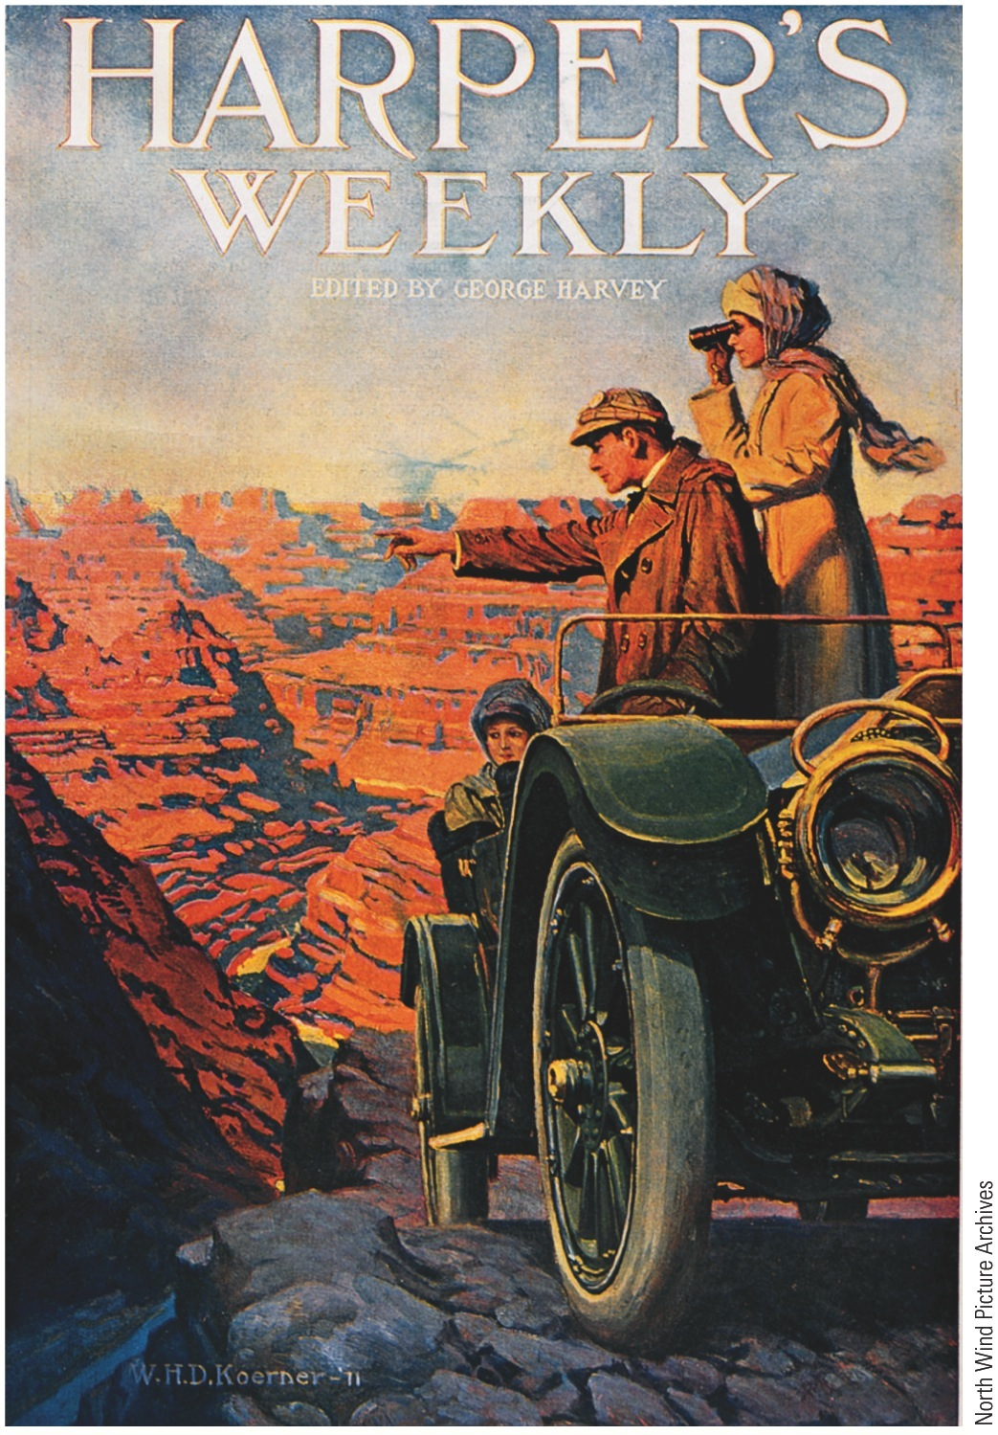
IX. Earth Control (cont.)
Westerners learned how to work with federal management of natural resources:
New agencies, such as Forest Service and Bureau of Reclamation
Worked with federal programs devoted to rational, large-scale, and long-term use of natural resources
Single-person enterprises shouldered aside, in interest of efficiency, by combined bulk of big business and big government

Slide 37
X. The “Roosevelt Panic” of 1907
Roosevelt's second term (1905-1909):
Called for regulating corporations, taxing incomes, and protecting workers
Declared (1904) under no circumstances would he be a candidate for a third term
Suffered sharp setback (1907) when short panic descended on Wall Street:
Frightened “runs” on banks
Financial world blamed Roosevelt
Conservatives called him “Theodore the Meddler”
Results of 1907 panic:
Paved way for long-overdue monetary reforms
Currency shortage showed need for more elastic medium of exchange
Congress (1908) responded with Aldrich-Vreeland Act:
Authorized national banks to issue emergency currency backed by various kinds of collateral
Path smoothed for momentous Federal Reserve Act of 1913 (see Chap. 29)

Slide 38
XI. The Rough Rider Thunders Out
Roosevelt in 1908:
Could have won second presidential nomination and won election
However, he felt bound by promise of 1904
Sought successor who would carry out “my policies”:
Selected William Henry Taft, secretary of war and a mild progressive
He often served when Roosevelt away

Slide 39
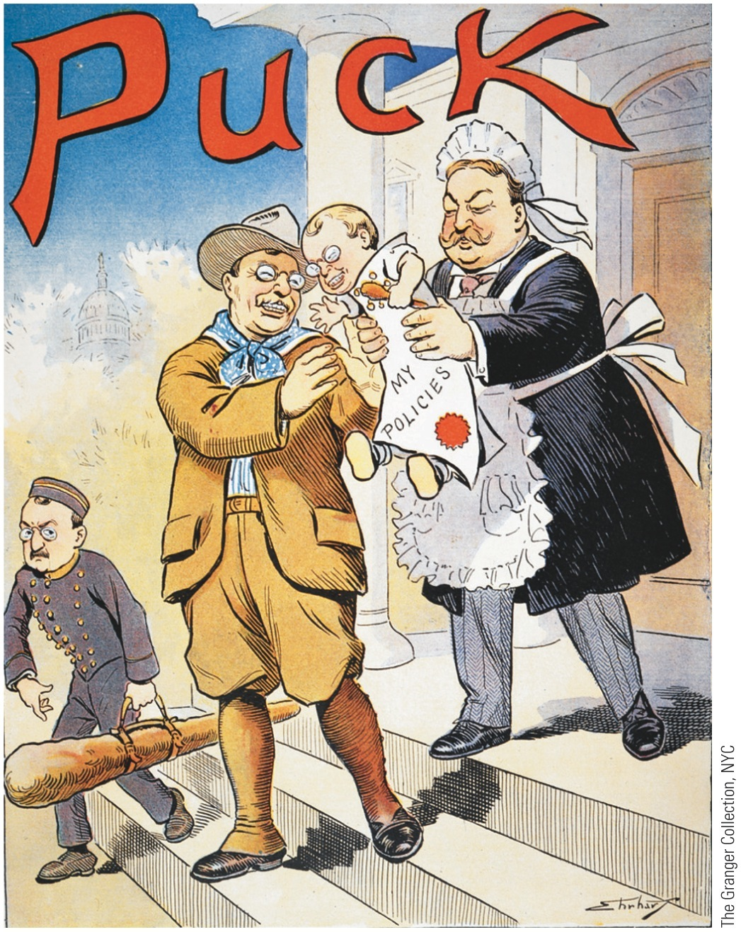
XI. The Rough Rider Thunders Out (cont.)
In 1908 TR “steamrolled” convention to get Taft's nomination on first ballot
Democrats nominated William Jennings Bryan again
Campaign of 1908:
Taft and Bryan both tried to claim progressive TR's mantle
Majority chose stability with Roosevelt-endorsed Taft, who polled 321 electoral votes to 162 for Bryan
Socialists amassed 420,793 votes for Eugene V. Debs (see Chap. 26)

Slide 40
XI. The Rough Rider Thunders Out (cont.)
Roosevelt branded by adversaries as wild-eyed radical
Number of laws he inspired not in proportion to amount of noise he made
Attacked by reigning business lords, but they knew they had a friend in White House
Should first and foremost be remembered as cowboy who tamed bronco of adolescent capitalism, thus ensuring it a long adult life
Roosevelt's achievements and popularity:
His youthfulness appealed to young of all ages
Served as political lightning rod to protect capitalists against popular indignation and against socialism
Sought middle road between unbridled individualism and paternalist collectivism

Slide 41
XI. The Rough Rider Thunders Out (cont.)
In conservation crusade, he tried to mediate between:
Romantic preservationists and rapacious resource-predators
Probably his most typical and his most lasting achievement
Other contributions of Roosevelt:
Greatly enlarged power/prestige of presidency
Helped shape progressive movement and later liberal reform
Opened eyes of Americans to fact that they shared world with other nations and needed to accept responsibilities of a great power

Slide 42
XII. Taft: A Round Peg in a Square Hole
William Howard Taft:
Enviable reputation as lawyer and judge
Trusted administrator under Roosevelt
Suffered from lethal political handicaps:
Not a dashing political leader like TR
Recoiling from controversy, Taft generally adopted attitude of passivity toward Congress
Taft a poor judge of public opinion
His candor made him chronic victim of “foot-in-mouth” disease
A mild progressive, but at heart wedded to status quo rather than change
His cabinet did not contain a single representative of party's “insurgent” wing

Slide 43
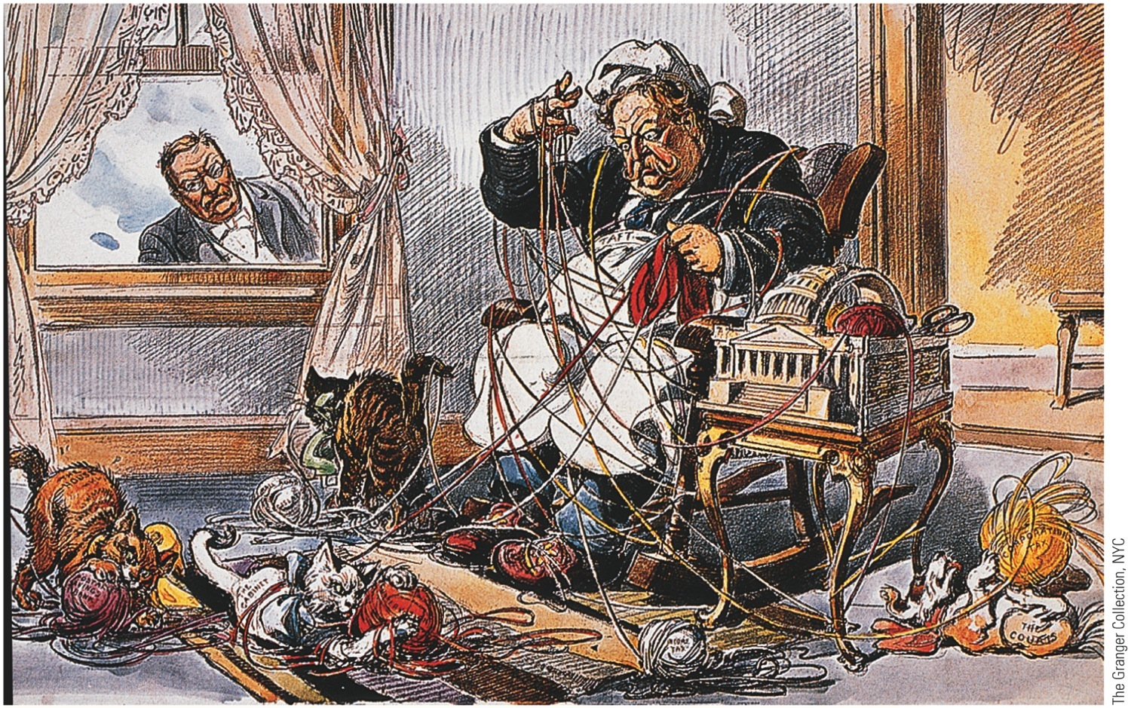
p657
Notes:
Ex-President Theodore Roosevelt Watches President Taft Struggle with the
Demands of Government, 1910

Slide 44
XIII. The Dollar Goes Abroad as a Diplomat
Taft's foreign policy:
Use investments to boost American political interests abroad—dollar diplomacy:
Encouraged Wall Street to invest in foreign areas of strategic concern to U.S.A.
Especially Far East and Panama Canal
Thus bankers would strengthen American defenses and foreign policies—bring prosperity to homeland
Almighty dollar supplanted TR's big stick
Railroad investments in Manchuria were Taft's most spectacular effort, but Russia and Japan blocked effort

Slide 45
XIII. The Dollar Goes Abroad as a Diplomat…and Taft is a trust-buster too.
New trouble spot in revolution-riddled Caribbean:
Wall Street encouraged to pump dollars into financial vacuums in Honduras and Haiti to keep foreign funds out
Sporadic disorders in Cuba, Honduras, and Dominican Republic brought American forces to restore order and protect American investments
2,500 marines (1912) landed in Nicaragua
Remained in Nicaragua for 13 years (see Map 29.1)
Taft gained some fame as smasher of monopolies:
Brought 90 suits against trusts during his four years compared to 44 for Roosevelt in 7½ years
Biggest action came in 1911 when Supreme Court ordered dissolution of Standard Oil Company:
Judged to be a combination in restraint of trade in violation of Sherman Anti-Trust Act of 1890

Slide 46
XIV. Taft the Trustbuster (cont.)
Supreme Court also handed down its famous “rule of reason”:
Doctrine—only those combinations that “unreasonably” restrained trade were illegal
Doctrine tore big hole in government's antitrust net
1911: antitrust suit against U.S. Steel Corporation:
Infuriated Roosevelt who had encouraged merger
Once Roosevelt's protégé, President Taft increasingly took on role of his antagonist

Slide 47
XV. Taft Splits the Republican Party
Progressives in Republican Party wanted lower tariffs:
Thought they had a friend in Taft
House passed moderately reductive bill
Senate added numerous upward tariff revisions
Much to dismay of supporters, Taft signed Payne-Aldrich Bill and called it “best bill that the Republican Party ever passed”
Taft proved to be dedicated conservationist:
Established Bureau of Mines to control mineral resources
His accomplishments overshadowed by Ballinger-Pinchot quarrel (1910):
Secretary of Interior Richard Ballinger opened public lands in Wyoming, Montana, Alaska to corporate use
Ballinger sharply criticized by Gifford Pinchot, chief of Agriculture Department's Division of Forestry and a stalwart Rooseveltian

Slide 48
XV. Taft Splits the Republican Party (cont.)
Taft dismissed Pinchot on charges of insubordination
Widened rift between Roosevelt and Taft
Reformist wing of Republican party up in arms:
Taft being pushed into arms of Old Guard
By 1910 Grand Old Party split wide-open, largely due to clumsiness of Taft
Roosevelt returned in 1910 and stirred up tempest by giving flaming speech at Osawatomie, Kansas
Announced doctrine of “New Nationalism:”
Urged national government to increase its power to remedy economic and social abuses
Results of divisions within Republican Party:
Lost badly in congressional elections of 1910
Democrats emerged with 228 seats, leaving once-dominant Republicans with only 161
A socialist representative, Victor L. Berger, elected from Milwaukee
Republicans, by virtue of holdovers, retained Senate, 51 to 41:
but even there reformers challenged Old Guard

Slide 49
XVI. The Taft-Roosevelt Rupture
Now a full-fledged revolt:
1911: National Progressive Republican League formed
Fiery Senator La Follette (Wisconsin) became leading presidential candidate for group
February 1912, Roosevelt wrote to seven governors that he was willing to accept Republican nomination
His reasoning—third-term tradition applied to three consecutive elective terms
Roosevelt entered primaries, pushing La Follette aside
Taft-Roosevelt explosion near in June 1912, at Republican convention in Chicago
Rooseveltites about 100 delegates short of winning nomination
Challenged right of some 250 Taft delegates to be seated
Most of the contests settled for Taft
Roosevelt refused to quit game:
Having tasted for first time bitter cup of defeat, TR led a third-party crusade

Slide 50
XVII. The “Bull Moose” Campaign of 1912
Democrats jubilant over Republican divisions
Assumed could win in 1912 with a strong reformer
Governor Woodrow Wilson seemed good fit:
Scholar of government who became reformist president of Princeton University in 1902
Elected governor of New Jersey in 1910, Wilson campaigned against “predatory” trusts
Once elected, Wilson drove through legislature a number of progressive reforms

Slide 51
XVII. The “Bull Moose” Campaign of 1912 (cont.)
Democrats met at Baltimore (1912):
Nominated Wilson, aided by William Jennings Bryan's switch to his side
His progressive reform platform dubbed New Freedom
Progressive Republican ticket:
Third-party with Roosevelt as its candidate for president
Pro-Roosevelt supporters held convention in Chicago in August 1912
Settlement-house pioneer Jane Addams placed Roosevelt's name in nomination for presidency:
Symbolized rising political status of women as well as Progressive support for social justice
TR received thunderous applause when he declared “We stand at Armageddon, and we battle for the Lord!”
Roosevelt said he felt “as strong as a bull moose” thus bull moose symbol

Slide 52
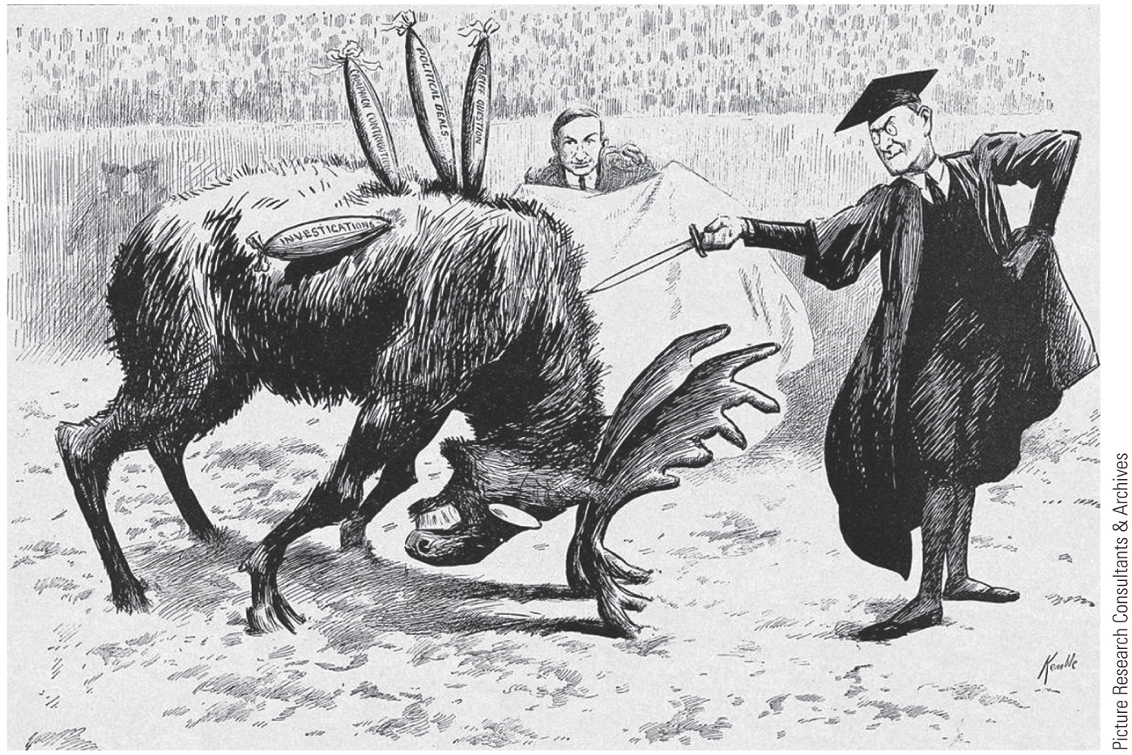
p660
Notes:
The Finishing Touch, 1912 Despite
the excitement generated by Roosevelt’s
Progressive Party challenge in
1912, the GOP split that year helped to
hand victory to the Democrats. This
election-eve cartoon depicts Woodrow
Wilson, attired in academic garb, preparing
to slay Roosevelt the charging
bull moose. The latter had already been
injured by a slew of controversies,
including allegations of improper campaign
contributions during a previous
election. Wilson’s campaign manager
and future treasury secretary, William
McAdoo, holds the cape.

Slide 53
XVII. The “Bull Moose” Campaign 1912 (cont.)
Big issue of campaign was two versions of reform:
TR and Wilson agreed on more active government, but disagreed on specific strategies
Roosevelt's New Nationalism:
Based on ideas of progressive thinker Herbert Cody in his book The Promise of American Life
Favored continued consolidation of trusts and labor unions
Paralleled by growth of powerful regulatory agencies
Campaigned for woman suffrage

Slide 54
XVII. The “Bull Mouse” Campaign 1919 (cont.)
Broad program of social welfare, including minimum wage laws and publicly supported health care
TR's Progressives looked forward to comprehensive welfare state of Franklin Roosevelt's New Deal
Wilson's New Freedom:
Favored small enterprise, entrepreneurship
Free functioning of unregulated, unmonopolized markets
Shunned social welfare proposals
Pinned economic faith on competition—the “man on the make,” as Wilson put it
Banking reform and tariff reduction
Keynote of Wilson's campaign not regulation but fragmentation of big industrial combines
Chiefly by vigorous enforcement of antitrust laws
Election of 1912 offered voters a choice not merely of policies but of political and economic philosophies--a rarity in U.S. History

Slide 55
XVII. The “Bull Mouse” Campaign 1919 (cont.)
Election's returns:
Wilson won with 435 electoral votes and 6,296,547 popular votes (41% of total)
Roosevelt finished second with 88 electoral votes and 4,118,571 popular votes
Taft won only eight electoral votes and 3,484,720 popular votes (see Map 28.1)
Socialist candidate, Eugene V. Debs, rolled up 900,672 popular votes, 6% of total cast

Slide 56
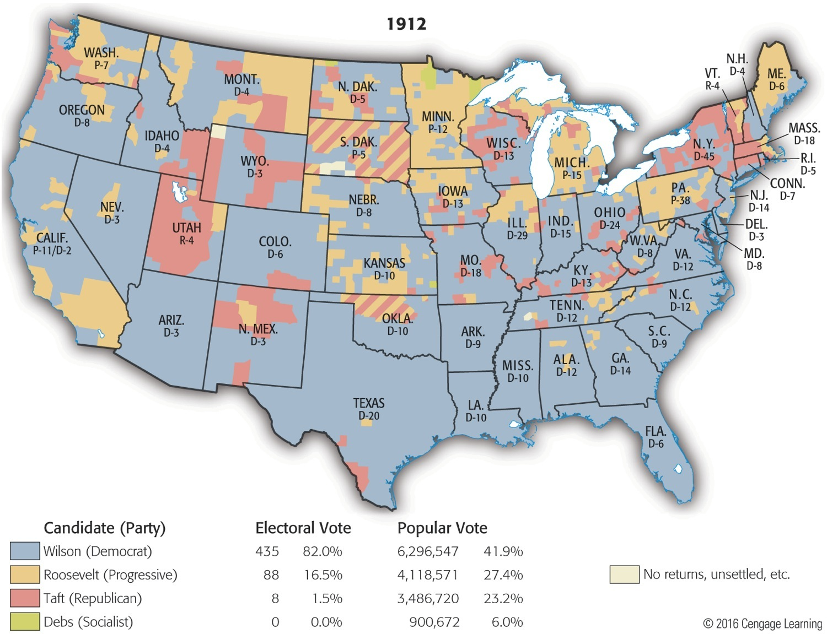
Map 28-1 p660
Notes:
Map 28.1 Presidential
Election of 1912 (showing
votes by county, with
electoral vote by state)
The Republican split surely
boosted Wilson to victory, as
he failed to win a clear majority
in any state outside the
old Confederacy. The election
gave the Democrats solid
control of the White House
and both houses of Congress
for the first time since the
Civil War. © 2016 Cengage Learning

