Slide 1
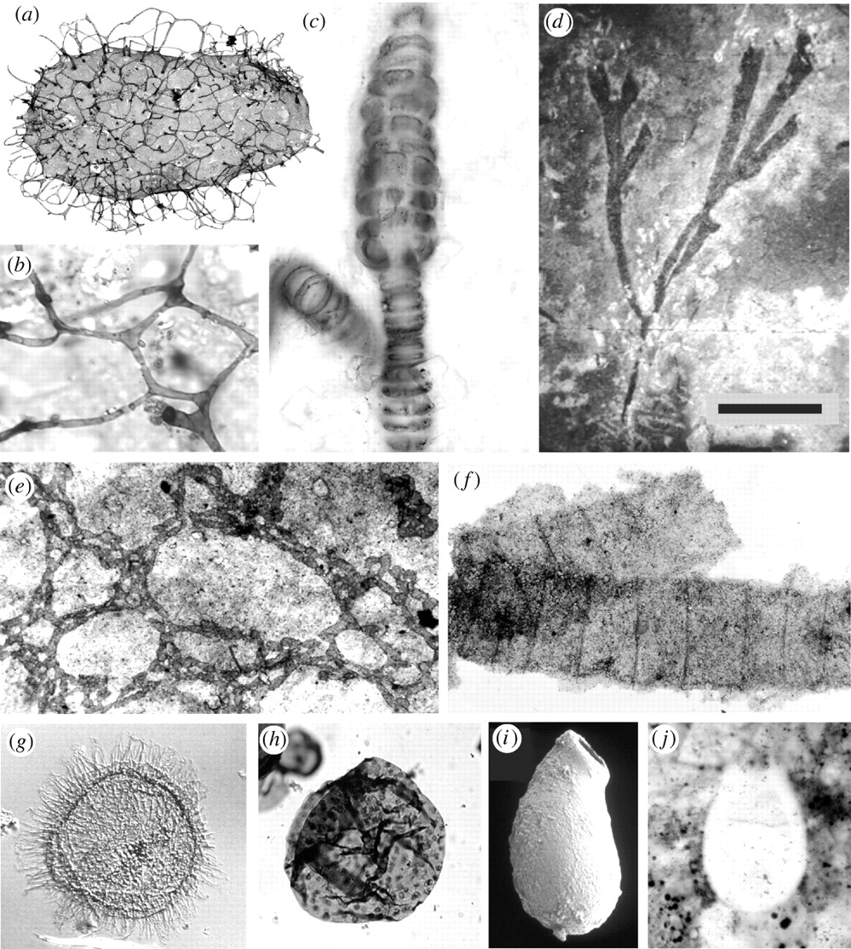
1.5 Origin of cells
Essential idea: There is an unbroken chain of life from the first cells on Earth to all cells in organisms alive today.
In the background you can see Late Mesoproterozoic and Neoproterozoic eukaryotic fossils images of cells. We know from such evidence that cells have always worked using the same basic principles.
By Chris Paine (modified by D. Knox)
https://bioknowledgy.weebly.com/
http://rstb.royalsocietypublishing.org/content/361/1470/1023/F3.large.jpg

Slide 2
Understandings, Applications and Skills
 | Statement | Guidance
1.5.U1 | Cells can only be formed by division of pre-existing cells. | Students should be aware that the 64 codons in the genetic code have the same meanings in nearly all organisms, but that there are some minor variations that are likely to have accrued since the common origin of life on Earth.
1.5.U2 | The first cells must have arisen from non-living material.
1.5.U3 | The origin of eukaryotic cells can be explained by the endosymbiotic theory. | Evidence for the endosymbiotic theory is expected. The origin of eukaryote cilia and flagella does not need to be included.
1.5.A1 | Evidence from Pasteur’s experiments that spontaneous generation of cells and organisms does not now occur on Earth.

Slide 3
Spontaneous Generation
Old idea based on observations…. Creation of life from organic matter.
Rotting meat turned into worms
Horse hair in water turned into fly larva
Mud turned into bullfrogs
Bread or cheese wrapped up and placed in corner turned into mice
Disproved by MANY experiments….You need to know Redi and Pasteur’s experiments

Slide 4
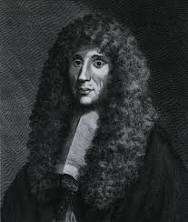
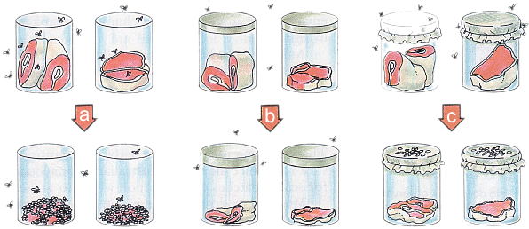
Redi’s Experiment to disprove Spontaneous Generation

Slide 5
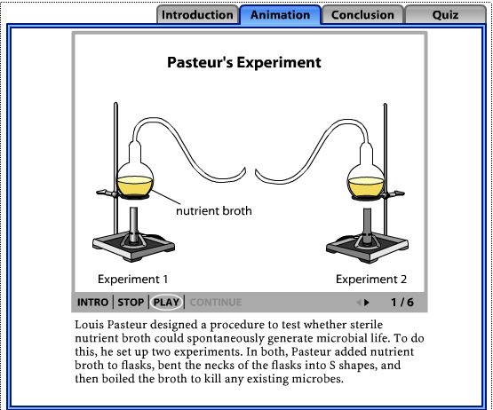
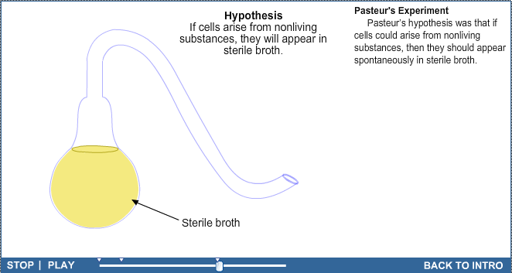
1.5.A1 Evidence from Pasteur’s experiments that spontaneous generation of cells and organisms does not now occur on Earth.
Use the tutorials to learn about Pasteur’s experiment.
Link to Video
http://www.sumanasinc.com/webcontent/animations/content/scientificmethod.html
LINK

Slide 6
1.5.A1 Evidence from Pasteur’s experiments that spontaneous generation of cells and organisms does not now occur on Earth.
Louis Pasteur designed an experiment to test whether sterile nutrient broth could spontaneously generate microbial life.
Results:
The broth in experiment 1 turned cloudy whilst the broth in experiment 2 remained clear.
This indicates that mircobe growth only occurred in experiment 1.
Method:
Two experiments were setup
In both, Pasteur added nutrient broth to flasks and bent the necks of the flasks into S shapes
Each flask was then heated to boil the broth in order than all existing microbes were killed.
After the broth had been sterilized, Pasteur broke off the swan necks from the flasks in Experiment 1, exposing the nutrient broth within them to air from above.
The flasks in Experiment 2 were left alone.
Conclusion: Pasteur rejected the hypothesis of spontaneous generation as for growth of microbes to occur a source of contamination was needed.
Q – was Pasteur correct, could spontaneous generation of life never occur?
http://bcs.whfreeman.com/thelifewire/content/chp03/0302003.html

Slide 7
1.1.U1 According to the cell theory, living organisms are composed of cells.
Remember this theory from 1.1 Introduction to cells?
Cell theory states that:
All living things are composed of cells (or cell products)
The cell is the smallest unit of life
Cells only arise from pre-existing cells
Source: http://www.engr.uconn.edu/alarm/research?id=63

Slide 8
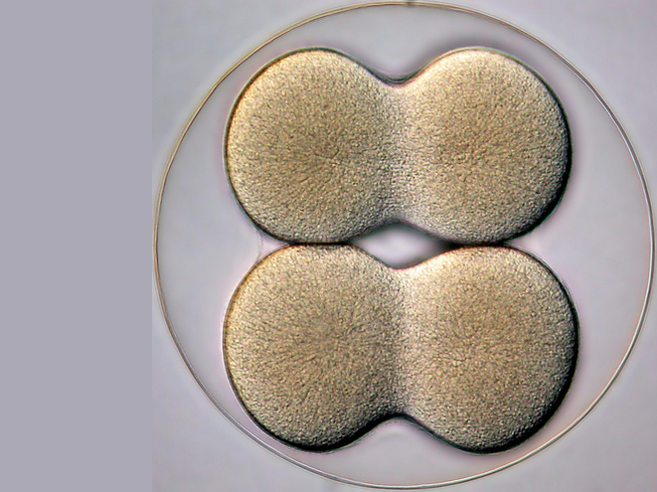
1.5.U1 Cells can only be formed by division of pre-existing cells.
Cells can only be formed by division of pre-existing cells:
Cells multiply through division
Mitosis results in genetically identical diploid daughter cells
Meiosis generates haploid gametes (sex cells)
4-cell stage of a sea biscuit by Bruno Vellutini on Flickr (CC) http://flic.kr/p/daWnnS

Slide 9
1.5.U1 Cells can only be formed by division of pre-existing cells.
What evidence do we have (other than Pasteur’s experiments) to support this theory?
4-cell stage of a sea biscuit by Bruno Vellutini on Flickr (CC) http://flic.kr/p/daWnnS

Slide 10
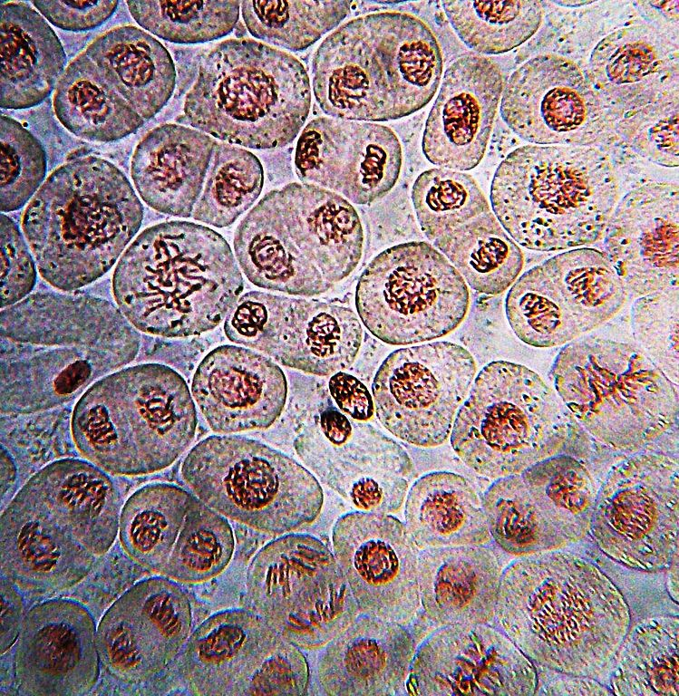
1.5.U1 Cells can only be formed by division of pre-existing cells.
All known examples of growth be it of a tissue, an organism or a population, are all a result of cell division.
http://upload.wikimedia.org/wikipedia/commons/thumb/d/d3/Onion_root_mitosis.jpg/749px-Onion_root_mitosis.jpg

Slide 11
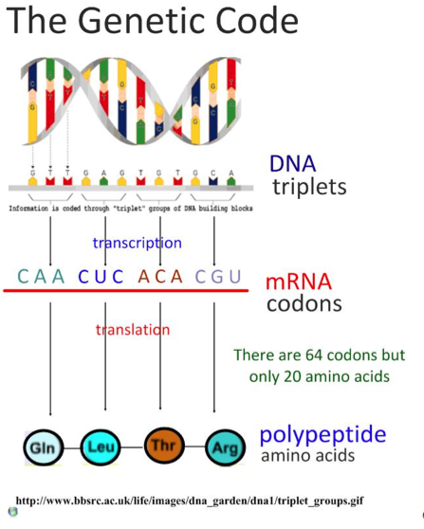
1.5.U1 Cells can only be formed by division of pre-existing cells.
Genetic code is universal each of the 64 codons (a codon is a combination of 3 DNA bases) produces the same amino acid in translation, regardless of the organism [2.7.A2]*.
The logical deduction is that all cells have arisen as the result of cell division from a single common ancestor.
There are some minor variations that are likely to have accrued since the common origin of life on Earth, but these are rare and most of the genetic code is universal most of the time.
http://www.slideshare.net/gurustip/protein-synthesis-35-transcription-translation-sl

Slide 12
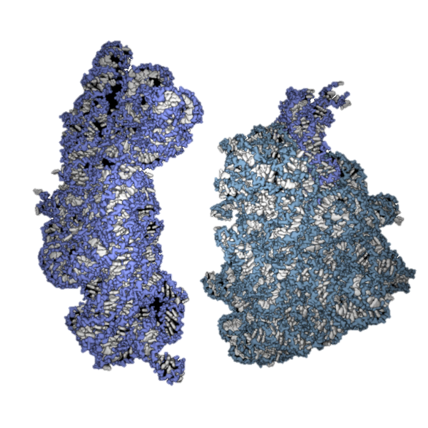
1.5.U2 The first cells must have arisen from non-living material.
If we accept that there were times in the history of the Earth when cells did not exist then it is an obvious point that ‘The first cells must have arisen from non-living material’. The only other possible explanation is that life, in the form of cells, was transported here from elsewhere in the universe. As illustrated above, it is extremely difficult (and given our level of technology currently impossible), to generate cells from anything but other cells. So how did the first cells arise?
Some of the key problems are:
Non-living synthesis of simple organic molecules, e.g. sugars and amino acids
Assembly of these organic molecules into polymers
Formation of polymers that can self-replicate (enabling inheritance)
Formation of membranes to package the organic molecules
http://exploringorigins.org/resources.html

Slide 13
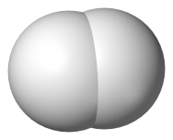
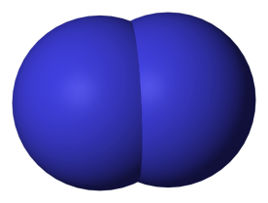
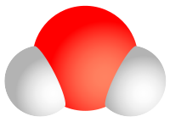
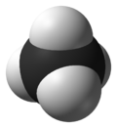
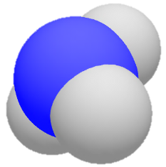
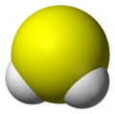
1.5.U2 The first cells must have arisen from non-living material.
Earth’s atmosphere was ‘reducing’ in the early days. It did not contain oxygen gas until after plants started photosynthesising
Can you identify these molecules?
All molecules public domain from Wikimedia Commons, Background image http://www.flickr.com/photos/lrargerich/4587244190/

Slide 14
1.5.U2 The first cells must have arisen from non-living material.
Earth’s atmosphere was oxygen free in the early days. It did not contain oxygen gas until after plants started photosynthesising
The atmosphere contained: Hydrogen
Nitrogen
Water vapour
Methane
Ammonia
Hydrogen sulfide
The gases came from abundant volcanic activity
All molecules public domain from Wikimedia Commons, Background image http://www.flickr.com/photos/lrargerich/4587244190/

Slide 15
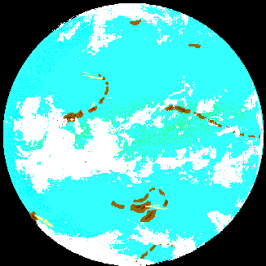
Early Earth– Archaean ERA– 4.0 billion years ago
Covered with a shallow sea
Atmosphere almost completely nitrogen. (no oxygen and little carbon dioxide)
Many erupting volcanoes
Planet is much warmer than today (60-70 C)
Sea rich in inorganic and simple macromolecules

Slide 16
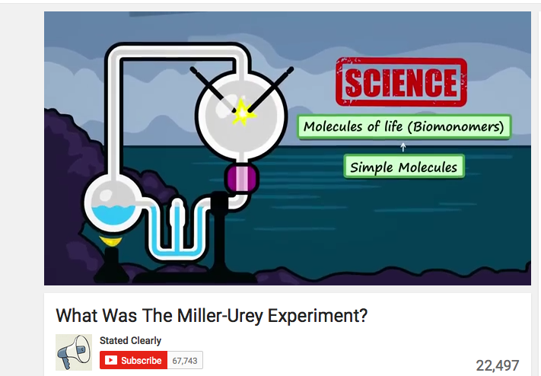
1.5.U2 The first cells must have arisen from non-living material.
These monomers mixed in the ‘primeval soup’, shallow oceans laden with chemicals
where it is thought that they reacted to form biological molecules
LINK

Slide 17
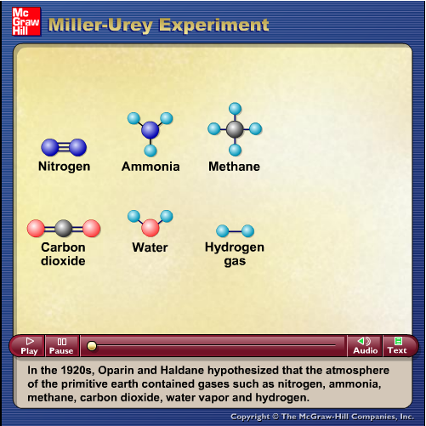
1.5.U2 The first cells must have arisen from non-living material.
After a week they found:
Thirteen of the twenty naturally occurring amino acids
Around 15% of the carbon was now in organic compounds
LINK
LINK

Slide 18
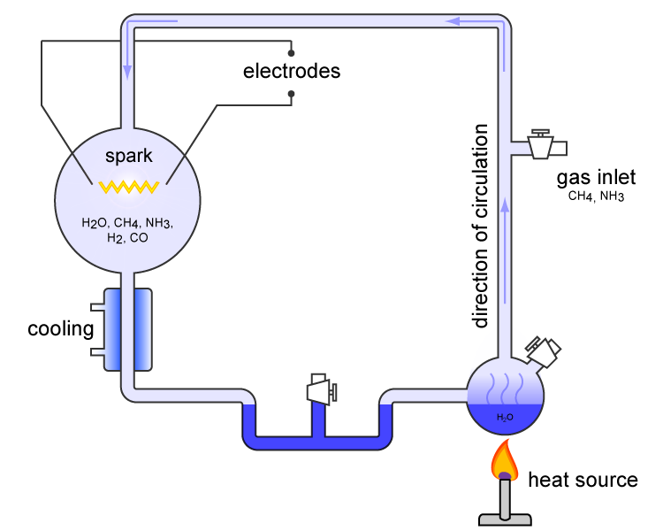
1.5.U2 The first cells must have arisen from non-living material.
1. Non-living synthesis of simple organic molecules:
Miller and Urey recreated the conditions of pre-biotic Earth in a closed system.
These conditions included a reducing atmosphere (low oxygen), high radiation levels, high temperatures and electrical storms
Water was boiled to form vapor and then was mixed with methane, ammonia and hydrogen
The mixture of gases was exposed to an electrical discharge (sparks) to simulate lightning
The mixture was then allowed to cool and after one week was found to contain some simple amino acids and complex oily hydrocarbons
Based on these findings, it was concluded that under the hypothesized conditions of pre-biotic Earth, organic molecules could be formed
Carny http://upload.wikimedia.org/wikipedia/commons/5/59/MUexperiment.png

Slide 19
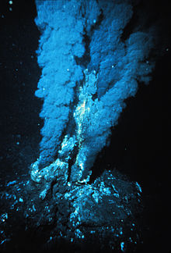
1.5.U2 The first cells must have arisen from non-living material.
2. Assembly of these organic molecules into polymers:
Miller and Urey’s experiments allowed for the formation of amino acids, but the conditions used also tended to hydrolyze (break) bonds preventing polymers forming.
Deep-sea thermal vents
Fissures in a planet's surface from which geothermally heated water issues. Vents are commonly found near in volcanically active areas)
Along with heat energy the Vents issue a ready supply of inorganic chemicals
Vents provide the right conditions and chemicals to allow organic polymers to arise.
http://upload.wikimedia.org/wikipedia/commons/thumb/6/6f/Blacksmoker_in_Atlantic_Ocean.jpg/220px-Blacksmoker_in_Atlantic_Ocean.jpg

Slide 20
1.5.U2 The first cells must have arisen from non-living material.
3. Formation of polymers that can self-replicate (enabling inheritance)
DNA though very stable and effective at storing information is not able to self-replicate by itself – enzymes are required
DNA probably came much later in life
RNA can both store information and self-replicate by itself
Therefore, RNA was probably the molecule of heredity
http://exploringorigins.org/resources.html
For more detail research the RNA World Hypothesis

Slide 21
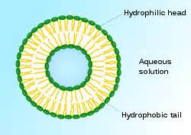
1.5.U2 The first cells must have arisen from non-living material.
4. Formation of membranes to package the organic molecules
Experiments have shown that phospholipids natural assemble into bilayers.
Formation of the bilayer creates an isolated internal environment different from the external environment
The formation of an internal environment means that optimal conditions, e.g. for replication or catalysis can be maintained.
Inside environment put molecules close to each other to facilitate reactions (increased efficiency)
http://upload.wikimedia.org/wikipedia/commons/thumb/0/01/Liposome_scheme-en.svg/220px-Liposome_scheme-en.svg.png

Slide 22
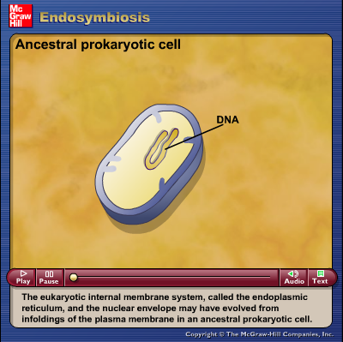
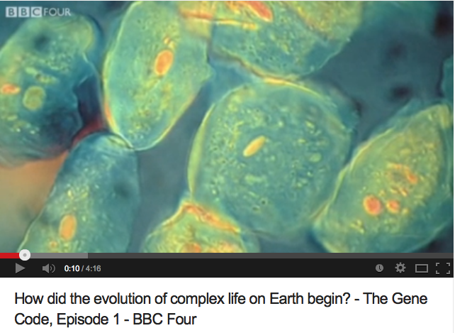
1.5.U3 The origin of eukaryotic cells can be explained by the endosymbiotic theory.
Endosymbiotic theory explains the existence of several organelles of eukaryotes. The theory states that the organelles (e.g. mitochondria and chloroplasts) originated as symbioses between separate single-celled organisms,
LINK
Link

Slide 23
1.5.U3 The origin of eukaryotic cells can be explained by the endosymbiotic theory.
Development of the Nucleus
A prokaryote grows in size and develops folds in it’s membrane to maintain an efficient SA:Vol
The infoldings are pinched off forming an internal membrane
The nucleoid region is enclosed in the internal membrane and hence becomes the nucelus
http://ib.bioninja.com.au/options/option-d-evolution-2/d1-origins-of-life-on-earth.html

Slide 24
1.5.U3 The origin of eukaryotic cells can be explained by the endosymbiotic theory.
The development of chloroplasts would be a very similar process except the benefit to the cell would be glucose/starch instead of ATP
Development of Mitochondria
An aerobic proteobacterium enters a larger anaerobic prokaryote (possibly as prey or a parasite)
It survives digestion to become a valuable endosymbiont
The aerobic proteobacterium provides a rich source of ATP to it’s host enabling it to out-compete other anaerobic prokaryotes
As the host cell grows and divides so does the aerobic proteobacterium therefore subsequent generations automatically contain aerobic proteobacterium.
The aerobic proteobacterium evolves and is assimilated and to become a mitochondrion.
http://ib.bioninja.com.au/options/option-d-evolution-2/d1-origins-of-life-on-earth.html

Slide 25
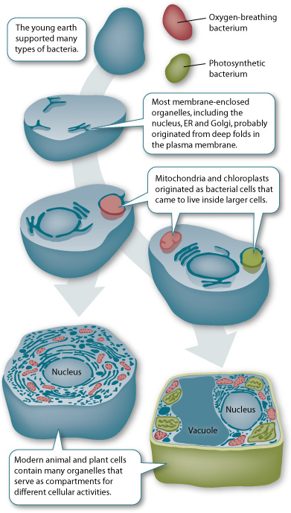
1.5.U3 The origin of eukaryotic cells can be explained by the endosymbiotic theory.
The evidence supporting the endosymbiotic theory for mitochondria and chloroplasts:
They have their own DNA (which is naked and circular)
They have ribosomes that are similar to prokaryotes (70S)
They have a double membrane and the inner membrane has proteins similar to prokaryotes
They are roughly the same size as bacteria and are susceptible to the antibiotic chloramphenicol
They transcribe their DNA and use the mRNA to synthesize some of their own proteins.
They can only be produced by division of pre-existing mitochondria and chloroplasts.
http://sites.roosevelt.edu/mbryson/files/2011/11/endosymbiosis.jpg

Slide 26
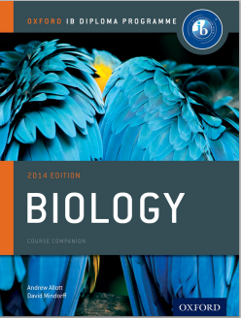
Bibliography / Acknowledgments
Jason de Nys

