Slide 1
Ecological Sampling
Measuring biotic and abiotic components of a system

Slide 2
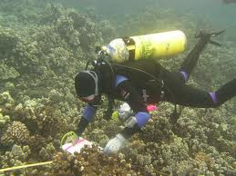
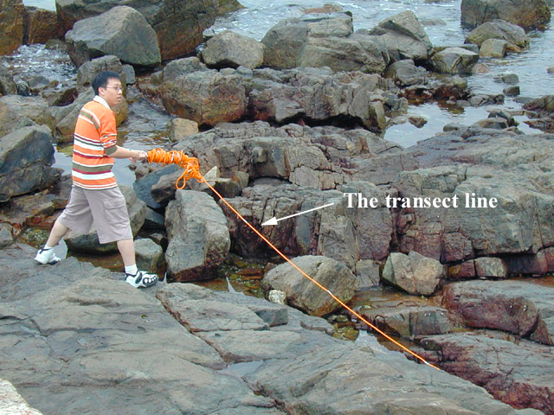
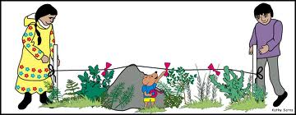
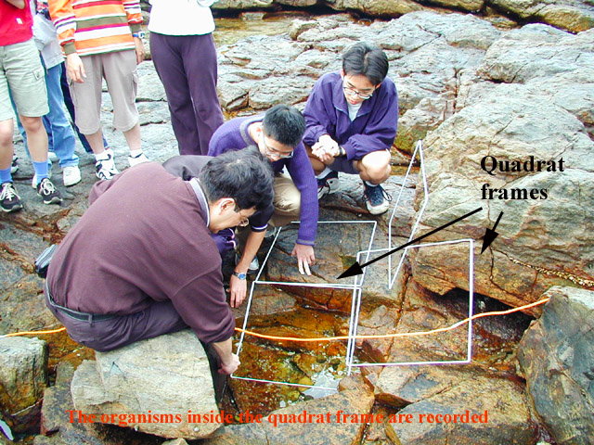
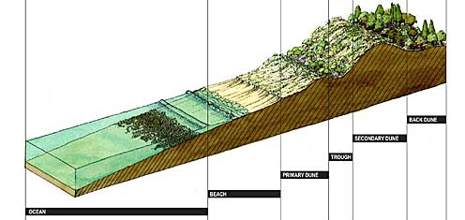

Slide 3
Ecological Sampling
What is a sample?
“A portion, piece, or segment that is representative of a whole”
Why do we sample?
it is usually impossible to measure the whole

Slide 4
One big assumption…
That the sample is representative of the whole
It is necessary to take enough samples so that an accurate representation is obtained
It is important to avoid bias when sampling

Slide 5
Choosing Method
Method 1 – Random Quadrat Method
Define large area of interest to study
Randomly select sub-areas to study.
Hopefully, random quadrats are representative of whole area.
This is used where the habitat being sampled is fairly uniform.
Where statistical tests are to be used which require randomly collected data.

Slide 6
How big and what shape?
Edge effect – As you increase the perimeter of a quadrat, you increase the investigators judgments calls of what is in or out of the quadrat.
Which shape is better and why?

Slide 7
How big and what shape?
Round or Square Quadrats are preferred because they have less perimeter.

Slide 8
Quadrat Size
The best Quadrat size depends on what’s measured.
Quadrat at least two times larger than the average canopy spread of largest species.
Quadrat size should permit most common species to occur in no more than 80% of all quadrats.
Ecologist uses expertise, intuition, and convenience to select quadrat size.

Slide 9
How many Quadrats?
Usually sampling 1 percent of the study area is sufficient.
Study area = 500 m² grassy meadow
Quadrat size 1 m²
5 Quadrats randomly placed
Study area = 5000 m² forest
Quadrat size 10 m²
5 Quadrats randomly placed

Slide 10
How to randomly place Quadrats?
Overlay a quadrat size grid on study area.
Use a random number generator to select quadrat

Slide 11
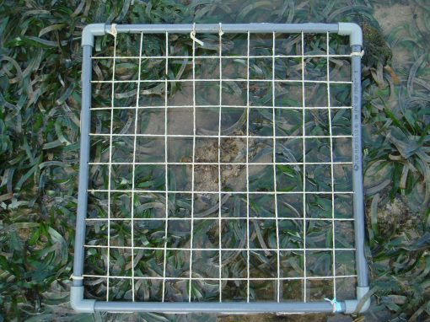
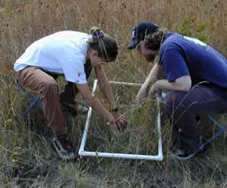
Quadrats

Slide 12
Line Transect
Line transects when an environmental gradient is identified along which communities of plants and, or animals change.
The line is broken into segments to allow analysis.
Best method for dense shrub dominated vegetation.

Slide 13
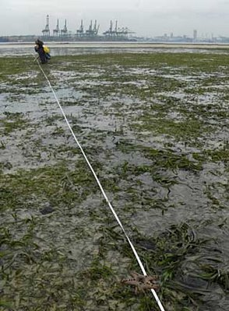
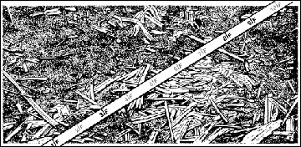
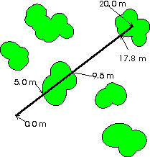
Line Transects

Slide 14
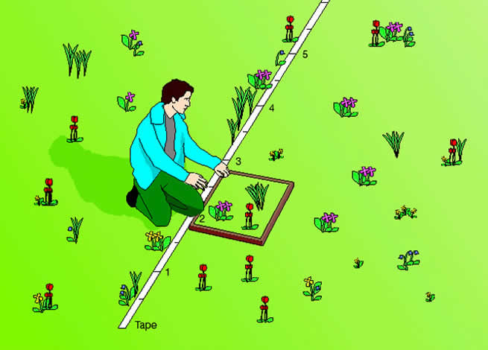
Best of Both Worlds
You can combine both quadrats and line transects.
Quadrats are placed uniformly or randomly along the transect to increase data collection and statistical analysis.

Slide 15
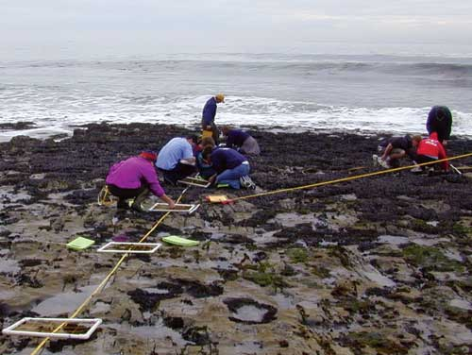

Slide 16
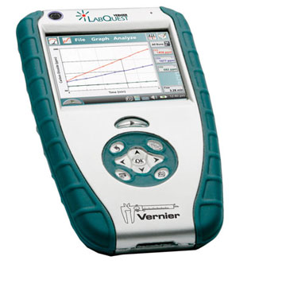
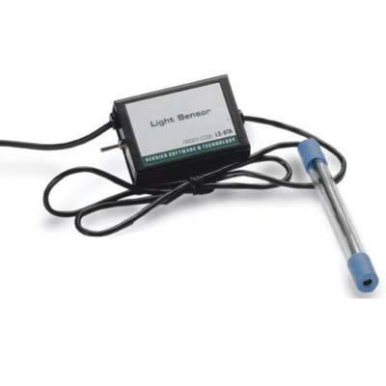
Measuring Abiotic Factors
Light
Light Meter –
Usually measured at chest height and ground height

Slide 17
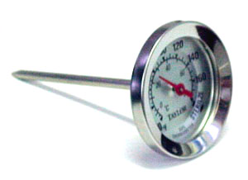
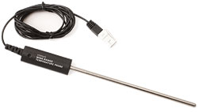
Measuring Abiotic Factors
Temperature
Measured 1 meter above and 0.1m below soil surface.

Slide 18
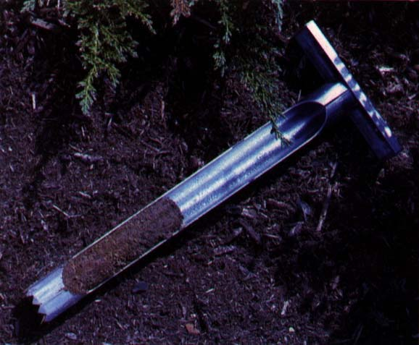
Measuring Abiotic Factors
Soil Properties
Soil pH, moisture, nutrients, and organic content.
Soil collected with a soil borer and brought back to lab for analysis

Slide 19
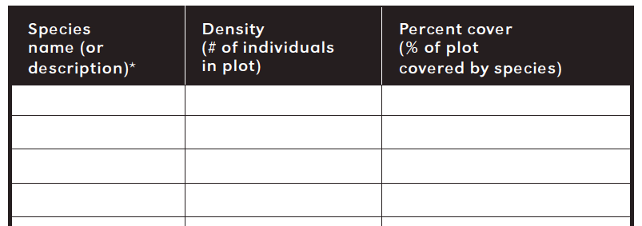
Measuring Biotic Factors
Within Quadrats measurements:

Slide 20
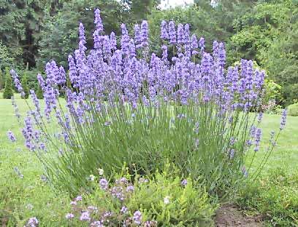
Measuring Biotic Factors
Density: # plants rooted in Quadrat
Area of Quadrat
For Example:
1.3 lavender plants/m²

Slide 21
Measuring Biotic Factors
Within Quadrats measurements:
Relative Density:
= Specific Species Density X100
Sum of ALL species Densities
For Example:
1.3 lavender plants/78.2 total plant density = 1.66

Slide 23
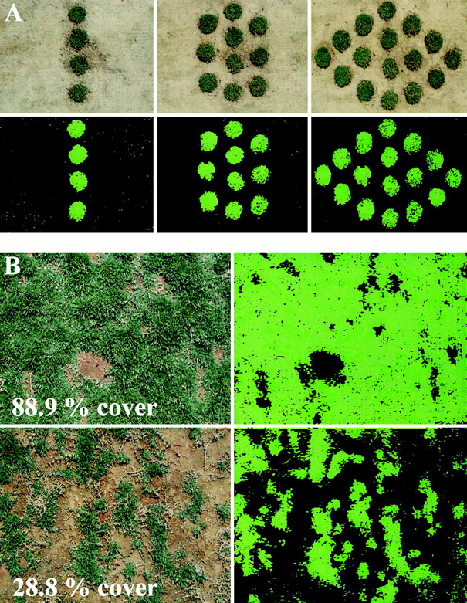
Measuring Biotic Factors
% Cover= % of Quadrat
Area Covered by a Species
For Example:

Slide 24
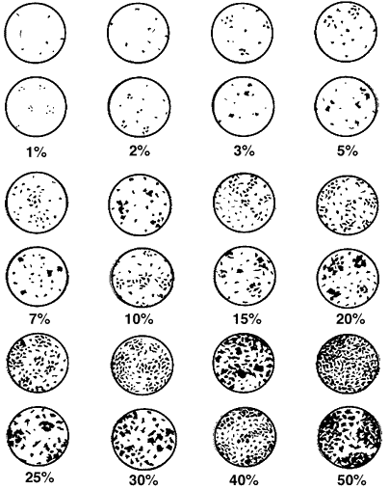
Use best estimating skills to measure percent cover.

Slide 25
Measuring Biotic Factors
Within Quadrats measurements:
Relative Cover:
= Specific Species Cover X100
Sum of ALL species Cover
For Example:
13% lavender plants/98% total plant cover = 13.3

Slide 26
Measuring Biotic Factors
Within Quadrats measurements:
Frequency:
= # of quadrats in which species occur
total # of quadrats sampled
For Example:
lavender plants in 8 quadrats/10 quadrats sampled = 0.8

Slide 27
Measuring Biotic Factors
Within Quadrats measurements:
Relative Frequency:
= species frequency X100
total of frequency values for all species

Slide 28
Measuring Biotic Factors
Line Quadrat measurements:
For each plant encountered on the line –
Record starting point
Record ending point
Record maximum width perpendicular to line
Length= 0.7 m
Width = 1.5 m
1.2 meter
1.9 meter
1.5 meter

Slide 29
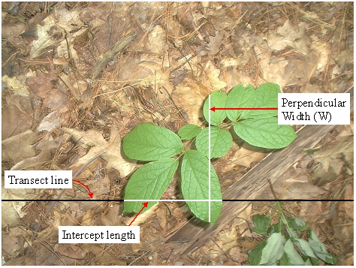

Slide 30
Measuring Biotic Factors
Line Quadrat measurements:
Cover =
sum of intercept lengths for a species X100
total length of transect
Length= 0.7 m
Width = 1.5 m
1.2 meter
1.9 meter
1.5 meter

Slide 31
Measuring Biotic Factors
Line Quadrat measurements:
Density =
Length= 0.7 m
Width = 1.5 m
1.2 meter
1.9 meter
1.5 meter

Slide 32
Measuring Biotic Factors
Line Quadrat measurements:
Frequency
= intervals with species x100
total number of transect intervals
1.2 meter
1.9 meter
1.5 meter

Slide 33
Measuring Biotic Factors
Relative values are calculated the same way as those described with the Quadrat method

Slide 34
Measuring Biotic Factors
Final Calculations
Importance Value = relative density + relative dominance + relative frequency

Slide 35
Measuring Biotic Factors
You need to learn the application of a Belt Transect on your own.

Slide 36
Measuring Biotic Factors
Next, Simpson’s Index

