Slide 1
APUSH Chapter 9
From the Articles to the Constitution…

Slide 2
I. A Shaky Start Toward Union
Disruptive forces stalked the land:
Departed Tories left political system inclined toward experimentation and innovation
Economy stumbled post-Revolution
Yet thirteen sovereign states:
Shared similar political structures
Enjoyed rich political inheritance
Were blessed with good political leaders

Slide 3
II. Constitution Making in the States
Constitutional Congress in 1776 called on colonies to draft new state constitutions:
Asked colonies to summon themselves into being as new states
Sovereignty of new states would rest on authority of the people
Connecticut and Rhode Island merely retouched their colonial charters
Others would write new constitutions

Slide 4
II. Constitution Making in the States (cont.)
Common constitutional features:
As written documents, constitutions represented fundamental law, superior to ordinary legislation
Most contained bills of rights— protect prized liberties against legislative encroachment
Most required annual election of legislators
All created weak executive and judicial branches

Slide 5
II. Constitution Making in the States (cont.)
In new governments, legislatures were granted sweeping powers:
Democratic character reflected by presence of many from recently enfranchised western districts
Their influence was demonstrated when some states moved capitals into interior

Slide 6
III. Economic Crosscurrents
Economic changes:
States seized control of former crown lands
Land was cheap and easily available
In America, economic democracy preceded political democracy
Revolution also stimulated manufacturing

Slide 7
III. Economic Crosscurrents (cont.)
Drawbacks of economic independence:
Most British commerce reserved for loyal parts of the empire
American ships now barred from British and British West Indies harbors
Fisheries were disrupted
Americans could freely trade with foreign nations
New commercial outlets (e.g., China in 1784) partially compensated for loss of old ones

Slide 8
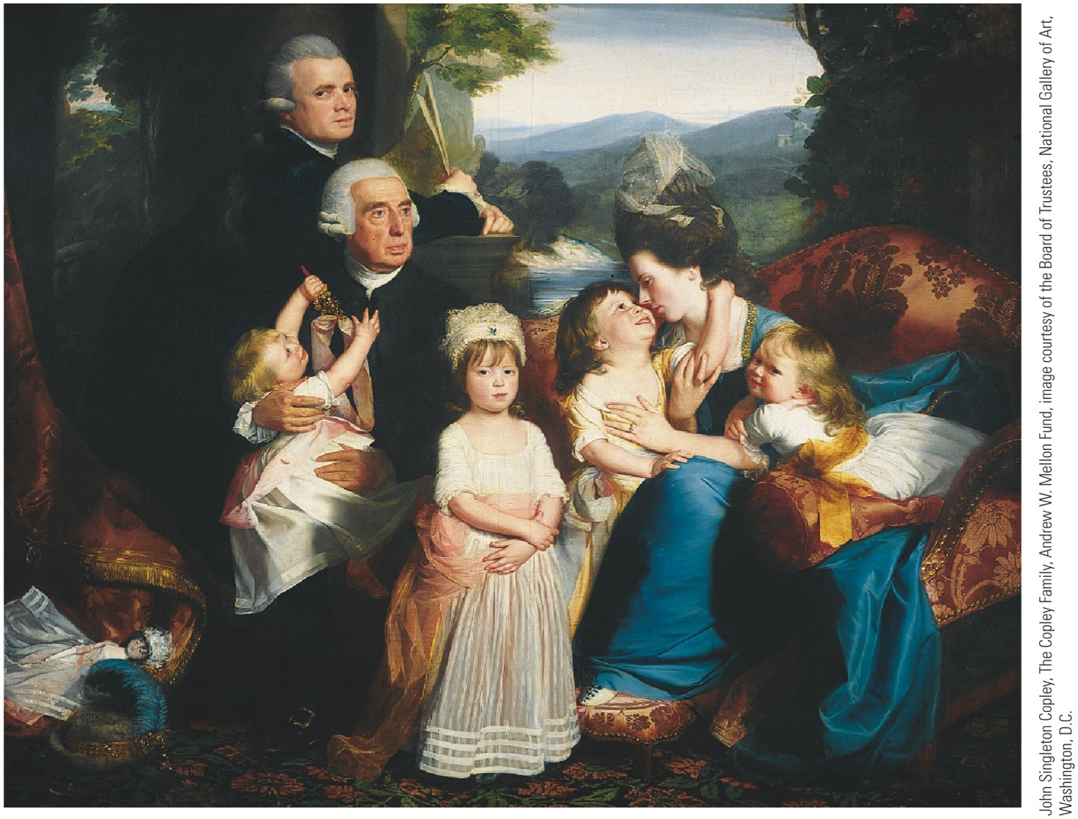
p162

Slide 9
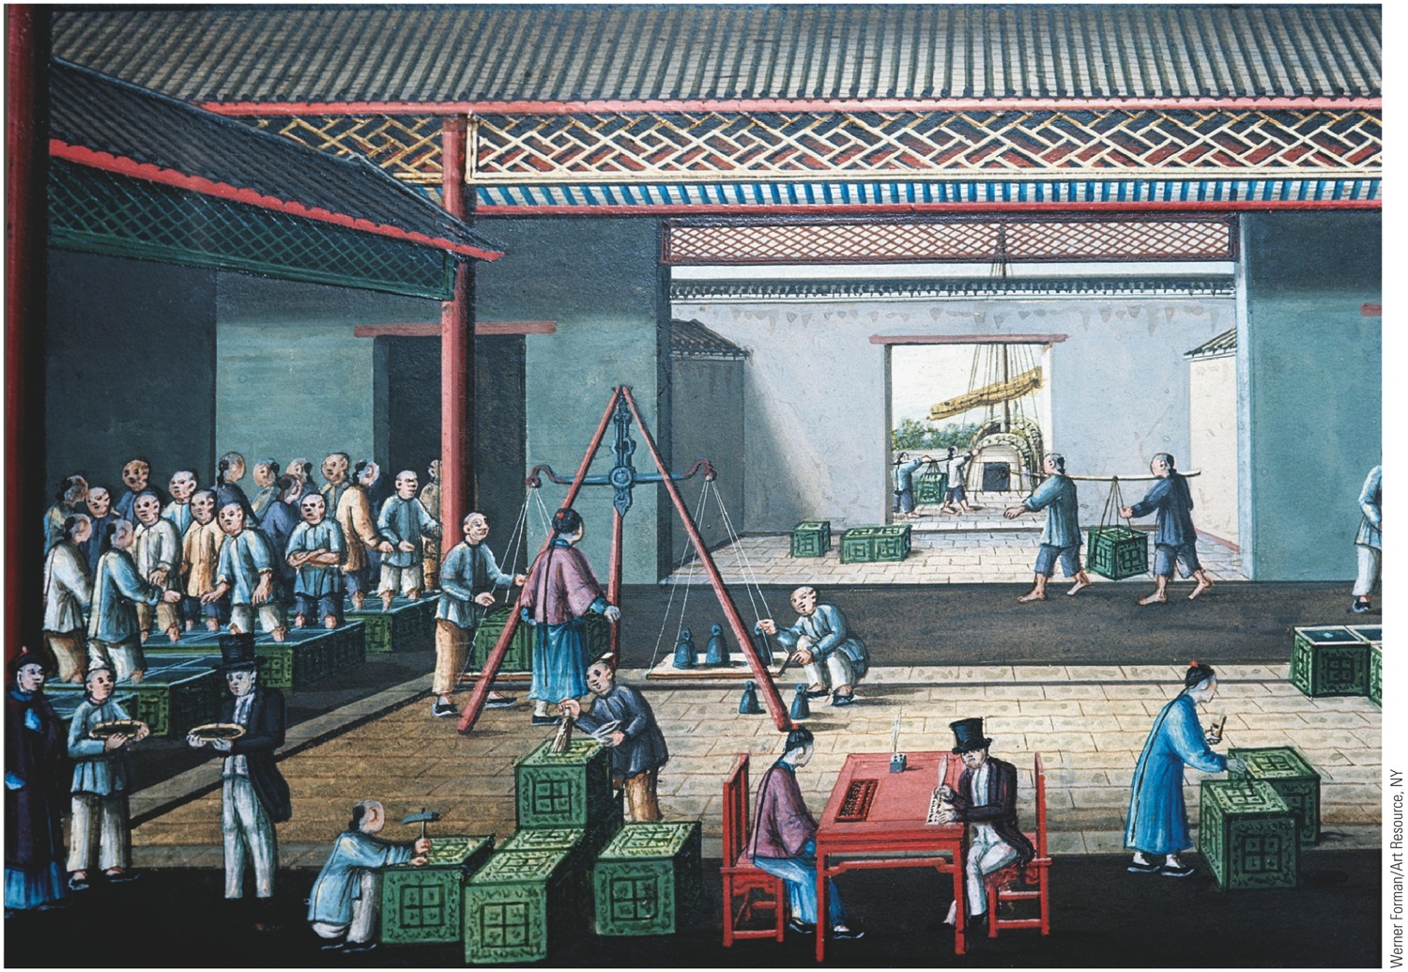
p163
Notes:
Western Merchants Negotiating for Tea in Hong Kong, ca. 1800 Yankee merchants
and shippers figured prominently in the booming trade with China in the late
eighteenth century. Among the American entrepreneurs who prospered in the China
trade was Warren Delano, ancestor of President Franklin Delano Roosevelt.

Slide 10
III. Economic Crosscurrents (cont.)
War spawned demoralizing speculation and profiteering.
State governments borrowed more than they could repay.
Runaway inflation ruined many.
Average citizen was worse off financially at the end of Revolution than at start.

Slide 11
III. Economic Crosscurrents (cont.)
Whole economic and social atmosphere was unhealthy:
A newly rich class of profiteers was conspicuous
Once-wealthy people were destitute
Controversies leading to Revolution had bred:
keen distaste for taxes
encouraged disrespect for laws in general

Slide 12
IV. Creating a Confederation
Second Continental Congress:
Little more than a conference of ambassadors
Was totally without constitutional authority
Asserted some control over military and foreign policy
In all respects, thirteen states were sovereign:
Coined money
Raised armies and navies
Erected tariff barriers

Slide 13
IV. Creating a Confederation (cont.)
Articles of Confederation:
Adopted by Congress in 1777, but not ratified by states until 1781
Chief point of contention was western lands:
6 states had no holdings beyond Allegheny Mtns
7 (esp. New York & Virginia) held huge acreage
Land-rich states could use trans-Allegheny tracts to pay off debts

Slide 14
IV. Creating a Confederation (cont.)
Unanimous approval of Articles by all thirteen states was required:
Maryland held out until March 1781 to get agreement by New York to surrender its western lands
Congress pledged to dispose of these vast areas for “common benefit”
Promised to carve out a number of “republican” states, which overtime would be admitted to union
Pledge redeemed in Northwest Ordinance of 1787 (see Map 9.1).
Disposal of western lands helped encourage union

Slide 15
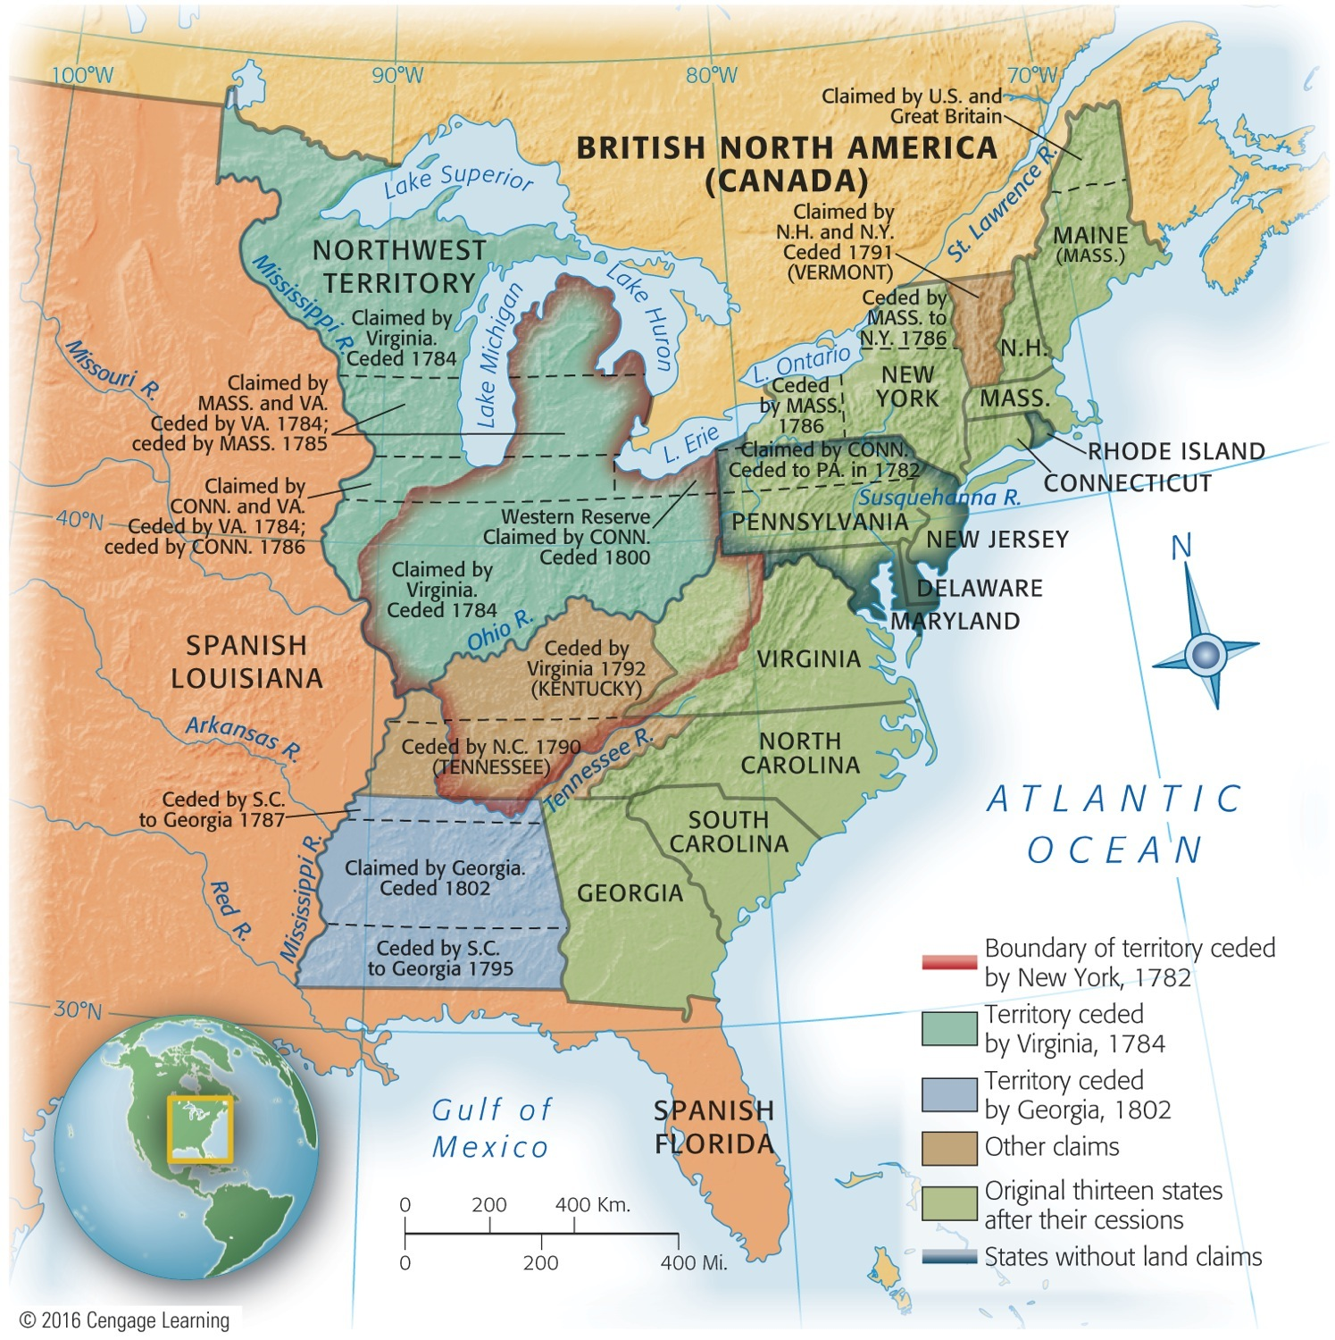
Map 9-1 p164
Notes:
Map 9.1 Western Land Cessions
to the United States, 1782–1802

Slide 16
V. The Articles of Confederation: America's First Constitution
Articles of Confederation:
Provided for loose confederation or “firm league of friendship”
thirteen independent states linked together to deal with common problems, such as foreign affairs
Congress was chief agency
No executive branch
Judicial issues left almost exclusively to states

Slide 17
V. The Articles of Confederation: America's First Constitution (cont.)
Congress, though dominant, was hobbled:
Each state had a single vote
All important bills required support of nine states
Any amendment to Articles required unanimous ratification
Congress was weak—and was purposely designed to be weak

Slide 18
V. The Articles of Confederation: America's First Constitution (cont.)
Two major weakness of Articles:
Congress had no power to regulate commerce
Congress could not enforce its own tax-collection
Congress could advise, advocate, and appeal:
In dealing with states, it could not coerce or control
Nor could it act directly on individuals

Slide 19
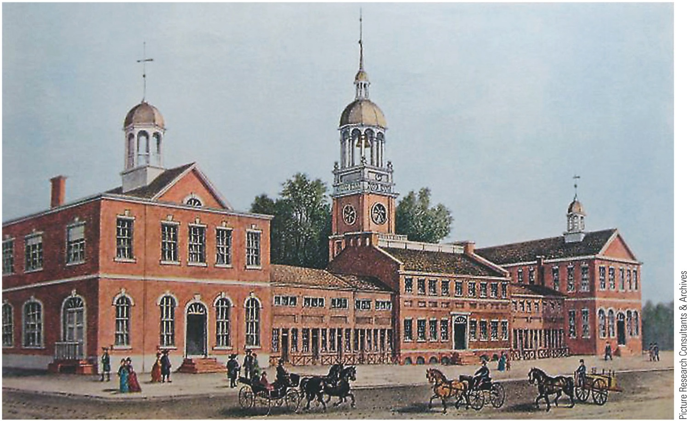
p165
Notes:
Independence Hall, Philadelphia, 1776 Originally built in the 1730s as a meeting place for
the Pennsylvania colonial assembly, this building witnessed much history: here Washington was
given command of the Continental Army, the Declaration of Independence was signed, and the
Constitution was hammered out. The building began to be called “Independence Hall” in the
1820s and is today a major tourist destination in Philadelphia.

Slide 20
VI. Landmarks in Land Laws
Passages of public domain legislation:
Old Northwest = area northwest of Ohio River, east of Mississippi River, south of Great Lakes
Land Ordinance of 1785 (see Map 9.2) set up orderly process to sell land in Old Northwest and use proceeds to pay national debt:
After surveyed, land divided into townships, then into sections
Sixteenth section sold to fund education

Slide 21
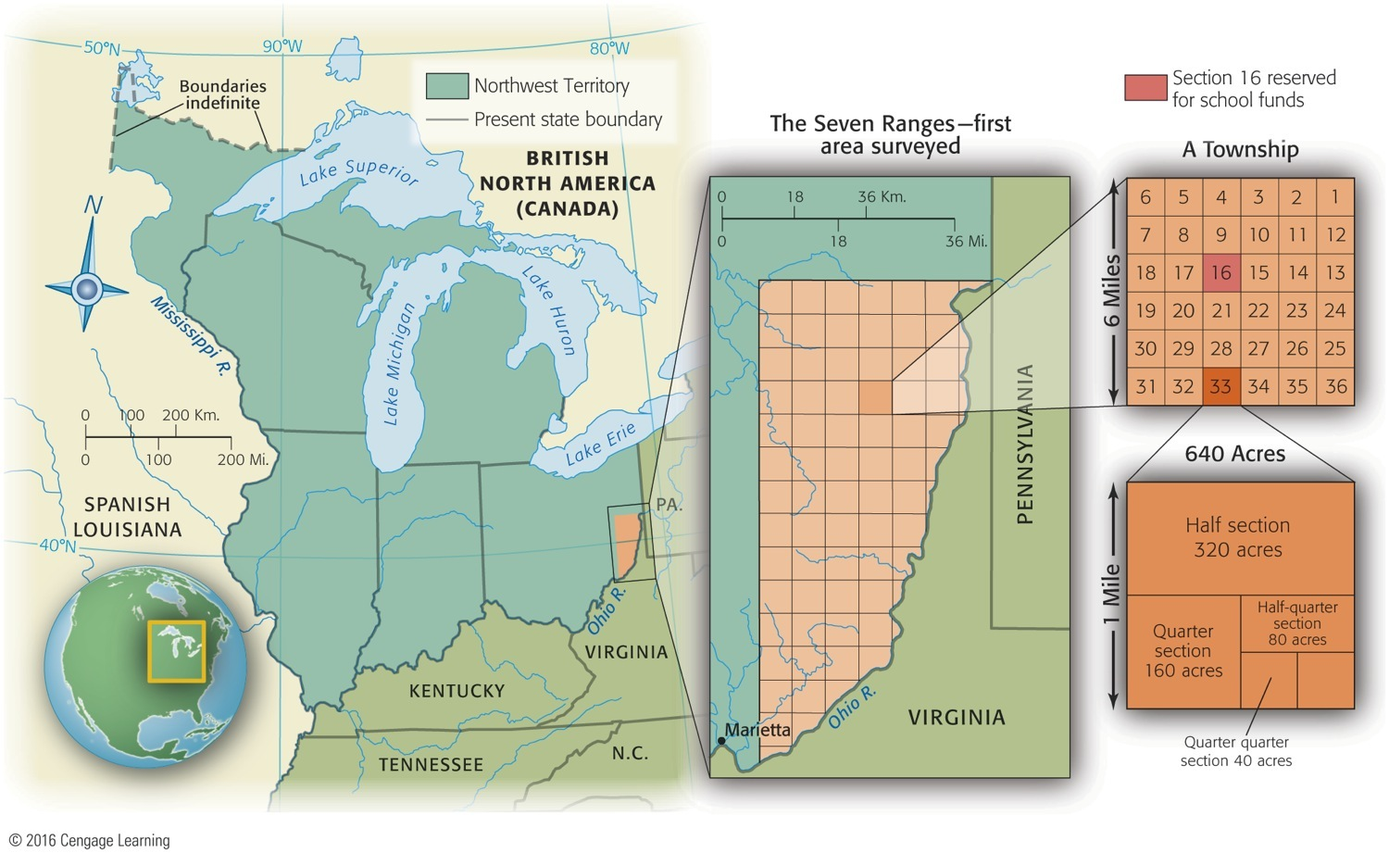
Map 9-2 p166
Notes:
Map 9.2 Surveying the Old Northwest Under the Land Ordinance of 1785 Sections
of a township under the Land Ordinance of 1785.

Slide 22
VI. Landmarks in Land Laws (cont.)
Northwest Ordinance of 1787:
Governance of old Northwest -- how nation would deal with its colonies:
First temporary tutelage, then permanent equality
First, two evolutionary territorial stages under subordination to federal government
Once a territory had 60,000 inhabitants, it could be admitted by Congress as a state
Ordinance forbade slavery in old Northwest

Slide 23
VII. The World's Ugly Duckling
Relations with Britain remained troubled:
England refused to send a minister to America
Declined to negotiate a commercial treaty or to repeal Navigation Laws
Closed West Indies trade to the states
Tried, with help of Allen brothers of Vermont, to annex rebellious area to Canada
Maintained a chain of trading posts on U.S. soil
Continued fur trade with Indians

Slide 24
VII. The World's Ugly Duckling: (cont.)
Spain was openly hostile to new Republic:
Controlled all-important Mississippi River on which pioneers shipped their produce
In 1784 Spain closed river to American commerce threatening West with strangulation
Claimed large areas north of Gulf of Mexico
Schemed with Indians to keep Americans east of Appalachians
Because Spain & Britain influenced Indians, America unable to exercise control over half of its territory (see Map 9.3).

Slide 25
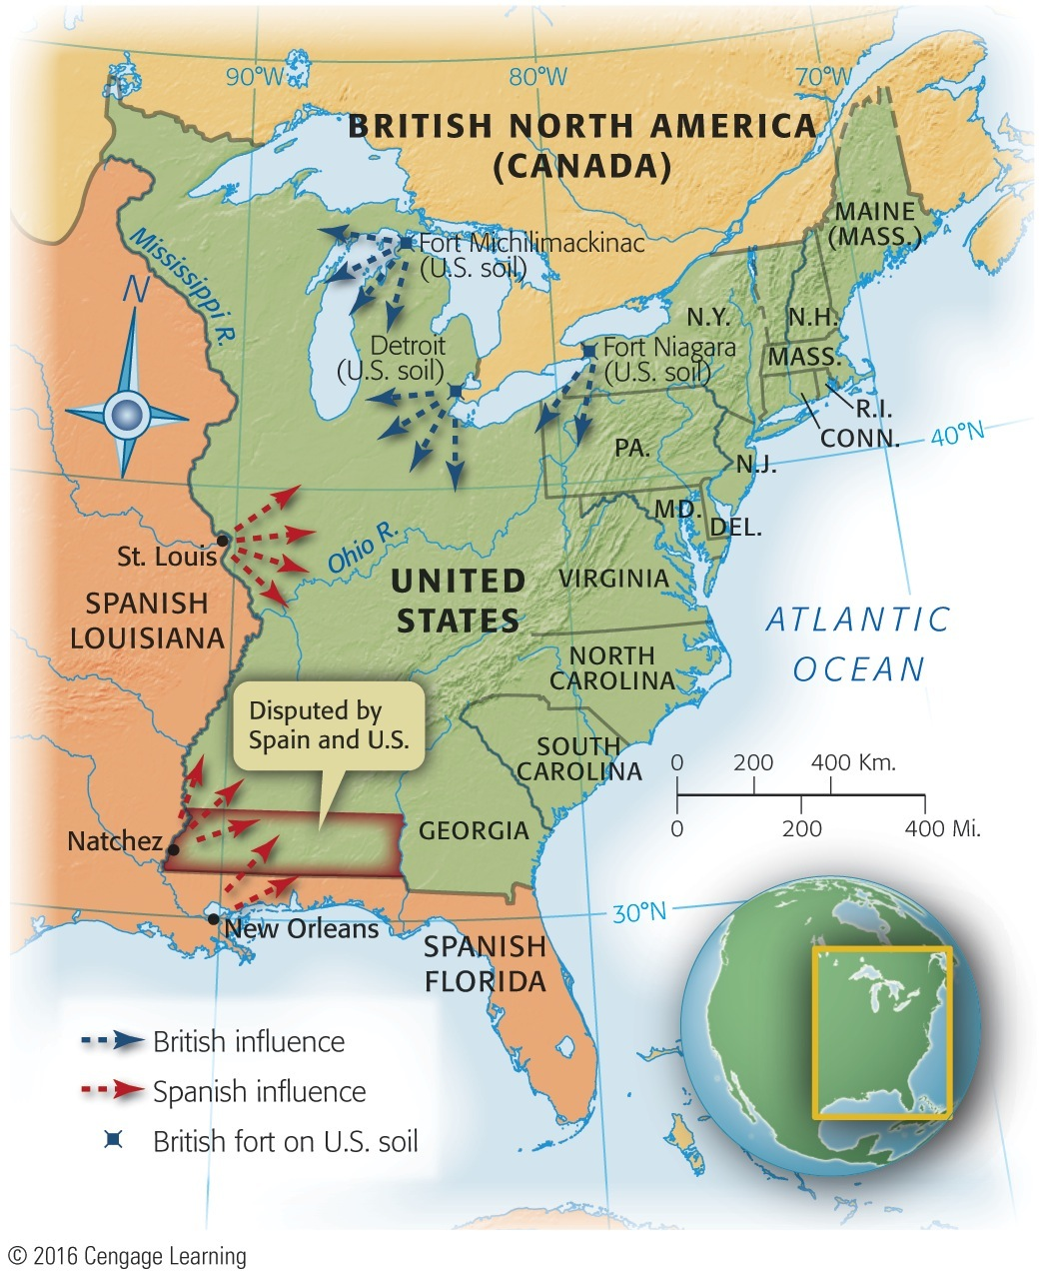
Map 9-3 p167
Notes:
Map 9.3 Main Centers of Spanish and British Influence
After 1783 This map shows graphically that the United
States in 1783 achieved complete independence in name
only, particularly in the area west of the Appalachian Mountains.
Not until twenty years had passed did the new Republic,
with the purchase of Louisiana from France in 1803, eliminate
foreign influence from the east bank of the Mississippi
River. Much of Florida remained in Spanish hands until the
Adams-Oni´s Treaty of 1819 (see p. 239–240).

Slide 26
VII. The World's Ugly Duckling (cont.)
France, America's friend, cooled off now that Britain humbled
North African pirates ravaged America's Mediterranean commence
New nation too weak to fight pirates and too poor to pay bribes.

Slide 27
VII. The Horrid Specter of Anarchy
Economic problems, mid-1780s:
System of raising tax money was breaking down
Interest on public debt was escalating
Some states were levying their own duties
Some were printing depreciated paper money
Shays's Rebellion in western Massachusetts:
Impoverished farmers lost land through mortgage foreclosures and tax delinquencies

Slide 28
VII. The Horrid Specter of Anarchy (cont.)
Led by Captain Daniel Shays, desperate debtors demanded:
State issue paper money, lighten taxes, and suspend property takeovers
Hundreds attempted to enforce demands
Massachusetts authorities responded by raising small army and skirmishes occurred
After 3 Shaysites killed and one wounded, movement collapsed

Slide 29
VII. The Horrid Specter of Anarchy (cont.)
Shays's followers were crushed, but memory remained:
Massachusetts passed debtor-relief laws
Shays's outburst caused fear among propertied class
Civic virtue insufficient to rein in self-interest
Needed stronger central government to block “mobocracy”

Slide 30
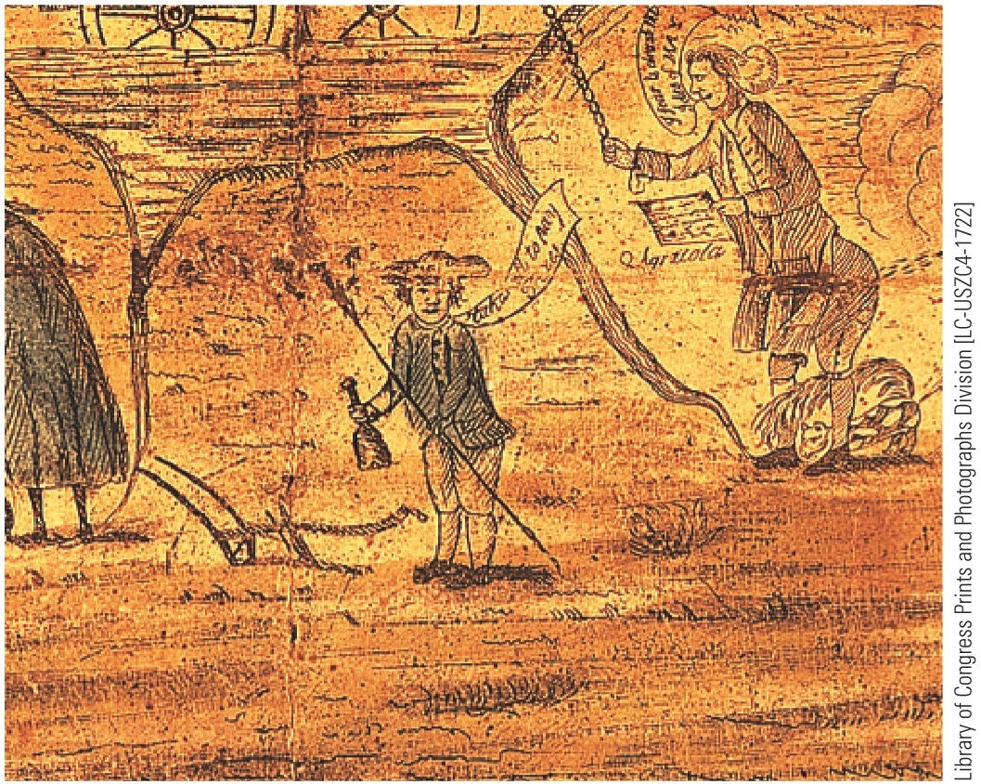
p168
Notes:
Debtors Protest, 1787 This drawing done on the eve of
the writing of the U.S. Constitution features a farmer with a
plow, a rake, and a bottle complaining, “Takes all to pay
taxes.” The discontent of debt-rich and currency-poor
farmers alarmed republican leaders and helped persuade
them that the Articles of Confederation needed to be
replaced with a new constitution.

Slide 31
IX. A Convention of “Demigods”
Annapolis convention of 1786:
Called to deal with commercial disputes
Nine states appointed delegates, only 5 attended
Alexander Hamilton got convention to call for meeting in Philadelphia in 1787 to bolster entire fabric of Articles of Confederation
Eventually Congress agreed to a convention “for the sole and express purpose of revising” Articles
Each state sent representatives, except Rhode Island

Slide 32
IX. A Convention of “Demigods” (cont.)
55 emissaries from 12 states convened in Philadelphia on May 25, 1787
Sessions were held in secrecy, with armed sentinels at doors
Caliber of participants was extraordinarily high—“demigods,” Jefferson called them
Most were lawyers with experience at state constitution-making
George Washington was elected chairman
Benjamin Franklin served as elder statesman

Slide 33
IX. A Convention of “Demigods” (cont.)
James Madison's contributions were so notable he was dubbed “the Father of the Constitution”
Alexander Hamilton advocated a super-powerful central government
Most Revolutionary leaders of 1776 were absent
Jefferson, J. Adams, and Thomas Paine in Europe
Samuel Adams & John Hancock were not elected
Patrick Henry was elected from Virginia, but declined, declaring he “smelled a rat.”
Time had come to fashion a solid political system

Slide 34
X. Patriots in Philadelphia
The 55 delegates:
A conservative, well-to-do body of lawyers, merchants, shippers, land speculators, moneylenders
Not a single person from the debtor groups
Young (average age 42) but experienced statesmen
Nationalists, more interested in preserving young Republic then stirring popular democracy
Hoped to crystallize evaporating pools of Revolutionary idealism into stable political structure that would endure

Slide 35
XI. Hammering Out a Bundle of Compromises
Some delegates decided to completely scrap Articles of Confederation
Despite explicit instructions from Congress to revise
Were determined to overthrow existing government by peaceful means (see Table 9.1)

Slide 36
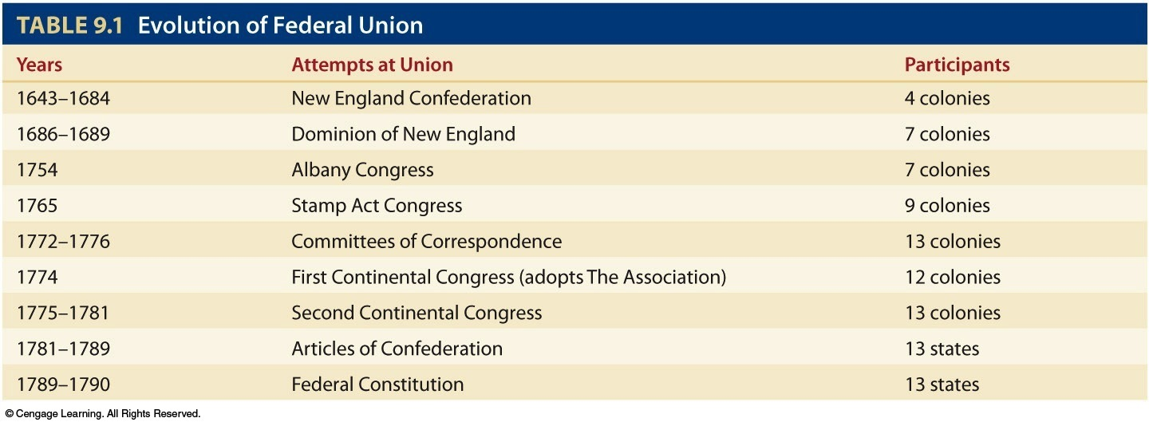
Table 9-1 p171

Slide 37
XI. Hammering Out a Bundle of Compromises (cont.)
Proposals:
Virginia Plan—“large-state plan”: representation in both houses of bicameral Congress would be based on population—an arrangement that advantaged larger states
New Jersey Plan—“small-state plan”: provided for equal representation in unicameral Congress, regardless of size and population
Bitter debate Because small states feared Virginia scheme would allow domination by large states

Slide 38
XI. Hammering Out a Bundle of Compromises (cont.)
The Great Compromise:
Larger states gained representation by population in House of Representatives (Art. I, Sec. II, para. 3 see the Appendix)
Smaller states were appeased by equal representation in Senate (Art. I, Sec. III, para. 1)
Agreed that all tax bills or revenue measures must originate in House, where population counted more heavily (Art. I, Sec. VII, para. 1).
Compromise broke deadlock

Slide 39
XI. Hammering Out a Bundle of Compromises (cont.)
The final Constitution was:
Short Because grew from Anglo-American common law legal tradition
Provide flexible guide to broad rules of procedures rather than detailed laws
The original (unamended) Constitution contained just 7 articles and took about 10 pages to print

Slide 40
XI. Hammering Out a Bundle of Compromises (cont.)
The President:
Broad authority to make appointments to domestic offices, including judgeships
Power to veto legislation
Not absolute power to wage war
Congress retained crucial right to declare war
Constitution a bundle of compromises:
Elect president indirectly by Electoral College rather than by direct means

Slide 41
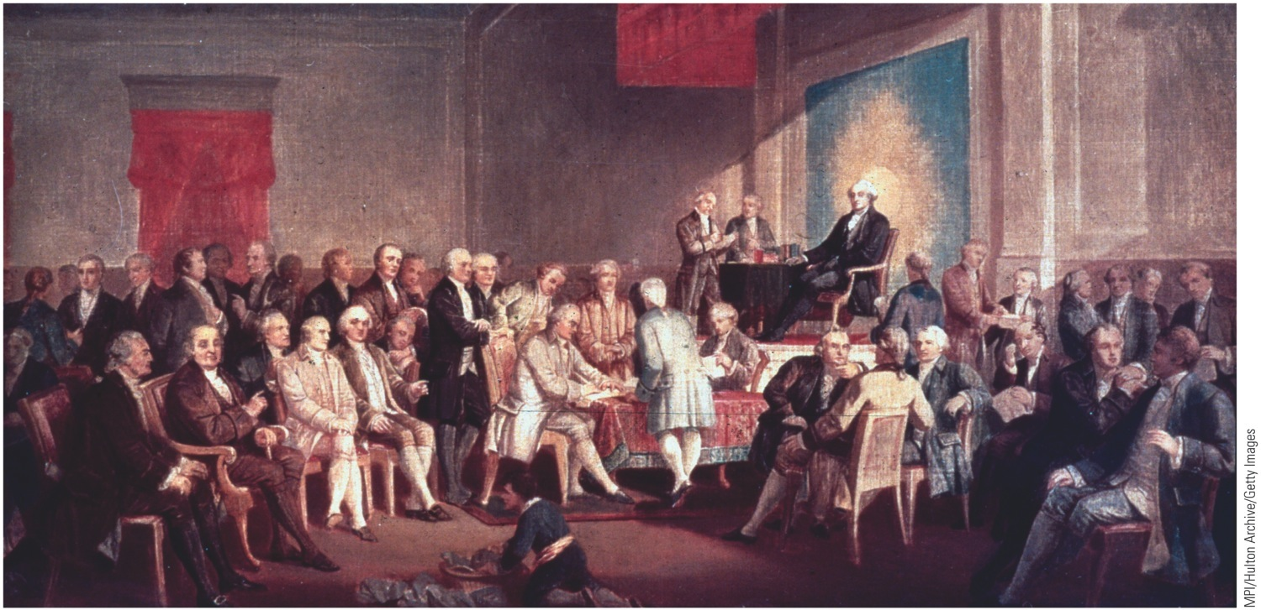
p172
Notes:
Signing of the Constitution of the United States, 1787 George Washington
presided from the dais as the Constitutional Convention's president. At a table in the
front row sat James Madison, later called the Father of the Constitution, who recorded
the proceedings in shorthand. Daily from 10 a.m. to 3 p.m., from late May through mid-
September 1787, the fifty-five delegates wrangled over ideas for a new federal
government.

Slide 42
XI. Hammering Out a Bundle Compromises (cont.)
A state's share of electors based on total of its senators and representatives in Congress (see Art. II, Sec. I, para. 2)
Slavery and Constitution (see Table 9.2):
Three-fifths compromise: slave as three-fifths of a person for representation (see Art. I, Sec. II, para. 3)
Slave trade could continue until end of 1807 (see Art. I, Sec. IX, para 1).

Slide 43
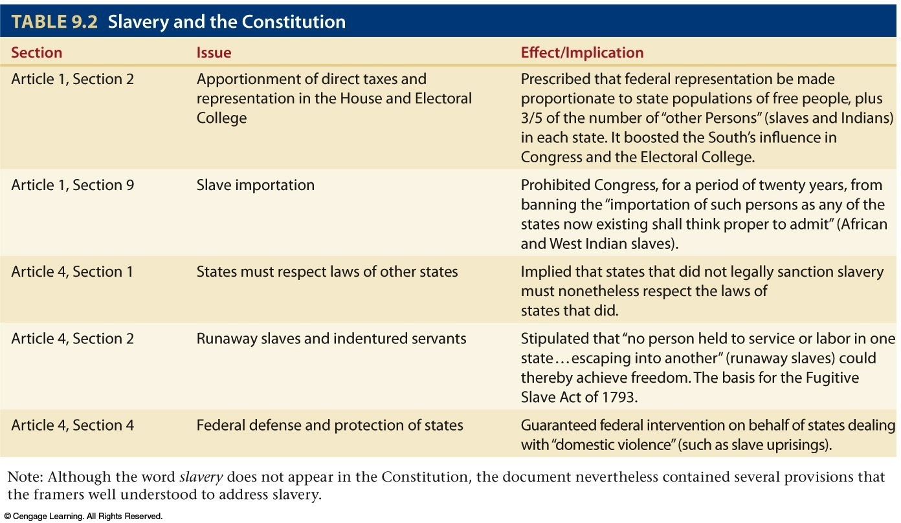
Table 9-2 p173

Slide 44
XIII. The Clash of Federalists and Antifederalists
Framers foresaw that nationwide acceptance of Constitution would be difficult:
Unanimous ratification by all thirteen states required by still-standing Articles of Confederation
Because Rhode Island certain to veto, delegates stipulated that when 9 states had approved through specifically elected conventions, Constitution would be supreme law in those states (see Art. VII).

Slide 45
XIII. The Clash of Federalists and Antifederalists (cont.)
American people were handed a new document (see Table 9.3):
Antifederalists—opposed a stronger federal government
Federalists—supported a strong federal government

Slide 46
XIII. The Clash of Federalists and Antifederalists (cont.)
Antifederalists (Samuel Adams, Patrick Henry, Richard Henry Lee) were states' rights devotees (see Map 9.4), backcountry dwellers, small farmers, paper-moneyites and debtors
Federalists (George Washington, Benjamin Franklin) were those who lived on seaboard, wealthy, educated, better organized
Antifederalists argued document drafted by elite would weaken states & threaten individual liberties

Slide 47
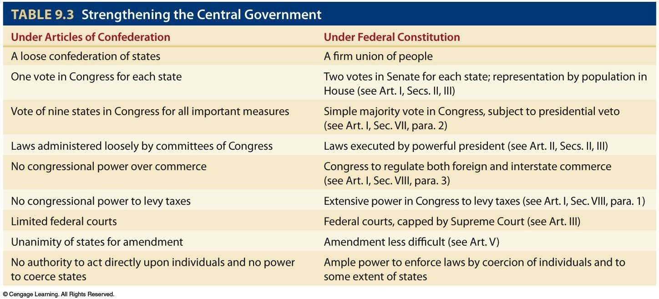
Table 9-3 p174

Slide 48
Division of Government Powers
The key for the states to agree to the Constitution is to understand the division of powers:

Slide 49
Separation of Powers
The division of powers is not just Federal versus state governments. It is also in the three branches of government.

Slide 50
XIV. The Great Debate in the States
Special elections held for members of ratifying conventions (see Table 9.4)
Candidates—federalist or antifederalist—were elected based on whether they were for or were against Constitution
Four small states quickly accepted Constitution
Pennsylvania was first large state to ratify
Massachusetts presented challenges, including demand for bill of rights

Slide 51
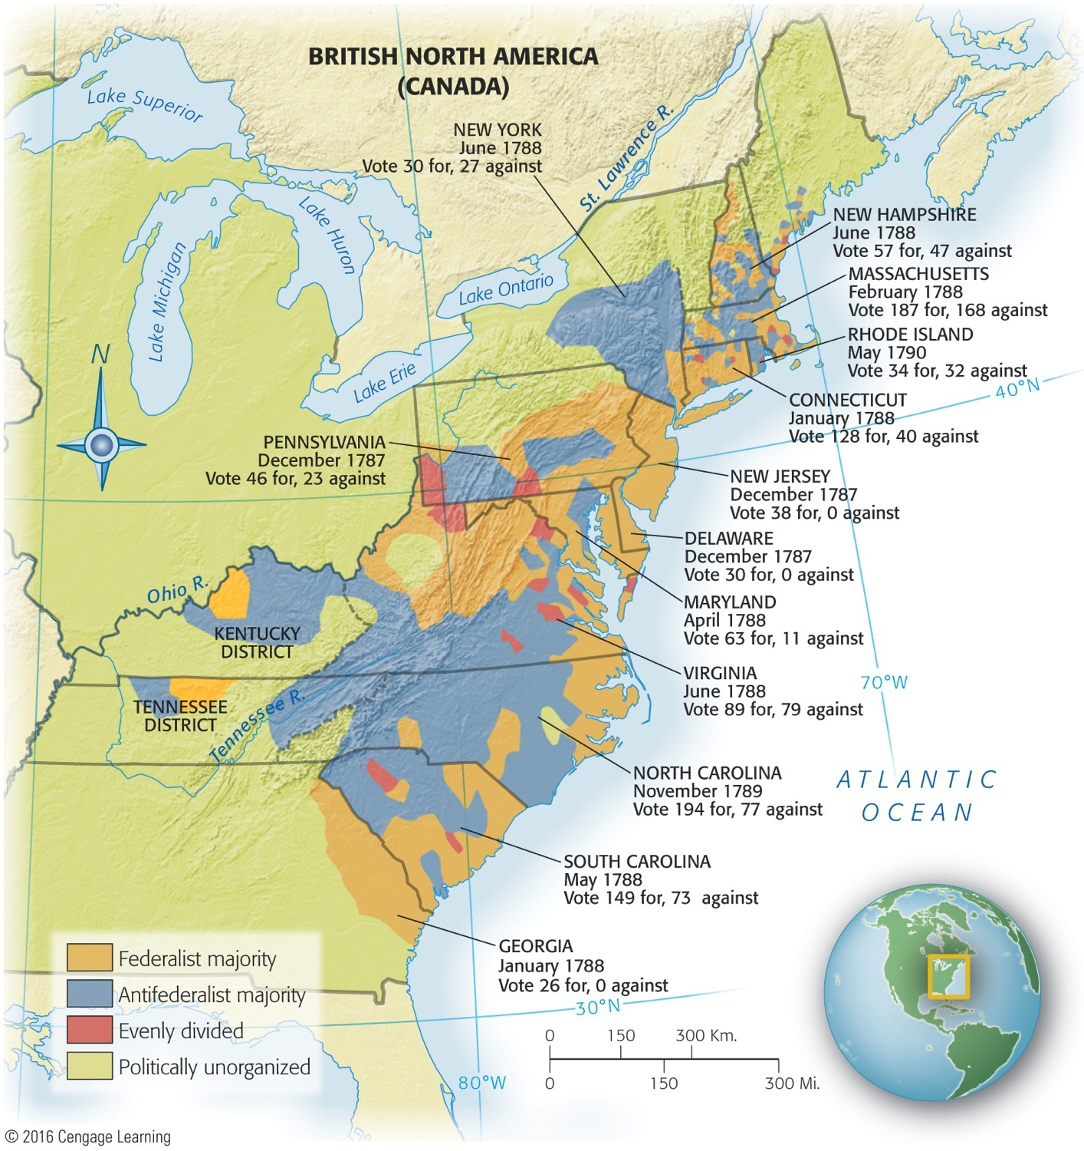
Map 9-4 p175
Notes:
Map 9.4 The Struggle over
Ratification This mottled map
shows that federalist support
tended to cluster around the
coastal areas, which had enjoyed
profitable commerce with the
outside world, including the
export of grain and tobacco.
Impoverished frontiersmen,
suspicious of a powerful new
central government under the
Constitution, were generally
antifederalists.

Slide 52
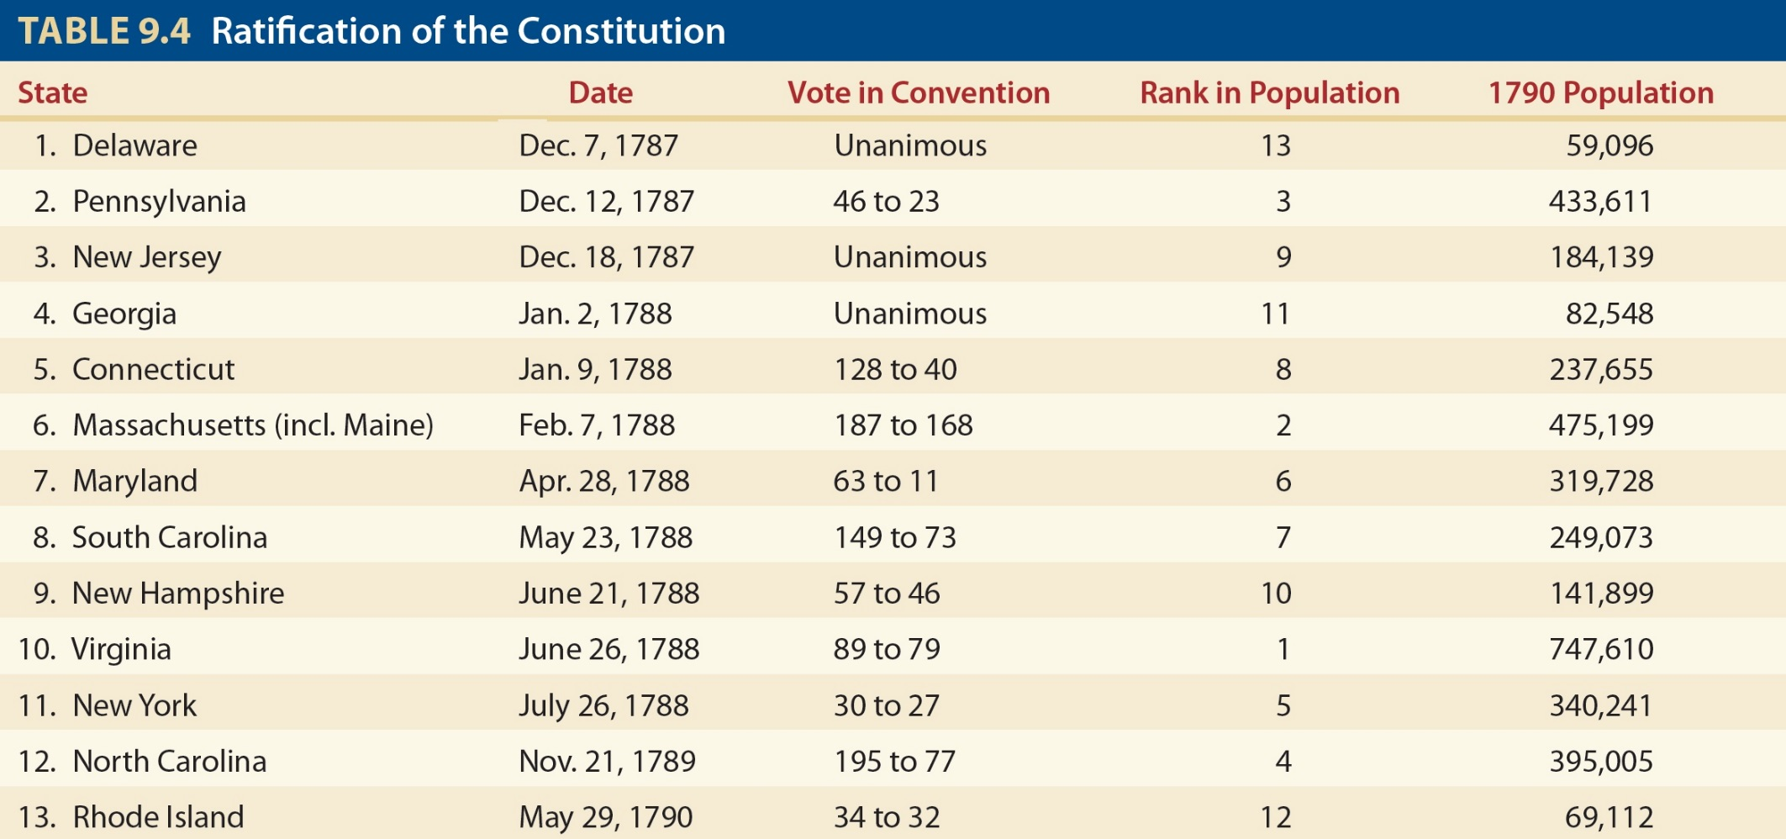
Table 9-4 p175

Slide 53
XIV. The Great Debate in the States (cont.)
Once assured of such a protection, Massachusetts ratified by margin of 187 to 168
Three more states then signed
New Hampshire was the last
All but Virginia, New York, North Carolina, and Rhode Island had taken shelter under “new federal roof”
Document officially signed on June 21, 1788

Slide 54
XV. The Four Laggard States
Virginia:
Provided fierce antifederalist opposition
They claimed document was death warrant of liberty
Federalists G. Washington, J. Madison, and John Marshall lent influential support
After intensive debate, state convention ratified it 89 to 79

Slide 55
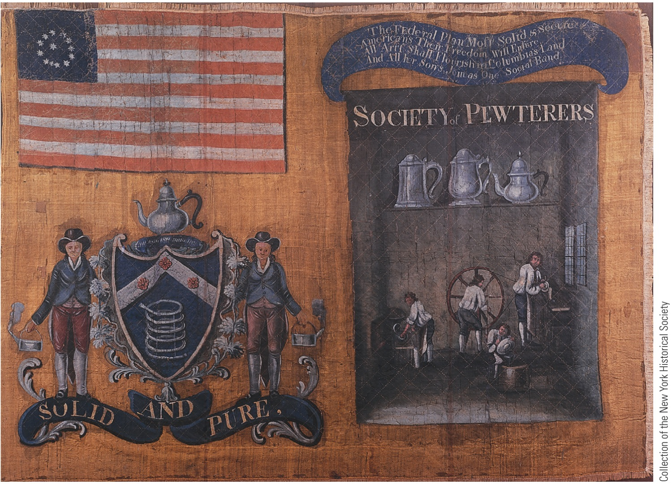
p176
Notes:
Banner Paraded by the Society
of Pewterers in New York City,
1788 This silk banner was carried
by members of the Society of
Pewterers in a parade in New York
City, on July 23, 1788, to celebrate
the impending ratification of the
United States Constitution by New
York State. The enthusiasm of these
craftsmen for the Constitution
confirms that not all federalists
were well-to-do.

Slide 56
XV. The Four Laggard States (cont.)
New York:
Alexander Hamilton joined John Jay and James Madison in a series of federalist newspaper articles
The Federalist Papers were most penetrating commentary ever written on Constitution
Most famous one is Madison's Federalist No. 10
Refuted that it was impossible to extend a republican form of government over a large territory
New York finally yielded, ratifying by count of 30 to 27

Slide 57
XV. The Four Laggard States (cont.)
North Carolina, after a hostile convention, adjourned without taking a vote
Rhode Island didn't summon a convention, rejected Constitution by popular referendum
Two most ruggedly individualist centers remained true to form

Slide 58
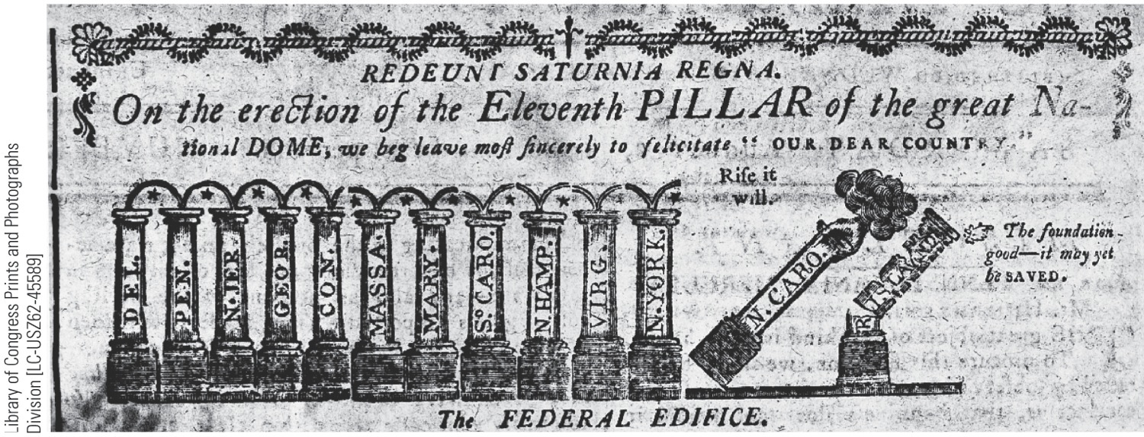
p177
Notes:
A Triumphant Cartoon
This cartoon appeared in the
Massachusetts Centinel on
August 2, 1788. Note the two
laggards, especially the sorry
condition of Rhode Island.

Slide 59
XV. The Four Laggard States (cont.)
No lives were lost, but riots broke out in New York and Pennsylvania.
Lots of behind-the-scenes pressure on delegates who had promised to vote against Constitution.
Last four states ratified, not because they wanted to, but because they had to:
Could not safely exist outside new nation

