Slide 1
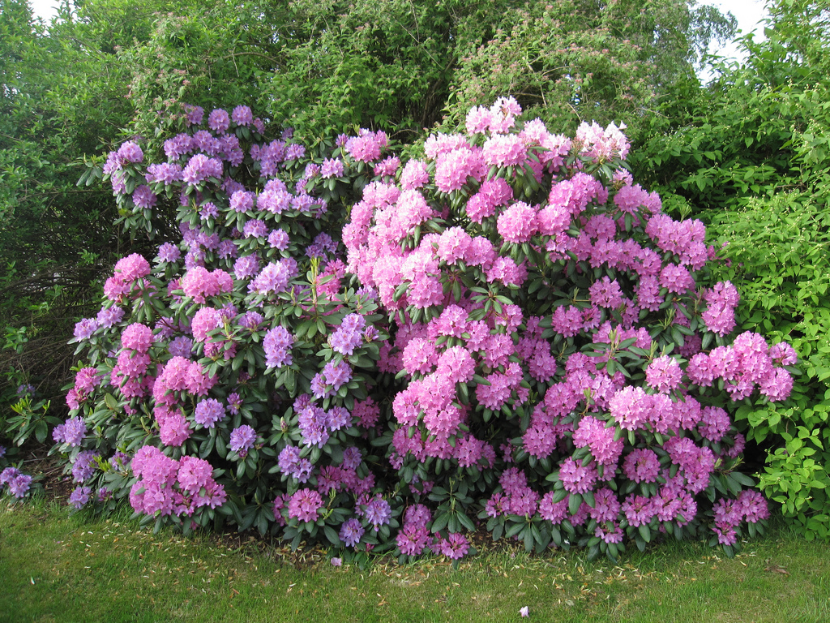
C.3 Impacts of humans on ecosystems
Essential idea: Human activities impact on ecosystem function.
Rhododendrons are beautiful eye catching shrubs that grow in many gardens throughout the world. Rhododendrons are native to alpine regions in Asia. Since their introduction to non-native regions they become an invasive species causing major disruptions to ecosystems, e.g. in Western Europe they have out-competed local woodland plants causing major reductions in local biodiversity.
By Chris Paine (Modified by D. Knox)

Slide 2
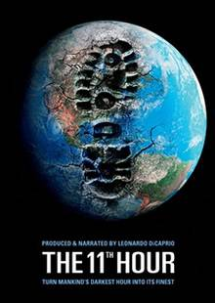
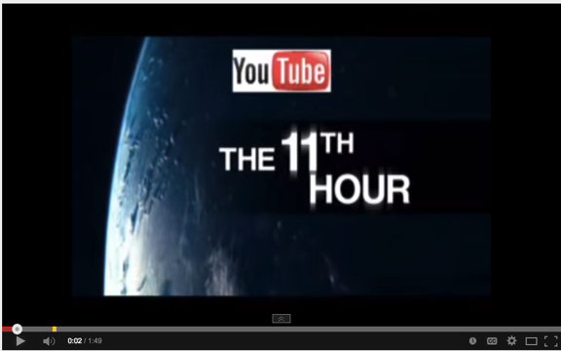
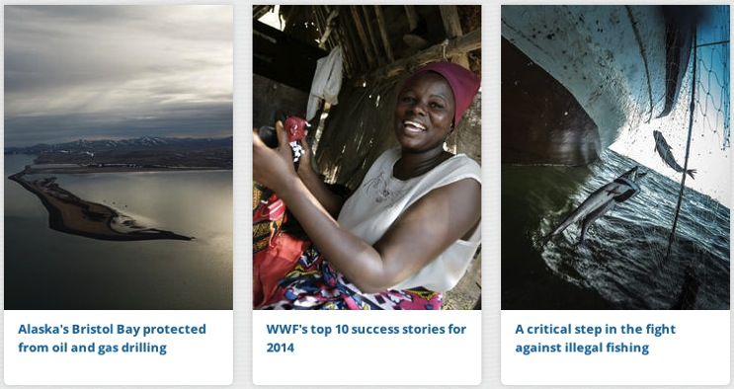
Human Impacts on ecosystems
Watch Leonardo Di Caprio’s message before watching his very poignant movie “The 11th Hour”
The WWF and UNEP links gives more information about the issues and what can and is being done to solve problems

Slide 3
C.3.U1 Introduced alien species can escape into local ecosystems and become invasive.

Slide 4
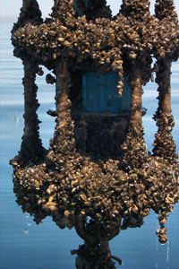
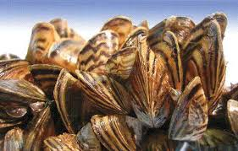
C.3.U1 Introduced alien species can escape into local ecosystems and become invasive.
Native to the lakes of southern Russia
Invasive species in North America, Great Britain, Italy,
Spain, and Sweden.
- They disrupt the ecosystems and damage harbors,
waterways, ships and boats, and water treatment/
power plants. The zebra mussels also cling to pipes under
the water and clog them.
-cost of management of zebra mussel in the Great Lakes
alone exceeds $500 million a year
Believed to be the source of deadly Avian botulism (bacteria)
poisoning that has killed 10,000s of birds in the Great Lakes
Causing the near extinction of many species in the Great Lake
system by out-competing native species for food and by
growing on top of and suffocating the native clams and mussels
https://en.wikipedia.org/wiki/Zebra_mussel

Slide 5
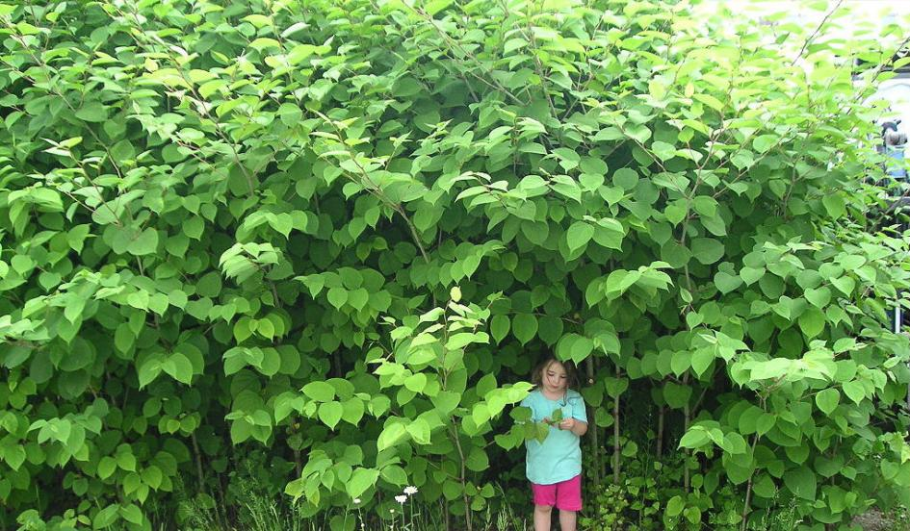
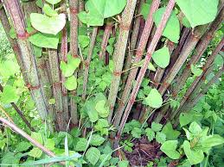
C.3.U1 Introduced alien species can escape into local ecosystems and become invasive.
Native to East Asia (Japan, china, And Korea)
Invasive to Europe, North America, and Australia. Its actually illegal to grow this
In your yard in Australia.
Categorized by the ”World Conservation Union” as one of the world’s worst invasive species
Introduced in the 19th century to Britain as an ornamental species (pretty in my yard)
It has an invasive root system that damages concrete foundations and roads. It clogs flood
Channels.
Grows very thick and crowds (out competes) native species.
UK – Banks may refuse mortgage if plant is found on property
Very difficult to eradicate
https://en.wikipedia.org/wiki/Fallopia_japonica

Slide 6
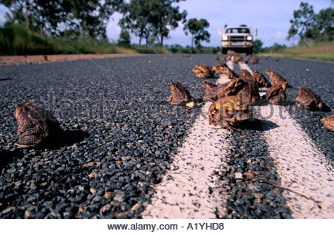
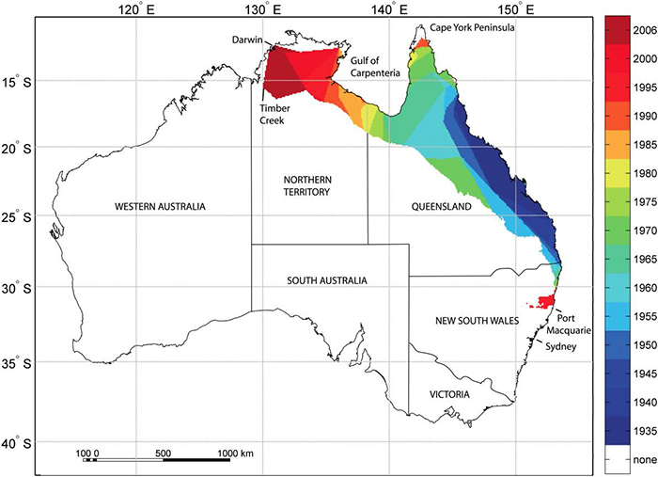
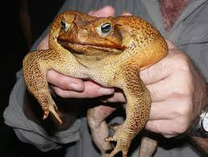
C.3.U1 Introduced alien species can escape into local ecosystems and become invasive.
-SPECIFICALLY NAMED IN IB SYLLABUS

Slide 7
C.3.U1 Introduced alien species can escape into local ecosystems and become invasive.
-SPECIFICALLY NAMED IN IB SYLLABUS
Australia’s isolation made it really suseptable to invasive speces (no natural predators or parasites)
Invasive rabbits, foxes, cats, and plants have overwhelmed the native flora and fauna.
-
- Toads are native to Central and South America
- Adult Toads can be 1.8 kg and are poisonous (usually not deadly but makes you very sick)
102 toads were introduced to Australia in 1935 in an attempt to control insects eating the sugar cane crop.
Now there are estimated over 200,000,000 and have been known to spread disease affecting local biodiversity
No evidence that the toad affected the insects eating the sugar cane.
Toads are adapting to new habitats and eating everything.

Slide 8
C.3.U1 Introduced alien species can escape into local ecosystems and become invasive.
-Eradication (removal)
Proposed introduction of virus or bacteria but will it also affect local populations
Release sterile males to compete with fertile males.
Insert gene into females so they only produce male offspring
Chemical lure in water to attract tadpoles.
All proposals but nothing has worked to a great extent

Slide 9
Other examples of Invasive Species
10-of-the-worlds-worst-invasive-species (at least for this article)
United States Department of Agriculture Website
Global Invasive Species Database (Egypt)

Slide 10
C.3.U2 Competitive exclusion and the absence of predators can lead to reduction in the numbers of endemic species when alien species become invasive.
Competitive exclusion principle: Two species cannot occupy the same niche in a community, as there will be competition for the same resources. When one species has even the slightest advantage or edge over another then the one with the advantage will dominate.
Advantages can come in different forms for example:
High reproductive rate
Larger size / more aggressive
Faster / more efficient forager
Absence of predator
Invasive species often lack a predator, due to being in a foreign environment. In the case of invasive plants this can mean an absence of suitable herbivores.

Slide 11
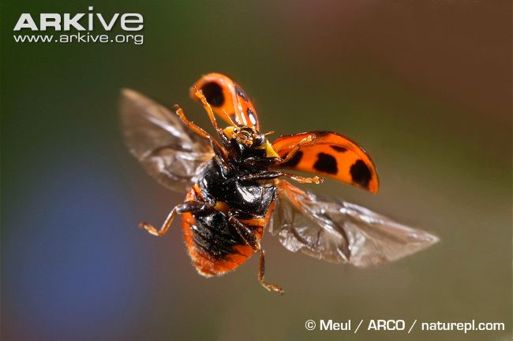
C.3.U2 Competitive exclusion and the absence of predators can lead to reduction in the numbers of endemic species when alien species become invasive.
The harlequin ladybird was originally introduced to the United Kingdom as a biological control agent to manage populations of aphids and other agricultural pests.
broad diet
live in a broad range of habitats
The large size (relative to native ladybirds)
high reproductive rate
occupies a large fundamental niche (can affect many species)
Strong competitor
Consequence: native ladybird species are being outcompeted and becoming endangered.
Additional downside: In cooler weather when there is a lack of aphids, the harlequin ladybird may eat fruit crops, which can cause economic loss.
http://www.arkive.org/uk-invasive-species/image-G78823

Slide 12
C.3.S2 Evaluation of eradication programmes and biological control as measures to reduce the impact of alien species.

Slide 13
C.3.S2 Evaluation of eradication programmes and biological control as measures to reduce the impact of alien species.
http://www.issg.org/database/welcome/
Research two different species and evaluate the management strategies

Slide 14
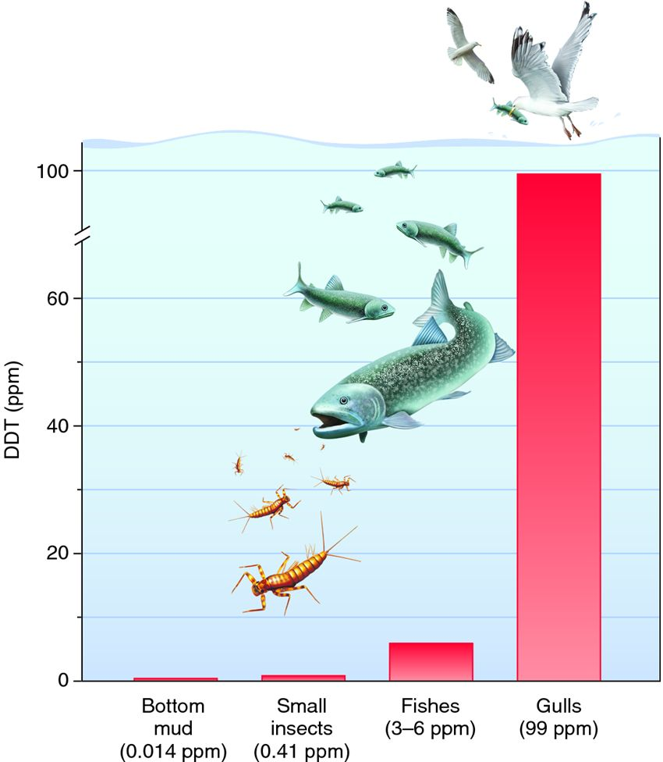
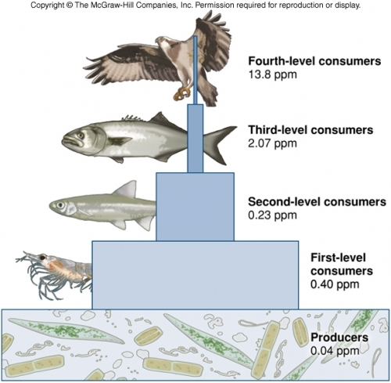
Biomagnification
Pollutants become concentrated in the tissues of organisms at higher trophic levels.

Slide 15
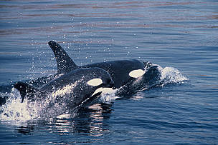
C.3.U3 Pollutants become concentrated in the tissues of organisms at higher trophic levels by biomagnification.
Norwegian killer whales most toxic mammals in Arctic
http://wwf.panda.org/?53520/norwegian-killer-whales-most-toxic-mammals-in-arctic

Slide 16
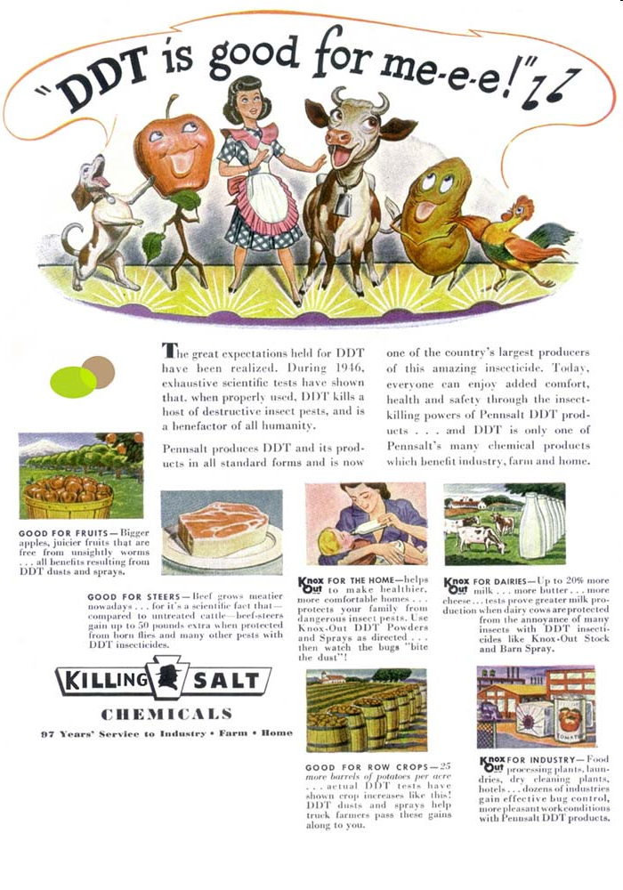
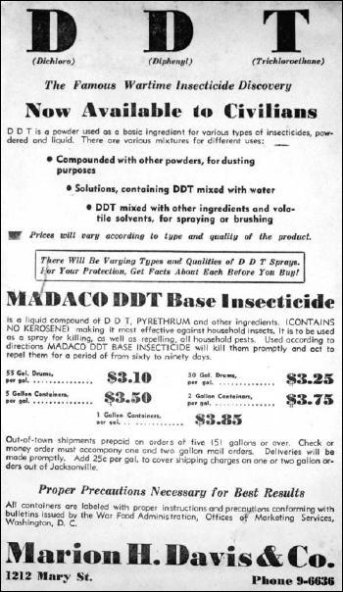
DDT – (dichlorodiphenyltrichloroethane) was applied to crops to control insect damage.
DDT Preparation and Use in 1946 Health Campaign Against Malaria in Kenya
Relatively Cheap

Slide 17
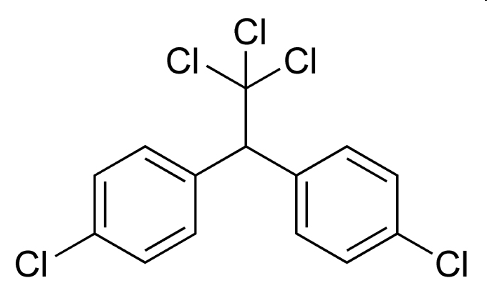
DDT
DDT (dichlorodiphenyltrichloroethane) was applied to crops to control insect damage starting in the 1940s
In the early 1970s, it was discovered that DDT had entered the food chain.
Fish ate insects sprayed with DDT.
Hawks, eagles, and pelicans ate the fish.

Slide 18
C.3.U3 Pollutants become concentrated in the tissues of organisms at higher trophic levels by biomagnification.

Slide 19
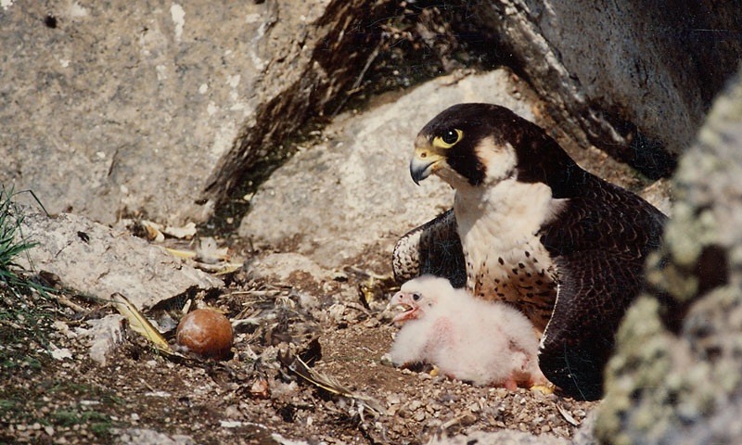
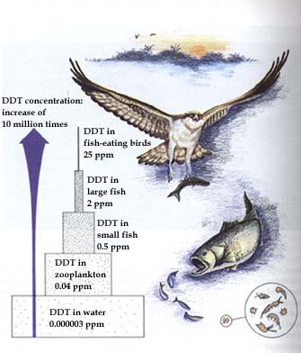
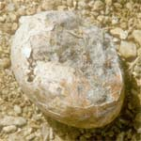
C.3.S1 Analysis of data illustrating the causes and consequences of biomagnification.
Read the essay on the biomagnification of DDT and the effect on Peregrine Falcons (Falco peregrinus):
Key dates:
1955 – DDT use as a pesticide becomes widespread in the US
1972 – DDT usage in the US is banned
Biomagnification of DDT in a different predatory bird
http://www.fws.gov/contaminants/images/DDT.jpg
http://www2.ucsc.edu/scpbrg/Images/Peregrines/crushedegg.jpg
http://www.nps.gov/yuch/naturescience/images/PeregrineAdultWithChicks.jpg

Slide 20
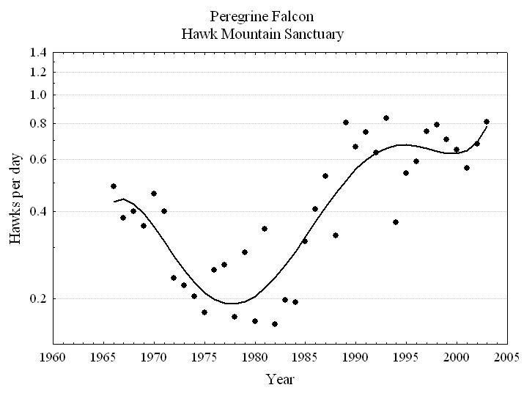
C.3.S1 Analysis of data illustrating the causes and consequences of biomagnification.
Analysis questions:
Describe the trend shown by the data.
Deduce the strength of the correlation
Evaluate the limitations of the data in supporting the link between DDT and the decrease in Peregrine Falcons.
http://www.nps.gov/yuch/naturescience/images/PeregrineAdultWithChicks.jpg
https://sites.google.com/site/peregrinefalconcp2014/endangered-species

Slide 21
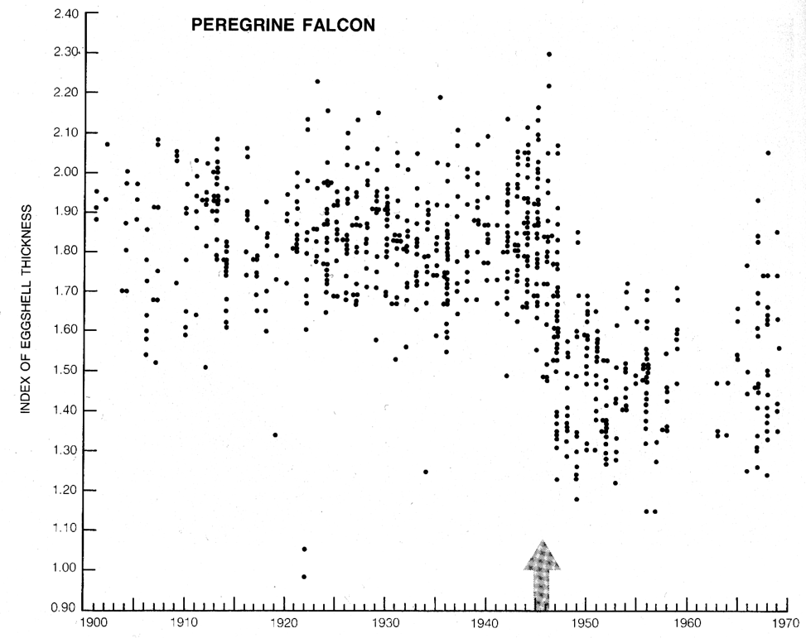
C.3.S1 Analysis of data illustrating the causes and consequences of biomagnification.
Analysis questions:
Describe the trend shown by the data in relation to the use of DDT
Estimate the percentage change in egg shell thickness between 1950 and 1958
Suggest why the range of egg shell thickness increased after 1966.
http://www.nps.gov/yuch/naturescience/images/PeregrineAdultWithChicks.jpg
http://jan.ucc.nau.edu/~doetqp-p/courses/env440/env440_2/lectures/lec25/lec25.html

Slide 22
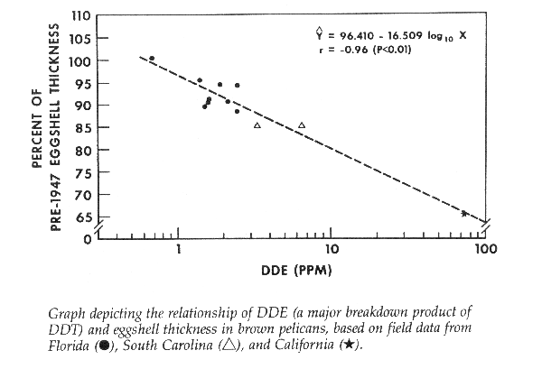
C.3.S1 Analysis of data illustrating the causes and consequences of biomagnification.
Analysis questions:
Describe the correlation between DDE and egg shell thickness.
Evaluate the limitations of the data supporting the link between DDT and egg shell thickness in Peregrine Falcons.
Explain why egg shell thickness is correlated with sightings of Peregrine Falcons
http://www.nps.gov/yuch/naturescience/images/PeregrineAdultWithChicks.jpg
http://jan.ucc.nau.edu/~doetqp-p/courses/env440/env440_2/lectures/lec25/lec25.html

Slide 23
C.3.A2 Discussion of the trade-off between control of the malarial parasite and DDT pollution.
What is DDT (dichlorodiphenyltrichloroethane)?
Prior to 1972 when its use was banned (in the US), DDT was a commonly used pesticide.
What is it used for now?
Some parts of the world continue to use DDT in disease-control programs.
Why Are We Concerned About DDT?
Even though DDT has been banned since 1972, it can take more than 15 years to break down in our environment.
How are we exposed to DDT?
By eating contaminated fish and shellfish
Infants may be exposed through breast milk
By eating imported food directly exposed to DDT
By eating crops grown in contaminated soil
What harmful effects can DDT have on us?
Human carcinogen (e.g. liver cancer)
Damages the liver
Temporarily damages the nervous system (damages developing brains)
Reduces reproductive success (lower fertility and genital birth defects)
Damages reproductive system
Sources of DDT
DDT in soil can be absorbed by some growing plants and by the animals or people who eat those plants
DDT in water is absorbed by fish and shellfish in those waterways
Atmospheric deposition
Soil and sediment runoff
Improper use and disposal
http://www.epa.gov/pbt/pubs/ddt.htm

Slide 24
C.3.A2 Discussion of the trade-off between control of the malarial parasite and DDT pollution.
http://www.npr.org/templates/story/story.php?storyId=6083944
http://www.telegraph.co.uk/news/science/science-news/10600234/Banned-pesticide-DDT-may-raise-risk-of-Alzheimers-disease.html
http://www.scientificamerican.com/article/ddt-use-to-combat-malaria/

Slide 25
C.3.A2 Discussion of the trade-off between control of the malarial parasite and DDT pollution.
Pros | Cons
Affordable and effective at killing mosquitoes that carry malaria | It is sprayed inside homes and buildings and people exposed may suffer serious health effects (inc. reduced fertility, genital birth defects, cancer and damage to developing brains)
Where the use of DDT was discontinued for malaria vector control malarial rates and deaths increased.
Alternative strategies were not as successful. | Persists in the environment for long periods of time (more than 15 years)
Health costs (of treating malaria) greatly reduced
“DDT should really be the last resort against malaria, rather than the first line of defense”
http://www.scientificamerican.com/article/ddt-use-to-combat-malaria/

Slide 26
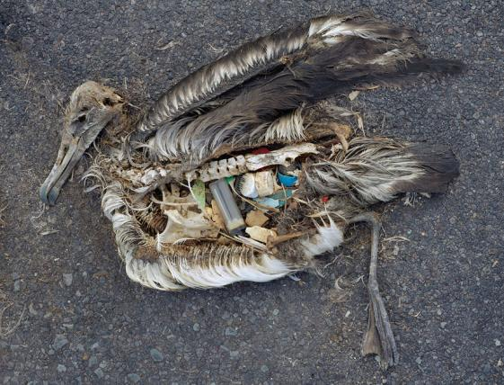
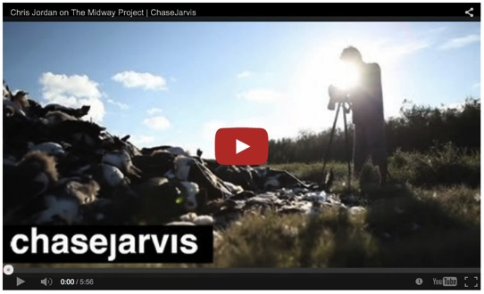
C.3.A3 Case study of the impact of marine plastic debris on Laysan albatrosses and one other named species.
“Many birds accidentally eat plastic and other marine debris floating in the ocean, mistaking it for food. But the problem is intensified in Laysan albatrosses because of the way they catch fish, squid and other seafood: by skimming the surface of the water with their beak. Along the way, they accidentally pick up a lot of floating plastic, which they then feed to their chicks. Adults can regurgitate plastic they’ve swallowed, but chicks are unable to, so it fills up their stomachs.”
“The effects of plastic on the chicks hasn't been scientifically proven. It’s probable that it injures or kills the birds by cutting their stomachs or taking up space, making them feel “full” when they are starving.”
Watch the video to learn about the impact of plastics on Laysan albatrosses
http://ocean.si.edu/slideshow/laysan-albatrosses%E2%80%99-plastic-problem

Slide 27
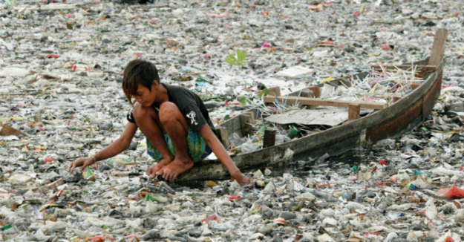
C.3.U4 Macroplastic and microplastic debris has accumulated in marine environments.
Plastic is a broad term that describes a number of different polymers
Plastic debris < 1mm is defined as Microplastic < 1mm. It is harder to see but it is estimated to account for 65% of all ocean debris
large visible plastic debris > 1mm (e.g. bottles, nets, bags, buoys) is defined as Macroplastic
Sources include:
plastic bottles and bags
detergent containers
food wrapping
synthetic clothes (fibres released after every wash)
Majority of debris is litter blown or disposed of into water systems
Ocean currents concentrate plastic debris in large circular currents called gyres.
Most plastics are not biodegradable and may persist for centuries.
http://projectoceanus.files.wordpress.com/2014/08/garbage-patch.jpg?w=625&h=326

Slide 28
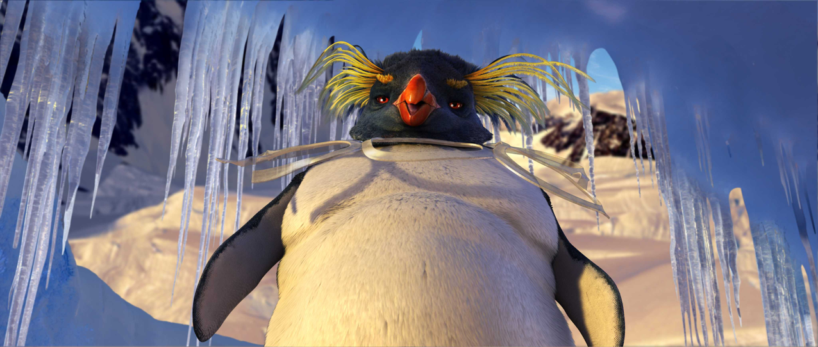
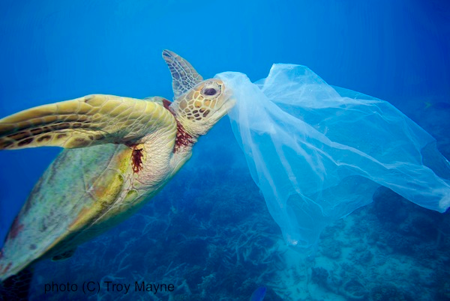
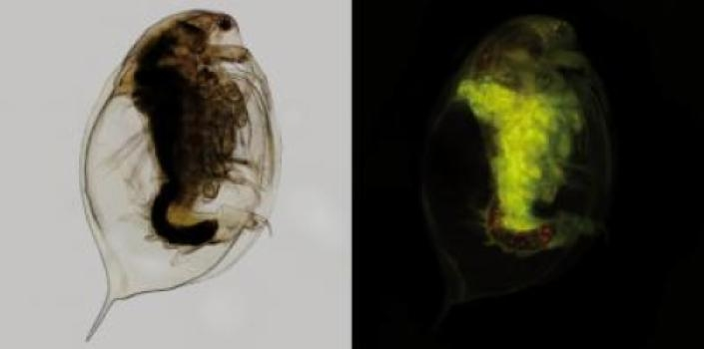
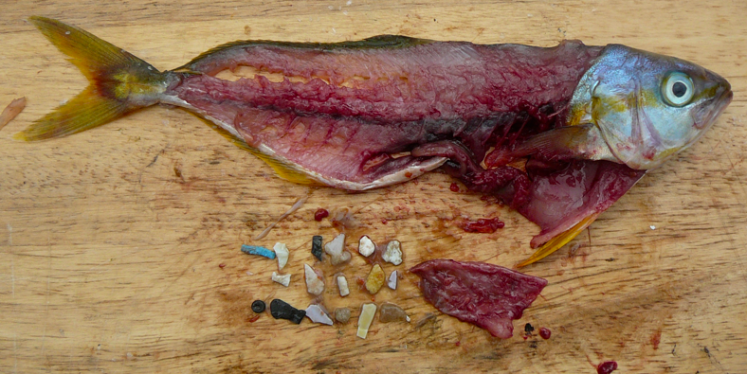
C.3.U4 Macroplastic and microplastic debris has accumulated in marine environments.
Blocks the intestine/stomach (animals ceases feeding, this leads to starvation)
Both macroplastic and microplastic debris are ingested by many marine organisms, which mistake debris for food.
Suffocation – if inhaled or wrapped around the throat
http://img2.wikia.nocookie.net/__cb20130928223451/happyfeet/images/3/3f/2006_happy_feet_034.jpg
http://www.projectaware.org/sites/default/files/GRN_plasticbag_Australia_TroyMayne_web.jpg
enters the food chain (biomagnification)
accumulates in cells
Poisons – some plastics contain toxic chemicals
http://projectoceanus.files.wordpress.com/2014/08/garbage-patch.jpg?w=625&h=326
http://images.sciencedaily.com/2013/10/131007122539-large.jpg
http://5gyres.org/wp-content/uploads/2014/07/black-pellet-in-fish.png

Slide 29
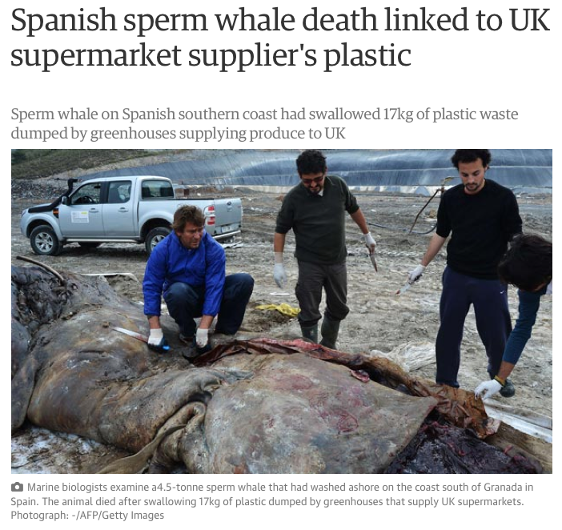
C.3.A3 Case study of the impact of marine plastic debris on Laysan albatrosses and one other named species.
http://www.theguardian.com/world/2013/mar/08/spain-sperm-whale-death-swallowed-plastic

Slide 30
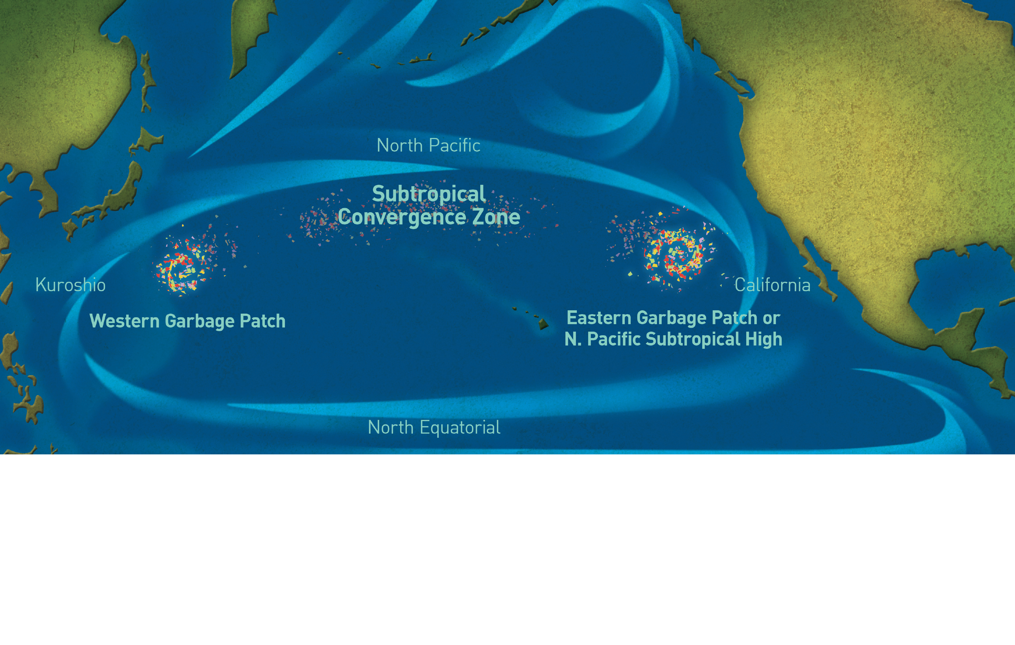
Great Pacific Garbage Patch
National Geographic
One of several stable areas of ocean water that has a higher concentration of plastic debris. Most of the plastic is at the microplastic level.

Slide 31
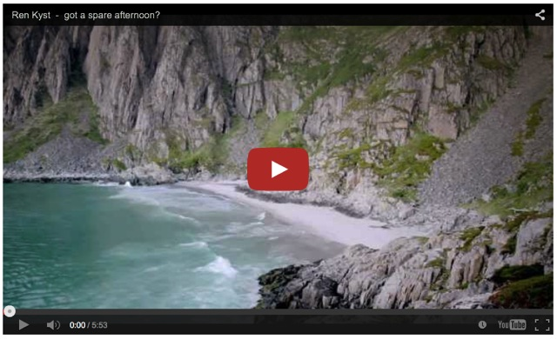
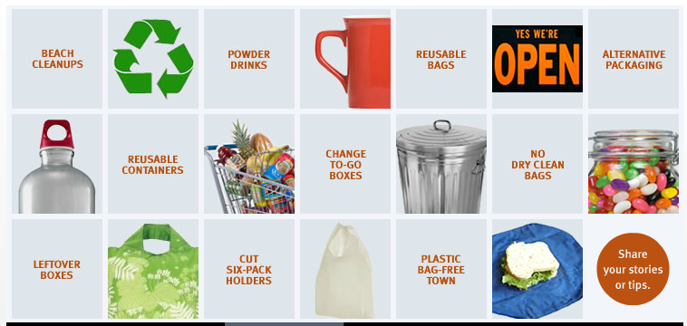
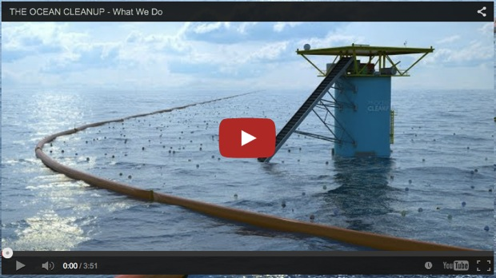
C.3.U4 Macroplastic and microplastic debris has accumulated in marine environments.
Watch a beach clean ups in Tromso (Norway)
What can you do?
Advice from Monterey Bay Aquarium
Watch what The Ocean Clean Up does
http://www.montereybayaquarium.org/conservation/research/laysan-albatross-and-plastics
http://youtu.be/6IjaZ2g-21E

Slide 32
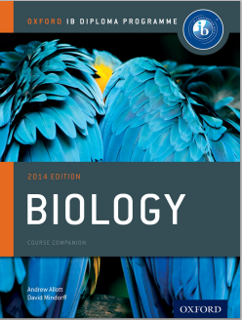
Bibliography / Acknowledgments
Jason de Nys

