Slide 1
United States History
Unit One Review:
The Southern Colonies

Slide 2
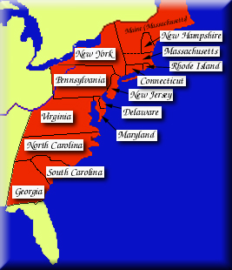
England’s New World Empire
Circa: 1776
New England Colonies
Middle Colonies
Plantation Colonies

Slide 3
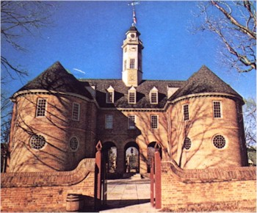
England’s New World Empire Southern Plantation Colonies:
Maryland
Virginia
North Carolina
South Carolina
Georgia
Colonial Capitol at
Williamsburg, Virginia

Slide 4
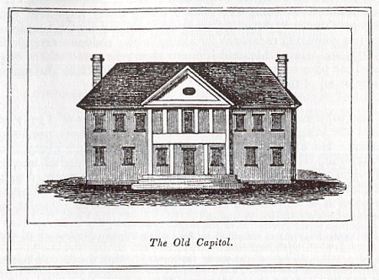
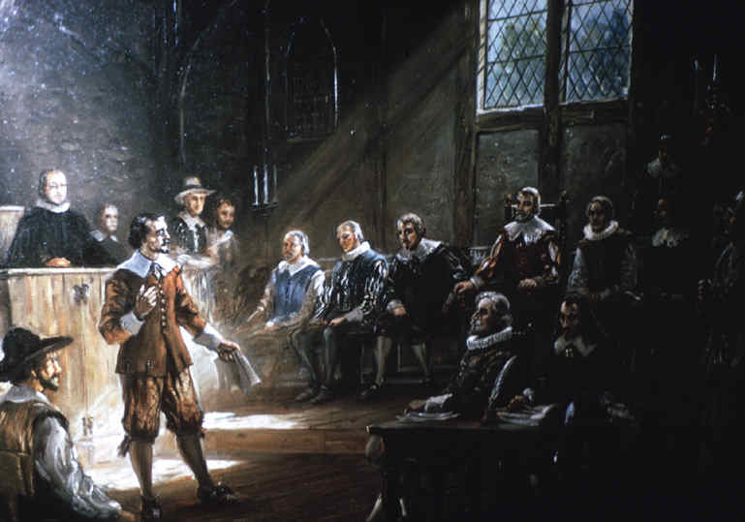
Virginia Colony:
House of Burgesses – Established July 30, 1619
Early House Structure
First Meeting, July 30, 1619

Slide 5
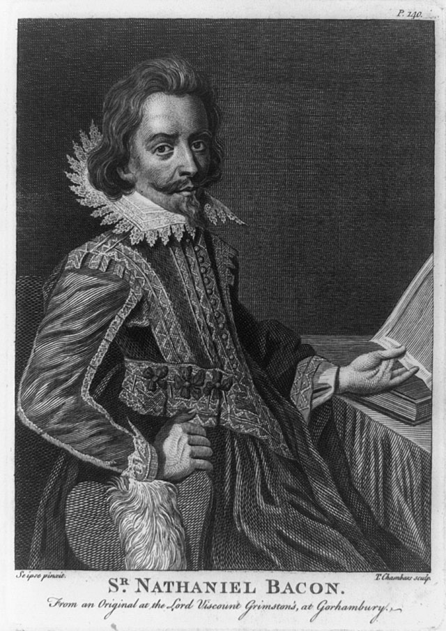
NOTES:
Bacon’s Rebellion, 1676
Governor William Berkley of Virginia
Nathaniel Bacon
After Bacon’s Rebellion
Virginia Planters turned
to slavery for a labor
supply instead of
Indentured Servants

Slide 6
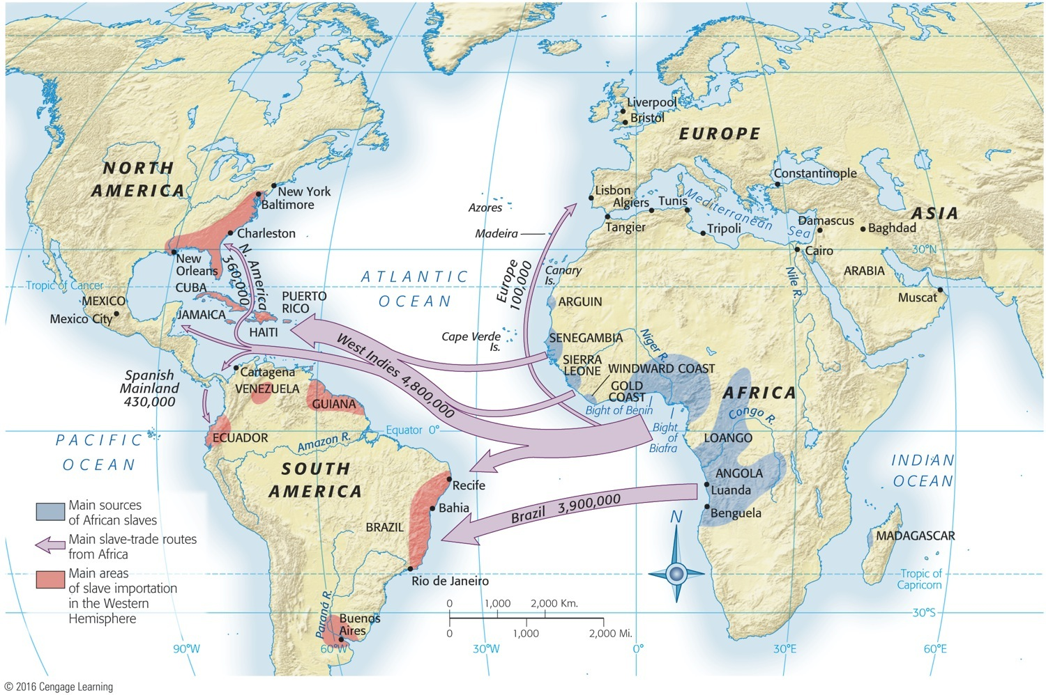
Map 4.1 p67
Notes:
Map 4.1 Main Sources and Destinations of African Slaves, ca. 1500–1860 More than three
centuries of the “African Diaspora” scattered blacks throughout the New World. Britain’s North American
colonies (the future United States) constituted the extreme northern periphery of this system, receiving
about 400,000 of the nearly 10 million arrivals, the great majority of whom ended up in the West Indies
and Brazil.

Slide 7
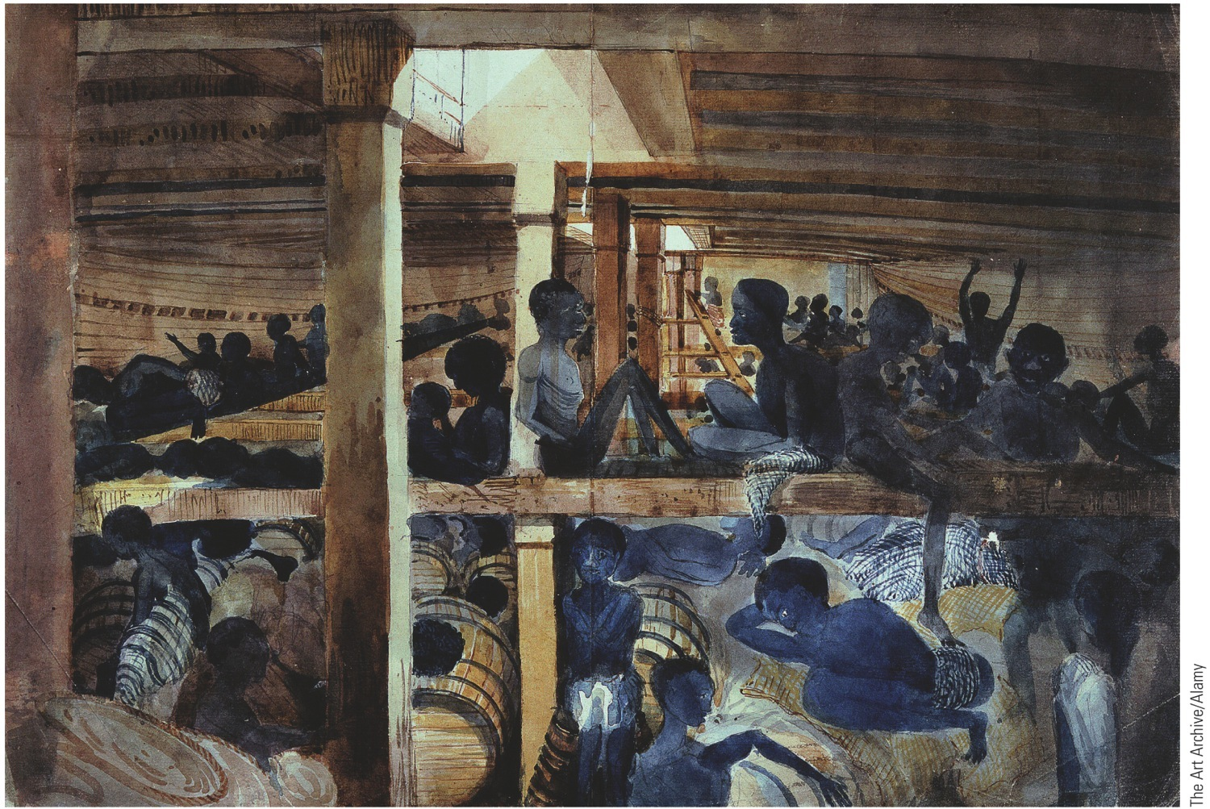
p68
Notes:
The Slave Ship Albatross, 1846 This eyewitness painting captures the dankness,
gloom, and despair that reigned in the slaver’s cargo hold.

Slide 8
IV. Colonial Slavery (cont.)
In the early 1600s, the legal difference between African slaves and white servants was unclear, but that changed as the number of Africans greatly increased.
1662: Virginia statutes began to define the iron conditions of slavery for blacks.
“Slave codes” marked blacks and their children as property (“chattels”) for life.

Slide 9
IV. Colonial Slavery (cont.)
Some colonies made it a crime to teach a slave to read or write.
Not even conversion to Christianity could qualify a slave for freedom.
As the 1600s ended, racial discrimination clearly molded the American slave system.
Slavery then shaped race relations throughout the English colonies.

Slide 10
V. Southern Society
As slavery spread, gaps in the South’s social structure widened:
A hierarchy of wealth and status became defined.
At the top were powerful great planter families: the Fitzhughs, the Lees, and the Washingtons.
By the Revolutionary War, 70% of the leaders of the Virginia legislature came from families established in Virginia before 1690 (the “FFVs”).

Slide 11
V. Southern Society (cont.)
Most of the planter elite were hard-working.
Far beneath the planters were the small farmers, the largest social group.
Still lower were the landless whites.
Beneath them were those whites serving out their indenture.
Increasingly black slaves occupied the bottom rung of southern society.

Slide 12
V. Southern Society (cont.)
Few cities sprouted in the colonial South.
Thus an urban professional class (lawyers and financiers) was slow to emerge.
Southern life revolved around the isolated great plantations.
Waterways were the principal means of transport.
Roads were terrible.

Slide 13
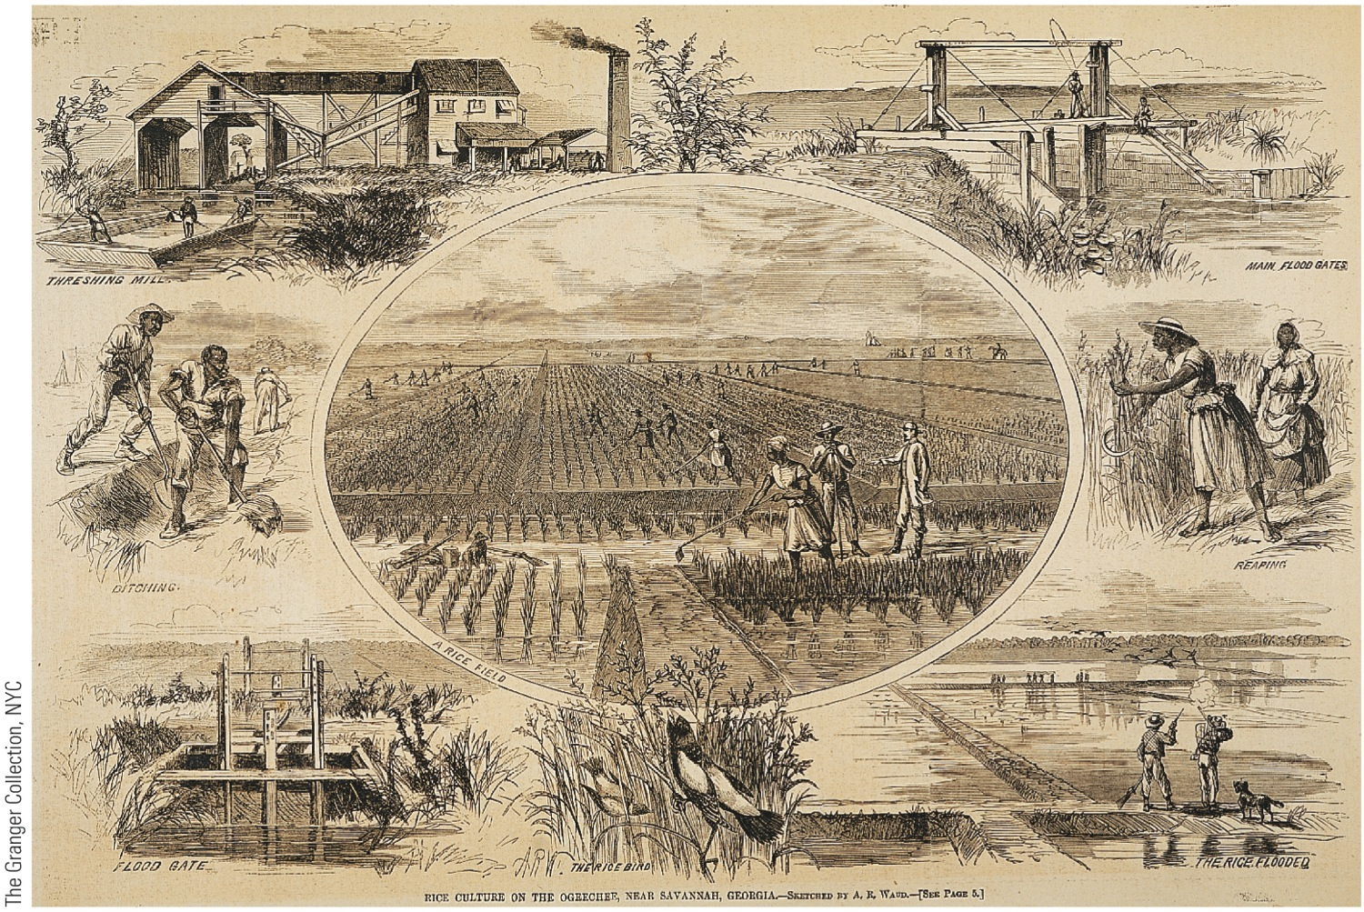
p69
Notes:
Rice Cultivation in the
Colonial South Rice growing,
imported from Africa
along with enslaved Africans
to work the swampy rice
fields, made South Carolina
the rice basket of the British
Empire.

Slide 14
The Carolina Colonies:
Charles Town – Charleston
Rice and Indigo
North Carolina, 1712

Slide 15
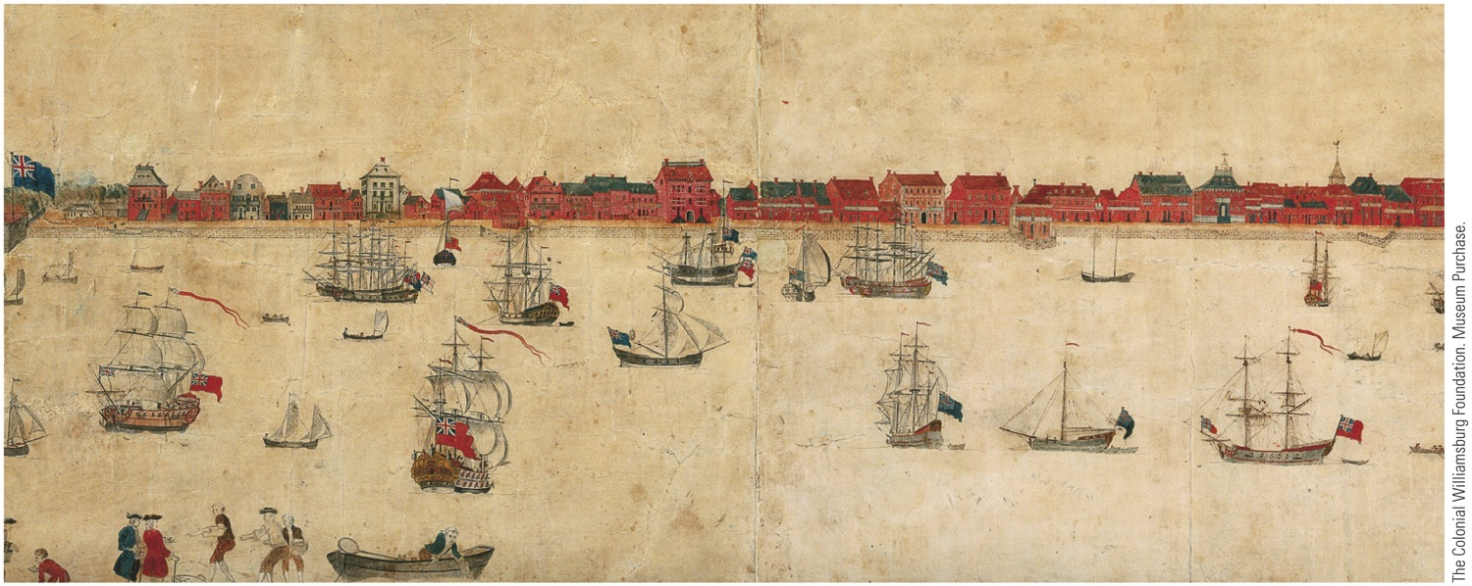
p70
Notes:
Charleston, South Carolina Founded in 1680, Charleston grew to become the bustling seaport
pictured in this drawing done in the 1730s. Charleston was by then the largest city in the mostly rural
southern colonies. It flourished as a seaport for the shipment to England of slave-grown Carolina rice.

Slide 16
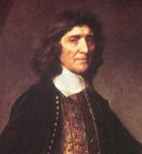
Maryland Colony:
A Haven for Catholicism
Maryland’s
Act of Toleration
1649
Lord Baltimore

Slide 17
Georgia Colony:
James Oglethorpe, 1733
“A colony for English debtors”

Slide 18
X. The Early Settlers’ Days and Ways
The cycles of the seasons and the sun set the schedules of all earliest Americans:
Overwhelming majority were farmers.
Daily tasks were assigned by gender and age.
Life was humble but comfortable compared to Europe because land was cheap.

Slide 19
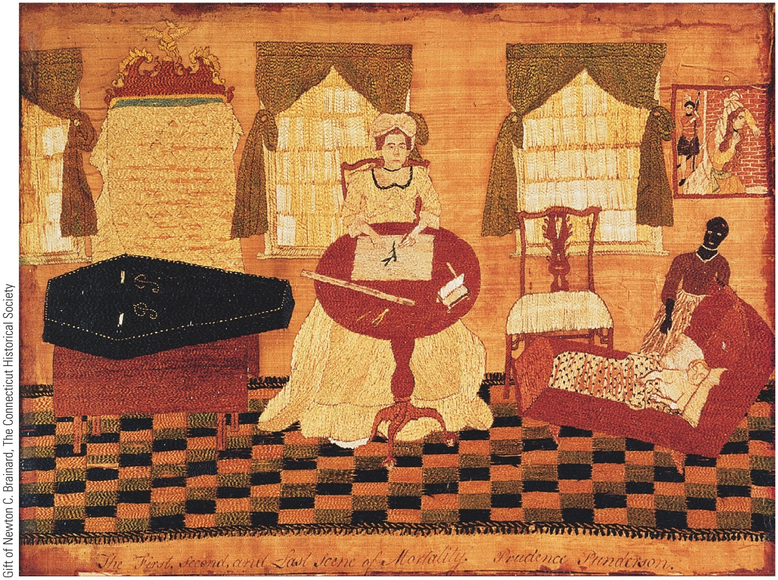
p75
Notes:
Life and Death in Colonial
America, by Prudence
Punderson Note the artist’s
initials, “P.P.,” on the coffin. This
embroidery suggests the stoic
resolve of a colonial woman,
calmly depicting the inevitable
progression of her own life from
the cradle to the grave.

Slide 20
X. The Early Settlers’ Days and Ways (cont.)
Most white migrants came from neither the richest nor the poorest classes in Europe.
Crude frontier life did not permit a flagrant display of class distinctions.
Some elite tried to recreate on a modified scale the social structure of the Old World.

Slide 21
X. The Early Settlers’ Days and Ways (cont.)
1689–1691: Leisler’s Rebellion in New York was caused by animosity between lordly landholders and aspiring merchants.
Efforts to reproduce the finely stratified societies of Europe proved feeble in early America, where equality and democracy found fertile soil—at least for white people.

Slide 22
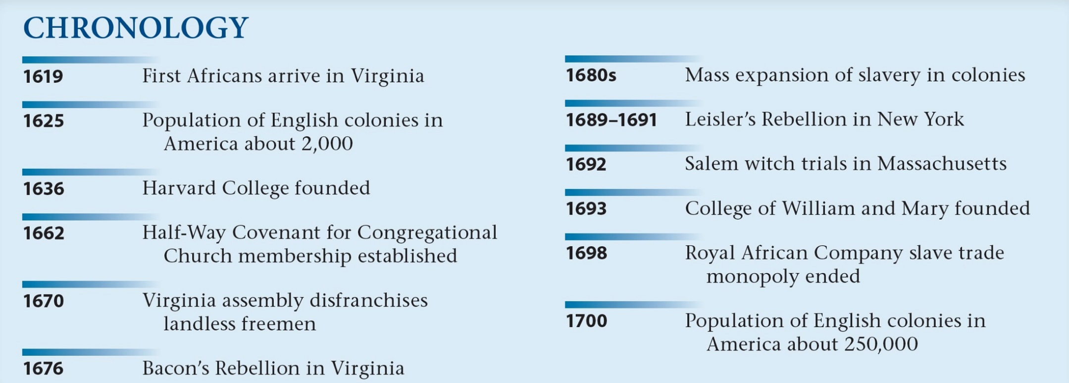
p76

