Slide 1
Exploration
Motives for and the Impact of European Exploration

Slide 2
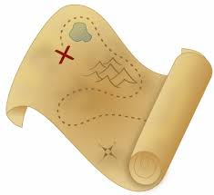
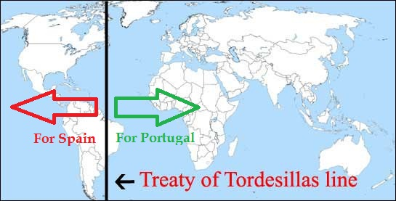
Exploration and Expansion
Portugal & Spain: first European countries to begin exploration
Treaty of Tordesillas,1494 : agreement between Portugal and Spain that stated the division of unexplored territories. All territories east of the line were controlled by Portugal and all territories west were controlled by Spain.
Netherlands, England, & France followed shortly after
Since the 5th century, stories of adventures and new discoveries around the world fascinated many

Slide 3
God, Gold, and Glory!
Reasons for Exploration:
Economic motives
Increase trade routes and Country’s wealth
Finding precious metals
Particularly gold and silver
Spiritual and Secular
Convert natives to Christianity

Slide 4
Christopher Columbus
Portugal and England reject his request for funding of explorations
Queen Isabella of Spain will finance expedition
Believed he could reach Asia by sailing west instead of east around Africa
October 1492- reach coastline of Cuba and island of Hispaniola

Slide 5
Amerigo Vespucci
Italian Explorer
First to realize that the Americas were separate from Asia
Realizes this after second voyage and maps out South American coast
Amerigo=America

Slide 6
The Impact of Disease on Native Americans Following Contact with Europeans
The following quotes illustrate the devastating impact that disease had on the native American population as a result of European exploration, invasion, and colonization.
Smallpox was the main killer, but other European diseases such as influenza and measles also caused great epidemics.
Mortality from disease in some Indian communities reached 50-90% and heavily contributed to the conquest of both the Aztec and Incan Empires.
These quotations are exerted from Chapter 2 of The Columbian Exchange: Biological and Cultural Consequences of 1492, by Alfred W. Crosby.

Slide 7
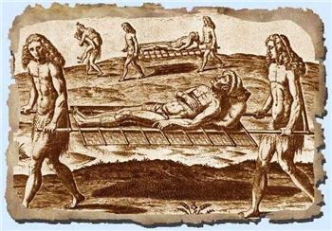

Slide 8
Oviedo, an early historian, estimated that a million Indians lived on Santo Domingo in 1492
“Of all those and those born afterwards, there are not now believed to be at the present time in this year of 1548 five hundred persons, children and adults, who are natives and are the progeny or lineage of those first.”

Slide 9
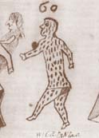

Slide 10
Indian of the Yucatan wrote about the time before the arrival of the Europeans:
“There was then no sickness; they had no aching bones; they had then no high fever; they had then no smallpox; they had then no burning chest; they had then no abdominal pain; they had then no consumption; they had then no headache. At that time the course of humanity was orderly. The foreigners made it otherwise when they arrived here.”

Slide 11
A maya chronicler of the sixteenth century:
“Great was the stench of the dead. After our fathers and grandfathers succumbed, half of the people fled to the fields. The dogs and vultures devoured the bodies. The mortality was terrible. Your grandfathers died, and with them died the son of the king and his brothers and kinsmen. So it was that we became orphans, oh, my sons! We were born to die!”

Slide 12
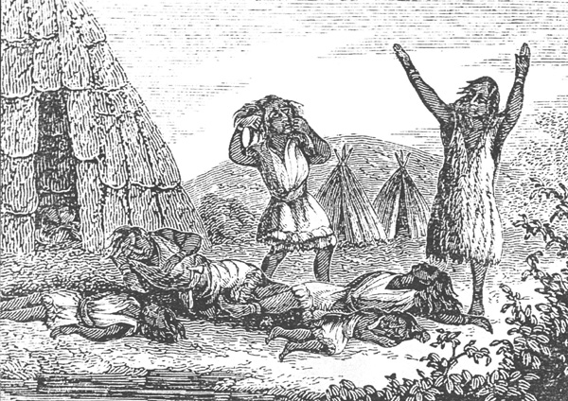

Slide 13
Bishop Diego de Landa writing about the people of the Yucatan in the late 1520s:
“A pestilence seized them, characterized by great pustules, which rotted their bodies with a great stench, so that the limbs fell to pieces in four or five days.”

Slide 14
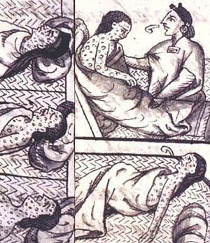

Slide 15
An eyewitness writes about the time right after the retreat of Cortes from Tenochtitlan before his conquest of the Aztec city:
“When the Christians were exhausted from war, God saw fit to send the Indians smallpox, and there was a great pestilence in the city . . .”

Slide 16
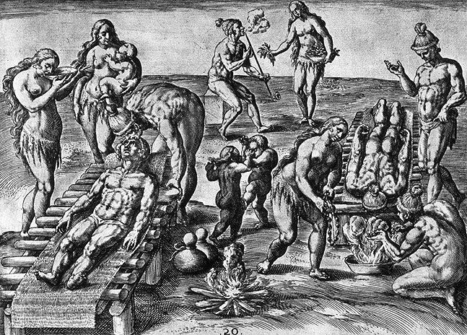

Slide 17
At the time of the fall of the city (tenochtitlan) after the 75 day siege:
“the streets, squares, houses, and courts were filled with bodies, so that it was almost impossible to pass. Even Cortes was sick from the stench in his nostrils.”

Slide 18
Indian testimony from Tenochtitlan:
“It was [the month of] Tepeilhuitl when it began, and it spread over the people as great destruction. Some it covered [with pustules] on all parts – their faces, their heads, their breasts, etc. There was a great havoc. Very many died of it. They could not walk; they only lay in their resting places and beds. They could not move; they could not stir; they could not change position, nor lie on one side; nor face down, nor on their backs. And if they stirred, much did they cry out. Great was its [smallpox] destruction. Covered, mantled with pustules, very many people died of them.”

Slide 19
German missionary in 1699:
“The Indians die so easily that the bare look and smell of a Spaniard causes them to give up the ghost.”

Slide 20
English observation around the time of Sir Francis Drake’s expedition against St. Augustine:
“The wilde people . . . Died verie fast and said amongest themselves, it was Inglisshe God that made them die so faste.”

Slide 21
Thomas Hariot commenting on the visitations of Indian villages during the time of the Roanoke island colony:
“But that within a few dayes after our departure from everies such townes, that people began to die very fast, and many in short space; in some townes about twentie, in some fourtie, in some sixties, & in one sixe score, which in trueth was very manie in respect to their numbers. . . The disease also was so strange that they neither knew what it was, nor how to cure it; the like report of the oldest men in the countrey never happened before, time out of mind.”

Slide 22
The Jesuit relations reporting on the effects of french settlement in 1616:
The Indians “are astonished and often complain that, since the French mingle with and carry on trade with them, they are dying fast and the population is thinning out. For they assert that, before this association and intercourse, all their countries were very populous and they tell how one by one the different coasts, according as they have begun to traffic with us, have been more reduced by disease.”

Slide 23
A report on Indians around Boston Bay in 1622:
The Indians had “died on heapes, as they lay in their houses; and the living were able to shift for themselves, would runne away and let them dy, and let there Carkases ly above the ground without burial. . . . And the bones and skulls upon the severall places of their habitations made such a spectable after my coming into those partes, that, as I travailed in the Forrest nere the Massachusetts, it seemed to me a new found Golgotha.”

Slide 24
Increase trade + increase expansion= Commercial Capitalism
Key Terms:
Colony- settlement of people living in a new territory, linked with a parent country through trade and direct government control
Mercantilism- set of principles that dominates economic thought
Balance of Trade- difference in value between what a nation imports and what it exports over time.
Balance favorable= goods exported are of greater value than those imported

Slide 25
The Slave Trade
Concept of enslaving humans is not new. Slavery has been practiced since ancient times.
Demand for enslaved Africans shifted dramatically with discovery of Americas and planting of the sugarcane
First boatload of enslaved Africans brought by the Spanish in 1518

Slide 26
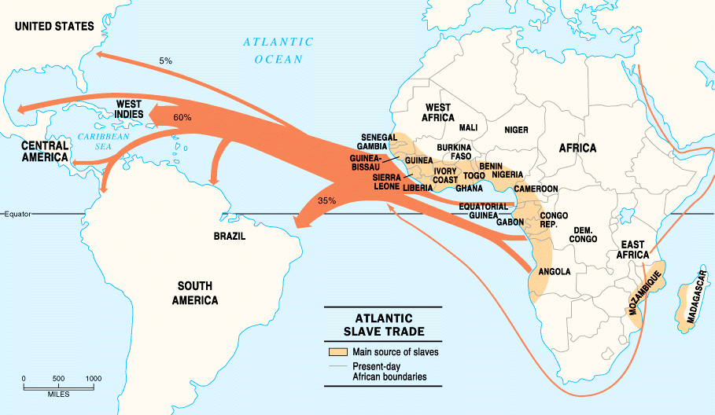
Trans-Atlantic Slave Trade

Slide 27
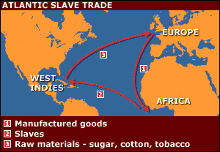
Triangular Trade
European manufactured goods (guns and cloth) brought to Africa
African Slaves then shipped to Americas to work
Products from America then shipped back to Europe

Slide 28
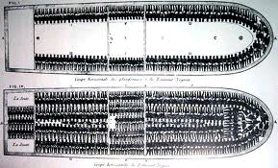
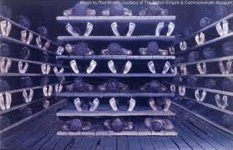
The Middle Passage- journey of enslaved people from Africa to America
Middle portion of Triangular Trade
Many enslaved will die on journey

Slide 29
Effects of Slave Trade
Depopulation of some areas
Deprived communities of youngest and strongest
Increased warfare

Slide 30
Impact of European Expansion
Native populations ravaged by disease
Influx of gold and silver into Europe. Helped to create bigger economic market.
New products introduced across the continents (ex: Columbian Exchange)
Deepened colonial rivalries

