Slide 1
Chapters 2-3
Early American Settlements: Jamestown, Plymouth, and more!

Slide 2
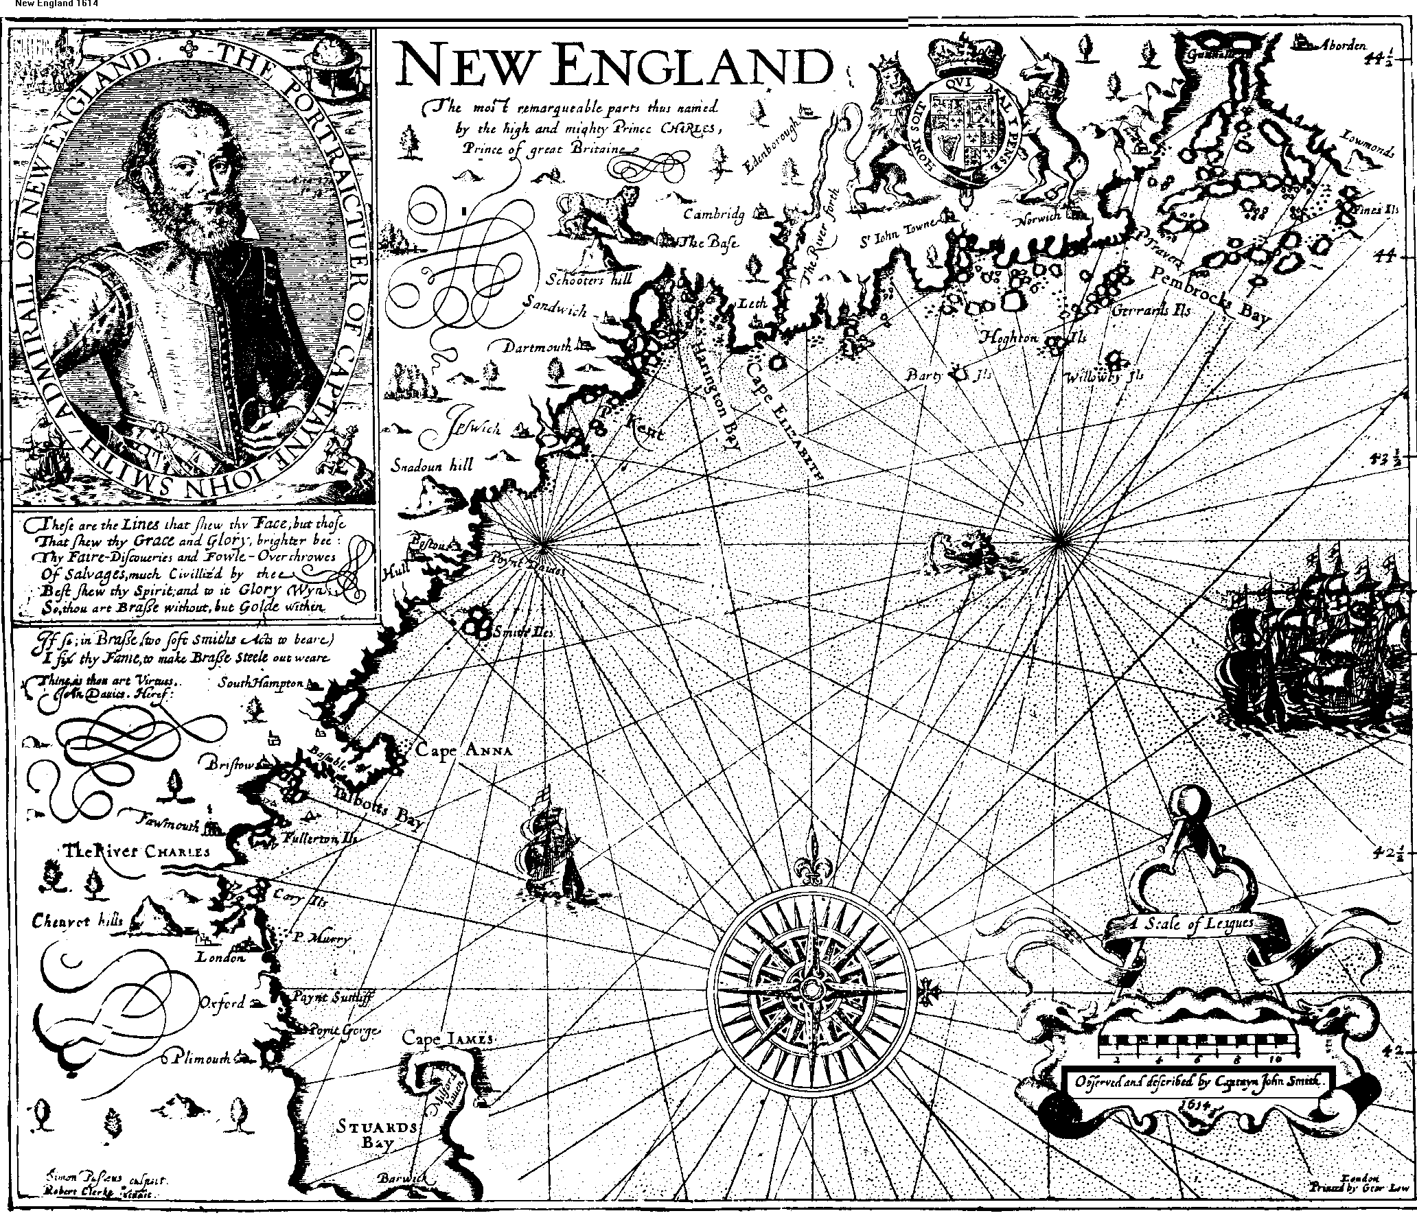

Slide 3
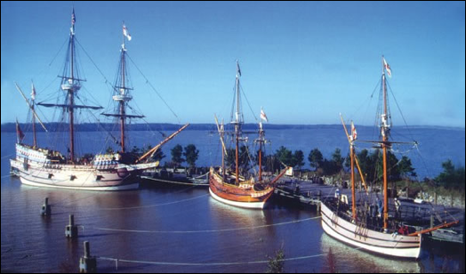
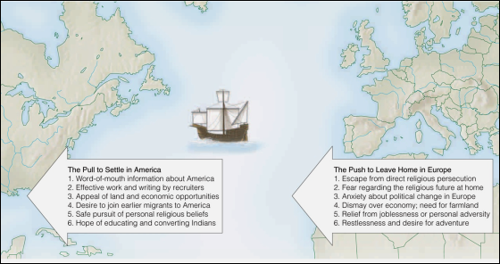

Slide 4
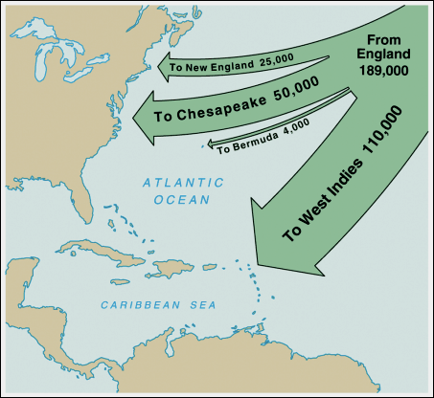

Slide 5
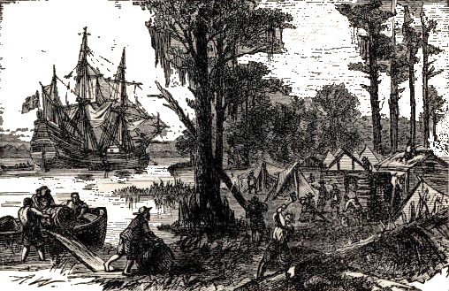
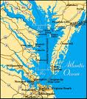
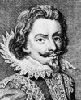
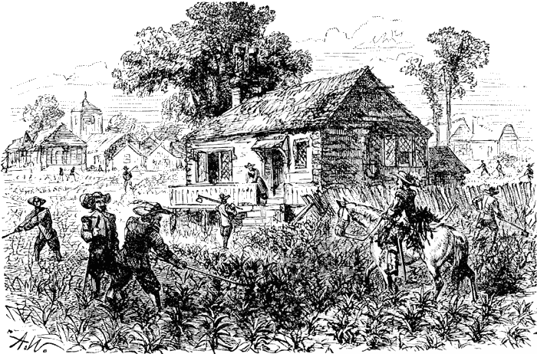
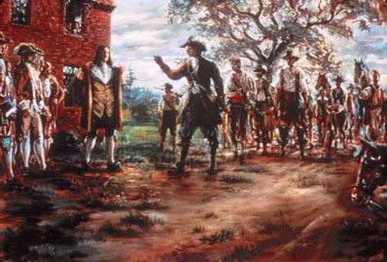
THE JAMESTOWN COLONY
The Big Idea:
The English overcame hunger, disease, and conflicts with Native Americans to establish a successful colony in Virginia.
(these are charter colonies that are funded by joint-stock companies)
1585: First colony at Roanoke: soon ends in failure
1590: Remains of second failed Roanoke colony found
The "Starving Time"
Located on the James River,
just off the Chesapeake Bay!
1607: Colony at Jamestown founded
1609-10: Jamestown suffers the "Starving Time"
John Smith is the land-hungry leader of the colony.
1613: First shipment of Virginia tobacco sent to England
How did they survive?
WITH HELP
Lured by the profits of tobacco and land (under the HEADRIGHT SYSTEM), new settlers begin to arrive in the colony.
A powerful Native American chief named Powhatan hoped to use the English against his own enemies and to trade for their metal weapons. He teaches them to cultivate TOBACCO.
1619: House of Burgesses first meets
(the 1st representative body in colonial America
with the power to make laws and raise taxes!)
1640: Tobacco shipments reach 3 million pounds per year
1676: Bacon's Rebellion attacks colonial government
When intense fighting broke out between the Indians and the settlers, Governor Berkeley protested the slaughter of Indians and refused to send troops to the frontier. In protest, Nathaniel Bacon and his followers marched to Jamestown and burned the town in revolt.

Slide 6
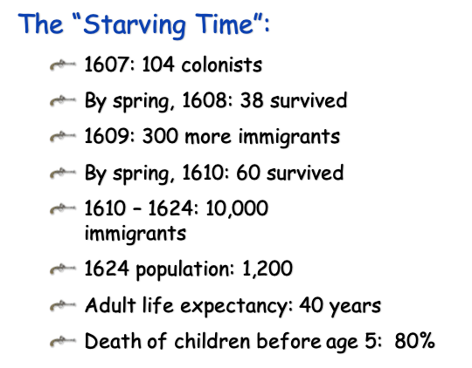
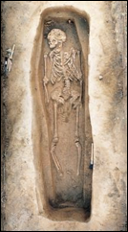

Slide 7
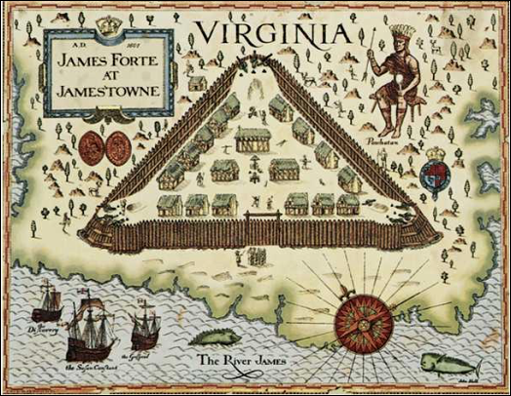

Slide 8
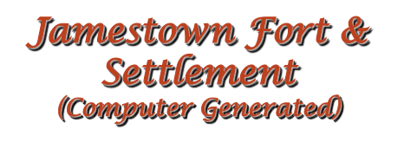
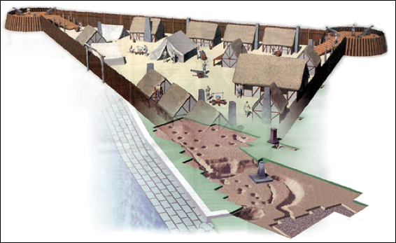

Slide 9
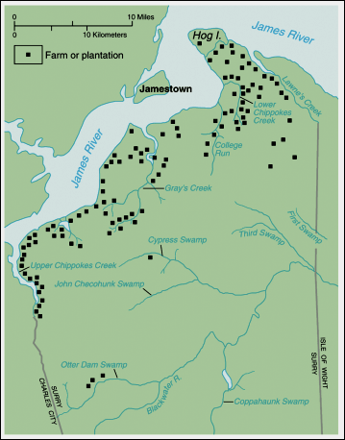

Slide 10
Concluding Questions
·Why were the Europeans exploring the coast of North America?
·What were the relations like between the colonists and the Native Americans?
·How did geography influence the development of the colony?
·What sort of economic development took place in the colony of Virginia?
·What was the need for western expansion based on? What reasons were at the heart of the shift to slave labor?

Slide 11
Part 2
Plymouth and New England

Slide 12
New England Colonies
Massachusetts (including Maine, Plymouth Plantation)
Connecticut
Rhode Island
New Hampshire
Colonial Flag sometimes called the Flag of New England

Slide 13
Puritanism
Predestination
Religious Schism between Anglicans and Puritans
Separatists
Work ethic; strict and pious

Slide 14
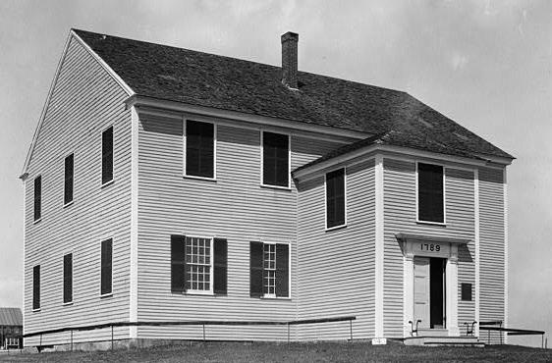
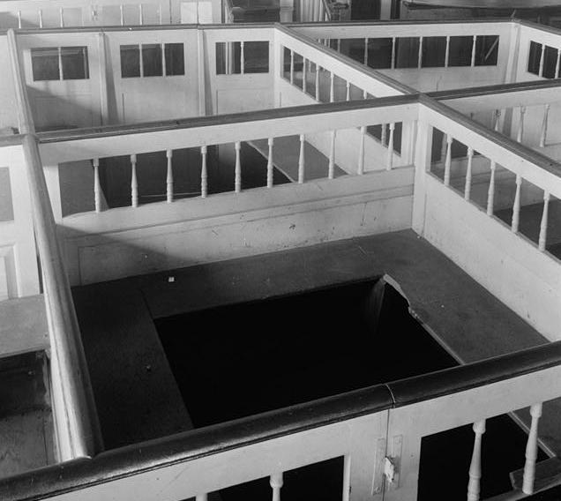
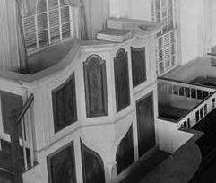
Puritan Churches
Meeting House,
Rhode Island,
1789
Family Pews
Pulpit

Slide 15
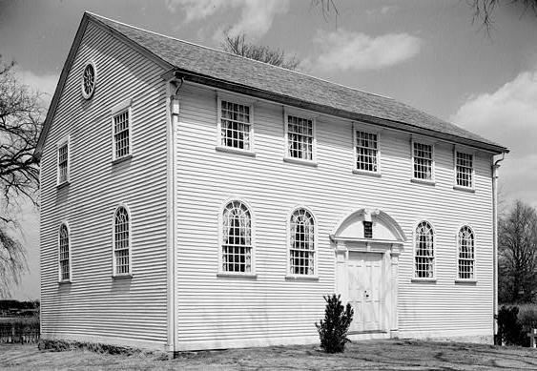
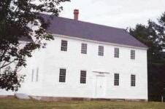
Puritan Churches
Puritan
Meeting
Houses
Rhode Island

Slide 16
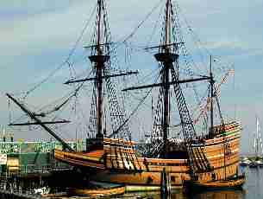
William Bradford’s Pilgrims
Plymouth
Plantation
(Pilgrims)
Separatists
Mayflower
Compact

Slide 17
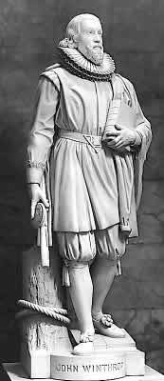
Massachusetts Bay Colony, 1629
Fleeing reign of Charles I
Mass. Charter
John Winthrop
J. Winthrop

Slide 18
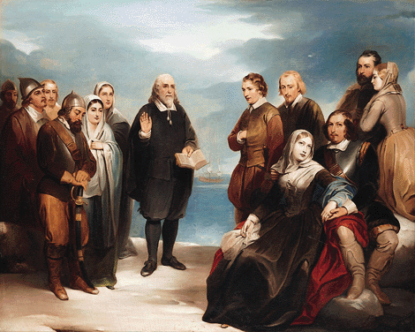
Image of Puritans:
1845 Portrait of Pilgrims

Slide 19
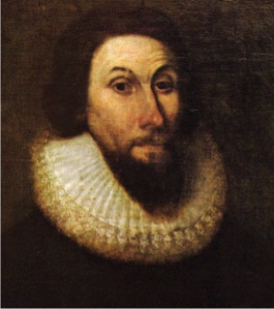
Image of Puritans:
1640s Portrait of John Winthrop by Van Dyke

Slide 20
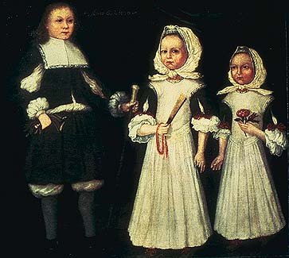
Image of Puritans:
Mason children of New England, 1670

Slide 21
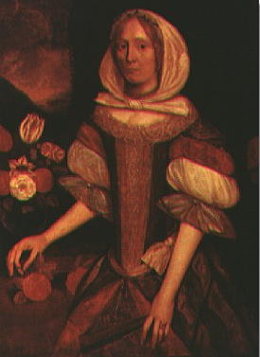
Image of Puritans:
Elizabeth Wensley of Boston, 1670

Slide 22
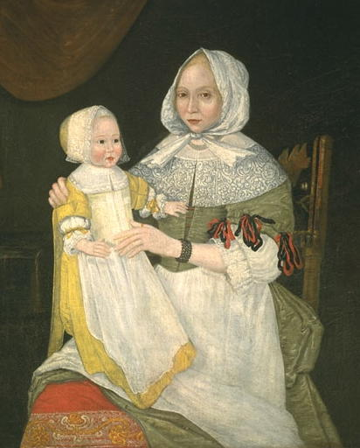
Image of Puritans:
Elizabeth Freake & Mary, 1671/74

Slide 23
Salem Witchcraft Trials, 1692

Slide 24
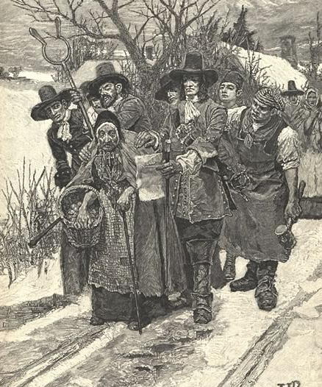
Image of Puritans:
Lithograph of Arrest of a Salem Witch
1883

Slide 25
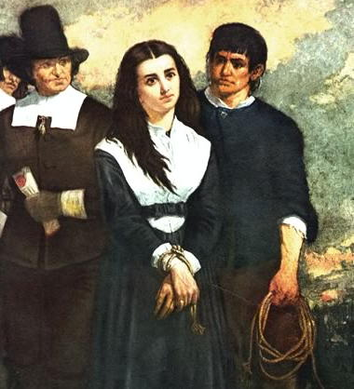
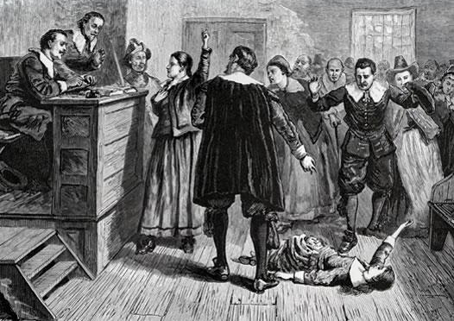
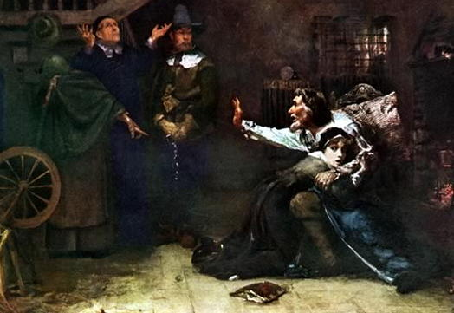
Image of Puritans:
19th Century Images of Salem Witches
1876
1869
1884

Slide 26
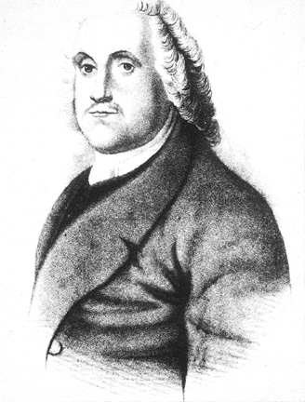
Roger Williams
Was originally part of the Massachusetts colony, and he got exiled.
Resettled to Rhode Island.
Introduced religious tolerance (freedom) to New England in doing so.
The capital of Rhode Island, Providence, refers to “God’s merciful Providence” to it’s residents.
Roger Williams

Slide 27
The Bloudy Tenent of Persecution, 1644.
God requireth not an uniformity of
Religion to be inacted and inforced in any civil state… true civility and
Christianity may both flourish in a
state or Kingdome, notwithstanding the permission of divers and contrary consciences, either of Jew or Gentile.
Roger Williams

Slide 28
Lifestyles of Puritan New England
Puritan Oligarchy
Townships
Covenants
Town Meetings

Slide 29
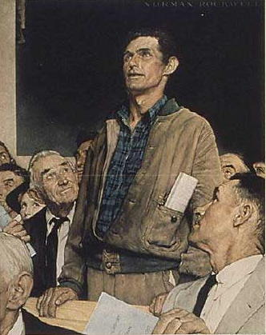
Roots of Democracy in Puritanism
Congregationalist form of church government
Town Meetings

