Slide 1
Writing Review!

Slide 2
HOW TO SAQ

Slide 3
The Short Answer Questions (SAQ) follow the Multiple Choice portion of the AP exam.
You have 40 minutes.

Slide 4
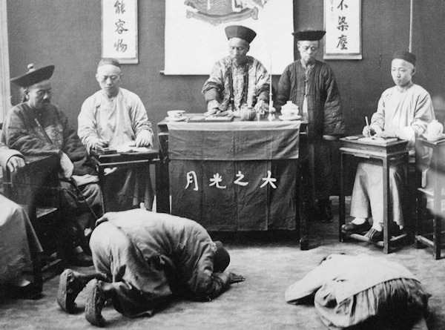
The Short Answer Questions (SAQ) follow the Multiple Choice portion of the AP exam.
Using the picture below, answer all parts of the question that follows
A. Identify ONE way the interaction above represents the Tang Dynasty’s hegemony over neighboring states.
B. Explain how the picture represents a continuity in Chinese imperial history.
C. Explain on way in which the interaction between China and central Asia changed after the collapse of the Song Dynasty.
There are
4 SAQs, and each one has 3 parts.

Slide 5
SAQ Overview
What types of questions are asked?
SAQ will come from the Key Concepts and Thematic Learning Objectives
Each SAQ will deal with at least one Historical Thinking Skill
How are they scored?
1 point per part, 3 points per question
On the AP test, you probably need to earn 7 of 9 points on the 3 SAQs to be on track to earn a 5

Slide 6
SAQ Formatting
Must write within square space, no exceptions
Do each part of the question (typically A, B, C) separately, not as one paragraph with all 3 responses
Each response can be a good sentence or two. Try to be brief and accurate
Must be complete sentences. No bullet points.

Slide 7
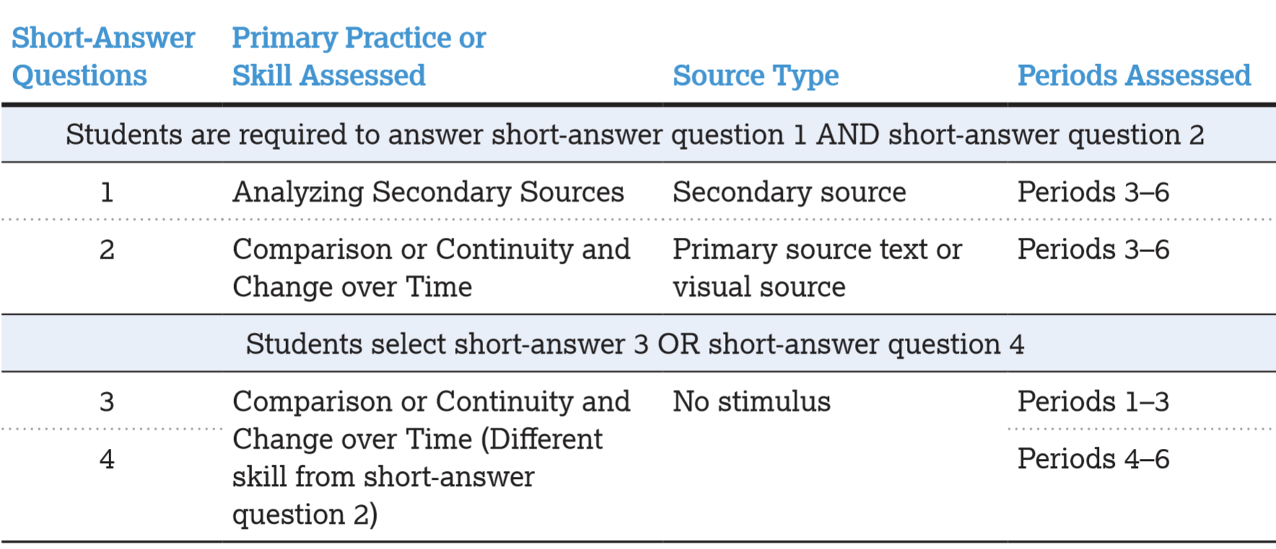
You must answer questions 1 & 2, but you have a choice of answering either question 3 or 4.

Slide 8
Short-Answer Questions
Section 1, part B of the AP World exam consists of 4 short-answer questions. Students are required to answer the first two, and choose to answer either the third or fourth question.
The first question primarily assess the skill of analyzing secondary sources, asking students to respond to a historian’s argument. The question addresses content from periods 3 – 6.

Slide 9
Short-Answer Questions
Section 1, part B of the AP World exam consists of 4 short-answer questions. Students are required to answer the first two, and choose to answer either the third or fourth question.
The second question primarily assesses the skill of comparison, or change and continuity over time. It asks students to respond to a primary source written text or to a visual source such as a picture, map, or chart. This question also addresses content from periods 3 – 6.

Slide 10
Short-Answer Questions
Section 1, part B of the AP World exam consists of 4 short-answer questions. Students are required to answer the first two, and choose to answer either the third or fourth question.
Students choose to answer either the third or fourth question which deal with periods 1 – 3 or 4 – 6 respectively. These questions ask students to respond to general propositions about world history and they primarily assess the same skill; either comparison, or change and continuity over time. Neither of them will assess the same skill in question 2.

Slide 11
TIMING:
3 QUESTIONS
3 PARTS (ABC)
x
9 THINGS TO DO
9 40 MINUTES
4:26 PER PART

Slide 12
SAQ Advice
Pay really close attention to the verbs: describe, identify, explain, analyze, provide historical evidence
We will practice multiple versions throughout the year – they are on all unit tests as well
Must address question – make sure your response is appropriate to theme/learning objective/historical thinking skill
AP means ANSWER THE PROMPT
Image courtesy of Mr. Freeman at Freeman-pedia.com

Slide 13
Format of the questions:
Part A will ask you to:
“Identify …” or “Describe …”
Parts B and C will ask you to
“Explain …”
ACE strategy will still be helpful on parts “B” and “C.”

Slide 14
Spiraling of skills
A Response
Part A requires a fairly simple answer. You can probably answer with a sentence or two.
Part B is more complex, asking you to explain what you know about the prompt.
Part C will probably ask for higher levels of analysis, for you to compare what you know with other things that are going on.
B Response
C Response

Slide 15
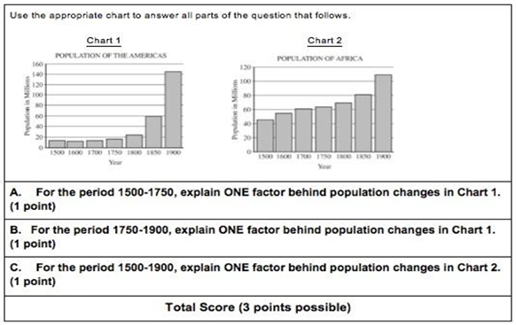
Example!

Slide 16
For the period 1500-1750, explain ONE factor behind population changes in Chart 1.
“From 1500 to 1750 the population in the Americas did not increase drastically. This was due to the fact that the Americas were discovered in 1492 and still being settled. Settlers also had to contend with disgruntled Native Americans, but the population did increase slightly.”

Slide 17
For the period 1500-1750, explain ONE factor behind population changes in Chart 1.
“From 1500 to 1750 the population in the Americas did not increase drastically. This was due to the fact that the Americas were discovered in 1492 and still being settled. Settlers also had to contend with disgruntled Native Americans, but the population did increase slightly.”
Does NOT earn the point---Neither explanation provides a clear rationale for the lack of population change. They could have discussed the relationship between settlers and indigenous populations with regard to disease and occasional violence as reasons for only a slight increase in population.

Slide 18
For the period 1500-1750, explain ONE factor behind population changes in Chart 1.
“From 1500 to 1750 the population in the Americas was for the most part the same, with little population growth or decrease. However it can be seen in Chart 1 that from 1500 to 1600 there is a small drop in population. This is most likely from the death of millions of natives in the Americas as a result of European conquest. And from 1700 to 1750 there is a slight rise in population most likely from the rising migration of Europeans into the Americas.”

Slide 19
For the period 1500-1750, explain ONE factor behind population changes in Chart 1.
“From 1500 to 1750 the population in the Americas was for the most part the same, with little population growth or decrease. However it can be seen in Chart 1 that from 1500 to 1600 there is a small drop in population. This is most likely from the death of millions of natives in the Americas as a result of European conquest. And from 1700 to 1750 there is a slight rise in population most likely from the rising migration of Europeans into the Americas.”
Earns the point---Explains small drop in population from 1500-1600 and slight rise from 1700-1750.

Slide 20
For the period 1750-1900, explain ONE factor behind population changes in Chart 1.
“One factor behind the massive population growth in the Americas from 1750 to 1900 was that settlers [finally settled] the whole country. This dealt with purchases of land such as the Louisiana Purchase.”

Slide 21
For the period 1750-1900, explain ONE factor behind population changes in Chart 1.
“One factor behind the massive population growth in the Americas from 1750 to 1900 was that settlers [finally settled] the whole country. This dealt with purchases of land such as the Louisiana Purchase.”
Does NOT earn the point---Attempts to explain “massive population growth” by the fact “that settlers [finally settled] the whole country.” If the settlers were already somewhere in the Americas, total population would not be affected by where they are. The response could have addressed the steep increases in immigration to the Americas or even the population growth that occurred as settled families grew in size.

Slide 22
For the period 1750-1900, explain ONE factor behind population changes in Chart 1.
“From 1750 to 1900 the population is increased by almost 8 times the population in 1750. This is a direct result of Europeans settling and living in the Americas and the rising nations of Canada and the United States of America.”

Slide 23
For the period 1750-1900, explain ONE factor behind population changes in Chart 1.
“From 1750 to 1900 the population is increased by almost 8 times the population in 1750. This is a direct result of Europeans settling and living in the Americas and the rising nations of Canada and the United States of America.”
Earns the point---Recognizes factor related to dramatic growth from 1750-1900. Also attempts to discuss “the rising nations of Canada and the United States of America.”, but does not explain how prosperity, growth, and potential opportunities present in both nations at the time may have lead to increased population.

Slide 24
What good responses will include (from the College Board)
Accomplish all three tasks set by the question (A, B, and C).
It should answer each task with complete sentences and must show some specific knowledge of history to receive credit.
Depending on the question, a good response should:
Explain a historical interpretation, compare two interpretations, and/or explain how evidence relates to an interpretation.
Go beyond simply quoting or paraphrasing primary or secondary sources in explaining their meaning or significance.
Address causes and effects, similarities and differences, or continuities and changes over time for different historical issues, and provide specific evidence in relation to the prompt.

Slide 25
How to write a thesis statement

Slide 26
What to include:
Dates or Time Period
Region or country you select (if given the option)
Tell what changed or stayed the same using the categories stated in the prompt
Remember: the categories you put in your thesis MUST be the ones given to you by the prompt!
If the prompt asks you to address changes in labor systems, don’t write about political change

Slide 27
So, the basic template is:
Between __(beginning date)____ and __(ending date)______, ___(area you chose to write about___) changed in the area of ____(category(ies) from the prompt)___ but stayed the same in the area of __(the other category(ies) from the prompt)__.

Slide 28
How to LEQ
(Long Essay Question)

Slide 29
LEQ
On exam, 75 self-budgeted minutes to write DBQ and LEQ
So, approximately 35 minutes to write LEQ
Choice of two essays – you only do ONE
Choose the one you know the best
Tough part – you have no stimulus and no docs – relies solely on content knowledge
Guess what helps with this? READING all year long! ☺

Slide 30
Types of LEQs
Target the HTS:
Comparison (CC)
Causation (cause and effect)
Change and Continuity Over Time (CCOT)
Periodization

Slide 31
Rubric
Easy to understand and follow
Must be thorough to get points; cannot use oversimplifications
You need specific facts – aim for at least SIX – the more the better!
Thesis- 1 point
Contextualization- 1 point
Evidence- 2 points
Analysis & Reasoning- 2 points

Slide 32
Explanation of each type of essay
Tom Richey – video is for APUSH, but we have the exact same rubric for LEQ
http://www.tomrichey.net/the-apush-leq.html
Watch 6:32-12:56

Slide 33
How to Write a LEQ
Depends on which HTS skill you are asked
BUDGET YOUR TIME after the DBQ
No need for intro paragraph – get to the thesis right away
2nd body paragraph: Contextualization
3rd-5th Body paragraphs
For CC, CCOT, or Causation can do two or three content body paragraphs

Slide 34
Tips
Periodization will probably be the hardest essay to write
Comparison and Causation will probably be easiest as this is what you are the most used to in your writing careers
CCOT will require a bit more pre-planning before writing
So that’s what we are going to start with today!

Slide 35
LEQ – CCOT practice
Prompt: Analyze the changes and continuities in patterns of interaction along the Silk Roads from 200 B.C.E. to 1450 C.E.
How do we go about tackling this prompt and start our essay?
#1. PLAN
What do you know in this time period? List it on a timeline
Categorize your pieces of evidence as changes or continuities
Brief outline of essay
#2. WRITE with detail and tie everything to the prompt
Tonight – Write a thesis statement for this prompt

Slide 36
LEQ – CCOT practice
Prompt: Analyze the changes and continuities in patterns of interaction along the Silk Roads from 200 B.C.E. to 1450 C.E.
Thesis starter help
While there were changes in (region) during (time period) due to ______________________________, there were also continuities in (region) due to ____________________________.
While _________ stayed the same, in the period from ____ to _____, _______ changed from ________ to ________ and _________ changed from _________ to ___________.
During the time period between (x) and (y) in (region) (continuity), and (continuity) remained constant in (______), while there were significant changes in (_______) such as (change), and (change).

Slide 37
Writing the DBQ!
2017 and BEYOND!

Slide 38
What is it?
Document-based Question (DBQ)
Given a selection of documents, write an essay answering a question prompt
1 every year. Now 25% of grade
You get 7 documents now (used to be up to 10)
What could possibly be a “document”?

Slide 39
OMG I DON’T KNOW THIS!
DBQ is usually designed to scare you!
This is to force you to use the documents rather than only outside info
FOR THE MOST PART, YOU DON’T NEED TO KNOW MUCH ABOUT THE TOPIC!
Understand the game, and DON’T PANIC
“I think I put down something wrong!”
That’s ok. You’re a kid. We know this.

Slide 40
How does the DBQ work?
You get a 15 minute reading time, followed by a 40 min writing time.
Sort of
Read the documents and plan your essay. YOU MUST PLAN FOR THIS ONE. Seriously, don’t wing it

Slide 41
How is it graded?
AP World essays are graded basically by checklist – “did the student do _____?”
There are four things to remember
Thesis
Contextualization
Evidence
Analysis and Reasoning

Slide 42
Thesis
This is usually one sentence, but can be longer. Will probably tie with contextualization to make intro
MUST be in first paragraph.
A historical thesis is an argument. Think about how you would win an argument with your parents!
Use specific points in your thesis
“the blankity blank is blank because blankity, blankity and blankity”
“while some blankity believed blank, others believed blank, while people from blankistan believed blankity”
MUST answer the prompt. MUST NOT reword the prompt
If asks you about a relationship, think about how you could define a relationship
Typically “compare, contrast, change, continuity or context

Slide 45
Contextualization
What was going on in the world when the documents came about?
Imperialism? Golden Age? Dark Age? Exploration? No exploration? Cold War? Industrialization?
Must relate to the topic!
Be as specific as possible. Probably same century, and most definitely same Period
Put the topic “in its place” in history
Star Wars!

Slide 49
Use of Documents (Rule of Three)
In the past they used to award points for document grouping
While they don’t anymore, it is still not a bad idea
Many of the documents will have similar topics or be written by similar people or in similar times or, or, or….
It will probably help you to organize your thoughts if you organize the documents into 3ish groups.
Those three groups will probably be titled in your thesis. How easy is this!
Consider AP Themes! Do the documents have any common threads? How is 1 like 5?

Slide 50
Use of Documents (How to use)
In your body paragraphs you must support your thesis with evidence from the documents
Common structure:
“As seen in doc 3,5 and 7, blankity blank blank. Doc 3 argues that blankity because blank blank”
MAKE SURE TO UNDERLINE AND USE PARANTHESES TO SPECIFY WHICH DOC YOU ARE USING – OMG DON’T MAKE ME GUESS (Doc2)
Don’t quote the documents, write about what they say
How you “use” the document backs up your body paragraphs point. The point of your paragraph should be directly linked to the thesis. Don’t get off topic!

Slide 51
Sourcing of Documents (POV)
How does the author’s POV impact the documents
More than just bias! Explain why the bias is important (significance)
THINK! Can pictures lie? Might someone speak to one group of people differently from another? Can you lie with statistics? Are all maps accurate?
You now need to show POV for THREE sources!

Slide 52
Document Sourcing: Remember HIPPO!
Historical Context
Why was the document produced?
Intended Audience
Who was doc created for? Why does that matter?
Purpose
Why was the doc created?
Point of View
Why did the person say what they did the way they did?
Outside Information
What relevant information impacts this document
DO THIS THREE TIMES (Minimum)!

Slide 55
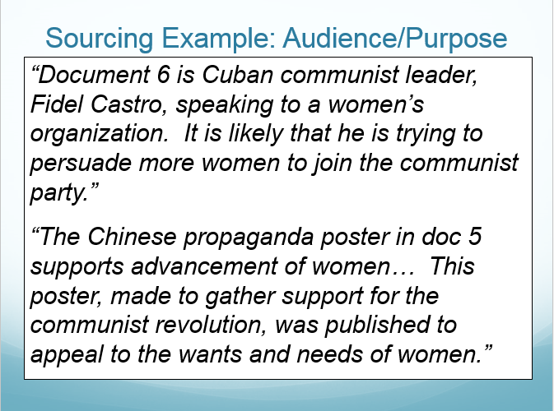

Slide 56
Outside Evidence
Must use some sliver of outside evidence that backs up your thesis statement
Cannot be close to anything in the documents, but should be relevant to the topic

Slide 58
Analysis and Reasoning: Complexity
“Extending”, basically show that you can think beyond the documents. Create a unique idea
Link to something similar in a different part of the world OR time period
Link a different theme than prompted
Easiest way is to do the opposite of whatever they ask you to do!
Whole essay is about comparison, do a contrasting paragraph
Whole essay is changes, what stayed the same?

Slide 59
You’re Finished! (Random things)
No need for a conclusion unless you didn’t have a solid thesis in the intro
Don’t erase if you screw up! Draw a line through and move on
Readers skip those lines
If necessary, you can draw lines to paragraphs you write out of order, just try to avoid this!
Don’t skip lines when writing!
Start the other essay, you’re running out of time!

