Slide 1
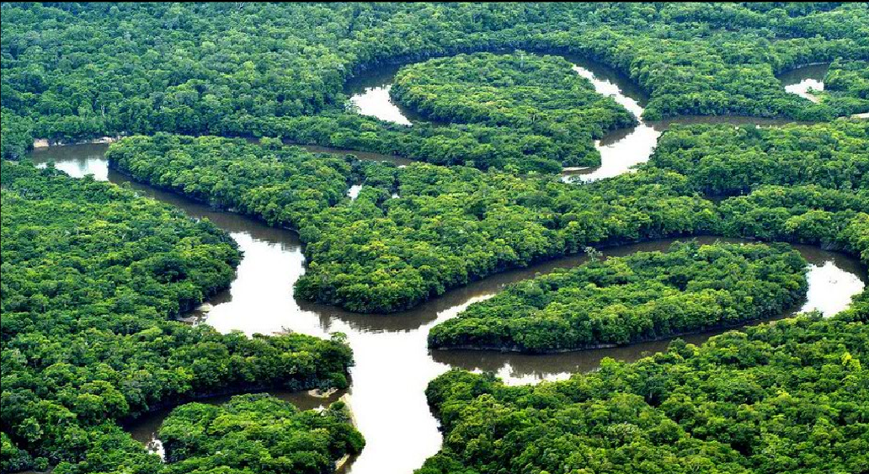
C.4 Conservation of biodiversity
Essential idea: Entire communities need to be conserved in order to preserve biodiversity.
The tremendous biodiversity of the amazon rainforest can only be conserved in situ it is simply too complex to recreate or conserve in part. Many species rely on a complex web of interactions with other species that they share the environment with, if the balance is disturbed then species will be lost and the community will become less diverse.
By Chris Paine (modified by D. Knox)
https://bioknowledgy.weebly.com/
http://3.bp.blogspot.com/-p19vnPIw5WY/Tla1Xp07zQI/AAAAAAAAAkE/Ot-Lo1ZwKOQ/s1600/amazon.png

Slide 2
Understandings, Applications and Skills
 | Statement | Guidance
C.4.U1 | An indicator species is an organism used to assess a specific environmental condition.
C.4.U2 | Relative numbers of indicator species can be used to calculate the value of a biotic index.
C.4.U3 | In situ conservation may require active management of nature reserves or national parks.
C.4.U4 | Ex situ conservation is the preservation of species outside their natural habitats.
C.4.U5 | Biogeographic factors affect species diversity.
C.4.U6 | Richness and evenness are components of biodiversity.
C.4.A1 | Case study of the captive breeding and reintroduction of an endangered animal species.
C.4.A2 | Analysis of the impact of biogeographic factors on diversity limited to island size and edge effects.
C.4.S1 | Analysis of the biodiversity of two local communities using Simpson's reciprocal index of diversity. | The formula for Simpson’s reciprocal index should be known by students.

Slide 3
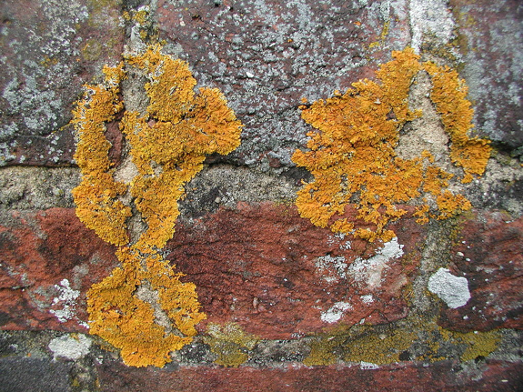
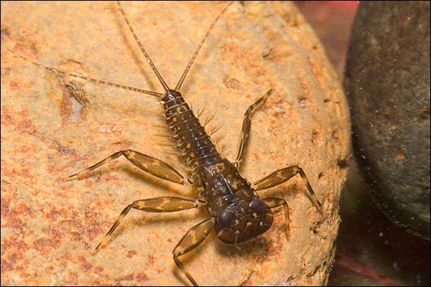
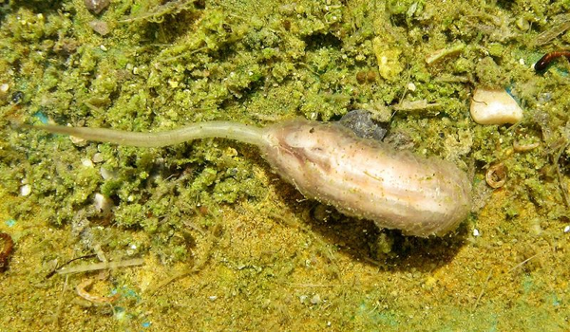
C.4.U1 An indicator species is an organism used to assess a specific environmental condition.
Indicator species are sensitive to (specific) environmental conditions. Because they have a limited range of tolerance. Their presence or absence can be used as a indicator of environmental conditions.
Different Lichens are susceptible to differing levels of air pollution (e.g. sulphur dioxide, which causes acid rain)
Mayfly larvae require high levels of dissolved oxygen in water …
http://commons.wikimedia.org/wiki/File:N2_Lichen.jpg
http://www.flyfishersatthecrossing.org/Mayfly_nymph.jpeg
… where as rat-tailed maggots tolerate much lower levels of dissolved oxygen in water.
http://commons.wikimedia.org/wiki/File:Langegg_Rattenschwanzlarve_Eristalini.jpg

Slide 4
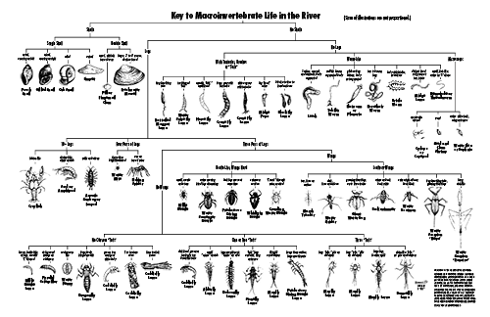

Slide 5
C.4.U2 Relative numbers of indicator species can be used to calculate the value of a biotic index.
Kick sampling can be used to collect macro invertebrates in shallow water:
A Biotic index compares the relative frequency of indicator species
It provide an overall environmental assessment of an ecosystem
A change in the biotic index over time indicates a change in the environmental conditions
One possible way to calculate the Biotic Index:
A high biotic index indicates an abundance of pollution sensitive organisms = unpolluted environment
A low biotic index indicates the absence of pollution sensitive organisms = polluted environment

Slide 6
C.4.U2 Relative numbers of indicator species can be used to calculate the value of a biotic index.
Kick sampling can be used to collect macro invertebrates in shallow water:
A Biotic index compares the relative frequency of indicator species
It provide an overall environmental assessment of an ecosystem
A change in the biotic index over time indicates a change in the environmental conditions
One possible way to calculate the Biotic Index:
A high biotic index indicates an abundance of pollution sensitive organisms = unpolluted environment
You don’t have to memorise the formula. understanding how to analyse the data is enough
A low biotic index indicates the absence of pollution sensitive organisms = polluted environment

Slide 7
C.4.U2 Relative numbers of indicator species can be used to calculate the value of a biotic index.

Slide 8
C.4.U2 Relative numbers of indicator species can be used to calculate the value of a biotic index.

Slide 9
C.4.U2 Relative numbers of indicator species can be used to calculate the value of a biotic index.

Slide 10
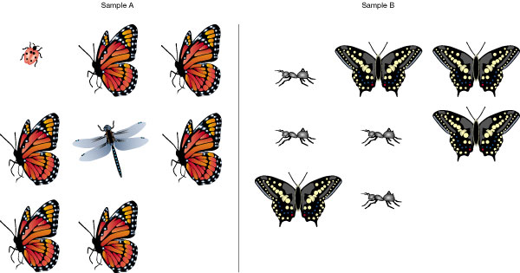
C.4.U6 Richness and evenness are components of biodiversity.
Biodiversity
is variety of organisms present in an ecosystem
Richness
The number of different species present.
Evenness
If a habitat has similar abundance for each species present, the habitat is said to have eveness.
More species therefore highest richness
Greatest eveness as the two populations have similar abundance.
http://www.nature.com/nature/journal/v405/n6783/images/405212aa.2.jpg

Slide 11
C.4.S1 Analysis of the biodiversity of two local communities using Simpson's reciprocal index of diversity.
Simpson’s reciprocal index can be used to calculate biodiversity.
total of organisms of all species
Simpson’s Reciprocal Index
N (N - 1)
D =
Σ n (n - 1)
the sum of (all species)
number of organisms of a single species
It takes into account both richness and evenness
The greater the biodiversity the higher the value of D
The lowest possible defined value of D is 1 (only one species found)
The maximum value is equal to the number of species found, this only occurs if all species are equally abundant.

Slide 12
C.4.S1 Analysis of the biodiversity of two local communities using Simpson's reciprocal index of diversity.
Compare the biodiversity of the two samples:
total of organisms of all species
Simpson’s Reciprocal Index
N (N - 1)
D =
Σ n (n - 1)
the sum of (all species)
number of organisms of a single species
http://www.nature.com/nature/journal/v405/n6783/images/405212aa.2.jpg

Slide 13
C.4.S1 Analysis of the biodiversity of two local communities using Simpson's reciprocal index of diversity.
Compare the biodiversity of the two samples:
Species* | Count
A | 6
B | 1
C | 1
Total | 8
Species* | Count
A | 4
B | 4
Total | 8
*correct names not required
http://www.nature.com/nature/journal/v405/n6783/images/405212aa.2.jpg

Slide 14
C.4.S1 Analysis of the biodiversity of two local communities using Simpson's reciprocal index of diversity.
Compare the biodiversity of the two samples:
total of organisms of all species
Simpson’s Reciprocal Index
N (N - 1)
Sample A
D =
Σ n (n - 1)
Species* | Count
A | 6
B | 1
C | 1
Total | 8
the sum of (all species)
number of organisms of a single species
8 (8 - 1)
56
D =
=
6 (6 - 1) + 1 (1 - 1) + 1 (1 - 1)
30 + 0 + 0
D = 1.87

Slide 15
C.4.S1 Analysis of the biodiversity of two local communities using Simpson's reciprocal index of diversity.
Compare the biodiversity of the two samples:
total of organisms of all species
Simpson’s Reciprocal Index
N (N - 1)
Sample B
D =
Σ n (n - 1)
Species* | Count
A | 4
B | 4
Total | 8
the sum of (all species)
number of organisms of a single species
8 (8 - 1)
56
D =
=
4 (4 - 1) + 4 (4 – 1)
12 + 12
D = 2
Sample B has slighter higher biodiversity

Slide 19
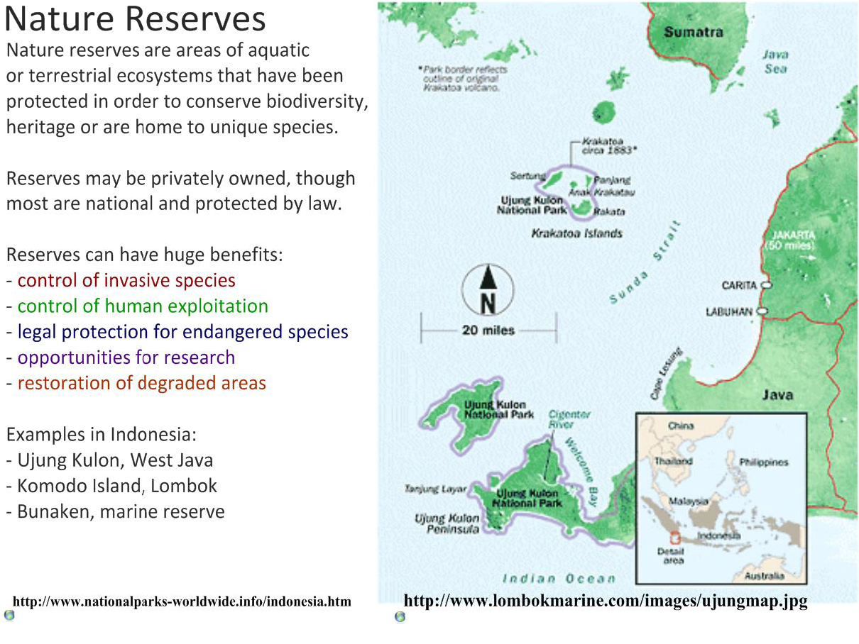
C.4.U3 In situ conservation may require active management of nature reserves or national parks.

Slide 20
C.4.U5 Biogeographic factors affect species diversity.
General Principles of Nature Reserves (exceptions may exist depending on composition of local wildlife)
http://ib.bioninja.com.au/_Media/conservation_med.jpeg

Slide 21
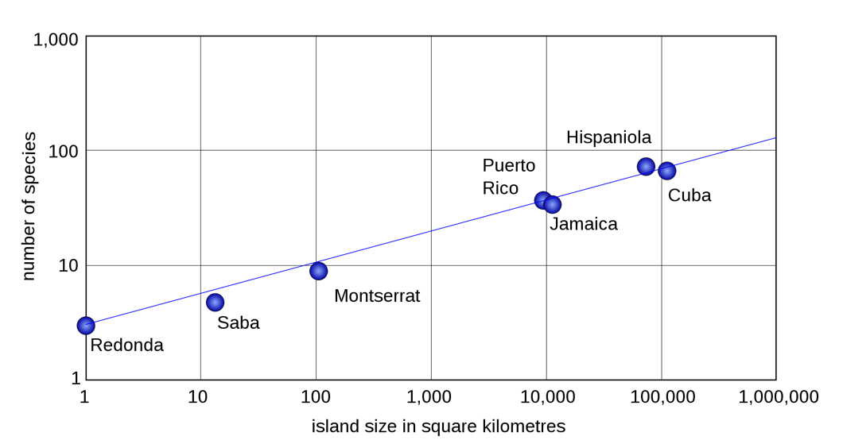
C.4.A2 Analysis of the impact of biogeographic factors on diversity limited to island size and edge effects.
Impact of island size on biodiversity
Total number of reptilian and amphibian species on seven small and large islands in the West Indies
Describe the relationship show in the graph.
Estimate the number of reptile and amphibian species likely to be found on an island of 1,000 km²
n.b. proximity to a continental mass will increase biodiversity as migration of animals and plants becomes easier.
http://upload.wikimedia.org/wikipedia/commons/thumb/1/13/Area_species_curve_herpetofauna.svg/2000px-Area_species_curve_herpetofauna.svg.png

Slide 22
What makes a protected area successful?
Buffer zones around them that:
Partially or completely funded by the government (stability)
Have educational programs (public awareness)
Attract visitors (funding, public support, recreation)
Are managed not just left to develop (maintained)
Have a high profile animal (Panda, Bear, Marsupial etc)

Slide 23
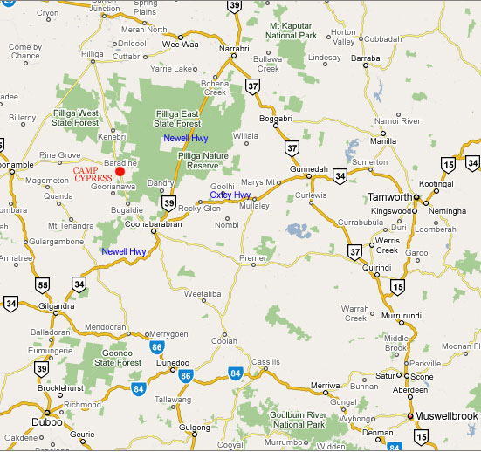
How to design a protected area
1. Large – allows more habitats and more species

Slide 24
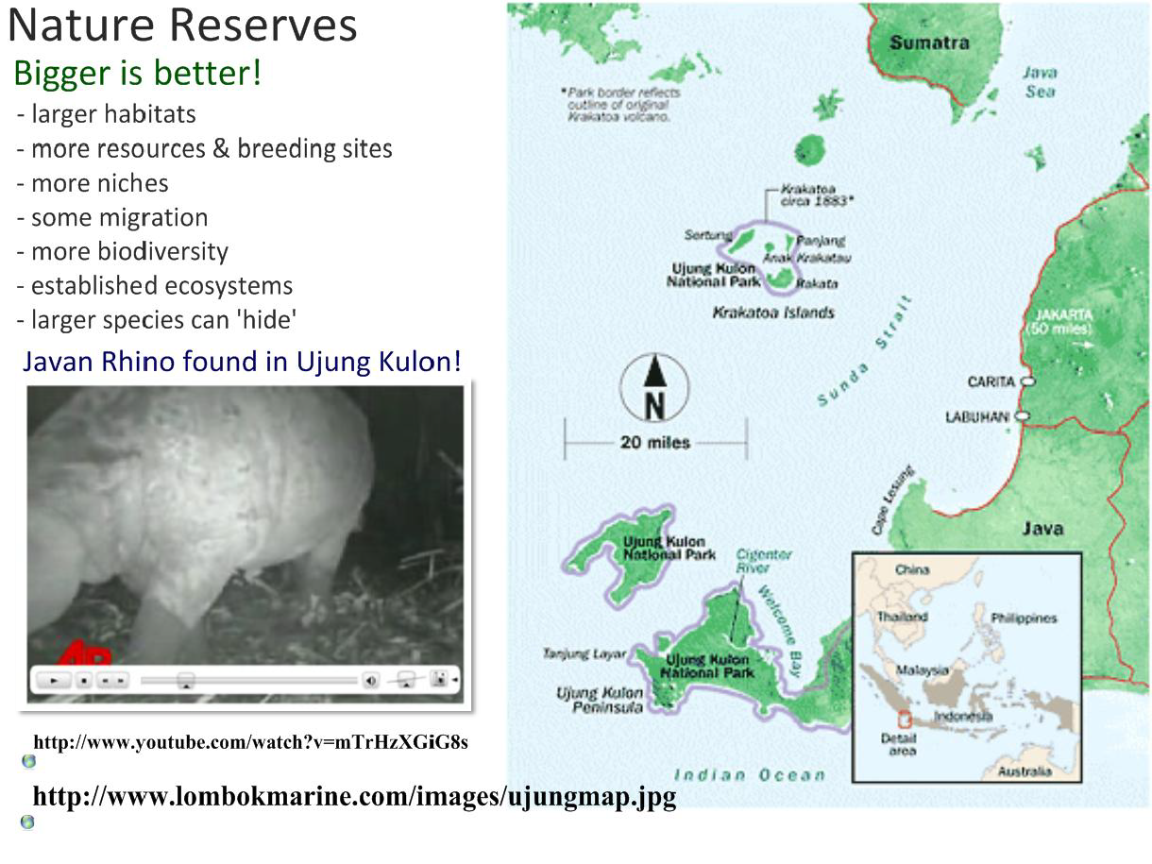
C.4.U3 In situ conservation may require active management of nature reserves or national parks.
Bigger reserves encourage greater biodiversity

Slide 25
How to design a protected area
2. Unfragmented – allows dispersal

Slide 26
How to design a protected area
2a. Close – if fragmentation unavoidable

Slide 27
How to design a protected area
2b. Grouped – if fragmentation unavoidable

Slide 28
How to design a protected area
2c. Corridors – if fragmentation unavoidable

Slide 29
C.4.U5 Biogeographic factors affect species diversity.
Corridors encourage greater biodiversity

Slide 30
How to design a protected area
3. Round – less edge effect such as interference like poaching

Slide 31
C.4.U5 Biogeographic factors affect species diversity.
Disturbance generally will decrease biodiversity, but there are exceptions.

Slide 32
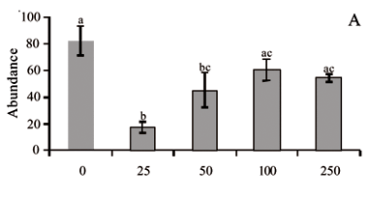
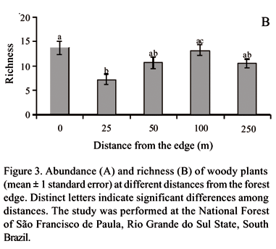
C.4.A2 Analysis of the impact of biogeographic factors on diversity limited to island size and edge effects.
Impact of the edge effect on biodiversity
The graphs show changes in plant community diversity and composition across an edge between Araucaria forest and pasture in South Brazil
Describe the relationship show in the abundance graph.
Deduce the edge effect upon biodiversity in Araucaria forests.
Suggest a reason why both abundance and richness is greatest at the forest edge.
Suggest a reason why abundance and richness decrease after 100 m from the forest edge.
http://www.scielo.br/scielo.php?pid=S0100-84042006000100008&script=sci_arttext

Slide 33
C.4.U3 In situ conservation may require active management of nature reserves or national parks.
Make sure you understand the practices used to actively manage reserves and can illustrate this with a good example.

Slide 34
C.4.U3 In situ conservation may require active management of nature reserves or national parks. C.4.U4 Ex situ conservation is the preservation of species outside their natural habitats.
Different strategies for the conservation of endangered species:
In-situ | Ex-situ
(in its natural habitat) | (away from its natural habitat)
Natural habitat conserved | Will work if habitat is lost
maintains the animal's normal behaviour | Easy to isolate the animal from the threats
Food web/chain structure of the ecosystem maintained | Species maybe too rare to breed / maintain populations in the wild
Captive breeding does not work for all species | Captive breeding can quickly increase numbers (for some species)
Habitat can be used for the reintroduction of animals from captive breeding programs
Habitat remains available to other (endangered) species
e.g. The Leighton Moss reserve in the UK maintains costal marsh, ideal breeding ground for the Avocet. Project Tiger reserves in India | e.g. Captive breeding of Pandas and Peregrine Falcons
e.g. re-planting of endangered species or the removal of invasive species, e.g. Rhodedendrons | e.g. Botanical gardens such as Kew in London and seed banks
Conservation efforts are often, in reality, a combination of approaches

Slide 35
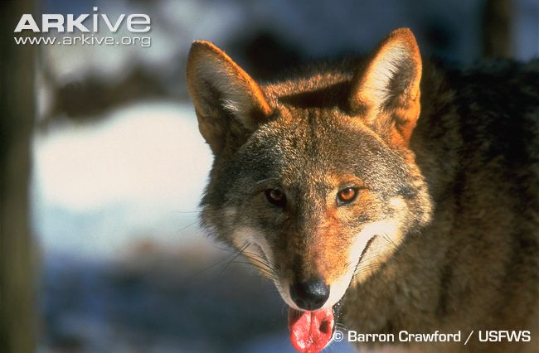
C.4.A1 Case study of the captive breeding and reintroduction of an endangered animal species.
A smaller relative of the grey wolf, the red wolf is one of the rarest canids in the world.
Threats during the 1900s:
Hunting/predator control programs (deemed to be a pest)
Destruction / alteration of habitat
Native to the Southeastern USA
The red wolf was designated an endangered species in 1967 and declared extinct in the wild in 1980.
U.S. Fish and Wildlife Service initiated a captive breeding program enabled the species to be reintroduced.
As of 2010, the reintroduced population of red wolves was thought to total around 130 individuals.

Slide 36
How wolves changed the course of a river?
Short Video (5 min)
Documentary on Yellowstone Wolves (50 min)
5 species brought back from the brink of extinction
13 species saved from extinction

Slide 37
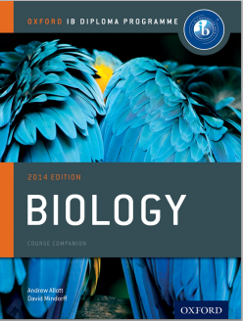
Bibliography / Acknowledgments
Jason de Nys

