Slide 1
Religion and Culture
Chapter 15

Slide 2
I. Reviving Religion
Religion, 1790-1860:
Church attendance still regular ritual for ¾ of 23 million Americans in 1850
Alexis de Tocqueville declared there was “no country in the world where the Christian religion retains a greater influence over the souls of men than in America.”
Yet religion of this era was not old-time religion of colonial days:
Austere Calvinism declined in American churches
Rationalist ideas of French Revolutionary era softened older orthodoxy:
Thomas Paine's The Age of Reason (1794) declared churches were “set up to terrify and enslave mankind, and monopolize power and profit.”
Many Founding Fathers, including Jefferson and Franklin, embraced Paine's liberal Deism

Slide 3
I. Reviving Religion (cont.)
Deism:
Relied on reason rather than revelation
On science rather than Bible
Rejected concept of original sin
Denied Christ's divinity
Yet Deists believed:
In Supreme Being who created knowable universe
Who endowed human beings with capacity for moral behavior

Slide 4
I. Reviving Religion (cont.)
Deism reflected continuing religious debate over free will and human salvation:
Overtime, many Protestants downplayed Calvinist emphasis on predestination and human depravity
Instead stressed essential goodness of human nature
Proclaimed belief in free will and possibility of salvation through good works
Pictured God not as stern Creator but as loving Father
Such ideas flourished among Methodists, Baptists, & Unitarians
Affected Presbyterians & Congregationalists too
Religious ferment propelled wave of revivals in early 1800s in Second Great Awakening

Slide 5
I. Reviving Religion (cont.)
Second Great Awakening one of most momentous episodes in history of American religion:
Converted countless souls
Shattered and reorganized many churches
Created numerous new sects
Encouraged evangelicalism in many areas of American life:
Prison reform, temperance cause, women's movement, and crusade to abolish slavery
Second Great Awakening spread on frontier by huge “camp meetings”:
Up to 25,000 people would gather for several days to listen to an itinerant preacher
Thousands of spiritually starved souls “got religion”
Many of “saved” soon backslid into former sinful ways
Revivals boosted church attendance

Slide 6
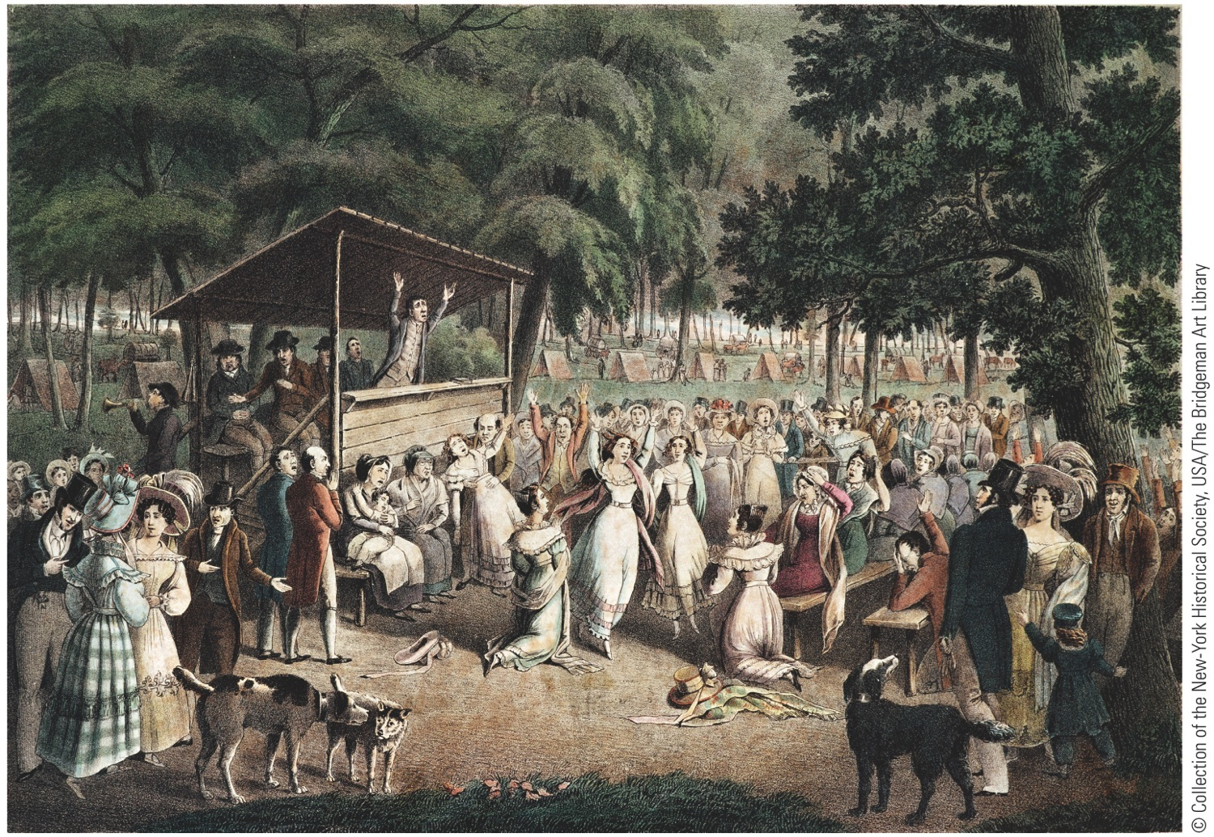
p310
Notes:
Religious Camp Meeting, by
J. Maze Burbank, 1839 At
huge, daylong encampments,
repentant sinners dedicated
themselves to lives of personal
rectitude and social reform.
Fire-and-brimstone preachers
like the one depicted here
inspired convulsions, speaking
in tongues, and ecstatic singing
and dancing among the
converted. Out of this religious
upheaval grew many of the
movements for social
improvement in the pre–Civil
War decades, including the
abolitionist crusade.

Slide 7
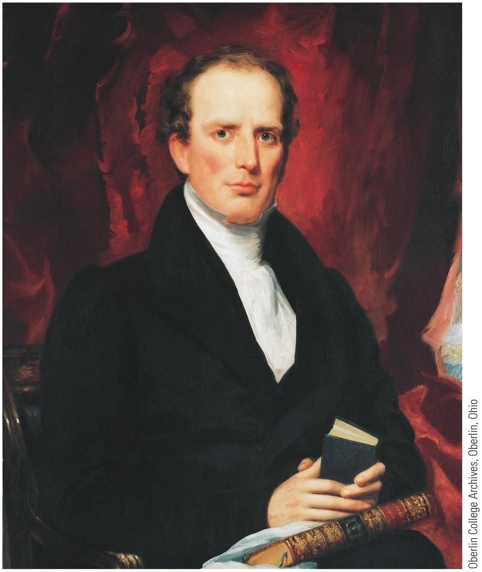
I. Reviving Religion (cont.)
Charles Grandison Finney was greatest of revival preachers:
Had deeply moving conversion experience
Led massive revivals in Rochester and New York City in 1830 and 1831
Preached a version of old-time religion, but was also an innovator:
Devised “anxious bench” where repentant sinners could sit in full view of congregation
Encouraged women to pray aloud in public

Slide 8
I. Reviving Religion (cont.)
Denounced both alcohol and slavery
Served as president of Oberlin College in Ohio, which he helped make a hotbed of revivalist activity and abolitionism
Key feature of Second Great Awakening was feminization of religion, both in church membership and theology:
Middle-class women were first and most fervent enthusiasts of religious revivalism
Made up majority of new church members

Slide 9
I. Reviving Religion (cont.)
Most likely to stay with church even after revival
Evangelicals preached a gospel of female spiritual worth
Offered women an active role in bringing their husbands and families back to God
Many women then turned to saving rest of society
Formed a host of benevolent and charitable organizations
Spearheaded most of era's ambitious reforms

Slide 10
II. Denominational Diversity
Revivals furthered fragmentation of religious faiths:
Western New York so blistered by sermonizers preaching “hellfire and damnation,” it came to be known as Burned-Over-District:
Millerites, or Adventists, rose from Burned-Over-District soil in 1830s
Named after William Miller
Interpreted Bible to mean Christ would return on October 22, 1844
Failure of Jesus to descend on schedule dampened but did not destroy movement
Like First Great Awakening, the Second tended to widen lines between classes and regions:
Prosperous and conservative denominations in East less affected
Episcopalians, Presbyterians, Congregationalists, & Unitarians tended to come from wealthier, better-educated, urban areas
Methodists, Baptist, & other sects tended to come from less prosperous, less “learned” communities in rural South and West

Slide 11
II. Denominational Diversity (cont.)
Religious diversity reflected growing social cleavages regarding slavery:
In 1844-45, southern Baptists & southern Methodists split from northern brethren
In 1857 Presbyterians, North & South, parted company
Secession of southern churches foreshadowed secession of southern states
First churches split; then political parties split; then Union split

Slide 12
III. A Desert Zion in Utah
Mormons:
Joseph Smith received golden plates in 1830, which constituted Book of Mormon
Also called Church of Jesus Christ of Latter-Day Saints
Mormons went first to Ohio, then to Missouri and Illinois:
Antagonized neighbors by voting as a unit
By openly drilling militia for defensive purpose
And by accusations of polygamy against Smith
In 1844 Smith and his brother were murdered by a mob in Carthage, Ill.
Brigham Young took over leadership:
Proved to be an aggressive leader
An eloquent preacher
A gifted administrator
Determined to escape further persecution, he led oppressed Mormons to Utah in 1846-47

Slide 13
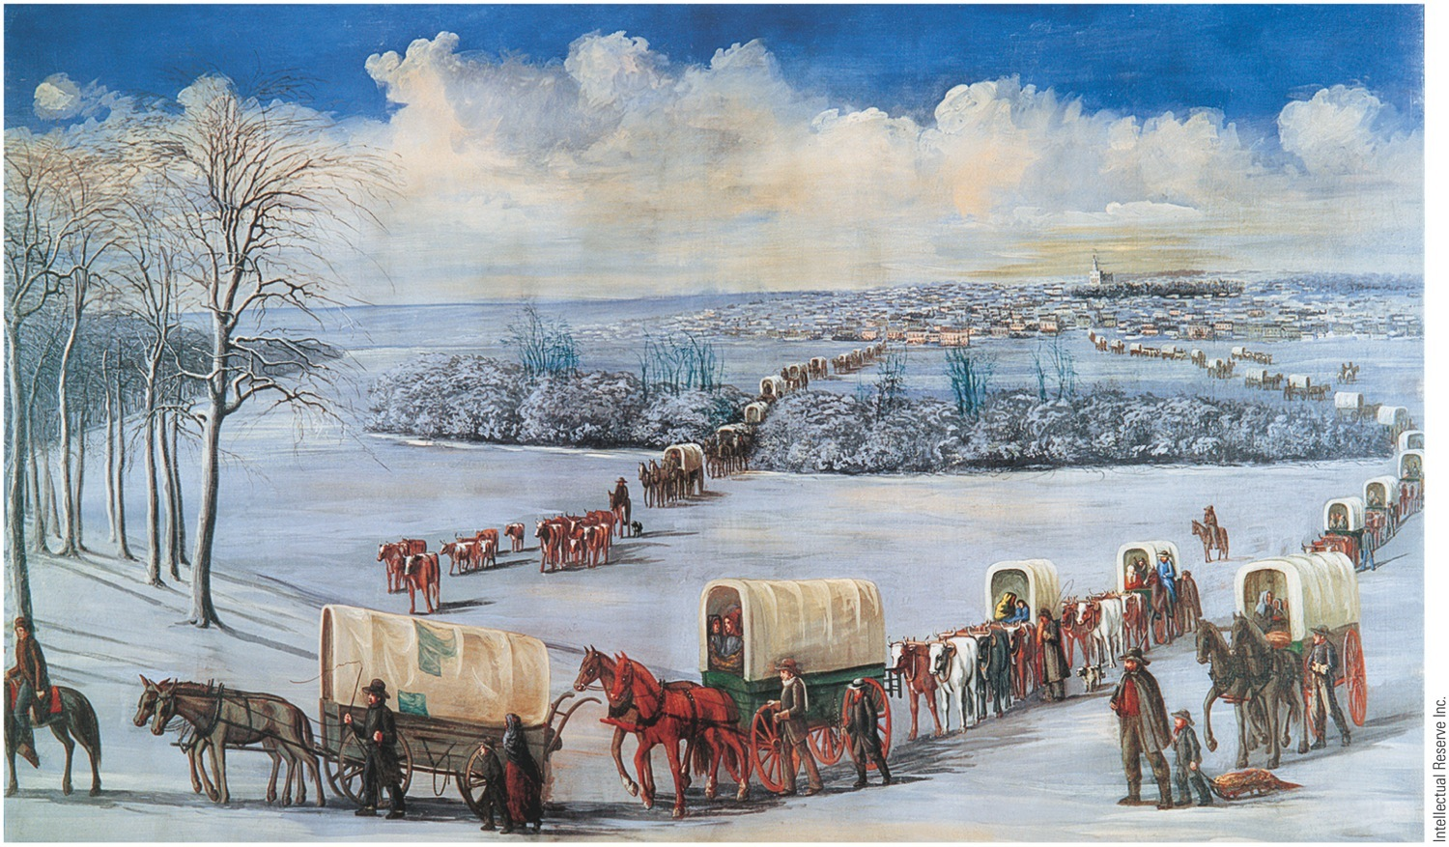
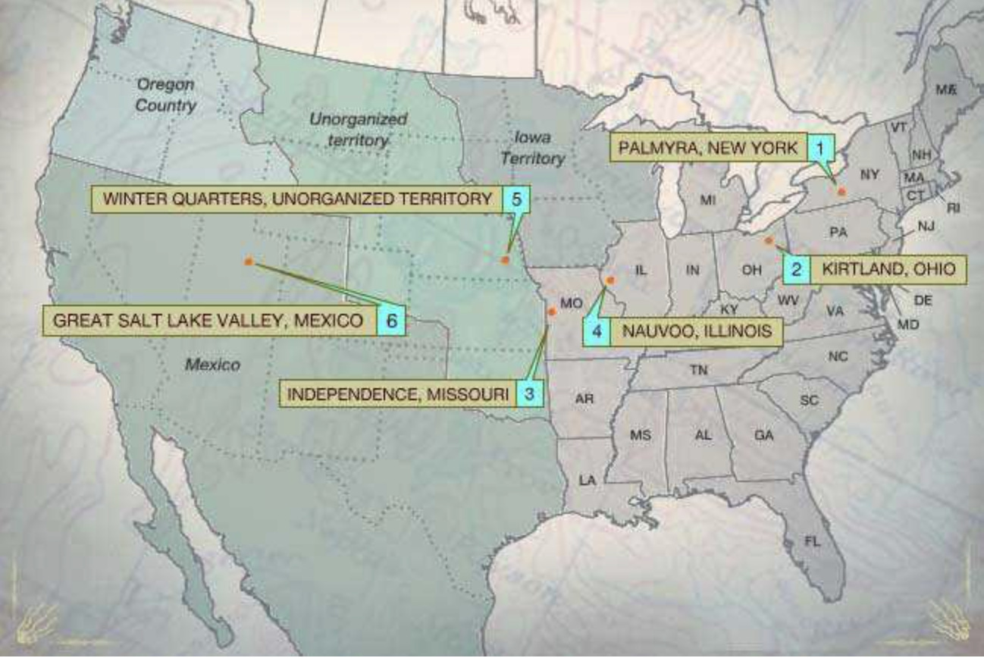
p312
Notes:
Mormon Trekkers Crossing the Mississippi on the Ice Driven out of Illinois after the murder
of founder Joseph Smith in 1844, the Mormons wintered near Council Bluffs, Iowa Territory, before
beginning the long overland trek to Utah.

Slide 14
III. A Desert Zion in Utah (cont.)
Mormons soon made desert bloom by means of ingenious & cooperative irrigation:
Crop of 1848, threatened by crickets, was saved by flock of gulls (A monument to seagulls still stands in Salt Lake City)
Semiarid Utah grew remarkably
5,000 settlers had arrived by end of 1848.
In 1850s many dedicated Mormons made 1,300 mile trek across plains pulling two-wheeled carts
Under Young's disciplined management, community became prosperous frontier theocracy and cooperative commonwealth
Young married as many as 27 women and begot 56 children
Population grew with thousands of immigrants from Europe, where Mormons had flourishing missionary movement

Slide 15
III. A Desert Zion in Utah
Crisis developed when U.S. Government unable to control Young, who had been made territorial governor in 1850:
Federal troops marched in 1857 against Mormons
Fortunately quarrel settled without serious bloodshed
Mormons had problems with anti-polygamy laws passed by Congress in 1862 and 1882:
Marital customs delayed statehood for Utah until 1896

Slide 16
Public Education
In 1820s working and middle class families began to demand tax supported schools.
Many parents, however, opposed public schools. They did not want to trust their kids’ education to the government. Many parents used their kids around the house as an extra source of labor.
Horace Mann lobbied for “the absolute right to an education of every human”
By 1850 most Northern states had public education.

Slide 17
IV. Free Schools for a Free People
Early schools:
Stayed open only a few months of year
Schoolteachers, mainly men, were ill-trained, ill-tempered, ill-paid
More stress on “lickin” than “larnin”
Usually taught “three Rs”—“readin', 'ritin', 'rithmetic”
To many rugged Americans, suspicious of “book larnin',” this was enough

Slide 18
IV. Free Schools for a Free People (cont.)
Horace Mann (1796-1859):
As secretary of Massachusetts Board of Education, he championed:
More and better schoolhouses
Longer school terms
Higher pay for teaches
Expanded curriculum
His influence radiated out to other states and improvements were made
Yet education remained an expensive luxury for many communities
By 1860 nation counted only 100 public secondary schools—and nearly a million white adult illiterates.
Black slaves in South were legally forbidden to receive instruction in reading and writing.
Free blacks in both North and South were usually excluded from schools.

Slide 19
IV. Free Schools for a Free People
Educational advances aided by improved textbooks, esp. by Noah Webster (1758-1843):
His books partly designed to promote patriotism
Devoted twenty years to famous dictionary
Published in 1828, it helped standardize American language
William H. McGuffey:
A teacher-preacher of rare power
His grade-school readers, first published in 1830s, sold 122 million copies
McGuffey's Readers hammered home lessons in morality, patriotism, and idealism

Slide 20
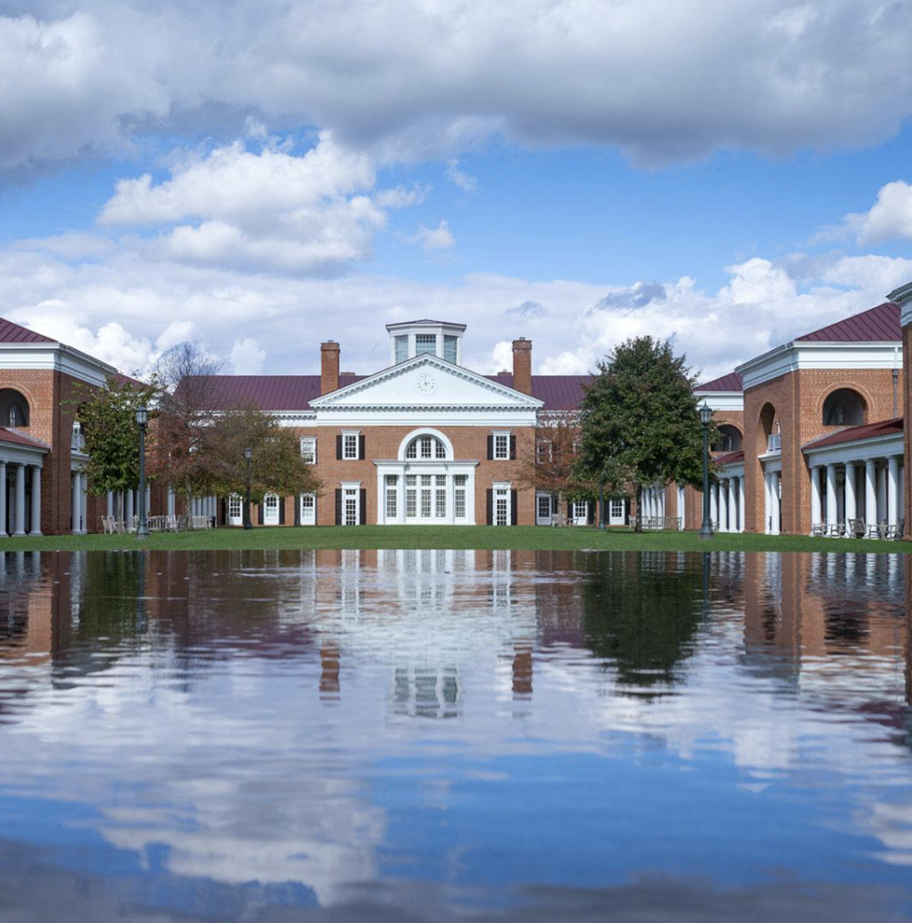
V. Higher Goals for Higher Learning
Higher education:
Second Great Awakening created many small, denominational, liberal arts colleges:
Chiefly in South and West
New colleges offered narrow, traditional curriculum of Latin, Greek, mathematics, and moral philosophy
First state-supported university in North Carolina (1795)
University of Virginia (1819):
Brainchild of Thomas Jefferson
Dedicated university to freedom from religion or political shackles
Modern languages and sciences received emphasis

Slide 21
V. Higher Goals for Higher Learning (cont.)
Higher education for women:
Frowned upon in early decades of 1800s
Women's education was to be in the home
Prejudices prevailed that too much learning injured brain, undermined health, and rendered a young lady unfit for marriage
Some access for women began:
Oberlin College admitted women in 1837
Mount Holyoke Seminary opened in 1837

Slide 22
V. Higher Goals for Higher Learning (cont.)
Adult learners:
Used private subscription libraries or increasingly public libraries
House-to-house peddlers fed public appetite for culture
Traveling lecturers carried learning to masses through lyceum lecture associations:
Platform for speakers in science, literature, & moral philosophy
Magazines flourished in pre-Civil War years, but most withered after short life
Reformers:
Most were intelligent, inspired idealists, touched by evangelical religion:
Dreamed of freeing world from earthly evils
Women prominent in reform, especially for suffrage:
Reform provided opportunity to escape home and enter public arena
Imprisonment for debt continued to be a nightmare:

Slide 23
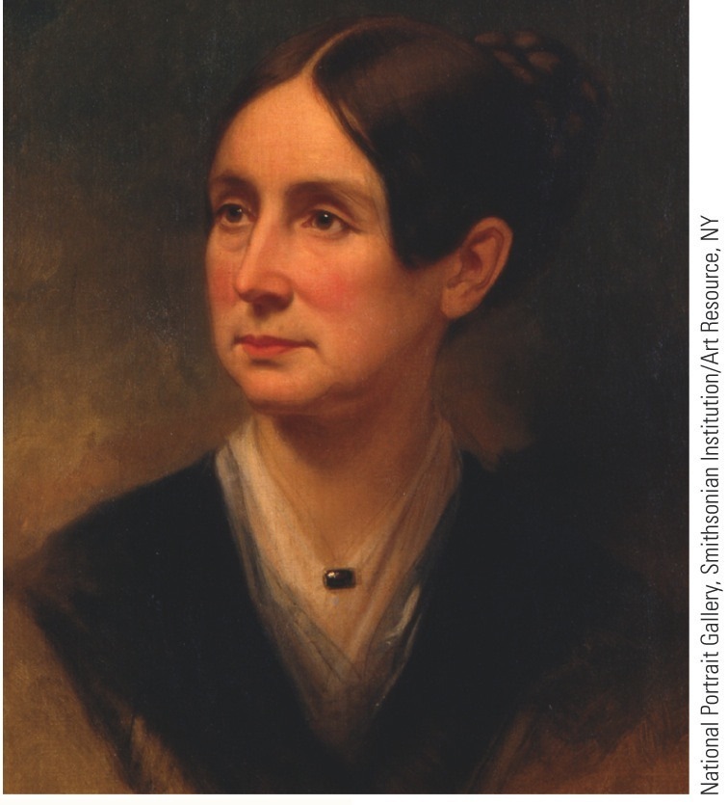
VI. An Age of Reform
Criminal codes in states were softened:
Number of capital offenses reduced
Brutal punishments slowly eliminated
Idea that prisons should reform as well as punish—hence “reformatories,” “houses of correction,” and “penitentiaries” (for penance)
Insane still treated with cruelty
Many chained in jails or poor house
Dorothy Dix (1802-1887):
Possessed infinite compassion and will-power
Travelled 60,000 miles in 8 years to document firsthand observation of insanity and asylums

Slide 24
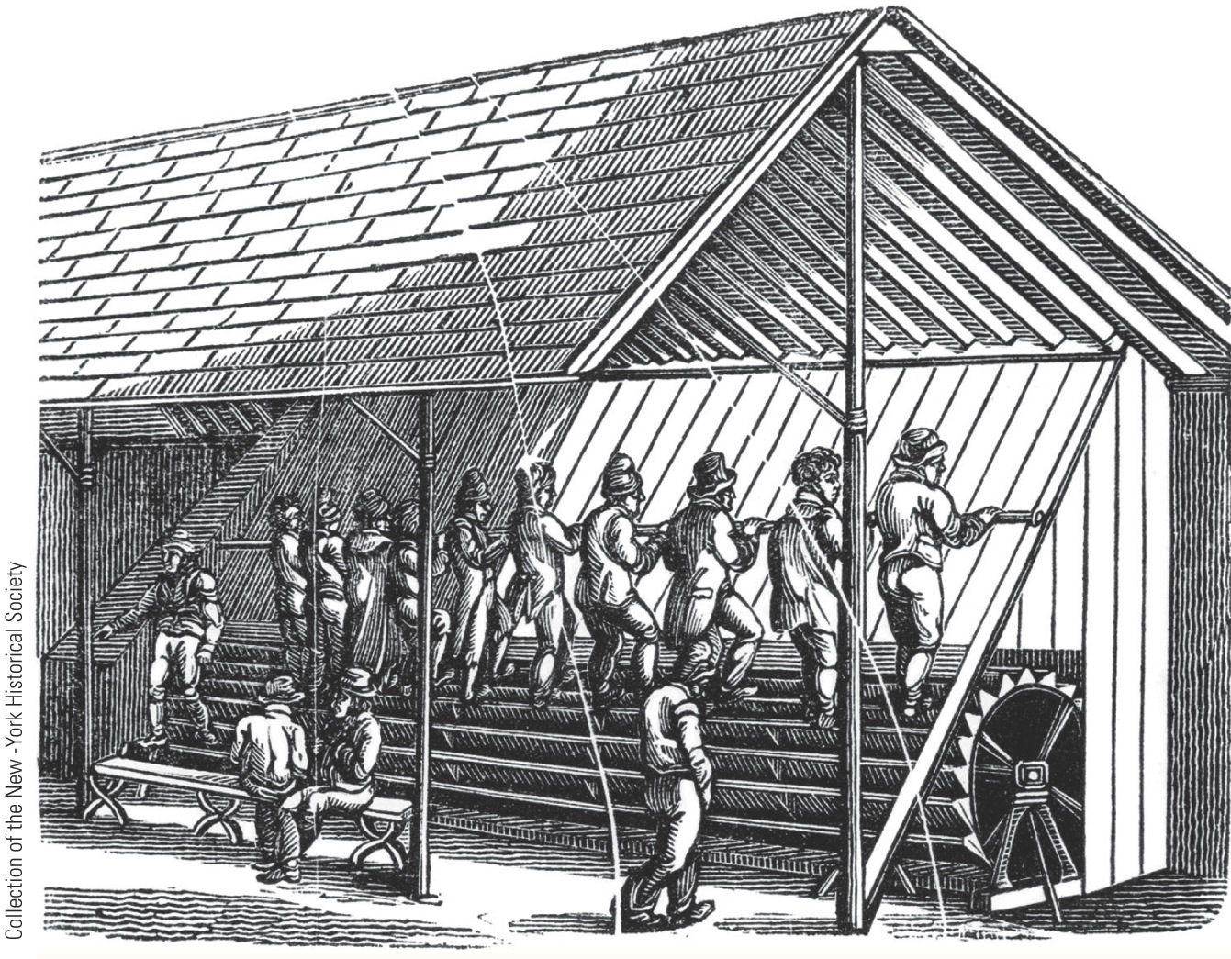
p317
Notes:
(left) The Stepping Mill, Auburn Prison, New York, 1823; (right) Portrait of Dorothea Dix by
Samuel Bell Waugh, 1868 Reformers like Dorothea Dix believed that idleness was a scourge and
prescribed rigorous exercise regimens for prisoners. At the experimental prison in Auburn, chained
prisoners were obliged to turn this wheel for long periods of time.

Slide 25
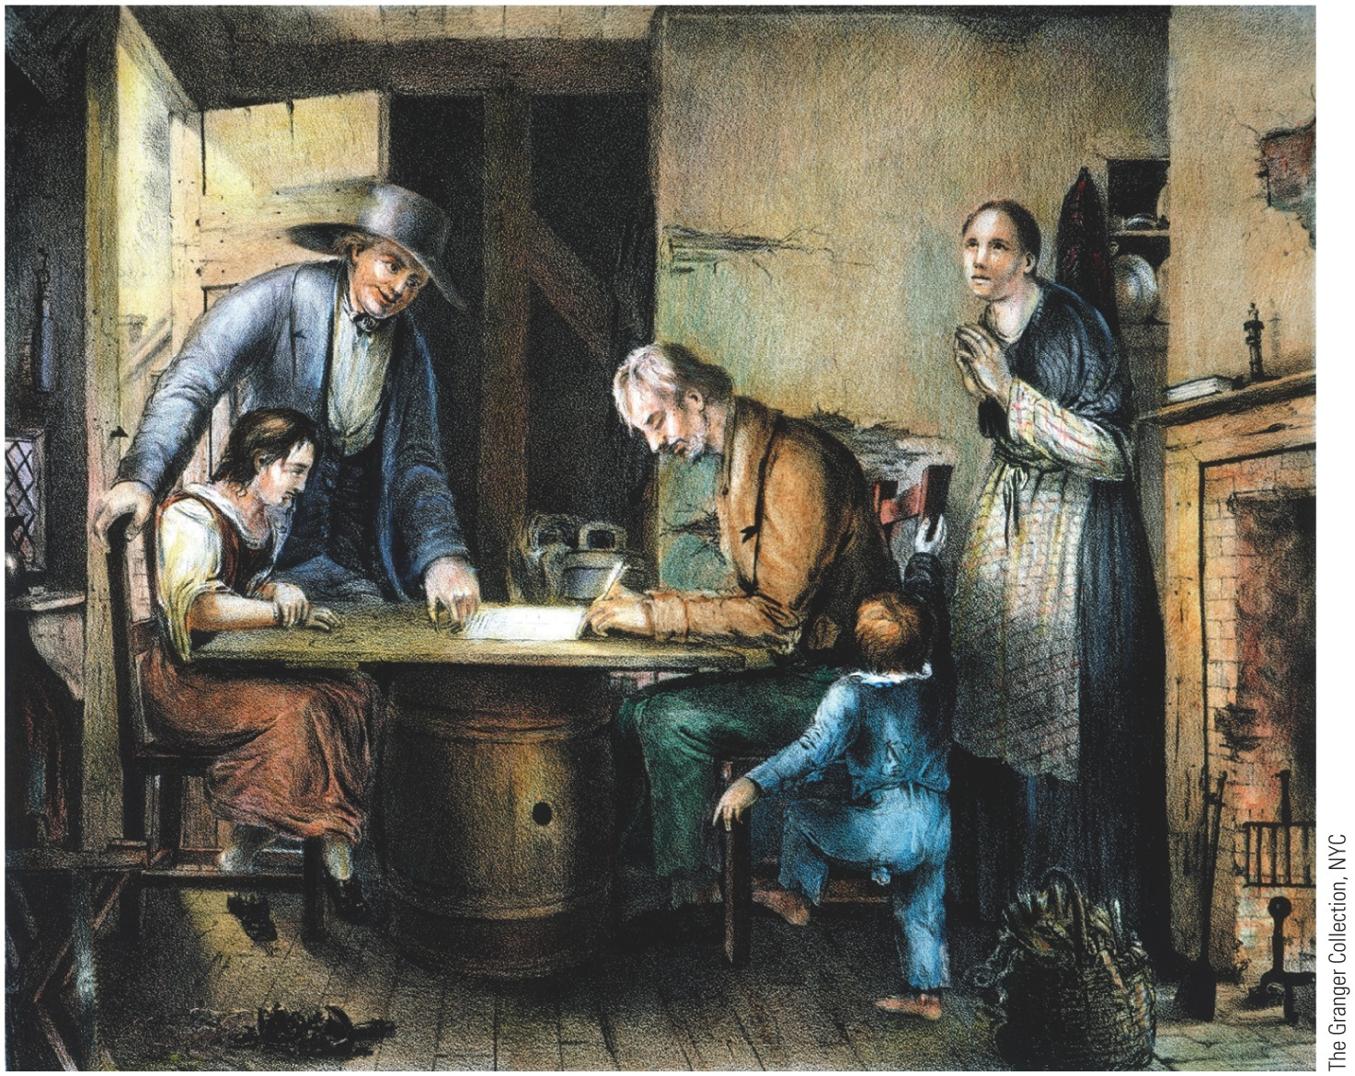
VII. Demon Rum—The “Old Deluder”
Ever-present problem of alcohol attracted dedicated reformers:
American Temperance Society formed in Boston (1826):
Implored drinkers to sign temperance pledge
Organized children's clubs—“Cold Water Army”
Used pictures, pamphlets, & lurid lectures to convey message
p318
Notes:
Signing the Pledge,
Lithograph, 1846 Temperance
reformers decried many evils of
alcohol, but they fulminated
especially against its corrupting
influence on family life. Here a
former drinker pledges to abstain
hereafter, while his hopeful wife
and children look on.

Slide 26
VII. Demon Rum—The “Old Deluder” (cont.)
Most popular tract was T.S. Arthur's Ten Nights in a Barroom and What I Saw There (1854)
Early foes of Demon Drink adopted two lines of attack:
Stiffen individual's will to resist alcohol = “temperance” rather than “teetotalism” or total elimination
Eliminate intoxicants by legislation:
Neal S. Dow, “Father of Prohibition,” sponsored Maine Law of 1851
Maine Law of 1851:
Banned manufacture & sale of intoxicating liquor
Others states followed Maine's example
By 1857, a dozen states passed prohibition laws
Clearly impossible to legislate thirst for alcohol out of existence
On eve of Civil War, prohibitionists had registered inspiriting gains
Less drinking among women

Slide 27
VIII. Women in Revolt
Women in America, 1800s:
Regarded as perpetual minors: not able to vote or own property, could be beaten by husband
Some now avoided marriage—10 % of adult women remained “spinsters” by Civil War
Gender differences strongly emphasized in 1800s
Burgeoning market economy separated women and men into distinct economic roles
Home was woman's special sphere, centerpiece of “cult of domesticity”

Slide 28
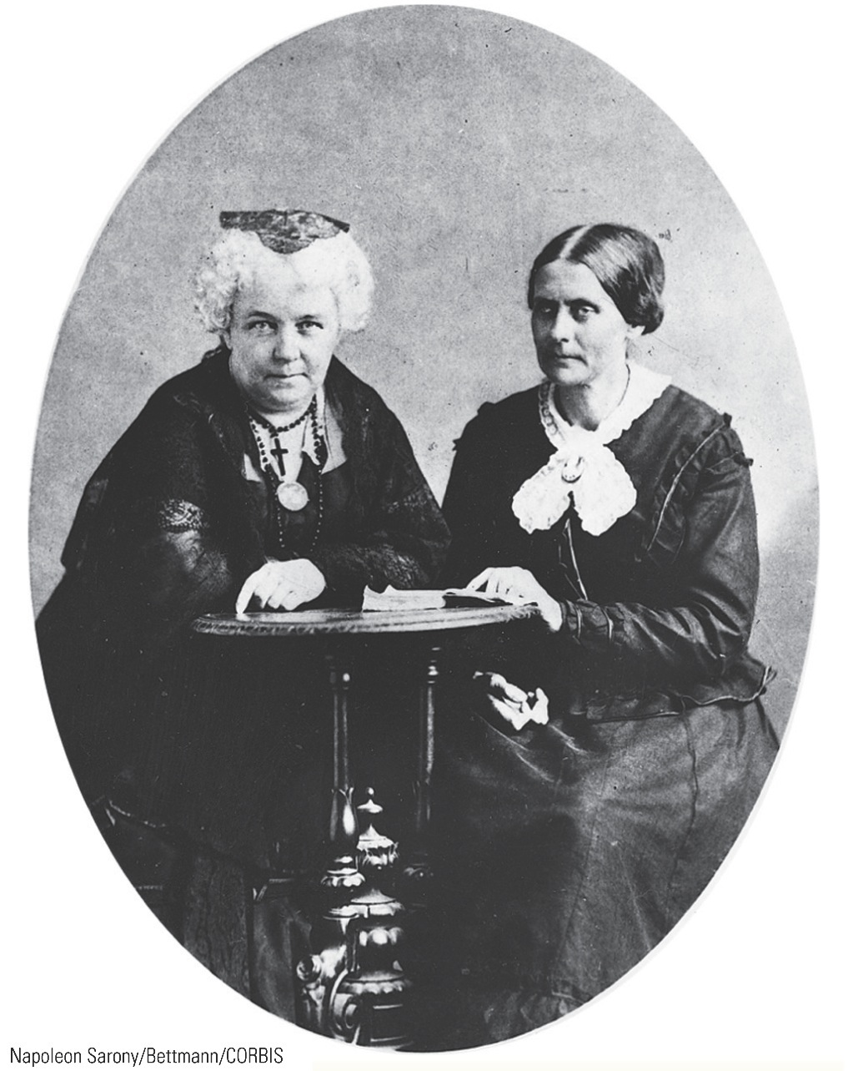
VIII. Women in Revolt
Clamorous female reformers:
Demanded rights for women
Campaigned for temperance and abolition of slavery
Like men, touched by evangelical spirit
Women's right movement mothered by:
Lucretia Mott, sprightly Quaker
Elizabeth Cady Stanton insisted on leaving “obey” out of her marriage ceremony and advocated suffrage for women
Quaker-raised Susan B. Anthony, a militant lecturer for woman's rights

Slide 29
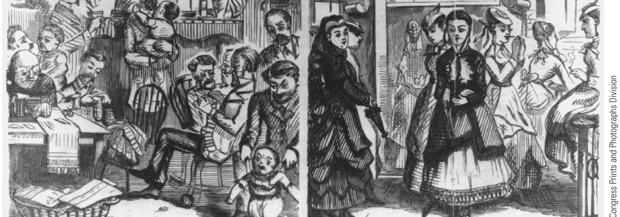
VIII. Women in Revolt (cont.)
Dr. Elizabeth Blackwell was first female graduate of a medical college
Talented Grimke sisters, Sarah and Angelina, championed antislavery
Lucy Stone retained maiden name after marriage—hence the latter-day “Lucy Stoners”
Amelia Bloomer revolted against current “street sweeping” female attire by donning a short skirt with Turkish trousers—“bloomers”

Slide 30
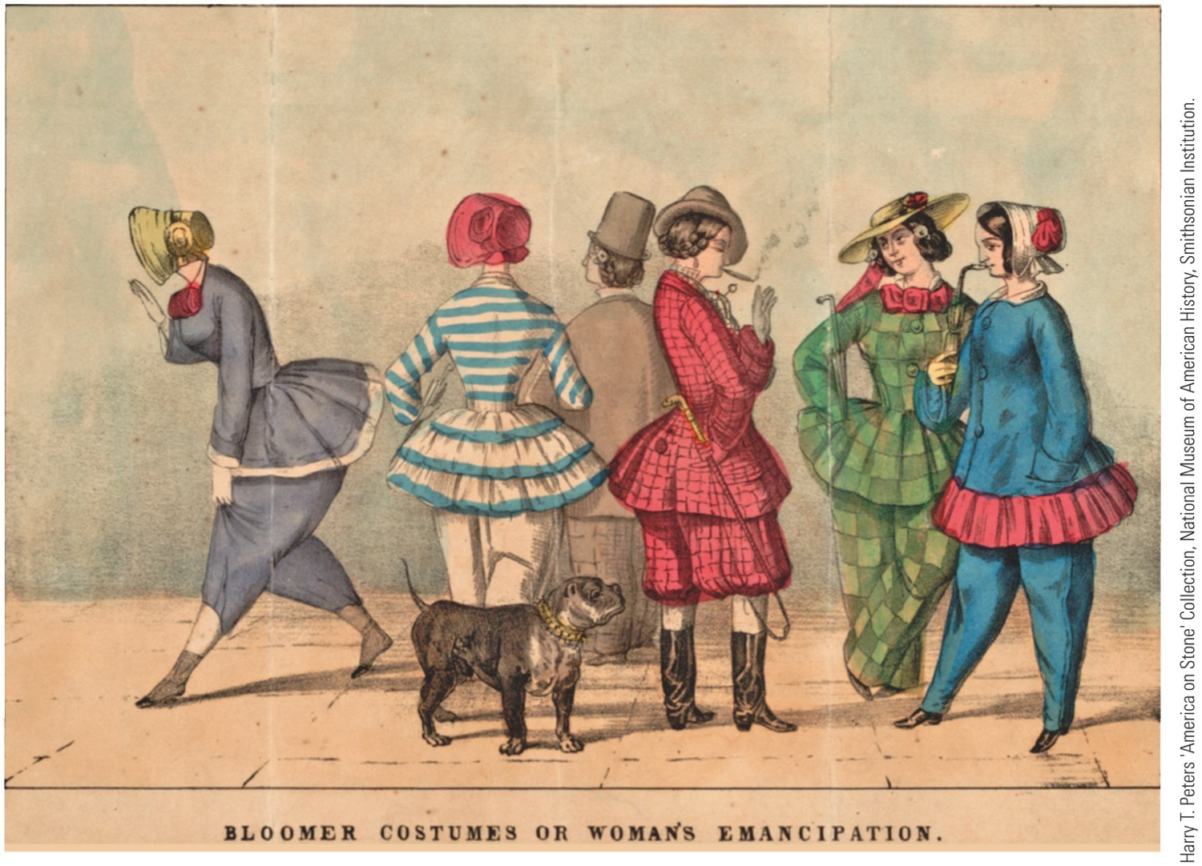
p321

Slide 31
VIII. Women in Revolt
Woman's Rights Convention at Seneca Falls, New York in 1848:
Stanton read a “Declaration of Sentiments”:
In spirit of Declaration of Independence— “all men and women are created equal”
One resolution formally demanded ballot for women
Seneca Falls meeting launched modern women's rights movement
Crusade for women's rights eclipsed by campaign against slavery
While any white male over age of 21 could vote, no woman could.
Yet women were being admitted to colleges.
Some states, like Mississippi in 1839, permitted wives to own property after marriage.

Slide 32
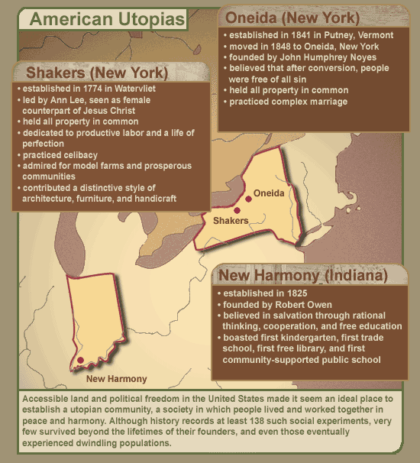
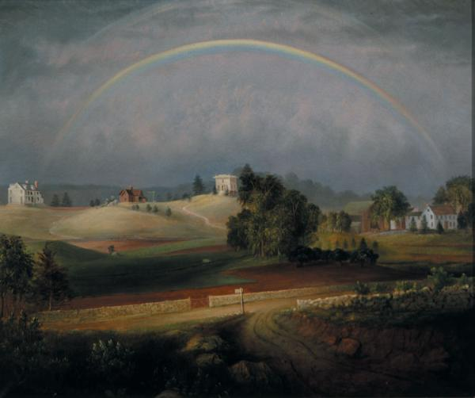
Utopian Communities
Brook Farm, Massachusetts

Slide 33
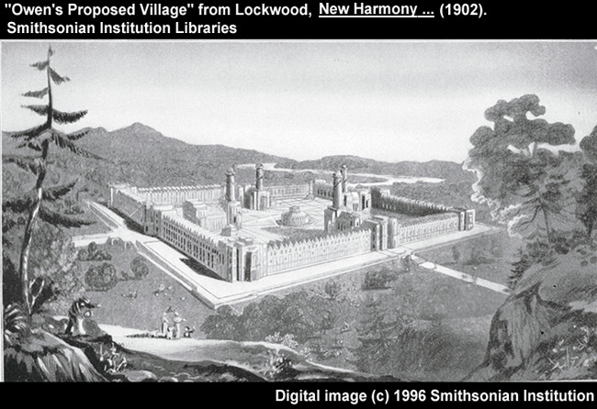
New Harmony, Indiana

Slide 34
X. The Dawn of Scientific Achievement
Medicine in America:
Very primitive by modern standards
People everywhere complained of ill health
Self-prescribed patent medicines common
Fad diets popular
Use of medicine by doctors often harmful
Victims of surgical operations tied down
Some medical progress by 1840s with anesthetics

Slide 35
XI. Artistic Achievements
Flush with political independence, Americans strained to achieve cultural autonomy and create a national art worthy of aspirations.
Architecture:
Americans copied Old World styles rather than created indigenous ones
Federal Style:
Borrowed from classical Greek and Roman examples
Emphasized symmetry, balance, and restraint
Public buildings incorporated neoclassical columns, domes, and pediments
Charles Bulfinch's design of Mass. State House
Benjamin Latrobe's additions to U.S. Capitol & President's House (now White House) showcased neoclassicism
Greek Revival:
Between 1820 and 1850
By midcentury, medieval Gothic forms with emphasis on arches, sloped roofs, and large, stained-glass windows

Slide 36
XI. Artistic Achievement
Palladian style
Thomas Jefferson's Virginia home, Monticello
Modeled Richmond's new capitol on ancient Roman temple
Jefferson's University of Virginia = finest example of neoclassicism
Difficult to create a distinctive style of painting:
America exported artists and imported art
Suffered Puritan prejudice—art a sinful waste of time

Slide 37
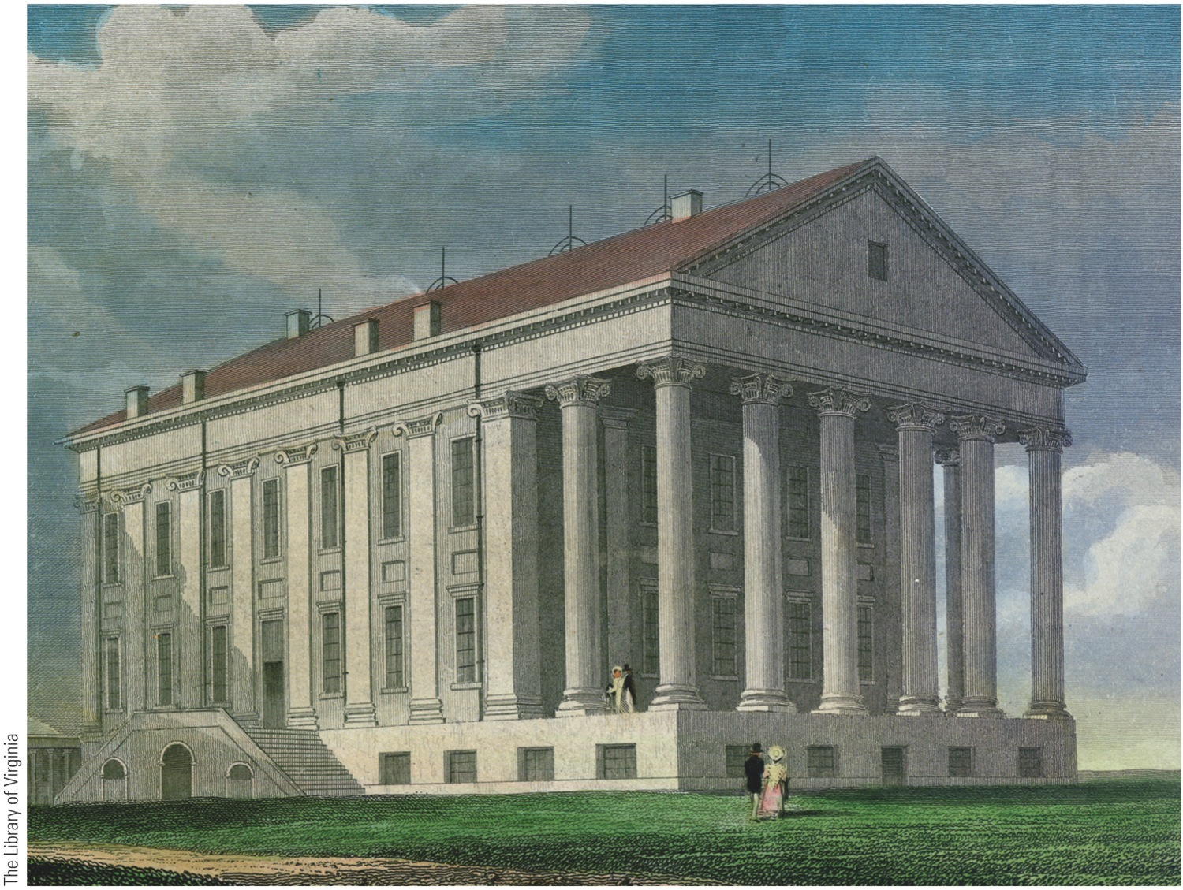
p327
Notes:
Virginia State Capitol,
1785–1788 With the coming
of the American Revolution,
Virginia Governor Thomas
Jefferson urged that the state
capital move from Williamsburg
to Richmond. There he
designed a new, neoclassical
capitol building inspired by
the Maison Carrée, an exceedingly
well-preserved Roman
temple in Nîmes, France. The
Virginia State Capitol became
the Capitol of the Confederacy
during the Civil War.

Slide 38
XII. The Blossoming of a National Literature
Busy conquering a continent, Americans poured creative efforts into practical outlets:
Political essays: The Federalist (1787-1788) by Jay, Hamilton, and Madison
Pamphlets: Thomas Paine's Common Sense (1776)
Political orations: Masterpieces of Daniel Webster
Benjamin Franklin's Autobiography (1818)
Romanticism:
Reaction against hyper-rational Enlightenment
Originated in revolutionary Europe and England
Emphasized imagination over reason, nature over civilization, intuition over calculation, and self over society
Celebrated human potential and prized heroic genius of individual artists

Slide 39
XII. The Blossoming of a National Literature (cont.)
American artists:
Washington Irving (1783-1859), first to win international recognition as literary figure
James Fenimore Cooper (1789-1851) gained world fame making New World themes respectable
William Cullen Bryant (1794-1878) wrote poetry and set model for journalism that was dignified, liberal, and conscientious

Slide 40
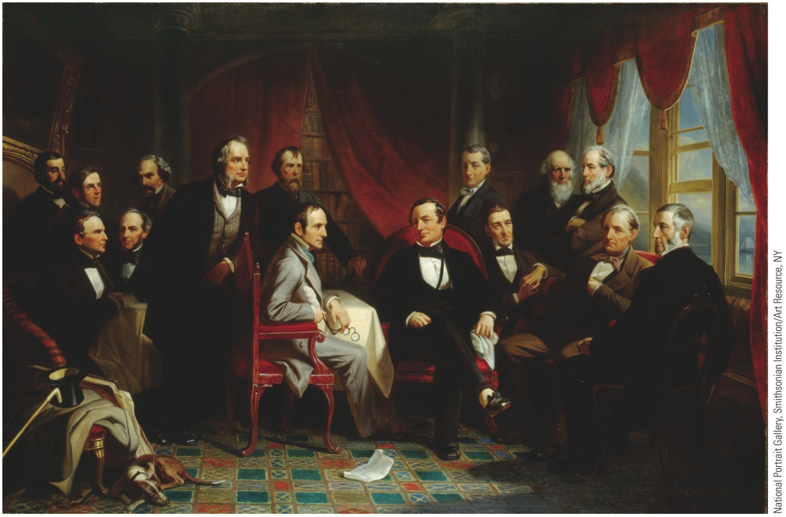
p330
Notes:
Portrait of Washington Irving and His Literary Friends at Sunnyside, 1864 T his apocryphal
gathering of America’s founding generation of writers, many of them now sadly unread, was
imagined to take place in the library of Washington Irving’s Hudson River home. Surrounding Irving,
seated in the armchair at center, are fourteen accomplished creators of history, philosophy, fiction,
and poetry: (seated, left to right) William Gilmore Simms, Fitz-Greene Halleck, William Hickling
Prescott, Irving, Ralph Waldo Emerson, James Fennimore Cooper, George Bancroft; (standing, left to
right) Henry Theodore Tuckerman, Oliver Wendell Holmes, Nathaniel Hawthorne, Henry Wadsworth
Longfellow, Nathaniel Parker Willis, James Kirke Paulding, William Cullen Bryant, John Pendleton
Kennedy. The portrait itself represented a collaborative effort of artists. Felix Octavius Carr Darley
did the original drawing, with the help of photographs taken by Matthew Brady. Christian Schussele
made a four-by-six-foot oil painting of the scene, and Thomas Oldham Barlow rendered it as a steelplate
engraving for distribution to a wide public.

Slide 41
XIII. Trumpeters of Transcendentalism
Transcendentalism:
Resulted from liberalizing of straight-laced Puritan theology
Rejected prevailing empiricist theory of John Locke that all knowledge comes through senses
Truth, rather, “transcends” senses: it cannot be found by observation alone
Every person possesses an inner light that can illuminate highest truth, and indirectly touch God
Beliefs of transcendentalism:
Individualist in matters of religion & society
Committed to self-reliance, self-culture, & self-discipline
Hostile to authority, formal institutions, & conventional wisdom
Romantic exaltation of dignity of individual—whether black or white—mainspring of numerous humanitarian reforms

Slide 42
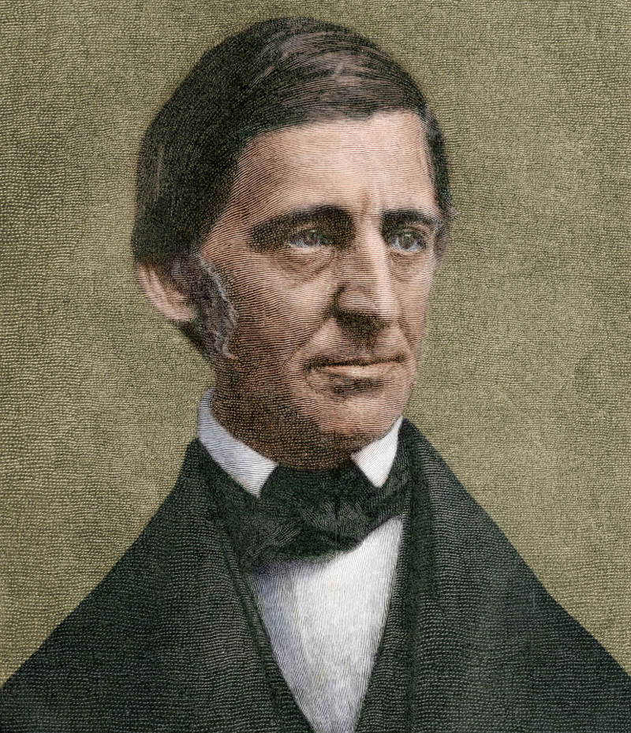
XIII. Trumpeters of Transcendentalism (cont.)
Best known transcendentalist was Ralph Waldo Emerson (1803-1882):
Most thrilling effort was “The American Scholar”:
Delivered at Harvard College in 1837
Intellectual declaration of independence
Urged American writers to throw off European traditions and delve into cultural riches surrounding them
Stressed self-reliance, self-improvement, self-confidence, optimism, and freedom

Slide 43
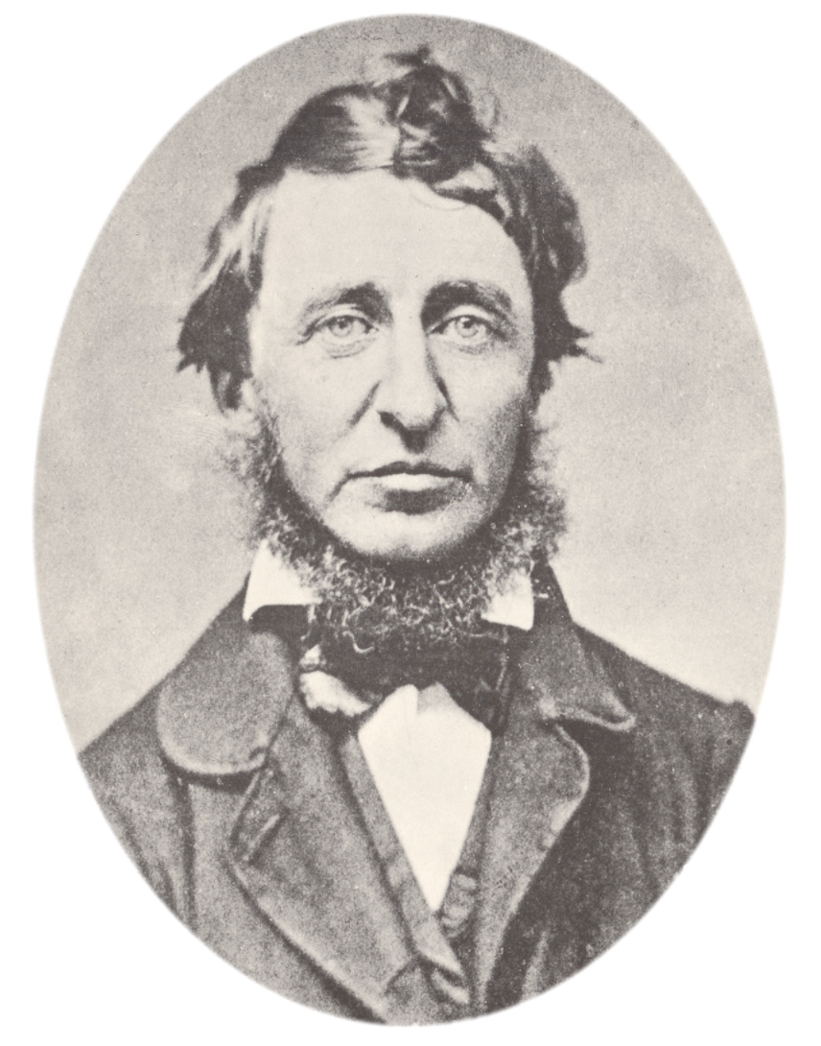
XIII. Trumpeters of Transcendentalism (cont.)
Henry David Thoreau (1817-1862):
Condemning a government that supported slavery, he refused to pay his Mass. poll tax
Walden: Or Life in the Woods (1854):
His two-year life on edge of Walden Pond
Epitomized romantic quest for isolation from society's corruptions
His essay “On the Duty of Civil Disobedience” (1849):
Influenced Mahatma Gandhi to resist British rule in India
Influenced Martin Luther King, Jr.'s ideas about nonviolence

Slide 44
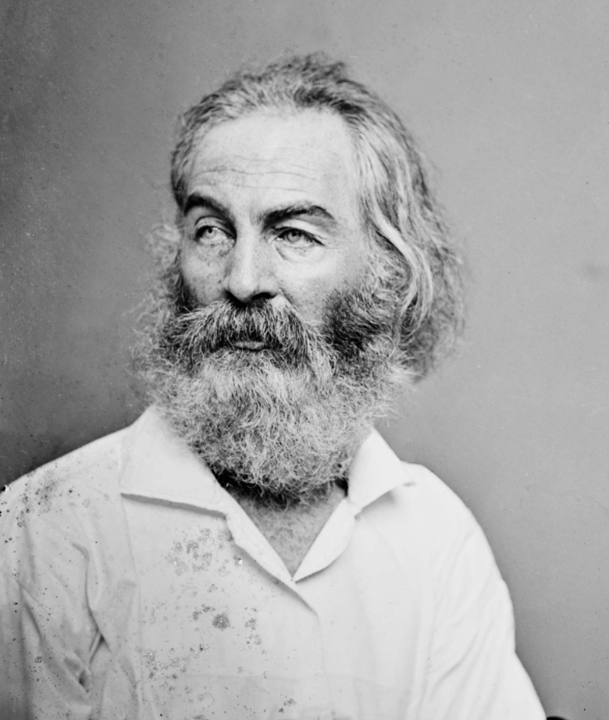
XIII. Trumpeters of Transcendentalism (cont.)
Walt Whitman (1819-1892):
Famous collection of poems Leaves of Grass (1855) highly emotional and unconventional
Dispensed with titles, stanzas, rhymes, and at times regular meter
Located divinity in commonplace natural objects as well as human body
Informally called “Poet Laureate of Democracy” for his praise of common people

Slide 45
XV. Literary Individualists and Dissenters
Not all writers believed in human goodness and social progress:
Edgar Allen Poe (1809-1849):
Gifted poet -- mesmerizing rhythms in “The Raven” (1845)
Excelled in short stories, especially Gothic horror type
Fascinated by ghostly and ghastly, as in “The Fall of the House of Usher”
Two writers reflected continuing Calvinist obsession with original sin and with never-ending struggle between good and evil:
Nathaniel Hawthorne (1804-1864):
Masterpiece The Scarlet Letter (1850) described Puritan practice of forcing adulteress to wear a scarlet “A” on her clothing
In The Marble Faun, he explored omnipresence of evil

Slide 46
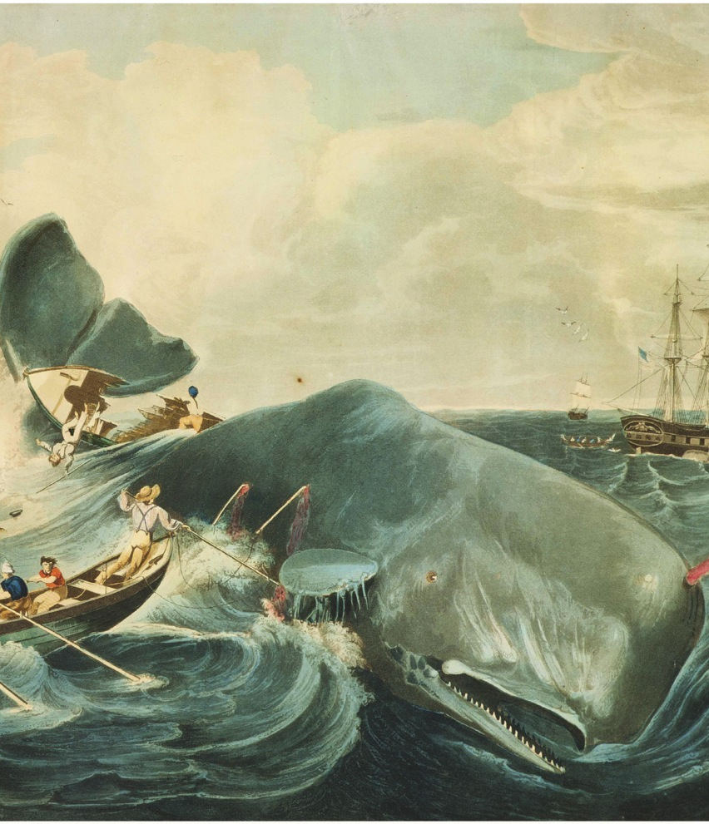
XV. Literary Individualists and Dissenters (cont.)
Herman Melville (1819-1891):
Masterpiece Moby Dick (1851) a complex allegory of good and evil
Had to wait until twentieth century for readers and for proper recognition

Slide 47
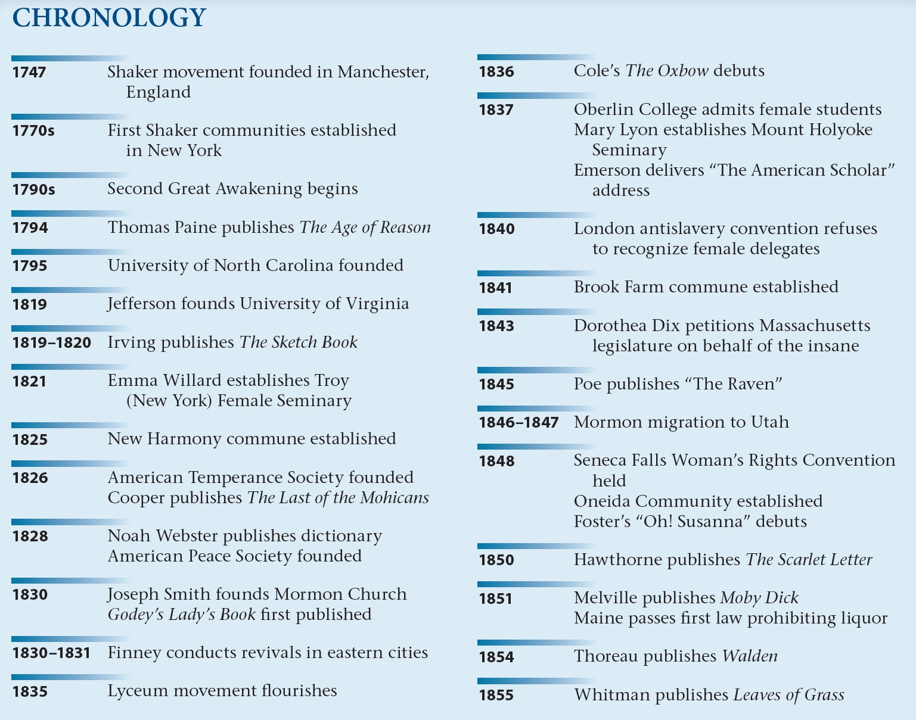
p336

