Slide 1
APUSH: Chapter 29
Wilson Years and World WAR I

Slide 2
I. Wilson: The Idealist in Politics
(Thomas) Woodrow Wilson:
Second Democratic president since 1861
First president from one of seceded southern states since Zachary Taylor, 64 years earlier
Wilson's admiration for Confederate attempt at independence inspired his ideal of self-determination
His ideal of faith in masses—if they were properly informed—came from Jeffersonian democracy
His inspirational political sermons reflected influence of his Presbyterian minster-father

Slide 3
I. Wilson: The Idealist in Politics (cont.)
Wilson convinced that Congress could not function properly unless president provided leadership
Repeated relied on his eloquence to appeal over heads of legislators to the sovereign people
Wilson suffered from serious defects of personality:
Incapable of showmanship like Roosevelt, he lacked common touch

Slide 4
II. Wilson Tackles the Tariff
Wilson's programs:
Called for assault on “the triple wall of privilege”: the tariff, the banks, and the trusts
He tackled tariff first:
Summoned Congress into special session in early 1913
In precedent-shattering move, he did not send his message over to Capitol to be read
He appeared in person before a joint session of Congress and presented his appeal with stunning clarity and force
House soon passed major reductions in Underwood Tariff

Slide 5
II. Wilson Tackles the Tariff (cont.)
When bill challenged in Senate by lobbyists:
Wilson issued message to public urging them to hold their elected representatives in line
Public opinion worked; in 1913 Senate approved bill Wilson wanted
Provided for a substantial reduction of import fees
Landmark in tax legislation:
Using recent 16th Amendment, Congress enacted graduated income tax beginning with moderate levy on incomes over $3,000 (average wage earner's annual income only $740)
By 1917, revenue from income tax shot ahead of revenue from tariffs

Slide 6
III. Wilson Battles the Bankers
Antiquated and inadequate banking and currency system
Nation's financial structure creaked along under Civil War National Banking Act
Most glaring defect was inelasticity of currency (1907 panic)
Since most banks located in New York, hard to mobilize bank reserves elsewhere in times of panic
Calls for reform supported by Louis D. Brandeis in book: Other People's Money and How the Bankers Use It (1914)

Slide 7
III. Wilson Battles the Bankers (cont.)
Wilson in June 1913 appeared personally before Congress again and called for sweeping bank reform:
Endorsed Democratic proposal for decentralized bank in government hands
Opposed Republican demands for huge private bank with fifteen branches
Federal Reserve Act (1913):
Wilson appealed to the sovereign people
Most important economic legislation between Civil War and New Deal

Slide 8
III. Wilson Battles the Bankers (cont.)
Federal Reserve Board:
Appointed by President
Would oversee nationwide system of twelve regional reserve districts
Each with its own central bank
Final authority of Federal Reserve Board guaranteed a substantial measure of public control
Board would be empowered to issue paper money
“Federal Reserve Notes”—backed by commercial paper
Thus amount of money in circulation could be swiftly increased as needed for legitimate requirements of business

Slide 9
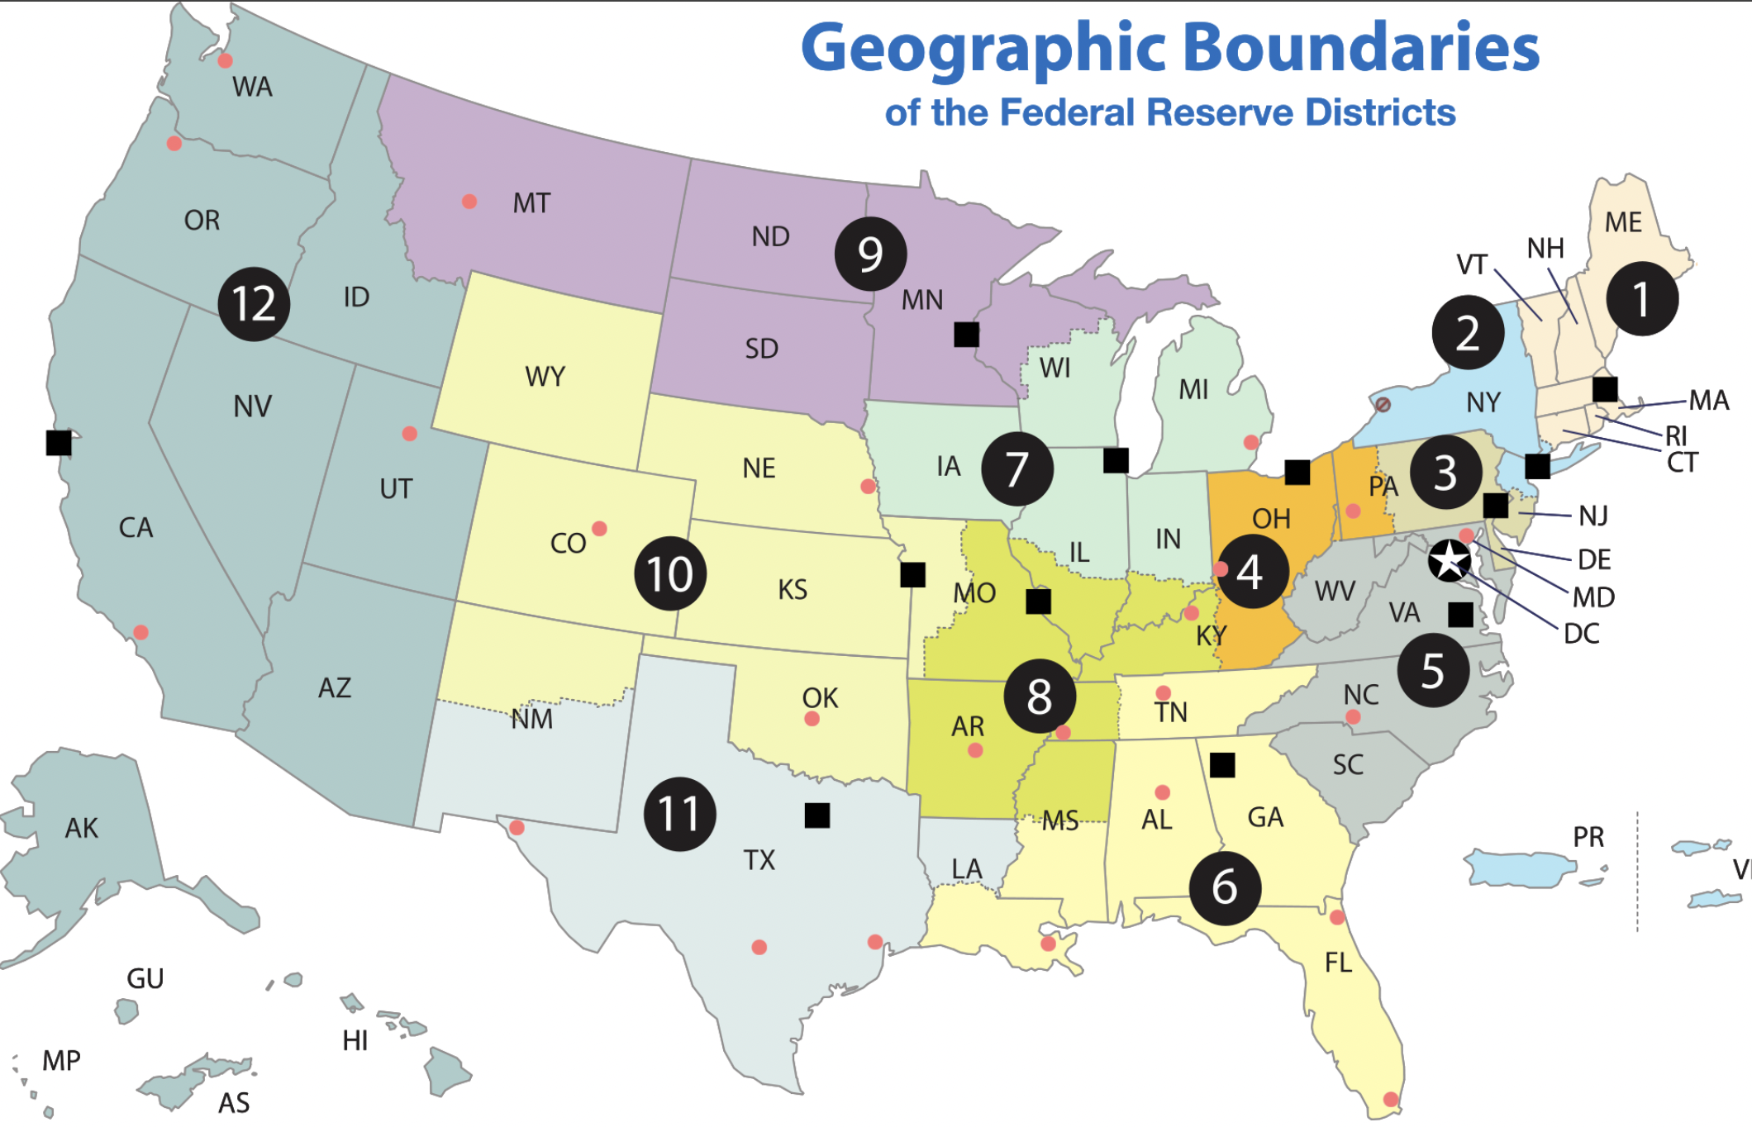

Slide 10
IV. The President Tames the Trusts
Wilson's third appearance before Congress led to Federal Trade Commission Act (1914):
Presidentially appointed commission could research industries engaged in interstate commerce
Commission could crush monopoly at source by rooting out unfair trade practices:
Including unlawful competition, false advertising, mislabeling, adulteration, and bribery

Slide 11
IV. The President Tames the Trusts (cont.)
Clayton Anti-Trust (1914):
Increased list of practices deemed objectionable:
Price discrimination and interlocking directorates (where same individual served as director of supposedly competing firms)
Achieved through holding companies (see Figure 29.1)
Conferred long-overdue benefits on labor:
Exempted labor and agricultural organization from anti-trust prosecution, while explicitly legalizing strikes and peaceful picketing
Samuel Gompers, Union leader, hailed act as Magna Carta of labor

Slide 12
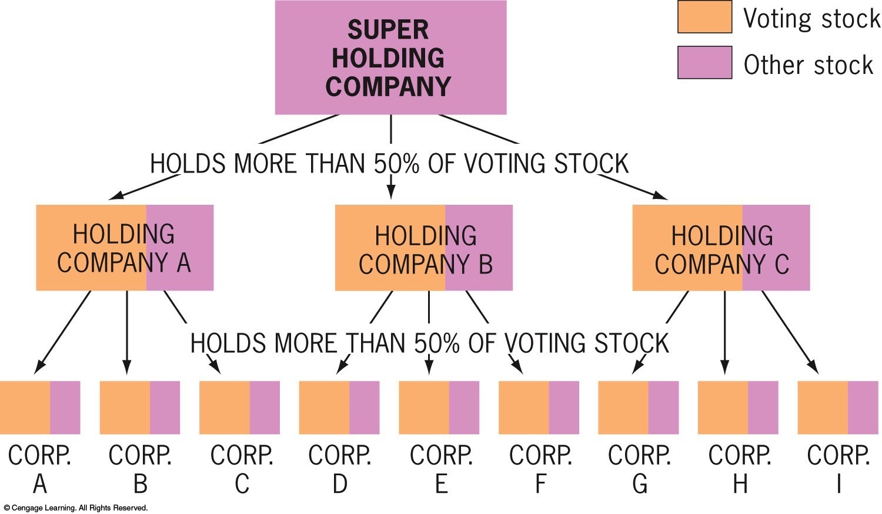
Figure 29-1 p665
Notes:
Figure 29.1 Organization of Holding Companies Keep
in mind that the voting stock of a corporation is often only a
fraction of the total stock. © 2016 Cengage Learning

Slide 13
V. Wilson at the Peak
Other progressive legislation:
Federal Farm Loan Act (1916):
Made credit available to farmers at low rates of interest—long demanded by Populists
Warehouse Act (1916):
Authorized loans on security of staple crops—another Populist idea
Other laws benefited rural areas by providing for highway construction and establishment of agricultural extension work in state colleges
La Follette Seaman's Act (1915):
Required decent treatment and living wage on American merchant ships
Workingmen's Compensation Act (1916):
Granted assistance to federal civil-service employees during periods of disability
1916: Wilson signed law restricting child labor on products flowing into interstate commerce (but Supreme Court later voided it)

Slide 14
VI. New Directions in Foreign Policy
Wilson's reaction to earlier foreign policies:
In contrast to Roosevelt and Taft, he recoiled at first from aggressive foreign policy
Hating imperialism, he was repelled by TR's big-stickism
Suspicious of Wall Street, he detested Taft's dollar diplomacy
In office only a week, he declared war on dollar diplomacy:
Proclaimed government would not support American investors in Latin America and China

Slide 15
VI. New Directions in Foreign Policy (cont.)
Persuaded Congress to repeal Panama Canal Tolls Act of 1912 –
It had exempted American coastwide shipping from tolls
Thereby provoked sharp protests from injured Britain
Jones Act (1916):
Granted Philippines territorial status and promised independence as soon as a “stable government” could be established
Wilson's racial prejudices did not expect this to happen for a long time
On July 4, 1946—30 years later—United States accepted Philippine independence

Slide 16
VI. New Directions in Foreign Policy (cont.)
Haiti's chaotic political situation caused Wilson to assume more active stance abroad
Political turmoil climaxed in 1914-1915 when outraged populace literally tore to pieces brutal Haitian president
Wilson dispatched marines to protect American lives and property
Marines remained in Haiti for nineteen years making Haiti an American protectorate

Slide 17
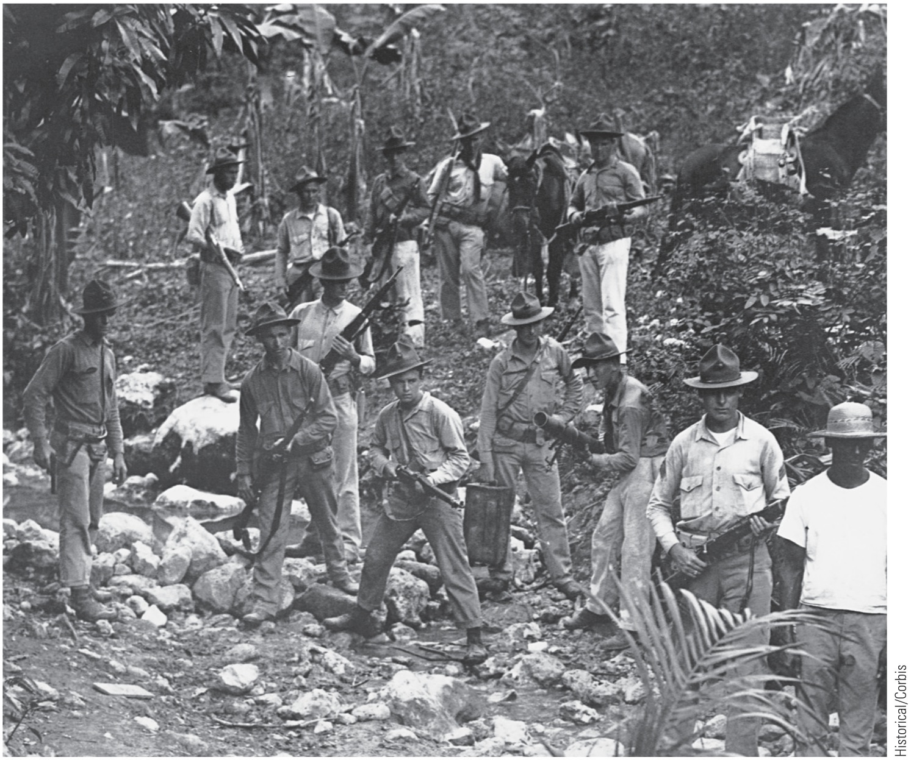
p666
Notes:
U.S. Marines in Haiti, 1919 The
United States sent the marines to
Haiti in 1915 to protect American
economic interests. They
remained for nineteen years.

Slide 18
VI. New Directions in Foreign Policy (cont.)
In 1916, Wilson used Roosevelt's corollary to Monroe Doctrine and concluded treaty with Haiti:
Provided for U.S. supervision of finances and police
In 1916, he sent marines to debt-cursed Dominican Republic
Came under American control for eight years
In 1917, United States purchased the Virgin Islands from Denmark
Uncle Sam tightening its grip in Caribbean Sea, with its vital approaches to Panama Canal (see Map 29.1)

Slide 19
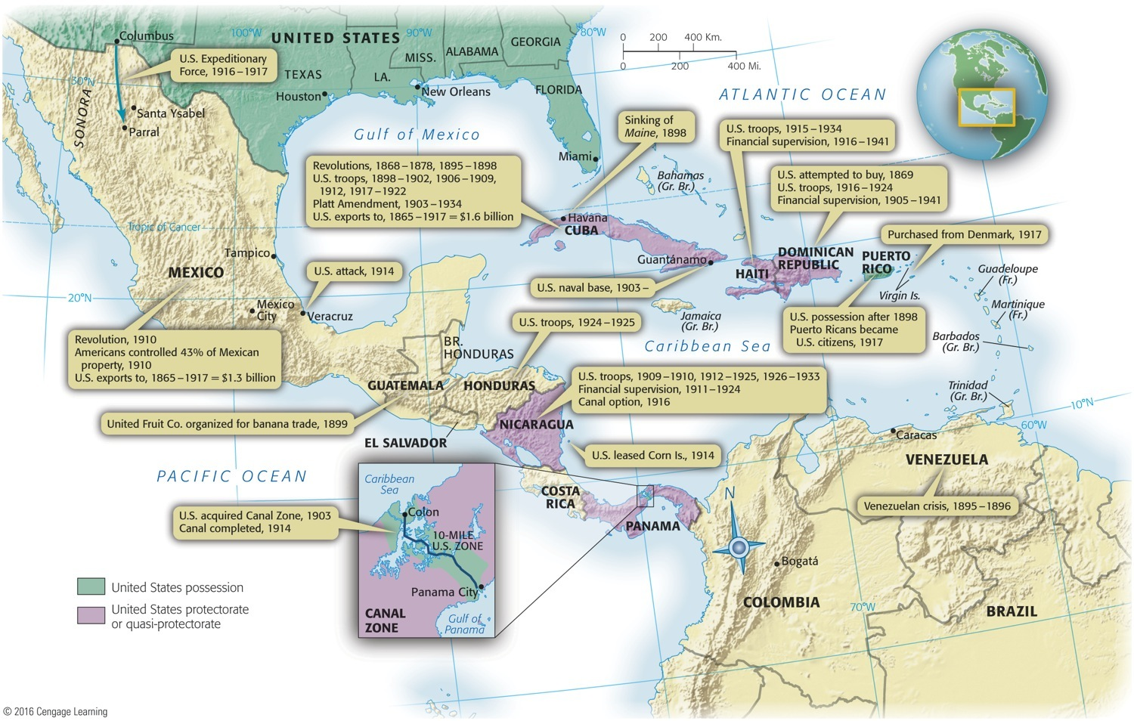
Map 29-1 p667
Notes:
Map 29.1 The United States in the Caribbean, 1898–1941 This map explains why
many Latin Americans accused the United States of turning the Caribbean Sea into a
“Yankee lake.” It also suggests that Uncle Sam was much less “isolationist” in his own
backyard than he was in faraway Europe or Asia. © 2016 Cengage Learning

Slide 20
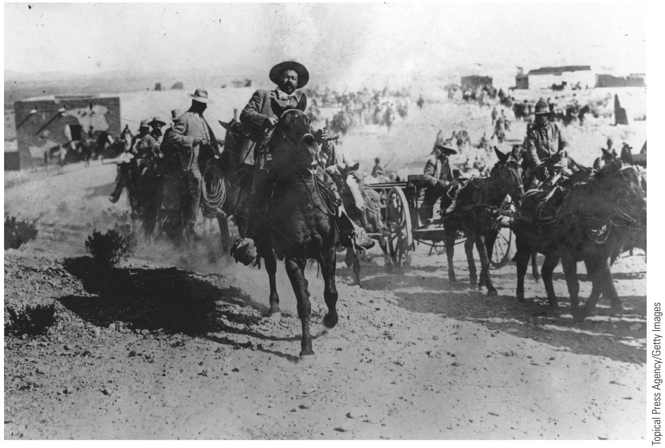
Late in the Mexican Revolutionary years Venustiano Carranza took over, and who resented Wilson's military meddling
“Pancho” Villa, chief rival to President Carranza,
Killed 16 American mining engineers traveling through northern Mexico in January 1916
One month later, Villa and his followers crossed border into Columbus, New Mexico and murdered another 19 Americans
p668
Notes:
“Pancho” Villa with His Ragtag
Army in Mexico, ca. 1916 His
daring, impetuosity, and horsemanship
made Villa a hero to the
masses of northern Mexico. Yet he
proved to be a violent and ineffective
crusader against social abuses,
and he was assassinated in 1923.

Slide 21
VII. Moralistic Diplomacy in Mexico (cont.)
General John J. (“Black Jack”) Pershing ordered to break up bandit band
His hastily organized force of several thousand mounted troops penetrated deep into Mexico
Clashed with Carranza's forces
Mauled Villistas but missed capturing Villa
As tensions with Germany mounted, Wilson withdrew Pershing from Mexico in January 1917

Slide 22
Road to War
Most of us might already know that the assassination of Archduke Franz Ferdinand started the war, but we don’t know how one man’s death served as the trigger.
Actually, there were several powerful forces already in motion, and they contributed to the outbreak of World War I.
These forces were:
Imperialism
Militarism
Nationalism
Alliances

Slide 23
The Forces at Work:
Imperialism is the theory of global domination, meaning the desire to create an empire.
In Europe, this created rivalries between the powerful nations.
Militarism is when a nation allows the production of a powerful army to serve as its own foreign policy.
In this system, a large army has top priority, and has more authority in the government.
Nationalism is when a country believes in itself, and acts in it’s own interests.
When this happens and another country does not like it, they may fight about the actions.
Alliances is the “I got your back” school of thought that got nations a false sense of security.
With this false sense, they became more reckless.

Slide 24
At the heart of it all…Bosnia
After the assassination of the Archduke, Austria-Hungary used it as an excuse to wipe out Serbia, who was upset with Austria-Hungary’s annexation of Bosnia.
When Austria-Hungary declares war of Serbia, the alliances spring into action.
Russia (aligned with Serbia) begins to mobilize,
Germany (with A-H) demands that Russia stops.
Russia refuses, so Germany declares war on Russia.
Germany wanted war for awhile. The Schlieffen Plan called for a quick sweep of France while Russia regrouped. This called for an invasion through Belgium.
Great Britain (with Belgium) declares war on Germany, who did not expect this.
So, in one week, all of Europe was at war.

Slide 25
The Powers at Work

Slide 26
VIII. Thunder Across the Sea
Wilson issued neutrality proclamation and called on Americans to be neutral in thought and deed
Both sides wooed U.S.A., great neutral in West
British enjoyed:
Cultural, linguistic, and economic ties with America
Advantage of controlling transatlantic cables
Their censors sheared away war stories harmful to Allies and drenched United States with tales of German bestiality
Germans and Austro-Hungarians:
Counted on sympathies of transplanted countrymen in America (some 11 million in 1914)

Slide 27
VIII. Thunder Across the Sea (cont.)
Some of these recent immigrants expressed noisy sympathy for fatherland
Most simply grateful to be distant from fray (see Table 29.1)
Most Americans:
Anti-German from outset
Kaiser Wilhelm II seemed embodiment of arrogant autocracy
Impression strengthened by German's ruthless strike at neutral Belgium

Slide 28
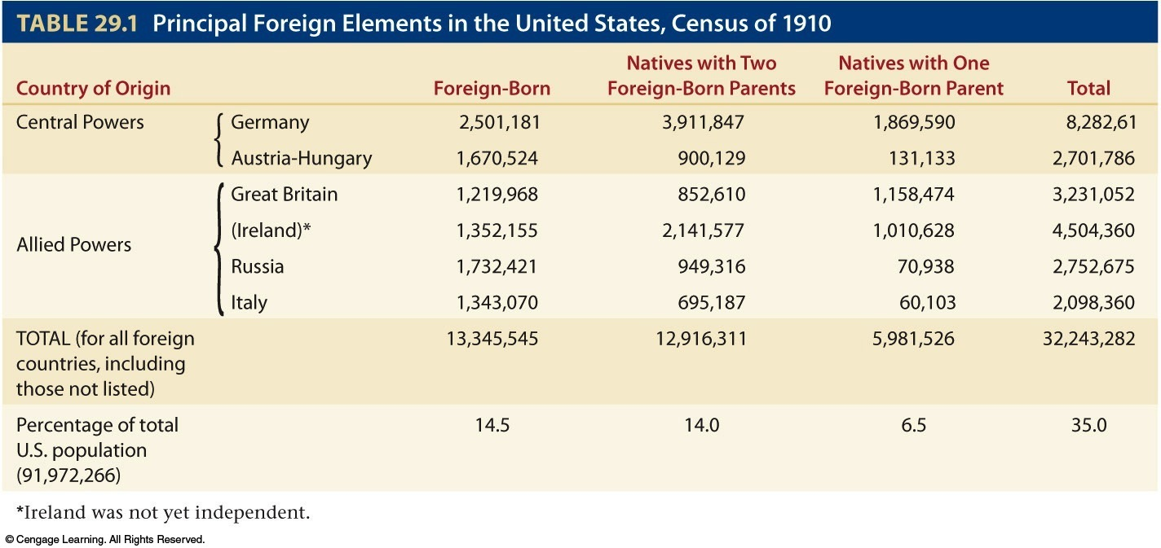
Table 29-1 p669

Slide 29
VIII. Thunder Across the Sea
German and Austrian agents further tarnished image of Central Powers when they resorted to violence in American factories and ports
German operative in 1915 absentmindedly left his briefcase on New York elevated car:
Documents detailing plans for industrial sabotage discovered and quickly publicized
Further inflamed American opinion against Kaiser
Yet great majority of Americans earnestly hoped to stay out of horrible war

Slide 30
IX. America Earns Blood Money
When war broke out in Europe, U.S.A. in midst of recession:
British and French war orders pulled U.S. industry onto peak of war-born prosperity (see Table 29.2)
Part of boon financed by American bankers
Notably Wall Street firm of J.P. Morgan and Company advanced to Allies enormous sum of $2.3 million during period of American neutrality

Slide 31
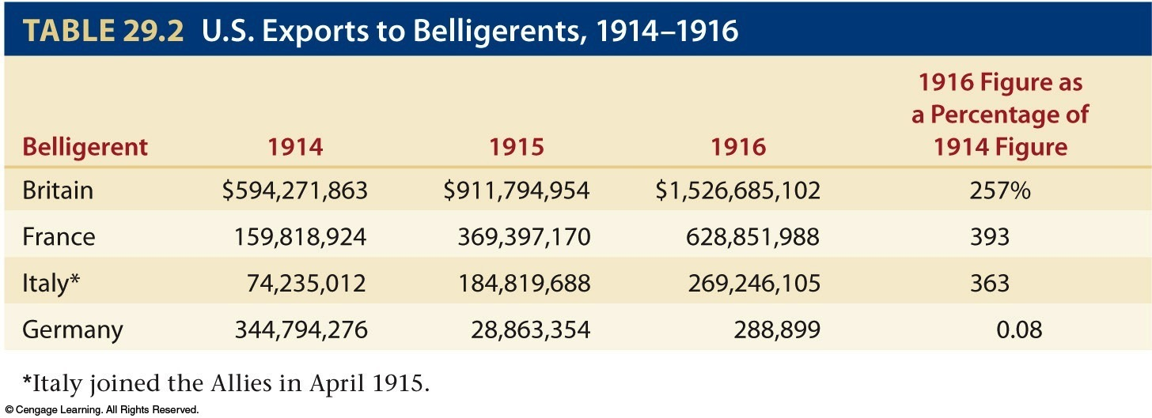

Slide 32
IX. America Earns Blood Money (cont.)
Germany legally could have had same level of trade with United States
Was prevented from doing so by British navy
British imposed blockade with mines and ships across North Sea gateway to German ports
Over protests from various Americans, British forced American vessels off high seas
Harassment of American shippers highly effective as trade between Germany and United States virtually ceased

Slide 33
IX. America Earns Blood Money
Germany did not want to be starved out:
Berlin announced submarine war area around British Isles (see Map 29.2)
New submarines not fit existing international laws
Posed threat to United States—so long as Wilson insisted on maintaining America's neutral rights
Berlin officials declared they would try not to sink neutral shipping, but warned mistakes would probably occur
Wilson decided on calculated risk:
Claimed profitable neutral trading rights while hoping no incidents would cause war

Slide 34
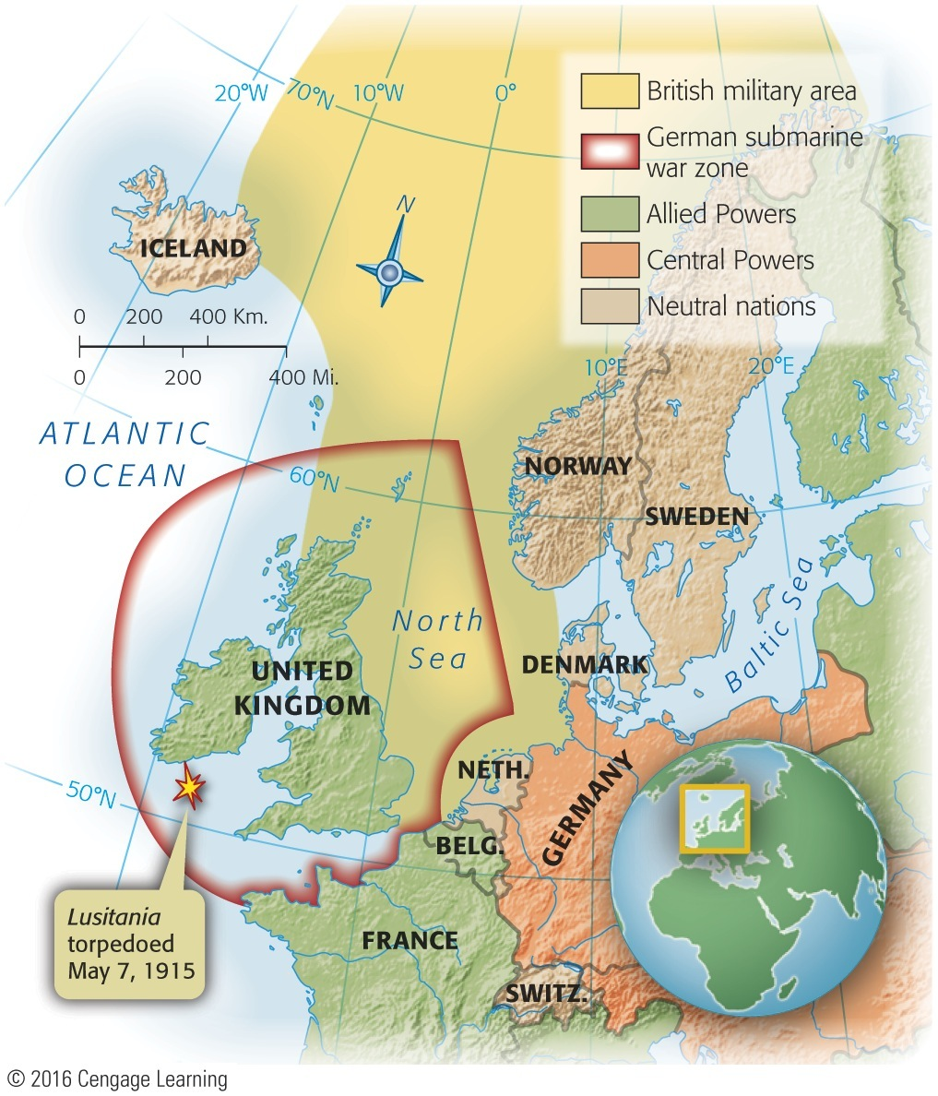
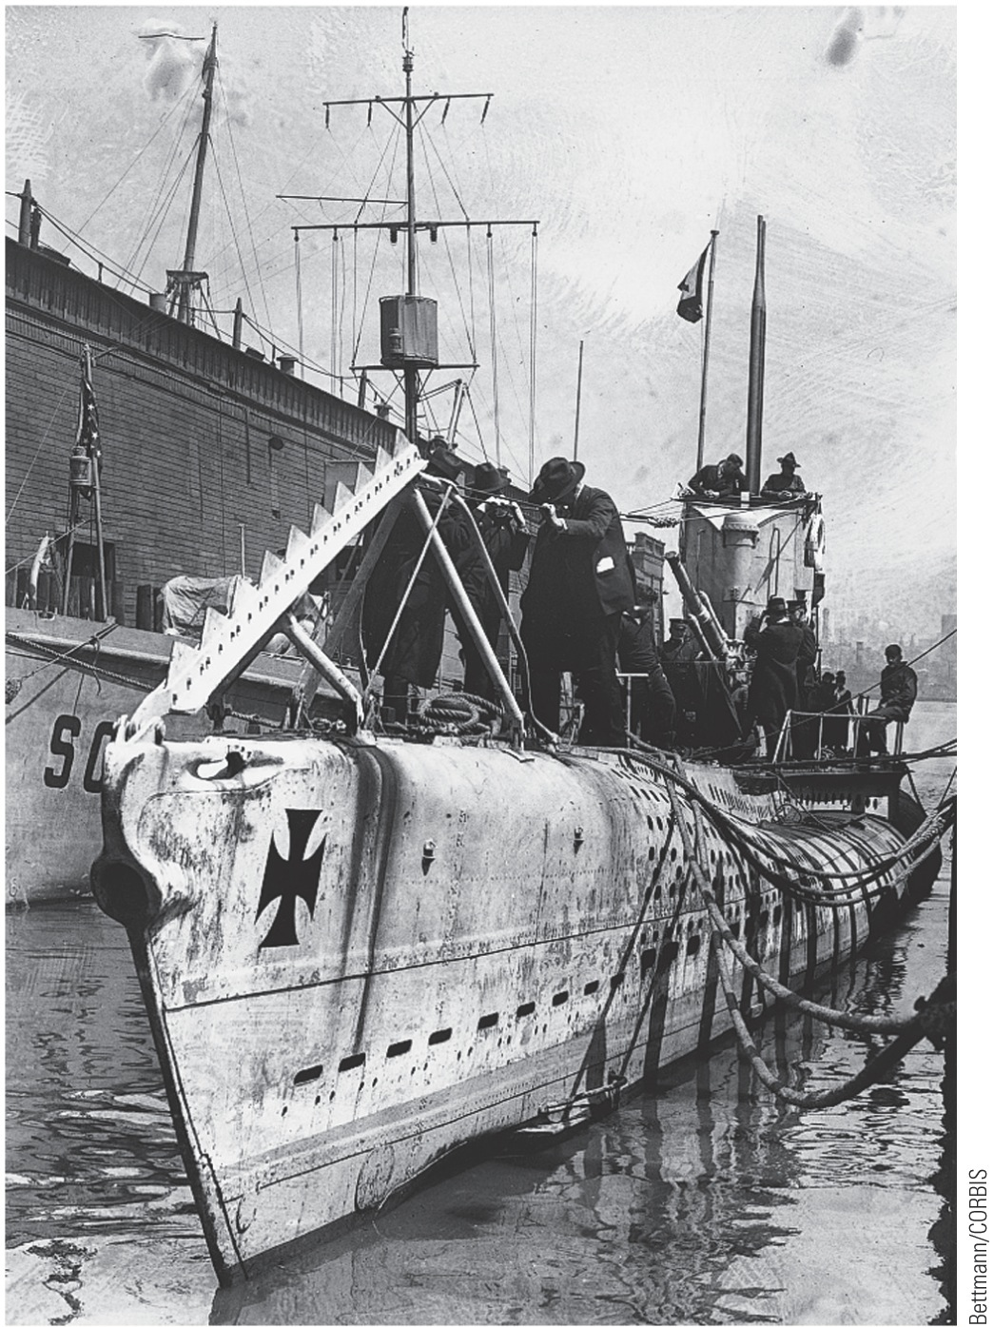
Map 29-2 p670
Notes:
Map 29.2 British Military Area (declared November 3,
1914) and German Submarine War Zone (declared
February 4, 1915) © 2016 Cengage Learning

Slide 35
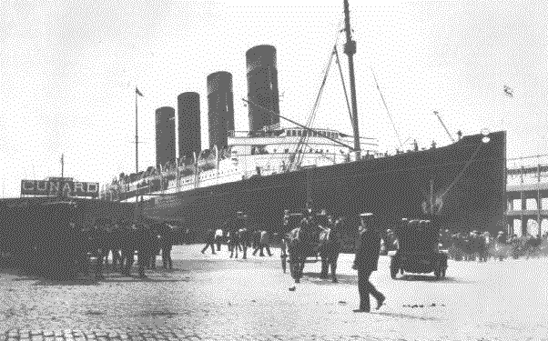
Germany’s warnings

Slide 36
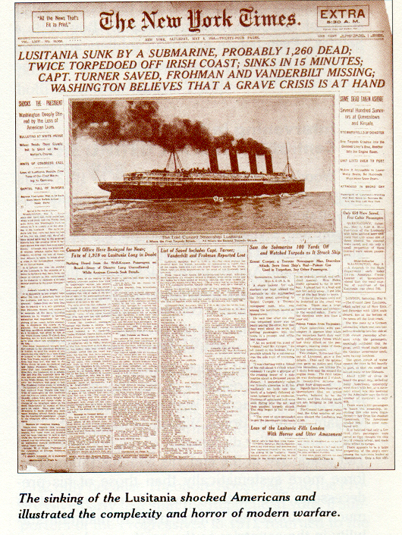
Here is the New York Times front page following the sinking.

Slide 37
IX. America Earns Blood Money
German submarines (U-boats “undersea boat”) began deadly work
In first months of 1915, sank 90 ships in war zone
British passenger liner Lusitania torpedoed and sank off coast of Ireland, May 7, 1915:
With loss of 1,198 lives, including 128 Americans
Lusitania was carrying forty-two hundred cases of small-arms ammunition
A fact Germany used to justify sinking
Americans shocked and angered at act of “mass murder” and “piracy”

Slide 38
IX. America Earns Blood Money
Talk of war from eastern United States, but not from rest of nation
Wilson did not want to lead disunited nation into war
By series of strong notes, Wilson attempted to take German warlords sharply to task
Policy too risky for Secretary of State Bryan who resigned
T. Roosevelt harshly criticized Wilson's measured approach
British liner, Arabic, sunk in August, 1915:
With loss of two American lives
Berlin reluctantly agreed not to sink unarmed and unresisting passenger ships without warning
Pledge appeared to be violated in March, 1916 when Germans torpedoed French passenger steamer, Sussex
Infuriated, Wilson informed Germans:
That unless they renounced inhuman practice of sinking merchant ships without warning, he would break diplomatic relations—almost certain prelude to war
Germany reluctantly knuckled under Wilson's Sussex ultimatum:
Germany agreed to not sink passenger and merchant ships without warning
Attached long string to their Sussex pledge

Slide 39
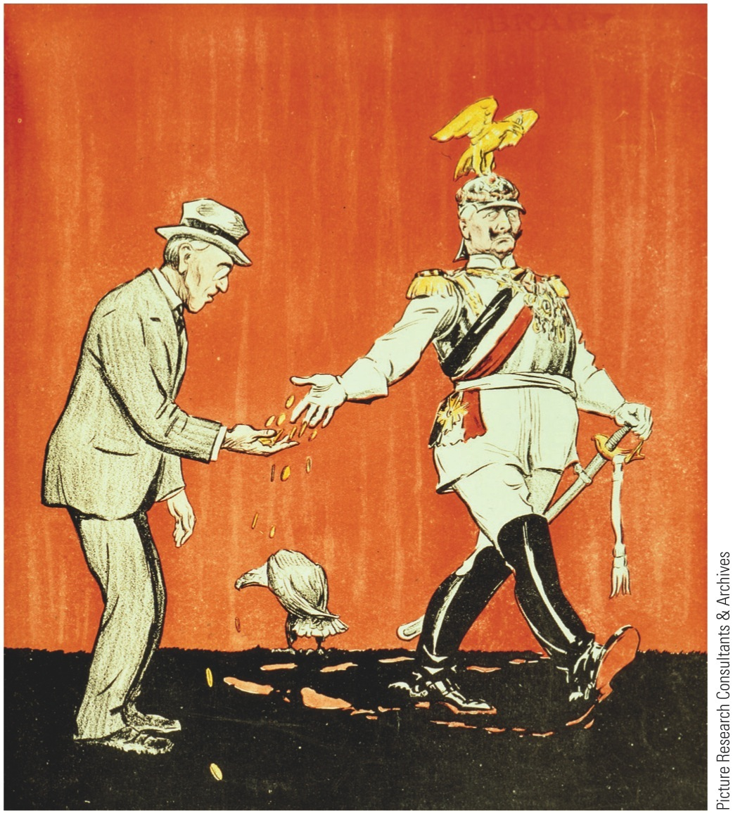
p672
Notes:
“Here’s Money for Your Americans. I May Drown Some
More.” Germany expressed “profound regret” for the
deaths of 128 Americans aboard the torpedoed passenger
liner Lusitania in 1915, but the incident helped feed a
mounting anti-German sentiment in the United States.

Slide 40
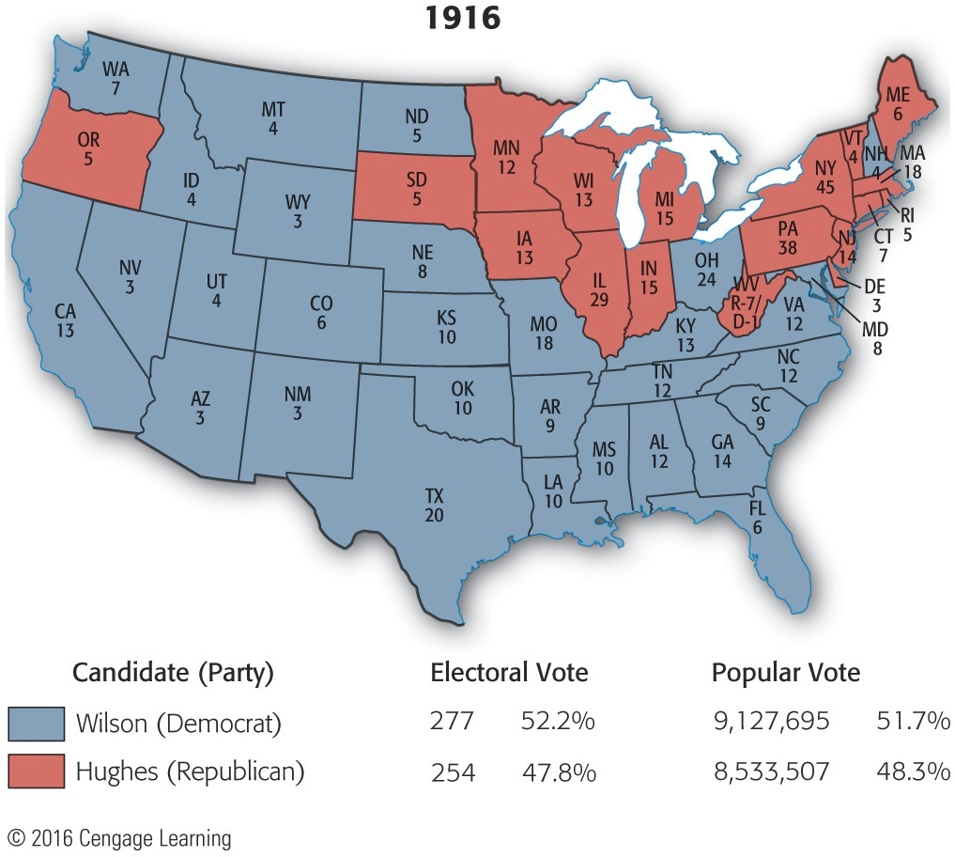
Map 29-3 p673
Notes:
Map 29.3 Presidential Election of 1916 (with electoral
vote by state) Wilson was so worried about being a lame
duck president in a time of great international tensions that
he drew up a plan whereby Hughes, if victorious, would be
appointed secretary of state, Wilson and the vice president
would resign, and Hughes would thus succeed immediately
to the presidency. © 2016 Cengage Learning

Slide 41
Wilson finally gets involved
After his election in 1916, Wilson soon realizes that staying out of war will be close to impossible.
First, the Germans resume unrestricted submarine warfare.
Then the British intercepted a telegram from Arthur Zimmermann that was being sent to Mexico.
It may sound small, but Zimmermann was Germany’s foreign minister and he suggested to Mexico that by aligning with Germany, they could regain lands lost during the Mexican War.
Mexico did not take this seriously, but the American public did, pushing for war.

Slide 42
p674
Notes:
WAR! A ttacks by German submarines finally forced Wilson’s hand, and he asked Congress for
a declaration of war on April 2, 1917. Four days later, after considerable debate and with fifty-six
dissenting votes, Congress obliged the president. The Granger Collection, NYC

Slide 43
XII. Wilsonian Idealism Enthroned
For more than a century, Americans prided themselves on isolation from Old World
Since 1914 that pride reinforced by bountiful profits gained through neutrality
Six senators and 50 representatives (including first congresswoman Jeannette Rankin, of Montana) voted against war resolution
Wilson could incite no enthusiasm by calling on nation to fight to make world safe from submarine attacks

Slide 44
XII. Wilsonian Idealism Enthroned (cont.)
Wilsonian idealism:
Personality of president and necessities of history perfectly matched
He believed modern world could not afford hyper-destructive war used by industrial states
Probably no other argument could have worked to arouse Americans to unprecedented burden:
Americans could be either isolationists or crusaders, nothing in between
Wilson's appeal worked—perhaps too well
Holding torch of idealism, president fired up public mind to fever pitch
Lost was Wilson's earlier plea for “peace without victory”

Slide 45
XIII. Wilson's Fourteen Potent Points
Wilson soon recognized as moral leader of Allied cause
On January 8, 1918, he delivered to Congress famed Fourteen Points:
(1) proposal to abolish secret treaties pleased liberals of all countries
(2) freedom of seas appealed to Germans and Americans who distrusted British sea power
(3) removal of economic barriers among nations had been goal of liberal internationalists everywhere
(4) reduction of armament burdens gratifying to taxpayers in all countries
(5) adjustment of colonial claims in interests of both native peoples and colonizers reassured anti-imperialists
Wilson's pronouncement about colonies potentially revolutionary:
Helped to delegitimize old empires
Opened road to eventual independence for millions of “subject people”

Slide 46
XIII. Wilson's Fourteen Potent Points (cont.)
Other points proved to be no less seductive:
Hope of independence (“self-determination”) to oppressed minority groups (e.g., Poles)
Capstone point (number fourteen):
Foreshadowed League of Nations:
International organization that would provide system of collective security
Wilson's points not applauded everywhere:
Some Allied leaders wanted territorial gains
Republicans mocked fourteen Points

Slide 47
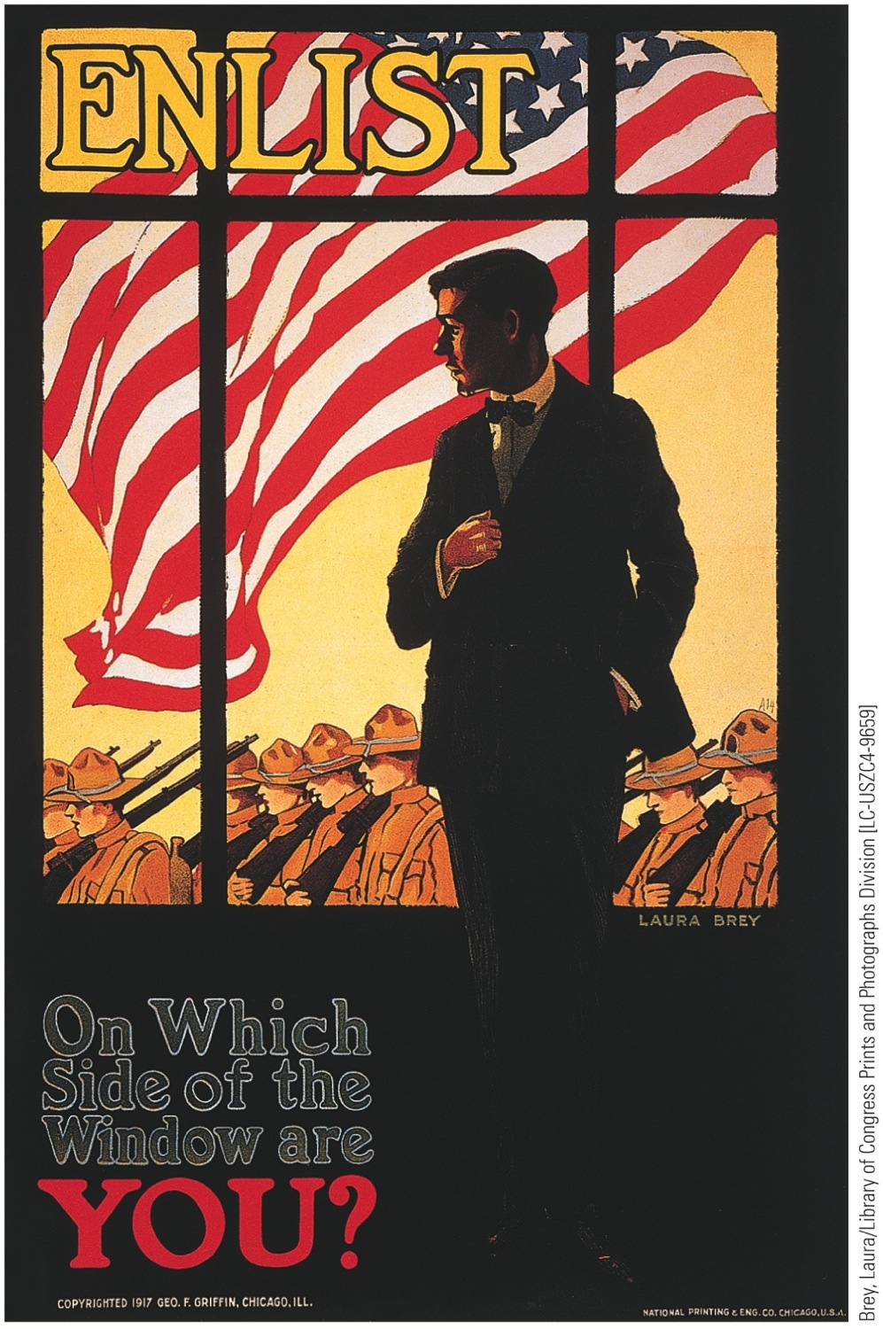
p676
Notes:
Patriotic Persuasion Worried about the public’s
enthusiasm for the war, the government employed all the
arts of psychology and propaganda to sustain the martial
spirit. The prewar song “I Didn’t Raise My Boy to Be a
Soldier” was changed to “I Didn’t Raise My Boy to Be a
Slacker,” which in turn inspired the cruel parody “I Didn’t
Raise My Boy to Be a Sausage.”

Slide 48
XIV. Germans in America
German Americans—over eight million:
Most proved to be dependably loyal to United States
A few tarred, feathered, and beaten
Hysterical hatred of Germans and things Germanic swept nation:
Orchestras found it unsafe to present German-composed music
German books removed from library shelves
German classes canceled
Sauerkraut became “liberty cabbage”
Hamburger, “liberty steak”
Espionage Act of 1917 and Sedition Act of 1918:
Reflected fears about Germans and antiwar Americans
1,900 prosecutions of antiwar Socialists and members of radical Industrial Workers of the World (IWW):
Socialist Eugene Debs sentenced to ten years in federal penitentiary
IWW leader William D. (“Big Bill”) Haywood and 99 associates also convicted
Virtually any criticism of government could be censored and punished

Slide 49
XV. Forging a War Economy
Wilson belatedly backed preparedness measures
Big obstacles confronted economic mobilizers:
Sheer ignorance among biggest roadblocks
No one knew precisely how much steel or explosive powder country capable of producing
Old ideas proved to be liabilities:
Traditional fear of big government hamstrung effort to orchestrate economy from Washington
Largely voluntary character of economic war organization
Wilson eventually succeeded in imposing some order on economic confusion:
Wartime restrictions on foodstuffs for alcohol accelerated wave of prohibition
1919: Eighteenth Amendment banned alcohol
Wilson expanded federal government in size and power to meet needs of war:
WIB set production quotas; Allocated raw materials
Set prices for government purchases

Slide 50
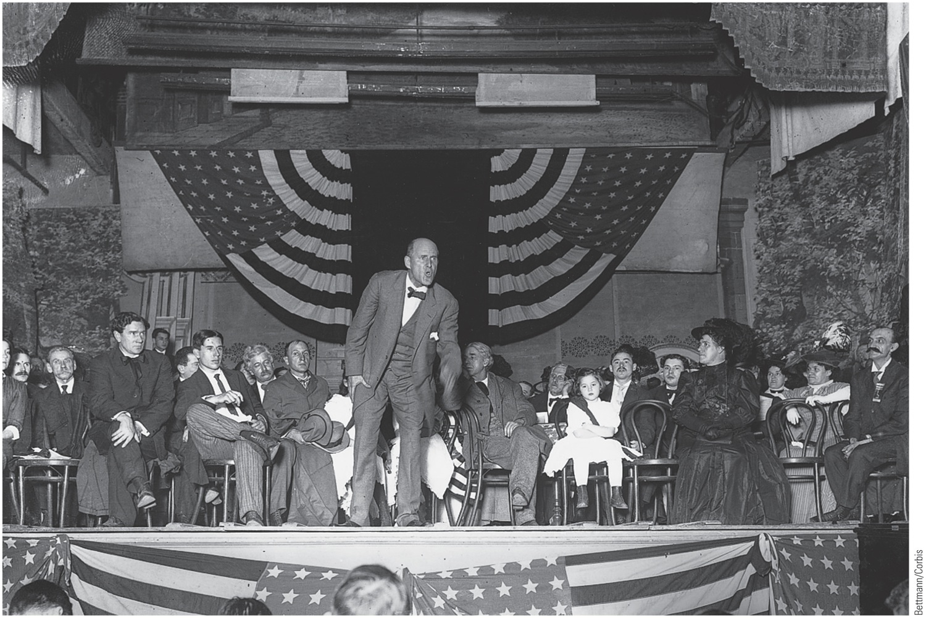
p677
Notes:
Socialist Leader Eugene V. Debs Addresses an Antiwar Rally in 1918 For his denunciation of
World War I, Debs was convicted under the Espionage Act of 1917 and sent to federal prison. In his
courtroom speech defending himself against charges of disloyalty, he passionately declared, “While
there is a lower class, I am in it; while there is a criminal element, I am of it; while there is a soul in
prison, I am not free.” He ran as a presidential candidate in 1920 while still incarcerated in his cell and
received nearly a million votes.

Slide 51
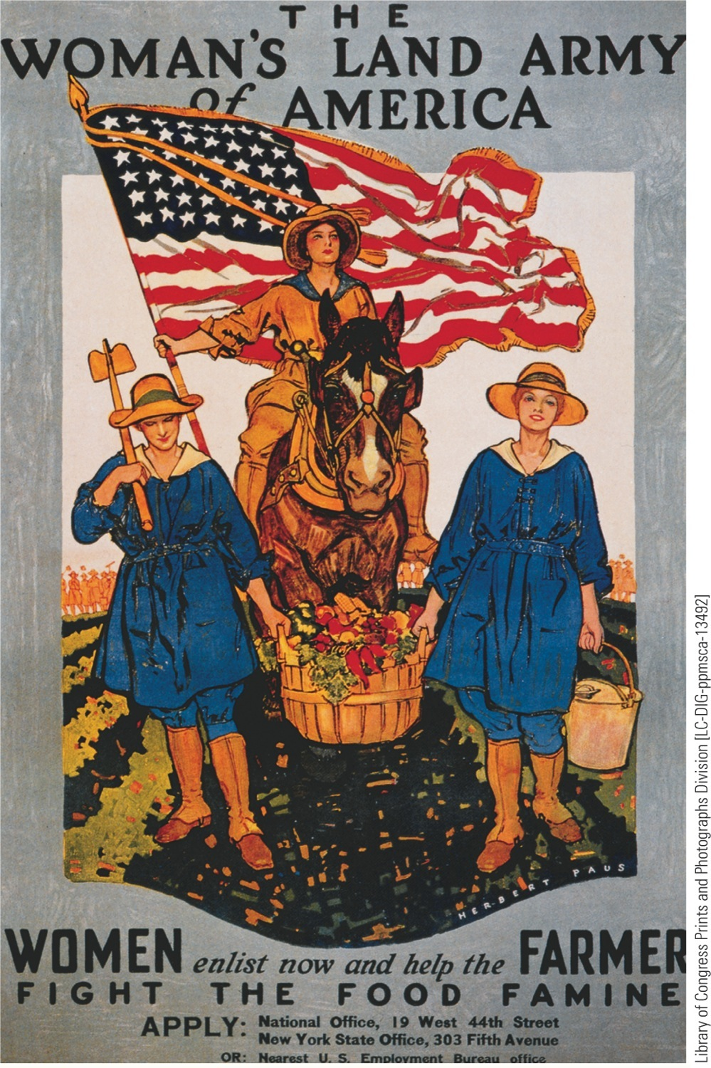
p678
Notes:
Food for Thought Wartime agencies flooded the
country with posters like this in 1917–1918, exhorting
women on the home front to “grow their own” and thus
ease the pressure on food supplies.

Slide 52
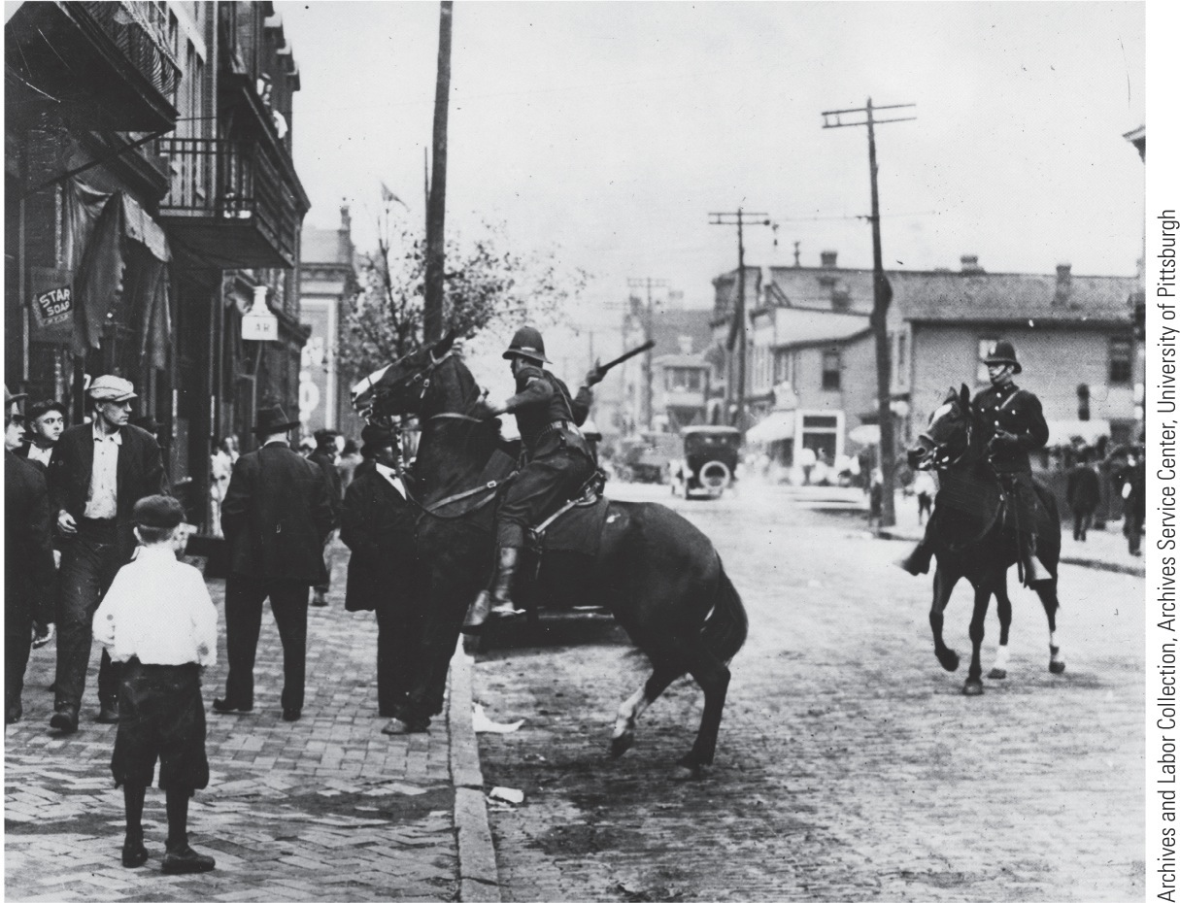
p678
Notes:
Suppressing the Steel Strike: Homestead,
1919 The big steel producers ferociously
resisted the unionization of their industry. In
Pittsburgh compliant local officials bent to the
steel makers’ will and issued an order banning all
outdoor meetings of strikers. This mounted state
policeman in the Pittsburgh borough of Homestead
enforced the order with a flailing billy club.
The steelworkers’ strike eventually failed, leaving
the steel industry un-unionized until the New
Deal championed labor’s cause in the depression
decade of the 1930s.

Slide 53
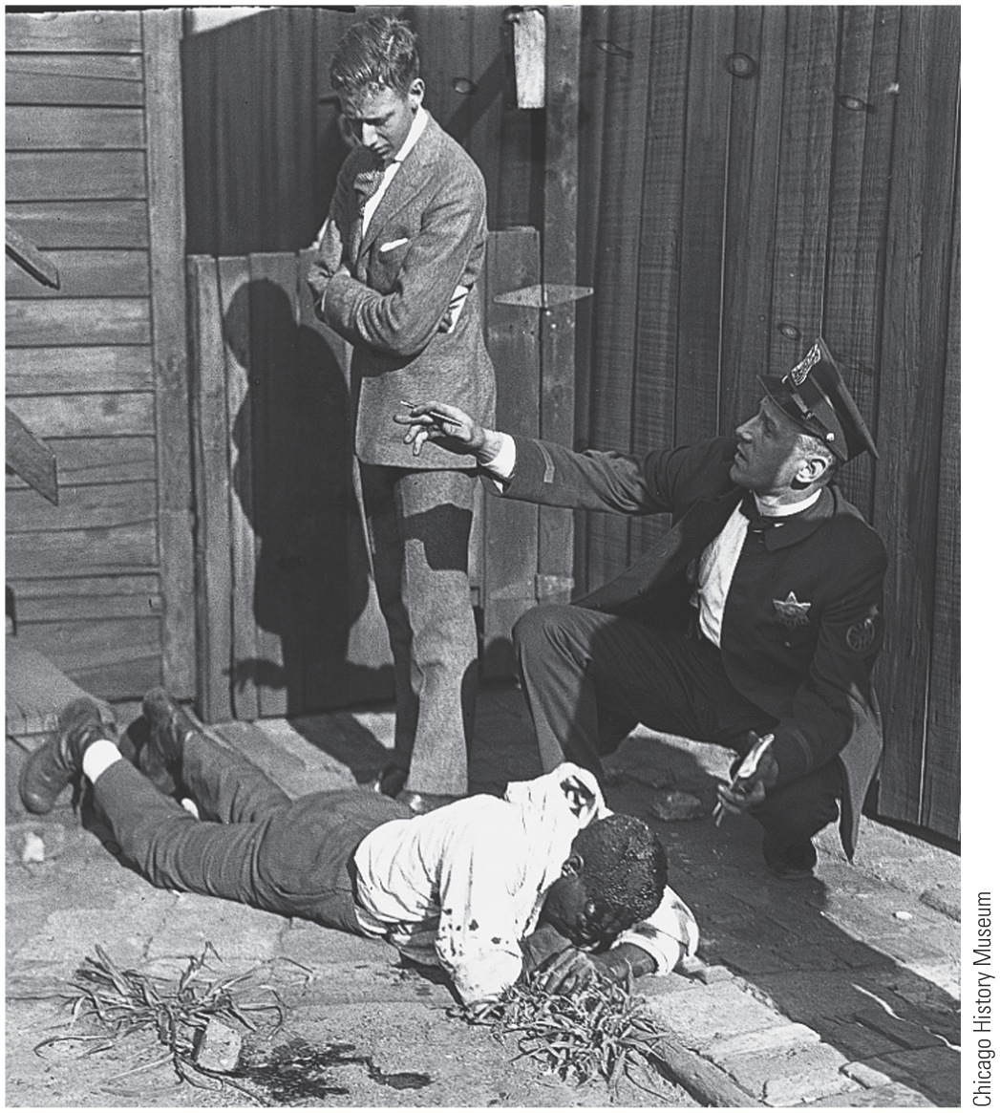
p679
Notes:
Chicago Race Riot, 1919 T he policeman apparently
arrived too late to spare this victim from being pelted by
stones from an angry mob.

Slide 54
XVII. Suffering Until Suffrage
Women heeded call of patriotism and opportunity:
Thousands entered factories and fields left by men going to frontline
War split women's movement deeply:
Many progressive-era feminists were pacifists
Found a voice in National Woman's party
Led by Quaker activist Alice Paul
Demonstrated against “Kaiser Wilson” with marches and hunger strikes

Slide 55
XVII. Suffering Until Suffrage (cont.)
Larger part of suffrage movement:
Represented by National American Woman Suffrage Association
Supported Wilson's war
Argued women must take part in war effort to earn role in shaping peace
Fight for democracy abroad was women's best hope for winning true democracy at home
War mobilization gave new momentum to suffrage fight:
Wilson endorsed suffrage as “vitally necessary war measure”
In 1917 New York voted for suffrage at state level
Followed by Michigan, Oklahoma, and South Dakota
Whole U.S.A. followed with Nineteenth Amendment (1920)

Slide 56
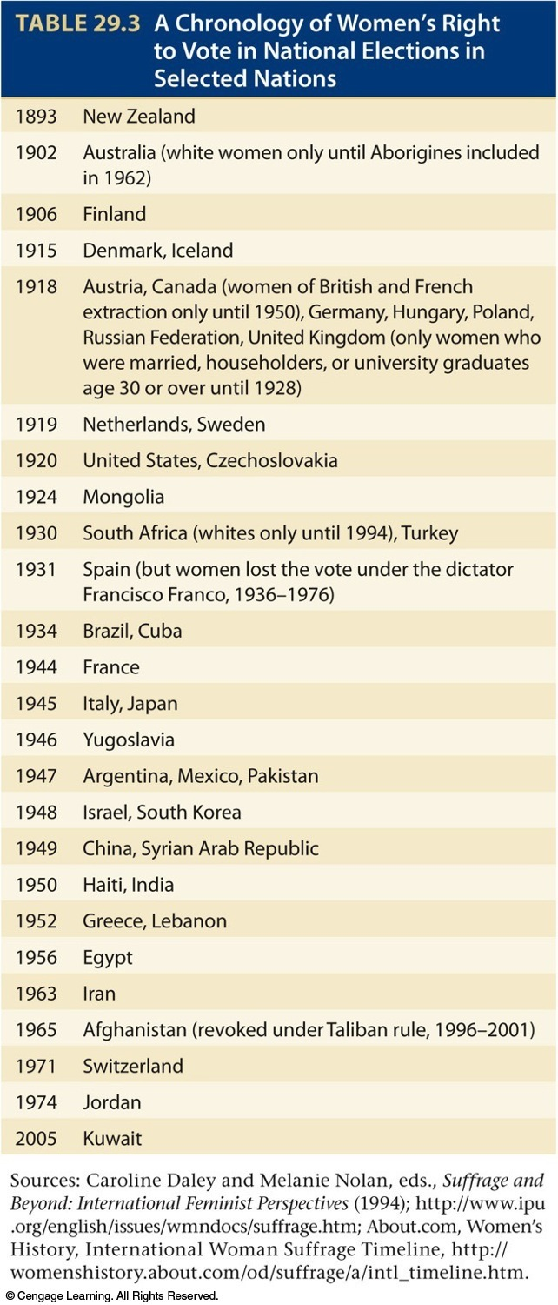
XVII. Suffering Until Suffrage
Ratified 70 years after first call for suffrage at Seneca Falls
Gave all American women right to vote (see Appendix and Table 29.3)
Women's wartime economic gains fleeting:
Permanent Women's Bureau in Department of Labor created to protect women in workplace
Most women workers gave up wartime jobs

Slide 57
XVIII. Making Plowboys into Doughboys
America's early role in war:
Did not dream of sending large force to France
Assumed naval power and material support would suffice
By April/May 1917, Europeans running out of money and manpower
Huge American army needed to be raised, trained, and transported quickly or whole western front would collapse

Slide 58
XVIII. Making Plowboys into Doughboys (cont.)
Conscription only answer to urgent need:
Wilson disliked draft, but eventually accepted conscription as disagreeable and temporary necessity
Immediately ran into problems with Congress
Later grudgingly passed conscription
Draft worked effectively overall
Army grew to over four million men
Women for first time admitted to armed forces:
11,000 to navy and 269 to marines
Army refused to enlist women

Slide 59
XVIII. Making Plowboys into Doughboys (cont.)
Africans Americans served in strictly segregated units, usually under white officers
Military authorities hesitated to train blacks for combat:
Thus majority assigned to “construction battalions” or put to work unloading ships
Recruits suppose to receive six months of training in America and two more overseas
because of urgency, many doughboys put more swiftly into battle

Slide 60
XIX. America Helps Hammer the “Hun”
Russia:
Bolsheviks seized power in 1917
Withdrew from “capitalistic war” 1918
This released many Germans from eastern front in Russia for western front in France
France:
Gradually began to bustle with U.S. doughboys (see Map 29.4):
First ones used for replacements or deployed in quiet sectors

Slide 61
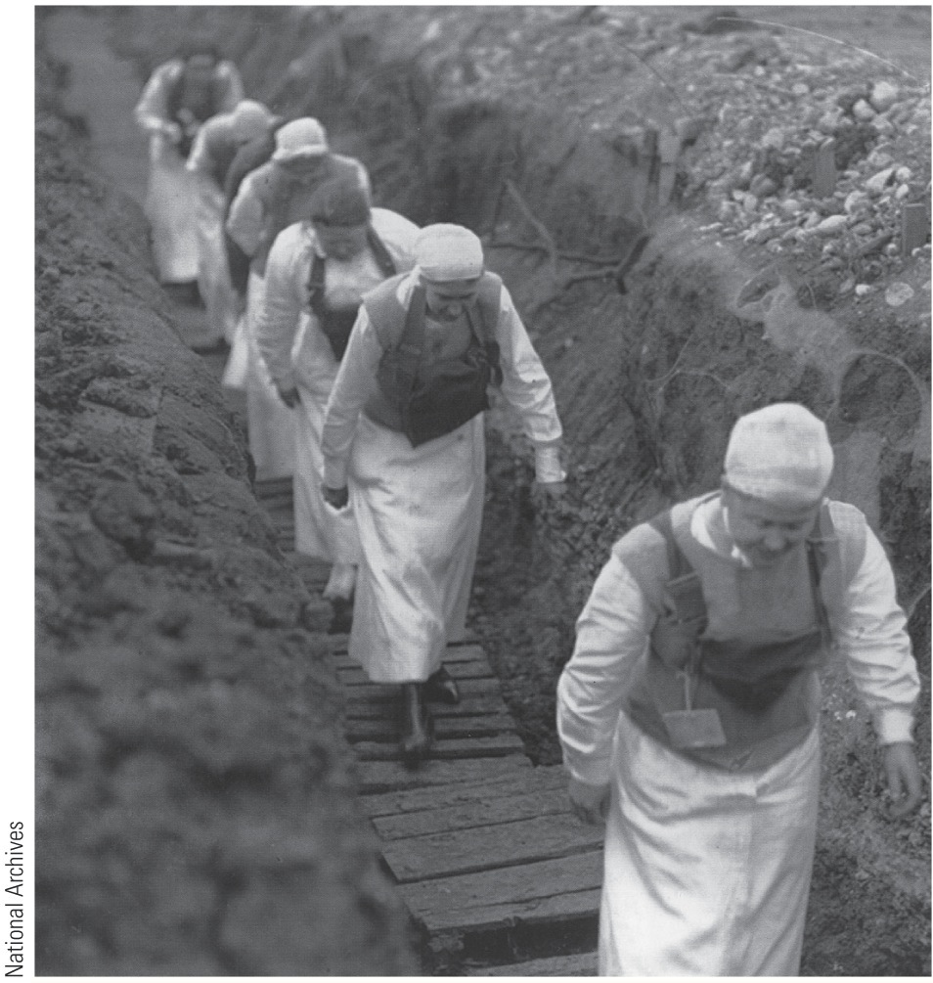
p681
Notes:
In the Trenches and to the Polls Wars often bring opportunities and innovations as well as
danger and destruction. As U.S. Army nurses went into harm’s way at the fighting front in France,
the century-long struggle for women’s suffrage intensified on the home front, culminating in the
Nineteenth Amendment in 1920.

Slide 62
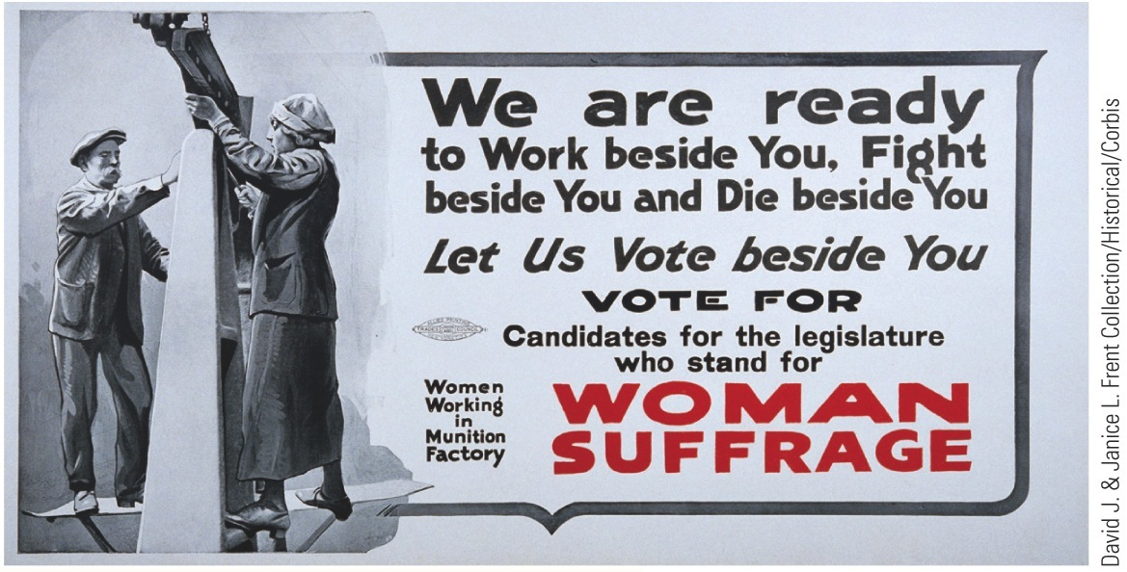
p681
Notes:
In the Trenches and to the Polls Wars often bring opportunities and innovations as well as
danger and destruction. As U.S. Army nurses went into harm’s way at the fighting front in France,
the century-long struggle for women’s suffrage intensified on the home front, culminating in the
Nineteenth Amendment in 1920.

Slide 63
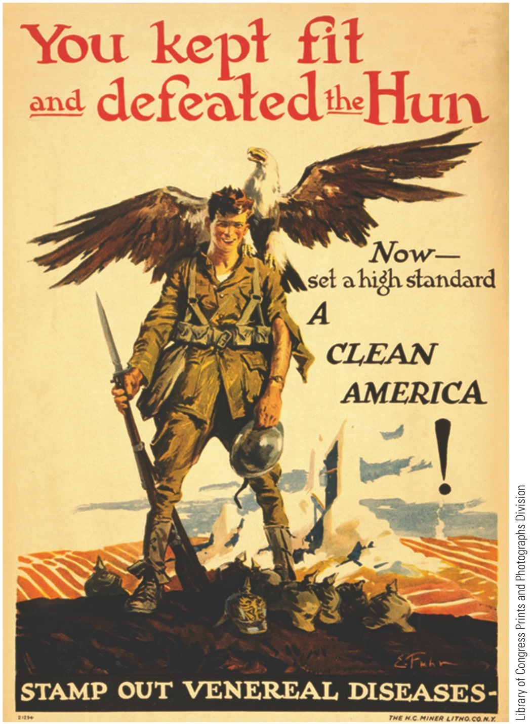
p682
Notes:
Battling Venereal Disease The American military
waged a half-hearted war on rampant venereal disease.

Slide 64
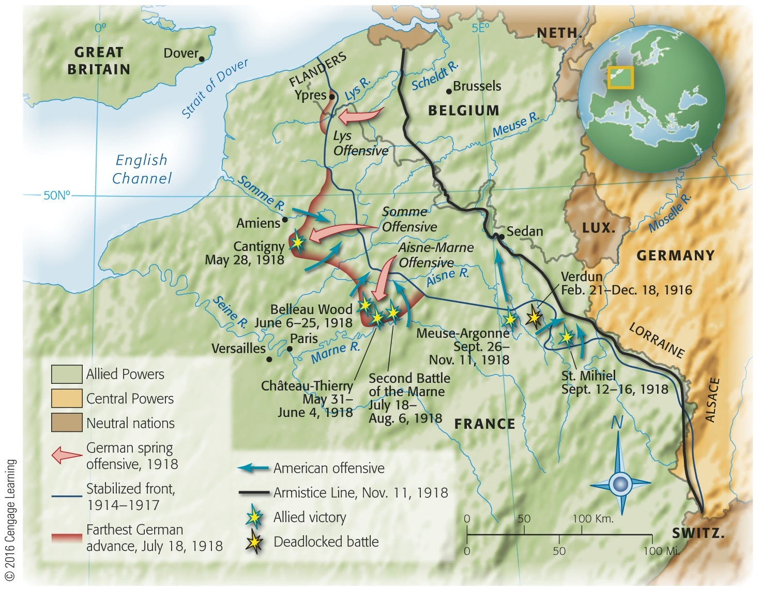
Map 29-4 p682
Notes:
Map 29.4 Major U.S. Operations
in France, 1918 One AE F soldier
recorded in his diary his baptism of
fire at St. Mihiel: “Hiked through dark
woods. No lights allowed, guided
by holding on the pack of the man
ahead. Stumbled through underbrush
for about half mile into an open field
where we waited in soaking rain until
about 10:00 p.m. We then started on
our hike to the St. Mihiel front, arriving
on the crest of a hill at 1:00 a.m. I saw
a sight which I shall never forget. It
was the zero hour and in one instant
the entire front as far as the eye could
reach in either direction was a sheet of
flame, while the heavy artillery made
the earth quake.” © 2016 Cengage Learning

Slide 65
XIX. America Helps Hammer the “Hun” (cont.)
Massive German drive of spring 1918:
Allies united under French marshal Foch
Germans smashed to within 40 miles of Paris, May 1918
Threatened to knock France out of war
30,000 Americans sent to Chateau-Thierry, right in teeth of German advance
First significant engagement of American troops in a European war
America put decisive weight on scales (see Figure 29.2) to blunt German drive
Americans joined in Second Battle of the Marine (July)
Marked beginning of German withdrawal

Slide 66
XIX. America Helps Hammer the “Hun” (cont.)
Americans now demanded and got separate army
General John J. Pershing assigned a front of 85 miles northwestward from Swiss border to French line:
Pershing's army undertook Meuse-Argonne offensive:
From September 26 to November 11, 1918
Battle lasted 47 days
Engaged 1.2 million American troops
120,000 Americans killed or wounded
Victory in sight

Slide 67
XIX. America Helps Hammer the “Hun” (cont.)
Berlin ready to hoist white flag:
Looked to Wilson in October 1918 for peace based on Fourteen Points:
Wilson demanded Kaiser be removed before any armistice could be negotiated
War-weary Germans took hint
Kaiser fled to Holland, lived for his remaining 23 years “unwept, unhonored, and unhung”
Exhausted Germans laid down arms at 11:00 on 11th day of 11th month, 1918

Slide 68
XIX. America Helps Hammer the “Hun” (cont.)
Costs exceeded comprehension:
9 million soldiers died
20 million suffered grievous wounds
30 million people died in influenza pandemic of 1918-1919
more than 550,000 Americans—more than ten times number of U.S. combat casualties—died from flu
U.S.'s main contributions to victory:
Foodstuffs, munitions, credits
Oil for first mechanized war
And manpower, but not battlefield victories
Yanks fought only two major battles—St. Mihiel and Meuse-Argonne, both in last two months of four-year war, and were still fighting in latter when war ended

Slide 69
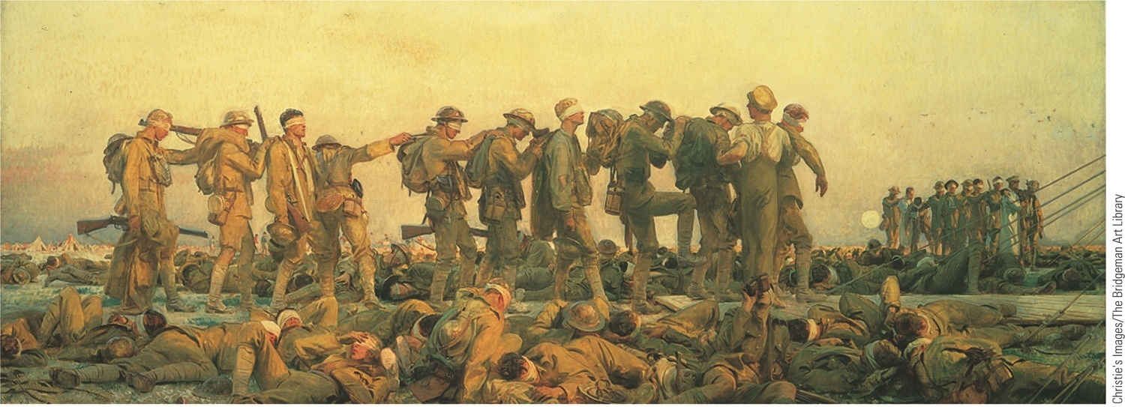
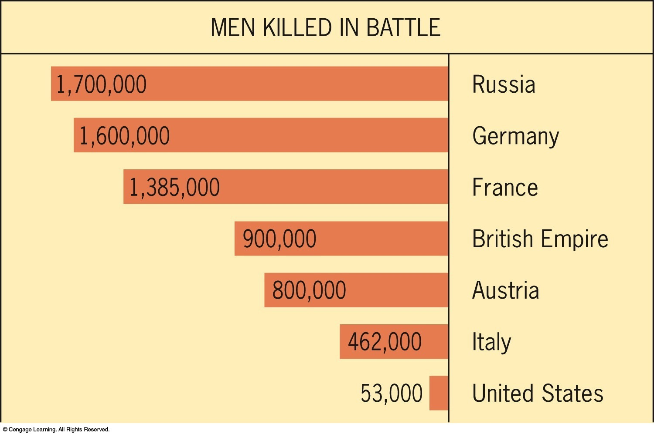
p684
Notes:
Gassed, by John Singer Sargent T he noted artist captures the horror of trench warfare in World War
I. The enemy was often distant and unseen, and death came impersonally from gas or artillery fire.
American troops, entering the line only in the war’s final days, were only briefly exposed to this kind
of brutal fighting.

Slide 70
XIX. America Helps Hammer the “Hun” (cont.)
It was prospect of endless U.S. troop reserves, rather than America's actual military performances, that eventually demoralized Germans
General Pershing's army:
Purchased more supplies in Europe than it shipped from United States
Most of its artillery and virtually all its aircraft provided by Britain and France
United States no arsenal of democracy in this war

Slide 71
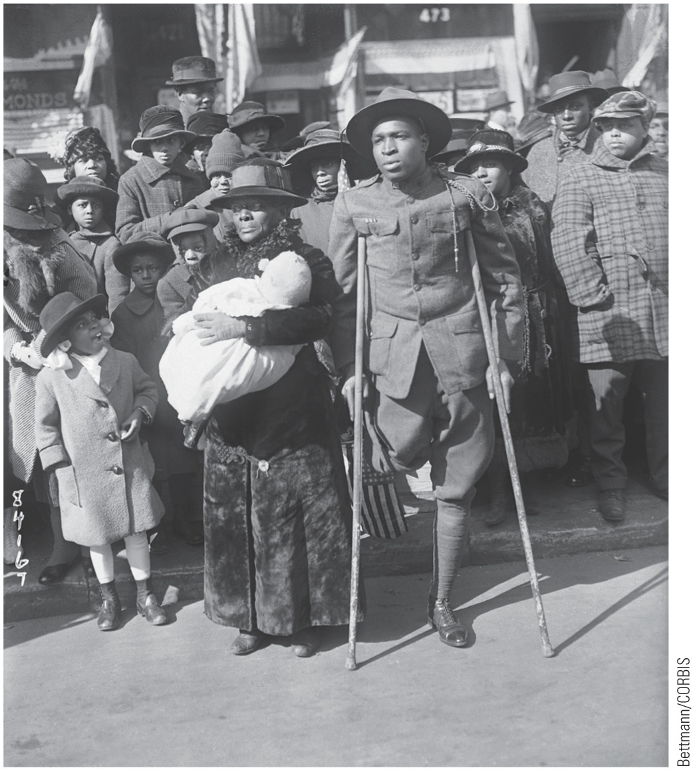
p685
Notes:
Home from the War, 1919 Most black troops in World
War I were denied combat duty and served as laborers
and stevedores, but this wounded veteran had seen some
tough fighting—though in a segregated unit, the 369th
Colored Infantry Regiment, also known as the “Hell-fighters
of Harlem.” Segregation followed black servicemen even
into death. When Congress appropriated money in 1930 to
send “Gold Star Mothers” to visit the graves of their slain
soldier-sons in France, it provided for separate ships, hotels,
and trains for African American women. Several black
mothers, preferring “to remain at home and retain our honor
and self-respect,” reluctantly refused to make the trip.

Slide 72
XX. Wilson Steps Down from Olympus
Wilson's role in shaping peace?
President towered at summit of popularity and power:
No other man had ever occupied so dizzy a pinnacle as moral leader of world
At this moment, his sureness of touch deserted him, and he began to make series of tragic fumbles
He called for Democratic congressional victory in election of November, 1918:
Backfired, voters returned narrow Republican majority to Congress
Wilson went to Paris as diminished leader

Slide 73
XX. Wilson Steps Down from Olympus (cont.)
Wilson's trip infuriated Republicans:
To that time, no president had traveled to Europe
Looked to critics like grandstanding
Snubbed Senate in assembling peace delegation
Neglected to include a single Republican senator in delegation
Logical choice would have been new chairman of Senate Committee on Foreign Relations:
Henry Cabot Lodge of Massachusetts
Wilson loathed Lodge, and feeling was reciprocated

Slide 74
XXI. An Idealist Amid the Imperialists
Wilson received tumultuous welcomes:
From masses of France, England, Italy
Paris Conference (January 18, 1919):
Big Four: Wilson, Premier Orlando (Italy), Prime Minister George (Britain), Premier Clemenceau (France)
Wilson wanted to prevent vengeful parceling of colonies and protectorates of vanquished powers
Less attentive to fate of colonies belonging to victorious French and English

Slide 75
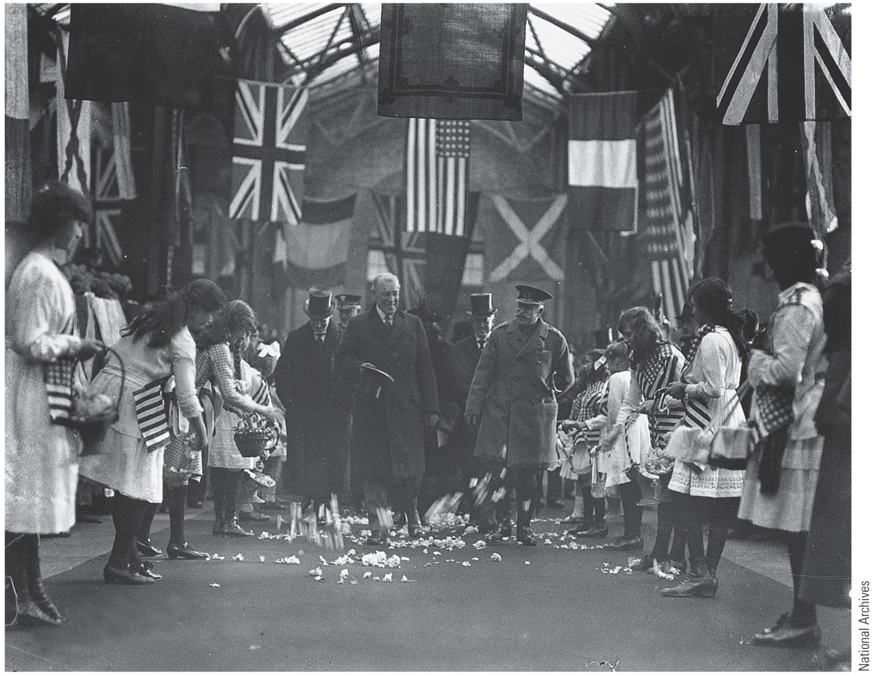
p686
Notes:
Wilson in Dover, England,
1919 H ailed by many
Europeans in early 1919 as the
savior of the Western world,
Wilson was a fallen idol only
a few months later, when
Americans repudiated the
peace treaty he had helped
to craft.

Slide 76
XXI. An Idealist Amid the Imperialists (cont.)
Victors received conquered territory (Syria to France, Iraq to England) as trustees of League of Nations
Basically prewar colonialism
In future, anticolonial nationalists would wield Wilsonian ideal of self-determination against imperial occupiers
Wilson envisioned League as a world parliament:
An assembly seat for all nations
Council controlled by great powers
Signal victory—when diplomats made League integral part of final peace treaty

Slide 77
XXI. An Idealist Amid the Imperialists (cont.)
Wilson's next battle with Japan:
During war, Japan seized China's Shandong (Shantung) Peninsula and German islands in Pacific
Japan received Pacific Islands under League mandate
Wilson strongly opposed Japanese control of Shandong as violation of self-determination for its 30 million Chinese
Wilson reluctantly accepted compromise:
Japan kept Germany's economic holdings in Shandong
Pledged to return peninsula to China at later date
Chinese outraged by imperialistic solution

Slide 78
XXI. An Idealist Amid the Imperialists (cont.)
Treaty of Versailles handed to Germans in June 1919:
Had been excluded from negotiations in Paris
Hoped for peace based on Fourteen Points
Vengeance, not reconciliation, was treaty's dominant tone
Loud and bitter cries of betrayal burst from Germans
Charges Adolf Hitler would later use
Wilson guilty of no conscious betrayal:
Allies torn by conflicting aims
Wilson had to compromise to get any agreement and especially to salvage League of Nations
Treaty had much to commend it:
Liberation of millions of minority peoples, e.g. Poles

Slide 79
XXII. Wilson's Battle for Ratification
Returning to America, Wilson sailed straight into political typhoon
Isolationists protested treaty:
Especially Wilson's commitment to usher U.S. into new League of Nations
Senators Williams Borah (Idaho), Hiram Johnson (California) and others were irreconcilables
Rejected any “entangling” alliance
Critics showered Treaty of Versailles with abuse
For Hun-haters, pact not harsh enough
Liberals thought it too harsh—a gross betrayal
“Hyphenated Americans” aroused because peace settlement not sufficiently favorable to native lands
Irish Americans feared League would empower England to crush any move for Irish independence

Slide 80
XXII. Wilson's Battle for Ratification (cont.)
Strong majority of people favored Treaty
July 1919, Lodge had no real hope of defeating it
He wanted only to amend it
To “Americanize,” “Republicanize,” or “senatorialize” it
To divide public opinion, Lodge read entire 264-page treaty aloud in Senate Foreign Relations Committee and held protracted hearings to air grievances

Slide 81
XXII. Wilson's Battle for Ratification (cont.)
Faced with such delaying tactics, Wilson decided to take case to nation:
Spectacular speechmaking tour undertaken despite protests of physicians and friends
Wilson's frail body began to sag under strains of:
Death of first wife in 1914
Partisan strife
Global war
Stressful peace conference

Slide 82
XXII. Wilson's Battle for Ratification (cont.)
Tour began September 1919 with lame start in isolationist strongholds of Midwest
Rocky Mountain region and Pacific Coast welcomed him:
High point—and breaking point—of return trip at Pueblo, Colorado, Sept. 25,1919
With tears coursing down, Wilson pleaded for League as only hope of preventing future wars
That night he collapsed from physical and nervous exhaustion

Slide 83
XXII. Wilson's Battle for Ratification (cont.)
Whisked back to Washington, where several days later he suffered stroke
Laid in darkened room in White House for several weeks
For more than 7 months, he did not meet cabinet
Senator Lodge now at helm:
Came up with fourteen formal reservations:
Reserved rights of United States under Monroe Doctrine and Constitution to protect U.S. sovereignty

Slide 84
XXII. Wilson's Battle for Ratification (cont.)
Wilson still strong enough to obstruct:
Sent word to all true Democrats to vote against treaty with Lodge reservations attached
Wilson hoped that when these were cleared away, path would be opened for ratification
Loyal Democrats in Senate on November 19, 1919 did Wilson's bidding
Combining with “irreconcilables”, they rejected treaty 55 to 39
Nation deeply shocked by verdict

Slide 85
XXII. Wilson's Battle for Ratification (cont.)
In March 1920 treaty brought up again with Lodge reservations tacked on
Wilson again sent word to loyal Democrats to vote down treaty with obnoxious reservations
He thus signed death warrant of treaty as far as Americans were concerned
On March 19, 1920, treaty netted simple majority but failed to get necessary two-thirds majority by count of 49 yeas to 35 nays
Who defeated treaty?:
Lodge-Wilson personal feud, traditionalism, isolationism, disillusionment, and partisanship all contributed
Wilson must bear substantial share of responsibility
He asked for all or nothing—and got nothing

Slide 86
XXIV. The Betrayal of Great Expectations
America's spurning of League short-sighted:
Republic had helped to win war, but foolishly kicked fruits of victory under table
League undercut by refusal of mightiest power on globe to join it
Ultimate failure lay at America's door-step
League designed, along with four other peace treaties, to rest upon United States
Senate spurned Security Treaty with France:
France then undertook to build powerful military
Thus Germany began to rearm illegally
United States hurt its own cause when it buried its head in sand
U.S. should have assumed war-born responsibilities and embraced role of global leader
Should have used its strength to shape world events.

