Slide 1
Chapter 12
War of 1812 aka the Second War for Independence

Slide 2
I. On to Canada over Land and Lakes
War of 1812:
Regular army ill-trained, ill-disciplined, and scattered
Had to be supplemented by even more poorly trained militias
Some generals were semi-senile heirlooms from Revolutionary War
Canada:
Important battleground because British forces were weakest there (see Map 12.1)

Slide 3
I. On to Canada over Land and Lakes (cont.)
Fighting in Canada:
America's offensive strategy poorly conceived
Missed by not capturing Montreal
Instead led a three-pronged invasion
Invading forces from Detroit, Niagara, & Lake Champlain were defeated soon after crossing Canadian border
By contrast:
British & Canadians displayed great energy
Quickly captured American fort Michilimackinac
Americans looked for success on water
American navy did much better than army
American craft were better than British ships
e.g., USS Constitution had thicker sides, heavier firepower, & larger crews

Slide 4
On to Canada over Land and Lakes
Control of Great Lakes was vital:
Energetic American officer Oliver Hazard Perry managed to build a fleet
Perry's victory on Lake Erie infused new life into American cause
Redcoats were forced from Detroit and Fort Malden and then beaten at Battle of Thames (October 1813)
Despite successes, Americans by late 1814 were far from invading Canada:
Thousands of redcoat veterans began to pour into Canada from Continent
With 10,000 troops, British prepared for war in 1814 against New York, along lake-river route
Lacking roads, invaders forced to bring supplies over Lake Champlain waterway

Slide 5
I. On to Canada over Land and Lakes (cont.)
American fleet, commanded by Thomas Macdonough, challenged British:
Desperate battle fought near Plattsburgh on September 11, 1814
Results of American victory were momentous:
British army forced to retreat
Macdonough saved upper New York from conquest
Affected concurrent negotiations of Anglo-American peace treaty in Europe

Slide 6
II. Washington Burned and New Orleans Defended
A second British force of 4,000 landed in Chesapeake Bay area in August 1814.
Marching toward to Washington, they dispersed 6,000 militiamen at Bladensburg.
Set buildings on fire, incl. Capitol & White House.

Slide 7
Washington Burned and New Orleans Defended
Americans at Baltimore, however, held firm:
British hammered Fort McHenry, but unable to take city
Francis Scott Key inspired to write “The Star-Spangled Banner”
A third British assault in 1814, aimed at New Orleans, menaced entire Mississippi Valley:
Andrew Jackson, fresh from victory at Battle of Horseshoe Bend (see Map 12.5), in command

Slide 8
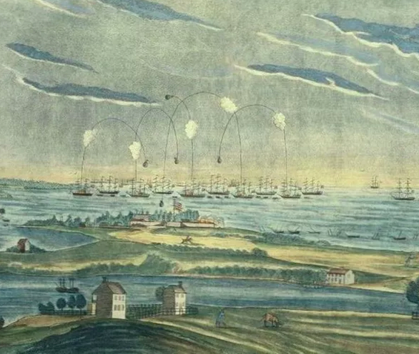
The Battle of Fort McHenry; Baltimore

Slide 9
II. Washington Burned and New Orleans Defended (cont.)
Jackson had 7,000 soldiers holding defensive positions.
8,000 British soldiers blundered badly:
Launched frontal assault on January 8, 1815
Suffered most devastating defeat of entire war
Lost over 2,000 killed and wounded in ½ hour
An astonishing victory for Jackson and his men
News of American victory in Battle of New Orleans was great encouragement.

Slide 10
II. Washington Burned and New Orleans Defended (cont.)
Jackson became a national hero.
Peace treaty signed at Ghent, Belgium:
Ended war two weeks before Battle of New Orleans
U.S.A. fought for honor as much as material gain
Battle of New Orleans restored that honor
British retaliated with devastating blockade along America's coast

Slide 11
III. The Treaty of Ghent
Tsar Alexander I of Russia proposed mediation in 1812:
His proposal brought 5 American peacemakers to Belgian city of Ghent in 1814
Group headed by John Quincy Adams
Confident from early military successes, British initially demanded a neutralized Indian buffer state in Great Lakes region, control of Great Lakes, & a substantial part of Maine

Slide 12
III. The Treaty of Ghent (cont.)
Americans flatly rejected these terms and talks stalemated:
British reverses in upper New York and Baltimore made London more willing to compromise
England also preoccupied with redrafting map of Europe at Congress of Vienna (1814-1815) and eyeing still-dangerous France
Treaty of Ghent, signed on Christmas Eve, 1814 was essentially an armistice.

Slide 13
IV. Federalist Grievances and the Hartford Convention
New England extremists proposed secession or at least separate peace with Britain:
Hartford Convention:
Massachusetts, Connecticut, & Rhode Island sent full delegations
New Hampshire & Vermont sent partial delegations
26 men met in secrecy for 3 weeks—Dec. 15, 1814 to Jan. 5, 1815—to discuss grievances
Only a few delegates advocated secession
Hartford Convention was not radical.
Convention's final report was moderate:
Demands reflected Federalist fears that New England was becoming subservient to South & West
Demanded financial assistance from Washington to compensate for lost trade
Proposed constitutional amendments requiring 2/3 vote in Congress before an embargo could be imposed, new states admitted, or war declared.

Slide 14
IV. Federalist Grievances and the Hartford Convention (cont.)
Delegates sought to abolish 3/5 clause
To limit presidents to single term
To prohibit election of two successive presidents from same state– this aimed at “Virginia dynasty”
Three envoys carried demands to Washington:
Arrived just as news of New Orleans victory appeared
Harford Convention was death of Federalist party
Federalists never again able to mount successful presidential campaign (see Map 12.2)

Slide 15
V. The Second War for American Independence
War of 1812 a small war:
6,000 Americans killed or wounded
Globally unimportant, war had huge consequences for United States:
Other nations developed new respect for America's prowess thanks to Perry & Macdonough
In diplomatic sense, conflict could be called 2nd War for American Independence

Slide 16
V. The Second War for American Independence (cont.)
Sectionalism dealt black eye.
Federalists were most conspicuous casualty.
War heroes emerged—Jackson and Harrison—both later became president.
Abandoned by British, Indians forced to make terms as best they could.
In economic sense, war bred greater U.S. independence via increased manufacturing.

Slide 17
V. The Second War for American Independence (cont.)
Canadian patriotism increased by war.
Many felt betrayed by Treaty of Ghent:
Aggrieved by failure to secure Indian buffer state or even mastery of Great Lakes
Rush-Bagot agreement (1817) between Britain & U.S.A. limited naval armament on Great Lakes
Border fortifications later removed
United States and Canada came to share world's longest unfortified boundary—5,527 miles

Slide 18
VI. Nascent Nationalism
Most impressive by-product of war was heightened nationalism (nation-consciousness or national oneness):
America may not have fought war as one nation, but it emerged as one nation
Washington Irving and James Fenimore Cooper attained international fame as American writers
Revised Bank of United States approved by Congress in 1816
New national capital began to rise in Washington
Army expanded to ten thousand
Navy further covered itself with victory in 1815 when it beat piratical plunderers of North Africa

Slide 19
VII. “The American System”
Nationalism manifested itself in manufacturing:
Patriotic Americans took pride in factories
British tried to crush U.S. factories in marketplace
Tariff of 1816—Congress passed first tariff:
Primarily for protection, not revenue
Rates were 20 to 25% of value of dutiable imports
High protective trend started
Nationalism highlighted by Henry Clay's plan for developing profitable home market:
His American System:
Strong banking system provide easy credit
Protective tariff for eastern manufacturing
Network of roads and canals, especially in Ohio, would meet great need for better transportation
Spending for this plan conflicted with Republican constitutional scruples.

Slide 20
VI. “The American System” (cont.)
Congress voted in 1817 to distribute $1.5 million to states for internal improvements:
President Madison vetoed measure as unconstitutional
Individual states had to fund their own construction, incl. Erie Canal, completed in 1825
Jeffersonian-Republicans rejected direct federal support for intrastate internal improvements
New England strongly opposed it because would further drain away population and create competing states in West

Slide 21
VIII. The So-Called Era of Good Feelings
James Monroe nominated for presidency in 1816:
Last time a Federalist would run
Monroe an experienced, levelheaded executive
Emerging nationalism cemented by Monroe's goodwill tour in 1817
Boston newspaper announced “Era of Good Feelings”

Slide 22
VIII. The So-Called Era of Good Feelings (cont.)
Era of Good Feelings:
Considerable tranquility and prosperity did exist in early Monroe years
But also a troubled time:
Extensive debate over tariff, the bank, internal improvements, and sale of public lands
Sectionalism was growing
Debate over slavery was growing

Slide 23
The Panic of 1819 and the Curse of Hard Times
1819: economic panic descended:
Deflation, bankruptcies, bank failures, unemployment, & overcrowded debtor's prisons
Factors contributing to catastrophe:
Over-speculation of frontier land
West hard hit when Bank of United States forced western banks to foreclose on farm mortgages
Hit poorer classes hard
Sowed seed of Jacksonian democracy
Called attention to inhumanity of imprisoning debtors
Agitation against imprisonment for debt resulted in remedial legislation in many states

Slide 24
X. Growing Pains of the West
The West:
9 states joined original thirteen between 1791 & 1819
To keep balance between North & South, states were admitted alternately, free and slave
Continuation of generation-old movement west:
Land was cheap
Eager newcomers from abroad
Tobacco exhausted land in South

Slide 25
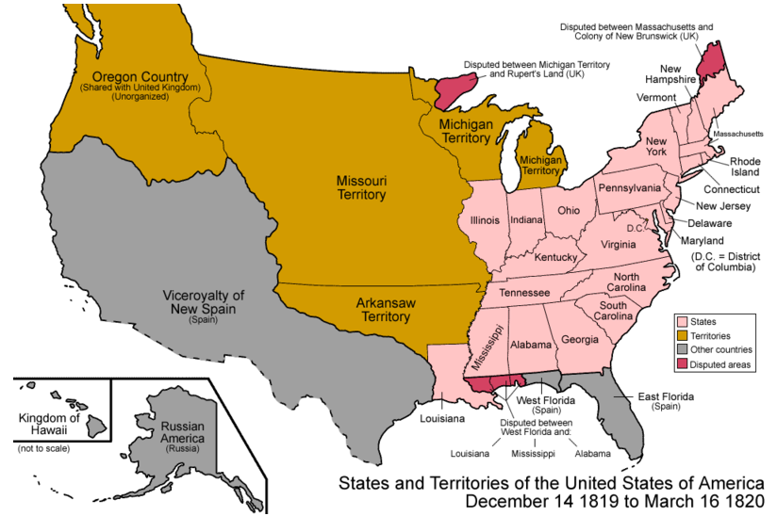
USA: 1819

Slide 26
X. Growing Pains of the West (cont.)
Other causes of growing West:
Acute economic distress during embargo years
Indians in Northwest and South crushed by Generals Harrison and Jackson
New highways improved land routes to Ohio Valley (e.g., Cumberland Road, 1811)
1811 first steamboat on western waters heralded new era of upstream navigation

Slide 27
X. Growing Pains of the West (cont.)
West still weak in population and influence:
Allied with other sections to gain influence
Land Act of 1820 helped with access to land:
Can buy 80 acres atminimum of $1.25 an acre in cash
West demanded government fund for transportation and slowly received it
West also frustrated by Bank of U.S. resistance to easy credit

Slide 28
XI. Slavery and the Sectional Balance
North-South tensions over West revealed in 1819.
Missouri petitioned for statehood:
Tallmadge amendment—
No more slaves could be brought into Missouri
Gradual emancipation of children born to slaves already there

Slide 29
XI. Slavery and the Sectional Balance (cont.)
Roar of anger from slaveholding Southerners:
Saw Tallmadge amendment as threat to sectional balance and whole future of slavery
If Congress abolished peculiar institution in Missouri, it might do so in older states of South.
A few Northerners protested evils of slavery:
Determined to prevent its spread into territories

Slide 30
XII. The Uneasy Missouri Compromise
Clay broke deadlock with three compromises.
Congress:
Admitted Missouri as slave state
Admitted Maine as free state
Kept balance between North and South
Prohibited slavery north of 36° 30' line —southern boundary of Missouri (see Map 12.3).

Slide 31
XII. The Uneasy Missouri Compromise (cont.)
Missouri Compromise lasted 34 years:
Vital formative period in young Republic
Preserved compact of states
Exposed divisive issue of slavery in West
Missouri Compromise and Panic of 1819 should have hurt Monroe's reelection in 1820
Monroe received every electoral vote except one because Federalists so weak

Slide 32
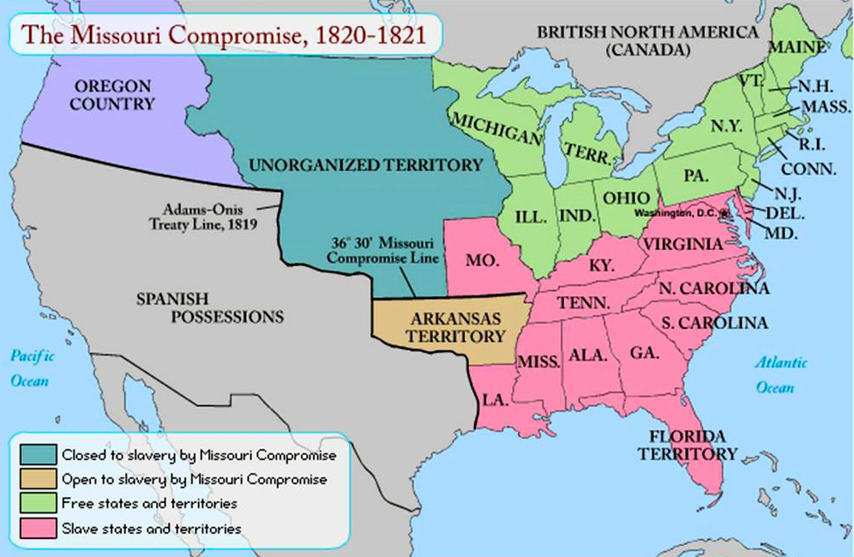

Slide 33
John Marshall and Judicial Nationalism
Supreme Court bolstered nationalism.
McCulloch v. Maryland (1819) strengthened U.S. government at expense of states:
Maryland attempted to destroy branch of Bank of United States by imposing tax on its notes
Marshall declared bank constitutional using doctrine of implied powers or loose construction
Increased federal authority when he denied right of Maryland to tax the bank

Slide 34
John Marshall and Judicial Nationalism
Cohens v. Virginia (1821) gave Marshall another opportunity to defend federal power:
Cohen brothers convicted by Virginia courts of illegally selling lottery tickets
They appealed conviction to Supreme Court
Court upheld conviction
Marshall asserted right of Supreme Court to review decisions of state courts in all questions involving powers of federal government

Slide 35
Judicial Dikes Against Democratic Excesses
Marshall also protected property rights.
Notorious case of Fletcher v. Peck (1810):
Georgia legislature granted 35 million acres in Yazoo River country (Mississippi) to private speculators
Next legislature canceled corrupt transaction
Court decreed grant a contract & Constitution forbids states from “impairing” contracts (Art. I. Sec. X, para. 1)
Protected property rights against popular pressures

Slide 36
Judicial Dikes Against Democratic Excesses
Fletcher enabled Court to assert right to void state laws conflicting with federal Constitution.
Dartmouth College v. Woodward (1819):
College sued when New Jersey changed charter granted to college by king in 1769
Marshall ruled original charter must stand
It was a contract and Constitution protected contracts against state encroachments
Dartmouth decision safeguarded businesses from domination by states
Created future problem when corporations escaped needed public control

Slide 37
XIV. Judicial Dikes Against Democratic Excesses (cont.)
If Marshall was Molding Father of Constitution, Daniel Webster was Expounding Father:
Expounded nationalistic philosophy
Challenged states' rights and nullification
Marshall's nationalistic decisions shaped U.S. history:
Buttressed federal Union
Created stable national environment for business
Checked excesses of elected state legislatures
Shaped Constitution along conservative, centralizing lines counter to emerging democratic spirit of era
Through him, Hamiltonians partly triumphed

Slide 38
XV. Sharing Oregon and Acquiring Florida
Anglo-American Convention (1818):
Permitted U.S.A. to share Newfoundland fisheries with Canada
Fixed vague northern limits of Louisiana along 49th parallel from Lake of the Woods (Minn.) to Rocky Mountains (see Map 12.4)
Provided for 10-year joint occupation of Oregon Country, without surrender of rights or claims of either America or Britain

Slide 39
Map of the Anglo-American Committee agreements

Slide 40
XV. Sharing Oregon and Acquiring Florida (cont.)
Semitropical Spanish Florida:
Americans already claimed West Florida, ratified by Congress in 1812
Bulk of Florida remained under Spanish rule (see Map 12.5)
Uprisings in South America forced Spain to remove troops from Florida
Jackson secured commission to enter Spanish territory

Slide 41
XV. Sharing Oregon and Acquiring Florida (cont.)
Exceeding his instructions, Jackson swept across Florida attacking Indians & any who assisted them
Monroe consulted cabinet and all wanted to discipline Jackson, except John Quincy Adams
Florida Purchase Treaty (1819):
Also known as Adams-Onis Treaty:
Spain ceded Florida & claims to Oregon in exchange for Texas

Slide 42
XVI. The Menace of Monarchy in America
Autocrats of Europe:
Stated world must be made safe from democracy
Smothered rebellions in Italy (1821) & Spain (1823)
Americans were alarmed:
If Europeans interfered in New World, Republicanism would suffer irreparable harm
Physical security of United States, mother of democracy, would be endangered

Slide 43
XVI. The Menace of Monarchy in America (cont.)
Russia's push from Alaska began when tsar in 1821 claimed jurisdiction over 100 miles of open sea to 51° (most of British Columbia)
Russia had trading posts as far as San Francisco Bay
American feared that Russia would block access to California, prospective U.S. window to Pacific

Slide 44
XVII. Monroe and His Doctrine
England wanted U.S.A. to issue a joint pledge asserting territorial integrity of New World.
Adams concluded a self-denying alliance with Britain would hamper American expansion and it was unnecessary.
He suspected England would block any European intervention in South America.

Slide 45
XVII. Monroe and His Doctrine (cont.)
Monroe Doctrine (1823):
In annual message to Congress, Monroe issued stern warning to Europe:
(1) noncolonization and (2) nonintervention
Regarding Russia's advance in Northwest, he proclaimed era of colonization over
He warned against foreign intervention, esp. in south
European powers offended but could do little because of British navy.

Slide 46
XVIII. Monroe's Doctrine Appraised
Russia relented even before Doctrine released
Russo-American Treaty (1824):
Fixed Russia's southern line at 54° 40'— present south tip of Alaska panhandle (see Map 12.6)
Monroe Doctrine might more accurately be called Self-Defense Doctrine:
Monroe concerned about security of his own country, not Latin America

Slide 47
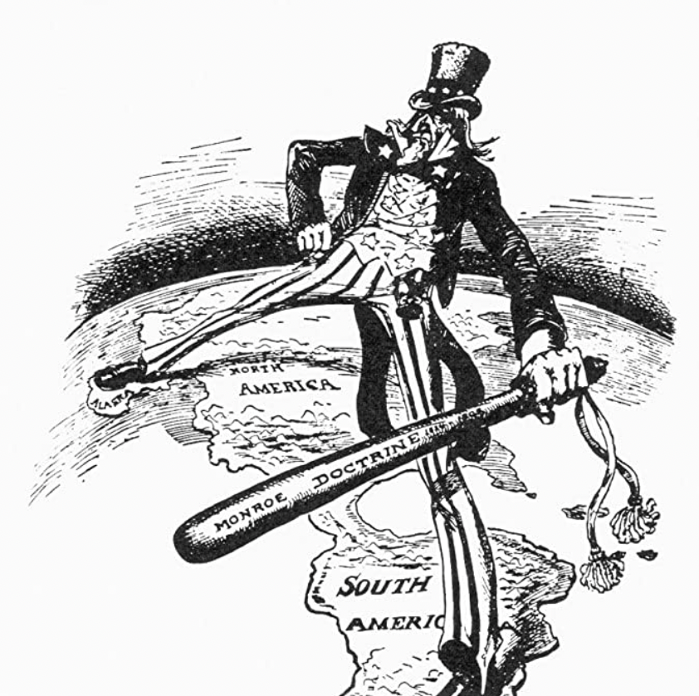
XVIII. Monroe's Doctrine Appraised
Monroe Doctrine has never been greater than America's power to eject a trespasser
It was never law—domestic or international
Merely personalized statement of policy by President Monroe
Expressed the post-1812 nationalism then energizing United States

