Slide 1
UltraStructure

Slide 2
Inner Life of Cell

Slide 3
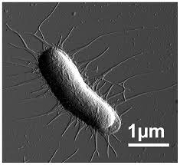
E. coli

Slide 4
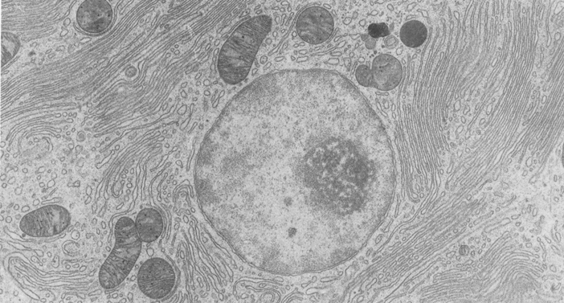
Eukaryotic Cell #1

Slide 5
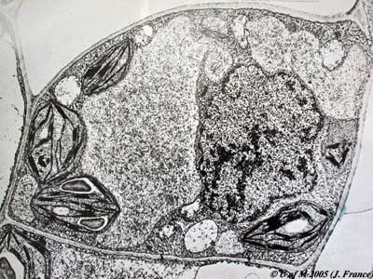
Eukaryotic Cell #2

Slide 6
Micrographs
Use the book of micrographs to observe and sketch each of the following…
Chloroplast (page 3)
Rough Endoplasmic Reticulum (page 5)
Golgi (page 8)
Secretion vesicles (page 8/9)
Lysosome (page 10, Figure (c))
Mitochondria (page 12)
Nucleus (page 16)

Slide 7
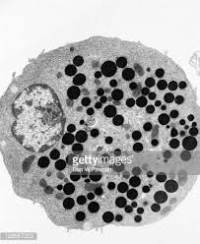
Identify organelles and deduce the function of specialized cells

Slide 8
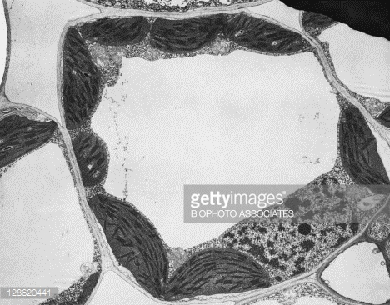
Identify organelles and deduce the function of specialized cells

Slide 9
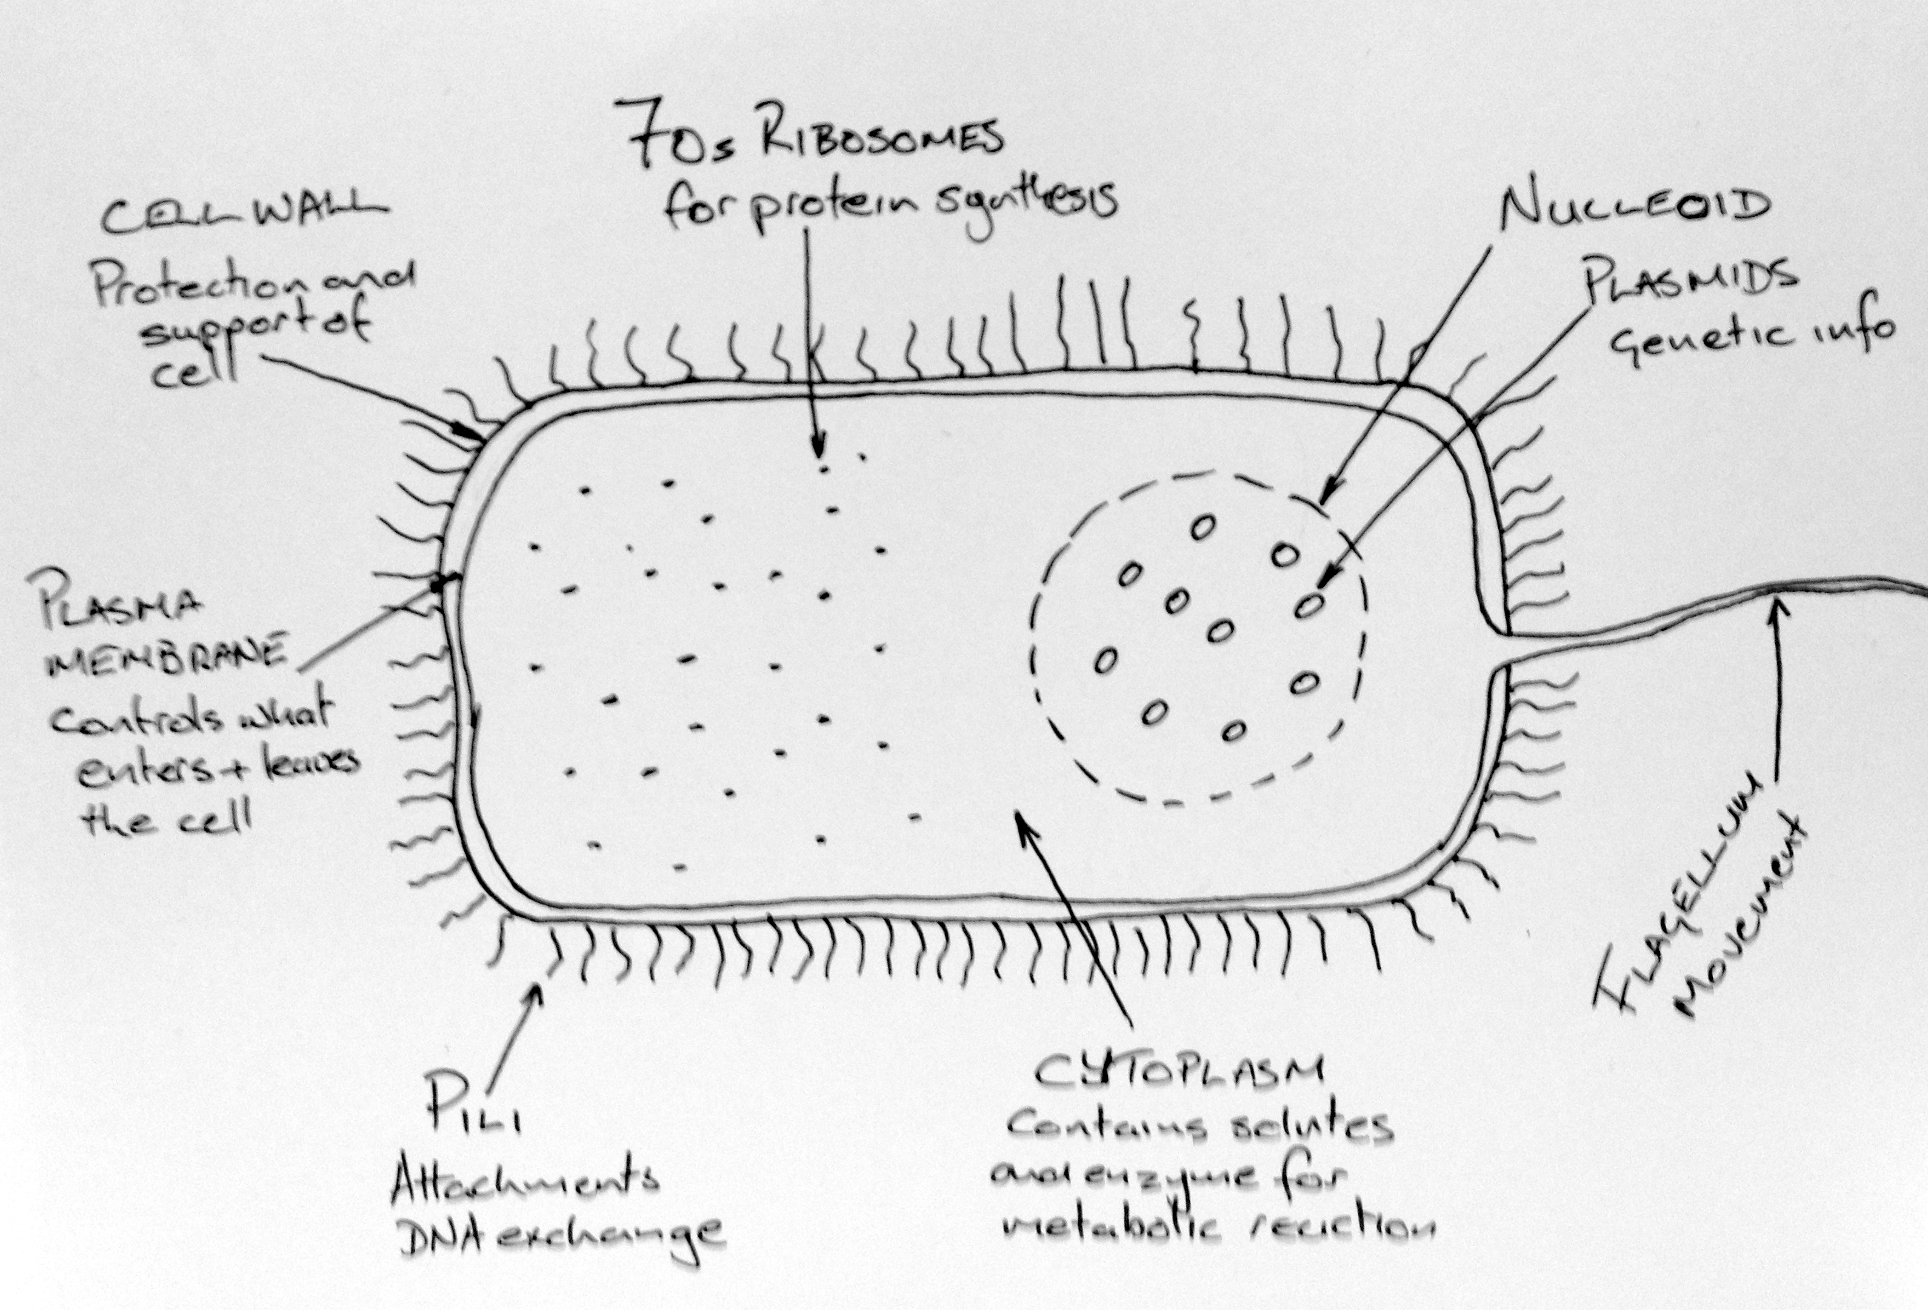
IB Acceptable Prokaryotic Cell with Annotations

