Slide 1
Heading toward Disunion
Chapter 19

Slide 2
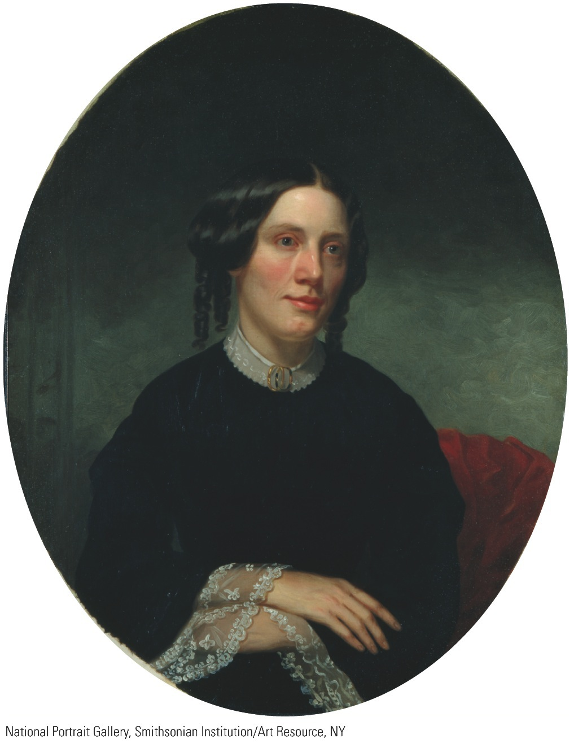
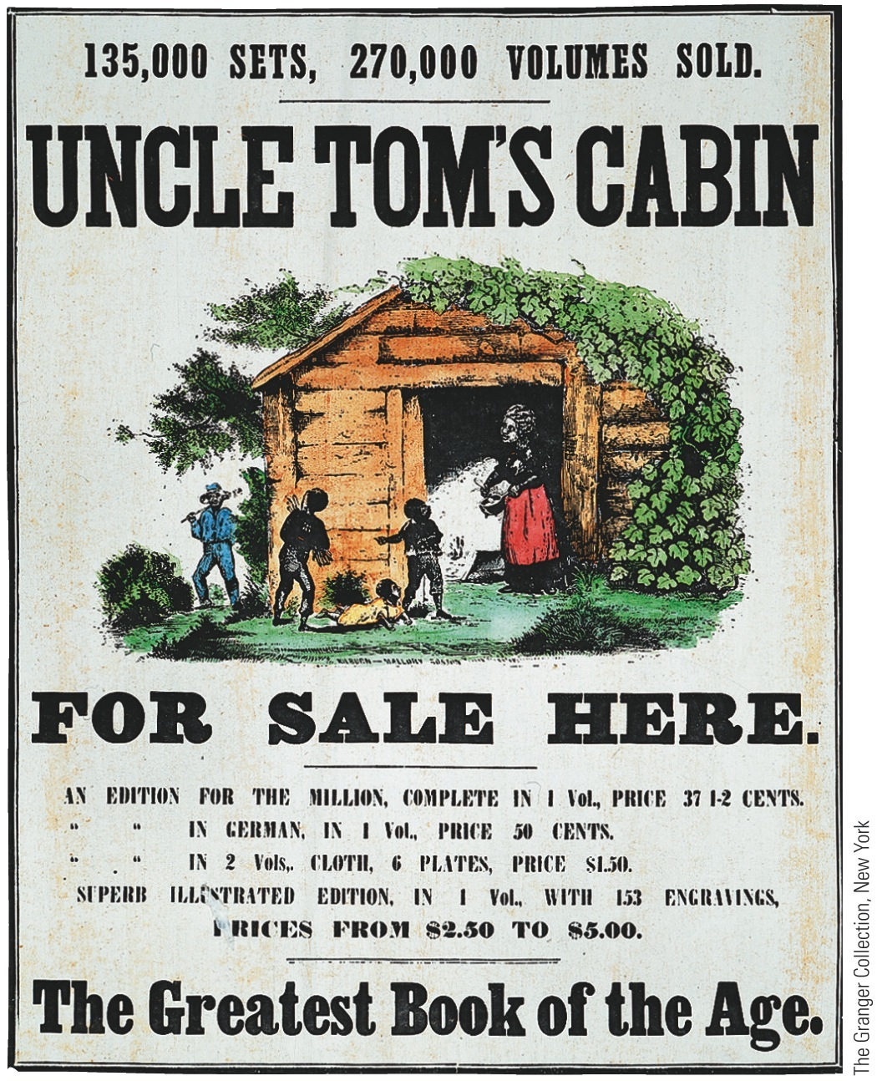
I. Stowe and Helper: Literary Incendiaries
Uncle Tom's Cabin—Harriet Beecher Stowe
She was determined to awaken North to wickedness of slavery
By laying bare its terrible inhumanity, especially splitting families
Relied on powerful imagery and touching pathos
Deeper sources of her anti-slavery sentiments lay in evangelical crusades of Second Great Awakening

Slide 3
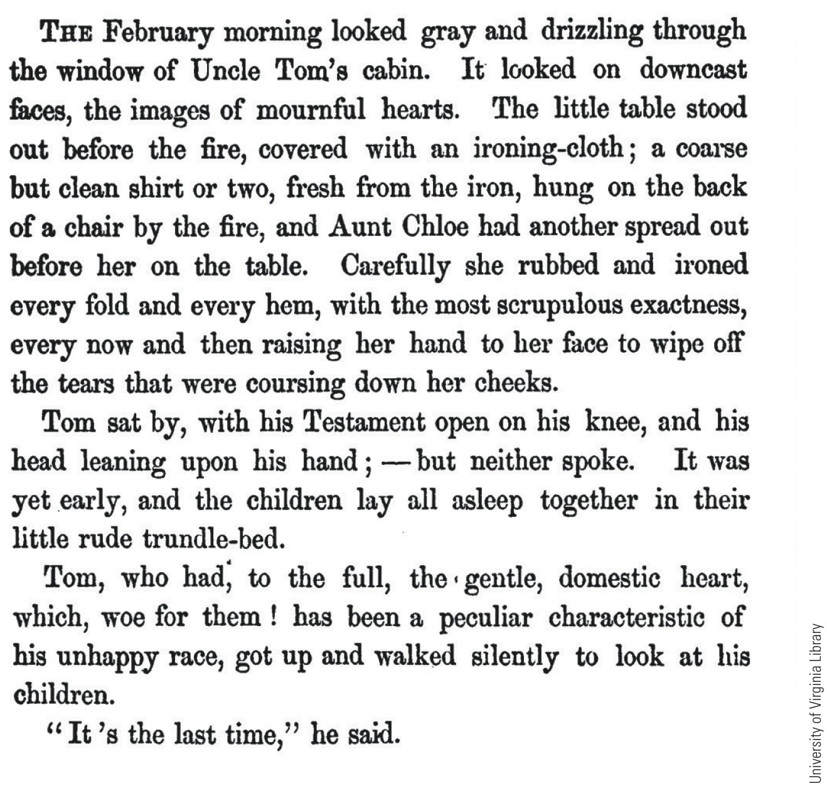
p401

Slide 4
I. Stowe and Helper: Literary Incendiaries (cont.)
Success of novel at home and abroad was sensational
Also lengthy runs on stage in “Tom shows”
No other novel in American history can be compared with it as a political force
When introduced to President in 1862; Lincoln remarked, “So you're the little woman who wrote the book that made this great war”
Stowe never witnessed slavery in Deep South:
Had seen it briefly during visit to Kentucky
Lived in Ohio, center of Underground Railroad activity
Uncle Tom:
Left endearing and enduring impression on North
Many swore they would have nothing to do with enforcing Fugitive Slave Law

Slide 5
I. Stowe and Helper: Literary Incendiaries (cont.)
Devoured by millions of impressionable youth
Immensely popular abroad, esp. Britain and France
The Impending Crisis of the South (1857) by Hinton R. Helper:
Hating slavery and blacks, he attempted to prove with statistics that, indirectly, non-slaveholding whites were ones who suffered most from millstone of slavery
He finally found a publisher in North
Helped fuel fears of planters that non-slaveholding majority might abandon them
Book banned in South
In North, thousands distributed as campaign literature by Republicans
Southerners embittered when learned northern brethren spreading wicked “lies”

Slide 6
II. The North-South Contest for Kansas
Popular sovereignty:
New England Emigrant Aid Company:
Antislavery organization sent 2,000 people to Kansas to forestall South and to make profit
Many carried new breech-loading Sharps rifles, nicknamed “Beecher's Bibles” after Rev. Henry Ward Beecher (Harriet Beecher Stowe's brother) who helped raise money to pay for them
Southern spokesmen raised cries of betrayal
Northern “Nebrascals,” out to “abolitionize” both Kansas and Nebraska
Some southern hotheads attempted to “assist” small groups of well-armed slave-owners to Kansas
Planting slavery in Kansas a losing game:
Slaves were valuable and volatile property
Foolish for owners to take them where bullets were flying
Kansas might be voted free under popular sovereignty
Census of 1860 found only two slaves among 107,000 souls in Kansas and only 15 in Nebraska

Slide 7
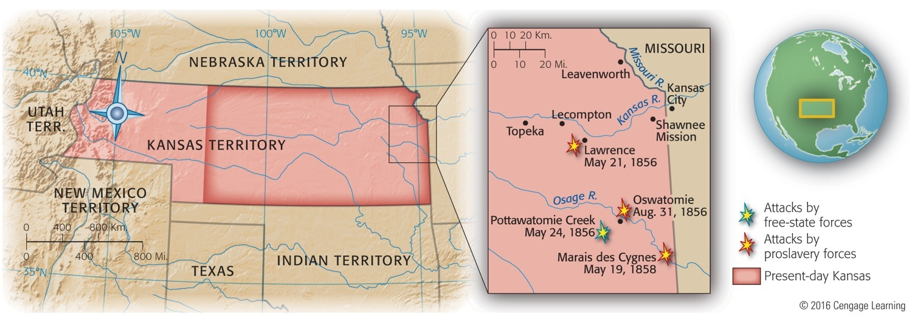
II. The North-South Contest for Kansas (cont.)
Crisis conditions in Kansas rapidly worsened (see Map 19.1):
1855 election for first territorial legislature:
Proslavery “border ruffians” poured in from Missouri to vote early and often
Slavery supporters triumphed; set up puppet government at Shawnee Mission
Free-soilers established extralegal regime of their own in Topeka

Slide 8
II. The North-South Contest for Kansas (cont.)
Confused Kansans had choice of two governments:
One based on fraud
Other on illegality
Tensions mounted as settlers feuded over conflicting land claims
Breaking point (1856): gang of proslavery raiders, alleging provocation, shot up and burned part of free-soil town of Lawrence
Outrage was prelude to bloodier tragedy

Slide 9
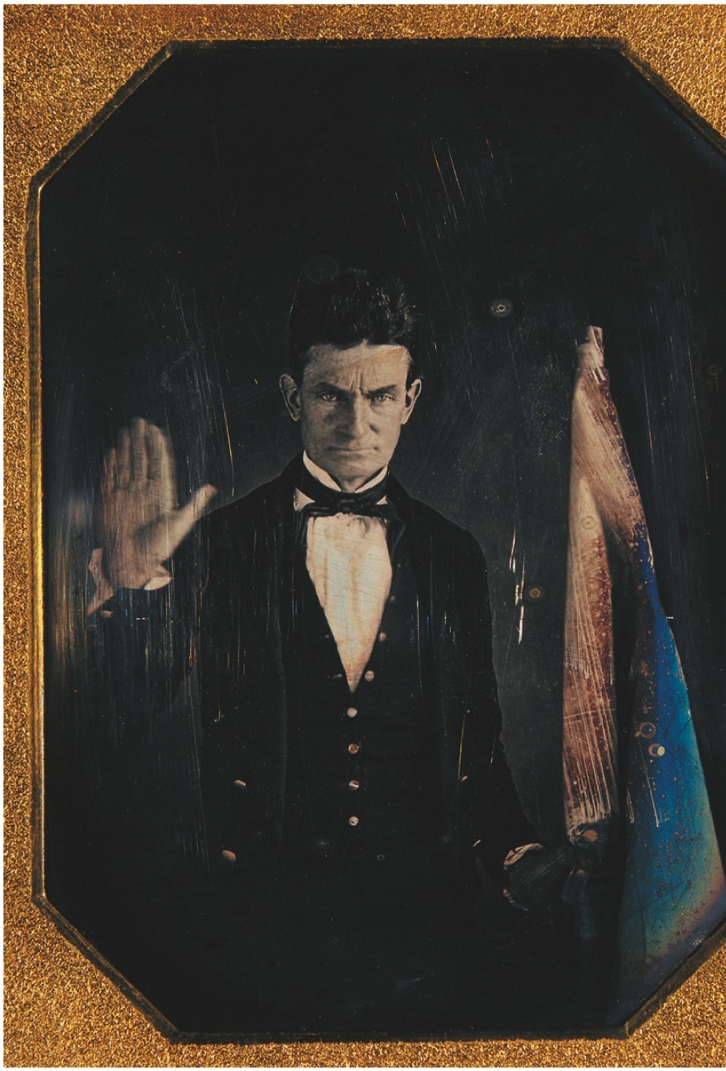
III. Kansas in Convulsion
John Brown now stalked upon Kansas battlefield
Obsessively dedicated to abolitionist cause:
Brooding over attack on Lawrence, he led a band to Pottawatomie Creek in May 1856
There they hacked to pieces 5 surprised men, presumed to be proslaveryites
Terrorist butchery besmirched free-soil cause
Brought vicious retaliation from proslavery forces

Slide 10
III. Kansas in Convulsion (cont.)
Civil war erupted in Kansas in 1856:
Continued until it merged with Civil War of 1861-1865
Destroyed millions of dollars' worth of property
Paralyzed agriculture in certain areas
Cost scores of lives
Kansas applied for statehood on popular sovereignty basis

Slide 11
III. Kansas in Convulsion
Lecompton Constitution: a proslavery document
people not allowed to vote for or against constitution as a whole
Vote for constitution either “with slavery” or “with no slavery” (but with protections for slavery already there)
Whatever the outcome, there would still be slavery
Free-soilers boycotted polls
Proslaveryites approved constitution with slavery in late 1857
Scene then shifted to Washington:
President Pierce had been succeeded by James Buchanan, who was strongly under southern influence
Buchanan supported Lecompton Constitution
Senator Douglas threw his support behind true popular sovereignty
Compromise: submit entire Lecompton Constitution to people
Free-soil voters thronged to polls and voted it down
Kansas remained a territory until 1861, when southern secessionists left Congress
Buchanan's action divided Democratic Party by antagonizing Democrats in North

Slide 12
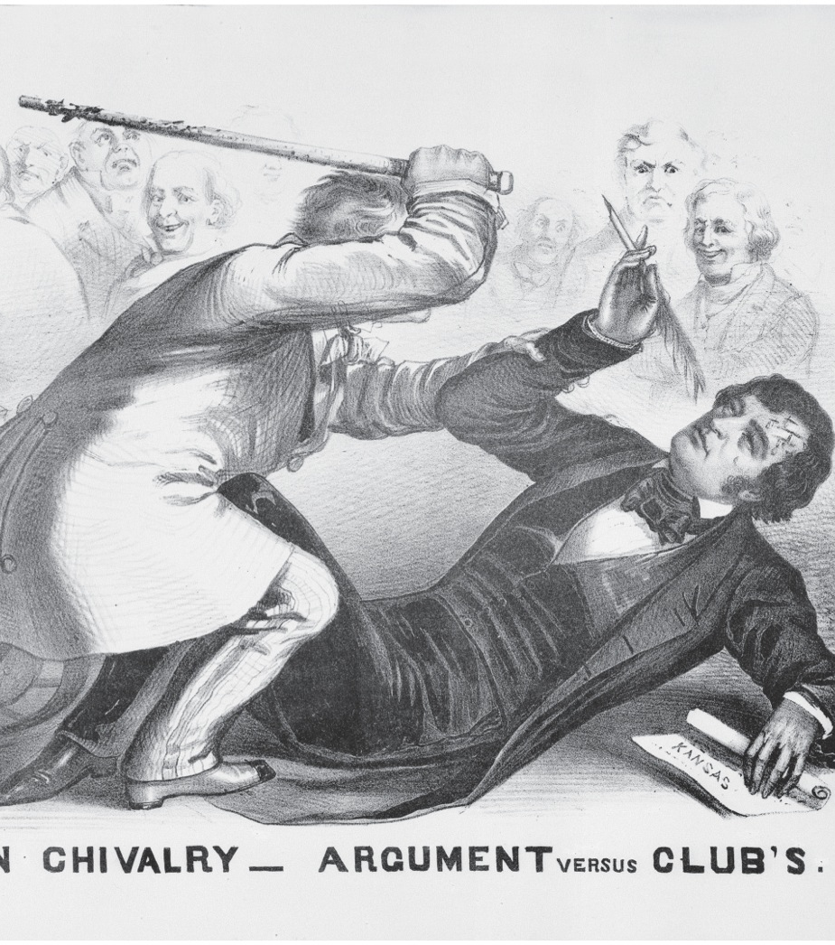
IV. “Bully” Brooks
Bleeding Kansas:
Spattered blood on Senate floor in 1856:
Senator Charles Sumner (Mass.) a leading abolitionist
Made himself one of most disliked men in Senate
Delivered speech “The Crime Against Kansas”
Condemned proslavery men
Referred insultingly to South Carolina and its senator Andrew Butler
Congressman Preston Brooks (S.C.):
Resented insults to his state and to its senator
To Brooks, only alternative was to chastise senator
On May 22, 1856, he approached Sumner and pounded him with an 11-ounce cane until it broke
House could not muster enough votes to expel Brooks
He resigned but was triumphantly reelected
Sumner had to go to Europe for treatment of his injuries
For 3 ½ years, Massachusetts kept his seat open until Sumner could return
Bleeding Sumner thus joined with Bleeding Kansas as political issues

Slide 13
IV. “Bully” Brooks and His Bludgeon
Free-soil North infuriated by Brooks:
Copies of Sumner's speech sold by thousands
Every blow to Sumner made thousands of Republicans
South not unanimous in approving Brooks, but:
Angered by Sumner's speech
Upset that speech so applauded in North
Sumner-Brooks clash and ensuing reactions revealed how dangerously inflamed passions had become
Blows rained on Sumner were among first blows of Civil War

Slide 14
V. “Old Buck” Versus “The Pathfinder”
Democrats met in Cincinnati to elect presidential standard-bearer of 1856
Delegates chose James Buchanan:
He was serving in London during Kansas-Nebraska uproar—therefore “Kansas-less”
In a crisis that called for giants, he was mediocre, irresolute, and confused
Republicans met in Philadelphia:
“Higher Law” Steward was conspicuous leader
However, final choice was John C. Frémont:
So-called “Pathfinder of the West”
Virtually without political experience, but not tarred with Kansas brush
Republicans came out strongly against extension of slavery into territories
Democrats declared emphatically for popular sovereignty.

Slide 15
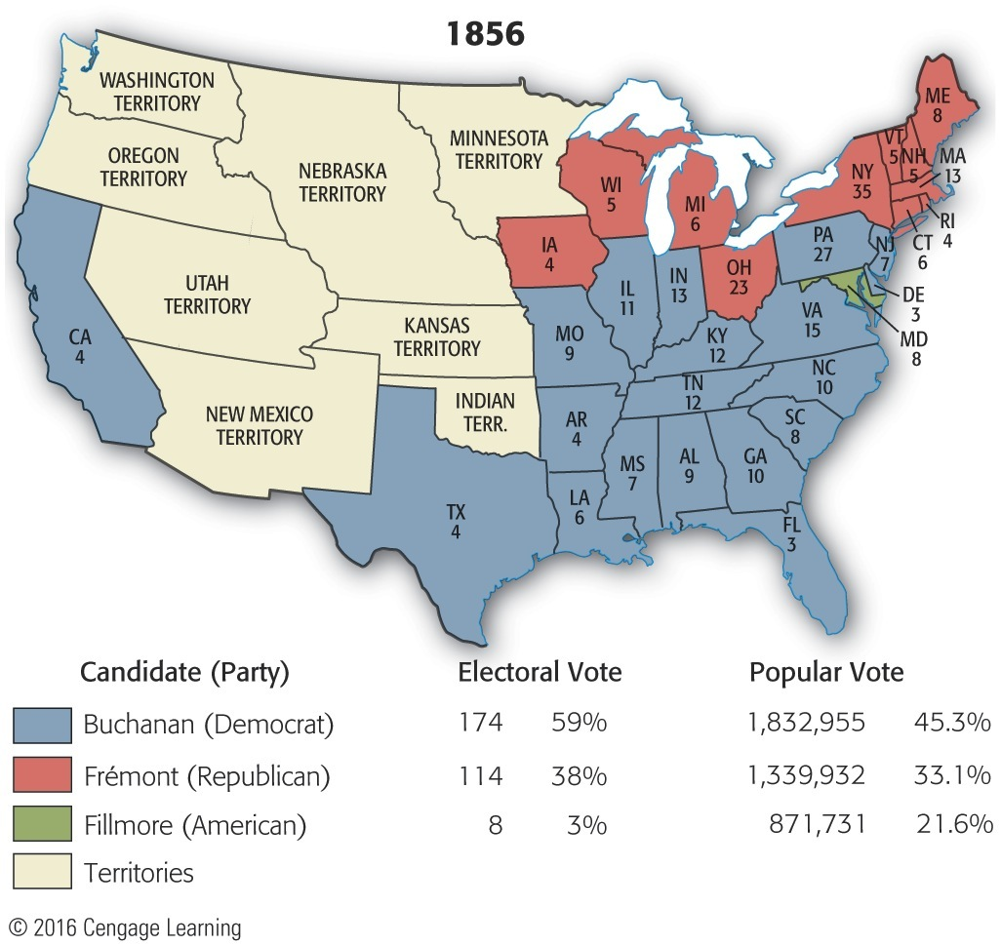
The 1856 election
The election returns:
Buchanan
Polled less than a majority of popular vote
Won handily (see Map 19.2)
Electoral College count was 174 to 114 (for Frémont) and 8 (for Fillmore)
Popular vote:
1,832,955 for Buchanan
1,339,932 for Frémont
871,731 for Fillmore

Slide 16
VI. The Electoral Fruits of 1856 (cont.)
Why Republican defeat:
Frémont's lack of honesty, capacity, sound judgment
Southern threat that election of “Black Republican” would be declaration of war, forcing South to secede
Many northerners thus intimidated to vote for Buchanan
Innate conservatism triumphed, assisted by southern bullyism
Fortunate for Union that secession and Civil War did not come in 1856:
Frémont was ill-balanced and second-rate figure
In 1856, North was more willing to let South depart in peace than in 1860
Dramatic events (1856-1860) aroused still-apathetic northerners to fighting pitch
1856 election cast long shadow as politicians, North and South, peered anxiously toward 1860

Slide 17
Dred Scott Case
Dred Scott, an enslaved man from Missouri filed suit against his owner.
Scott said that because he and his wife once lived in states where slavery was illegal, the couple was in fact free.
Scott did indeed live as a free man in a free state for 5 years.

Slide 18
Dred Scott Decision
The Supreme Court ruled 7 to 2 against Scott.
The ruling stated that Scott and therefore all slaves, were not citizens, and since the 5th Amendment protected private property, slaves had no right to sue in court.
The court also found the Missouri Compromise unconstitutional.
Slaves were property of their owners and congress could not deprive people of their property without due process.
Antislavery forces were disgusted with the decision.
The ruling meant that Congress had no power to ban slavery anywhere.

Slide 19
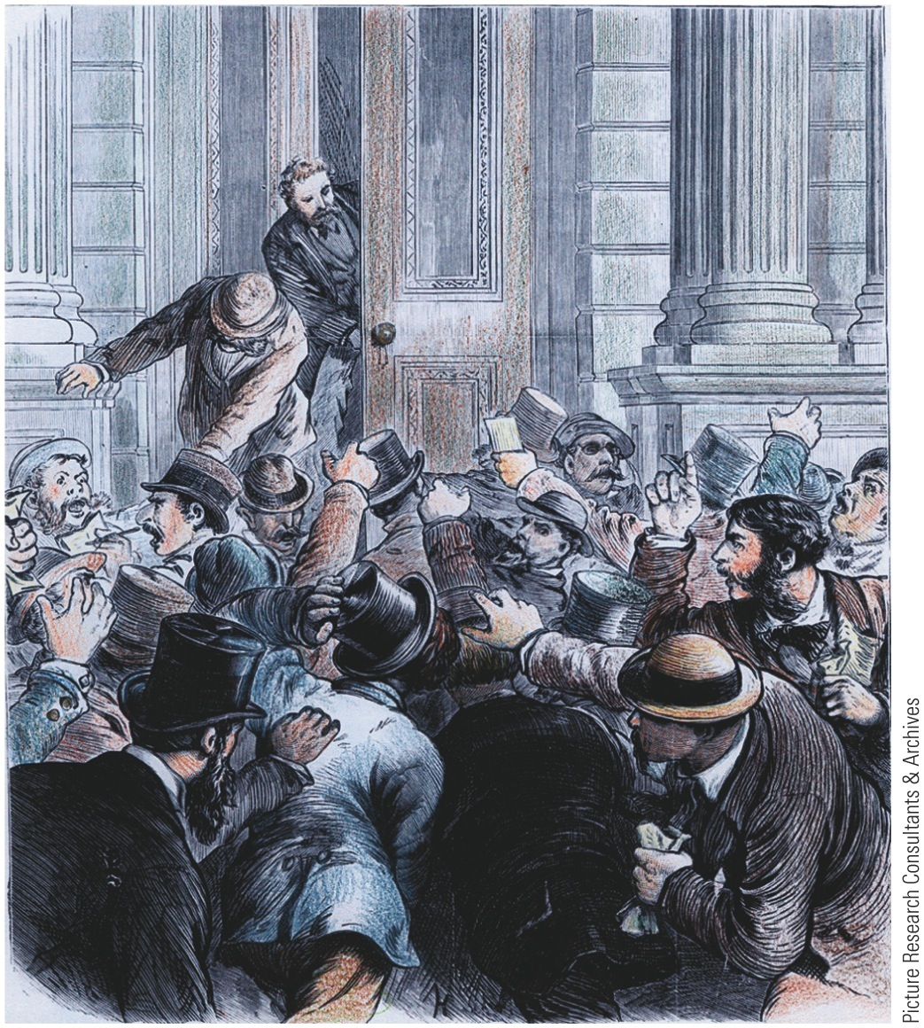
The Financial Crash of 1857
Panic of 1857: why crash?
Inpouring California gold inflated currency
Demands of Crimean War (Russia, 1853-1856) overstimulated grain production
Frenzied speculation in land and railroads
Over 5,000 businesses failed:
North and its grain growers hardest hit
South enjoyed favorable cotton prices abroad
Panic provided further proof cotton was king:
Helped drive overconfident southerners closer to shooting showdown
Distress in North, esp. agriculture, invigorated call for homesteads of 160 acres from public domain
Opposition to free farmland:
Eastern industrialists feared losing workers
South opposed because plantation slavery not possible on only 160 acres

Slide 20
VIII. The Financial Crash of 1857
Congress (1860) passed a homestead act
Public land available for 25 cents an acre
Killed by President Buchanan's veto
Panic of 1857 created clamor for higher tariff rates
because of large Treasury surplus as well as pressure from South, Congress lowered tariffs in 1857
Tariff of 1857:
Reduced duties to about 20 percent on dutiable goods—lowest point since 1812
As Treasury surplus melted away:
Industrials in North pointed to need for higher duties
Concerned mostly about need for increased protection
Panic of 1857 gave Republicans two surefire economic issues for 1860 election:
Protection for unprotected
Farms for farmless

Slide 21
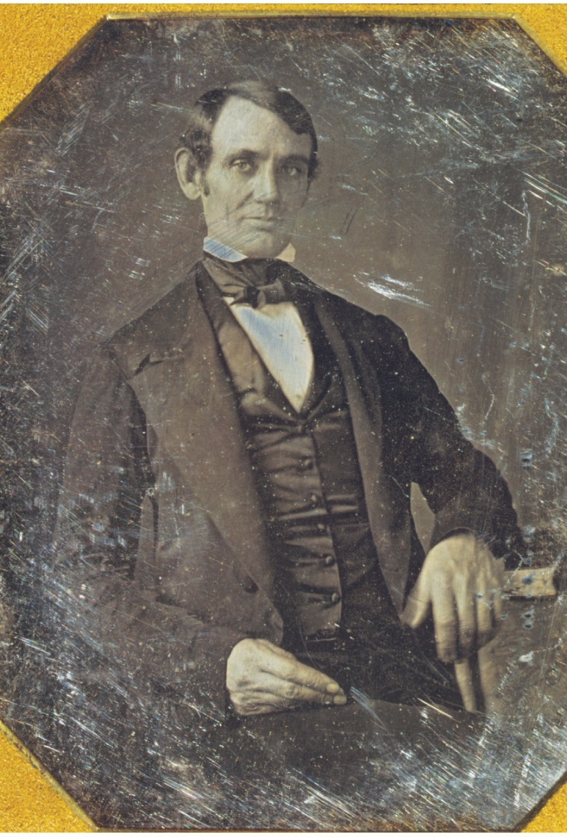
An Illinois Rail-Splitter Emerges
Illinois senatorial election of 1858 claimed national spotlight:
Senator Stephen Douglas up for reelection
Republicans ran Springfield lawyer, Abraham Lincoln:
Not well educated, but an avid reader
Married “above himself” into influential Todd family of Kentucky—helped to school him in patience and forbearance
Emerged as a trial lawyer in Illinois
Widely referred to as “Honest Abe”
Served an undistinguished term in Congress, 1847-1849
Kansas-Nebraska Act light a fire within him:
Emerged as one of foremost Republican politicians and orators in Northwest
At Republican convention in 1856, Lincoln received 100 votes for vice-presidential nomination

Slide 22
Lincoln Versus Douglas
Lincoln-Douglas debates:
Lincoln challenged Douglas to debates; Douglas accepted
Took place from August to October 1858
Most famous debate at Freeport, Illinois:
Lincoln presented a question based on Supreme Court ruling in Dred Scott decision
Douglas had already publicly answered Freeport question, and was consistent in his answer.
Freeport Doctrine:
No matter how Supreme Court ruled, slavery would stay down if people voted it down
Pro-slavery laws need to be passed by territorial legislatures
If unpopular, slavery would soon disappear
Douglas defeated Lincoln for Senate seat:
His loyalty to popular sovereignty was decisive
Senators then chosen by state legislatures
“Honest Abe” emerged as a power Republican figure.
Douglas, in winning Illinois, lost chances of winning presidency
Lincoln-Douglas debates proved to be one of the preliminary battles of Civil War.

Slide 23
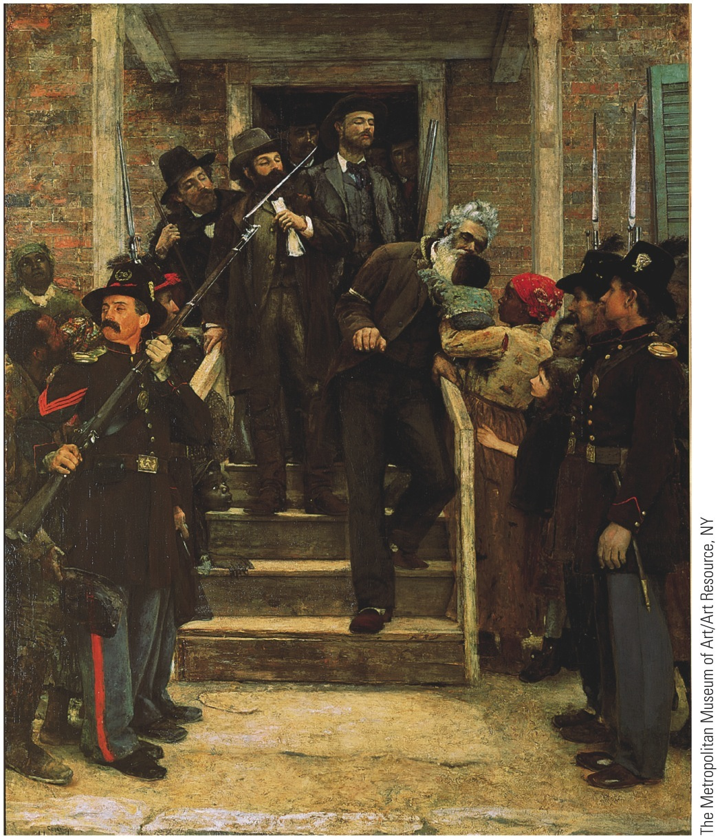
John Brown: Murderer or Martyr?
Studied tactics of black rebels Toussaint L'Ouverture (Chap. 11) and Nat Turner (Chap. 16)
Hatched scheme to invade South secretly:
Then call upon slaves to rebel and furnish them with arms
Establish a black free state as a sanctuary
Harpers Ferry:
Brown seized federal arsenal in October 1859
Killed seven innocent people (incl. a free black)
Injured ten or so more
Slaves failed to rise up
Brown and his remnants captured by U.S. Marines under Robert E. Lee:
Convicted of murder and treason
Marched up scaffold steps without flinching
Devotion to freedom so inflexible, he took on exalted character
Effects of Harper Ferry were inflammatory:
To South, Brown a murderer and an apostle of treason
Assumed entire North was “Brown-loving” Republicans
Moderate northerners and Republican leaders deplored Brown's actions
Abolitionists and ardent free-soilers infuriated by Brown's execution
Free-soil centers in North tolled bells, fired guns, lowered flags, and held rallies
Ghost of martyred Brown would not be laid to rest

Slide 24
XII. The Disruption of the Democrats
Presidential election of 1860 was most fateful in American history:
Democrats met in Charleston, South Carolina:
Douglas leading candidate of northern wing
Southern wing regarded him as traitor because of Lecompton Constitution and Freeport Doctrine
Cotton state delegates walked out
Remaining delegates disbanded after unable to generate enough votes to nominate Douglas
First tragic secession was secession of southerners from Democratic National Convention:
Departure became habit-forming
Democrats tried again in Baltimore:
Douglas Democrats firmly in control
After cotton-state delegates again withdrew, rest of delegates enthusiastically nominated Douglas
Platform came out squarely:
For popular sovereignty
Against obstruction of Fugitive Slave Law by states
Southern Democrats then selected John Breckinridge as their candidate:
Platform favored extension of slavery into territories and annexation of slave-populated Cuba

Slide 25
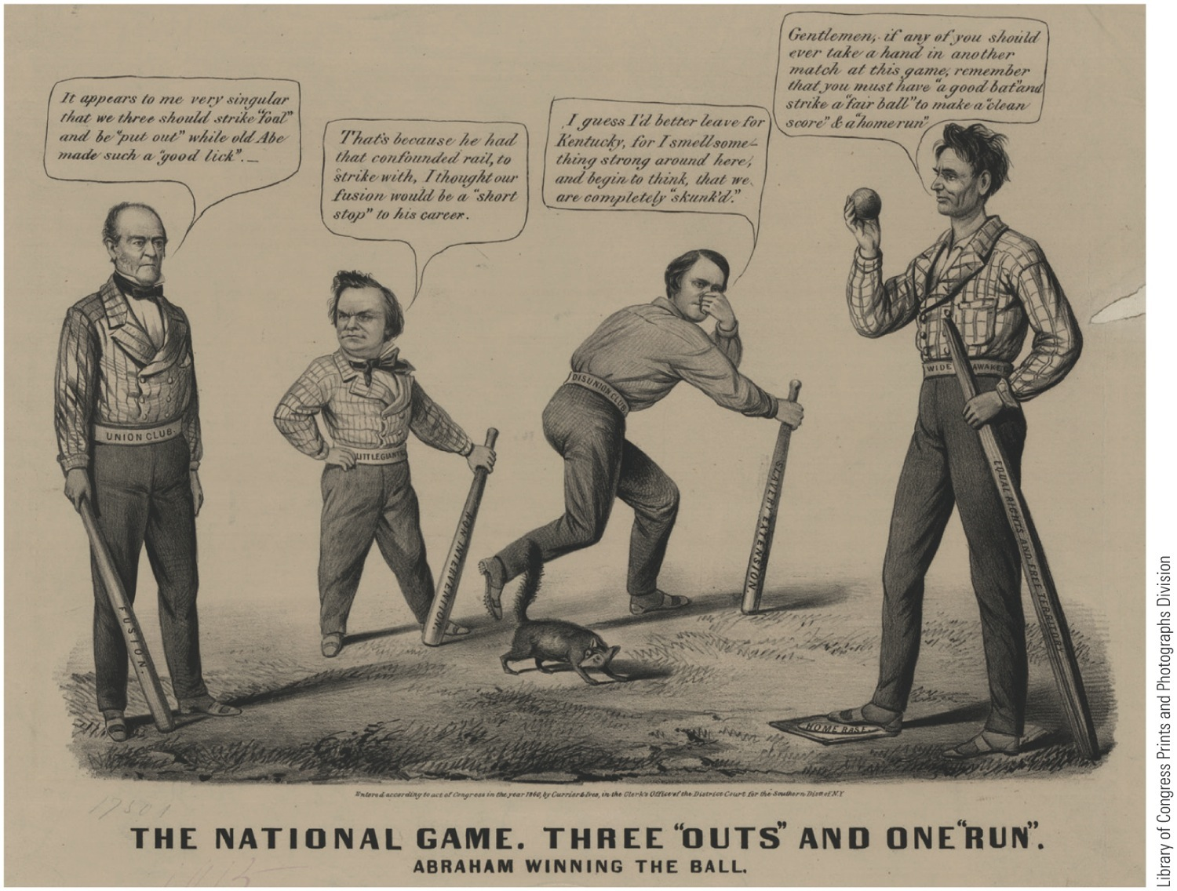
p413
Notes:
Lincoln Hits a Home Run in 1860 Currier & Ives, the producer of popular, inexpensive
prints, portrayed Lincoln’s victory over (from left to right) John Bell, Stephen
Douglas, and John C. Breckinridge as a baseball game. Baseball developed in New
York in the 1840s, and by 1860 the National Association of Baseball Players boasted
fifty clubs, several playing regular schedules and charging admission. This cartoon is
thought to be the first time baseball was used as a metaphor for politics. Note that
Lincoln is beardless. By February 1861, when he left Springfield, Illinois, by train for the
White House, he was fully bearded, having followed the advice of an eleven-year-old
girl from Westfield, New York, who urged him to grow whiskers because “you would
look a great deal better for your face is so thin.”

Slide 26
XIII. A Rail-Splitter Splits the Union
Republicans met in Chicago:
William Seward was best known candidate:
“Irrepressible conflict” speech at Rochester 1858 ruined his prospects
Enemies' slogan, “Success Rather Than Steward”
Lincoln of Illinois:
“Second Best,” but a strong candidate because had fewer enemies
Overtook Seward on third ballot to gain nomination
Platform made appeal to every nonsouthern group:
For free-soilers, nonextension of slavery
For northern manufacturers, a protective tariff
For immigrants, no abridgment of rights
For Northwest, a Pacific railroad
For West, internal improvements at federal expense
For farmers, free homesteads from public domain
Southern secessionists called Lincoln “abolitionist” rail-splitter who would split Union
Lincoln hated slavery, but he was no outright abolitionist
Lincoln enthusiasts staged roaring rallies and parades
Douglas waged vigorous speaking campaign
Returns proclaimed sweeping victory for Lincoln (see Table 19.1)

Slide 27
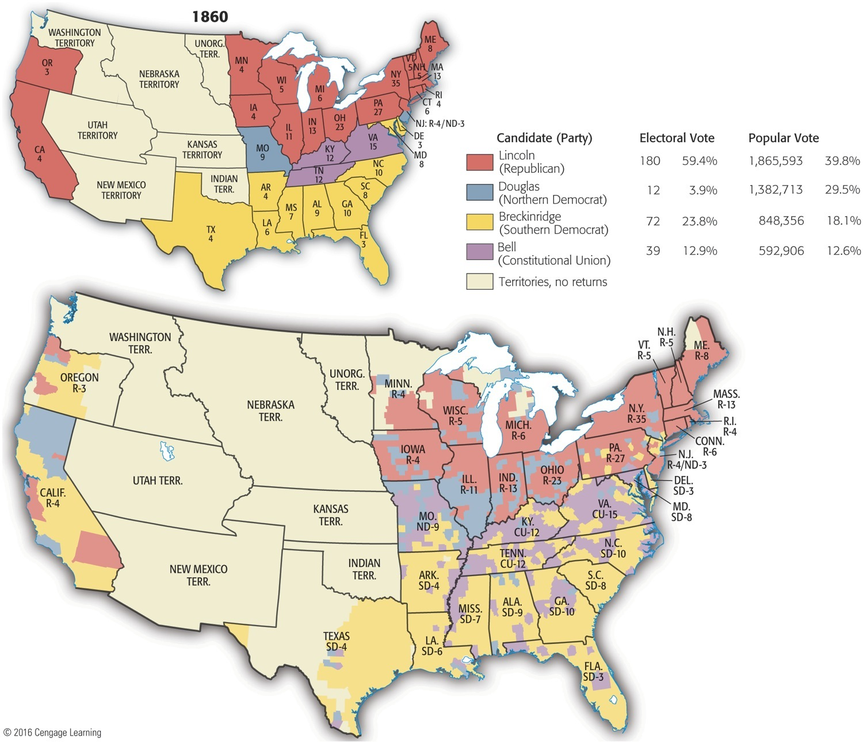
Map 19-3 p414
Notes:
Map 19.3 Presidential Election of 1860: Electoral Vote by State (top) and Popular Vote by
County (bottom) It is a surprising fact that Lincoln, often rated among the greatest presidents,
ranks near the bottom in percentage of popular votes. In all the eleven states that seceded, he
received only a scattering of one state’s votes—about 1.5 percent in Virginia. The vote by county for
Lincoln was virtually all cast in the North. The northern Democrat, Douglas, was also nearly shut out
in the South, which divided its votes between Breckinridge and Bell. (Note that only citizens of states
could vote; inhabitants of territories could not.) © 2016 Cengage Learning

Slide 28
XIV. The Electoral Upheaval of 1860
Lincoln a minority president:
60% of voters preferred someone else
Lincoln a sectional president:
In ten southern states, not on ballot
Election of 1860 was virtually two elections: one for North and one for South (see Map 19.3)
South Carolina rejoiced over Lincoln's victory; they now had excuse to secede
Douglas won only twelve electoral votes:
Campaigned energetically for himself
Douglas and Breckinridge together amassed 365,476 more votes than did Lincoln
Ballot box did not indicate strong sentiment for secession (see Map 19.4)
Breckinridge polled fewer votes in slave states than combined strength of Douglas and Bell
Breckinridge failed to carry his own state of Kentucky
Even though Republicans had elected Lincoln:
They controlled neither Senate nor House
South had 5-4 majority on Supreme Court
U.S. government could not touch slavery in slave states, except by constitutional amendment, which slave states could easily block

Slide 29
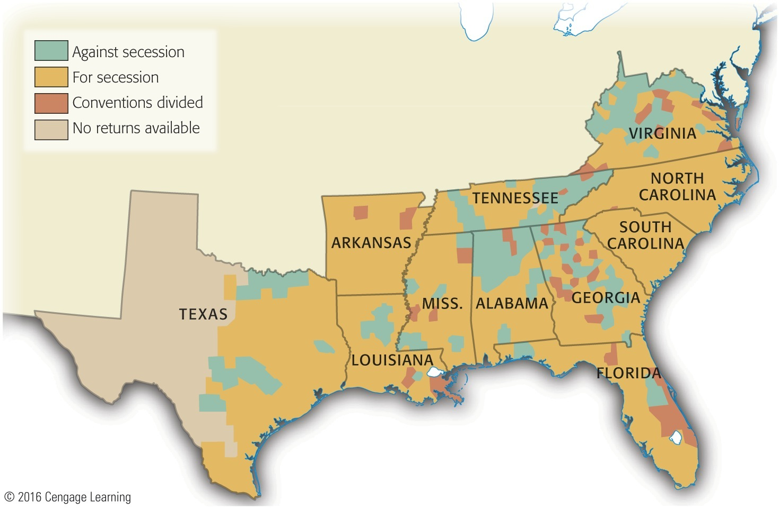
Map 19-4 p415
Notes:
Map 19.4 Southern Opposition
to Secession, 1860–1861 (showing
vote by county) This county
vote shows the opposition of the
antiplanter, antislavery mountain
whites in the Appalachian region.
There was also considerable resistance
to secession in Texas, where
Governor Sam Houston, who led
the Unionists, was deposed by
secessionists. © 2016 Cengage Learning

Slide 30
XIV. The Electoral Upheaval of 1860
Hot passions, not cool reason, began to drive events
South Carolina had threatened to secede if “sectional” Lincoln won:
Four days after election, S.C. called a special convention
Meeting in Charleston, December 1860, convention voted unanimously to secede
Action set off chain reaction of secession
Crittenden amendments to Constitution:
Sponsored by Senator John Jordan Crittenden (Kentucky) to appease South
Slavery in territories north of 36° 30' line banned, but south of line, it would be federally protected in all territories existing or “hereafter to be acquired”
Future states could come into Union with or without slavery as they choose
Slavery supporters guaranteed full rights in southern territories regardless of popular sovereignty during territorial period
Lincoln flatly rejected Crittenden scheme
Elected on platform that opposed extension of slavery, Lincoln felt he could not yield, even if slavery gains might only to be temporary

Slide 31
XVI. The Secessionist Exodus
As Crittenden Compromise failed in early 1861, six more southern states voted to secede:
Alabama, Mississippi, Florida, Georgia, Louisiana, Texas
Four more would join later, bringing total to eleven
Confederate States of America:
Formed by seven seceding states in Montgomery, Alabama in February 1861:
Chose Jefferson Davis as their president
Crisis deepened by “lame duck” interlude:
Lincoln could not take office until March 4, 1861
During this time, secessionist move gained momentum
Buchanan blamed for not holding nation together
He did not believe southern states could legally secede
He could find no authority in Constitution for stopping secession by force

Slide 32
Farewell to Union
Secessionists left for a number of reasons, most related to slavery:
Threatened by North's “despotic majority of numbers”
Dismayed by triumph of Republican party
Weary of free-soil criticism, abolitionist nagging, and Northern interference ranging from Underground Railroad to John Brown's raid
Supported secession because sure departure would be unopposed
Saw secession as golden opportunity to cast aside generations of “vassalage” to North
An independent Dixieland could develop its own banking and shipping and trade directly with Europe
Who could tell when “greedy” Republicans would pass oppressive protective tariff?
Tensions for decades between:
North with its manufacturing plants
South with its agricultural exports
Worldwide impulses of nationalism fermenting in South
Principles of self-determination from Declaration of Independence—seemed to many southerners to apply

Slide 33
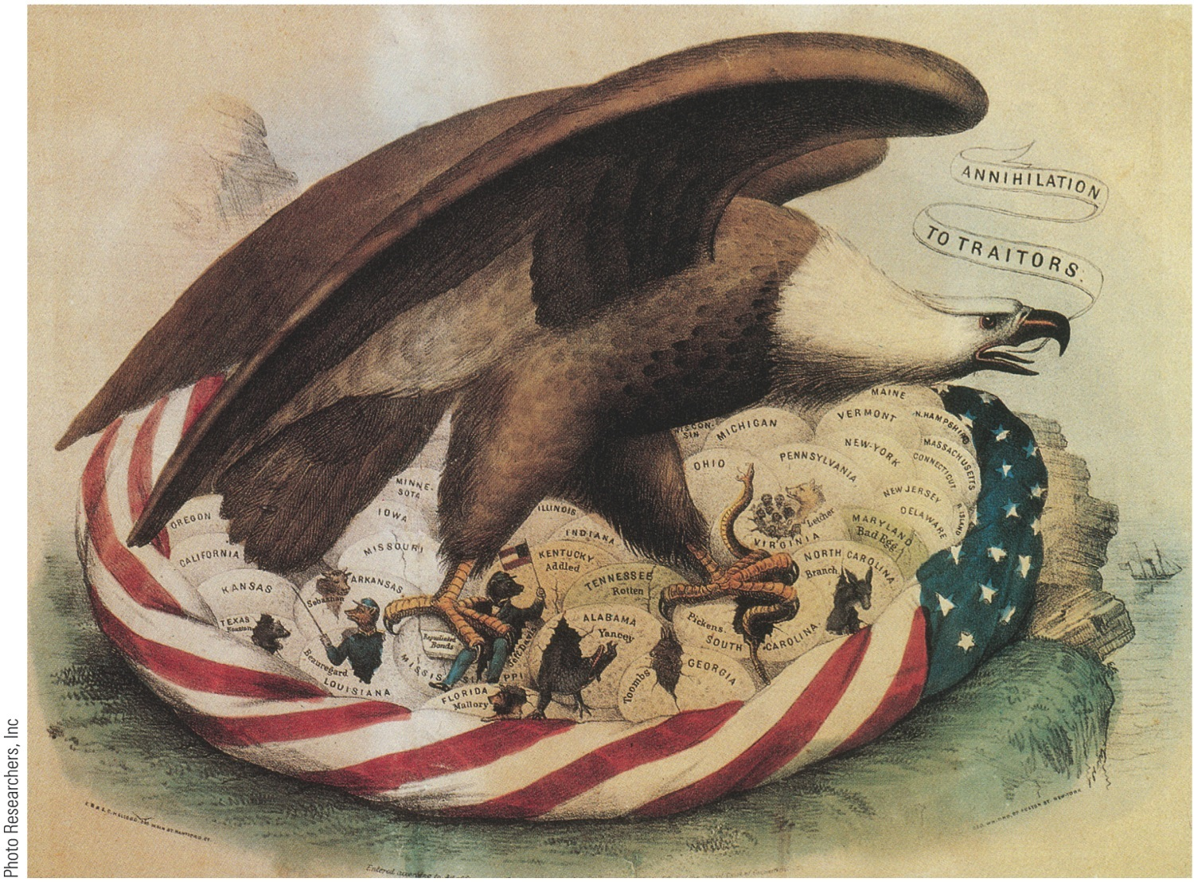
XVII. Farewell to Union
Few southern states felt they were doing anything wrong or immoral
Historical parallel ran even deeper:
1776: thirteen American colonies, led by rebel George Washington, seceded from British empire by throwing off yoke of King George III
1860-1861: eleven American states, led by rebel Jefferson Davis, were seceding from Union by throwing off yoke of “King” Abraham Lincoln
With Union burden gone, South confident that it could work out its own peculiar destiny more quietly, happily, and prosperously

Slide 34
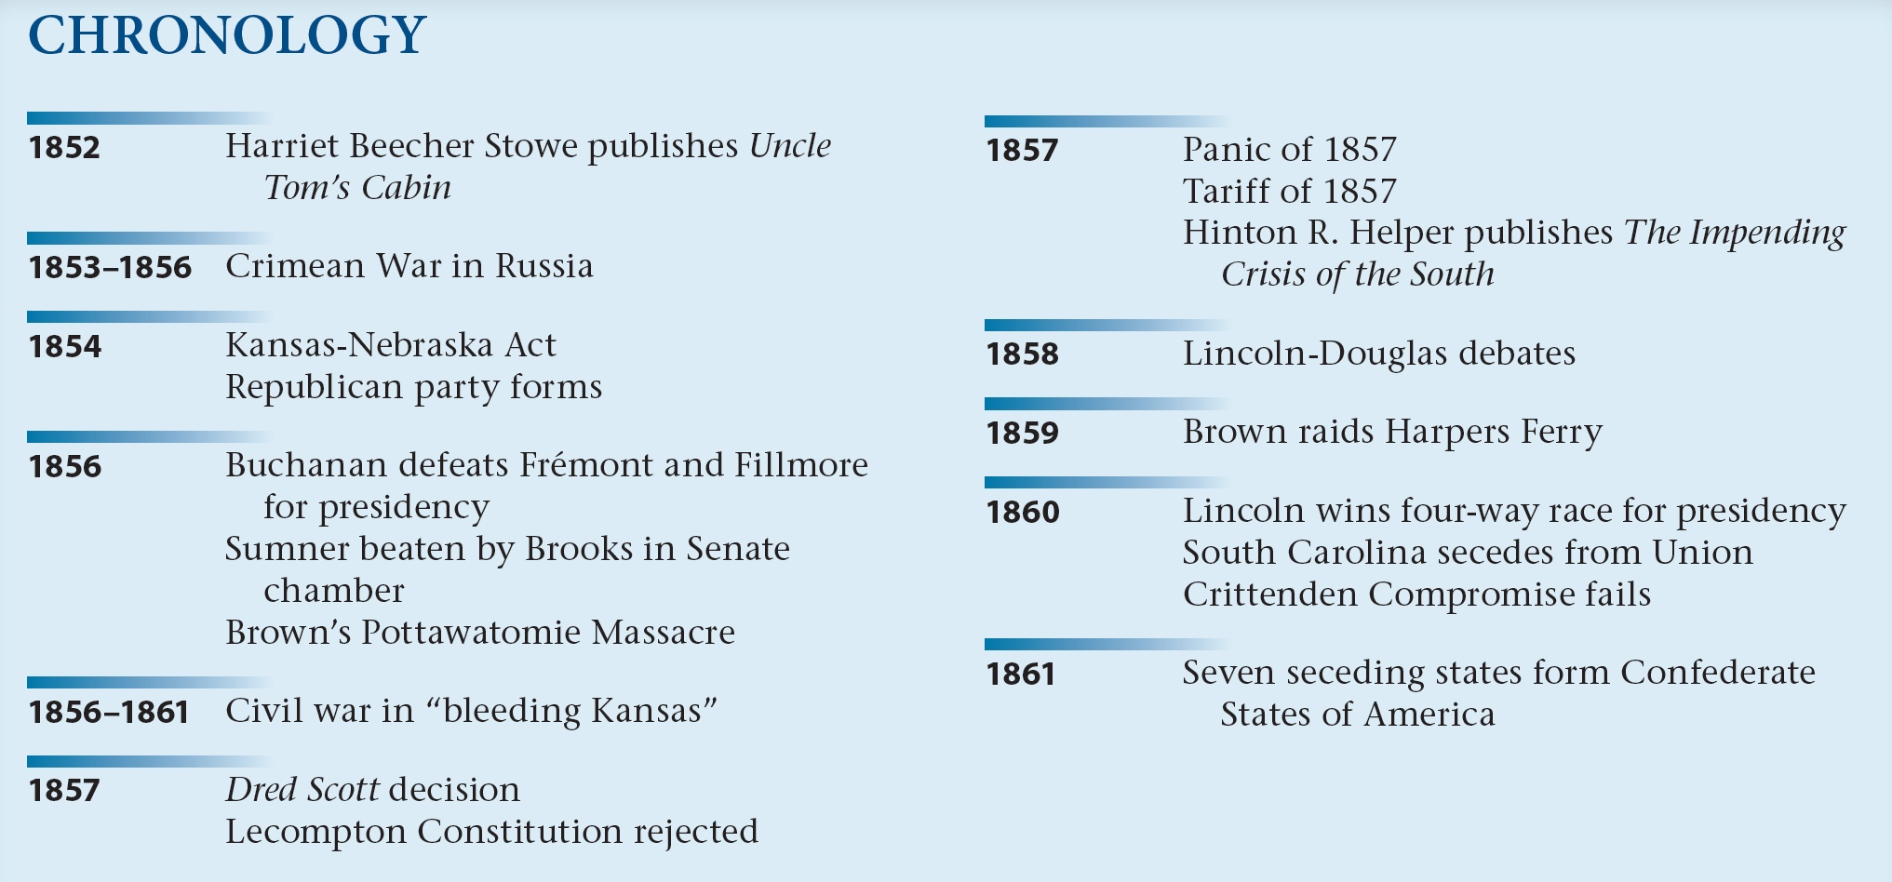
p420

