Slide 1
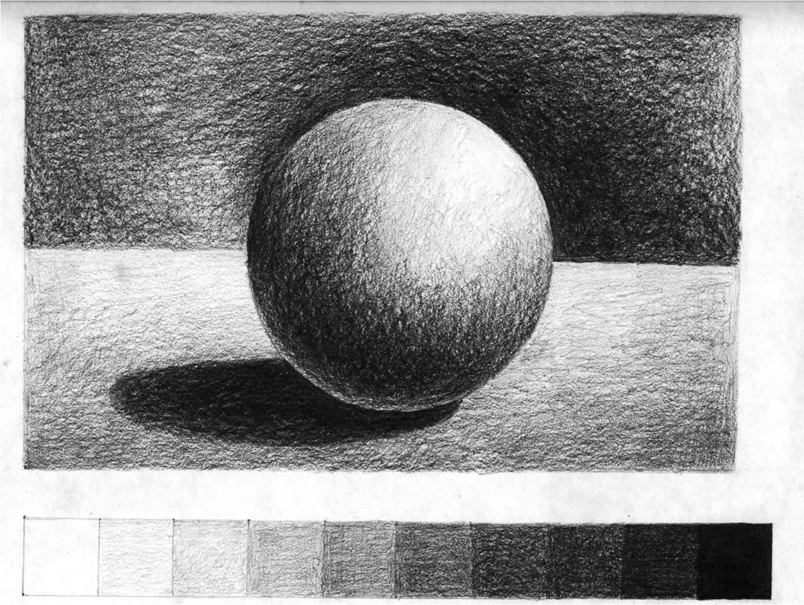

Slide 2
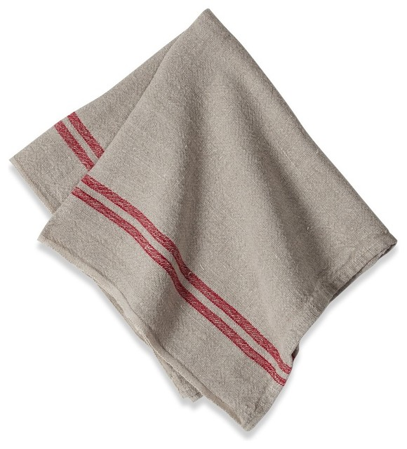

Slide 3
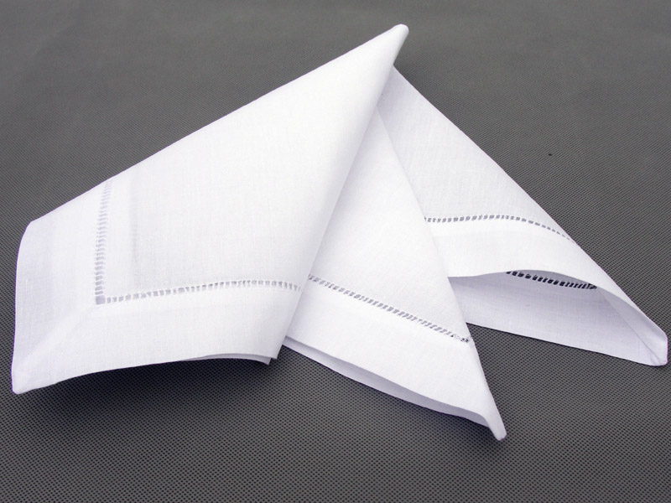

Slide 4
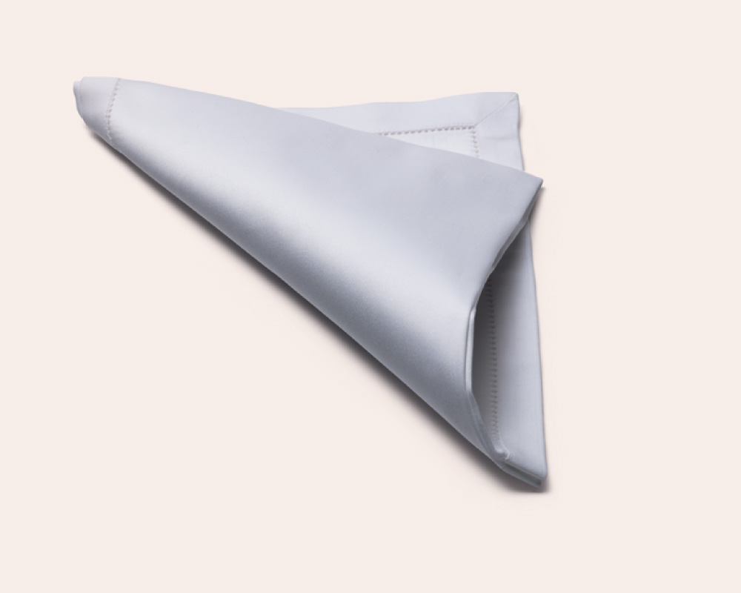

Slide 5
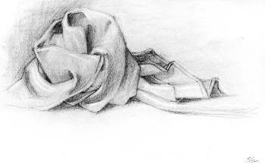

Slide 6
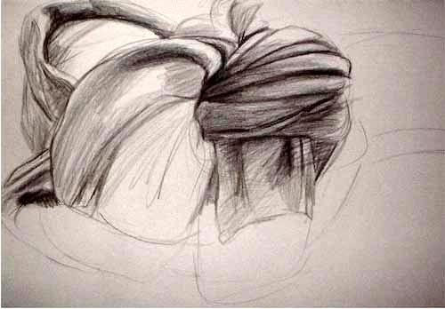

Slide 7
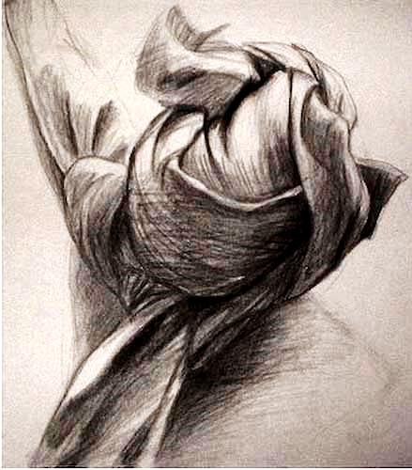

Slide 8
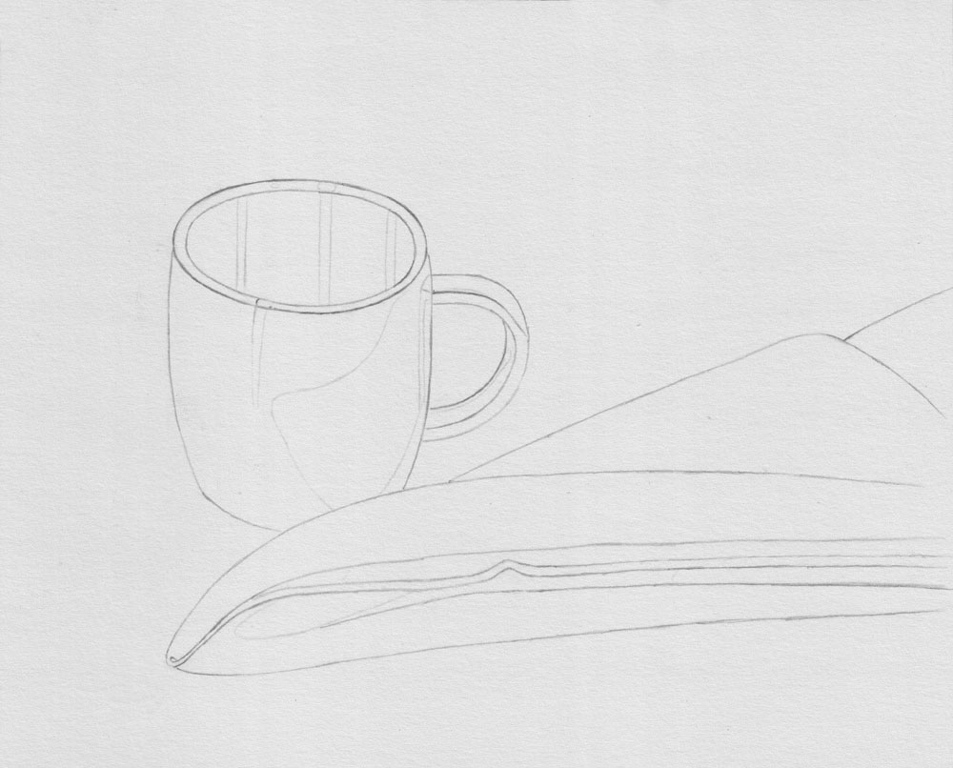

Slide 9
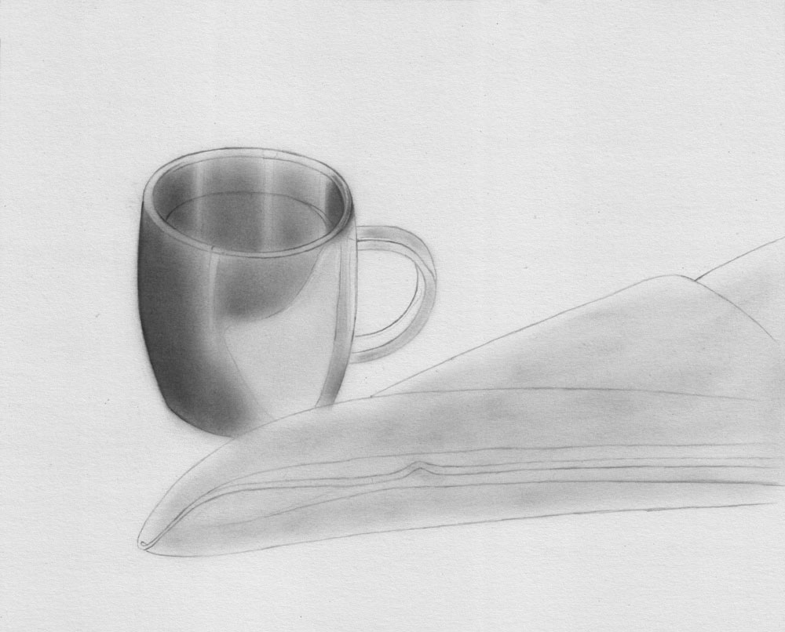

Slide 10
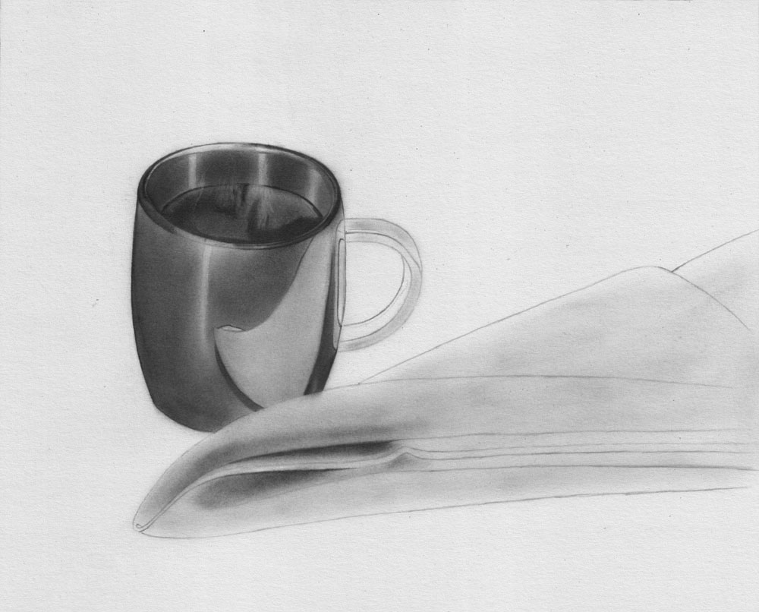

Slide 11
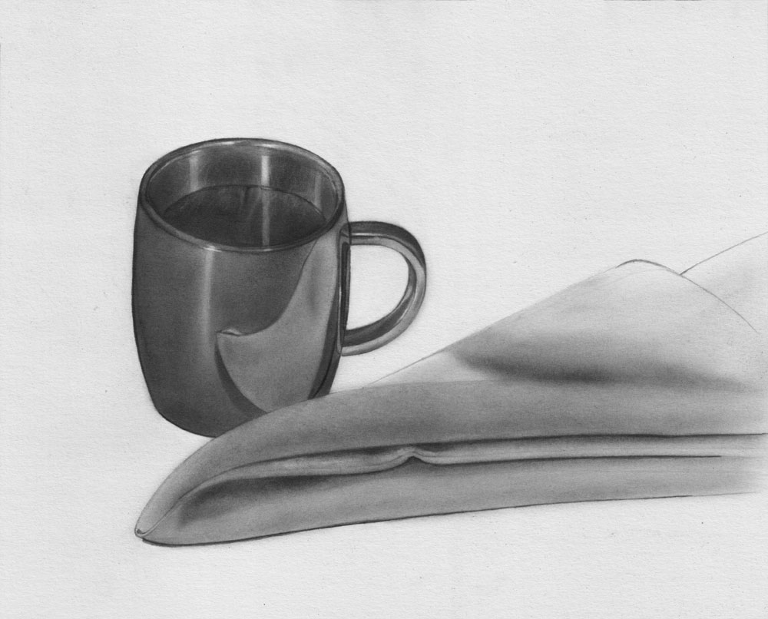

Slide 12
Criteria Assessed
Research/recording into a variety of compositions through thumbnail sketches
Photographs of the napkin where lighting/composition are considered
Images that are not used should be commented on through “printed screen” images with annotations
One outline recording of the napkin of the chosen photograph with some filled in values/shading in charcoal – annotations should be made along the way discussing future considerations
Zoom-in to areas of the napkin on 1 page in your sketchbook to practise anticipated challenges in shading
ONE FINAL ARTWORK completed in charcoal:
Values & highlighted areas
Relationship to original photograph
Position of the napkin on the page with consideration of the surrounding space – including 1-2 areas that may “spill off the page”
Sit shadows and/or ground lines
Use of charcoal medium:
Light lines applied with vine charcoal for placement of napkin
Use of blending with either brush/ear-bud/cotton-wool/blending stump
Use of eraser to develop highlights
Use of dark, compressed charcoal to identify areas with more detail
You may choose to allow some parts of the napkin to trail off and stay unfinished, but you must carefully decide which areas you want to use as a focus and to ensure that some areas are highly developed/realistic
Final reflection discussing improvements/developments/areas of concern/success/etc

