Slide 1
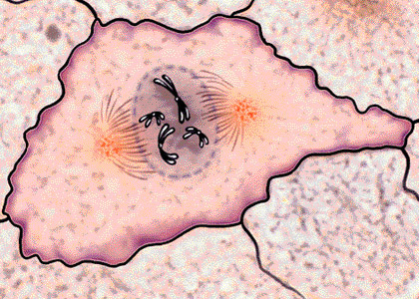
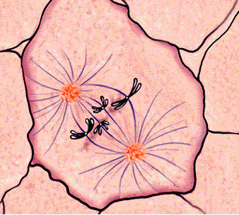
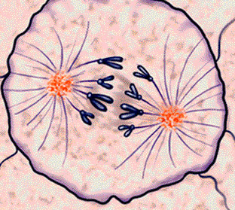
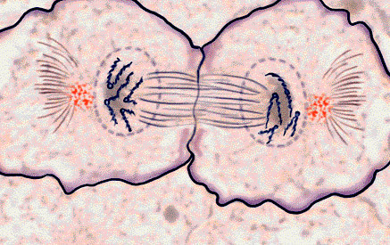
Mitosis

Slide 2
Mitosis

Slide 3
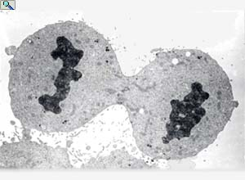
Any time new cells are required, mitosis is required:
Growth: | Multicellular organisms increase their size by increasing their number of cells through mitosis
Asexual reproduction: | Certain eukaryotic organisms may reproduce asexually by mitosis (e.g. vegetative reproduction)
Tissue Repair: | Damaged tissue can recover by replacing dead or damaged cells
Embryonic development: | A fertilised egg (zygote) will undergo mitosis and differentiation in order to develop into an embryo
http://www.haroldsmithlab.com/images/pg_HeLa_cell_division.jpg

Slide 4
What is a Chromosome?

Slide 6
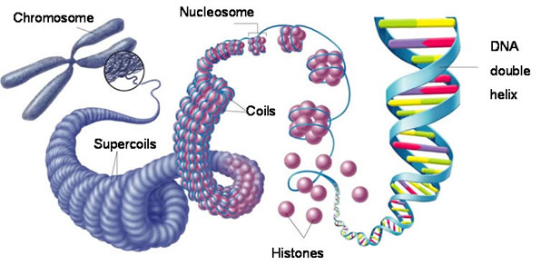
What is a Chromosome?

Slide 7
What is a Chromosome?
Video Link

Slide 8
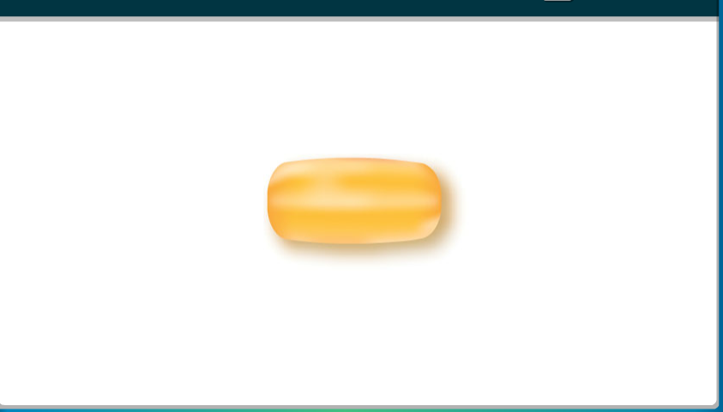
Cell Division - Prokaryotes
Binary Fission

Slide 9
Eukaryotic - Mitosis
Is the division of the cell’s nucleus.
Cells under go mitosis for a number of reasons including:
Growth and repair
Increased efficiency (Surface to volume ratio)
Better communications with the cell
Mitosis is apart of the cell’s life cycle

Slide 10
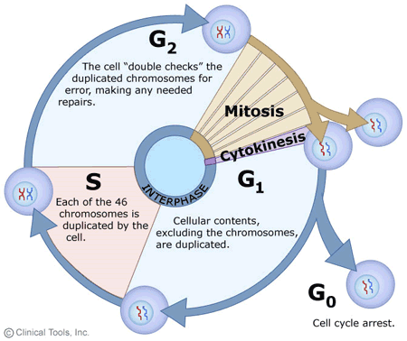
G₁ - Growth, normal
activities.
S – DNA replication
G₂ – Preps for mitosis
M - Mitosis
G₀ – Cell that is no longer dividing

Slide 11
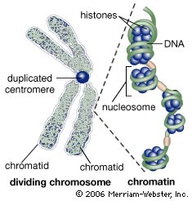
All the confusing C words…
Chromatin → Chromatid → Chromosome

Slide 12
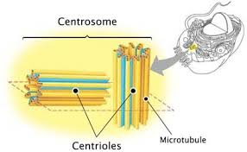
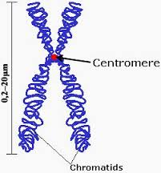
All the confusing C words…
Centrioles vs. Centrosomes vs. Centromere
Only in Animal Cells

Slide 13
Interphase

Slide 14
Interphase
Chromatin
Centrioles
Nucleolus
Nucleus

Slide 15
Interphase
Interphase is not a part of mitosis.
During interphase:
Metabolic reactions occur (ie respiration)
the cell’s DNA replicates
The centrioles replicate.
Interphase is divided into three phases:
G₁ when growth and normal activities occur
S when the cell’s DNA is replicated
G₂ when the cell prepares for division

Slide 16
Interphase

Slide 17
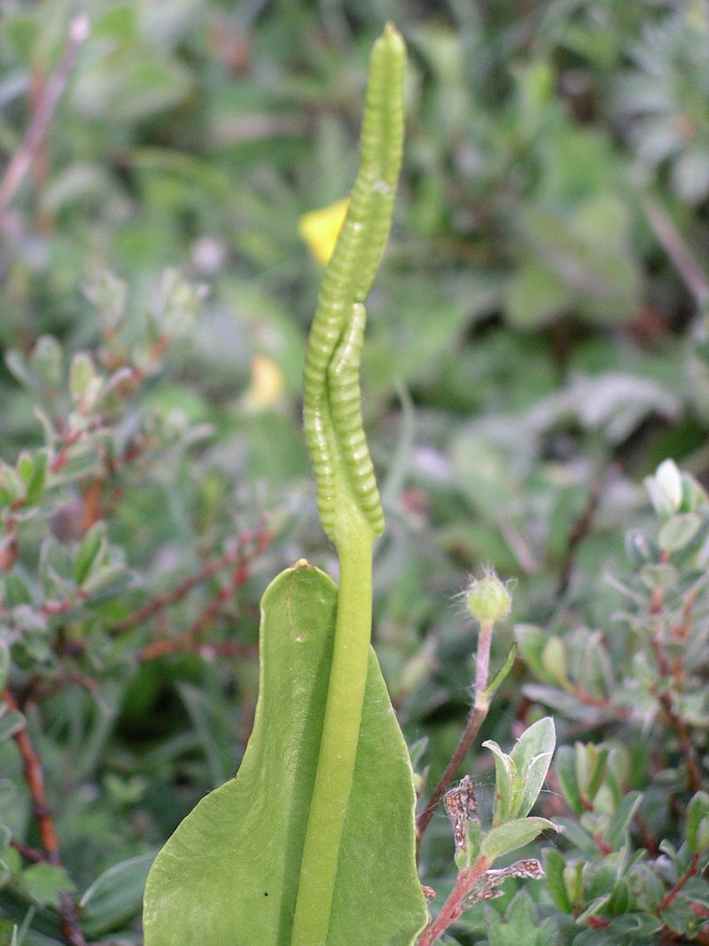
Chromosomes
Made of Chromatin that coils into a condensed chromosome
Naturally occur in pairs
Pairs are identical
Humans – 23 pairs of Chromosomes
Earthworm – 36 pairs of chromosomes
Adders-tongue – 630 pairs → → →

Slide 18
Prophase

Slide 19
Early Prophase
Chromosomes begin to condense or super coil.
Microtubules Organizing Centers (MTOC) begin building spindle fibers (varies by phyla – Centrosomes/Centrioles in animal cells)

Slide 20
Middle Prophase
Centrioles migrate to the poles.
Spindle fibers forming.
The nuclear membrane is breaking up.

Slide 21
Late Prophase
Centrioles at the poles.
Asters form in animals, but not plants.
Spindle fibers formed.
Chromatids moving towards the equatorial plate.

Slide 22
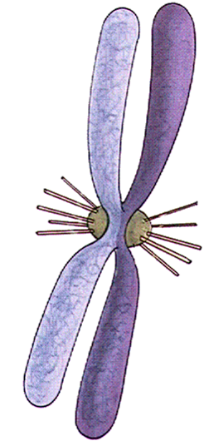
During prophase the DNA is now visible as chromosomes.

Slide 23
Sister Chromatids
Centromere
Spindle fiber

Slide 24
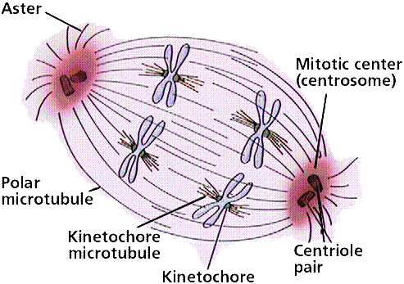

Slide 25
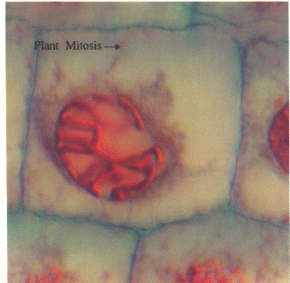
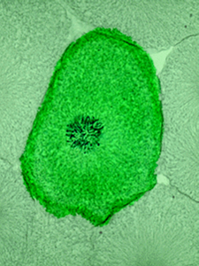
Plant & Animal Cells

Slide 26
Metaphase

Slide 27
Metaphase
Chromosome are now at the equatorial plate.
Microtubules attach to Centromere
Contraction of microtubules causes chromosomes to line up.

Slide 28
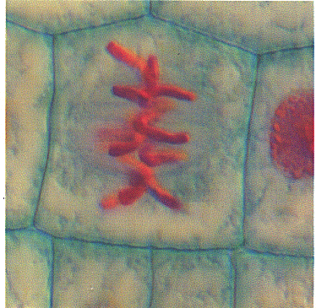
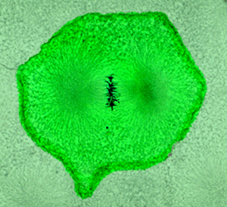
Plant & Animal Cells

Slide 29
Anaphase

Slide 30
Anaphase
Microtubules contract separating sister chromatids
Sisters start moving toward opposite poles.
As they separate they are now called daughter chromosomes.

Slide 31
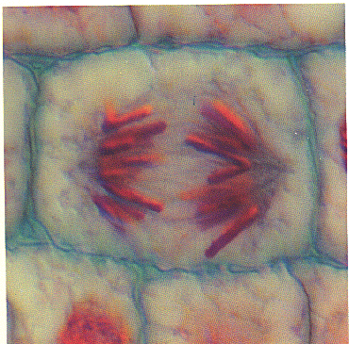
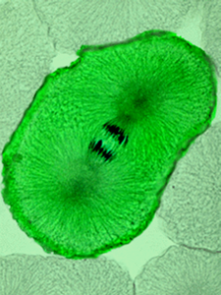
Plant & Animal Cells

Slide 32
Telophase

Slide 33
Telophase
Now the nuclear membrane begins to reform.
Chromosomes uncoil.
Spindles disappear.
Cytokinesis begins.

Slide 34
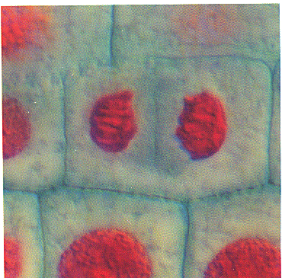
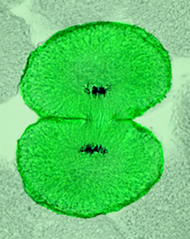
Plant & Animal Cells

Slide 35
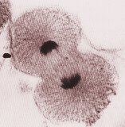
Cytokinesis
Is the division of the cytoplasm.
Animal cells do so by forming a cleavage furrow.
Plants form a cell plate.

Slide 36
Cell Plate Formation

Slide 37
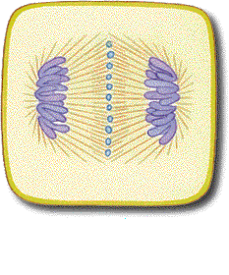
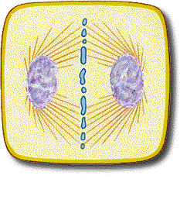
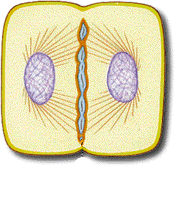
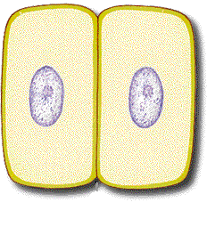

Slide 38
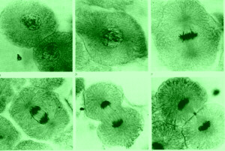

Slide 39
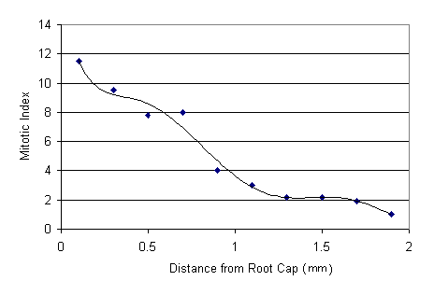
Mitotic Index
Ratio of (# cells in mitosis/total # cells)
Rapidly growing areas will have higher mitotic index.

Slide 40
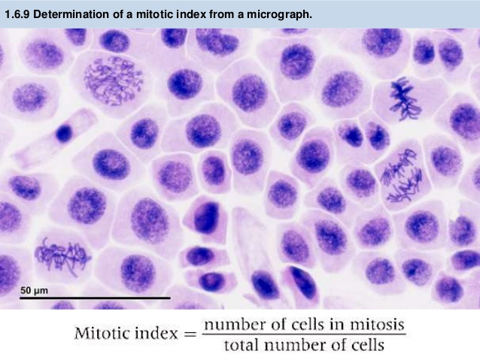

Slide 41
Mitotic Index
Can be used to diagnose cancer.
Cancerous tissue will have higher Mis than normal tissue

Slide 42
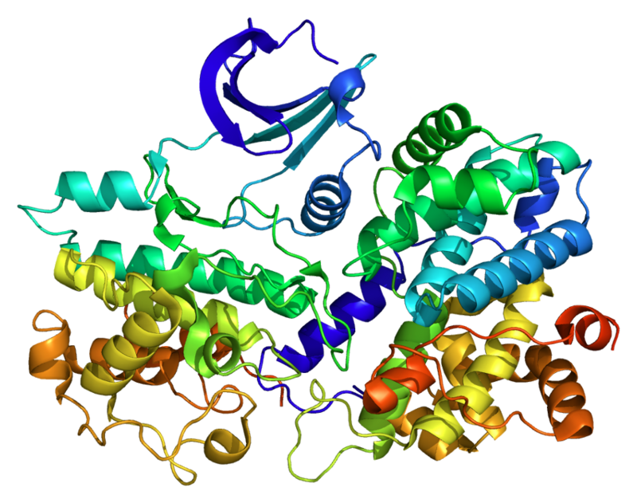
1.6.U5 Cyclins are involved in the control of the cell cycle.
Cyclins are a family of proteins that control the progression of cells through the cell cycle
1
Cells cannot progress to the next stage of the cell cycle unless the specific cyclin reaches it threshold.
2
Cyclins bind to enzymes called cyclin-dependent kinases
3
These kinases then become active and attach phosphate groups to other proteins in the cell.
4
The attachment of phosphate triggers the other proteins to become active and carry out tasks (specific to one of the phases of the cell cycle).
http://upload.wikimedia.org/wikipedia/commons/thumb/9/99/Protein_CCNE1_PDB_1w98.png/800px-Protein_CCNE1_PDB_1w98.png

Slide 43
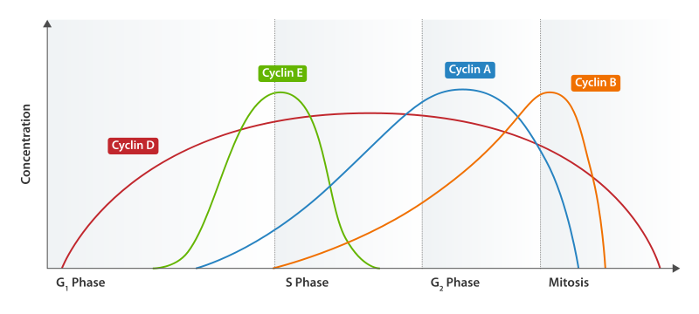
1.6.U5 Cyclins are involved in the control of the cell cycle.
Progression through parts of the cell cycle are affected in various ways by specific cyclins
prepares the cell for DNA replication in S phase.
activates DNA replication inside the nucleus in S phase.
promotes the assembly of the mitotic spindle and other tasks in the cytoplasm to prepare for mitosis.
Triggers cells to move from G0 to G1 and from G1 into S phase.
http://upload.wikimedia.org/wikipedia/commons/thumb/9/99/Protein_CCNE1_PDB_1w98.png/800px-Protein_CCNE1_PDB_1w98.png

Slide 44
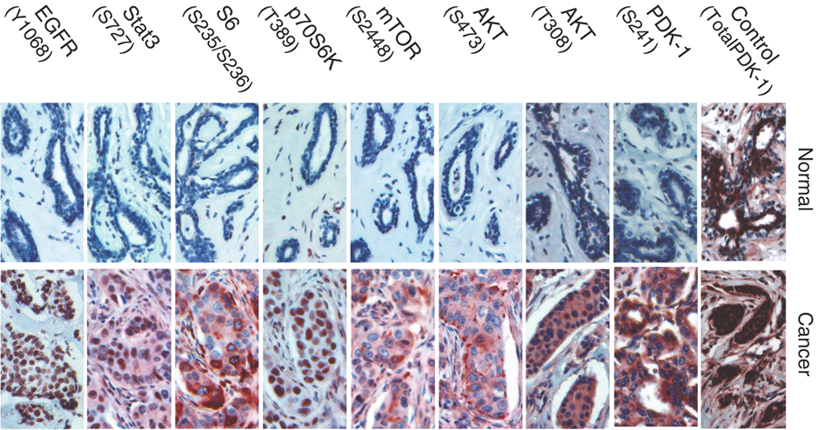
1.6.U6 Mutagens, oncogenes and metastasis are involved in the development of primary and secondary tumours.
Tumours are abnormal growth of tissue that develop at any stage of life in any part of the body. A cancer is a malignant tumour and is named after the part of the body where the cancer (primary tumour) first develops.

Slide 45
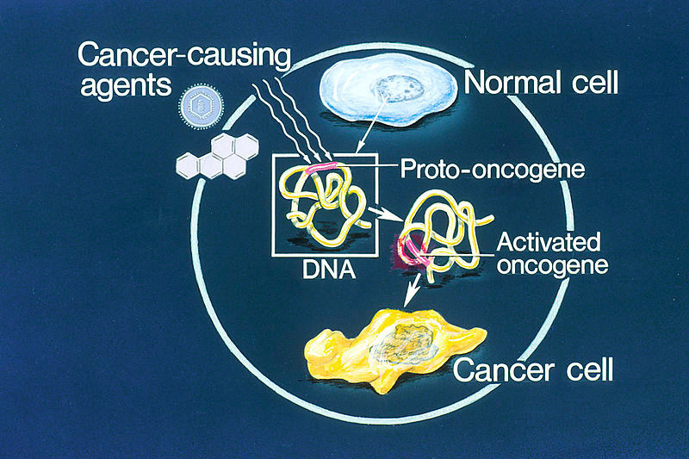
Mutagens and Mutations
A mutation is a change in an organisms genetic code. A mutation/change in the base sequence of a certain genes can result in cancer.
Mutagens are agents that cause gene mutations. Not all mutations result in cancers, but anything that causes a mutation has the potential to cause a cancer.
Mutagens can be:
chemicals that cause mutations are referred to as carcinogens
high energy radiation such as X-rays
short-wave ultraviolet light
Some viruses
http://en.wikipedia.org/wiki/Oncogene#mediaviewer/File:Oncogenes_illustration.jpg

Slide 46
Mutagens and Mutations
If a mutation occurs in an oncogenes it can become cancerous. In normal cells oncogenes control of the cell cycle and cell division.
mutation in a oncogene
malfunction in the control of the cell cycle
uncontrolled cell division
tumour formation
http://en.wikipedia.org/wiki/Oncogene#mediaviewer/File:Oncogenes_illustration.jpg

Slide 47
1.6.U6 Mutagens, oncogenes and metastasis are involved in the development of primary and secondary tumours.
Several mutations must occur in the same cell for it to become a tumour causing cell. The probability of this happening in a single cell is extremely small.
Factors (other than exposure to mutagens) that increase the probability of tumour development include:
the greater the number of cells the greater the chance of a mutation.
The longer a life span the greater the chance of a mutation.
http://en.wikipedia.org/wiki/Oncogene#mediaviewer/File:Oncogenes_illustration.jpg

Slide 48
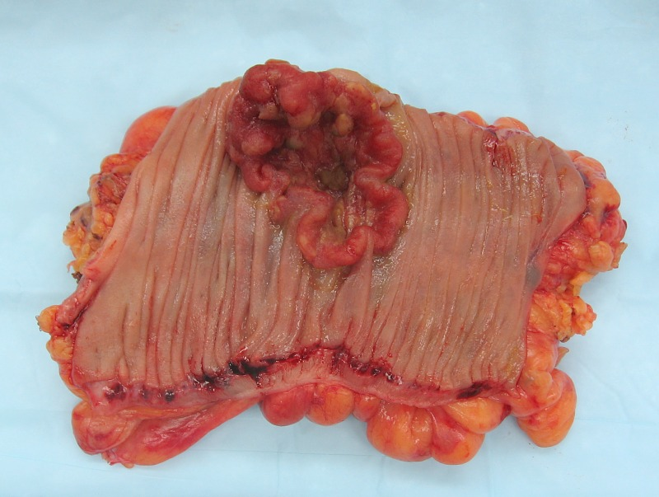
Metastasis
The development of a primary tumours (cancers) have been outlined. Below is how a primary tumor can become a secondary tumour.
A primary tumor is a malignant tumor growing at the site where the abnormal growth first occurred.
Cancerous cells can detach from the primary tumour.
http://en.wikipedia.org/wiki/Neoplasm#mediaviewer/File:Colon_cancer_2.jpg

Slide 49
Metastasis
The development of a primary tumours (cancers) have been outlined. Below is how a primary tumor can become a secondary tumour.
The circulating cancerous cells invade tissues at a different locations and develop into secondary tumours.
Some cancerous cells gain the ability to penetrate the walls of lymph or blood vessels and hence circulate around the body
http://en.wikipedia.org/wiki/Neoplasm#mediaviewer/File:Colon_cancer_2.jpg

Slide 50
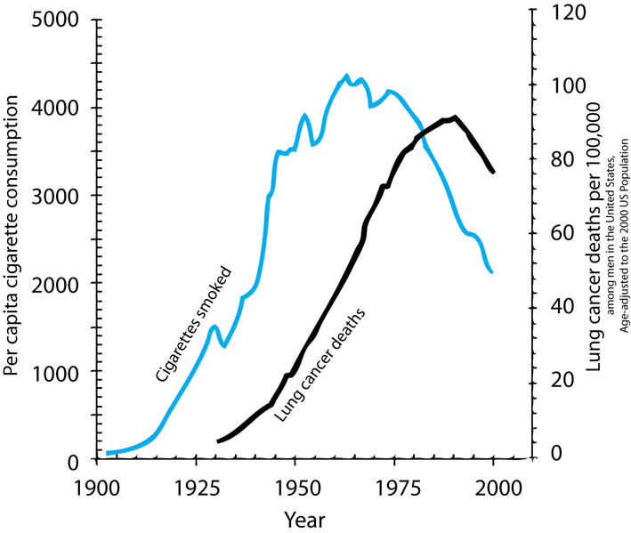
1.6.A1 The correlation between smoking and incidence of cancers.
Along with lung cancer, cancers of mouth and throat are very common as these areas are in direct contact with the smoke too. It might surprise you that the following cancers are also more common in smokers:
Head and neck
Bladder
Kidneys
Breast
Pancreas
Colon
Describe the relationship shown.
What type of correlation is shown
How strong is the correlation? Justify your answer by discussing the evidence.
The correlation shown here is lagged. A lag is a time gap between the factors. Estimate the size of the lag between cigarette consumption and lung cancer death.
http://en.wikipedia.org/wiki/File:Smoking_lung_cancer.png

Slide 51
1.6.A1 The correlation between smoking and incidence of cancers.
Correlation ≠ causation, however laboratory investigations have found:
more then 20 chemicals found in tobacco have caused cancers in laboratory animals and/or humans
More than 40 other chemicals found in tobacco have been identified as carcinogens
Describe the relationship shown.
What type of correlation is shown
How strong is the correlation? Justify your answer by discussing the evidence.
The correlation shown here is lagged. A lag is a time gap between the factors. Estimate the size of the lag between cigarette consumption and lung cancer death.
http://en.wikipedia.org/wiki/File:Smoking_lung_cancer.png

Slide 52
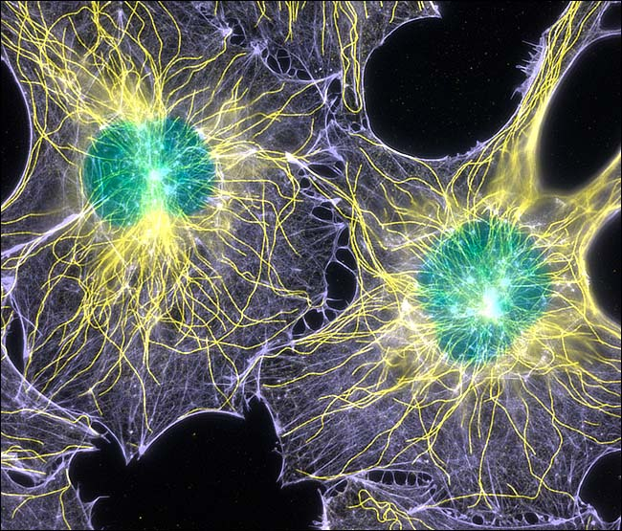
The End

