Slide 1
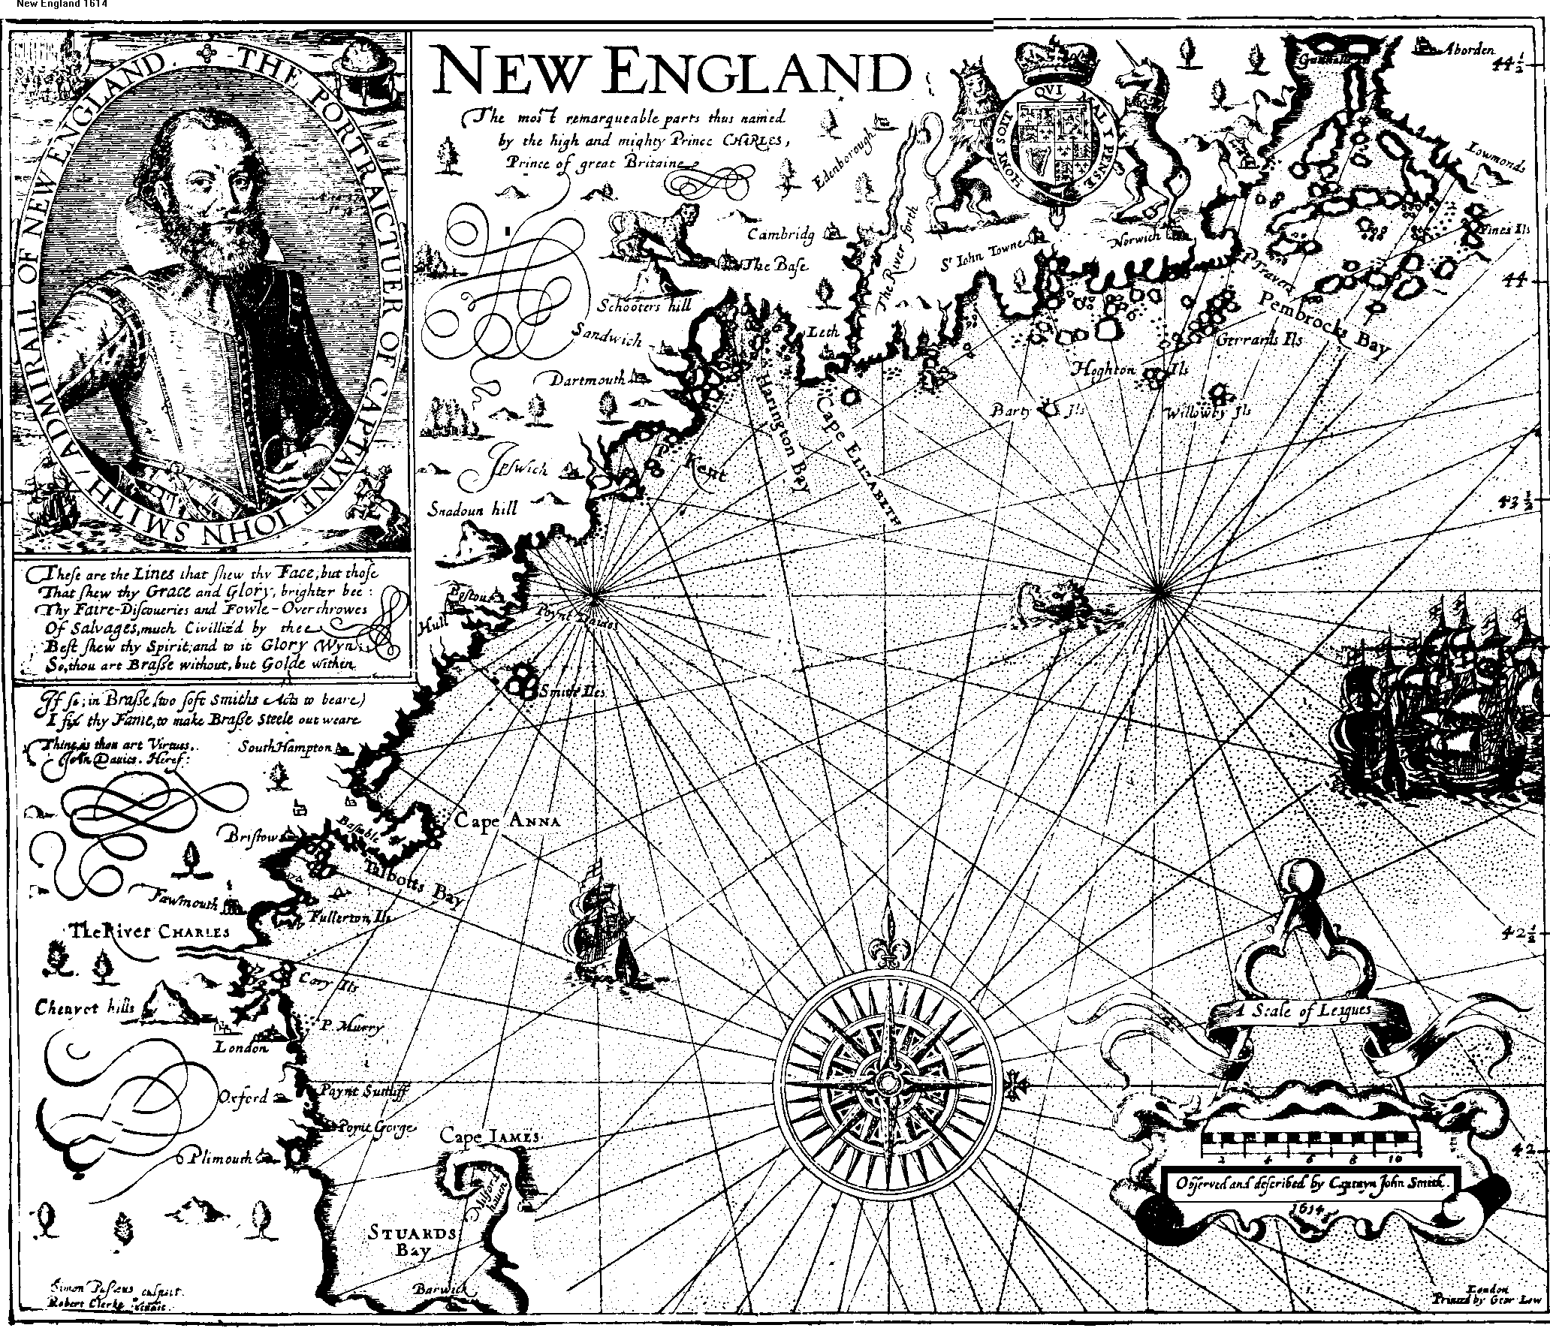

Slide 2
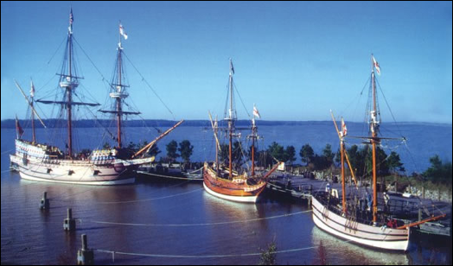
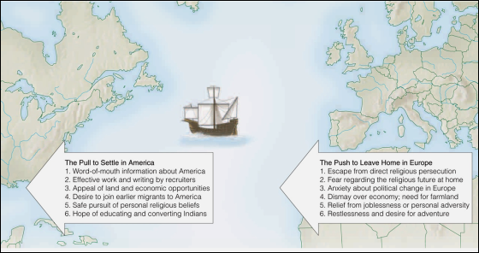

Slide 3
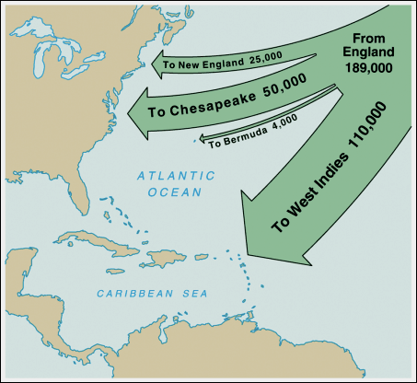

Slide 4
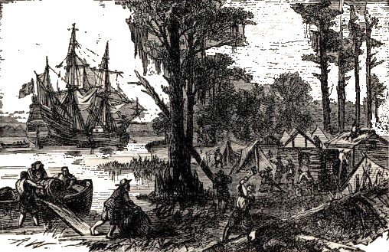
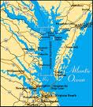
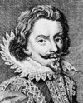
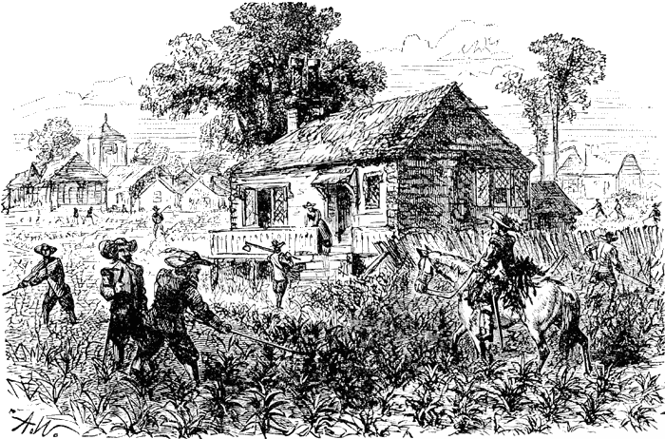
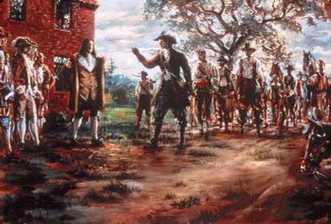
THE JAMESTOWN COLONY
The Big Idea:
The English overcame hunger, disease, and conflicts with Native Americans to establish a successful colony in Virginia.
(these are charter colonies that are funded by joint-stock companies)
1585: First colony at Roanoke: soon ends in failure
1590: Remains of second failed Roanoke colony found
The "Starving Time"
Located on the James River,
just off the Chesapeake Bay!
1607: Colony at Jamestown founded
1609-10: Jamestown suffers the "Starving Time"
John Smith is the land-hungry leader of the colony.
1613: First shipment of Virginia tobacco sent to England
How did they survive?
WITH HELP
Lured by the profits of tobacco and land (under the HEADRIGHT SYSTEM), new settlers begin to arrive in the colony.
A powerful Native American chief named Powhatan hoped to use the English against his own enemies and to trade for their metal weapons. He teaches them to cultivate TOBACCO.
1619: House of Burgesses first meets
(the 1st representative body in colonial America
with the power to make laws and raise taxes!)
1640: Tobacco shipments reach 3 million pounds per year
1676: Bacon's Rebellion attacks colonial government
When intense fighting broke out between the Indians and the settlers, Governor Berkeley protested the slaughter of Indians and refused to send troops to the frontier. In protest, Nathaniel Bacon and his followers marched to Jamestown and burned the town in revolt.

Slide 5
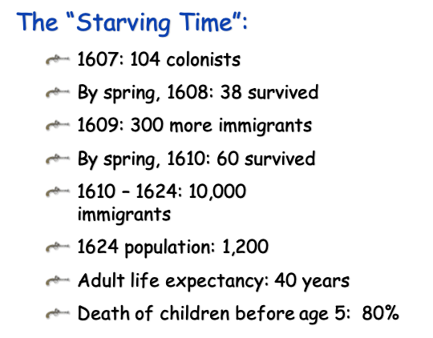
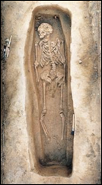

Slide 6
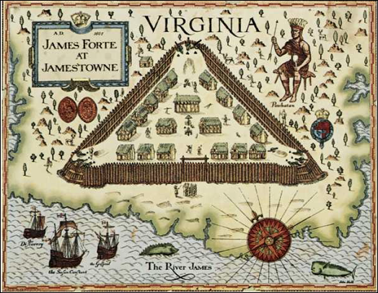

Slide 7
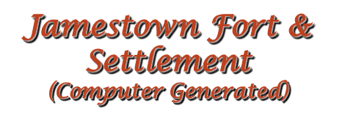
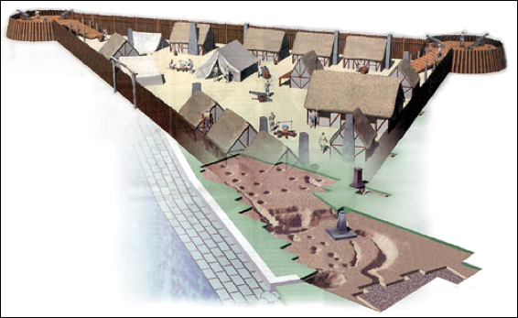

Slide 8
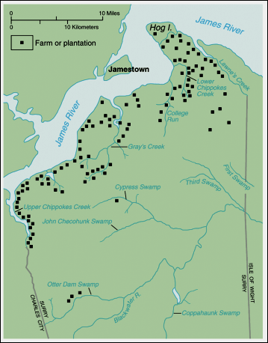

Slide 9
Concluding Questions
·Why were the Europeans exploring the coast of North America?
·What were the relations like between the colonists and the Native Americans?
·How did geography influence the development of the colony?
·What sort of economic development took place in the colony of Virginia?
·What was the need for western expansion based on? What reasons were at the heart of the shift to slave labor?

