Slide 1
Chapter 5, Part II
Colonial Life

Slide 2
II. A Mingling of the Races
America was a melting pot from beginning, with numerous foreign groups (see Map 5.1).
Germans were about 6% or 150,000 by 1775:
They fled religious persecution, economic oppression, and war in the 1700s and settled chiefly in Pennsylvania.
They were primarily Lutherans.
Known Pennsylvania Dutch, they were 1/3 of the colony’s population, living in the backcountry.

Slide 3
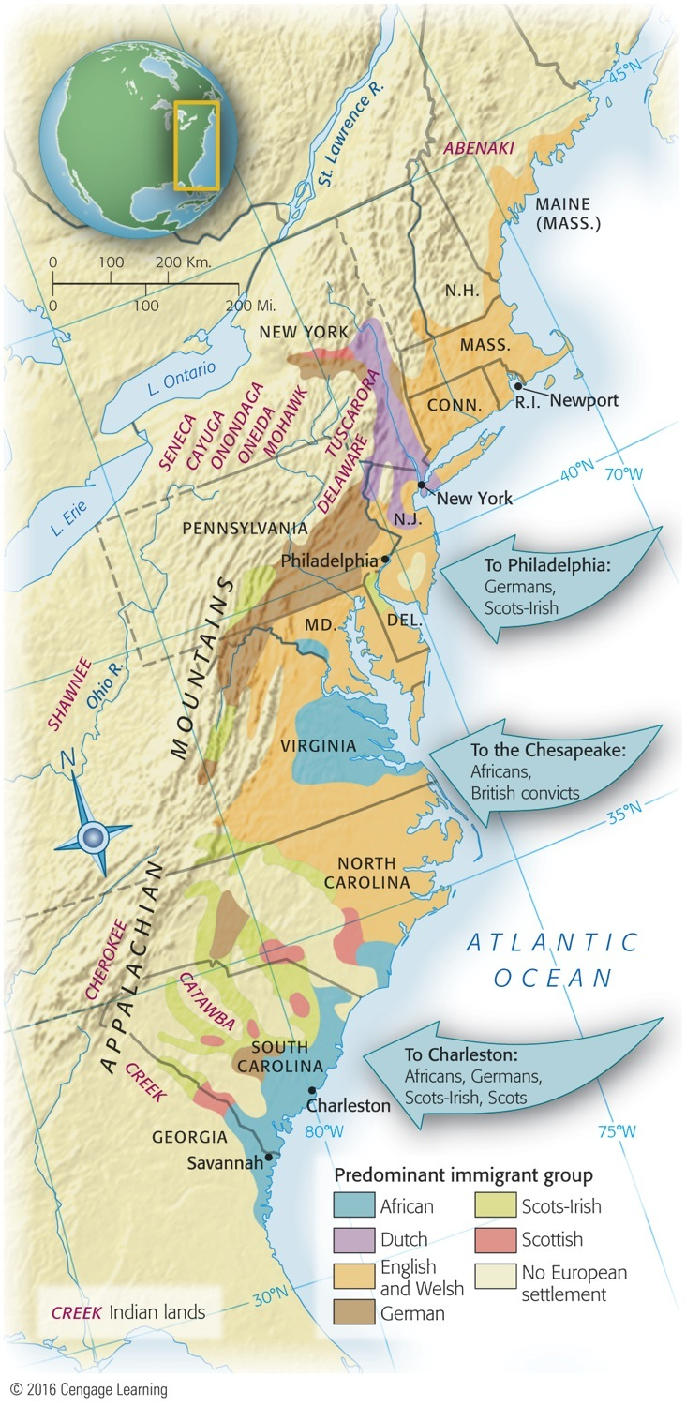
Map 5.1 p79
Notes:
Map 5.1 Immigrant Groups in 1775 America was
already a nation of diverse nationalities in the colonial
period. This map shows the great variety of immigrant
groups, especially in Pennsylvania and New York. It also
illustrates the tendency of later arrivals, particularly the
Scots-Irish, to push into the backcountry.

Slide 4
II. A Mingling of the Races
Scots-Irish numbered around 175,000, or 7% of the population, by 1775:
Although non-English, they spoke English.
Over centuries they had been transplanted to northern Ireland.
Their economic life had been hampered.
In the early 1700s ten of thousands came to America.
They became the first settlers of the West.

Slide 5
II. A Mingling of the Races (cont.)
Scots-Irish (cont.):
When they came up against the Allegheny Mountains, they moved southward to Maryland and down Virginia’s Shenandoah Valley.
They built flimsy log cabins.
They proved to be superb frontiersmen.
By the 1800s, they had settled along the eastern Appalachian foothills.

Slide 6
II. A Mingling of the Races (cont.)
Scots-Irish (cont.):
Pugnacious, lawless, and individualistic, they brought the Scottish secret of whiskey distilling.
They cherished no love for the British government, or any other government.
1764: The Paxton Boys marched on Philadelphia.
A few years later, they spearheaded the Regulator movement in North Carolina.

Slide 7
II. A Mingling of the Races (cont.)
About 5% were other European groups:
French Huguenots, Welsh, Dutch, Swedes, Jews, Irish, Swiss, and Scots Highlanders
49% of population = Anglo-Saxon (Figure 5.1)
Africans were the largest non-English group:
They were 20% of the colonial population in 1775.
The South held 90% of slaves.
New England had the least ethnic diversity.

Slide 8
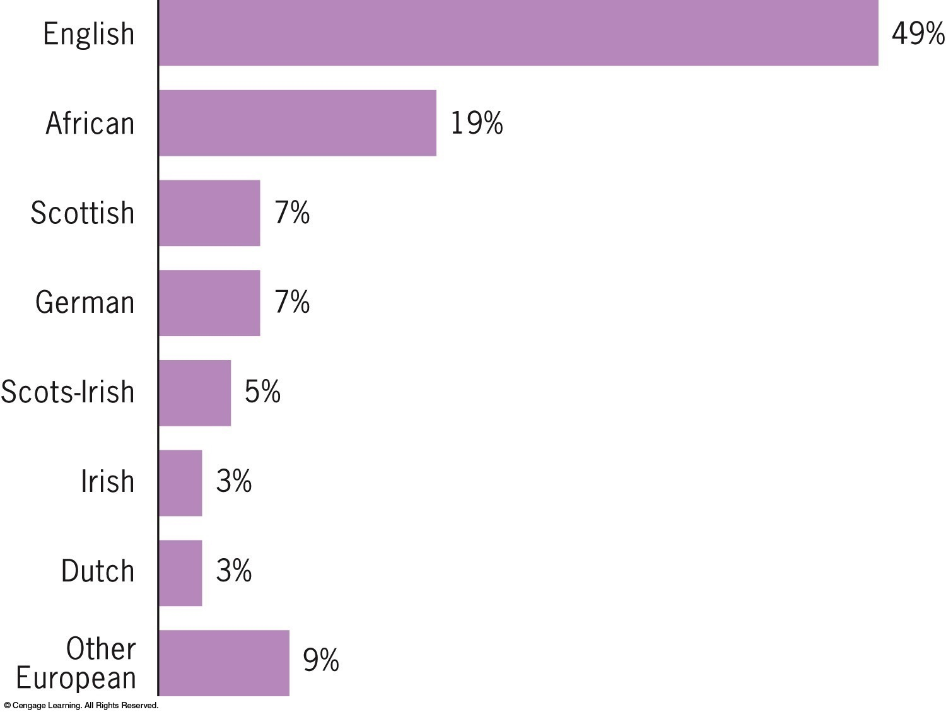
Figure 5.1 p80
Notes:
Figure 5.1 Ethnic and Racial Composition of the
American People, 1790
Based on surnames. Adapted from the American Council of Learned
Societies, “Report of Committee on Linguistic and National Stocks in
the Population of the United States,” 1932. Percentages total more than
100 percent due to rounding.)

Slide 9
II. A Mingling of the Races (cont.)
The middle colonies, especially Pennsylvania, received the bulk of later white immigrants.
Outside of New England about one-half were non-English in 1775.
Of the 56 signers of the Declaration of Independence in 1776, 18 were non-English and 8 were not born in the colonies.

Slide 10
II. A Mingling of the Races (cont.)
These immigrants laid the foundations for a new multicultural American national identity as different groups intermingled.
Likewise, the African American community was quite variegated in its cultural origins.
In New England “praying towns” and in Great Lakes villages, different groups of displaced Native Americans intermingled.

Slide 11
III. Africans in America
In the deepest South, slave life was severe:
The climate was hostile to health.
The labor was life-draining.
The rice and indigo plantations were a lonely life.
Blacks in the tobacco-growing Chesapeake region had a somewhat easier lot:
Tobacco plantations were larger and closer to one another than rice plantations.

Slide 12
III. Africans in America (cont.)
Blacks in Chesapeake region (cont.):
The size and proximity of plantations permitted slaves more visits with friends and relatives.
As the population of female slaves rose by 1720, family life was possible.
Growth was then mainly by natural increase, while the deeper South still depended on importation of slaves.
Number of slaves in the North grew as well.

Slide 13
III. Africans in America (cont.)
The language Gullah evolved among South Carolina blacks.
Slaves helped build country with their labor:
Some artisans: carpenters, bricklayers, tanners.
Mostly manual laborers: cleared swamps, etc.
Slaves resisted their oppression:
1712: New York slave revolt
1739: South Carolina slave revolt on Stono River

Slide 14
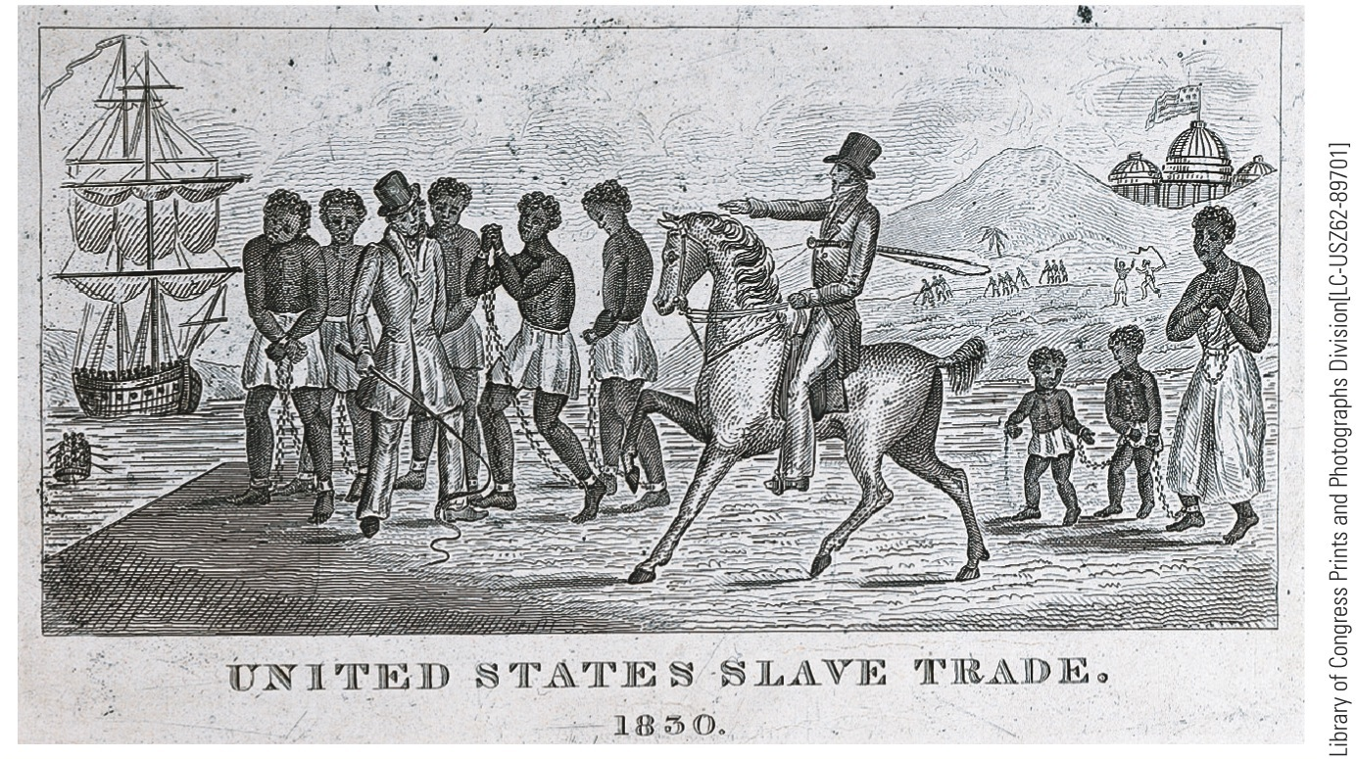
p82
Notes:
(above) Africans Destined for Slavery This engraving from 1830 is an
example of antislavery propaganda in the pre-Civil War era. It shows hapless
Africans being brought ashore in America under the whips of slave traders and,
ironically, under the figurative shadow of the national Capitol.
(right) Advertisements for Slave Sales in Charleston, South Carolina,
1753 Charleston had the largest slave market in the colonies.

Slide 15
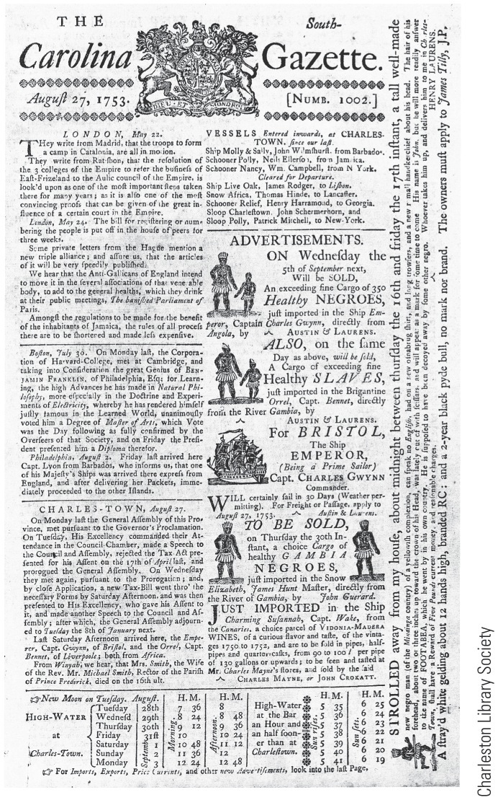
p82
Notes:
(above) Africans Destined for Slavery This engraving from 1830 is an
example of antislavery propaganda in the pre-Civil War era. It shows hapless
Africans being brought ashore in America under the whips of slave traders and,
ironically, under the figurative shadow of the national Capitol.
(right) Advertisements for Slave Sales in Charleston, South Carolina,
1753 Charleston had the largest slave market in the colonies.

Slide 16
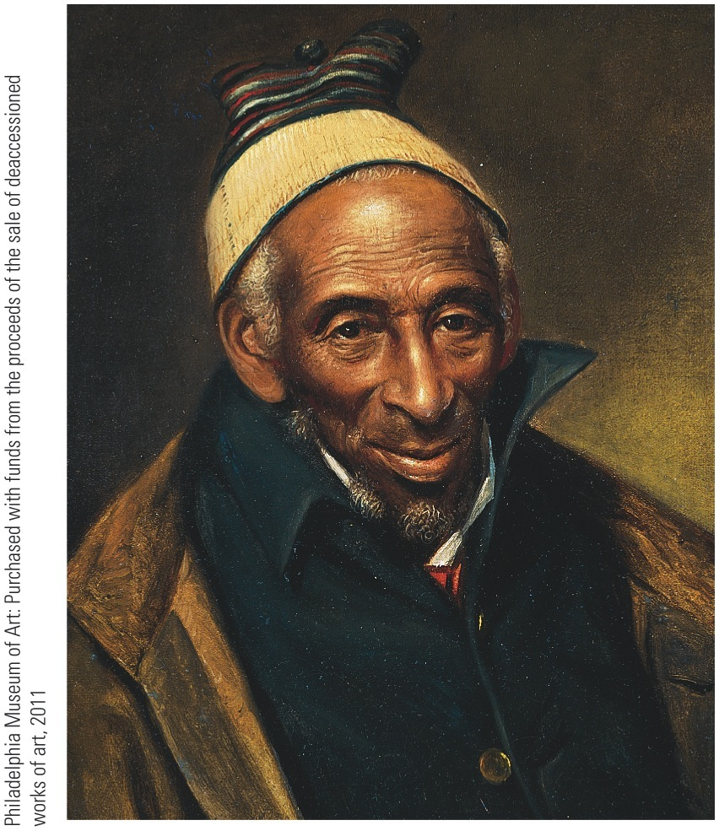
p83
Notes:
Yarrow Mamout, by Charles Willson Peale,
1819 When Peale painted this portrait,
Mamout was over one hundred years old. A
devout Muslim brought to Maryland as a
slave, he eventually bought his freedom and
settled in Georgetown.

Slide 17
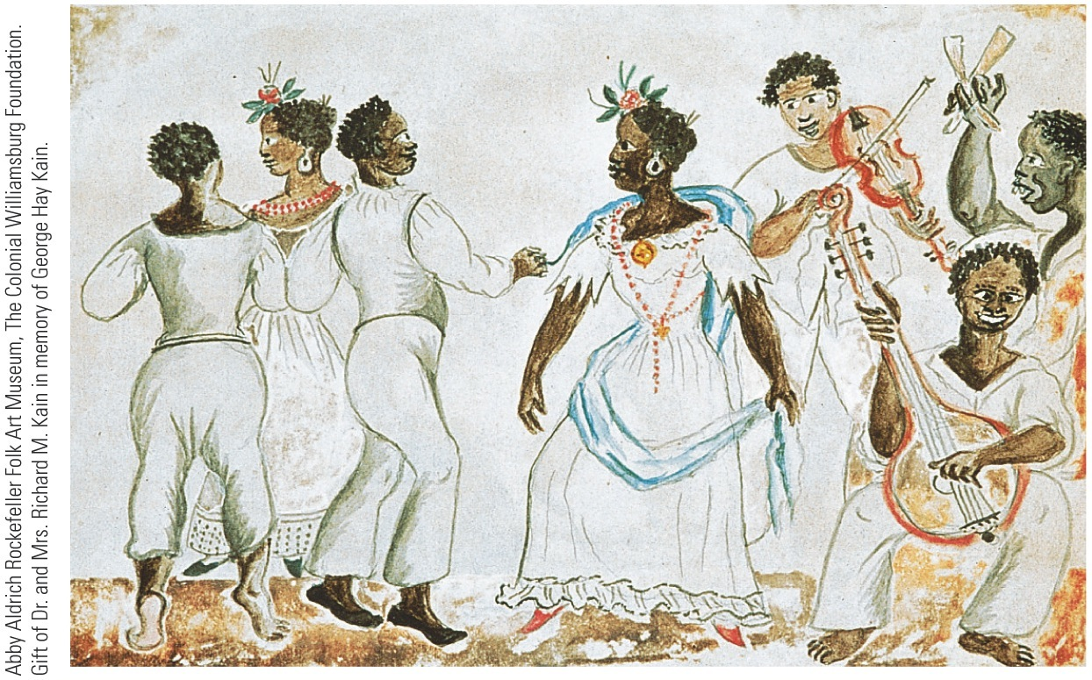
p83
Notes:
The Emergence of an African American Culture In this scene
from the mid-nineteenth century, African Americans play musical
instruments of European derivation, like the fiddle, as well as instruments
of African origin, like the bones and banjo—a vivid illustration
of the blending of the two cultures in the crucible of the New World.

Slide 18
IV. The Structure of Colonial Society (cont.)
America seemed a shining land of equality and opportunity, except for slavery.
But on the eve of revolution, America was showing signs of stratification and barriers to mobility:
Wars enriched merchant princes in New England and the middle colonies.
Wars created a class of widows and orphans.

Slide 19
IV. The Structure of Colonial Society (cont.)
In New England, with open land less available, descendants faced limited prospects:
Farms got smaller.
Younger children were hired out as wage laborers.
Boston’s homeless poor increased.
In the South, large plantations continued their disproportionate ownership of slaves:
The largest slaveowners increased their wealth.
Poor whites increasingly became tenant farmers.

Slide 20
IV. The Structure of Colonial Society (cont.)
Lower classes further swelled by the stream of indentured servants:
Many ultimately achieved prosperity.
Two signed the Declaration of Independence.
Less fortunate were 50,000 paupers and convicts (“jayle birds”) involuntarily shipped to America.

Slide 21
IV. The Structure of Colonial Society (cont.)
Least fortunate of all were the black slaves:
They enjoyed no equality with whites.
They were oppressed and downtrodden.
Some white colonists worried about the growing number of slaves in colonies.
British authorities, however, resisted any attempt to limit the transatlantic slave trade.

Slide 22
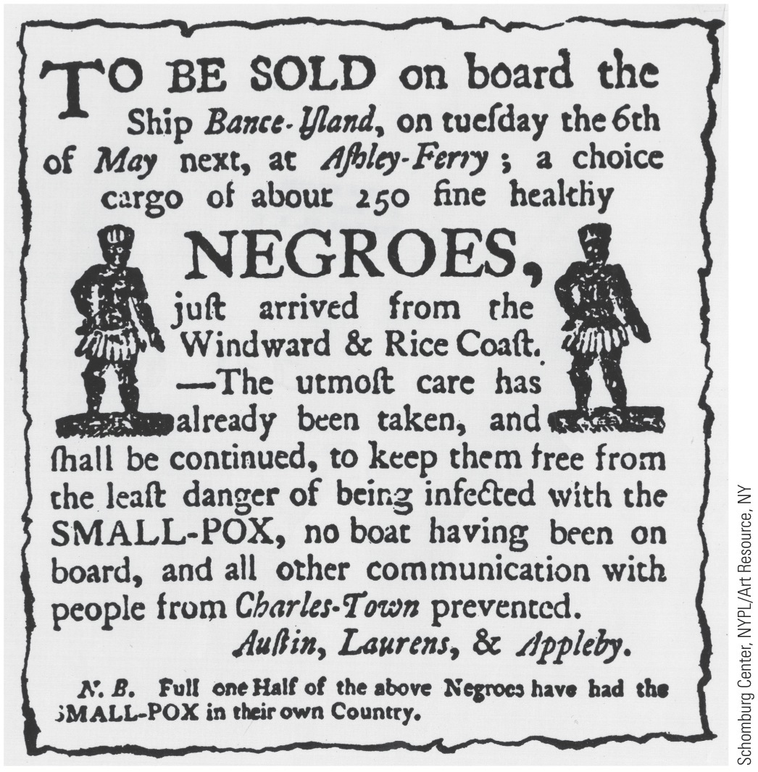
p84
Notes:
A South Carolina Advertisement for Slaves in the
1760s Note the reference to these slaves’ origin on West
Africa’s “Rice Coast,” a reminder of South Carolina’s reliance
on African skill and labor for rice cultivation. Note,
too, that half the slaves were said to have survived smallpox
and thus acquired immunity from further infection—
and that care had been taken to insulate the others from
a smallpox epidemic apparently then raging in
Charleston.

Slide 23
V. Clerics, Physicians, and Jurists
Colonial professions:
Most honored was the Christian ministry, but by 1775 ministers had less influence than earlier.
Most physicians were poorly trained.
First medical school was established in 1765.
Aspiring young doctors served as apprentices.
At first, lawyers were not favorably regarded.

Slide 24
VI. Workaday America
Agriculture was the leading occupation, employing 90% of people (see Map 5.2):
Tobacco the main crop of Maryland and Virginia.
Middle (“bread”) colonies produced much grain.
Overall, Americans enjoyed a higher standard of living than the masses of any country.
Fishing ranked far below agriculture, yet was rewarding, with a bustling commerce.
Commercial ventures were another path to wealth.

Slide 25
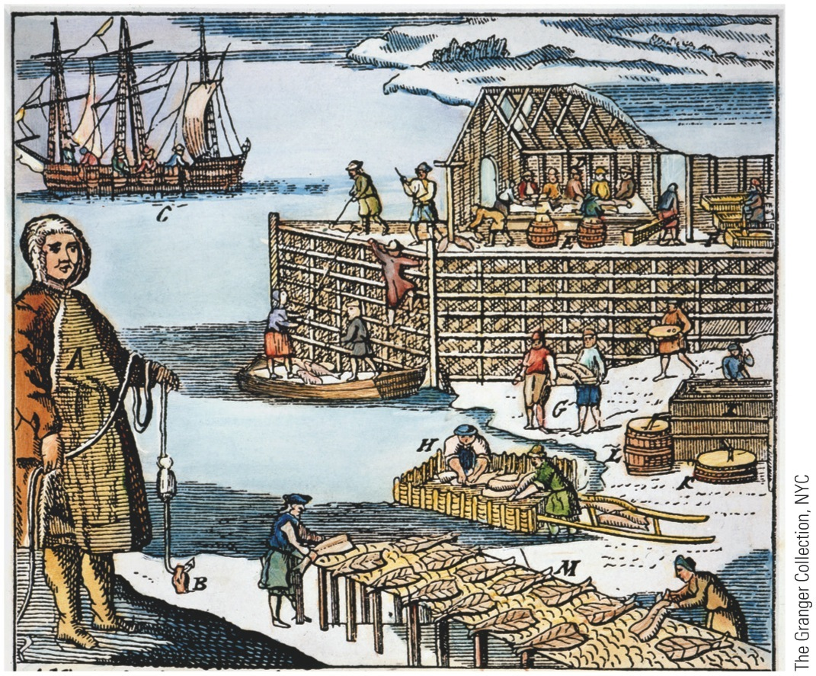
p86
Notes:
Codfishing in Newfoundland, 1738 Early European
explorers were awed by the enormous schools of cod on
the Grand Banks off Newfoundland. Fish were so numerous
that they sometimes impeded the progress of sailing
vessels. By the eighteenth century, New Englanders were
aggressively exploiting the apparently limitless Grand
Banks fishery, drying and salting huge catches for export
to Europe and the West Indies. Some three centuries later,
the accumulated predation of generations has depleted
the once-fabulous Grand Banks cod population.

Slide 26
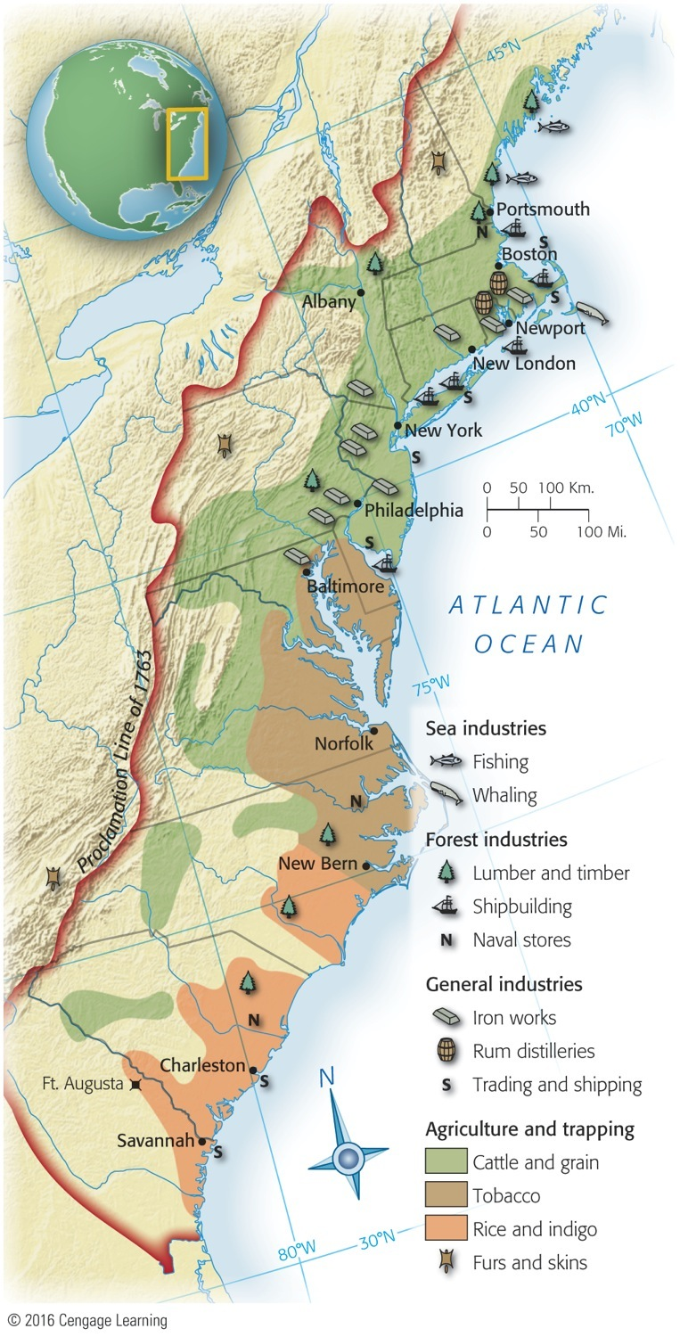
Map 5.2 p86
Notes:
Map 5.2 The Colonial Economy By the eighteenth
century, the various colonial regions had distinct economic
identities. The northern colonies grew grain and raised
cattle, harvested timber and fish, and built ships. The Chesapeake
colonies and North Carolina were still heavily dependent
on tobacco, whereas the southernmost colonies grew
mostly rice and indigo. Cotton, so important to the southern
economy in the nineteenth century, had not yet emerged as
a major crop.

Slide 27
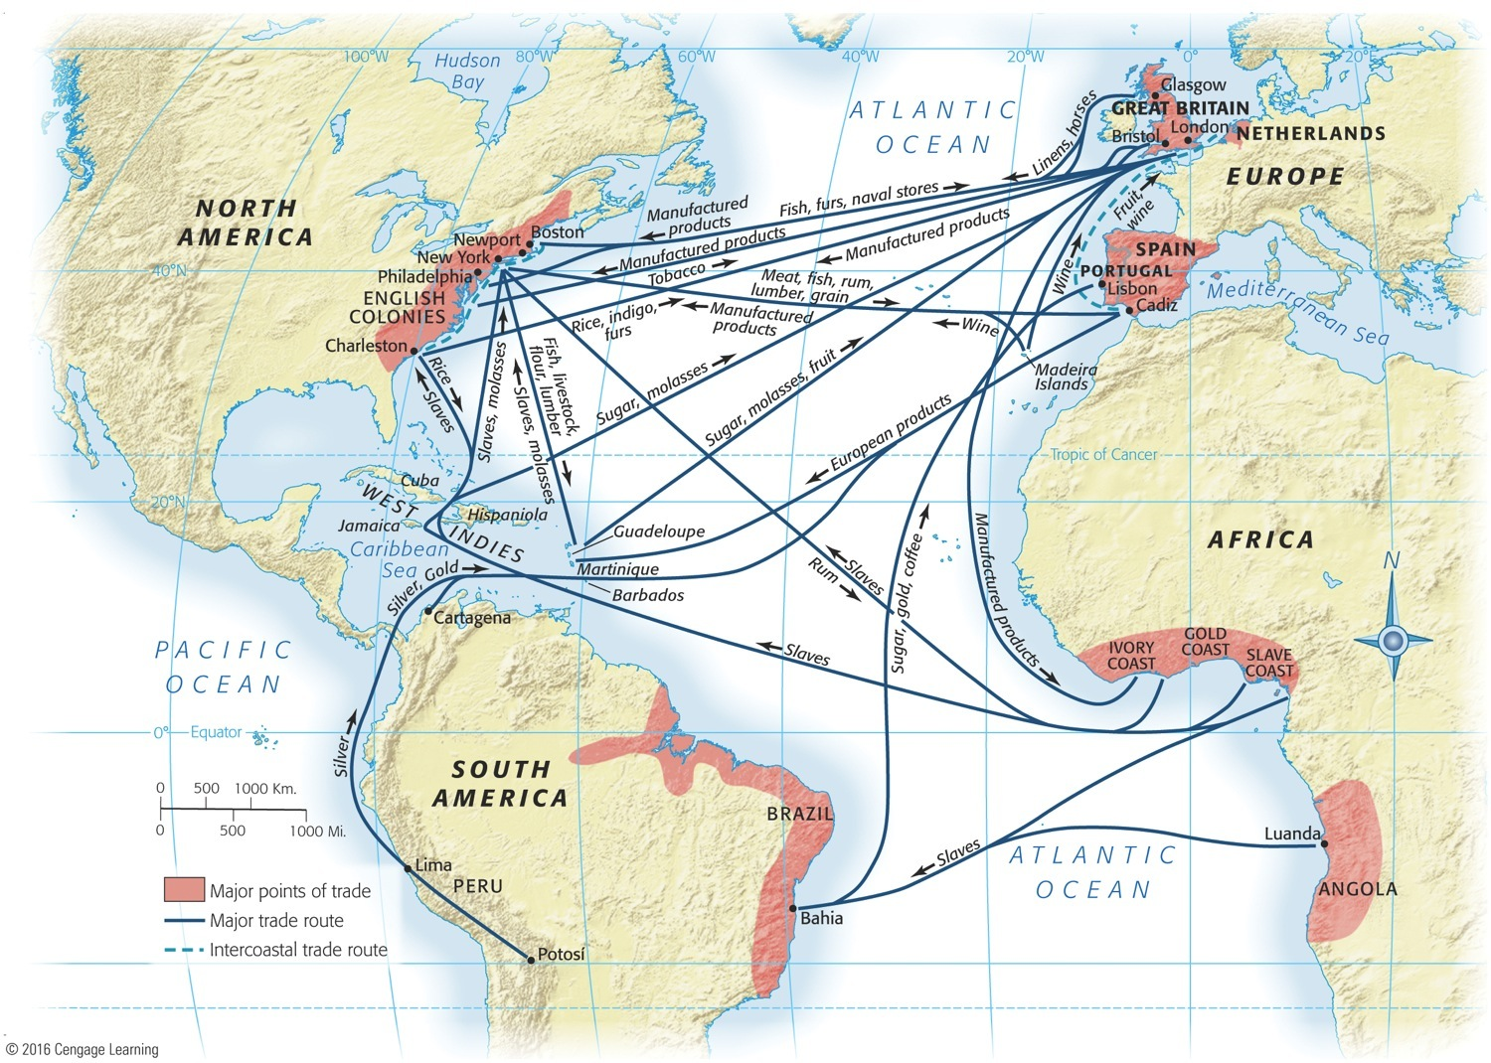
VI. Workaday America (cont.)
Triangular trade (Map 5.3) was very profitable.
Manufacturing was of secondary importance.
Household manufacturing (spinning and weaving by women) added impressive output.
Skilled craftspeople few and highly prized.
Lumbering was the most important manufacturing activity.
Colonial naval stores were also highly valued.

Slide 28
VI. Workaday America (cont.)
But an imbalance of trade developed by 1730s.
1733: British passed Molasses Act to squelch North American trade w/ French West Indies.
Americans responded with smuggling.
This foreshadowed the impending imperial crisis:
Headstrong Americans would rather revolt than submit to dictates of a far-off Parliament that seemed bent on destroying their livelihood.

